Slide 1
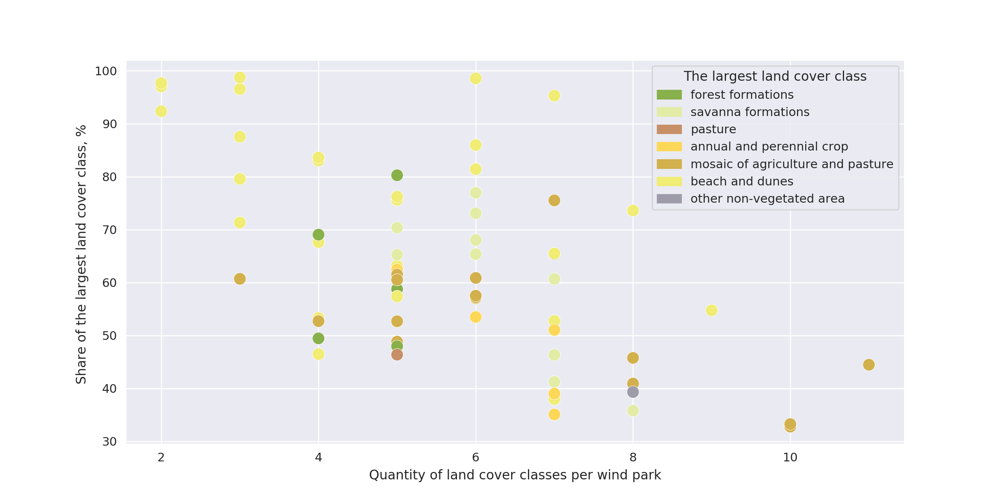
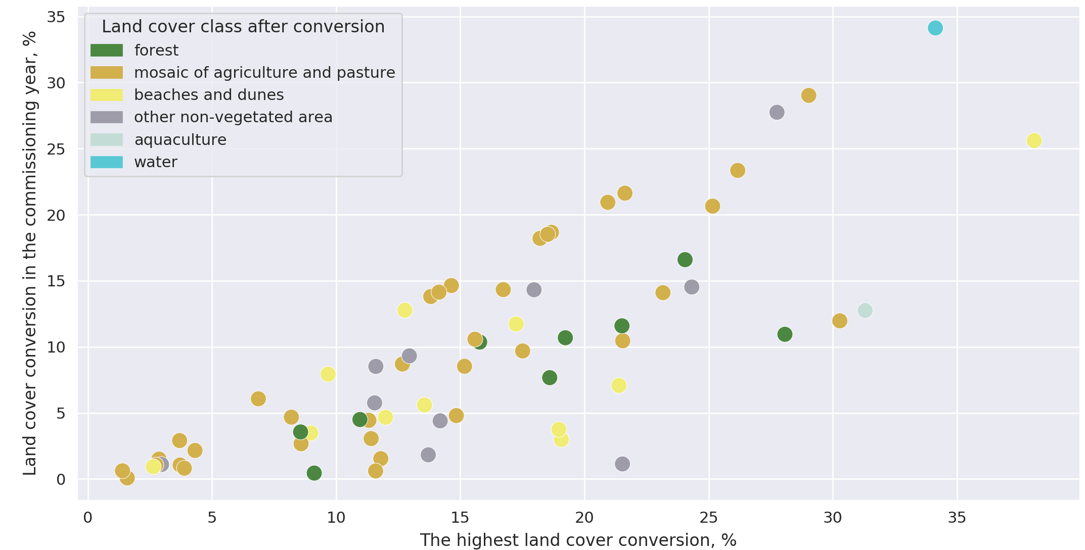
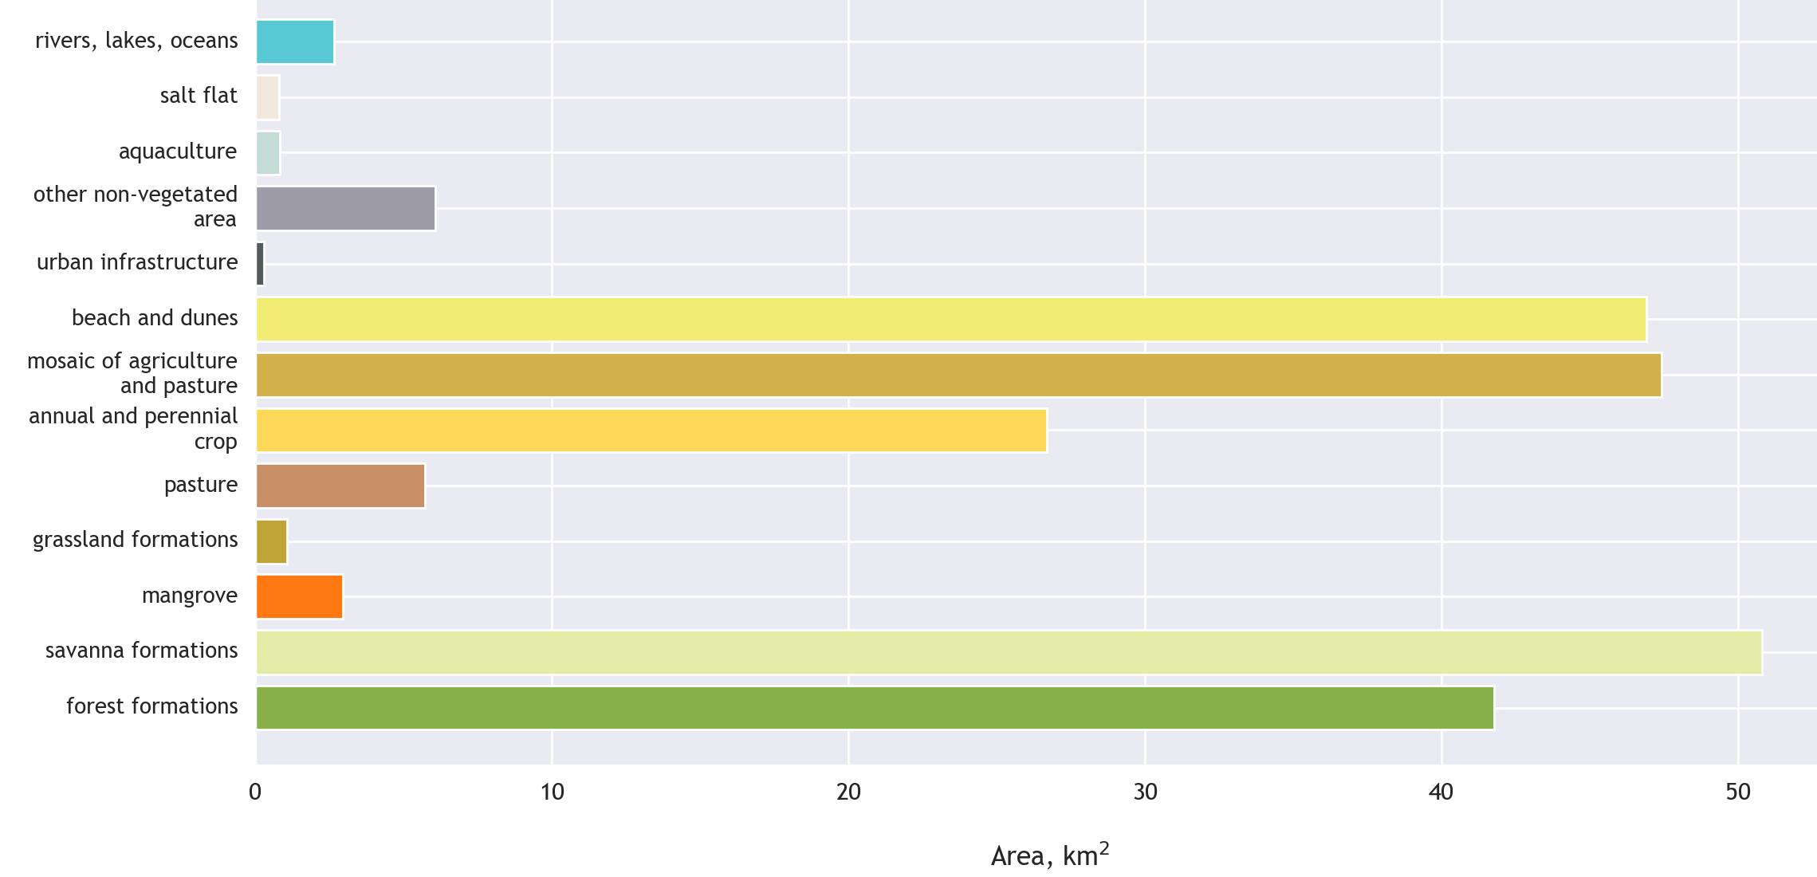
Land cover patterns of wind generation infrastructure in Brazil
Olga Turkovska¹, Johannes Schmidt¹, Katharina Gruber¹, and Felix Nitsch²
¹ Institute for Sustainable Economic Development, University of Natural Resources and Life Sciences, 1180, Feistmantelstrasse 4, Vienna, Austria
² Institute of Engineering Thermodynamics, German Aerospace Center, 70569, Pfaffenwaldring 38-40, Stuttgart, Germany
Contact: olga.turkovska@boku.ac.at
Introduction
Land cover patterns
Conclusions & Discussion
Despite uncertainties surrounding the estimates of land-use intensity for various electricity sources, wind-powered electricity has clearly lower intensity, i.e. 0.3–1.3 m² MWh-1 compared to biomass-powered electricity, i.e. 450-800 m² MWh-1 [1]. Low land-use intensity of wind-powered electricity suggests its minor negative impacts on land. However, at the local scale, commissioning of the wind parks leads to restriction of land-use for human settlements, negative impact on biodiversity [1], and social land conflicts [2].
Global transition towards renewable energy systems implies an increase of renewable energy deployment, including wind power. This will require additional land resources. Hence, we assess wind parks deployment from a land-use perspective in a case-study for one state in Brazil, i.e. Ceará. This case-study, primarily focuses in on descriptive statistics of land cover in the selected wind parks. We chose Ceará, as it has one of the highest numbers of installed wind parks in Brazil. We selected all 78 wind parks in Ceará, which were commissioned between 1999 and 2018.
Land occupied with energy generation infrastructure is not considered as a separate land-use/land cover class by MapBiomas data set. We assumed that energy land-use may be included as urban area or other non-vegetated area classes. Figure 1 shows that forest formations, savanna formations, mosaic of agriculture and pasture, and dunes are the most common classes identified within wind park territories. Therefore, despite the fine resolution of MapBiomas data set, territory that belongs to the wind parks, was not covered by a class that would indicate their technical nature.
This exercise assessed the land cover conversions, e.g. from savanna to agricultural land, limiting the studied area to the area of single wind parks. However, land cover conversions may occur at different locations, such as access roads built around the wind parks. Future work will explore these possibilities.
For a number of parks, we found the highest rates of land conversion occurring in the commissioning year (Figure 3). This can be a first indicator of wind parks driving the local land conversion. However, drawing this conclusion requires more verification in order to exclude the possibility of land classification errors. On the other hand, wind parks without major land conversion in commissioning year can lead us to an example of wind parks that have less negative impact on land.
Data & Method
MapBiomas (The Brazilian Annual Land Use and Land Cover Mapping Project): land-use/land cover data set with 30 x 30m spatial resolution, and annual temporal resolution from 1985 to 2017 [3].
ANEEL (Brazilian Electricity Regulatory Agency): spatial locations for wind turbines and wind parks installed in Brazil before 2019. Preliminary validation of ANEEL data set with Google Map images showed high correspondence between ANEEL wind turbines and wind parks locations and their actual locations. [4].
Overlaying MapBiomas data set with ANEEL wind parks location provided land cover information for each selected wind park area – if available – including the time period before and after wind park commissioning. We looked at aggregated land cover of the selected wind parks of Ceará in order to understand more about its predominant classes and diversity. Subsequently, we analyzed time series of wind parks’ land cover, exploring the possibility of local land cover conversion due to wind parks establishment. Analyzed land cover time series included the period from 2005 to 2017; we did not consider the earlier period due to low quality of MapBiomas mosaic. At this stage, we excluded wind parks established in 2018 due to lack of data. For analyzing the land cover conversion we aggregated agriculture and forestry subclasses to the respective major classes. Remaining land cover was considered at the level of subclass.
Figure 2 | Diversity of land cover amongst wind parks in Ceará. The region has very diverse wind parks in terms of land cover. A significant number of parks was built on territories with one predominant land cover, i.e. dunes and beaches. The predominant land cover takes more than 70 % of its territory. While other wind parks are much more diverse and are represented by more than 5 different land cover classes with still one predominant land class. Hence, typical land cover of wind farm in in Ceará includes one clearly predominant class. i.e. dunes or savanna and varies in diversity of land cover classes detected, i.e. between 2 and 11.
References
[1] Uwe R. Fritsche et al. „Energy and Land Use“. Global Land Outlook Working Paper (2017).
[2] C. Brannstrom, A. Gorayeb, J. S. Mendes, C. Loureiro, A. J. A. Meireles, E. V. Silva, A. L. R. Freitas, R.F.Oliveira. Is Brazilian wind power development sustainable? Insights from a review of conflicts in Ceará state.Renewable and Sustainable Energy Reviews (2017), 67, p. 62-71. https://doi.org/10.1016/j.rser.2016.08.047
[3] MapBiomas Project - Collection v.3.0 of the Annual Land Use Land Cover Maps of Brazil: http://mapbiomas.org/map#coverage
[4] ANEEL Geografical data for electrical sector: https://sigel.aneel.gov.br/Down/
Land conversion or land reclassification?
Acknowledgements
We gratefully acknowledge support from the European Research Council – “reFUEL” ERC-2017-STG 758149.
Figure 1 | Distribution of wind park territories amongst land cover classes in Ceará. In 2016, wind parks in Ceará occupied 234 km² of land. Savanna formations, forest formations, mosaic of agriculture and pasture & beach and dunes cover 71 % of wind parks territories according to MapBiomas dataset.
Figure 3 | Was the highest estimated conversion of each wind park in commissioning year? A year with the highest estimated conversion share plotted against estimated conversion in the commissioning year. A 45° degree line would indicate that largest land-conversions took place in the year of wind park commissioning.
https://refuel.world/

