Slide 1
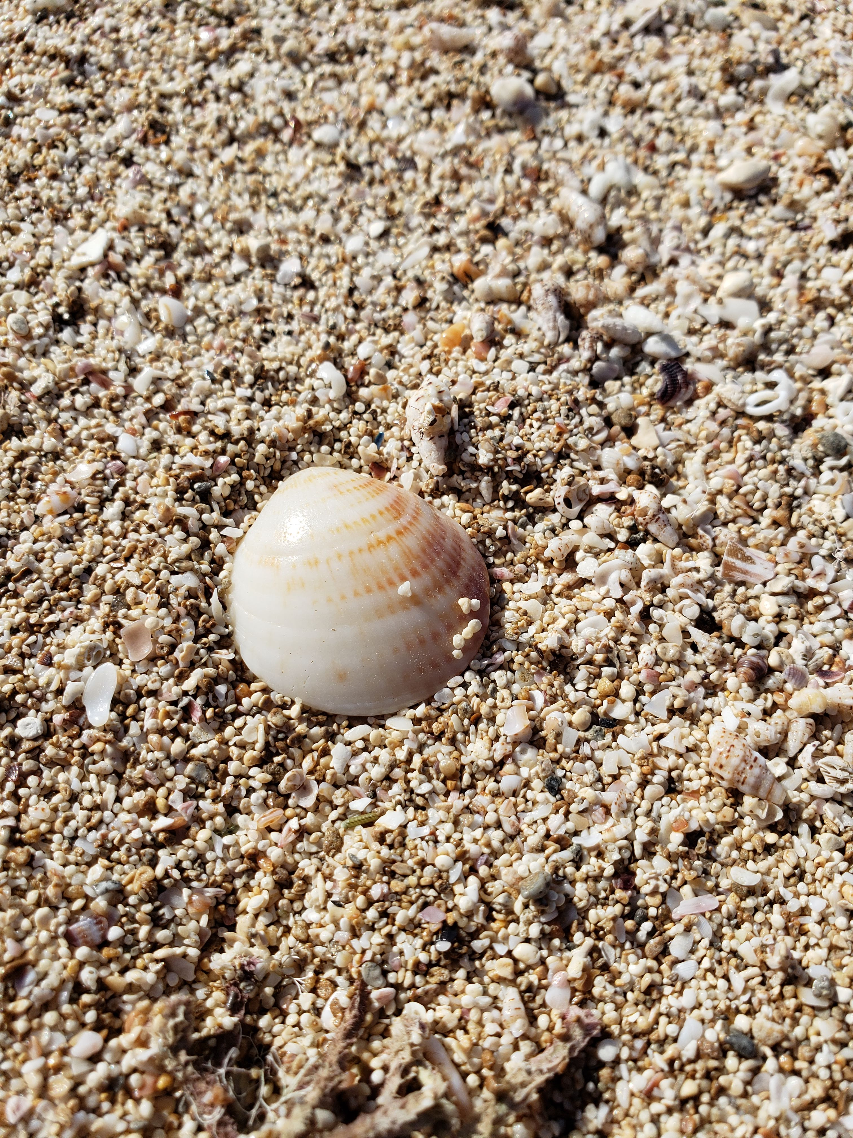
Where did they come from? Constraining the depth of origin of the mysteriously prolific Israeli Glycymeris assemblage
Daniel Killam¹, Adina Paytan², Timor Katz³ and Beverly Goodman¹
University of Haifa
UC Santa Cruz
Israel Oceanographic and Limnological Research

Slide 2
Strolling on the beach: a mystery!
Glycymeris nummaria (violet bittersweet clam) is the most common Israeli Mediterranean beach fossil
Can make up 98% of the assemblage on some beaches
Also found articulated within tsunami deposits, suggesting buried alive!
Where did they grow? How’d they become the most prevalent beach shell?

Slide 3
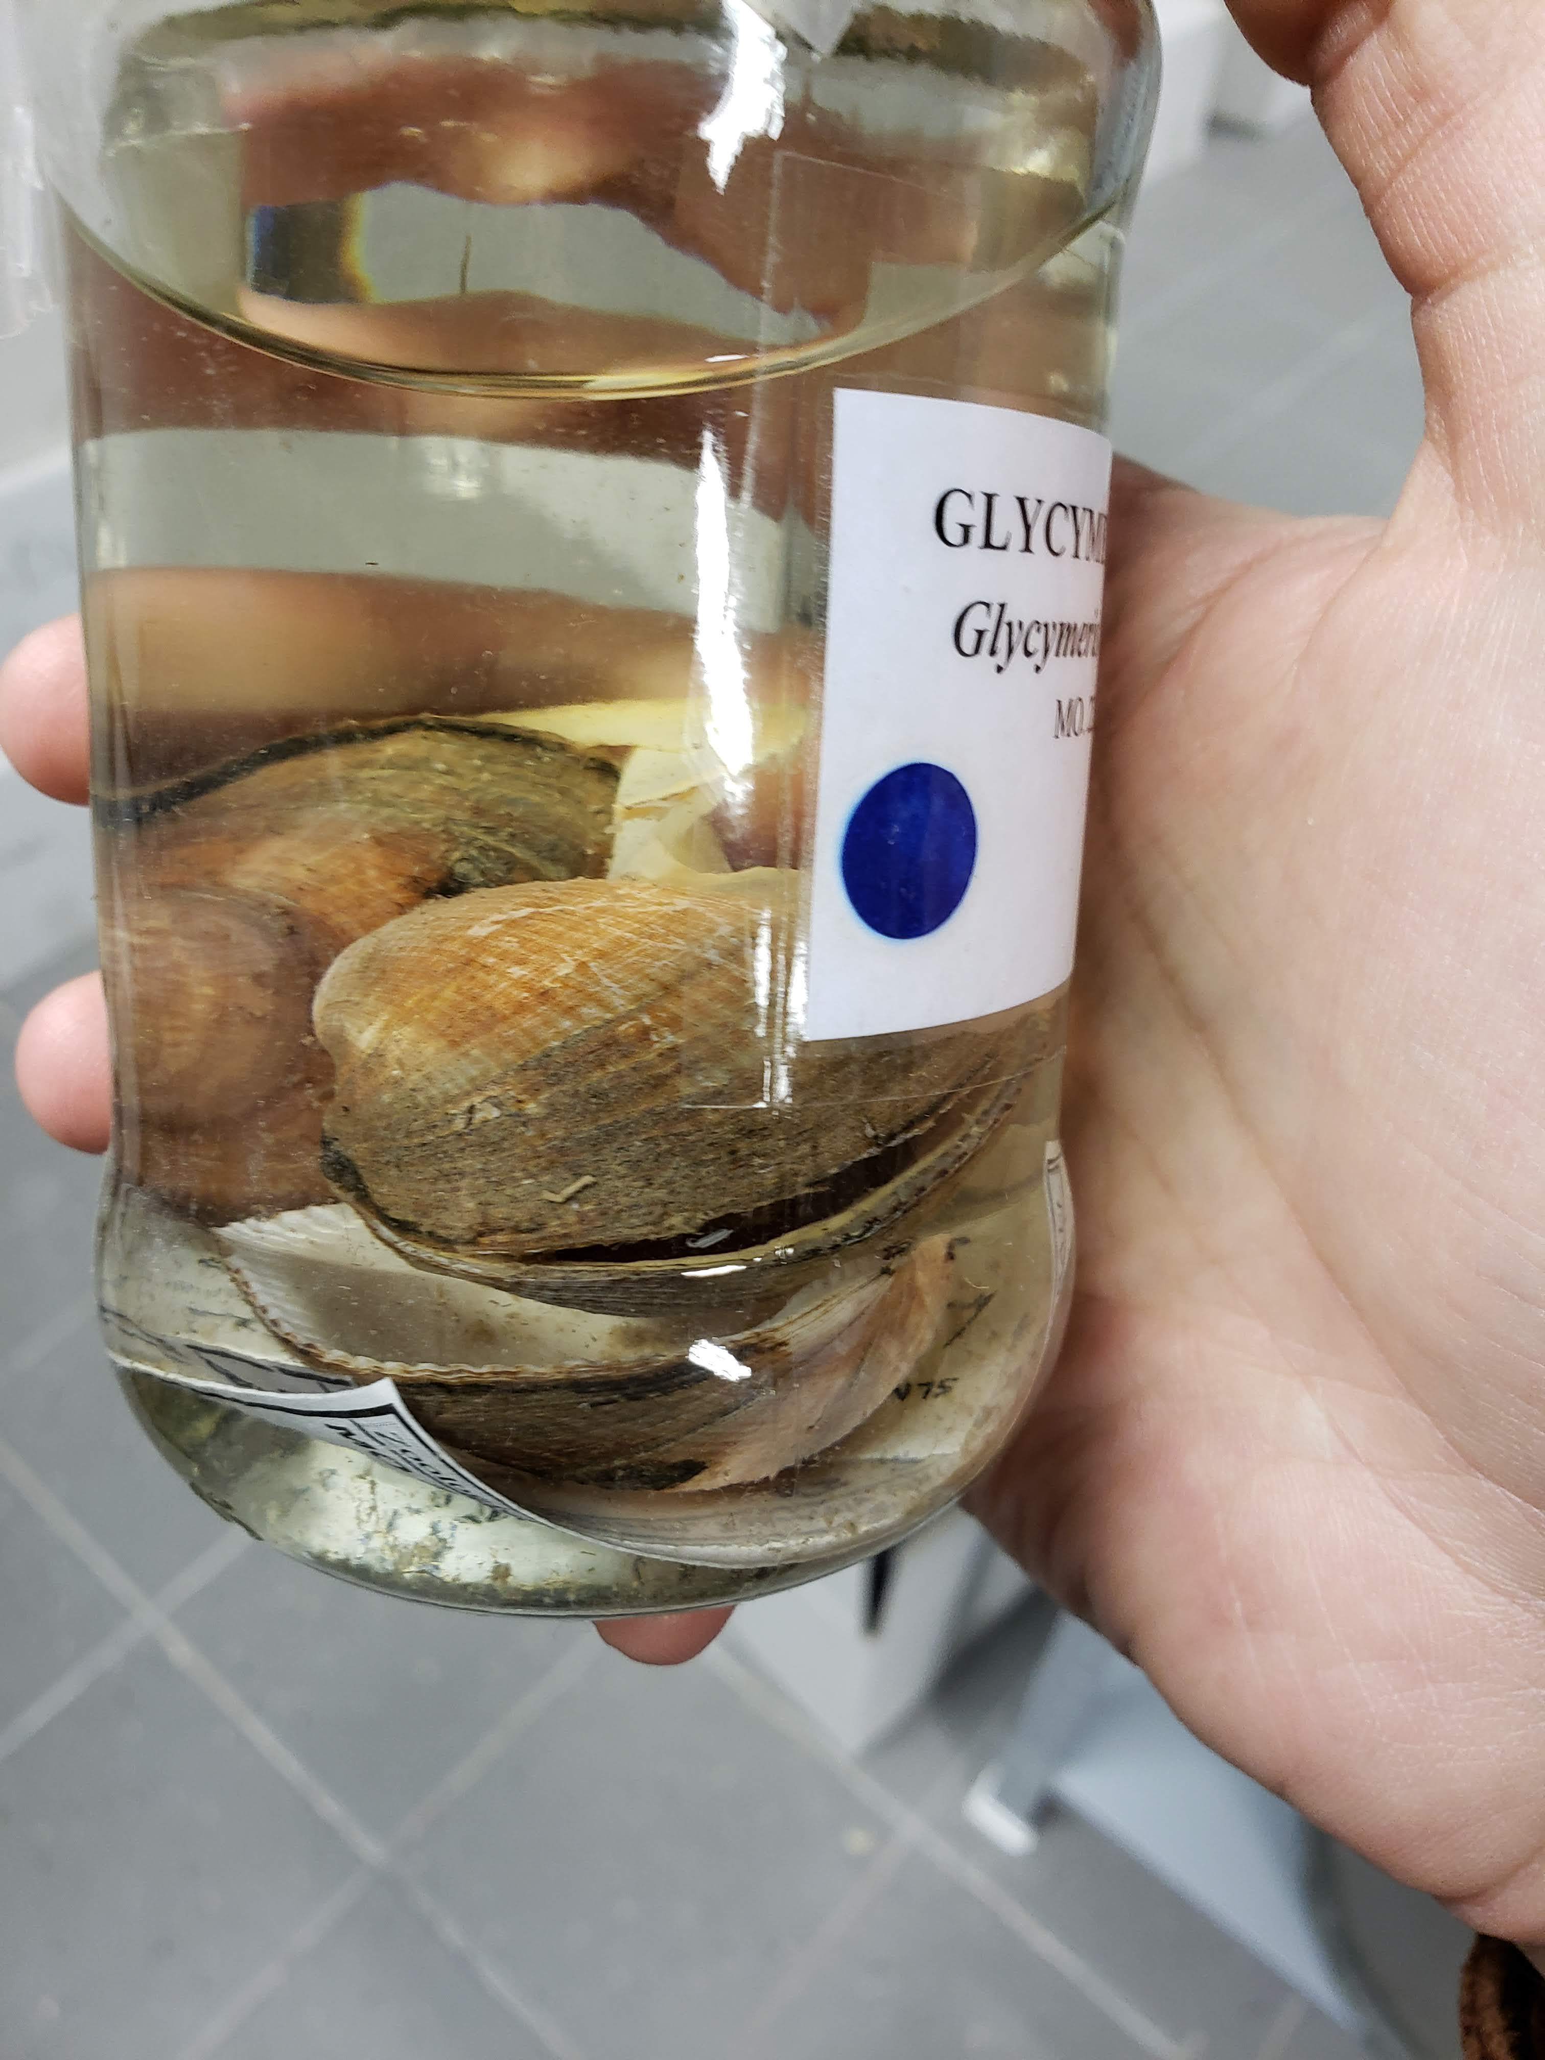
Where are they?
G. nummaria (prev. insubrica) is rare or extinct in present-day Eastern Mediterranean!
Found alive in the Adriatic and other areas of Western Med.
A few live-dredged specimens from 1960s-80s in Israeli museums
World Register of Marine Species
Sivan et al. 2006

Slide 4
Where are were they?
Generally found only in fine sandy substrates
From <10 m to up to 120 m depth
Shallow-buried, semi-infaunal life habit
Intensive searches have found none alive off of Israel in last 20 years
¹⁴C dating suggests population lived between 5500-800 bp
User aleksandergolemaj, iNaturalist.org

Slide 5
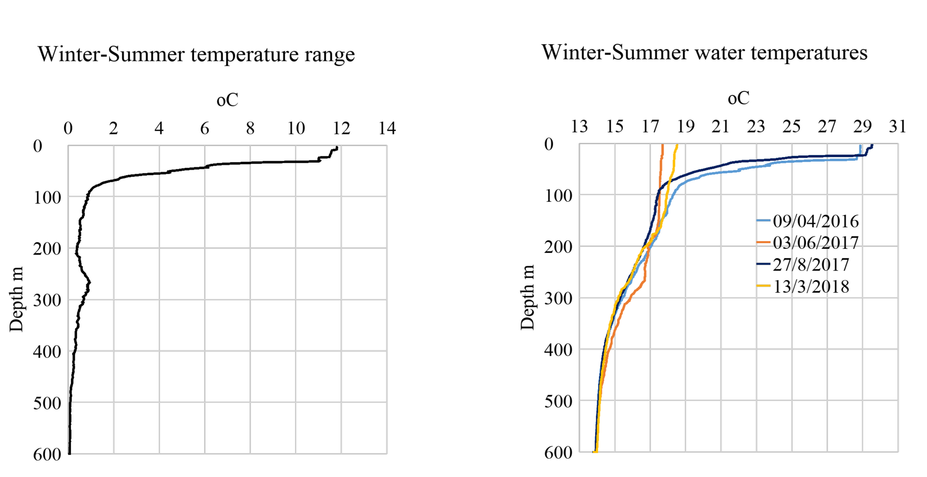
What kind of evidence can we search for?
Habitat depth off of Israel largely unknown
We have records of range of temperatures along a depth gradient
Deeper waters have a smaller annual range of temperatures
Fortunately, the clams keep a diary using their shells!

Slide 6
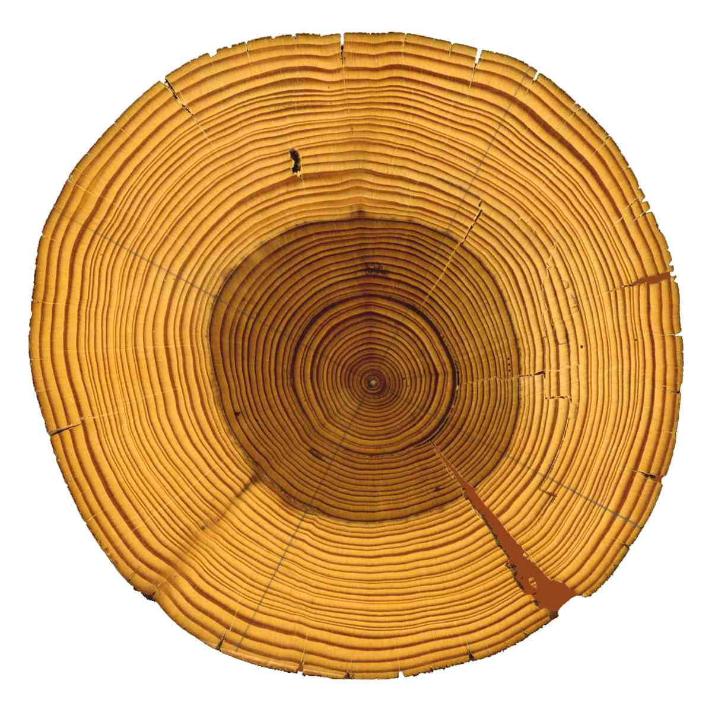
Reading the diary
Dendrochronology: the use of growth rings in trees to reconstruct time series of organisms’ life and environmental history

Slide 7
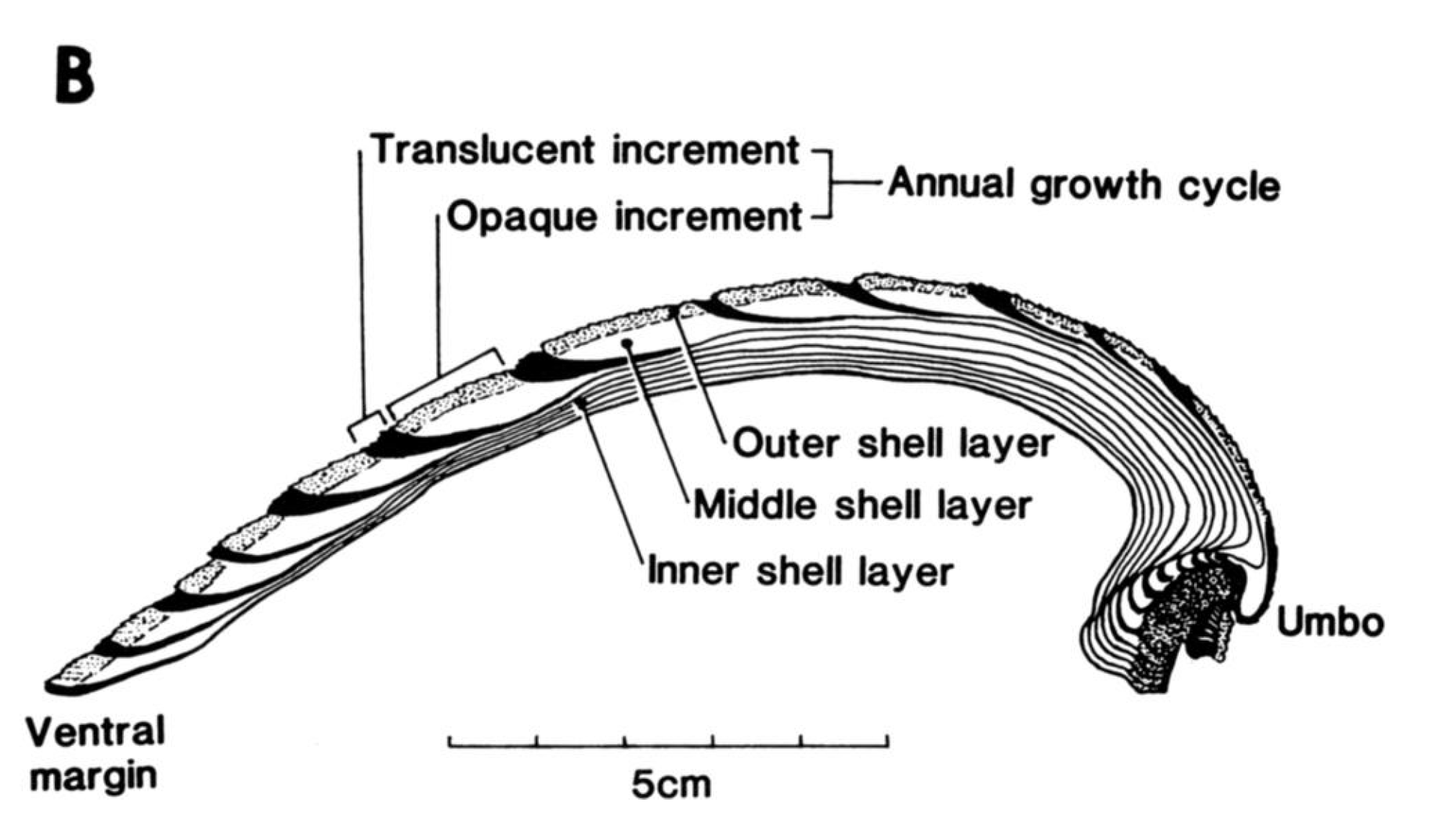
Reading the diary
Sclerochronology: the use of growth rings in shells to reconstruct time series of organisms’ life and environmental history
Jones and Quitmyer 1996

Slide 8
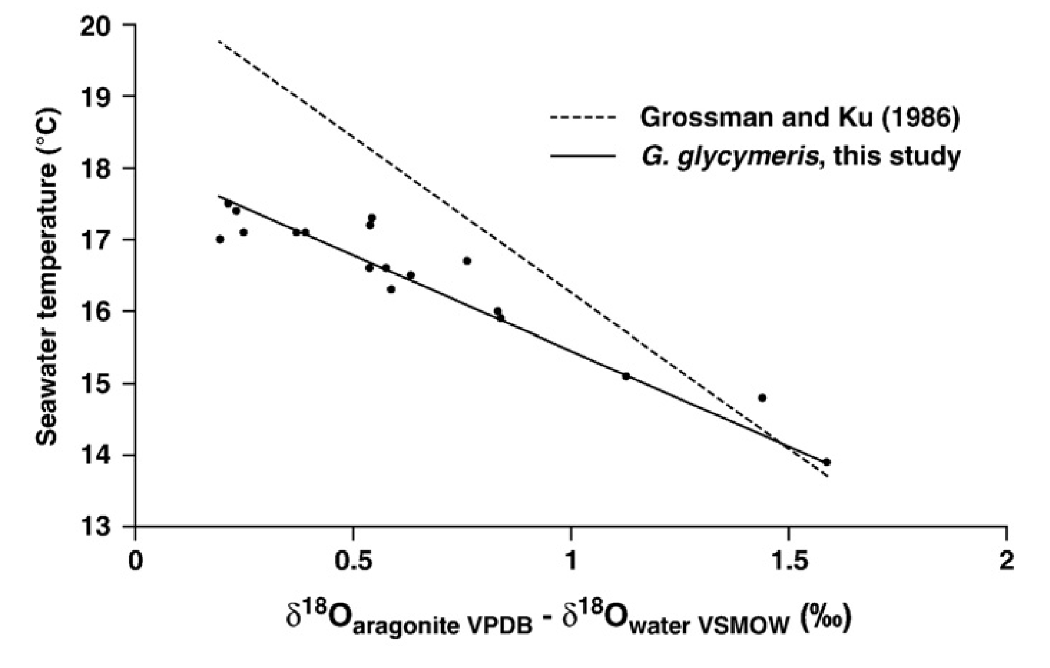
Isotope geochemistry
From Royer et al. 2013:
Ratio of ¹⁸O and ¹⁶O in shell carbonate relates to water temperature with known relationship (Grossman and Ku, 1986)
Ratio is reported as a positive/negative deviation from a standard (δ¹⁸O)
More negative δ¹⁸O value means a higher temperature
More targeted relationship has been published for closely related Glycymeris glycymeris

Slide 9
Isotope geochemistry
From Royer et al. 2013:
Ratio of ¹⁸O and ¹⁶O in shell carbonate relates to water temperature with known relationship (Grossman and Ku, 1986)
Ratio is reported as a positive/negative deviation from a standard (δ¹⁸O)
More negative δ¹⁸O value means a higher temperature
More targeted relationship has been published for closely related Glycymeris glycymeris

Slide 10
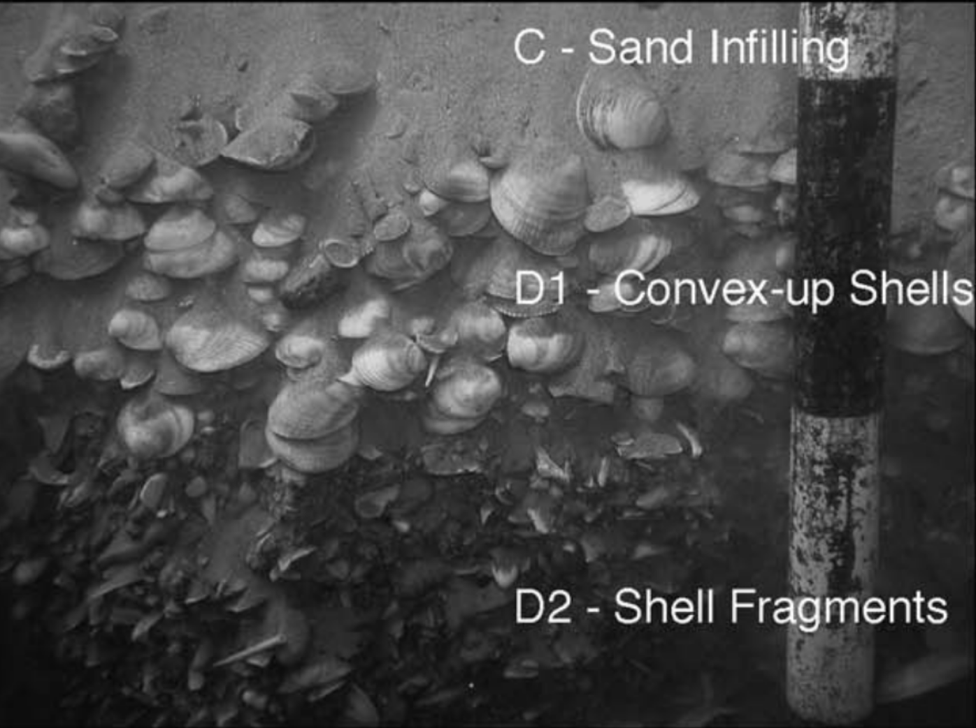
Clamples
Data: EMODnet.eu
Two shells from Dor beach from a mixed assemblage >800 yr bp
One shell from a tsunami deposit off of Caesarea dated as ~4300 yr bp
Reinhardt et al. 2006

Slide 11
What story do the clams tell us?
Individual shells record around 4-4.5°C of seasonal variability
All three originate at a similar high temperature

Slide 12
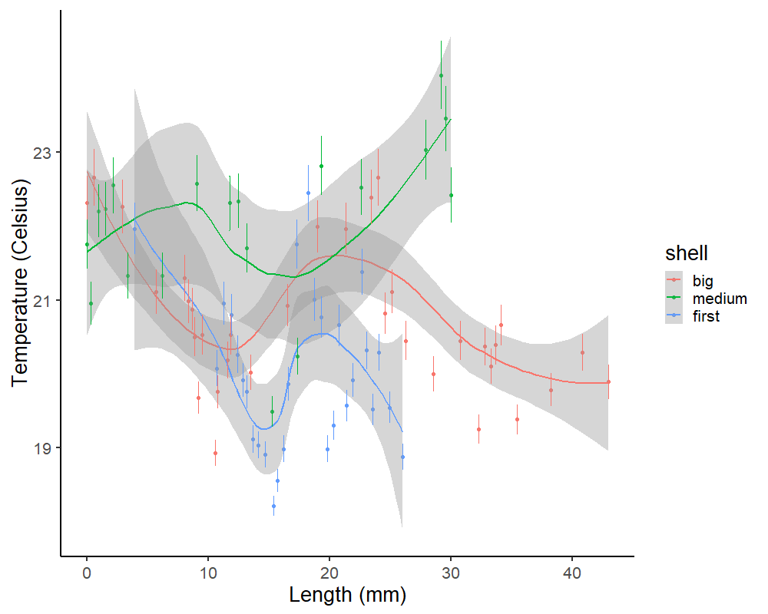
What story do the clams tell us?
Individual shells record around 4-4.5°C of seasonal variability
All three originate at a similar high temperature
Lived 1.5-2 years

Slide 13
What story do the clams tell us?
Individual shells record around 4-4.5°C of seasonal variability
All three originate at a similar high temperature
Lived 1.5-2 years
Previous cruise measurements from the area suggest show this temp range would be experienced at 30-50 m depth

Slide 14
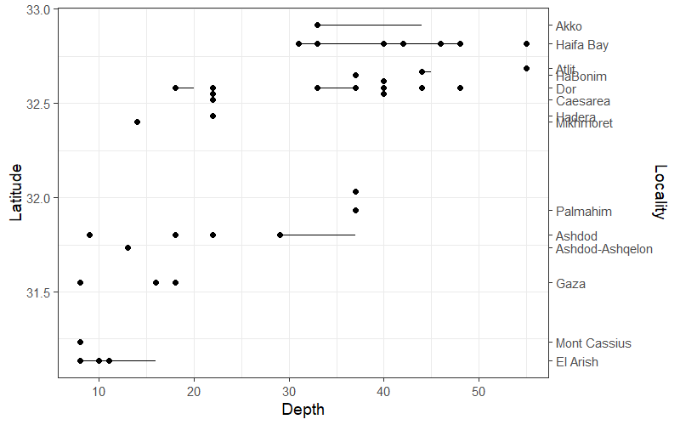
What story do the clams tell us?
The few live-caught G. nummaria were also found mostly at this depth range!
Data: Mienis et al. 2006

Slide 15
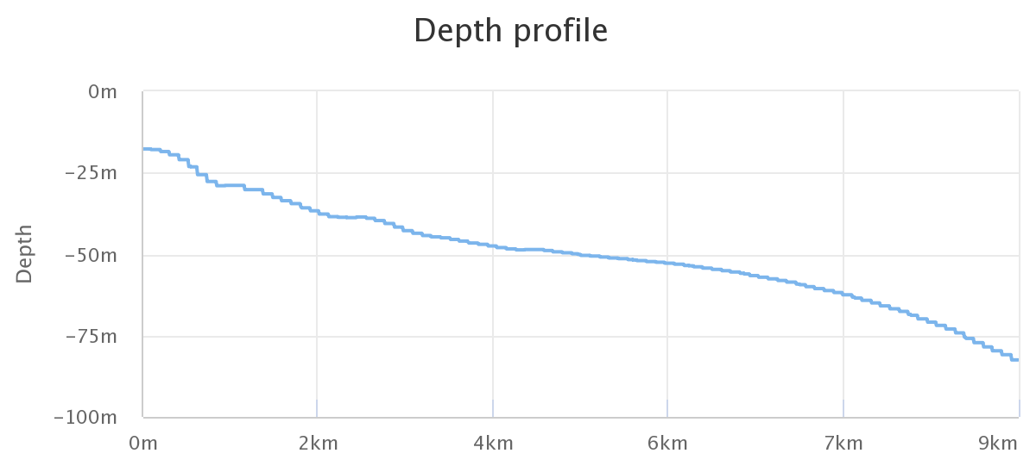
G. nummaria tells an Eastern Mediterranean story!
That depth is not experienced until >2 km off of the coast
Clam that perished living 2 km off the coast 4300 years ago, ended up buried, articulated in a tsunami deposit in shallow water
May have evidence of extreme, rapid transportation! Potential wave event around 4300 bp
Awaiting more δ¹⁸O results from modern museum clams from known depths, to better constrain exact depth of fossil specimens

Slide 16
Work to be done: Why did they disappear?
Substrate change? Sand availability has changed
In Spain, similar high-energy accumulations preceded local extinction linked to loss of coarse substrate (Gutierrez-Mas 2011)
Nutrient supply change?
Mainly feeds on detritus (Najdek et al. 2016), which may have decreased as Eastern Med has grown more oligotrophic
Trace metal proxies can track terrigenous and productivity-linked inputs
How did they get transported?
How much energy is needed to transport G. nummaria?
Do the shells create lift?
Can storms alone do it or are tsunamis part of the assemblage?

Slide 17
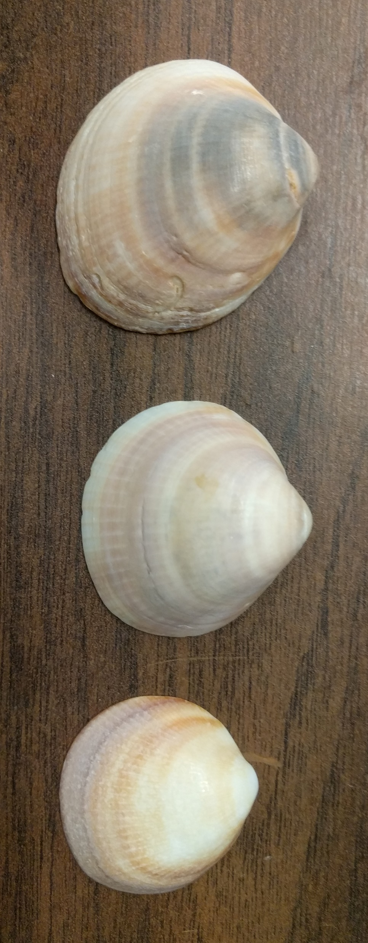
“Glycymeris nummaria (Linnaeus, 1758).” 2019. World Register of Marine Species. 2019. http://www.marinespecies.org/aphia.php?p=taxdetails&id=504509#distributions.
Grossman, Ethan L., and Teh-Lung Ku. 1986. “Oxygen and Carbon Isotope Fractionation in Biogenic Aragonite: Temperature Effects.” Chemical Geology: Isotope Geoscience Section 59: 59–74.
Gutierrez-Mas, J. M. 2011. “Glycymeris Shell Accumulations as Indicators of Recent Sea-Level Changes and High-Energy Events in Cadiz Bay (SW Spain).” Estuarine, Coastal and Shelf Science 92 (4): 546–54.
Jones, Douglas S., and Irvy R. Quitmyer. 1996. “Marking Time with Bivalve Shells: Oxygen Isotopes and Season of Annual Increment Formation.” PALAIOS 11 (4): 340–46.
Mienis, Henk, R. Zaslow, and D.E. Mayer. 2006. “Glycymeris in the Levant Sea. 1. Finds of Recent Glycymeris insubrica in the South East Corner of the Mediterranean.” Triton 13 (March): 5–9.
Najdek, Mirjana, Daria Ezgeta-Balić, Maria Blažina, Marija Crnčević, and Melita Peharda. 2016a. “Potential Food Sources of Glycymeris nummaria (Mollusca: Bivalvia) during the Annual Cycle Indicated by Fatty Acid Analysis.” Scientia Marina 80 (1): 123–29.
Reinhardt, Eduard G, Beverly N Goodman, Joe I Boyce, Gloria Lopez, Peter van Hengstum, W Jack Rink, Yossi Mart, and Avner Raban. 2006. “The Tsunami of 13 December AD 115 and the Destruction of Herod the Great’s Harbor at Caesarea Maritima, Israel.” Geology 34 (12): 1061–64.
Royer, Clémence, Julien Thébault, Laurent Chauvaud, and Frédéric Olivier. 2013. “Structural Analysis and Paleoenvironmental Potential of Dog Cockle Shells (Glycymeris glycymeris) in Brittany, Northwest France.” Palaeogeography, Palaeoclimatology, Palaeoecology 373: 123–32.
Sivan, D., M. Potasman, A. Almogi-Labin, D. E. Bar-Yosef Mayer, E. Spanier, and E. Boaretto. 2006. “The Glycymeris Query along the Coast and Shallow Shelf of Israel, Southeast Mediterranean.” Palaeogeography, Palaeoclimatology, Palaeoecology 233 (1): 134–48.
“Violet Bittersweet Clam (Glycymeris nummaria).” 2017. iNaturalist.org. November 14, 2017. https://www.inaturalist.org/observations/8803767.

Slide 18
Acknowledgements
Zuckerman Postdoctoral Fellowship
Colin Carney, UCSC Stable Isotope Lab
Henk Mienis, Steinhardt Museum, Tel Aviv

Slide 19
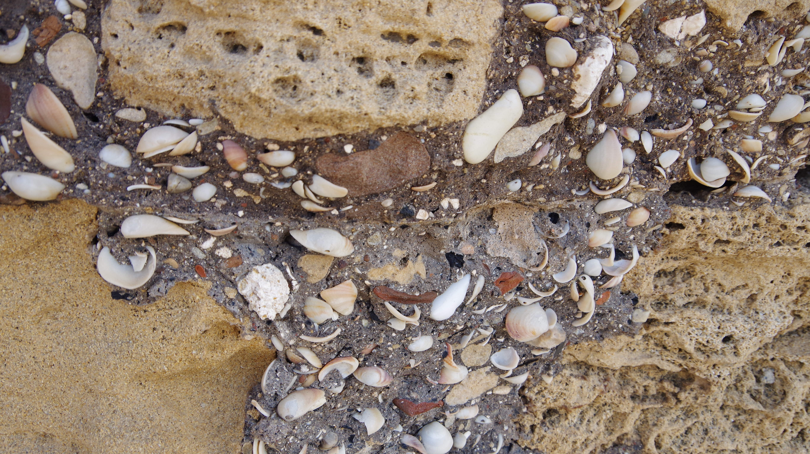
Questions?
Daniel.E.Killam@gmail.com
DantheClamMan.blog
Twitter: @dantheclamman

