Slide 1
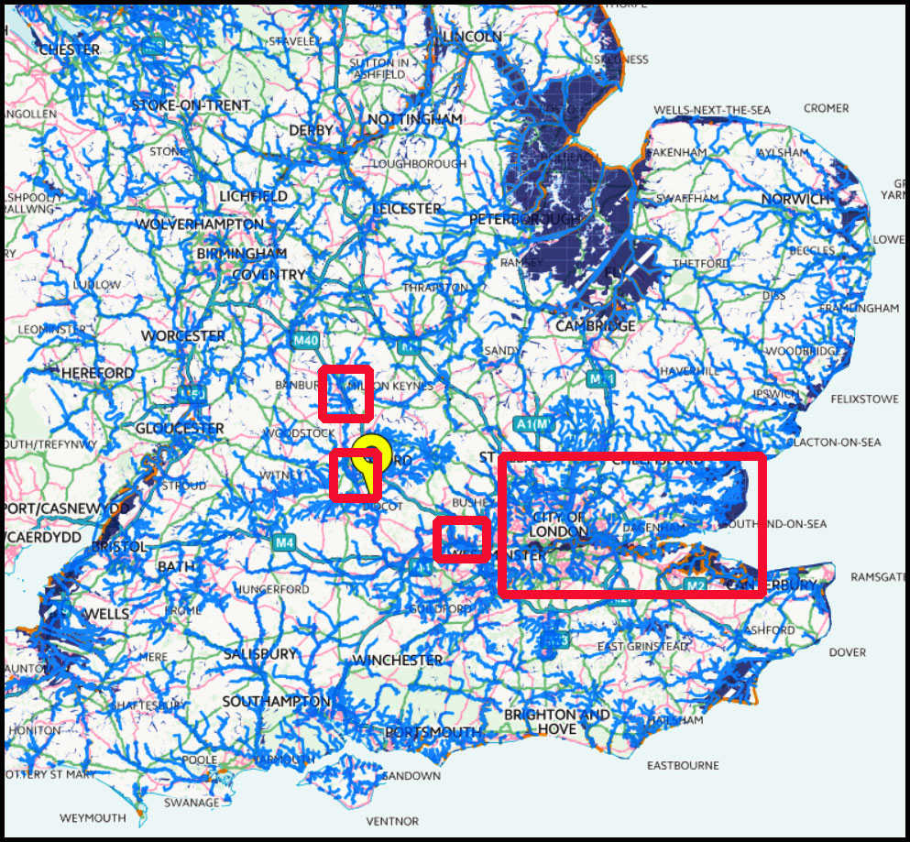
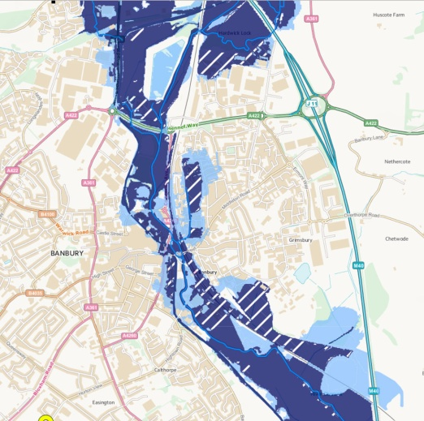
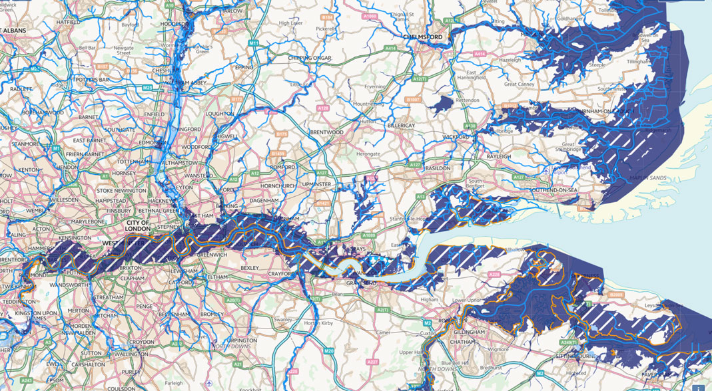
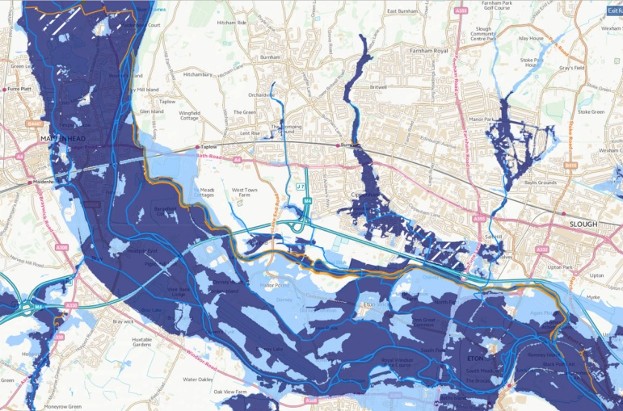
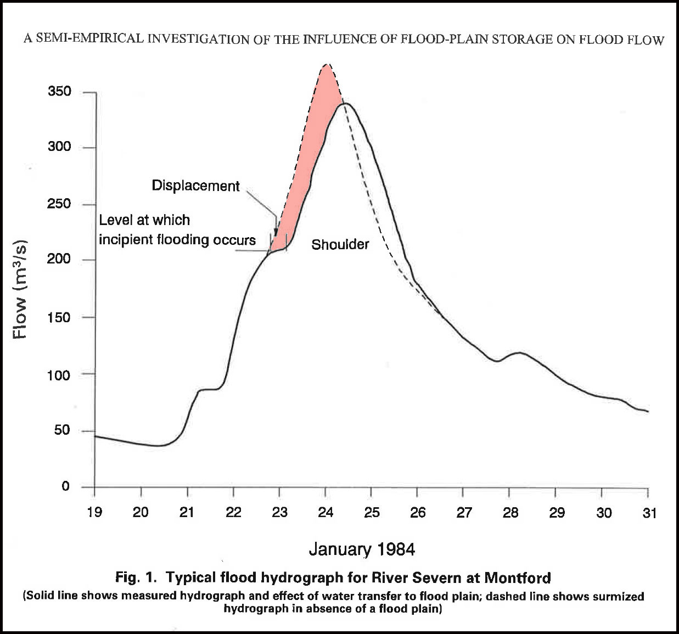
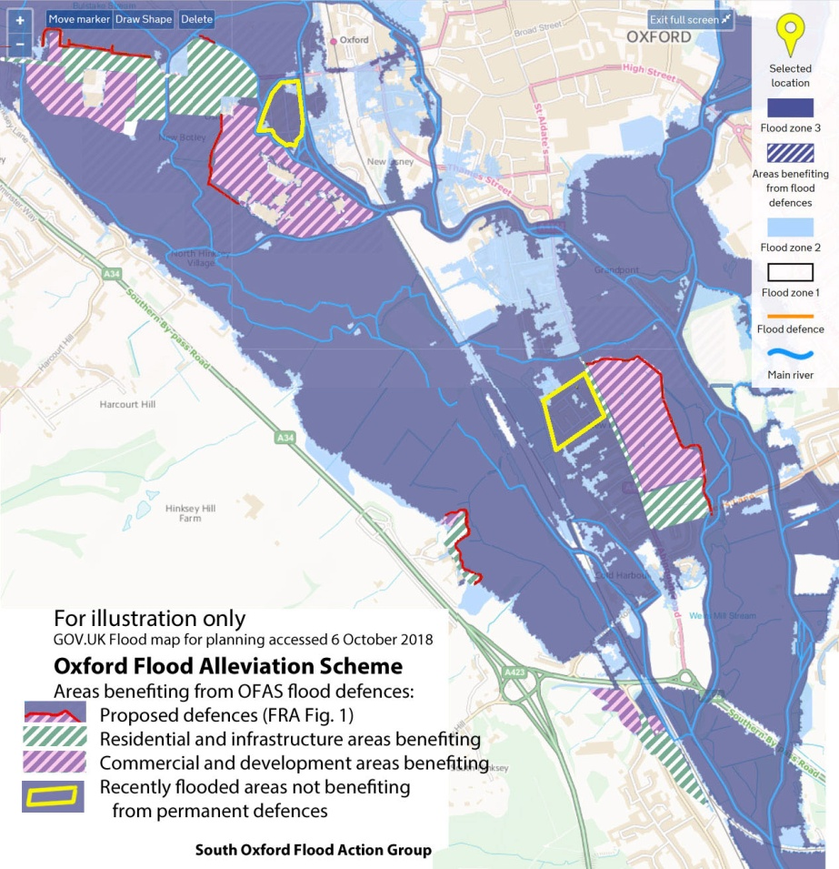
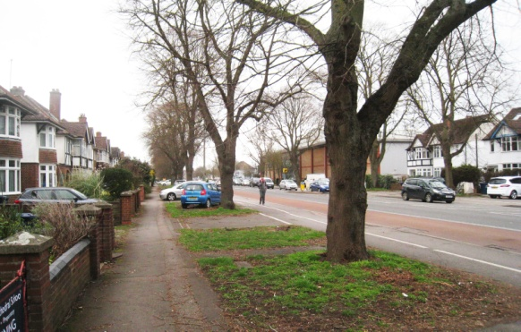
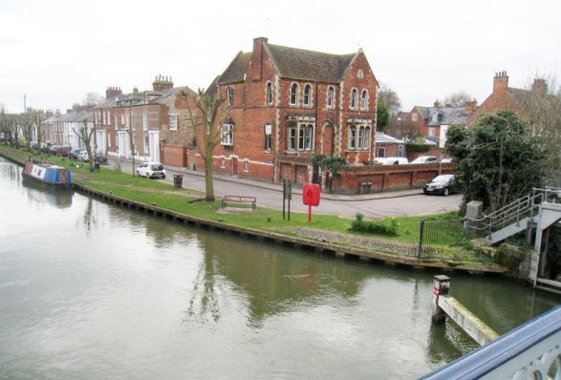
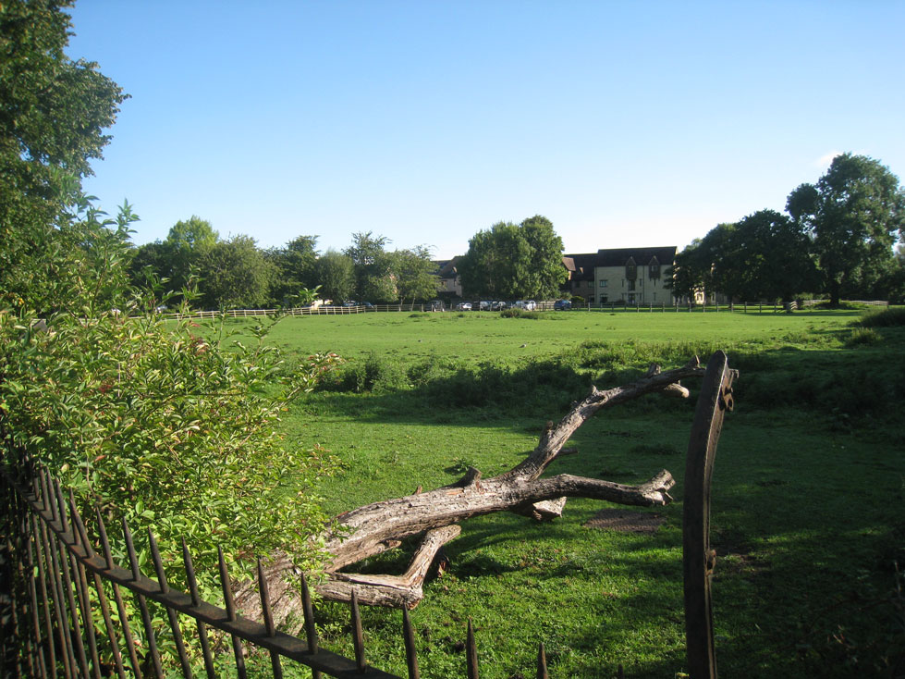
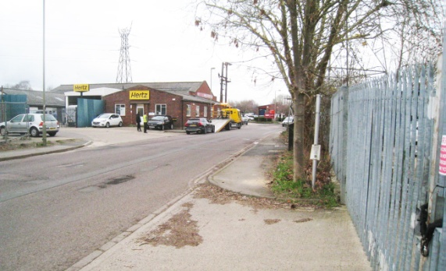
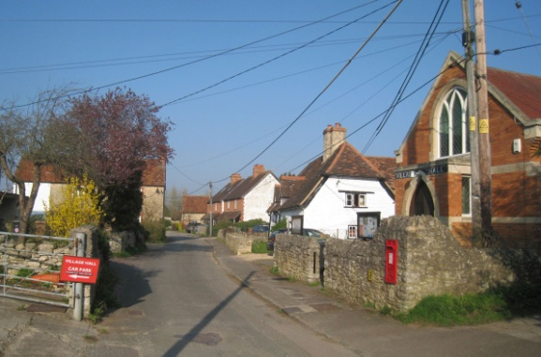
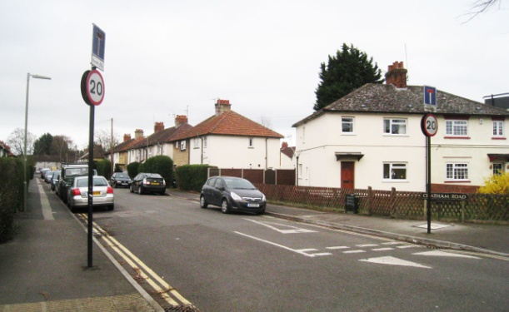
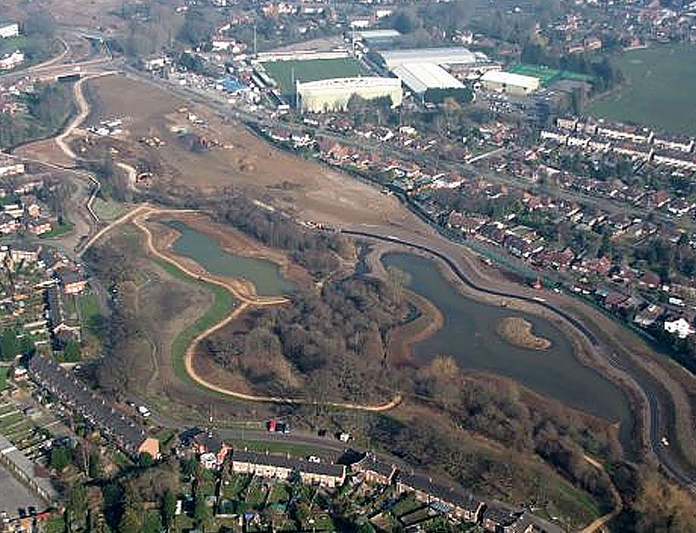
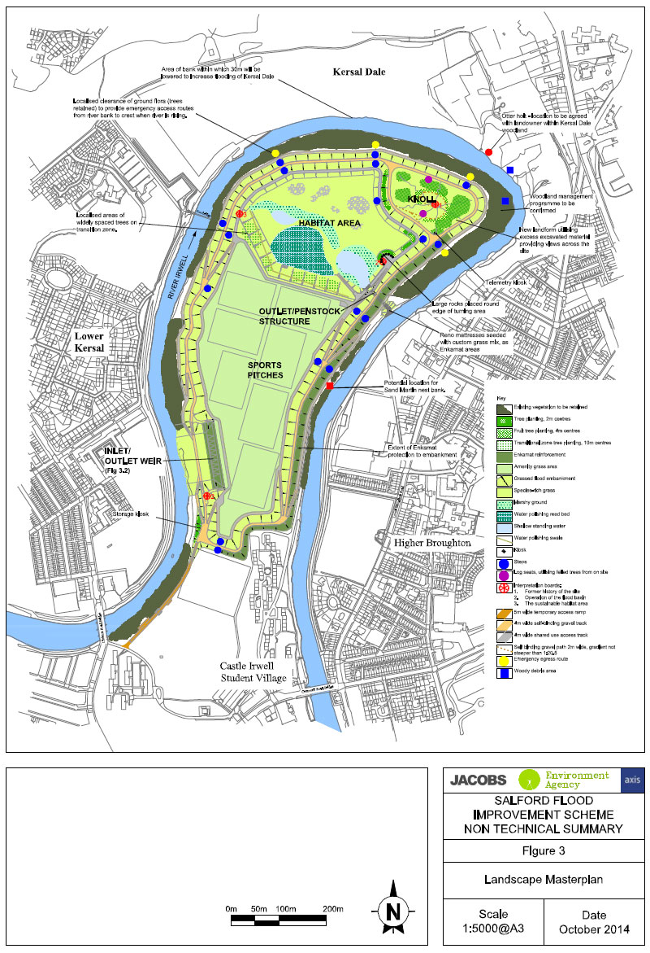
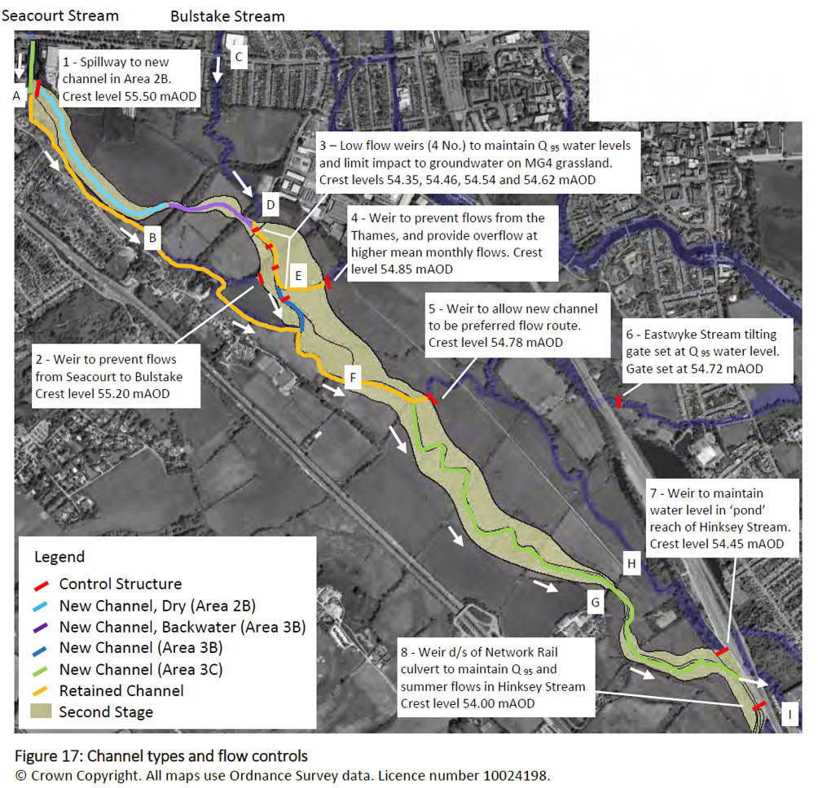
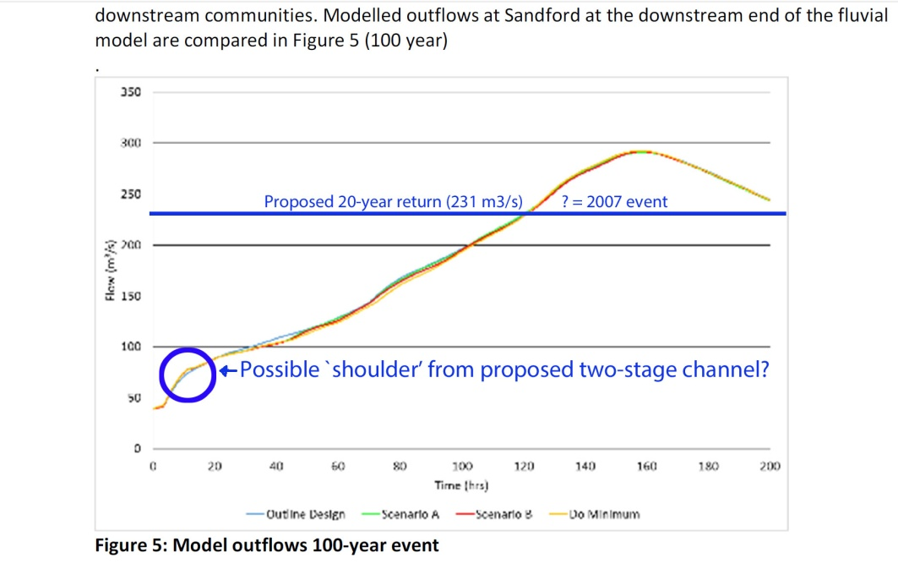
Geophysical Research Abstracts Vol. 21, EGU2019-18499, 2019
Natural and numerical? Balancing alternative flood compensation scenarios on a lowland valley ﬂoor
Brian Durham, Oxford, UK (brian@oxpot.demon.co.uk)
South Oxford
Flood Action Group
Natural flood plain management - long term investment (Fig. 1): Release of UK’s `long term investment scenarios’ for flood management under climate change coincides with decision-time for a flood scheme in the Thames catchment, where the effect of such investment on areas of a natural flood plain can be visualised.
For background, UK Environment Agency (EA) has carried out 23 case studies on natural flood management (NFM) of rivers and flood plains (accessed 15/03/2019), following which NFM investment is projected as 7% of Flood and Coastal Erosion Risk Management (FCERM) over 50-years (long term investment scenarios (LTIS, Jacobs 2019m, Table 6). Conventional FCERM activities are projected as 84%, including `building and maintaining defences’ and `more realistic scenarios for development on the flood plain’, which by implication creates `areas benefiting from flood defences’(ABFEDs). Existing ABFFDs are illustrated on current Flood Maps for Planning, reproduced here for R Thames catchment (the term ABFFD is not used in the LTIS). An imminent R Thames scheme at Oxford (OFAS) is explored by this poster, seeking synergy between NFM and conventional FCERM investment.
Hydrology (Fig 2): For a natural valley ﬂoor, McCartney and Nadan (1995) presented comparative hydrographs for the R Severn at Montford, UK, with a ‘shoulder’ illustrating how the ﬂood plain had absorbed the effect of peak ﬂows (Fig. 2). They concluded: ‘The availability of natural ﬂood-plain storage signiﬁcantly reduced the magnitude of major ﬂoods’. Their approach was reﬁned by O’Sullivan et al (2012), who ‘generate[d] downstream ﬂow hydrographs in a generalised river reach for deﬁned upstream hydrographs encompassing a range of ﬂows and duration’. They concluded that ‘in the 5-year to 50-year return period range, the ﬂoodplain provides a signiﬁcant area for extra storage of water’.
Effect of long term investment on natural flood storage (Fig. 3): In the R Thames catchment the Oxford Flood Alleviation Scheme (OFAS) offers a range of conventional investments (Fig. 3).
Each defended area displaces existing flood storage, which under planning and construction industry guidance (SFRAs, CIRIA C164) requires compensation (the Oxford total 352,575 m³ may exclude temporary defences, i.e. Areas 6 and 7). Options are:
Direct storage compensation (replacement volume is level-for-level);
Indirect storage compensation (with `control structures’ Lancaster et al 2004, CIRIA C624, p 168. Exemplar Fig. 4b, Salford Scheme).
Not explicit in the CIRIA guidance, but proposed at Oxford is:
No worsening elsewhere (NWE) compensation, verified by a numerical model (Fig. 4c and d). EA notes `the issue and its relevance to the research programme is fully understood’ Environment Agency 10/12/2018.
Storage compensation principles as applied (Fig 4): CIRIA direct flood storage is created at Woking’s Hoe Valley by recovering flood plain landfill for a residential ABFFD, while Salford’s Irwell scheme uses an inlet/outlet weir and penstocks to create CIRIA indirect storage. Oxford’s NWE compensation principle with two-stage channel achieves a shoulder (circled blue) on the downstream hydrograph at flood flows around 80m³/s.
Conclusions: This study identifies a need to reconcile NWE compensation with local planning guidance based on construction industry principles, and asks:
Does hydrology have the tools to quantify NWE compensation against that by physical storage?
Without such accountability, might reliance on NWE compensation lead to growth of ABFFDs and single-stage channels relative to natural flood plains?
Would this be clarified by a `library’ of quasi-empirical numerical models collected via the planning process? (see )
Fig. 1b: Banbury ABFFDs
Study area Thames Valley
ABFFDs from EA Flood Map (16/03/2019);
Fig. 1a: Location
Oxford: see inferred ABFFDs below, Fig. 3
Fig 1c: Jubilee River ABFFDs
Fig. 1d: Thames tideway ABFFDs
Hydrology
Fig 2: R Severn, Montford, Shropshire
Hydrograph Jan 1984.
Including natural flood plain (recorded);
Without flood plain (surmised red).
After McCartney and Nadan 1995
1
6
2
7
3
1
6
3
4
2
5
4
Fig 3. Oxford ABFFDs inferred from planning application:
Green tint - existing residential and infrastructure;
Red tint - commercial/speculative;
Yellow boxes - temporary defences
5
Recovered landfill creates ABFFD
Fig. 4. Storage compensation in practice :
Above - Direct compensation at Woking’s Hoe Valley;
Centre – Indirect compensation at Salford’s flood scheme, equivalent to 260 Olympic swimming pools;
Right – NWE compensation at Oxford, equivalent to 110 Olympic pools, with downstream hydrograph.
Potential research strands
Strand 1: Assemble numerical models of alternative compensatory storage scenarios in a generalised river reach, applying a nominal simulated displacement to the O’Sullivan et al (2012) index.
Strand 2: Use of the UK planning process to build a quasi-empirical library of numerically-modelled attenuation outcomes arising from alternative compensation scenarios.
Strand 3: Audit of extent of landﬁll occupying ﬂood plains where recovery of the ﬁll might provide cost-effective direct compensation.
Thanks to: Roger Bettess; Simon Collings; EA FCERM Evidence; Tim King; Edmund Penning-Rowsell.
Brian Durham brian@oxpot.demon.co.uk

