Slide 1
Semantic web tools for risk management and communication in emergency
Daniele Bignami, Giovanni Menduni, and Tommaso Sansone

Slide 2
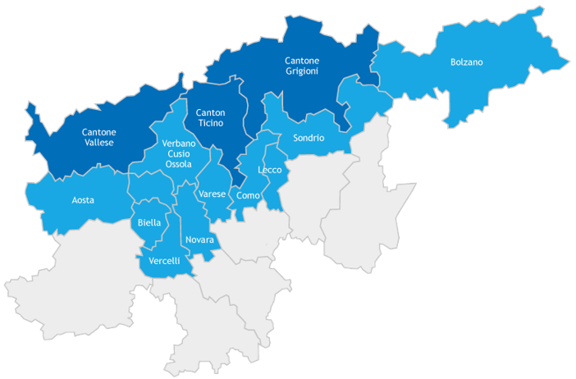
Improving emergencies management in borderlands between Italy and Switzerland
The Gestisco project
Notes:
Ambito = scope, framework

Slide 3
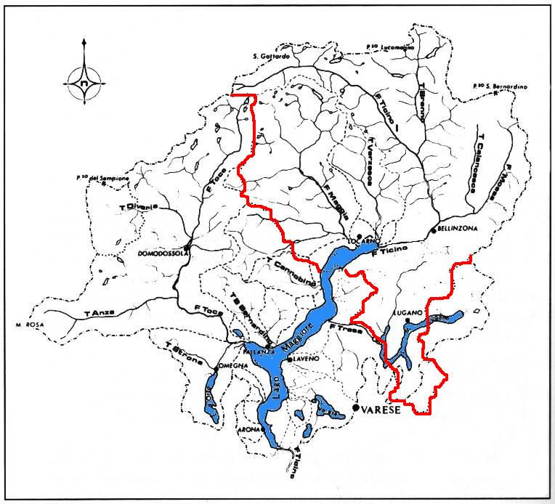
Improving emergencies management in borderlands between Italy and Switzerland
Risk often involves both countries simultaneously
Ticino river basin

Slide 4
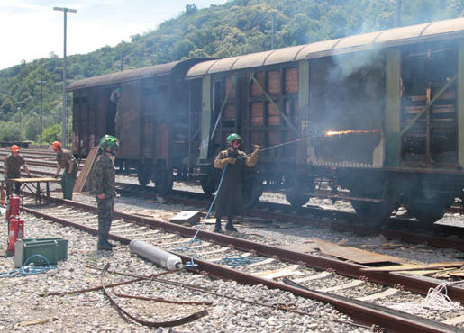
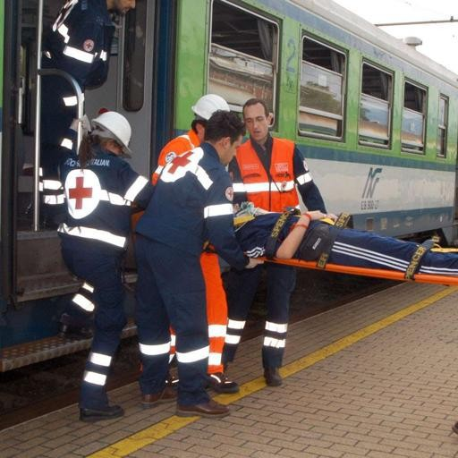
Improving emergencies management in borderlands between Italy and Switzerland
Emergency often involves both countries simultaneously
Odescalchi preparedness drill
(2016)

Slide 5
Improving emergencies management in borderlands between Italy and Switzerland
Problem:
Overlap and mismatch of terminology of different civil protection technical languages
Reduced effectiveness of civil protection activities and intervention
Notes:
Ambito = scope, framework

Slide 6
An issue of communication in civil protection activities in borderlands between Italy and Switzerland
Some examples
Type of mismatch | Example | Switzerland civil protection | Italian civil protection
The same lemma has different meanings (Polysemy) | "B Emergency" "Straripamento", "Inondazione", "Allagamento" | Biological hazard emergency Flood Flood Flood | Regional scale emergency Water channel overflow Costal flood Flood involving buildings (typically the interior)
The same concept/object has different lemmas (Synonymy) | Emergency management structures | Cantonal governing body | "Regional operative center", "Provincial operative center", "Mixed operative center"

Slide 7
An issue of communication in civil protection activities in borderlands between Italy and Switzerland
Need
Reorganizing the technical terminology to grant the efficiency of the civil protection activities.
Solution
Developing a tool to analyze, manage and interface the different risk management languages.
Metaglossary

Slide 8
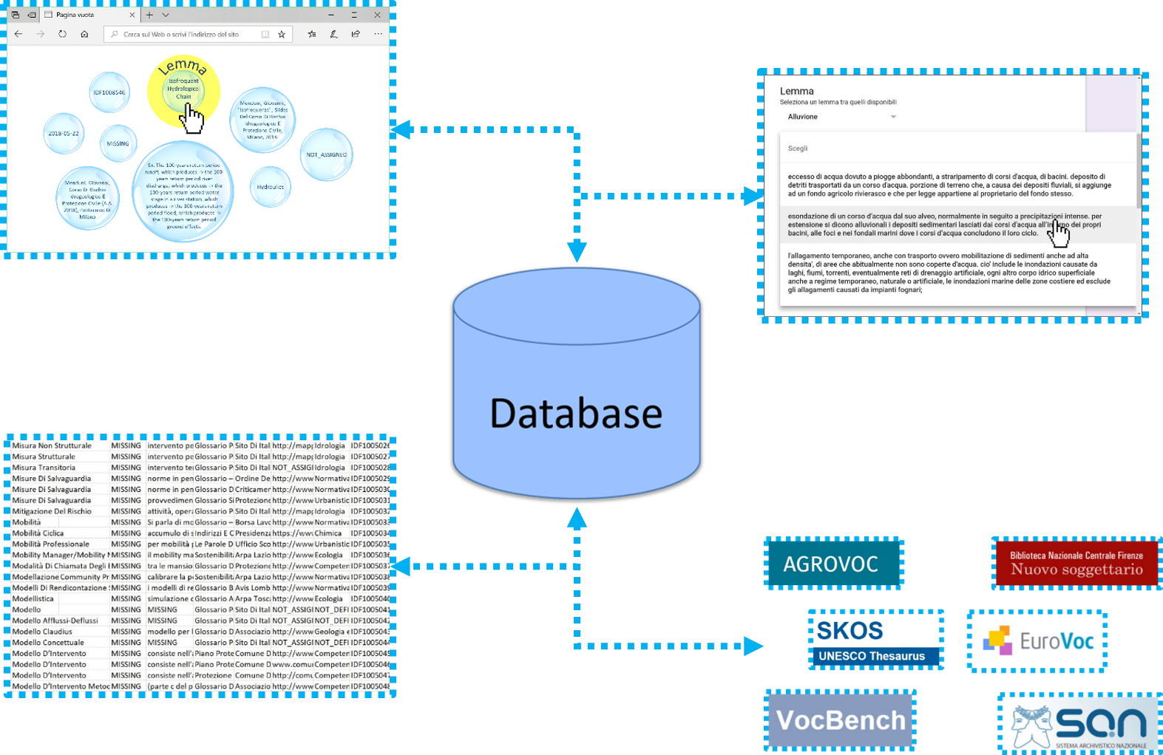
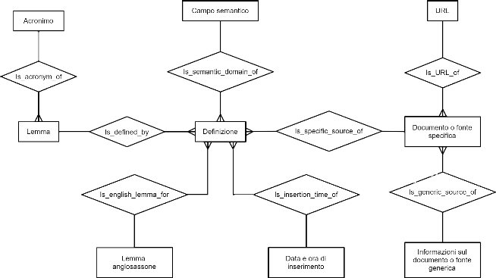
What is a metaglossary?
meta- (prefix): With sense ‘beyond, above, at a higher level’.
a. Prefixed to the name of a subject to denote another which deals with ulterior issues in the same field, or which raises questions about the nature of the original discipline and its methods and assumptions.
Rearrangement of the definition of prefix «meta-», in Oxford English Dictionary
1
3
2
Notes:
“Something more than a glossary”
A glossary made of other glossaries
A structure organizing and describing the glossaries data (metadata)
A platform to collect, display, share and link linguistic data (the content of the glossaries)

Slide 9
What is the metaglossary like?
Assembly line
Searching for local glossaries
Parsing the glossaries and formatting the information
Differentiating the data and adding metadata
Merging glossaries into one
Semantic classification of linguistic data
Building the relational structure of the database
Metaglossary

Slide 10
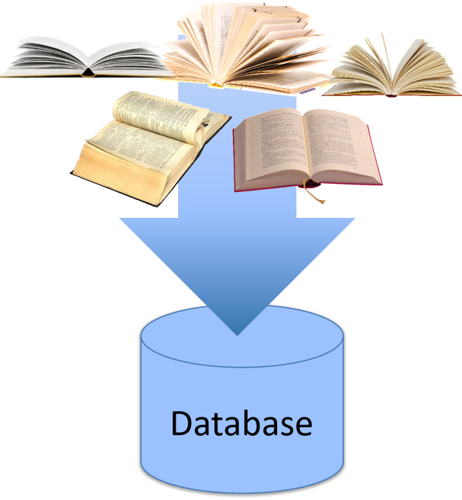
What is the metaglossary like?
Data differentiation and metadata assignment
The result is a collection and rearrangement of already existing knowledge. Original language does not get changed
It empowers local civil protection associations, corps and institutes
Italian lemma
URL
It enhances local rescue cultures and practices
English lemma
Semantic
tag
Acronym
Definition
Source
Notes:
Empower=responsabilizzare
Enhance=valorizzare

Slide 11
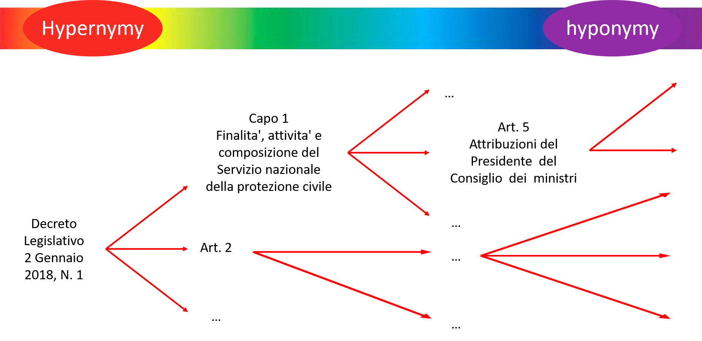
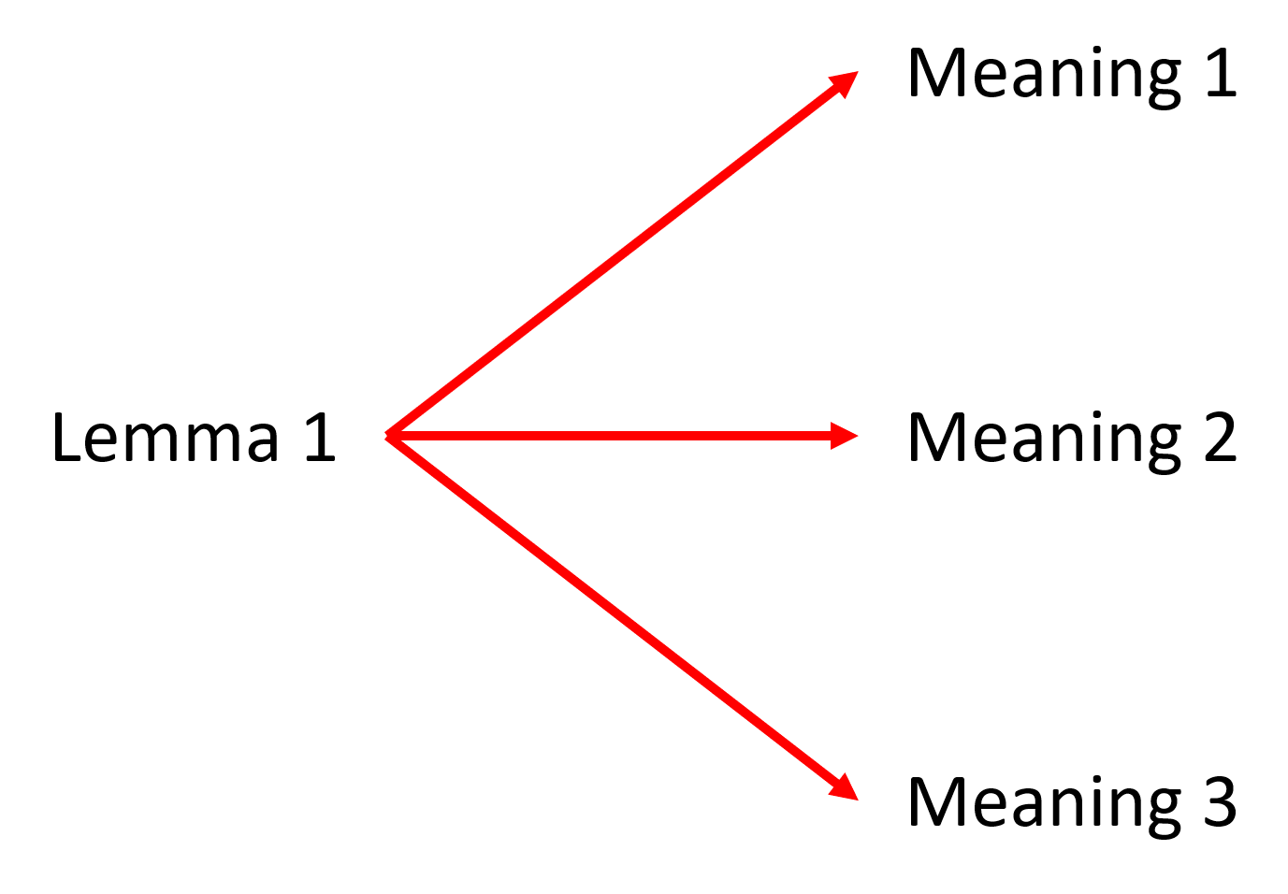
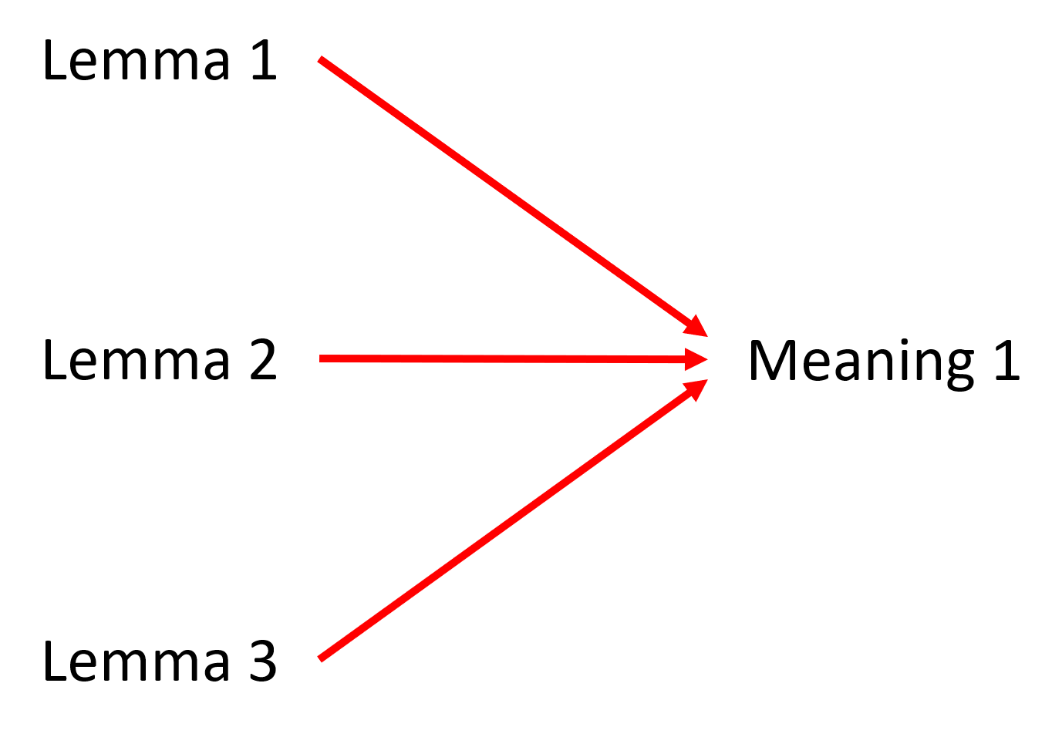
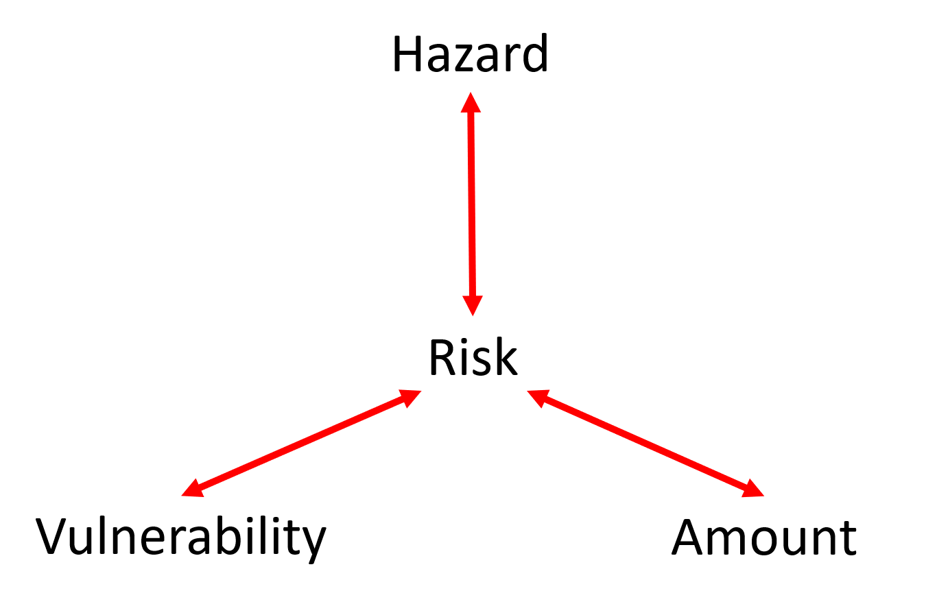
What is the metaglossary like?
Semantic relationships network
Polysemy
Synonymy
Top concept

Slide 12
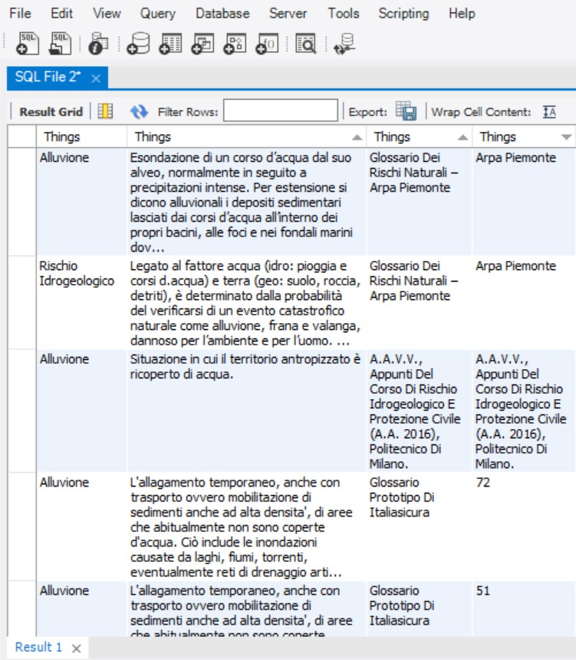
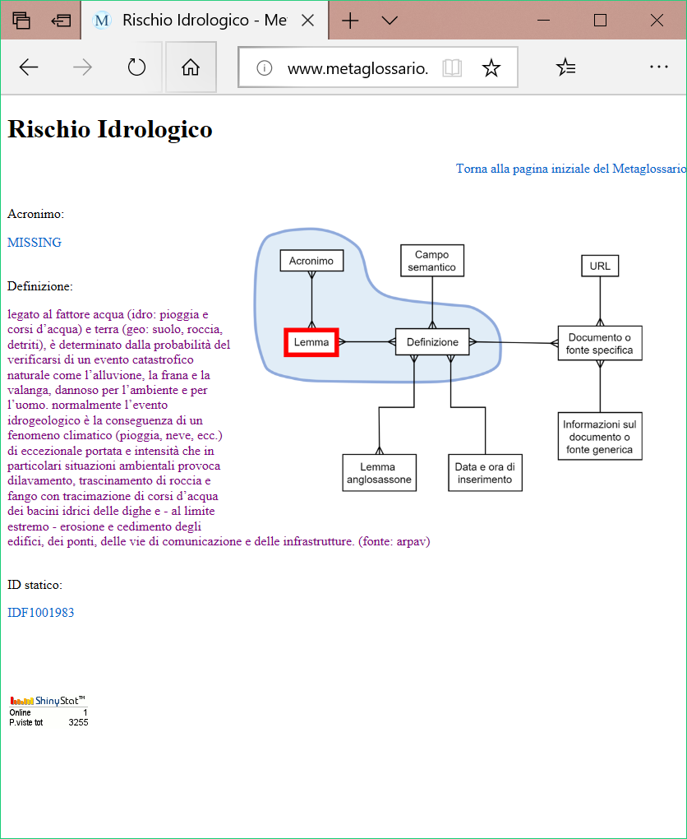
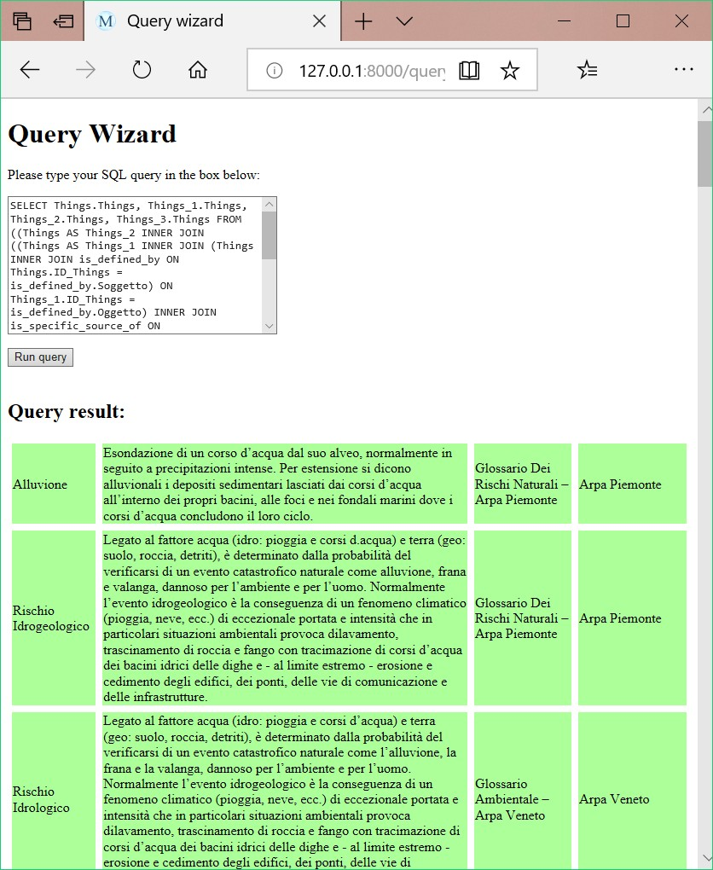
What is the metaglossary like?
Developed versions
Database file
Pure HTML website
3-tier web application
Notes:
Vai molto veloce.

Slide 13
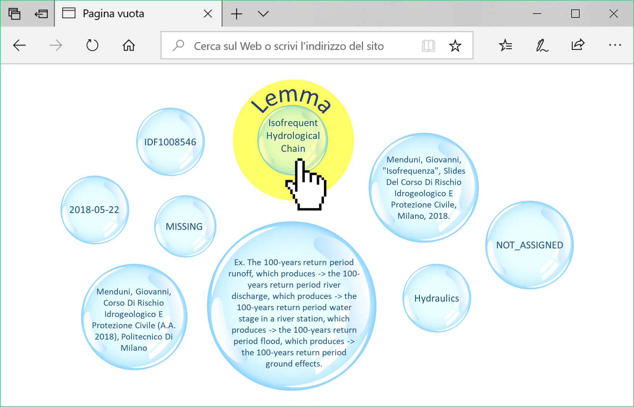
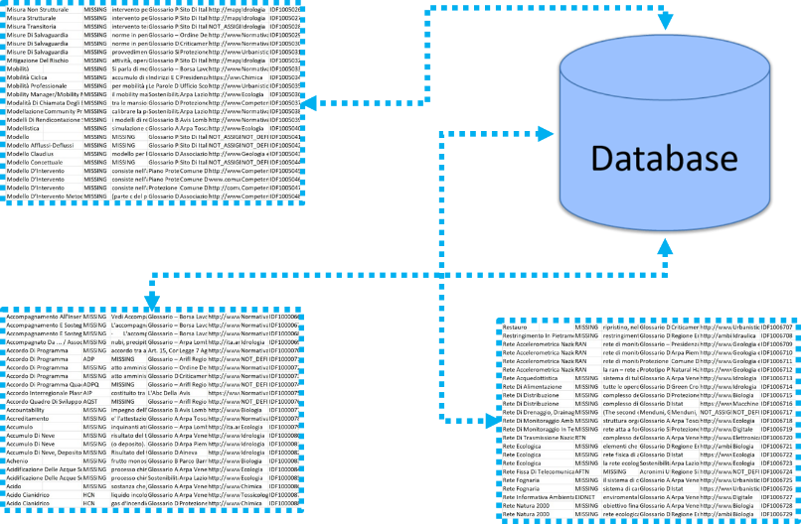
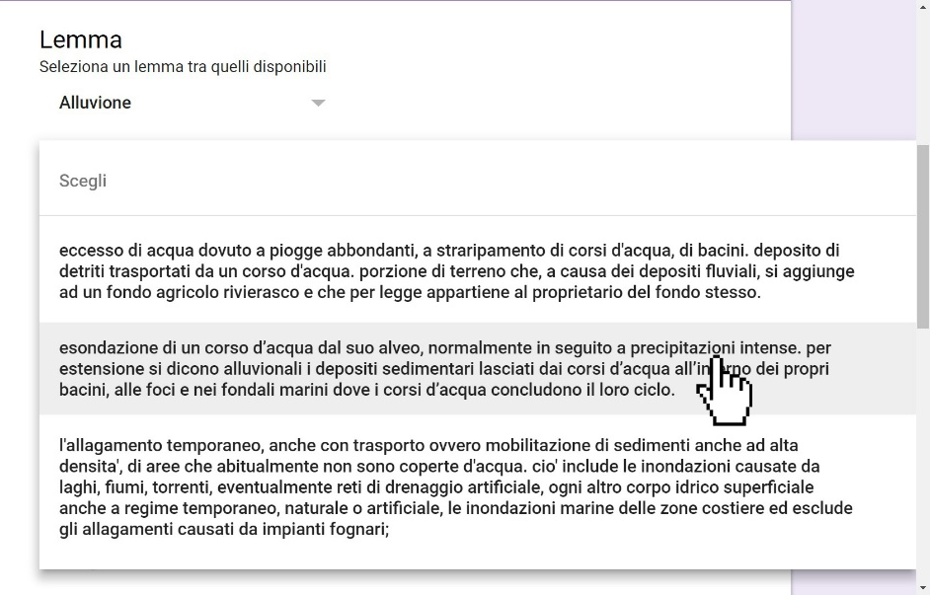
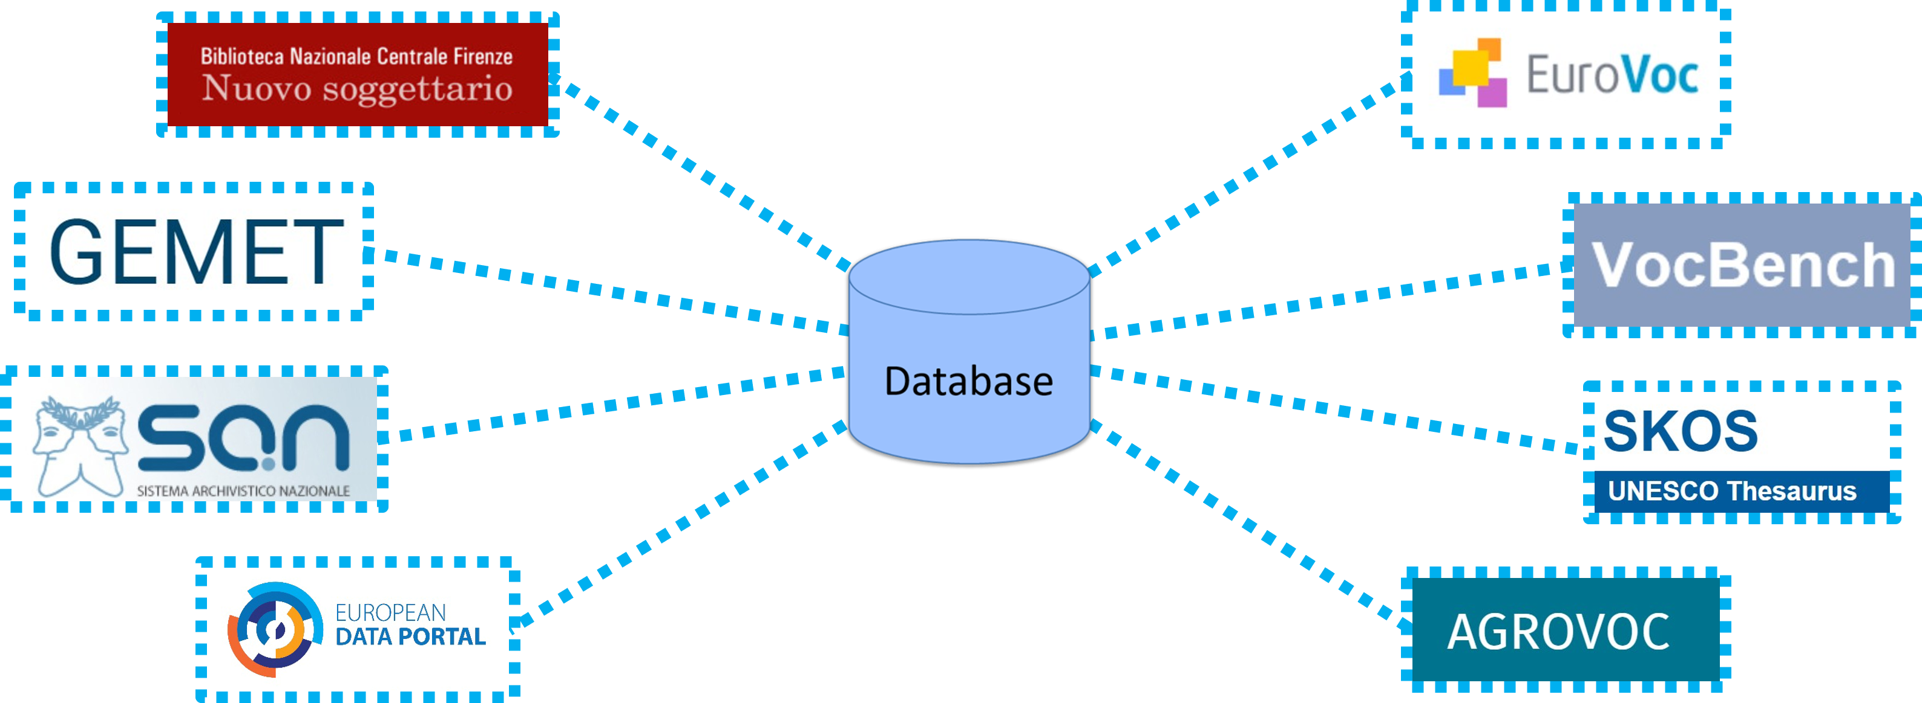
Further developement

Slide 14
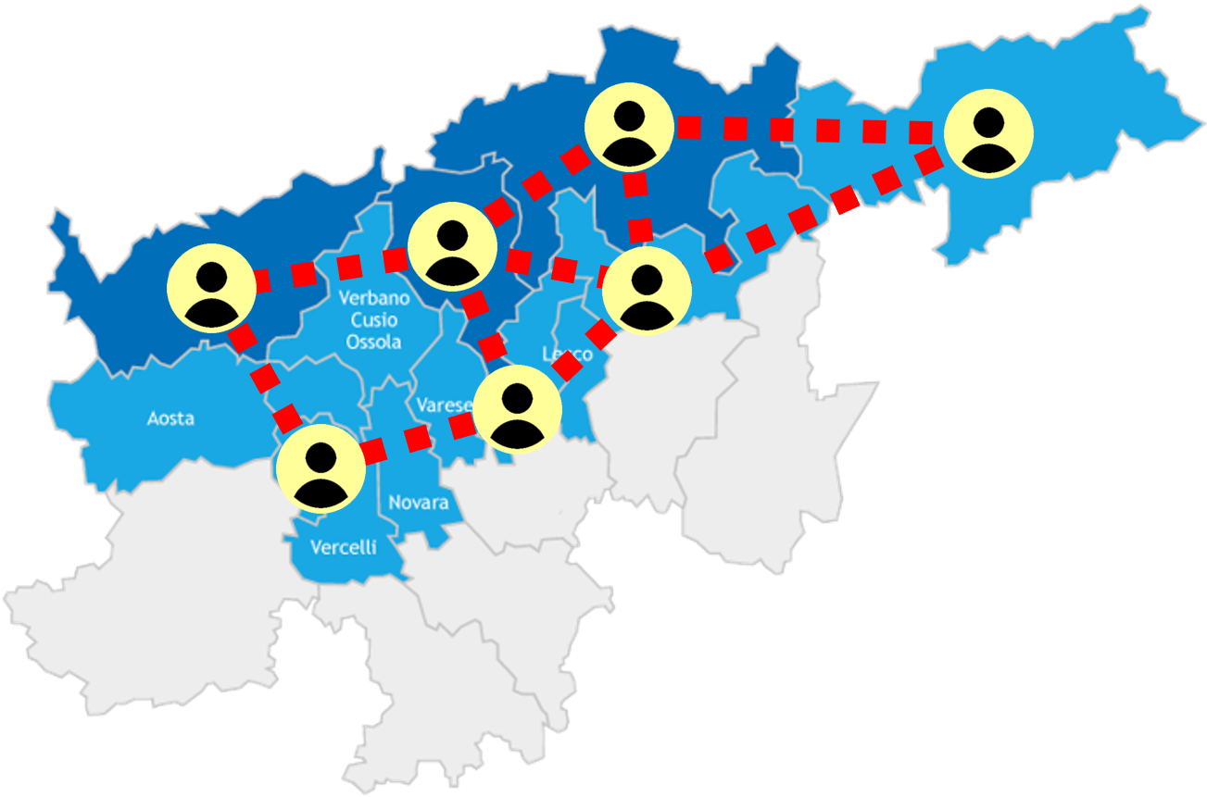
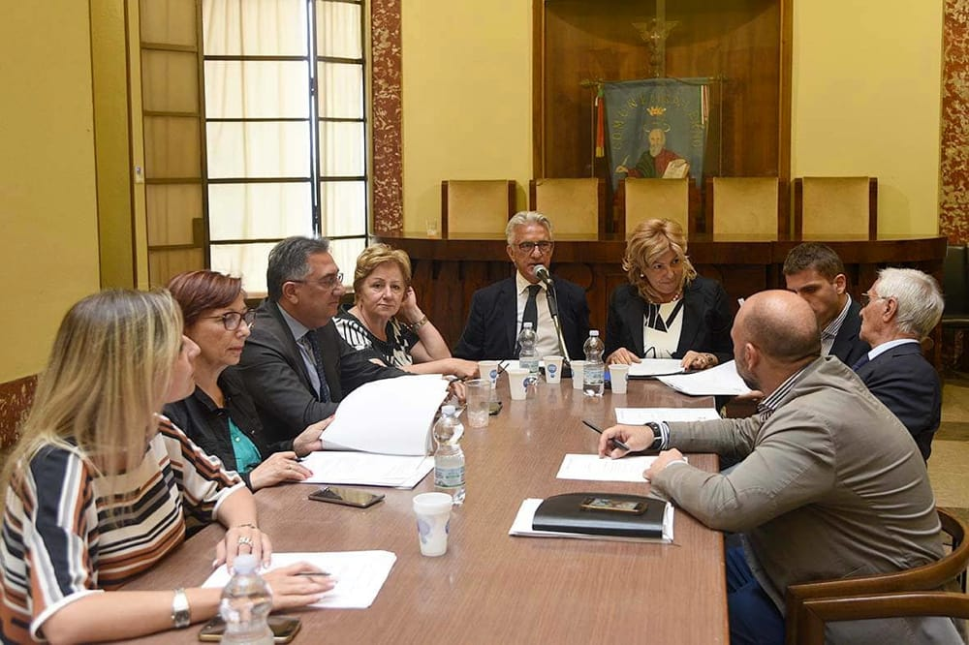
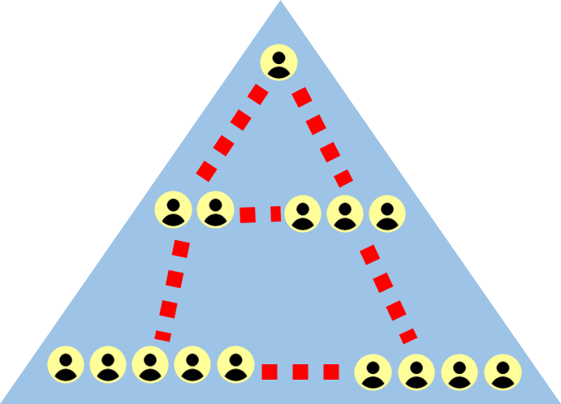
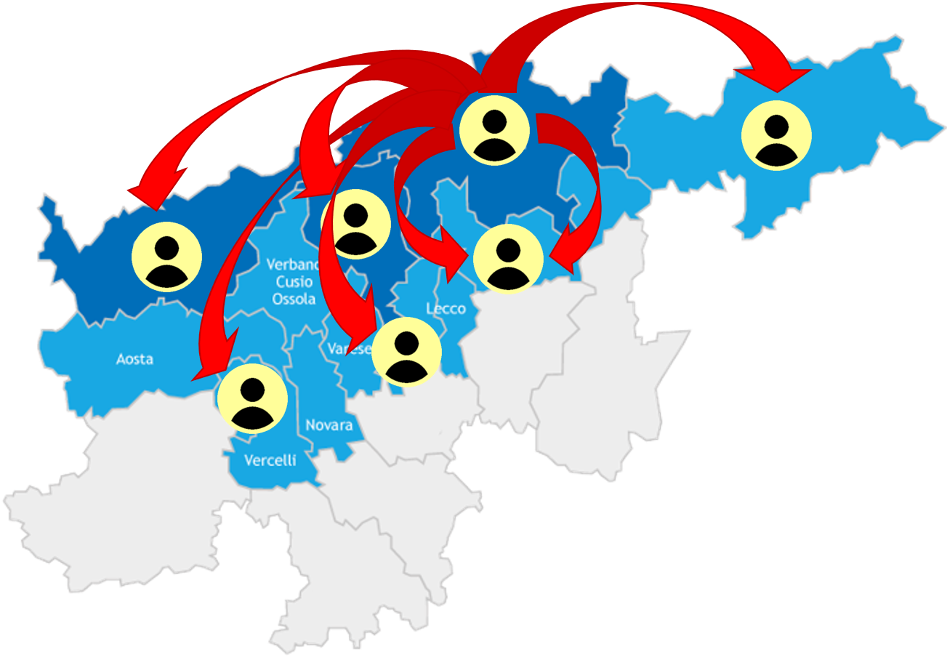
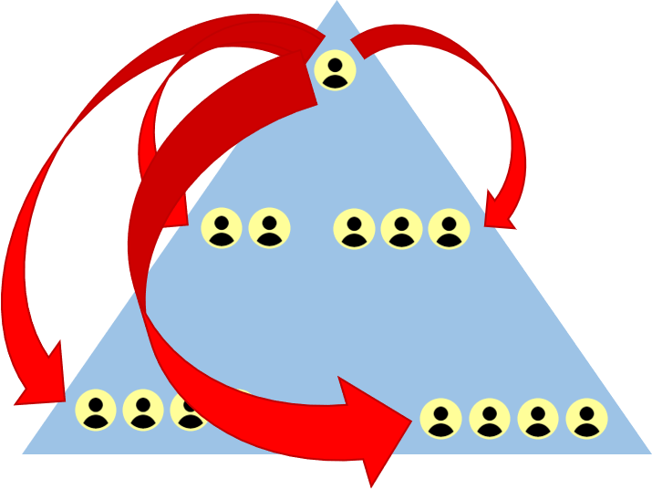
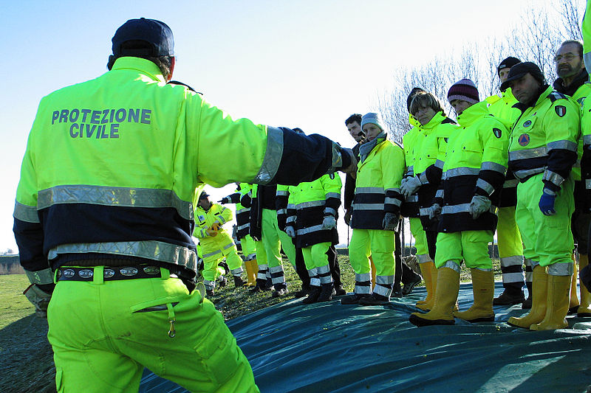
Applications
Notes:
Facilitare la comunicazione e il coordinamento
tra soggetti di diversa estrazione e competenza, anche non istituzionali.
tra diversi livelli di operatori appartenenti allo stesso ente.
tra vari distaccamenti di organizzazioni complesse o distribuite sul territorio.
Veicolare conoscenza tecnica e normativa
al di fuori del proprio territorio o dal livello amministrativo alle realtà locali (azione top-down).
da altri territori verso il proprio o dalle realtà locali verso il livello amministrativo (azione bottom-up).
Supportare
la redazione di nuove normative e dei piani di protezione civile.
la formazione di operatori specializzati nell’ambito della protezione civile.

Slide 15
Thanks for your attention!
Daniele Bignami¹ (daniele.bignami@fondazione.polimi.it),
Giovanni Menduni² (giovanni.menduni@polimi.it),
Tommaso Sansone¹ (tommaso.sansone@mail.polimi.it)
¹Fondazione Politecnico di Milano, Piazza Leonardo da Vinci 32, Milano, Italy.
²Civil and Environmental Engineering department, Politecnico di Milano, Piazza Leonardo da vinci 32, Milano, Italy.

