Slide 1
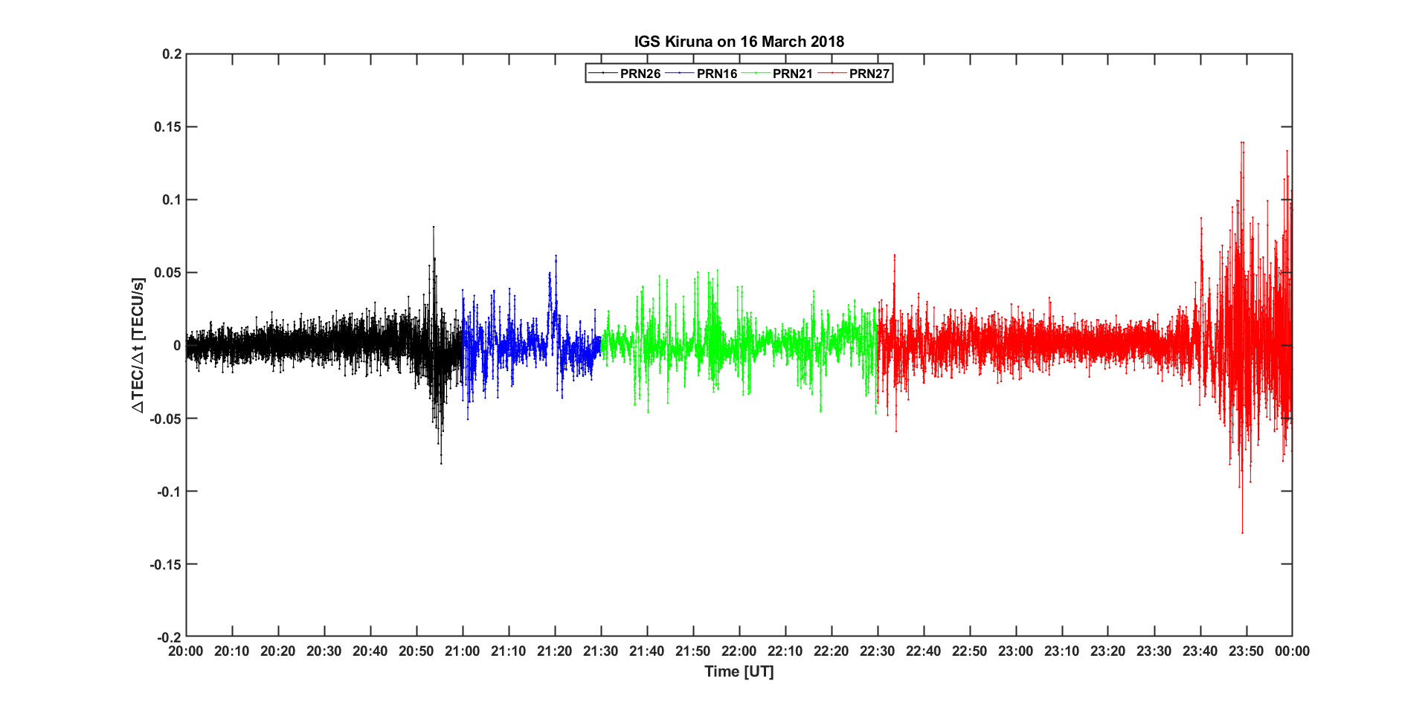
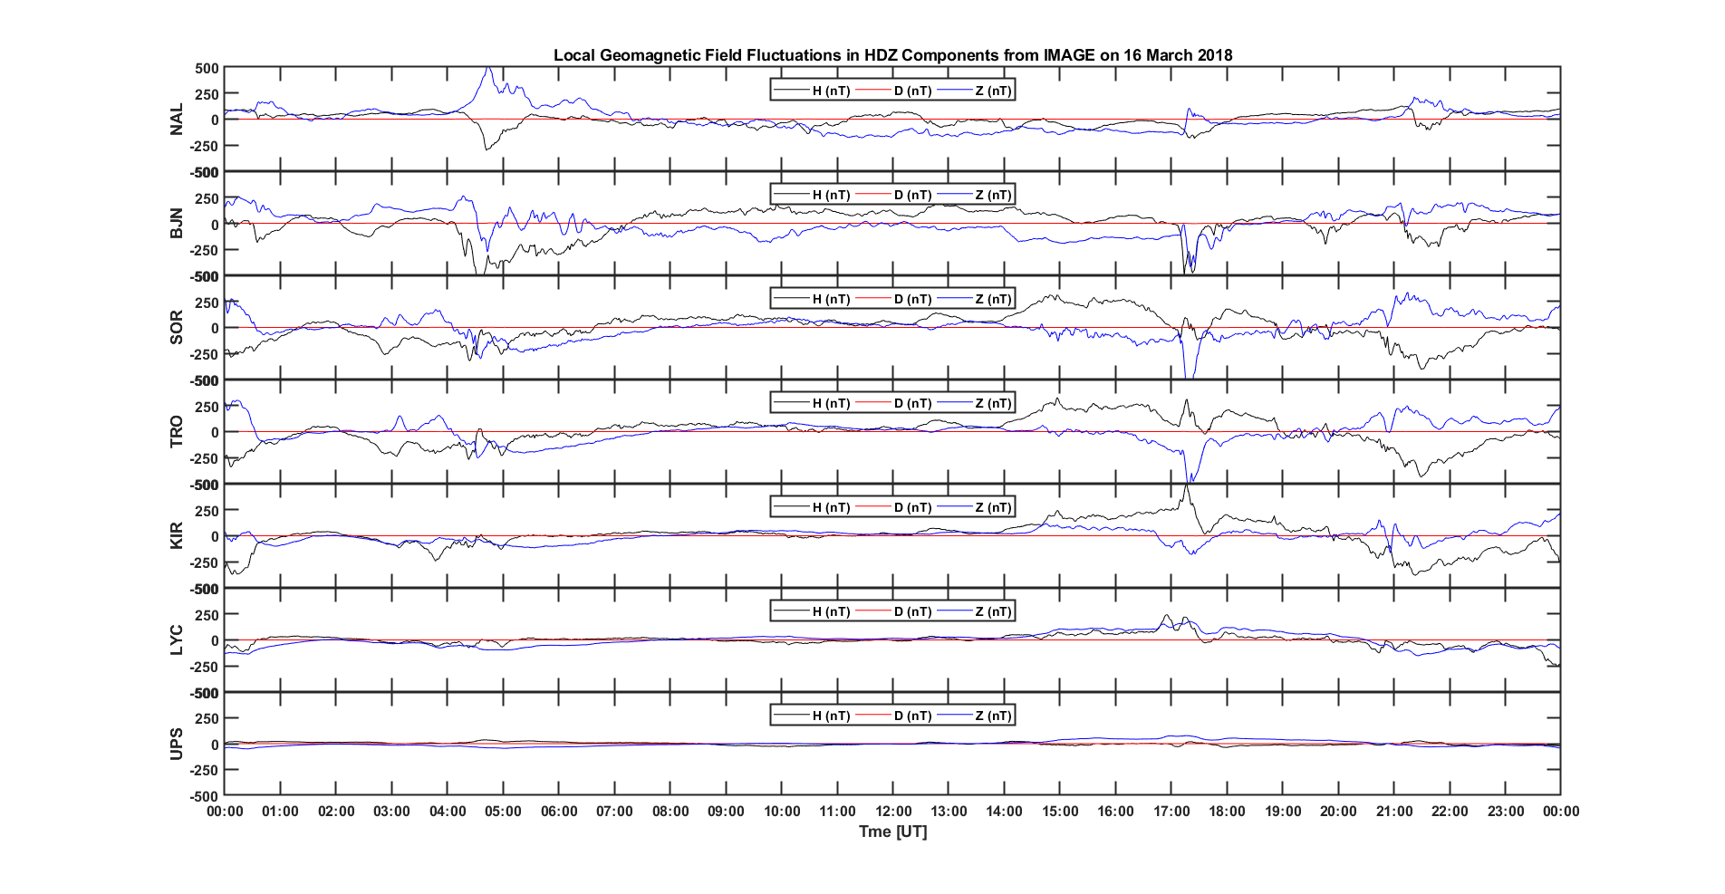
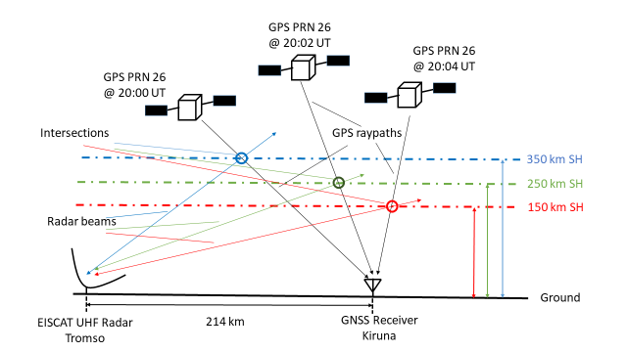
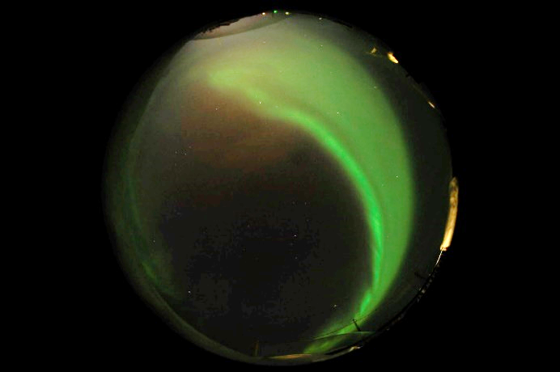
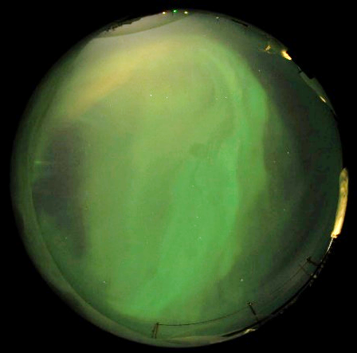
Fig. 2: 4 GPS PRNs orbital trajectories in terms of azimuth and elevation over Kiruna on 16 March 2018
Estimate of Plasma Structures Inducing TEC Fluctuations on GPS Signals in the European Auroral Sector
by using EISCAT/ESR Radars
Habila Mormi John^{1,2}, Biagio Forte¹, Ivan Astin¹, Tom Allbrook¹, Alex Arnold¹
¹Department of Electronic and Electrical Engineering, University of Bath, Claverton Down, Bath, United Kingdom, BA2 7AY.
²Department of Electrical and Electronic Engineering, University of Abuja, P. M. B. 117, Airport Road, Abuja, Nigeria.
hmj42@bath.ac.uk
A. Background
D. Results
GNSS-based technologies experience disruption of service and outages during adverse ionospheric conditions.
Plasma gradients forming in the ionosphere over large-to-small scales during adverse space weather conditions introduce signals and services disruptions in terms of scintillation and Total Electron Content (TEC) fluctuations.
The presence of plasma gradients can limit the GNSS receiver tracking capability and therefore degrades the positioning and timing accuracy.
As an objective, the experiment was to estimate the ionisation structures responsible for TEC fluctuations on GPS signals in the auroral ionosphere by means of EISCAT/ESR electron density profiles.
Further, the main point of the experiment was to relate plasma structures in phase screens across specific GPS ray paths to TEC fluctuations observed along these GPS ray paths.
In this experiment, the radar electron density profiles and the GPS TEC fluctuations are used to infer the origin of the observed signature on the GPS signals from large-scale ionisation structures in the E and F regions during the time of observation.
The results will assist in the design of robust GNSS receivers and positioning algorithm for enhanced performance and reliability.
Enhanced TEC fluctuations
B. Data and Methodology
Fig. 3: 1-Hz GPS TEC Fluctuations observed from the IGS geodetic receiver in Kiruna [KIRU] on 16 March 2018 [Data available through IGS]
Only EISCAT radar measurements of 16 March 2018 experimental campaign between 20:00 and 24:00 UT is presented.
1-Hz RINEX observation data obtained from a geodetic International GNSS Service (IGS) station at Kiruna.
HDZ components data derived from the International Monitor for Auroral Geomagnetic Effects (IMAGE) network to determine the occurrence of auroral substorm onset.
All-Sky Camera (ASC) data obtained from Kiruna, Sweden courtesy of IRF (Department of Space Physics), Kiruna, Sweden to measure auroral activity.
Here, we present the geometry of the experiment and its rationale.
Stations likely in the auroral oval
Description of EISCAT/Kiruna Experiment
Measurement time
Fig. 4: HDZ-component fluctuations from IMAGE Data on 16 March 2018 ($K_{p} index=4)$
North is Up
East is Left
20:54 UT
21:20 UT
Fig. 5: Aurora in view over Kiruna ASC on 16 March 2018 [Courtesy IRF]
E. Conclusions
Enhanced TEC fluctuations were observed on all considered GPS PRNs together with the H-field component perturbations suggesting auroral substorm onset with Kiruna likely within the auroral oval.
ASC shows 557.7 nm oxygen emissions above 100 km altitude indicating auroral arcs, diffuse aurora, and an evidence of particle precipitation in correspondence to TEC fluctuations.
Combination of EISCAT measurements with GNSS data and supporting evidences will further reveal the type of ionisation structure inducing TEC fluctuations on GPS signals.
The geometry of the experiment is intended to estimate ionospheric plasma irregularities inducing TEC fluctuation along a phase screen at different shell heights.
Fig. 1: The raypaths between PRN26 and Kiruna followed and intersected by EISCAT beams between 20:00 and 20:04 UT at 150, 250, and 350 km shell heights
Various GPS PRNs were selected based on:
EISCAT constraints (minimum elevation angle of 23⁰).
Position in the auroral oval (a band displaced towards the nightside of the Earth.
Ionospheric irregularities are observed during nighttime in the auroral region.
Satellites positions were predicted through calsky.com.
F. Acknowledgements
H. M. J. wishes to thank Petroleum Technology Development Fund (PTDF), Abuja, Nigeria for providing PhD research scholarship.
The EISCAT/ESR campaigns were supported through the EISCAT UK time allocation.
This work was supported by the Natural Environment Research Council [grant number NE/R009082/1] and by the European Space Agency and Thales Alenia Space Italy [H2020-MOM-TASI-016-00002].
EISCAT is an international association supported by research organisations in China (CRIRP), Finland (SA), Japan (NIPR and STEL), Norway (NFR), Sweden (VR), and United Kingdom (NERC).
The 1-Hz RINEX data were accessed through the International GNSS Service (IGS).
We thank the institutes who maintain the IMAGE Magnetometer Array: Tromsø Geophysical Observatory of UiT the Arctic University of Norway (Norway), Finnish Meteorological Institute (Finland), Institute of Geophysics Polish Academy of Sciences (Poland), GFZ German Research Centre for Geosciences (Germany), Geological Survey of Sweden (Sweden), Swedish Institute of Space Physics (Sweden), Sodankylä Geophysical Observatory of the University of Oulu (Finland), and Polar Geophysical Institute (Russia).
The authors wish to thank IRF (Department of Space Physics), Kiruna, Sweden for providing the optical ASC data.
GPS satellite positions were predicted through a very helpful utility at calsky.com.

