Slide 1
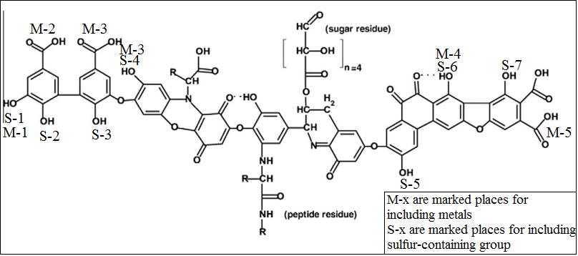
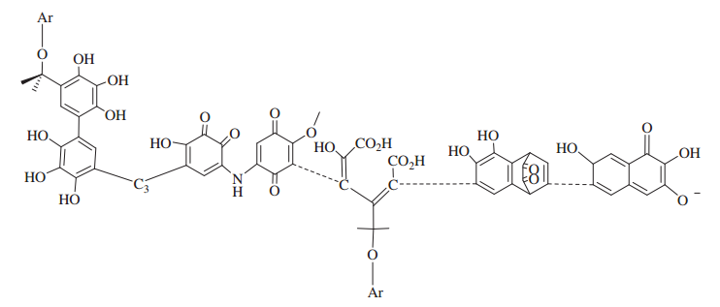
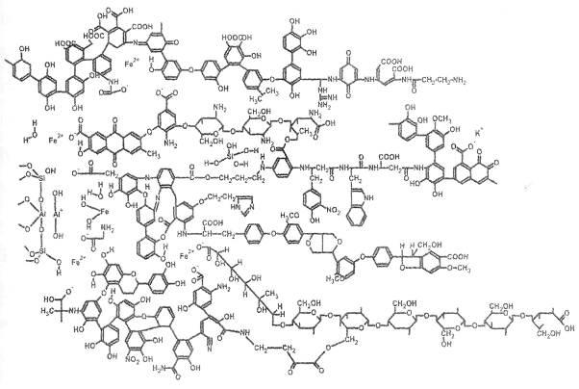
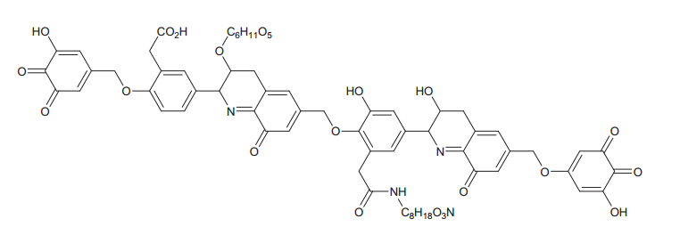
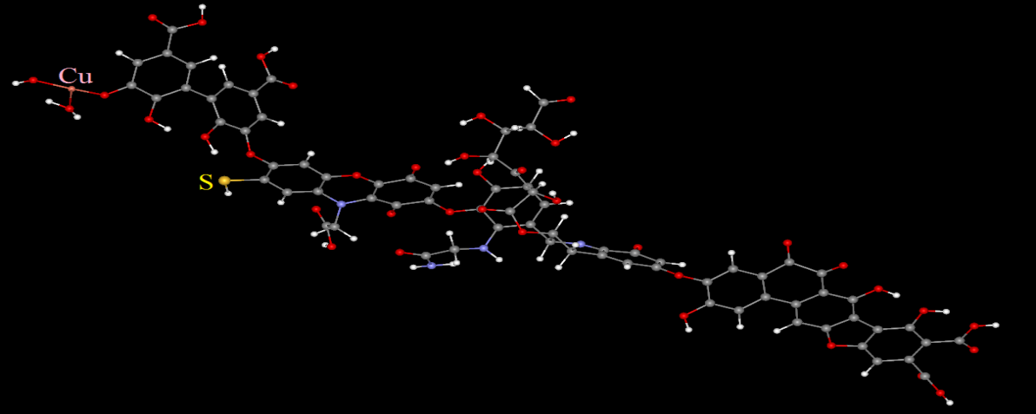
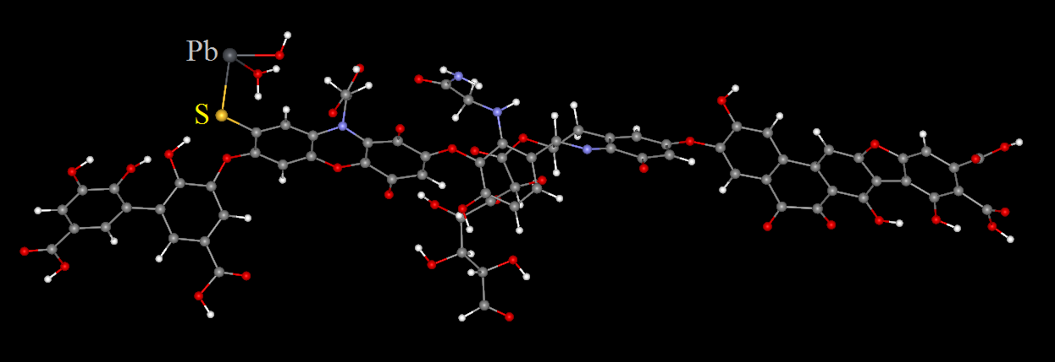
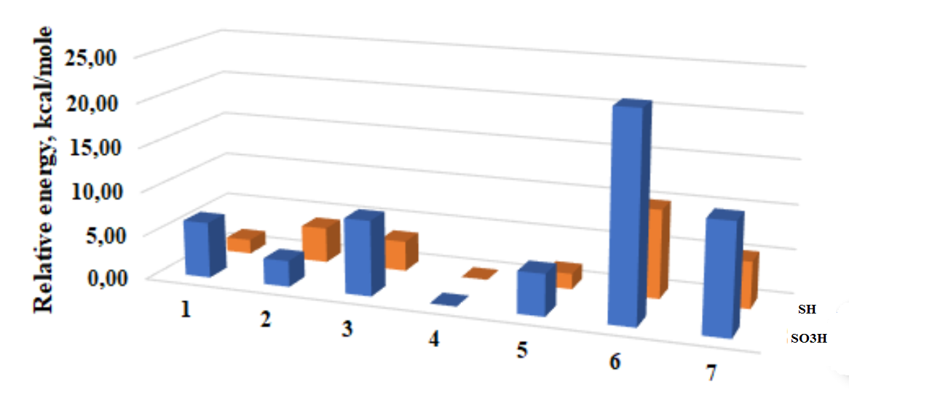
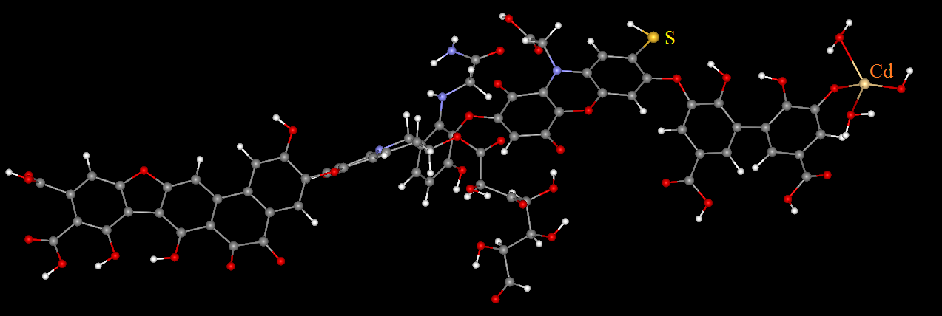
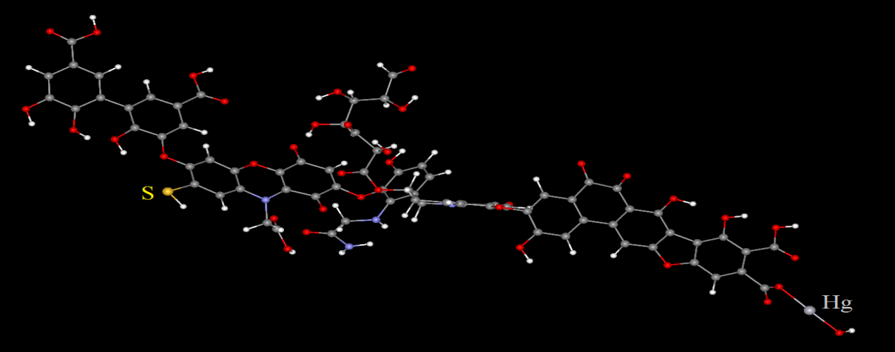
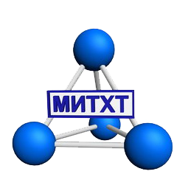
Interaction of humic acids with heavy metals - a theoretical study
Elizaveta S. Konkova ^{1,2}, Oleg N. Shishilov ¹, Alexandra S. Konkova ², Sergey A. Gromov ^{2,3}
¹ Russian Technological University – MIREA, Institute of Fine Chemical Technologies, Vernadskogo avenue 86, Moscow, 119571, Russia (e-mail: e.konkova.igce@gmail.com)
² Yu.A. Izrael Institute of Global Climate and Ecology, Moscow, Russia ³ Institute of Geography, Russian Academy of Sciences, Moscow, Russia
A complexation with humic acids (HA) is one of most probable pathways for binding of heavy metals in the natural environment that can prevent their further spread over the surroundings. HA have a complicate irregular structure containing up to twenty different functional groups (-COOH, -OH, -C=O, -NH₂, -SH, - SO₃H, etc.) and heteroatoms contents vary in wide ranges (20-35% w/w for oxygen, 1–5% w/w of nitrogen and ≤1% w/w of sulfur). Sulfur-containing groups of HA are highly active sites for complexing with heavy metals. Sulfur content is larger in organic surface layers of wetland soils compared to, for example, neighboring well-aerated soils due to enrichment of marsh soil organic matter with sulfur.
Main purpose of our study was to check possibilities for binding of heavy metals ions by different functional groups of humic acids and evaluate storage capacity of humic substances towards heavy metals.
Selection of HA model
Real humic acids are very complicate polymeric compounds with irregular structure and variable composition, so as the first step we selected an appropriate model of HA for study. Several models have been described in literature including Flaig’s model [Flaig, 1960], Dragunov’s model, Kleinhempel’s model [Kleinhempel, 1970], Stevenson’s model [1982], Orlov’s model [1994], etc.
Figure 2
Complexation of heavy metals with HA
Four heavy metals were chosen for the study: mercury, cadmium, copper and lead. Their ions in formal oxidation state +2 were placed to sulfur, hydroxyl and carboxyl groups consistently (sequence of placements is on fig 1). Coordination environment of every ion was completed with OH and H₂O in such a way that complex in general is electroneutral and the ions have characteristic coordination environment and coordination number (2 for Hg²⁺ and 4 for Cu²⁺, Cd²⁺ and Pb²⁺. All calculations were performed in the frame of scalar-relativistic approximation of DFT method using the Priroda program with PBE functional and SBK basis. Full geometry optimization and calculations of energy and IR frequencies were carried out (absence of imaginary frequencies was used a global minima criteria)
We analyzed the listed above models considering several parameters: presence of key functional groups, ratio between the groups, ratio between aliphatic and aromatic parts and total size of molecule, which is also important taking into account time required for calculations. Following these criteria we chosen Stevenson’s model as the most suitable for our study. The only disadvantages is absence of S-containing groups in the model, so as the first step we determined the most probably positions for -SH and -SO₃H groups (see below).
Modification of Stevenson’s model
Stevenson’s model of humic molecule structure was modified at the preliminary stage of investigation. Modification was carried out through placing S-containing groups (-SH and -SO₃H) instead of different HO-groups (figure 2) followed by comparison of energy for corresponding isomers. Semi-empirical method PM3 was used for geometry optimization and calculations of energy and IR frequencies (absence of imaginary frequencies was used a global minima criteria). Results are given in figure 1 and table.
Relative Energy of sulfur -containing isomers, kcal/mol
Group position | SO₃H group | SH group
1 | 12.3 | 5.2
2 | 22.9 | 9.9
3 | 6.3 | 1.6
4 | 3.0 | 4.0
5 | 8.5 | 3.4
6 | 0.0 | 0.0
7 | 4.7 | 1.8
Relative energies of isomers containing ions of heavy metals, kcal/mol
Coordinated group | Hg | Cd | Cu | Pb
-COOH | 16.1 | 19.5 | 5.9 | 0.0
-OH | 26.9 | 34.5 | 18.9 | 17.5
-SH | 0.0 | 0.0 | 0.0 | 0.1
Figure 1
For both –SH and –SO₃H groups position 4 was found to be the most probable location of S-containing groups in the molecule of humic acid in the frame of Stevenson’s model. This position also seems to be preferable from the point of view of metals ions coordination since it is not too much sterically hindered.
Conclusion: Within the Stevenson’s model we investigated potential places for including sulfur containing groups. We theoretically studied complexation of heavy metals with different functional groups of HA. Applying PBE exchange-correlation functional and basic set SBK it was shown that SH-groups are most likely binding sites for Hg, Cd and Pb. In case of Cu and ,especially, Pb the O-containing carboxyl groups are highly competitive and could be preferable for complexation.

