Slide 1
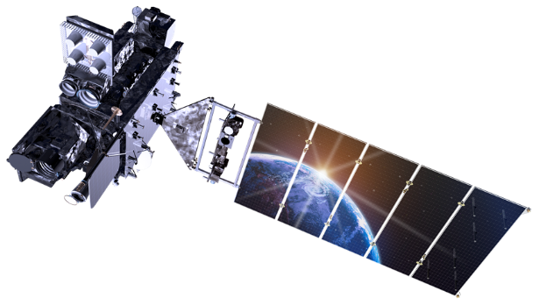
GOES-17 Magnetometer On-Orbit Calibration Design and Results
Michael Grotenhuis¹ • Derrick Early² • Timothy Rood³ • Jeffrey Kronenwetter² • Douglas Freesland⁴
Robert Dence⁵ • Tony Miller⁵ • Alexander Krimchansky⁶
¹SSAI Inc., Lanham USA • ²Chesapeake Aerospace, Grasonville USA • ³Advanced Solutions, Littleton USA,
⁴ACS Engineering, Clarksville USA • ⁵Lockheed Martin Space, Littleton USA • ⁶NASA, Greenbelt USA
EGU General Assembly 2019 • April 9, 2019 • Vienna, Austria

Slide 2
Agenda
Introduction to GOES/GOES-17 Magnetometer
Magnetometer Bias Measurement Example
Overview of GOES-16 (original) calibration maneuver
Overview of GOES-17 (new) calibration maneuver
GOES-16 vs GOES-17 calibration maneuver comparison
Maneuver Analysis and Simulation
GOES-17 Calibration Maneuver Results
Conclusions/Acknowledgements

Slide 3
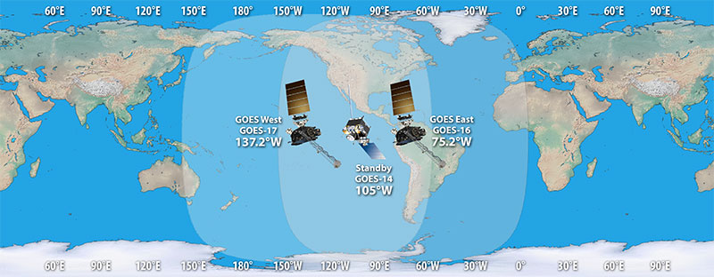
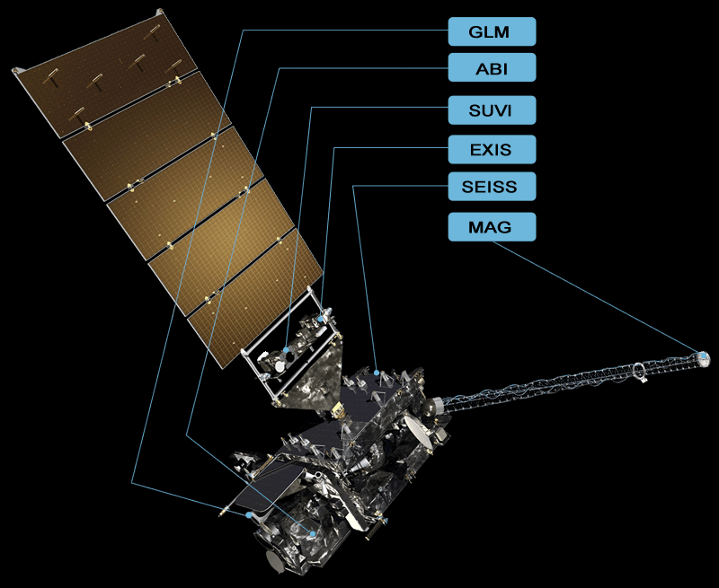
Introduction
Geostationary Operational Environmental Satellites (GOES)
GOES-17
United States weather satellites in geostationary orbits
Joint project between the National Oceanic and Atmospheric Administration (NOAA) and the National Aeronautics and Space Administration (NASA)
Identified as GOES-S prior to reaching geostationary orbit
Newest GOES satellite and the second in the GOES-R series
Payload of two Earth-observing and four space weather instruments
www.goes-r.gov
www.goes-r.gov

Slide 4
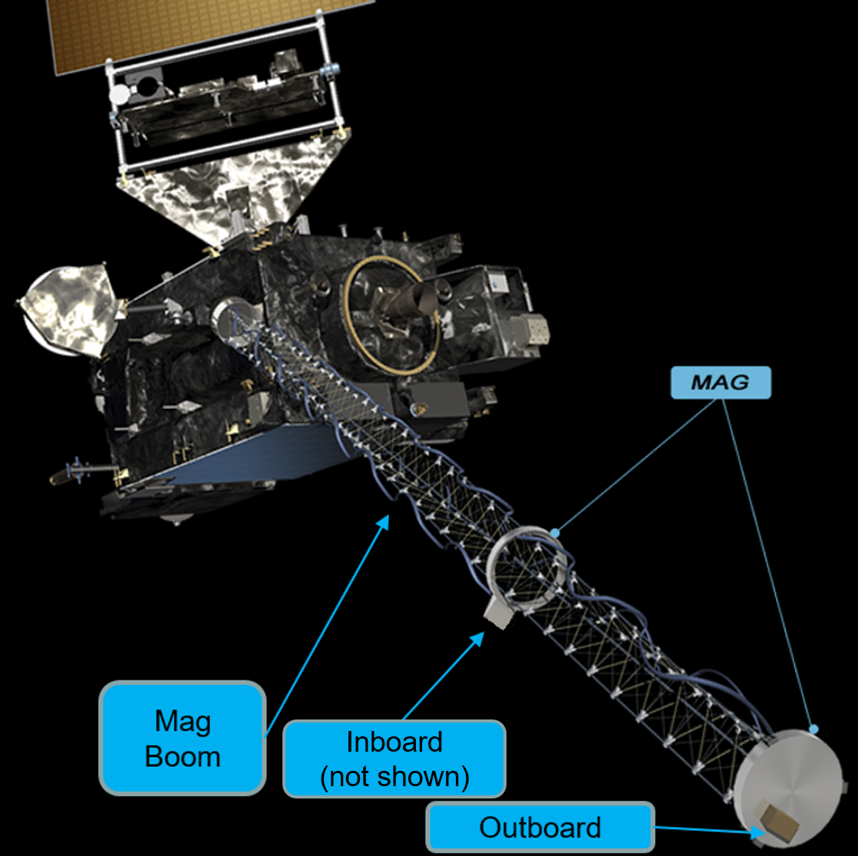
Introduction
GOES-17 Magnetometer
Measures the “in-situ” ambient magnetic field at geostationary orbit
Used for space weather predications and “nowcasting”
Consists of inboard (IB) and outboard (OB) fluxgate sensors mounted on a deployable boom 6.3 and 8.5 meters from the spacecraft, respectively
Both the IB and OB measure the magnetic field in three orthogonal axes. The Z-axis follows the centerline of the deployed boom while X and Y are parallel to the mounting plate
GOES-17 Magnetometer Bias
Both the spacecraft and the magnetometer itself generate magnetic fields that corrupt ambient field measurements
This generates a bias, or zero-offset, that must be measured so that it can be removed in calibrated field data

Slide 5
Measuring Magnetometer Bias: A Simplified Example
$Measurement 1= B_{z}+bias$_{Z}
$$B$$
Constant ambient field
Rotate 180°. Bias “rotates with” instrument
$Measurement 2=−B_{z}+bias$_{Z}
z
$$biasZ=\left(Measurement 1+Measurement 2\right)/2$$
In practice, a 180° rotation is not required, but is ideal from a signal-to-noise perspective (maximum “observability”).
Also, note that the assumption that the ambient field is constant is improved by reducing the time between measurements.

Slide 6
GOES-16 (Original) Magnetometer Calibration Maneuver
Courtesy of Lockheed-Martin

Slide 7
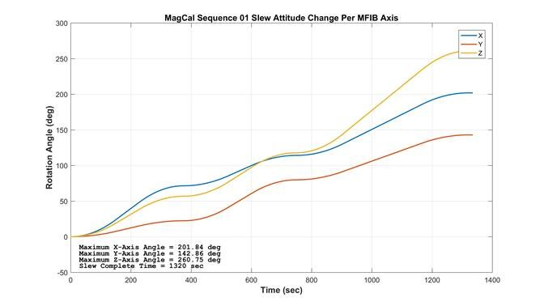
GOES-16 (Original) Magnetometer Calibration Maneuver Summary
Relative Slew #1
6 min, 15 sec in duration
Max angular rate: 0.43 °/second
Inboard magnetometer sensor frame axes amount of rotation (Euler angles):
X-axis: ~75°
Y-axis: ~25°
Z-axis: ~60°
Relative Slew #2
6 min, 15 sec in duration
Max angular rate: 0.43 °/second
Inboard magnetometer sensor frame axes amount of rotation (Euler angles):
X-axis: ~45°
Y-axis: ~50°
Z-axis: ~60°
Nadir Slew #3 – back to Nadir Pointing (standard operational attitude)
9 min, 30 sec in duration
Inboard magnetometer sensor frame axes amount of rotation (Euler angles):
X-axis: ~80°
Y-axis: ~65°
Z-axis: ~145°
Constrained by maximum spacecraft +Z axis offpoint of 29° to ensure adequate communications coverage. Constraint was based upon pre-launch predictions.
Estimate of GOES-16 maneuver bias measurement error from three maneuvers ranged from 3.1 to 5.1 nT, precipitating the need for an improved calibration maneuver for GOES-17.
Courtesy of Lockheed-Martin
Slew 1
Slew 2
Slew 3

Slide 8
GOES-17 (New) Magnetometer Calibration Maneuver
Courtesy of Lockheed-Martin

Slide 9
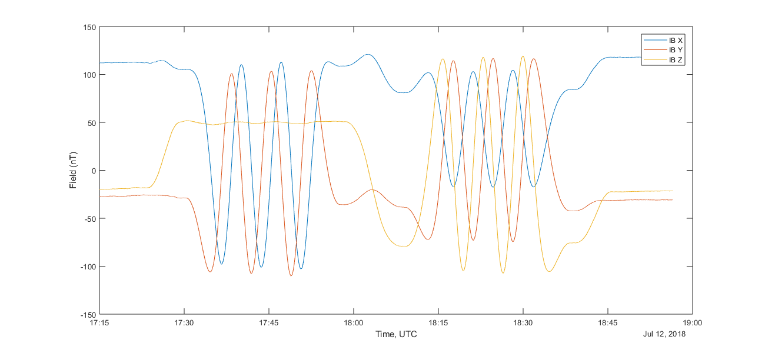
GOES-17 (New) Magnetometer Calibration Maneuver Summary
Relative Slew #1
Relative Slew #2 – Calibration slew for X and Y axes
27 min, 4 sec in duration
Fastest (middle) 360° is 7 min, 3.53 sec
Max angular rate: 0.85 °/second (original maneuver: 0.43 °/second)
Six 180° rotations about the MAG sensor frame Z-axis (parallel to the boom)
“Full observability” of sensor frame X and Y axes bias
Relative Slew #3
Relative Slew #4 – Calibration slew for Z axis
29 min, 2 sec in duration
Fastest (middle) 360° rotation is 7 min, 3.53 sec
Max angular rate: 0.85 °/second (original maneuver: 0.43 °/second)
Six 180° rotations about axis perpendicular to MAG sensor frame Z-axis (perpendicular to the boom)
“Full observability” of sensor frame Z axis bias
Nadir Slew #5 – back to Nadir Pointing (standard operational attitude)
Re-evaluation of comm coverage from GOES-16 flight data allowed a larger spacecraft +Z axis offpoint from nadir than with original maneuver.
An additional version of the new calibration maneuver was created for use during operations (instead of the post-launch period), consisting of one 360° rotation for each calibration slew instead of three, which minimizes operations outage.
MAG IB Field data from Jul 12, 2018 maneuver

Slide 10
GOES-16 vs GOES-17 Magnetometer Calibration Maneuver Comparison
 | GOES-16 Maneuver | GOES-17 Maneuver
Maximum Angular Rate | 0.43 °/second | 0.85 °/second
Calibration Slew #1 Rotation Amount | 94° | 6x180°
Calibration Slew #2 Rotation Amount | 94° | 6x180°
Calibration Slew Rotation Axes | None aligned with MAG boom axes | One aligned with MAG boom, one normal to MAG boom (“Full observability” of X/Y and Z axes)
Overall maneuver time | 22 minutes | 82 minutes
Forward Hemi Antenna Comm Constraint | ACRF Z-axis within 30° of nadir | ACRF Z-axis within 60° of ground station

Slide 11
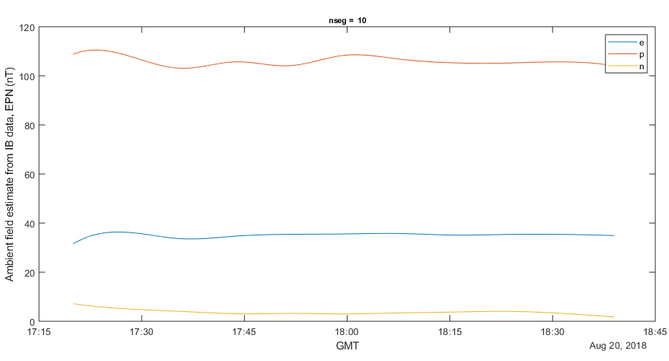
GOES-17 (New) Calibration Maneuver Analysis
New calibration maneuver is 78 minutes in duration as opposed to 22 minutes for the original maneuver. Improved analysis is needed where the background is not assumed to be constant, as it was with GOES-16.
New analysis spline-fits background field in EPN coordinates (improvement over G16 analysis method, which assumed constant background), minimizes field estimate errors (same as G16 method)
New method finds sensor bias and misalignment (same as G16 method)
Simulations were run to validate the method, find the optimal number of spline fit segments
One year of GOES-16 data was used
For each day, data corresponding to the maneuver time period was artificially rotated using the maneuver rotations
The error for that day was the bias computed from the artificially rotated data
Background spline fit from Aug 20, 2018 maneuver

Slide 12
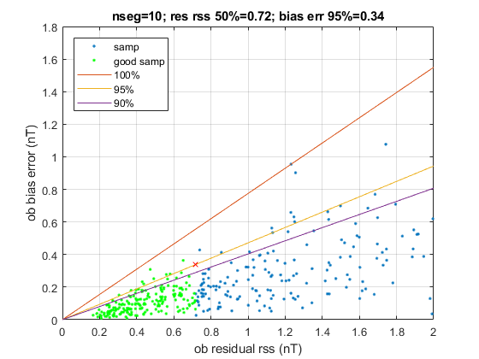
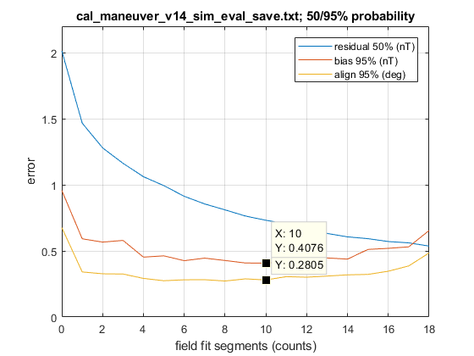
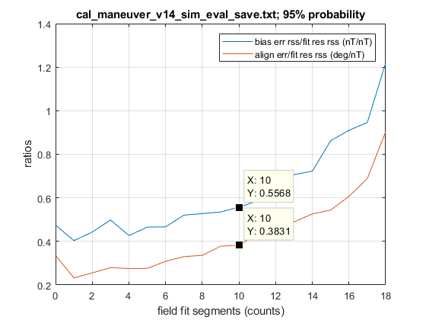
New Maneuver Analysis Simulation Results
Simulations were run, varying the number of segments, to find the number of segments with the least bias error and the bias error-to-spline fit residual RSS ratio for which 95% of the data points were at or below. A similar analysis was completed for the alignment measurement error.
Simulations indicate that ~10 spline segments is ideal. Larger numbers of spline segments over-fit the background, i.e. fit noise. Error-to-residual ratios from simulations can be used to estimate error based on spline fit residual.
Simulation result for 10 spline fit segments. The yellow line represents the 95% confidence level, i.e. 95% of the data points are at or below the bias error-to-residual RSS ratio represented by the yellow line.
Alignment and bias error vs. number of spline segments at median RSS with 95% confidence
Alignment and bias 95% confidence error-to-residual ratios vs. number of spline segments

Slide 13
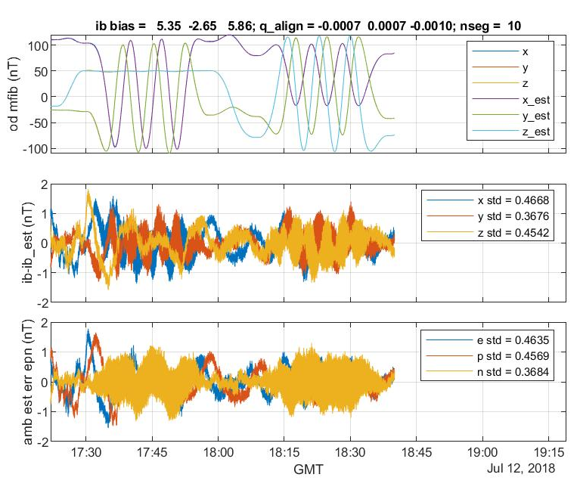
GOES-17 Calibration Maneuver Results
July 12, 2018 calibration maneuver:
Kp index (measure of geomagnetic activity) = 1
IB bias measurement error estimate: 0.42 nT
OB bias measurement error estimate: 0.38 nT
IB alignment measurement error estimate: 0.29°
OB alignment measurement error estimate: 0.26°
August 20, 2018 calibration maneuver:
Kp index = 3 at start of maneuver, 4 by end of maneuver
IB bias measurement error estimate: 0.73 nT
OB bias measurement error estimate: 0.74 nT
IB alignment measurement error estimate: 0.50°
OB alignment measurement error estimate: 0.51°
Error estimates are RSS of all three axes.
Since the Kp index was higher on August 20, it is not surprising that the errors are larger.
Estimate of GOES-16 maneuver bias measurement error: 3.1 to 5.1 nT
GOES-17 IB fields (top), background fit residual in IB frame (middle), and background fit residual in EPN/error estimate (bottom) from July 12, 2018 calibration maneuver

Slide 14
Conclusions/Acknowledgements
Conclusions
New/GOES-17 Magnetometer calibration maneuver is a marked improvement over the original/GOES-16 maneuver in angle of rotations/axis “observability”. New maneuver has twelve 180° calibration rotations parallel/perpendicular to boom axes vs. two 94° calibration rotations not aligned with boom axes for GOES-16
Maneuver rotation speed increased by a factor of ~2x, reducing background variability
New maneuver analysis spline-fits the background field, instead of assuming it is constant as in the old method
Simulations determined the optimal number of spline fit segments
GOES-17 calibration maneuver bias measurement uncertainty is improved by about an order of magnitude over GOES-16
Acknowledgements
This work was supported under the National Aeronautics and Space Administration Goddard Space Flight Center contracts NNG15CR65C, NNG09HR00C, and 80GSFC18C0120.
The authors gratefully acknowledge the insight provided by Dr. Jim Chapel and Brian Clapp (retired) of Lockheed Martin, as well as Dr. Paul Lotoaniu and Dr. Sam Califf of the University of Colorado-CIRES/NOAA-NCEI, and Dr. Rob Redmon of NOAA in developing the calibration maneuvers.
The authors also gratefully acknowledge the MOST team, in particular Jess Endicter of ASRC, for maneuver planning and simulation and for conducting the actual maneuvers flawlessly.
Finally, thank you to Dr. Delano Carter for his support in execution of the maneuver analysis simulations.

