Slide 1
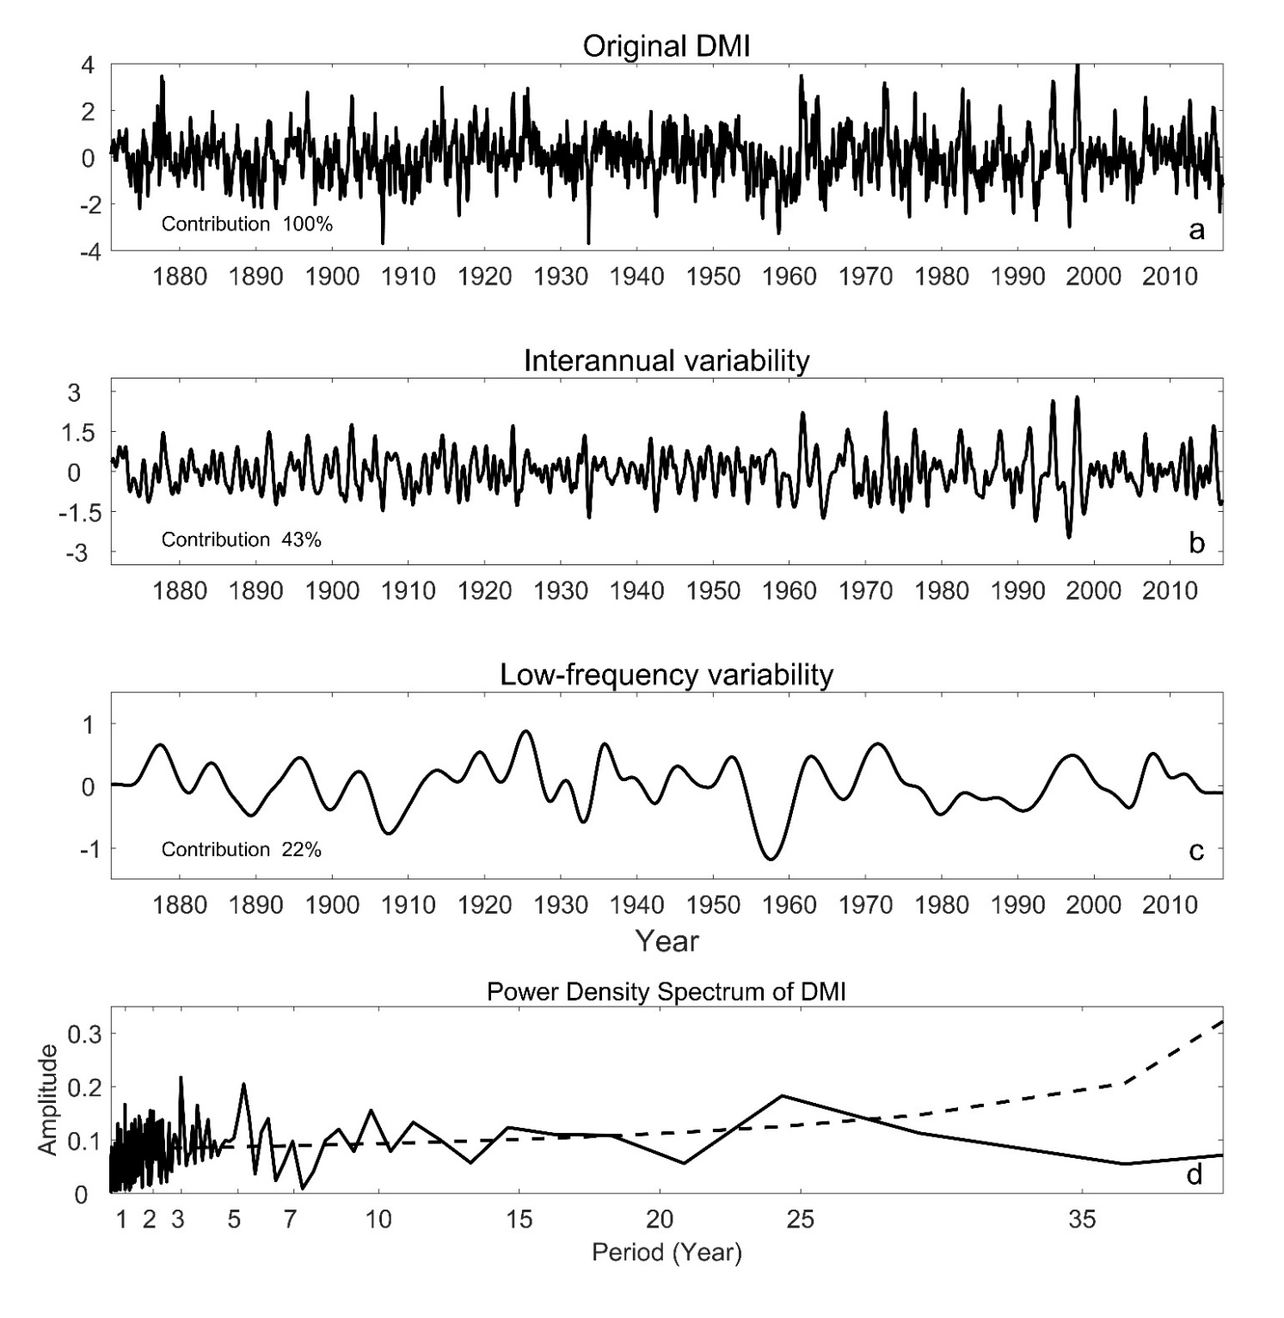
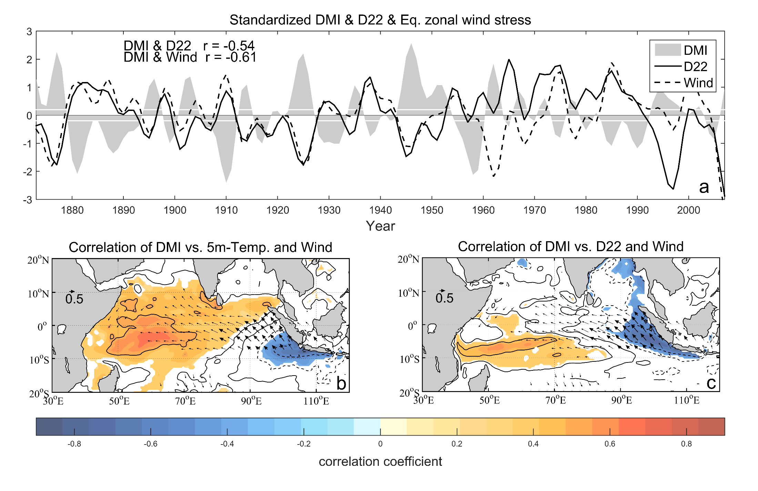
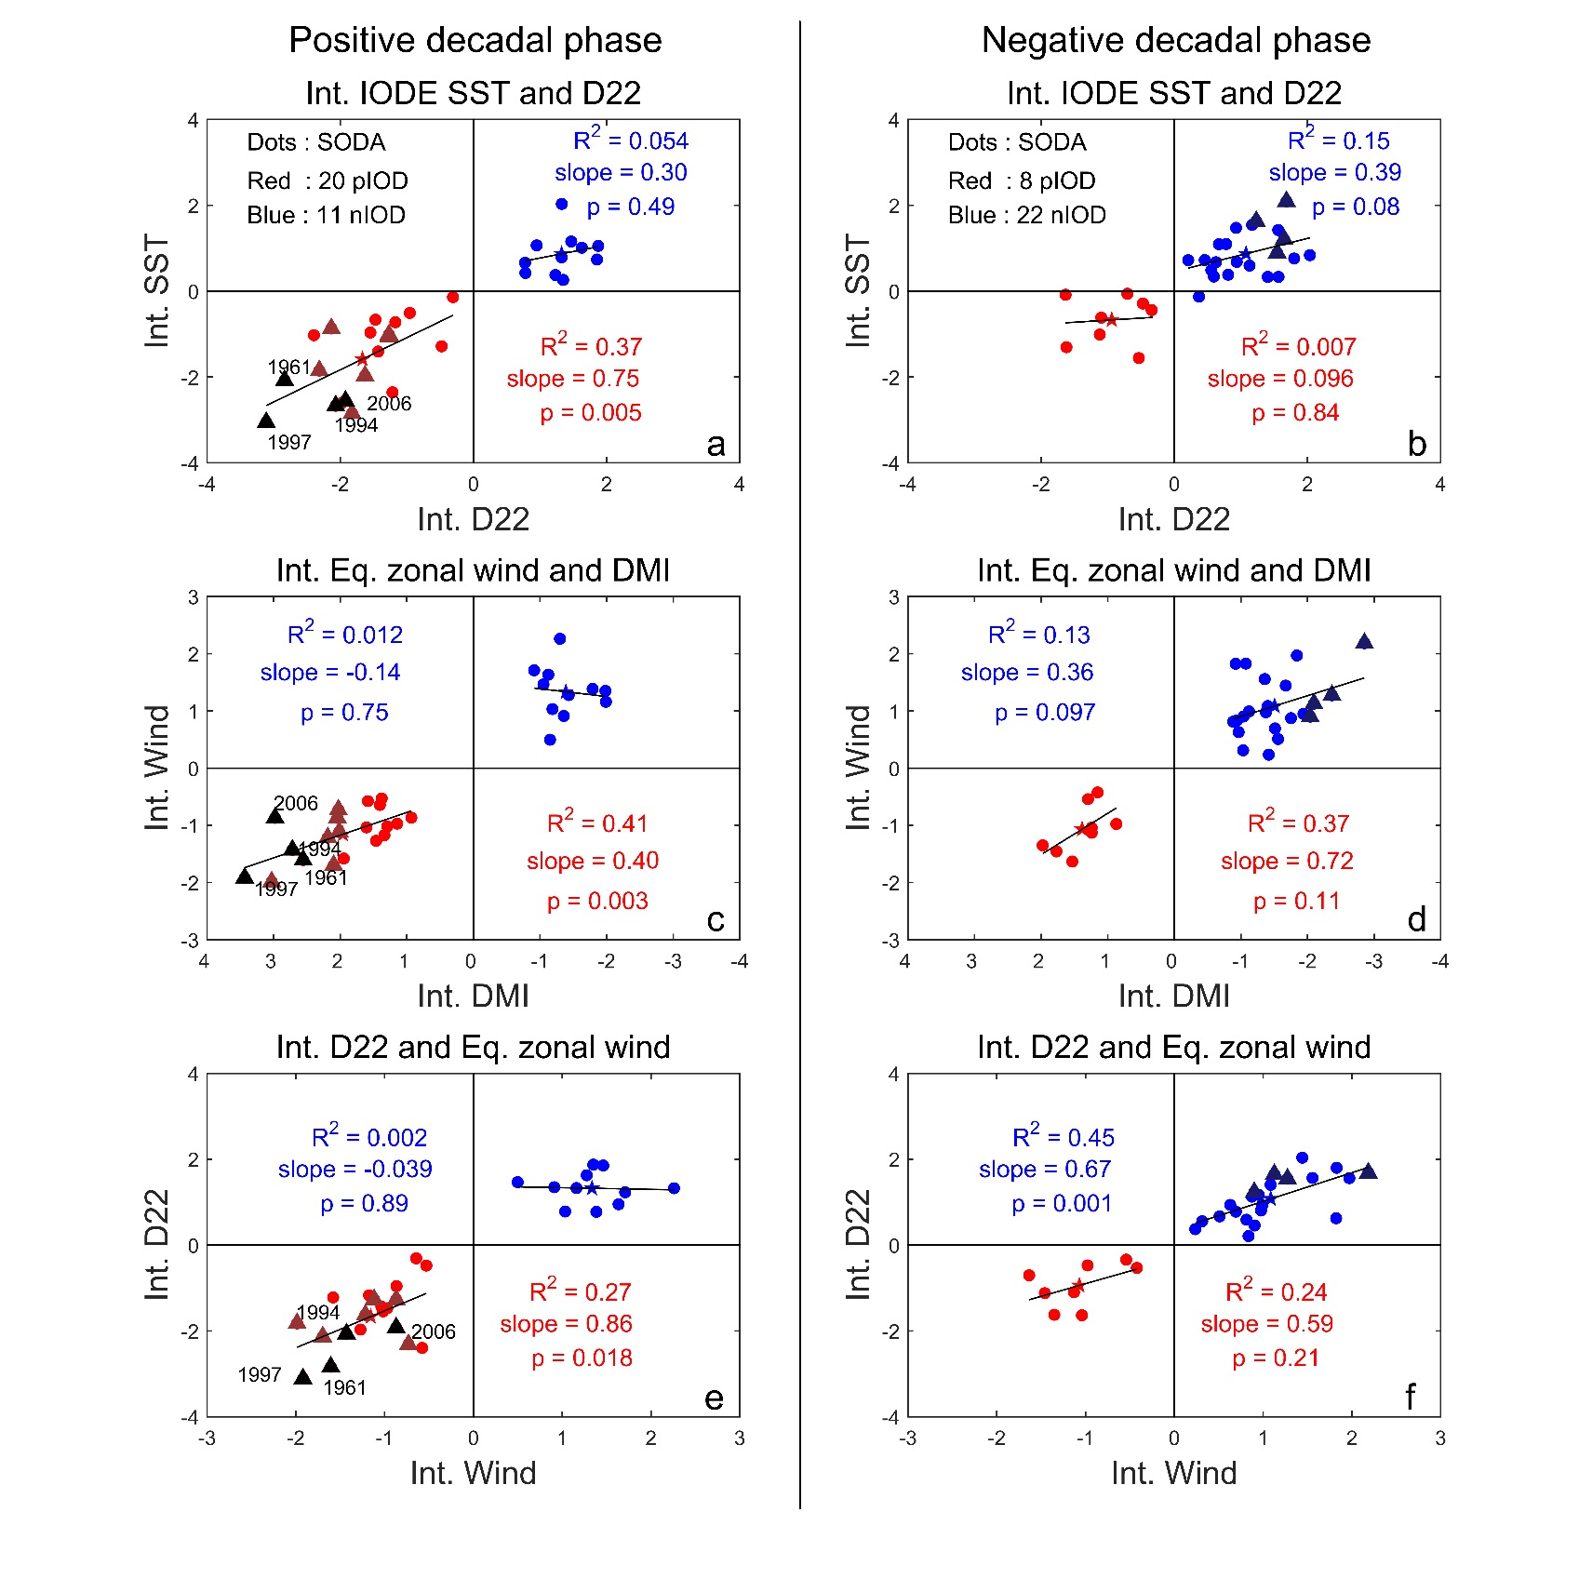
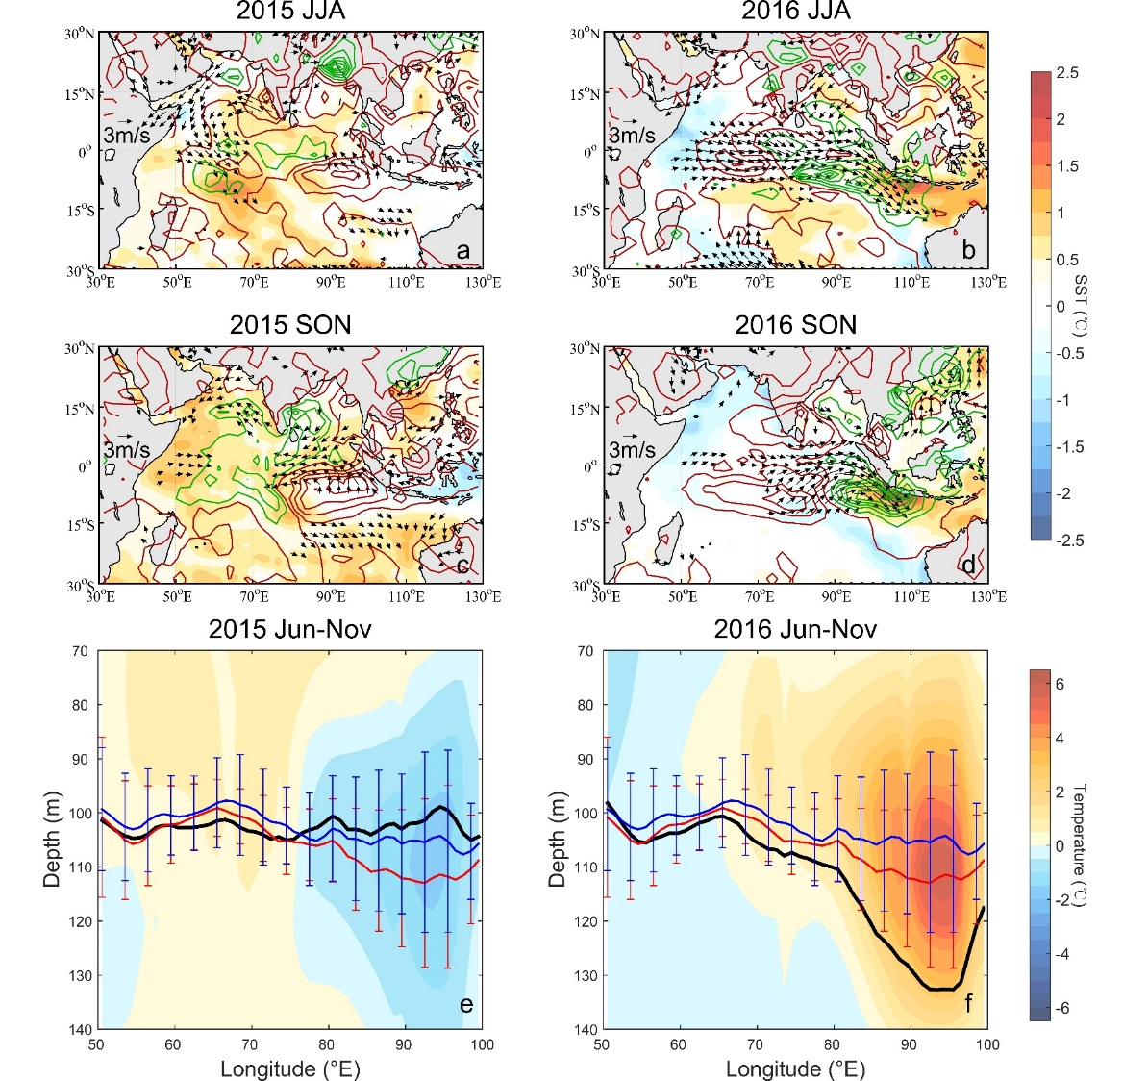
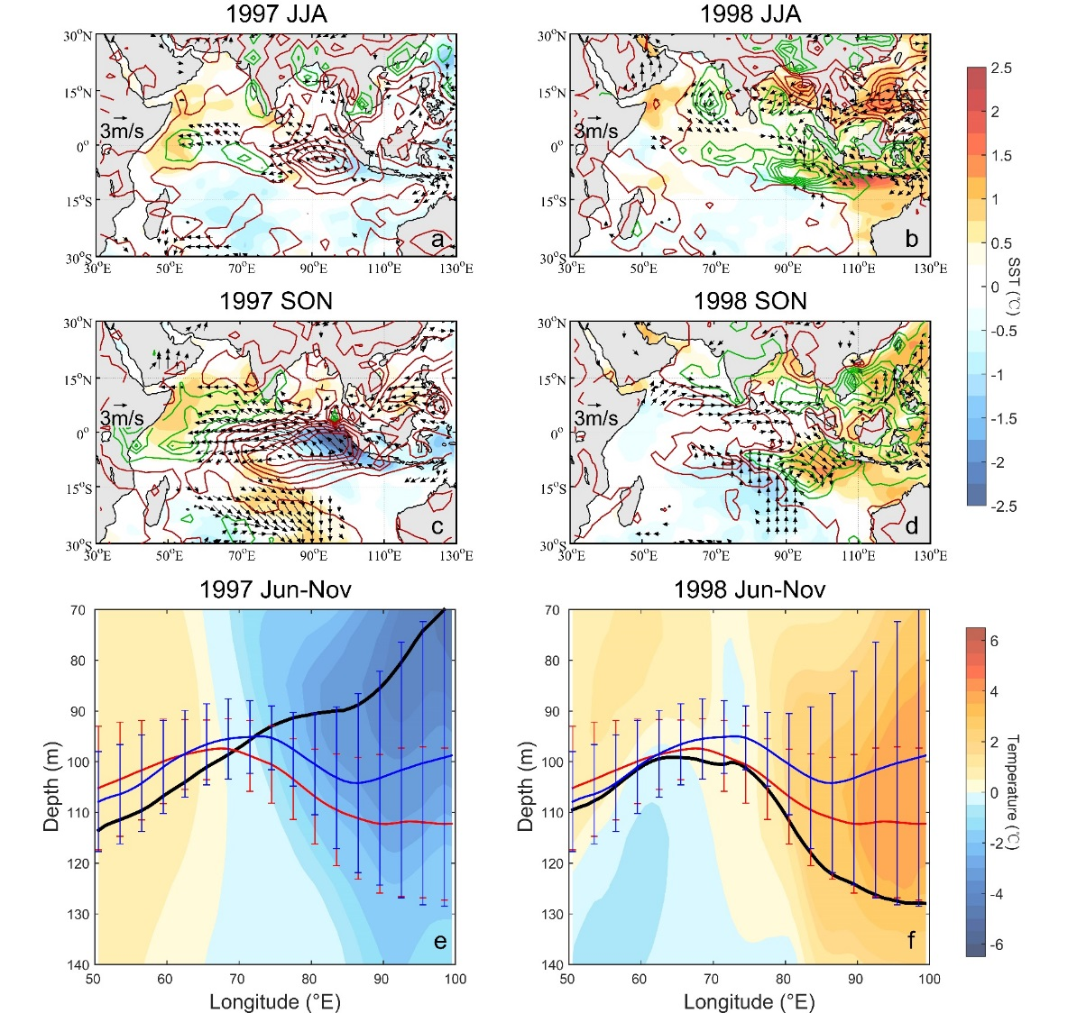
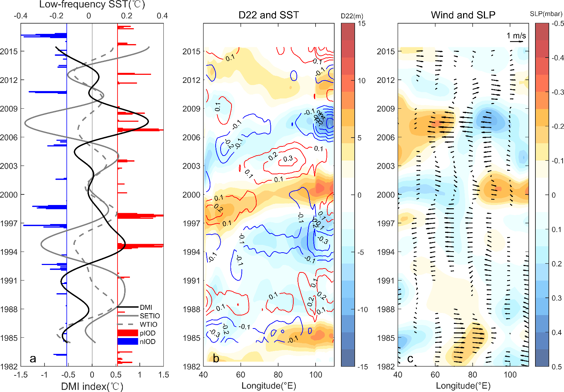
Low-Frequency Variability and the Unusual Indian Ocean Dipole Events in 2015 and 2016
Lianyi Zhang, Yan Du (SCSIO)
Wenju Cai (QNLM/CSIRO)
The 2015 positive IOD was a weak but west-dominated event; the following 2016 negative IOD was one of the strongest events in the record.
The deepened thermocline related with low-frequency variability played a role.
An decadal IOD-like pattern is identified and it was negative phase during 2015-16.
Deeper thermocline in the southeastern TIO was unfavorable for positive IOD occurrence and intensity, but conducive to negative IOD during the negative decadal IOD phase.
4. Similar variation of DMI, D22 and equatorial zonal winds in form of a IOD-like pattern at decadal timescale, suggesting a coupled ocean-atmosphere oscillation.
2. Derived by complete ensemble EMD, the low-frequency variability is considerable (22%), which more than a half of the interannual variability (43%). The monthly DMI reveals low-frequency spectrum peaks at 5, 10 and 24 years.
1. An unusual positive IOD event occurred in 2015 with an extreme El Niño. Unusually, sea surface temperature (SST) warming in the west-central tropical Indian Ocean (TIO) dominated the strong zonal SST gradient as cooling off Sumatra-Java was weak. Over the southeastern TIO, deeper thermocline has suppressed the upwelling cooling since 2012.
3. The low-frequency variations (low-pass filtered by 5-year) of SST, SSH, SLP, and surface wind in the equatorial IO. The coupled ocean-atmosphere interactions show variations on decadal time scales.
5.1 More pIOD (nIOD) during positive (negative) decadal phase.
5.2 Thermocline-SST-wind feedback are more active and robust in the positive decadal phase (IOD asymmetry).
5.3 Extreme events only occur in corresponding decadal phase.
Ref: Zhang, L. Y., Du, Y., and Cai, W. J. (2018). Low-frequency variability and the unusual Indian Ocean Dipole events in 2015 and 2016, Geophys. Res. Lett., 45, 1040–1048.

