Slide 1
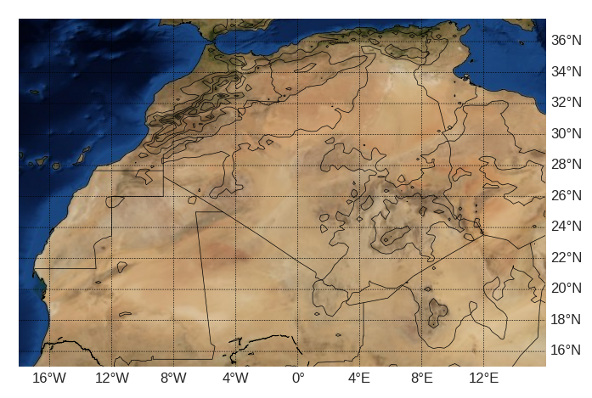
Automated tracking of dust-emitting cold pool outflow boundaries in the Central and Western Sahara
Thomas Caton Harrison, Richard Washington and Sebastian Engelstaedter
University of Oxford
INTRO
Methods
Detecting CPOs in SEVIRI
Propagation speed estimation
Data
Validation
Results
CPO
climatology
CPO diurnal cycle
Event
evolution
Next steps and conclusions
Next steps
Conclusions
Appendices

Slide 2
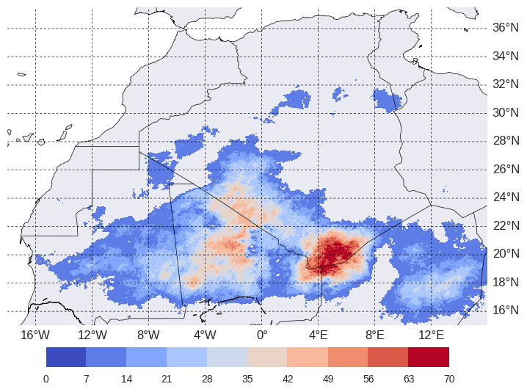
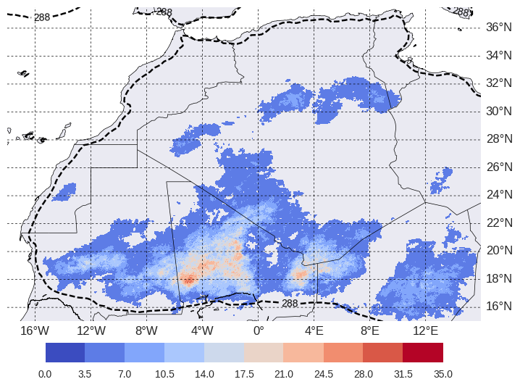
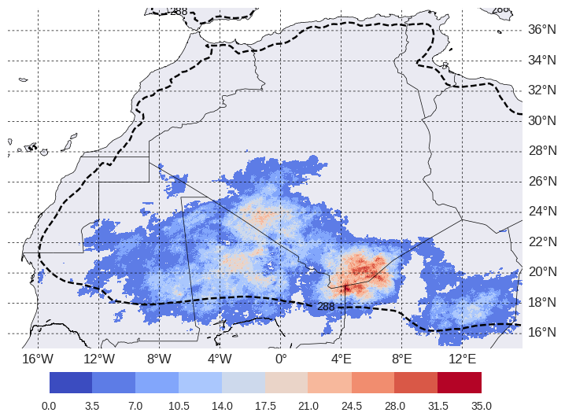
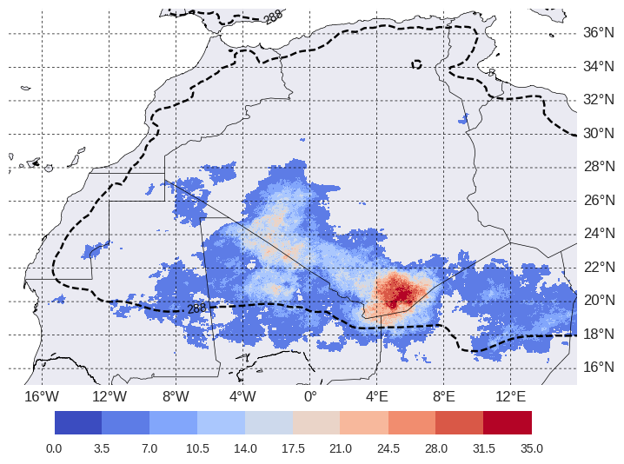
CPO pixels June, July and August 2004-2017
CPO pixels June2004-2017
CPO pixels July 2004-2017
CPO pixels August 2004-2017

Slide 3
Cold pool outflows and dust emission in the central and western Sahara
What are cold pool outflows and why are we interested?
Cold pools (see diagram) are regions of cool air formed under convective storm systems due to precipitating and evaporating hydrometeors. As these hit the surface, they propagate outwards horizontally as a density current. Turbulent winds at the leading edge of this outflow (the gust front) are capable of lofting mineral aerosols, producing ‘haboob’ dust storms.
These are thought to be responsible for the bulk of dust emission in the central and western Sahara (Allen et al., 2013), which is in turn the world’s largest dust source in boreal summer.
Play →
‘Pink dust’ imagery, with dust in bright pink, convective cloud in red. Black indicates the cloud is capped with ice. The blue channel saturates over the warm desert surface during the day.
Pink dust gif courtesy: Ian Ashpole

Slide 4
Project focus region and aims
Research aims
Develop an objective methodology for flagging and tracking active cold pool outflow boundaries
Generate a climatology of dust-emitting CPOs and identify hotspots
Estimate propagation speeds for outflow boundaries
Interrogate the drivers of cold pool activity over key dust source regions – what is the relative contribution of local and remote CPOs? Does speed play a role?
Map of the Central and Western Sahara with black contours indicating orography at 500m intervals

Slide 5
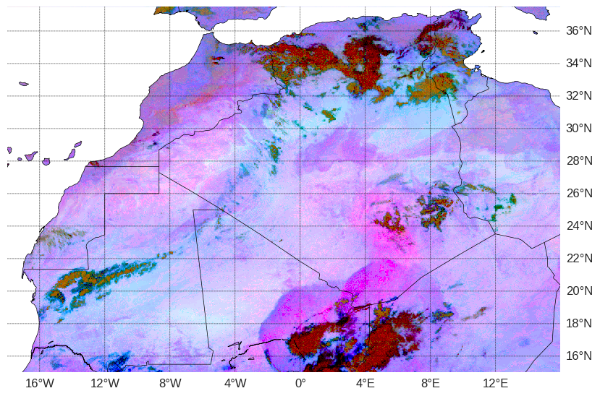
Methods
Data
Meteosat SEVIRI imagery
SEVIRI: Spinning Enhanced Visible and Infrared Imager
Imagery available at 3 km resolution (at nadir) with 15 minute temporal resolution
Differences between the 12.0, 10.8 and 8.7 µm channels often used to highlight dust (Ackerman, 1997)
Imagery from June, July and August 2004-2017 processed in this paper (123,648 images)
500 KM
TUNISIA
MOROCCO
LIBYA
ALGERIA
WESTERN
SAHARA
MALI
Outflow boundary leading edge
Lofted dust
NIGER
MAURITANIA
Deep convective cloud
Ackerman, S. A. (1997). Remote sensing aerosols using satellite infrared observations. Journal of Geophysical Research: Atmospheres, 102 (D14), 17069-17079.

Slide 6
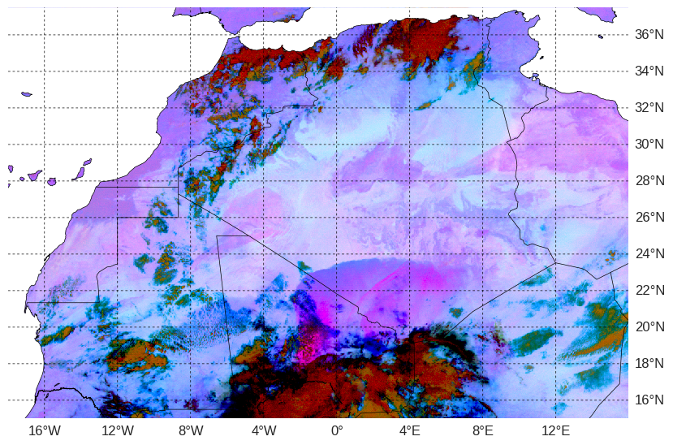
Methods
Detecting CPOs in SEVIRI: original image (1/6)
Detection algorithm
Step 1: an unprocessed ‘pink dust’ composite showing a cold pool outflow feature propagating northwards into southern Algeria, generated by the deep convective cloud to the south. Example from 01:15 on the 10th July 2011.

Slide 7
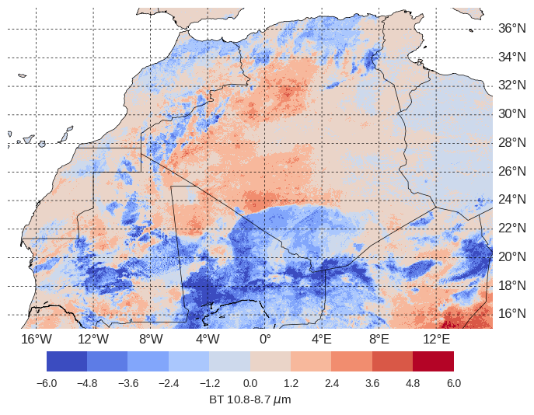
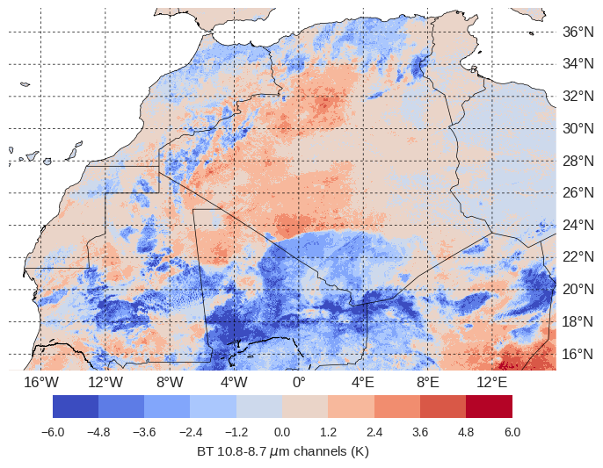
Methods
Detecting CPOs in SEVIRI: Brightness temperature difference anomaly (2/6)
Detection algorithm
Step 2: difference between the 10.8 and 8.7 micron channels, taken as an anomaly relative to a 15-day moving window average (to subtract constant surface features)

Slide 8
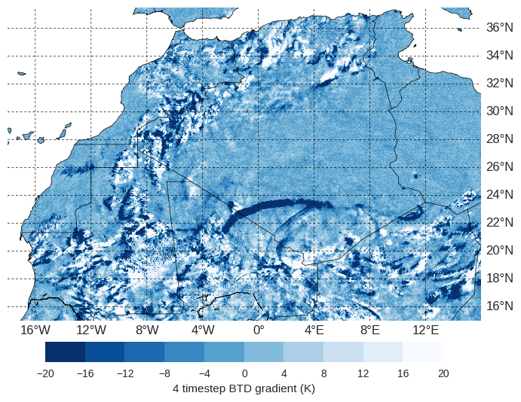
Methods
Detecting CPOs in SEVIRI: Temporal gradient (3/6)
Detection algorithm
Step 3: if the current timestep is t, the field shown here is (t-[t-4])+([t-1]-[t-4])+([t-2]-[t-4])+([t-3]-[t-4])
I.e, rewards pixels where the difference is great between now and one hour ago, but has also been maintained since then
Means front-like changes are rewarded more than a brief dip in the BTD

Slide 9
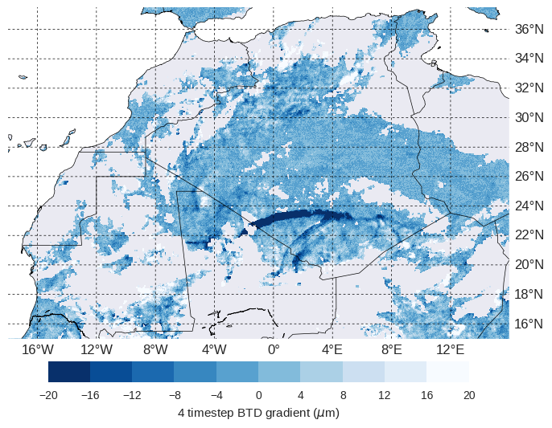
Methods
Detecting CPOs in SEVIRI: ‘Cloud’ masking (4/6)
Detection algorithm
Step 4: a ‘cloud mask’ is applied (grey pixels). This is where BT10.8anom < 0, and is extremely conservative, also masking certain regions without cloud.
Crucially, masks all cloud features which may have falsely been detected as CPOs
Less conservative cloud schemes were tested and found to introduce many false positives

Slide 10
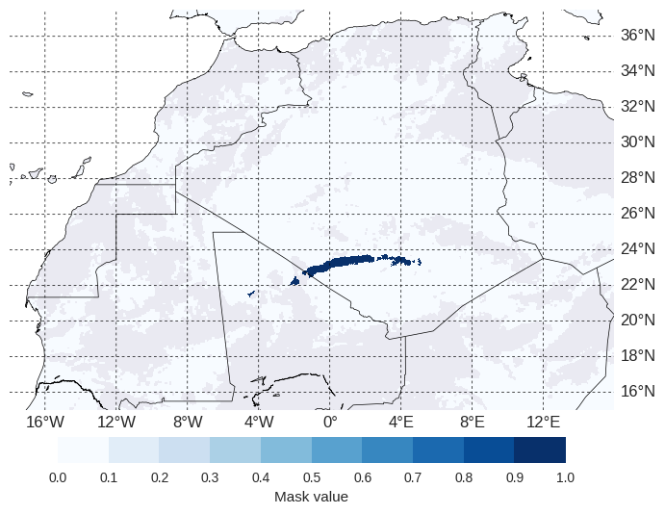
Methods
Detecting CPOs in SEVIRI: original image (5/6)
Detection algorithm
Step 5: Apply a first-pass mask which identifies regions with a brightness temperature difference gradient under -20 K
Then apply a second-pass mask which keeps only those features which contain one pixel under -30 K.
Pixels detected with this mask are displayed in dark blue

Slide 11
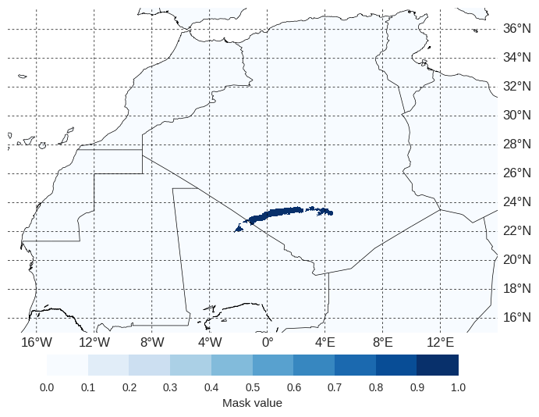
Methods
Detecting CPOs in SEVIRI: original image (6/6)
Detection algorithm
Step 6: Track all detected features through time as objects and store their duration. Discard events unless they:
Exceed 2 hours in duration
Exceed 250 pixels in size during their lifetime
Contain at least one ‘dust’ pixel (see Ashpole and Washington, 2012)
Are initiated within 500 km of deep convection

Slide 12
Methods
Summary of algorithm
Algorithm operates in two phases:
Processing of each timestep of raw satellite data
Post-processing of features tracked as objects
I.e. we identify candidate CPOs first and then use their characteristics as individuals to determine if they are genuine
Extract Brightness Temperatures at 12.0 and 10.8 μm
NO
Calculate the BT 12.0-10.8 μm anomaly relative to a 15-day moving window centred on the timestep (BTD field)
Does the feature have a total duration exceeding 2 hours
YES
Mask the data with a < 0 K threshold on the 10.8 μm 15-day anomaly field to identify cloud
Does the feature exceed 250 pixels in size at some point during its lifetime?
Discard feature
NO
Identify as dust-emitting CPO
Calculate the difference between the current BTD field and that of the previous timestep (t-1). Sum with the difference for the preceding three timesteps (t-2 to t-4) to get the Brightness Temperature Difference Gradient (BTDG).
YES
Does the feature contain at least one pixel associated with a tracked dust plume at some point during its lifetime?
NO
Apply a first pass threshold mask of BTDG < -20 K. Apply a second pass such that only blobs containing at least one pixel with BTDG < -30 K are kept.
YES
YES
NO
Is the feature initiated within 500 KM of deep convection?
Run tracking algorithm for all data to obtain a library of tracked features
Phase 1 – algorithm applied at each timestep
Phase 2 – algorithm applied to each tracked feature

Slide 13
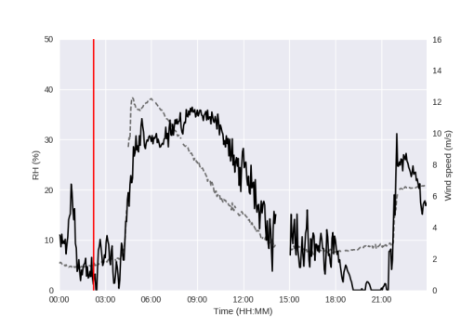
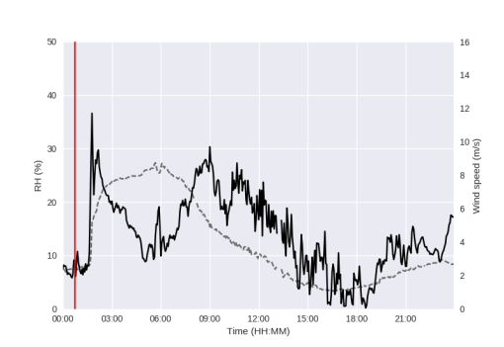
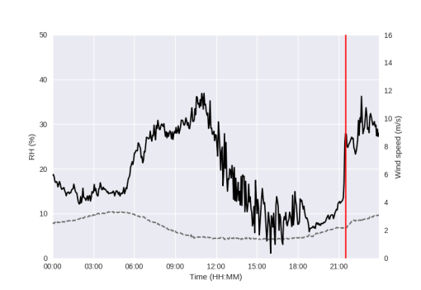
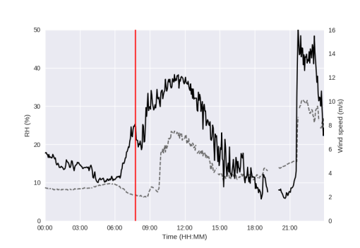
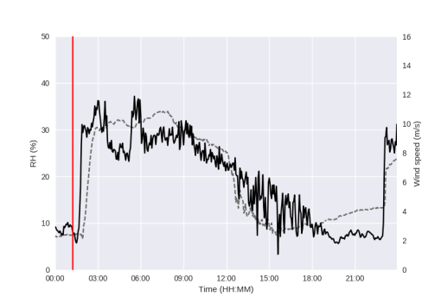
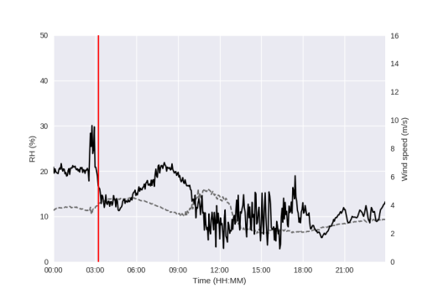
Methods
Validation: evidence of the signature of detected CPOs in surface data (1/2)
During the Fennec Campaign in 2011/12, automatic weather stations were placed in the central Sahara near the Algerian border. Examples of individual days from two of these stations are shown here, with wind speed (black) and RH (grey, dashed).
Times when automatically detected CPOs passed these stations are marked with a vertical red line

Slide 14
Methods
Validation: comparison with a manual approach (2/2)
All dust-emitting CPOs visible in SEVIRI imagery for July 2011 were manually identified
The automated system correctly identifies 26 out of 35 events (74% hit rate)
6.8% of the total pixels flagged by the automated scheme are not associated with a genuine CPO

Slide 15
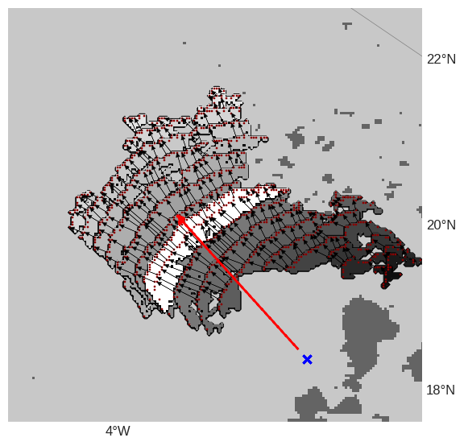
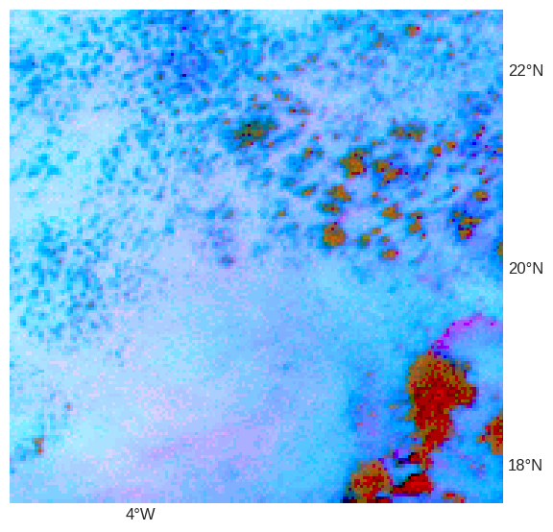
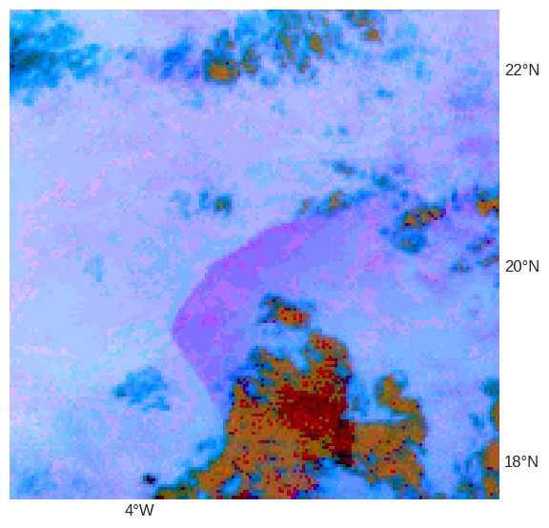
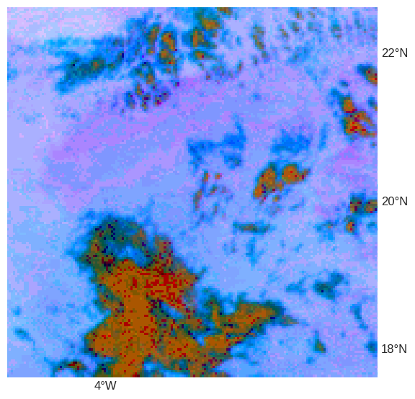
Methods
Estimating propagation speed of CPOs (1/2)
Propagation speed is estimated as the average speed of each pixel of the leading edge of the pixel (see Appendix B for more details)
Unlike an approach based on the centroid, this approach avoids false speed/direction caused by noise in the detection system
E.g. in the example to the left the early timesteps are largely obscured by cloud
(a)
(c)
(b)
(b)
(a)
Convective
cloud
(c)
Each timestep of a detected CPO from 15:30 09/07/2010. Earlier timesteps are shaded darker. Includes estimated propagation direction (red arrow), leading edge pixels (red pixels), convective cloud in the first timestep (dark blobs) and the estimated ‘source point’ as a blue cross. Vectors used for speed estimates are marked as black arrows.

Slide 16
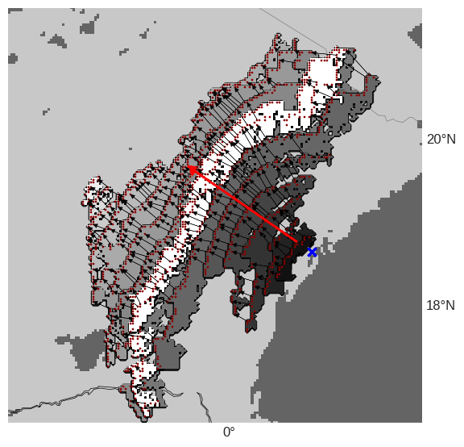
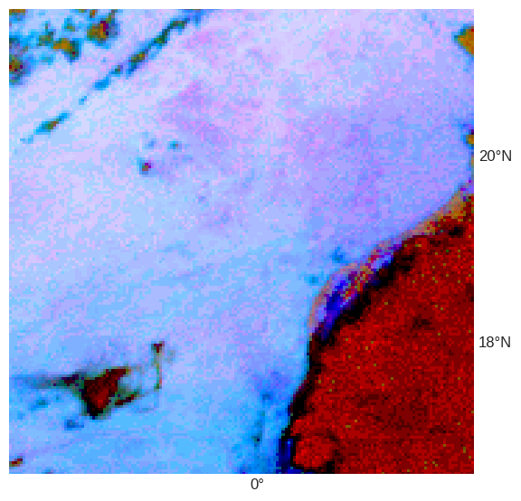
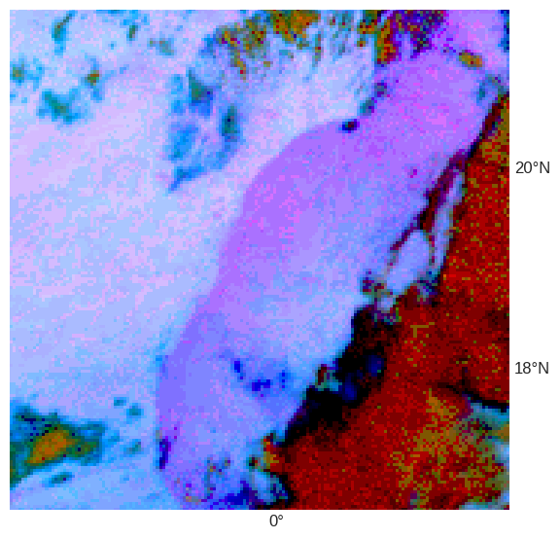
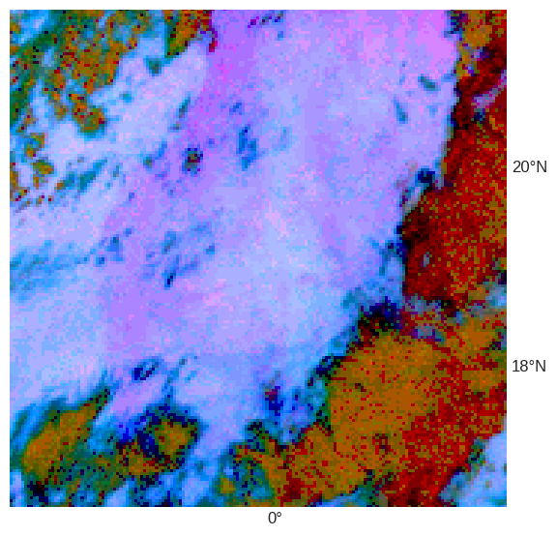
Methods
Estimating propagation speed of CPOs (2/2)
Propagation speed is estimated as the average speed of each pixel of the leading edge of the pixel (see Appendix B for more details)
Unlike an approach based on the centroid, this approach avoids false speed/direction caused by noise in the detection system
E.g. in the example to the left the early timesteps are largely obscured by cloud
(a)
(c)
(b)
(b)
(a)
Convective
cloud
(c)
Each timestep of a detected CPO from 18:30 28/07/2004. Earlier timesteps are shaded darker. Includes estimated propagation direction (red arrow), leading edge pixels (red pixels), convective cloud in the first timestep (dark blobs) and the estimated ‘source point’ as a blue cross. Vectors used for speed estimates are marked as black arrows.

Slide 17
Results
CPO climatology (1/2) – occurrence
Position of the 288 K dewpoint temperature contour from ERA5 also marked (proxy for the ITD)
CPOs are prevalent even hundreds of KMs from the peak rainbelt of the WAM
Clear hotspot around the Mali-Algeria-Niger triple point, increases through summer
Activity north of the Malian border increases after June
CPO pixels June, July and August 2004-2017
CPO pixels June2004-2017
CPO pixels July 2004-2017
CPO pixels August 2004-2017

Slide 18
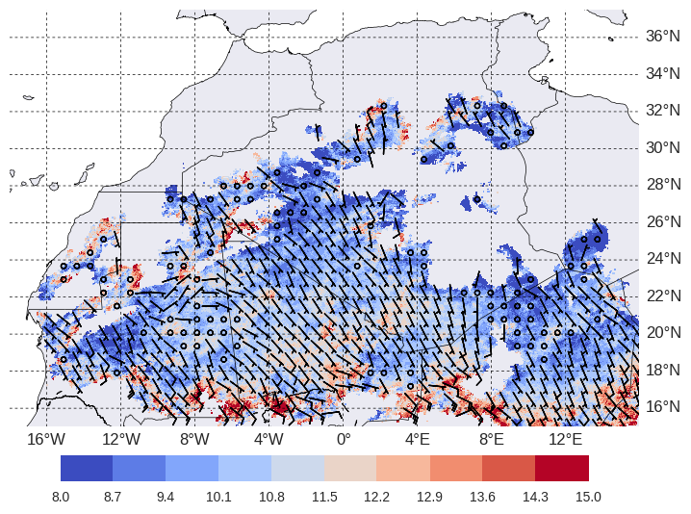
Results
CPO climatology (2/2) – propagation speed and direction
Almost all CPOs come from the south, indicating they are WAM generated
Northwestward orientation in line with the preferred propagation direction of WAM MCSs
Some evidence for a decay in speeds far from peak generation zones
CPO propagation vectors overlain on map of mean CPO propagation speed (m/s)

Slide 19
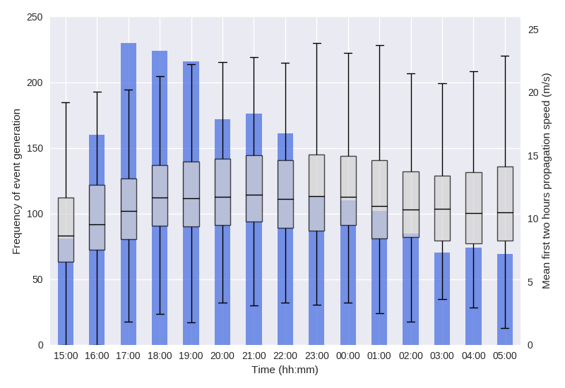
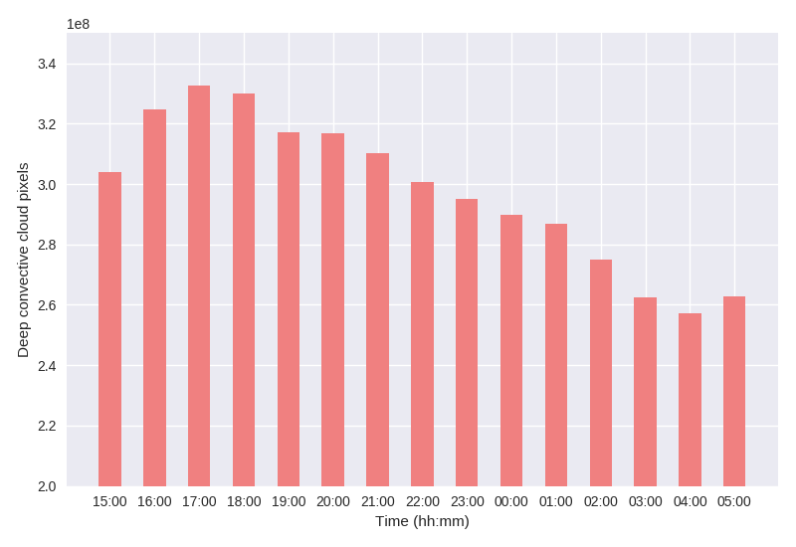
Results
CPO diurnal cycle
Most CPOs are generated in the evening, with peak time between 1700-1800 UTC
This may be slightly behind the true time as CPOs are spotted late by the algorithm due to cloud
Generation of CPOs follows the diurnal cycle of deep convection closely
A peak in propagation speed lags it slightly, suggesting it is capped during the day and enhanced by boundary layer stability
Diurnal cycle of CPO generation (blue) and propagation speed (boxes)
Diurnal cycle of deep convective cloud pixels (BT10.8 < 230 K)

Slide 20
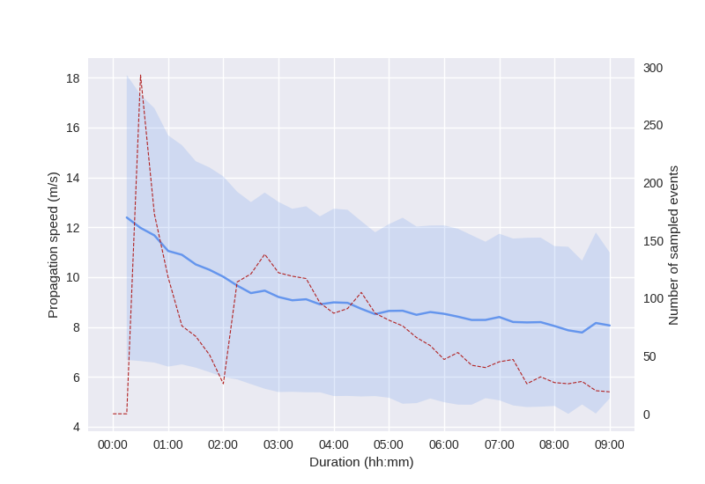
Results
Event evolution (1/2) – lifetime propagation speeds
CPOs decay in propagation speed through their lifetime (by several m/s, depending on duration)
The largest fall in speed occurs within approximately the first 2 hours
Events are observed with a duration up to 9 hours, although this is rare
Mean propagation speed of a CPO through its lifetime (blue, with one StDev shaded), with frequency of events with this duration marked in red (dashed)

Slide 21
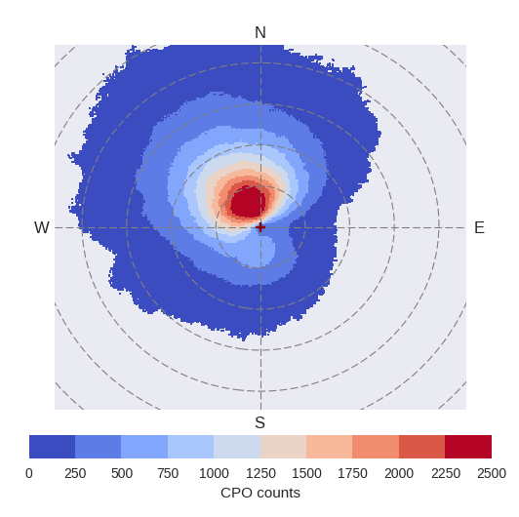
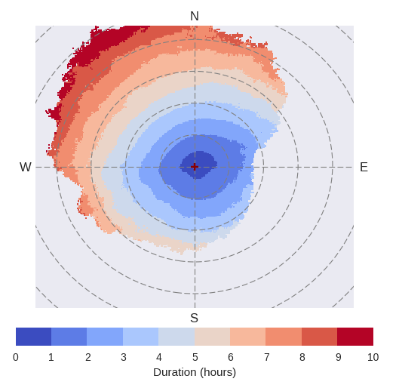
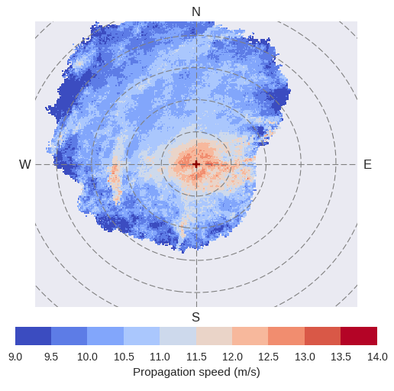
Results
Event evolution (2/2) – composite events
Events propagate above all to the northwest
A small proportion of CPOs travel up to 500km, with the vast majority under 200km
CPOs can travel for upwards of 9 hours (before reverting to ‘dust fronts’)
Propagation speeds peak within the first 100km, with some limited evidence for greater speeds along an east-west axis
Composites of CPO quantities, with each observed event overlain, propagating away from its origin (red cross). Each dashed ring is 100km.
Top left: frequency
Top right: duration
Bottom left: propagation speed

Slide 22
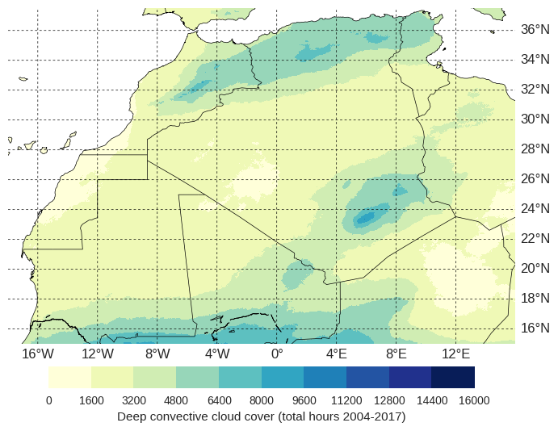
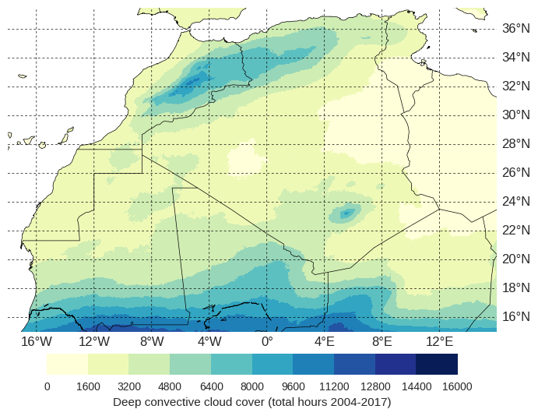
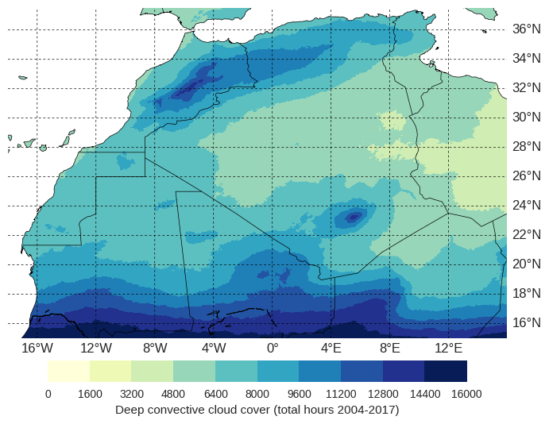
Results
Drivers of CPO activity at key dust sources (unfinished)
Peak CPO hotspots map onto regions of deep convection
The northwards advance of the ITD through summer corresponds to enhanced cloud cover over northern Mali
A protrusion of enhanced cloud cover downstream of the Aïr Mountains (20°N, 0°E) could explain the central Saharan CPOs north of this feature which are not present further west

Slide 23
Next steps
Next steps: linking CPO outflow boundaries to dust source activation
What is the contribution of remotely generated vs. locally generated cold pools for key dust source regions?
What are the convective initiation points for key CPO hotspots?
Is there evidence of cold pool ‘recycling’ as a major contributor to CPO activity in the remote Sahara?
Does CPO propagation speed play any role in effectiveness for emission of dust?
Are nocturnal CPOs more far-ranging than daytime events?
Further interesting questions:
How does moisture transport in reanalyses (e.g. ERA5) compare with that inferred from CPO observations?
How do freshly generated and aged cold pools compare in their meteorological impacts at the surface (with Fennec AWS or new data)?

Slide 24
Next steps
Summary of key findings
CPOs can be automatically tracked in the central Sahara, allowing us to study their behaviour and identify preferred regions
WAM-generated CPOs are common deep in the central Sahara, hundreds of kilometres from where they are normally generated
Hotspots of CPO activity exist around the triple point of Mali-Algeria-Niger. CPO activity increases here through the summer season
Remote CPOs further north become more common in July and August as the ITD moves north
CPOs generation peaks around 1700-1800 UTC
CPOs decay in speed through their lifetime, and are most commonly observed travelling northwestwards
Suggests CPOs are a key vehicle for moisture transport into the remote Sahara, with implications for model and reanalyses moisture budget errors

Slide 25
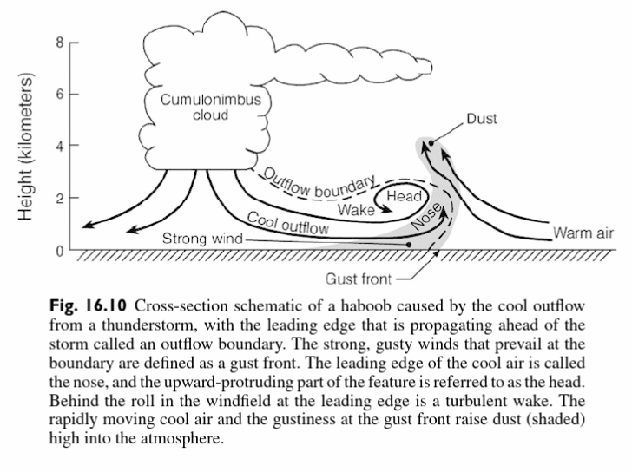
Appendices
Appendix A – Cold pool outflow (haboob) diagram from Warner (2004)
Source: Warner, T. T. (2004), Desert Meteorology, 595 pp., Cambridge Univ. Press, New York.

Slide 26
Appendices
Appendix B – Estimation of leading edges
Find the orientation of the CPO from the bestfit line of the timestep with the most detected pixels (white pixels)
The propagation direction is perpendicular to this (red arrow)
Rotate the coordinates so that the CPO is orientated north
Identify the northernmost pixels at each timestep as the leading edge
Unrotate the CPO
(a)
(c)
(b)
(b)
(a)
Convective
cloud
(c)

