Slide 1
NASA web-based decision support systems tools: Climate data access, and retrieval (NASAaccess) and hydrological modeling visualization (SWAT-online)
Ibrahim Mohammed^{1,*}, Spencer McDonald², John Bolten¹, Sarva Pulla³, Chinaporn Meechaiya⁴, Amanda (Weigel) Markert³, Jim Nelson², Raghavan Srinivasan⁵, Venkat Lakshmi⁶
¹NASA Goddard Space Flight Center, ²Brigham Young University,³NASA Marshall Space Flight Center, ⁴Asian Disaster Preparedness Center, ⁵Texas A&M University, ⁶University of Virginia
*Ibrahim.mohammed@nasa.gov
Try our Apps!
This work was fully supported by the National Aeronautics and Space Administration (NASA) Applied Sciences Grants entitled ‘Improved hydrologic decision support for the Lower Mekong River basin through integrated remote sensing and modeling’ (Grant # NNX16AT88G, and Grant # NNX16AT86G).
EGU2019-5585
Notes:
2-min madness

Slide 2
Introduction
NASAaccess & SWAT-online software programs were developed for hydroclimatic applications.
The web apps and software packages presented are modular and can be hosted anywhere (public or private servers).
The tools presented give easy access and retrieval capabilities to weather and climate data for any watershed.
The tools presented provide formatted data that can be seamlessly ingested into any hydrological model.
This animation shows rain data collected by the GPM Core Observatory and the partner satellites currently in orbit on March 17, 2014. The end of the animation focuses in on a storm system that moved over the eastern United States, showing GPM Microwave Imager data of rain and snow rates. This is the first time a single satellite has collected simultaneous data on rain and snow for a single storm.
Try our Apps!
Animation Credit:
NASA's Scientific Visualization Studio Data provided by the joint NASA/JAXA GPM mission
EGU2019-5585
Notes:
2-min madness
This animation shows rain data collected by the GPM Core Observatory and the partner satellites currently in orbit on March 17, 2014. The end of the animation focuses in on a storm system that moved over the eastern United States, showing GPM Microwave Imager data of rain and snow rates. This is the first time a single satellite has collected simultaneous data on rain and snow for a single storm.

Slide 3
Objectives
The NASAaccess web app and software package presented address needs for data retrieval, formatting and analysis.
The SWAT-online web app functionalities presented address needs for the SWAT model data visualization.
The benefit of this work is seen as:
Saving time for scientists tasked with analyzing weather and climate data as well as developing hydrological models.
bridging the gap for non-technically trained stakeholders and decision makers charged with water, climate and environmental management decisions.
Try our Apps!
EGU2019-5585
Notes:
2-min madness

Slide 4
Summary
NASAaccess and SWAT-online are tools contributed to assist in using information and communication technologies to store, manage, and analyze water data so that more people can understand the water cycle and its impact on the environment.
Try our Apps!
EGU2019-5585

Slide 5
NASAaccess
Lower Mekong River Basin Model (Case Study)
SWAT-online
Online Demo
Soil & Water Assessment Tool (SWAT)
Motivation
Try our Apps!
This work was fully supported by the National Aeronautics and Space Administration (NASA) Applied Sciences Grants entitled ‘Improved hydrologic decision support for the Lower Mekong River basin through integrated remote sensing and modeling’ (Grant # NNX16AT88G, and Grant # NNX16AT86G).
EGU2019-5585

Slide 6
NASAaccess - Downloading and reformatting tool for NASA Earth observation data products
NASAaccess is an R package as well as a Tethys App that can generate gridded ascii tables of climate (CIMP5) and weather data (GPM, TRMM, GLDAS) needed to drive various hydrological models (e.g., SWAT, VIC, RHESSys, ..etc.)
Try our Apps!
A Tethys App to generate and process global weather data for hydrologic models on the cloud
A package bundles together code, data, documentation, and tests, and is easy to share with others.
EGU2019-5585

Slide 7
NASAaccess - Downloading and reformatting tool for NASA Earth observation data products
GLDASpolyCentroid
Generate air temperature input files from NASA GLDAS modeled remote sensing products at polygon centroid.
GPMpolyCentroid
Generate rainfall input files from NASA GPM/TRMM remote sensing products at polygon centroid.
NEX_GDPPswat
GLDASwat
GPMswat
Generate rainfall or air temperature input files from NASA NEX-GDPP remote sensing climate change data products within watershed boundaries.
Generate SWAT air temperature input files from NASA GLDAS modeled remote sensing products within watershed boundaries.
Generate SWAT rainfall input files from NASA GPM/TRMM remote sensing products within watershed boundaries.
NASAaccess
Try our Apps!
EGU2019-5585

Slide 8
NASAaccess software Tethys organization
The application structure for the NASAaccess app follows the Model-View-Controller (MVC) software architecture.
The model is responsible for initializing the database, a PostgreSQL database in this case, and managing the database structure.
The controllers are scripts written in Python that handle the logic and functionality of the web application and connect the data in the database and the server to the front end.
McDonlad et al., 2019. in review
The Model-view-controller architecture for the NASAaccess app
What is Tethys?
EGU2019-5585

Slide 9
The NASAaccess web app process flowchart
McDonlad et al., 2019. in review
EGU2019-5585

Slide 10
NASAaccess Info
The NASAaccess Tethys App is a web platform developed to generate weather input files needed for the Soil and Water Assessment Tool (SWAT) and other hydrologic models.
More information about methodologies used in NASAaccess can be obtained from Mohammed et al., 2018 (https://doi.org/10.3390/rs10060885).
This application was built to provide a user interface for accessing the NASAaccess R package without needing a local installation of R or setting a user account at NASA GES DISC.
How To Access GPM/TRMM/GLDAS data products using NASAaccess Tethys App:
Select a watershed or upload your own.
Select a DEM or upload your own.
Select a date range.
Select at least one of the NASAaccess functions.
Click the "Run NASAaccess" button.
Provide an email address for the app to contact you when the data is ready and click "Submit”.
Navigate the the NASAaaccess web application (in the same app portal) to download the data.
Try our Apps!
EGU2019-5585

Slide 11
Lower Mekong River Basin Model (Case Study)
SWAT-online
Motivation
Online Demo
Soil & Water Assessment Tool (SWAT)
Try our Apps!
EGU2019-5585

Slide 12
Case Study: Lower Mekong River Basin
Mohammed et al., 2018. http://dx.doi.org/10.3390/rs10060885
Multiple satellite-based earth observations and traditional station data along with the Soil & Water Assessment Tool (SWAT) hydrologic model were employed to enhance the Lower Mekong River Basin region’s hydrological decision support system.
Input data was obtained using NASAaccess software.
Model input and output data is visualized and analyzed using SWAT-online web app.
Results indicate that TRMM and GPM products have good quality over the southern part of the Lower Mekong River.
EGU2019-5585

Slide 13
NASAaccess & Input Data
Mohammed et al., 2018. http://dx.doi.org/10.3390/rs10060885
Annual aggregated weighted average precipitation in meters over the Lower Mekong River Basin using satellite-based remote sensing (RS) and in-situ data.
Mean annual aggregated weighted air temperature pattern (maximum and minimum air temperatures) in degrees Celsius using remote-sensing-calculated products and in-situ data.
EGU2019-5585

Slide 14
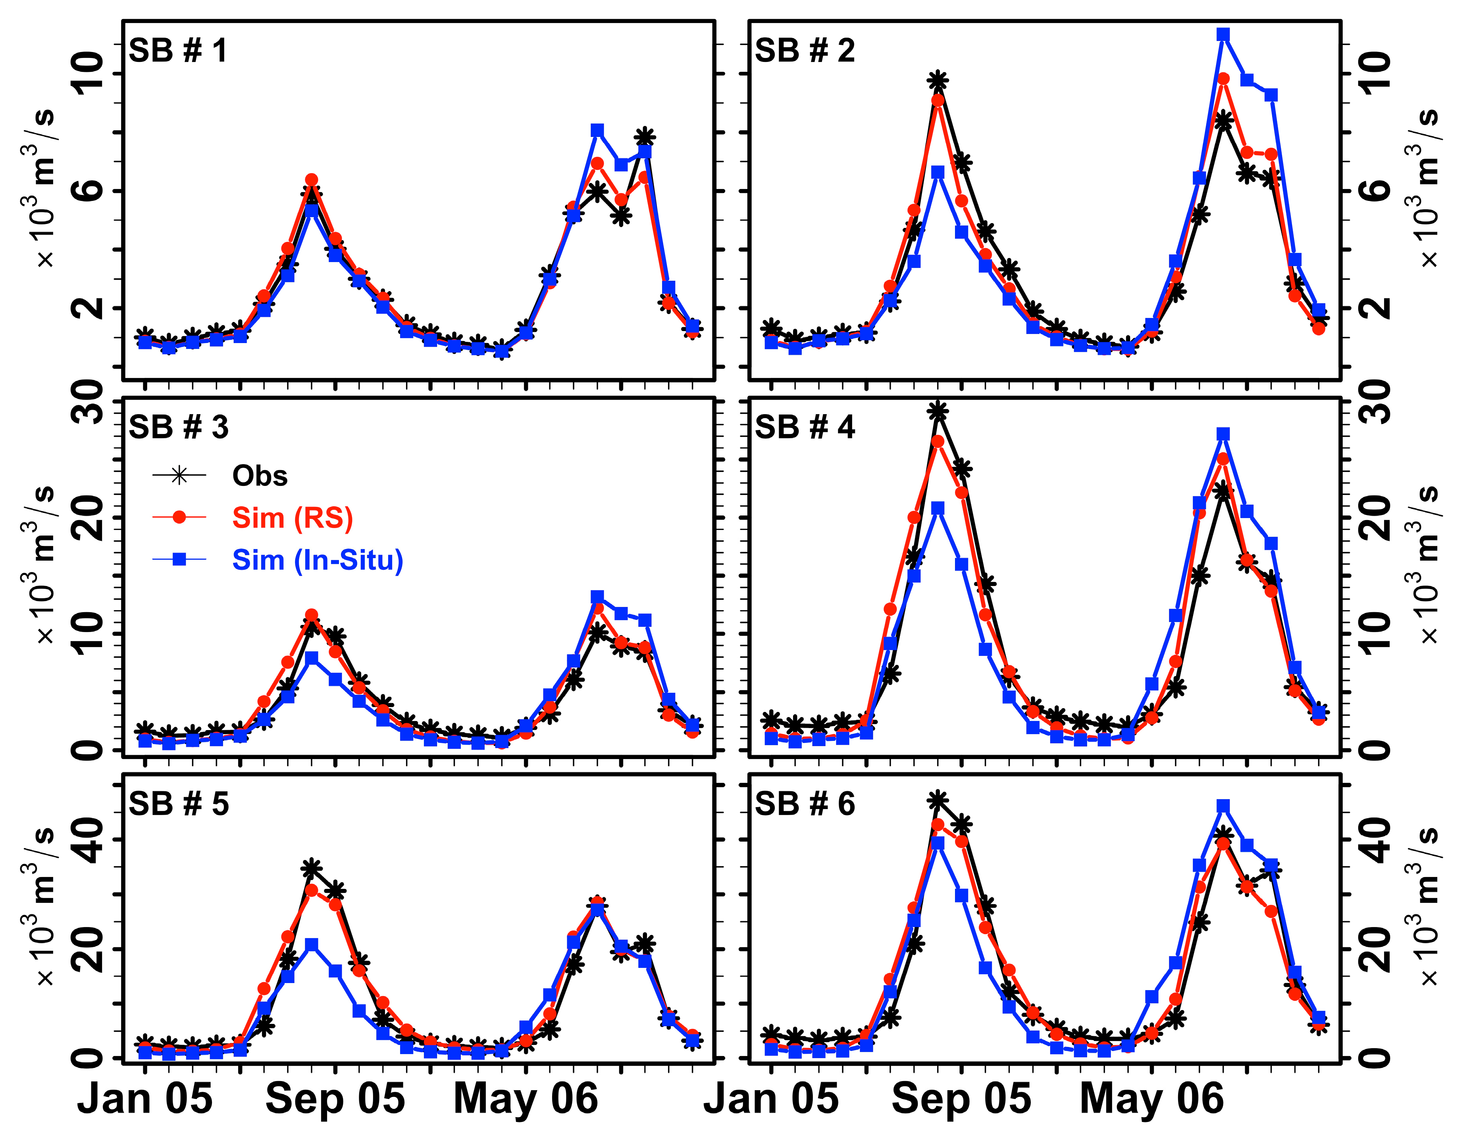
Remote sensing and gauge driven SWAT models - Streamflow Comparison
Mohammed et al., 2018. http://dx.doi.org/10.3390/rs10060885
Sub Basin # | NSE (RS Driven Model) | NSE (In-Situ Driven Model)
SB#1 Chiang Sean | 0.96 | 0.91
SB#2 Luang Prabang | 0.94 | 0.70
SB#3 Vien Tiane | 0.91 | 0.75
Sub Basin # | Qerr % (RS Driven Model) | Qerr % (In-Situ Driven Model)
SB#1 Chiang Sean | 0.81 | 0.53
SB#2 Luang Prabang | -0.29 | 2.02
SB#3 Vien Tiane | 0.88 | -3.31
Monthly mean observed and simulated streamflow discharge in m³/s at six sub-basin watersheds in calibration of the Lower Mekong River Basin model (TRMM).
EGU2019-5585

Slide 15
Monthly mean observed and simulated streamflow discharge in m³/s at six sub-basin watersheds in calibration of the Lower Mekong River Basin model (TRMM)
X
Mohammed et al., 2018. http://dx.doi.org/10.3390/rs10060885
EGU2019-5585

Slide 16
Remote Sensing (GPM) & Lower Mekong River Basin SWAT Model
Monthly mean observed and simulated streamflow discharge in m³/s at six sub-basin watersheds with the use of the Lower Mekong River Basin SWAT model for 2015 (GPM).
The GPM-IMERG precipitation data used to drive the LMRB model for verification.
The SWAT model able to explain between 71% to 96% of the variance observed in monthly discharge from Chiang Sean, Thailand to Kratie, Cambodia when driven by GPM-IMERG.
Mohammed et al., 2018. http://dx.doi.org/10.3390/rs10060885
EGU2019-5585

Slide 17
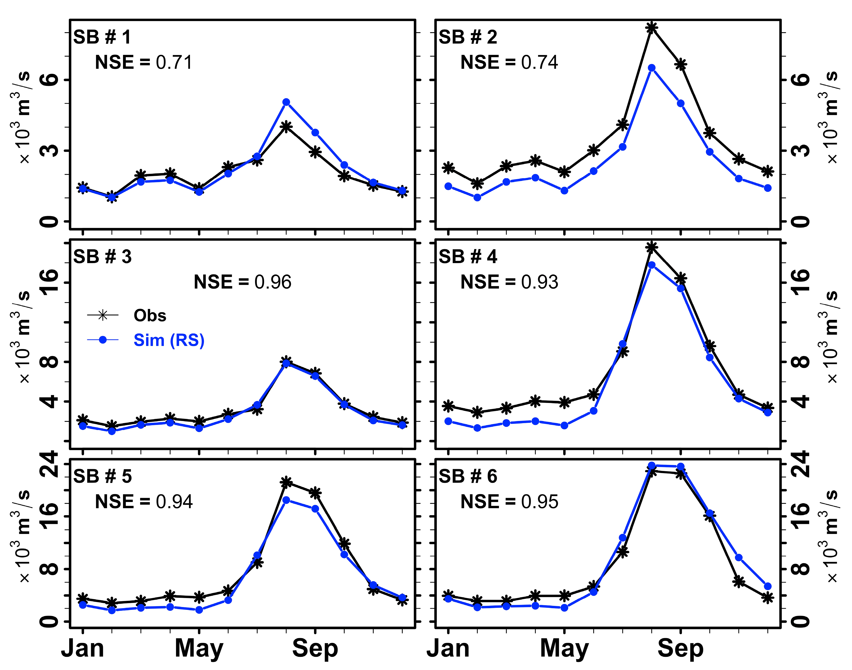
Monthly mean observed and simulated streamflow discharge in m³/s at six sub-basin watersheds with the use of the Lower Mekong River Basin SWAT model for 2015 (GPM)
X
Mohammed et al., 2018. http://dx.doi.org/10.3390/rs10060885
EGU2019-5585

Slide 18
SWAT-online
Online Demo
Soil & Water Assessment Tool (SWAT)
Motivation
Try our Apps!
EGU2019-5585

Slide 19
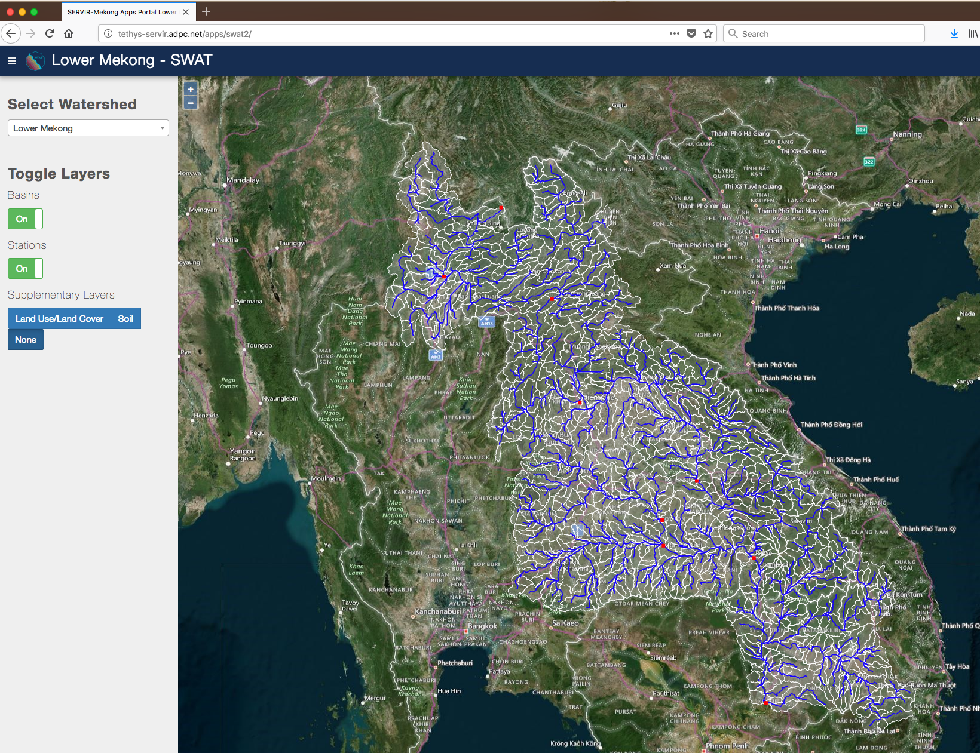
SWAT-online
The Soil and Water Assessment Tool (SWAT) is a powerful modelling tool that allows scientists to simulate many of the physical processes involved in the water cycle.
SWAT-online is a Tethys App for visualizing and sharing inputs/outputs of any SWAT Model project.
SWAT-online represents an effort to lower technical barriers for the SWAT model through using open source web development, web services, and cloud storage technologies.
A Tethys web app to visualize and share inputs/outputs from the Soil and Water Assessment Tool (SWAT)
Try our Apps!
What is SWAT?
EGU2019-5585

Slide 20
SWAT-online software Tethys organization
The application structure for the SWAT online data viewer app follows the Model-View-Controller (MVC) software architecture.
Scientists are able to leverage the wealth of already developed Python packages (e.g. pandas, gdal, numpy) along with their own customized scripts to control the data retrieval, processing, and analysis functions of their own SWAT model Project.
McDonlad et al., 2019. in review
The Model-view-controller architecture for the SWAT-online app
What is Tethys?
EGU2019-5585

Slide 21
SWAT-online time series visualization
The SWAT-online web app supports time series visualization of variables from the SWAT model output files.
The SWAT-online also supports the geospatial visualization of the stream network.
Try our Apps!
EGU2019-5585

Slide 22
Visualization of variables from the SWAT model output – Reach data example
X
EGU2019-5585

Slide 23
SWAT-online time series visualization – Cont.
Try our Apps!
Daily streamflow time series extracted from SWAT model framework.
EGU2019-5585

Slide 24
SWAT-online time series visualization – Cont.
Daily precipitation time series (left) over sub-basin area (up) extracted from SWAT model framework.
Try our Apps!
EGU2019-5585

Slide 25
SWAT-online Land use land cover layer coverage statistics
Try our Apps!
Land Cover/Land Use coverage statistics. The agricultural lands (25.9% of the sub-basin area) are broken into multiple crops as shown above.
EGU2019-5585

Slide 26
SWAT-online Soil layer coverage statistics
Try our Apps!
Soil layer coverage map is clipped to sub-basin boundary using GDAL library and coverage statistics are computed for the selected area.
EGU2019-5585

Slide 27
The SWAT online data viewer visualization methods
McDonlad et al., 2019. in review
EGU2019-5585

Slide 28
SWAT-online app info
The SWAT Data Viewer is a web application for visualizing and sharing inputs/outputs from the Soil and Water Assessment Tool (SWAT). It is currently being developed by a team at NASA Goddard Space Flight Center as part of a NASA-SERVIR Applied Science grant in the Lower Mekong region.
Explore the SWAT model inputs and outputs
Select a Variable (or multiple)
Select start and end dates
Click the "Get {RCH or SUB} Data" button to query the model outputs for the selected parameters
Click the "Add Data to Cart" to add a .csv file of the time-series to data cart for downloading
View land use and soil coverage information
Click the "Clip {LULC or SOIL} Raster" to view the land cover and soil within the contributing area to the selected stream or subbasin
Click the "Compute {LULC or SOIL} Statistics" to view a pie chart depicting the coverage distribution of different land cover and soil classes
Access GPM (precipitation) and GLDAS (air temperature) data products from NASA
Select a date range
Select at least one of the NASAaccess functions
Click the "Run NASAaccess" button
Provide an email address for the app to contact you when the data is ready and click "Submit"
Navigate the the NASAaccess web application (in the same app portal) to download the data
Download data
Time-series data will be in csv form
Upstream subbasin and stream layers are GeoJSON files
Upstream land cover and soil layers are TIFF files
Try our Apps!
EGU2019-5585

Slide 29
Online Demo
Soil & Water Assessment Tool (SWAT)
Motivation
Try our Apps!
EGU2019-5585

Slide 30
SWAT – Soil and Water Assessment Tool
SWAT is a conceptual watershed-scale hydrological model designed to address challenges related to water management, sediment, climate change, land use change, and agricultural chemical yield.
The SWAT applications range from the field scale to the watershed scale to the continental scale.
The SWAT model components are hydrology, weather, sedimentation, soil temperature, crop growth, nutrients, pesticides, and agricultural management.
Schematic of SWAT development history and model adaptations (adapted from Gassman et al., 2007)
https://swat.tamu.edu/
SWAT-online
EGU2019-5585
Notes:
SWAT info

Slide 31
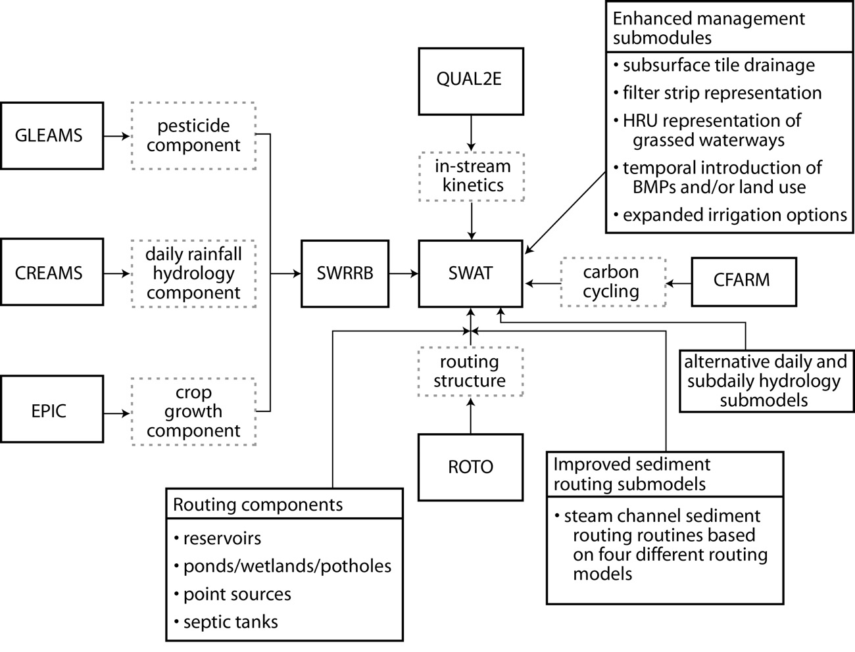
Schematic of SWAT development history and model adaptations (adapted from Gassman et al., 2007)
X
Gassman et al., 2007. https://doi.org/10.13031/2013.23637
EGU2019-5585

Slide 32
What is Tethys?
The component diagram for Tethys Platform.
The Tethys platform (Swain et al., 2016) was created to lower barriers of web application development for engineers and hydrologists so they could better share models and data. The Tethys combines many of the most commonly used technologies and scripting languages for database management, data processing, and web design into a relatively easy to use framework for developing web-based applications and decision support tools.
Swain et al. 2016. https://doi.org/10.1016/j.envsoft.2016.08.003
SWAT-online
NASAaccess
EGU2019-5585

