Slide 1

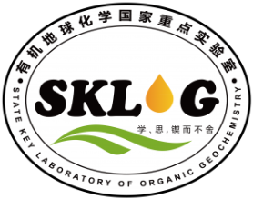
Compositions and structures of particulate and colloidal organic matter in aquatic environment by advanced analytical techniques
Yong Ranª, Dainan Zhangª, Wen Huangª, Shujie Huª, Jingdong Mao^{b}
ªState Key Laboratory of Organic Geochemistry, Guangzhou Institute of Geochemistry, Chinese Academy of Sciences
^{b}Old Dominino University, Norlfolk, Virginia, USA

Slide 2
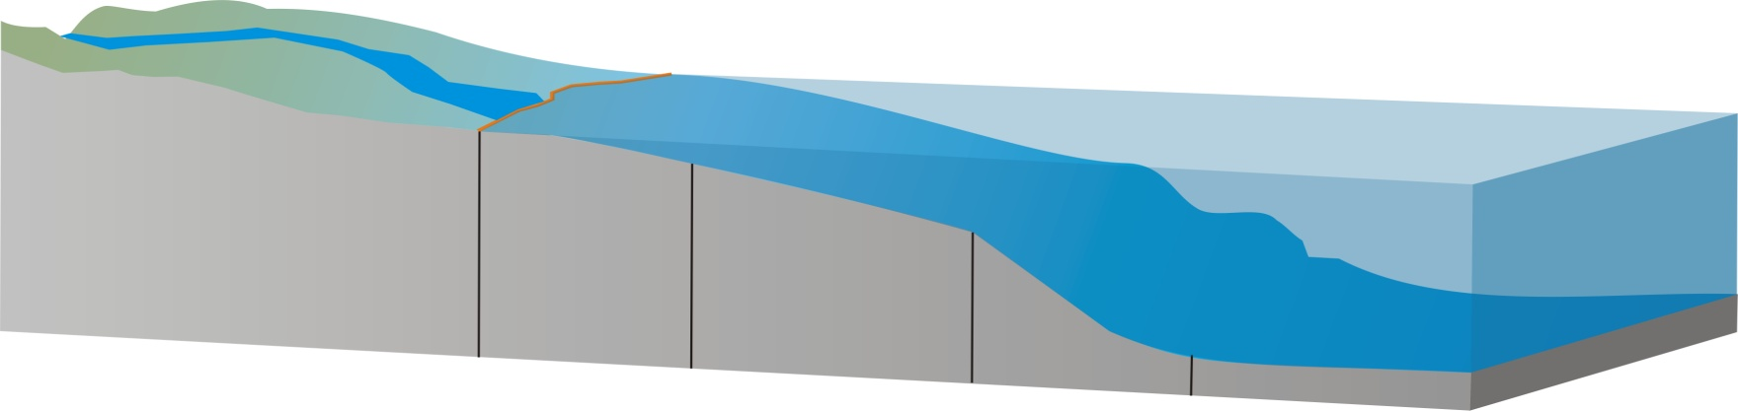
Introduction
Precipitation 1623-1900 mm/y
Dry deposition 21-40 g/m²/y
DOC ~1200 mg/m²/y
POC 3200-4400 mg/m²/y
TN 1000-2000 mg/m²/y
Runoff water 3.3×10¹¹ m³/y
DOC 6.8×10⁵ t/y
POC 1.5×10⁵ t/y
Pearl river basins
South china sea
Notes:
首先来看一下目前的环境状况以及研究进展。有机质作为全球碳循环的重要组成部分，存在于所有生态系统中。而有机质从陆源迁移到海洋最主要的途径是河流运输以及大气沉降。在珠江流域，每年通过河流输送到海洋中的总有机碳（OC）可达8.3万吨，其中颗粒碳仅占20%。Zafiriou报道全球范围内大气输送到海洋有机碳的年通量为1亿吨，因而可能在生态系统的碳循环中有其重要作用。从东南沿海输送进南海的大气有机碳通量未见报道。但大气在珠江流域的年沉降有机碳通量为4400-5600mg/m2。在这些有机质在全球循环过程中，有机污染物和重金属与之结合随之迁移。有机质的结构决定着结合能力的大小。因此，研究河流有机质和沉降有机质的组成和来源以及污染物在不同相中的分配具有重要意义。

Slide 3
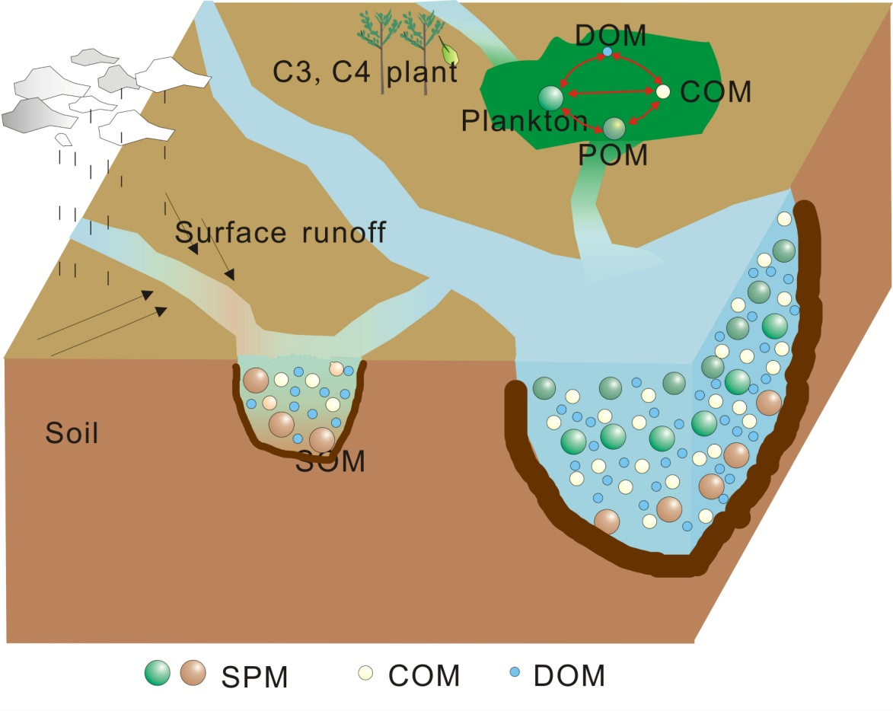
Sources, Composition, and Transformation of NOM
RO
XAD resins
Ultra high speed centrafugation
ultrafiltration
Time comsuming
Pollution
No clear size limit
Membrane filtration
flocculation
High speed centrafugation
Notes:
河流有机质主要以降解程度很高的土壤有机质（Hedges et al., 1994, 1997）和河流自生有机质（Jaffe et al., 1995）为主。主要包括三种形式：溶解有机质（DOM）、颗粒有机质（POM）、沉积有机质。其中，溶解有机质（DOM）、颗粒有机质（POM）在水体中均匀分布，分离比较困难，但易于随水迁移，决定着污染物的迁移和归宿。对颗粒物而言，目前的分离方法，主要有膜过滤，絮凝，高速离心。这三种方法的优缺点是：膜过滤费时，絮凝造成污染，高速离心无法定量尺寸。对胶体而言，目前的分离方法主要有：XAD树脂，反渗透，超滤等。这三种方法的优缺点是：XAD树脂操作较繁琐，酸、碱的使用，可能引起DOM结构的变化。反渗透，灰分高不利于后续表征，且对小分子有机质（就是对环境污染物不起作用的有机质）也进行了截留。超滤超滤膜昂贵、易损坏、并且不同的厂家生产的超滤膜可能会产生不一样的回收率，需要标样经常标定和校准。在本实验中采用反渗透和超滤联用的方法收集有机质提高有机质含量，减少小分子的干扰。对分离后的有机质最常用的表征手段是元素分析，同位素，红外，拉曼和核磁。

Slide 4
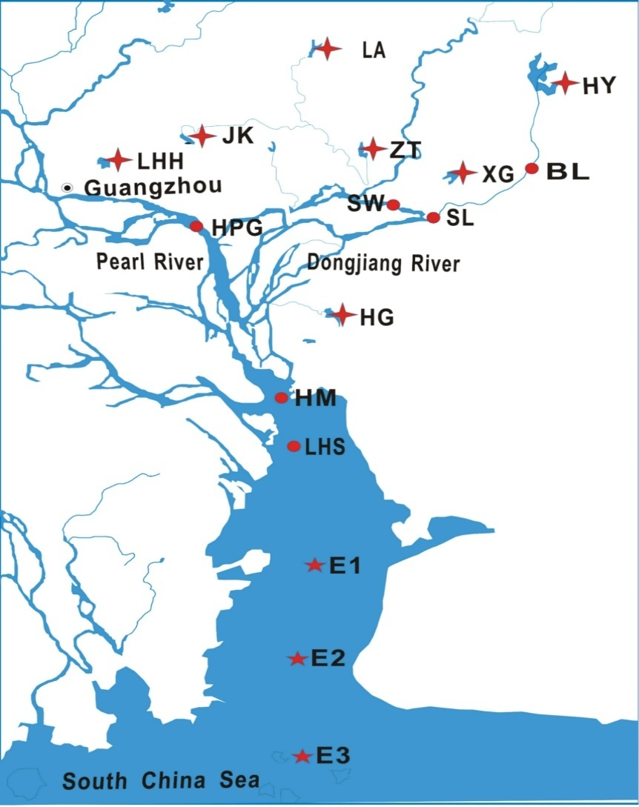
Isolation of POM and COM
Natural water
河水
centrafugation
POM
Water (except SPM）
过滤后的水样
RO
RO
RO
RO
RO
Water and salts
DOM
UF
UF
UF
UF
UF
Low size organic matter
Drying under vacuum
COM powder
Notes:
In the present study, continuous flow centrifugation and RO combined with TFF were used to isolate COM and POM from large volumes of water collected from various lacustrine and riverine sampling sites in the Pearl River basin with different trophic states Spell it out if you do not do so in the above in the introduction.
Defined in the above in the introduction.

Slide 5
Sources and Compositions of NOM
C/N ratios, stable carbon and radiocarbon isotopic compositions, biomarkers
Plankton，C/N<8, δ¹³C：-22 ‰ ~-42‰
Terrestrial plants，C/N>15, C4 plants δ¹³C： -8‰ ~-13‰, C3 plants δ¹³C： -27‰ ~-30‰
Radio carbon: Δ¹⁴C: 0 modern carbon, >-999, kerogen carbon
Biochemical tracer: chlorophyll a (Chl a)
Biomarkers: lignin phenols, amino acids
Notes:
The sources and cycling of OM have been investigated by various analyses, including bulk parameters such as C/N ratios, stable carbon and radiocarbon isotopic compositions and organic biomarkers.

Slide 6
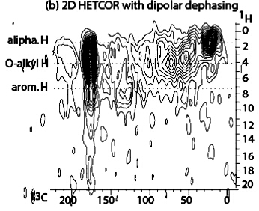
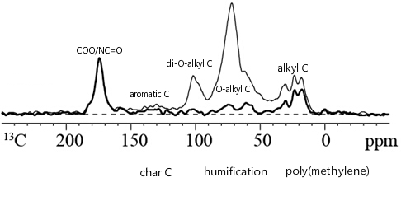
Compositions and Structures of NOM
Advanced solid-state NMR characterization
The relative abundances (%) of functional groups
Index of humification
The abundances of black carbon
Chemical and nanometer-scale structures
Notes:
Advanced ¹³C solid-state NMR experiment can provide representative NOM structures, analyzing samples non-destructively irrespective of solubility.

Slide 7
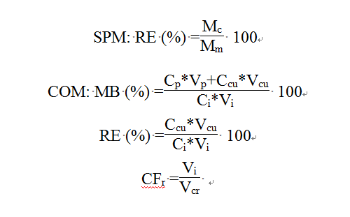
QA/QC
The recovery of SPM: 80%
The mass balance of DOC: 98%
Notes:
可以发现，溶解有机质的质量平衡在98%左右，胶体有机质的回收率在35%左右，与仅通过超滤获得的结果类似。颗粒物通过过膜收集来衡量离心机对颗粒物的截留率，可以发现颗粒物的回收率在80%以上。预实验发现，RO过程中的浓缩因子小于40有较高的回收率，但为了后续处理的方便需要在超滤过程中采用较高的回收率。

Slide 8
Elemental Compositions of POM and COM
Site | N | C | H | O | C/N
Sl-8 | 1.32 | 7.87 | 1.99 | 14.92 | 6.94
Sl-9 | 0.43 | 2.91 | 1.55 | 11.50 | 7.96
Estuary 1 | 0.34 | 2.23 | 2.16 | 8.69 | 7.75
Eatuary 2 | 0.68 | 3.98 | 1.72 | 9.67 | 6.88
Eatuary 3 | 0.32 | 2.07 | 2.05 | 8.06 | 7.49
Eatuary 3-1 | 0.28 | 1.57 | 1.88 | 8.09 | 6.52
Eatuary 3-2 | 0.31 | 1.82 | 1.99 | 9.05 | 6.76
Sl-4.1 | 0.19 | 1.33 | 1.68 | 18.61 | 8.01
Lhs-.4.1 | 0.63 | 4.10 | 1.61 | 18.46 | 7.61
Bl | 0.32 | 1.90 | 1.86 |  | 7.01
HY | 1.51 | 11.36 | 2.14 |  | 8.78
XG | 2.58 | 15.24 | 3.42 |  | 6.89
HG | 4.61 | 24.83 | 4.43 |  | 6.28
LA | 3.19 | 20.66 | 3.82 |  | 7.55
ZT | 1.88 | 10.76 | 2.19 |  | 6.69
LHH | 5.87 | 31.91 | 5.11 | 31.90 | 6.34
river
C% 2.98±1.97
C/N 7.29±0.53
reservoir
C%19.13±8.92
C/N 7.22±0.95

Slide 9
Isotopic Compositions
POM
COM
HG LHH PRE1 LA BL SL9 ZT HY PRE3 SL XG LHS
Avg. ¹³C for POM was -26.54‰ ; Avg. ¹³C for DOM was -23.62‰;
¹³C for POM was higher than for COM, implying different sources for them.

Slide 10
Distribution of NOM and Effect of Eutrophication
Notes:
珠江流域水体中有机质主要小分子溶解态为主，约占总有机制的50%以上，POC和COC各占20到30%。一般认为溶解有机碳小于2.5为寡营养话水体，在寡营养话水体DOC:POC比值一般大于10:1，而富营养化水体，藻类大量繁殖，产生丰富的颗粒碳，因此富营养化水体中DOC：POC比值一般小于6:1.这几个点主要位于石龙和博罗，主要是河道交叉和淘沙，造成了POC升高。

Slide 11
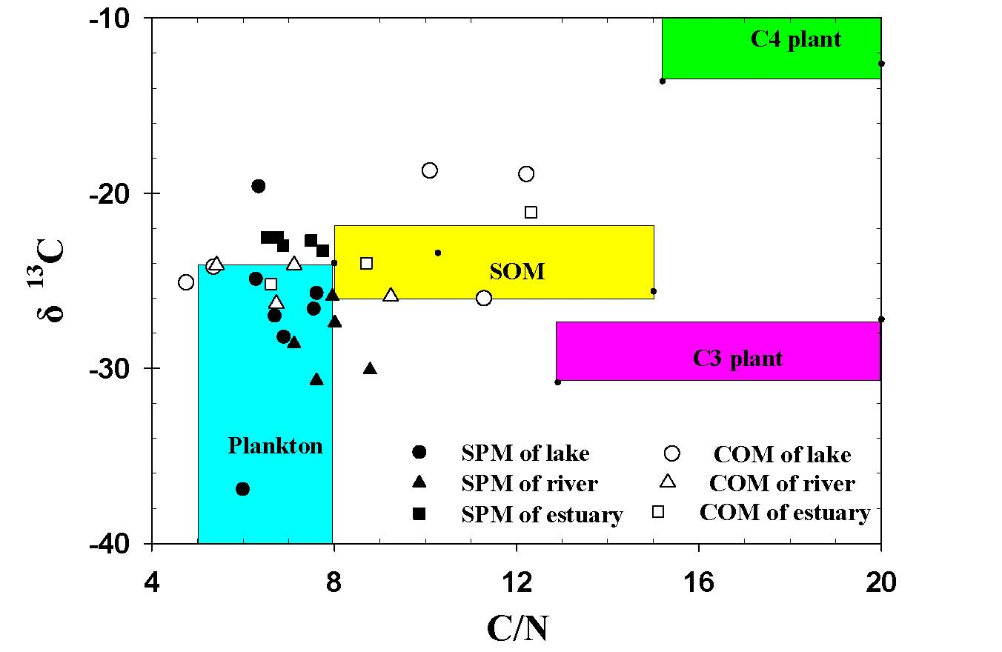
Sources of POC and COM
POM: phytoplankton was the dominant source .
COM: plankton and soil organic matter were the main sources.
δ¹³C values in plankton were affected by δ¹³C values in DIC, aqueous CO₂ concentration, and growth rate.
Notes:
有机质的来源可以通过C/N比值和稳定碳同位素来判定，一般代表河流自生有机质的浮游生物C/N比值小于8，陆源有机质中的土壤有机质和高等植物C/N比值>12.可以发现，珠江流域水体中颗粒有机质主要以浮游生物为主。浮游生物来源的稳定碳同位素一般为-24到-42. 浮游生物的稳定碳同位素的范围较广，这主要与浮游生物对无机碳的固定形式以及物种、CO2 丰度、生长率、营养盐、透光度等有关。浮游生物通过光合作用固定无机碳，无机碳来源的不同大大影响浮游生物的稳定碳同位素，例如大气溶解产生的CO2的稳定同位素约为0，无机盐中的无机碳约为-23，呼吸作用和有机质的降解产生的CO2约为-27。JK水库位于垃圾填埋场附近，有极高的溶解碳，无机碳可能来自于有机质的降解，因此有较低的未定碳同位素值-36，其他的地点主要采用大气CO2固定，范围较为一致，LHH有最高的POC，稳定碳同位素值也较大，-19。这主要与浮游生物的生长速率有关，当生长速率过大，CO2的控制生长的因素，C13的含量就相对丰富。一般而言，有机质的降解顺序，从颗粒态到溶解态，从胶体到小分子溶解有机质，含氮丰富的有机质优先降解，因此胶体的C/N比值》颗粒物。当湖泊DOC》6，河流DOC》3.5，的极富营养水体中，颗粒物的C/N比值》胶体，这与这些水体的胶体中有大量的细菌病毒来源有关。因此POM以浮游生物，胶体以浮游生物，土壤有机质和细菌的混合来源。

Slide 12
POC Derived from Algae
Algal OC/POC：9.2%-47.6%, an average: 37%
Algal OC/POC: rivers: 40-48%; reserviore urban lakes: 16%
Algal OC was dominate composition of POC.
( Li et al., 2014, MPB)

Slide 13
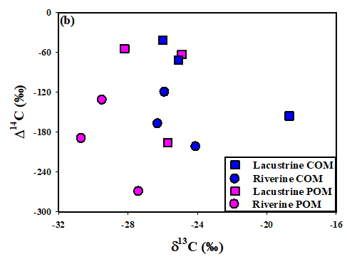

Sources and chemical structures of COM and POM
Notes:
Based on their disparate Δ¹⁴C and δ¹³C signatures, COM and POM samples are derived from various sources. In comparision with other investigations in fresh water, the Δ¹⁴C values of COM in this investigation are quite different. For example, Δ¹⁴C values of DOC, LW DOC, or HW DOC almost reflected contemporary radiocarbon signatures (Longworth et al., 2007; Zigah et al., 2011, 2014).

Slide 14
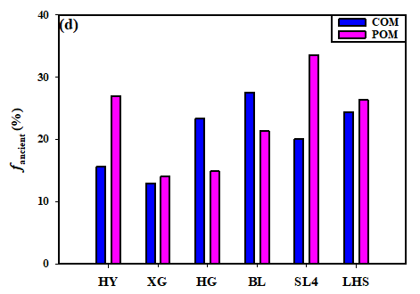

Sources and chemical structures of COM and POM
Notes:
As shown in this Figure, ancient organic carbon accounted for 12.9% to 26.9%, and 20.0% to 33.5% in the lacustrine and riverine samples, respectively, further demonstrating that ancient OM is a significant component of the lacustrine and riverine COM and POM samples in the Pearl River basin.

Slide 15

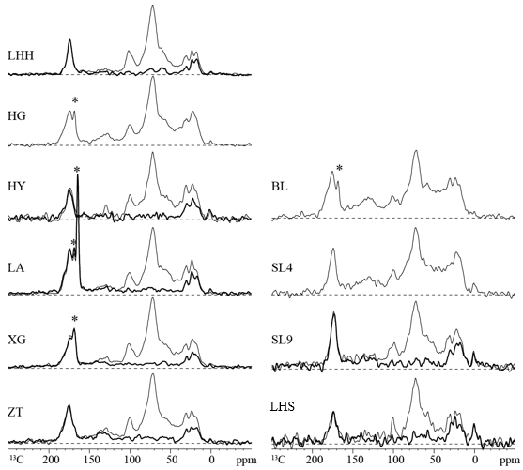
Sources and chemical structures of COM and POM
lacustrine POM contained markedly higher alkyl C and slightly higher COO/NC=O relative to lacustrine COM; lacustrine COM samples contained more carbohydrate-like C than riverine COM samples.

Slide 16
Abundances of functional groups
Alkyl carbon and O-Alkyl carbon is the main functional groups for COM and POM(50%-60%）
SPM contained significantly more alkyl C (35% vs. 22%) than COM, and COM contained more O-alkyl C (33% % vs. 20%) than SPM
Notes:
通过核磁分析可以发现自然水体中有机质的主要成分是烷基碳和烷氧基碳，约占到总量的50%-60%。颗粒有机质有更多的烷基碳，胶体有机制有更多的烷氧基碳。对于胶体有机质而言，湖泊胶体有机质有更多的烷氧基碳和二氧烷基碳，河流胶体有机质有更多的羧基碳和芳香碳。芳香碳一般来自于木质素和单宁酸，因此河流胶体有机质有更多的陆源来源，羧基碳一般有芳香酮、脂环碳化合物的氧化产生，因此与湖泊相比，河流胶体有机质的降解程度更高。

Slide 17
Index of humification/abundances of black carbon
Humification index of POM was 11%-14%, lower than that of COM (9%-18%).
The result indicated that the BC/OC in POM was 5.8%-6.3%，2.4%-8.2% in COM, similar to those estimated from BPCA and Combustion method.
Notes:
有机质在腐殖化的过程中，会发生交联、去质子化。因此非质子碳可以用来评价有机质的腐殖化程度，。非质子碳谱图化学位移
在5-60 ppm 的信号一般代表流动性的OCH3、CH2、和CCH3 结构。Helms 等（2012）报道非质子化的芳香碳一般由高温、高度交联产生、或者来自于沥青，在自然环境难以降解。而新鲜的有机质首先在烷氧基（60-114 ppm）上发生去质子化。因此在本研究中，通过对烷氧基区域非质子碳的定量来衡量有机质的非质子化程度，结果表明POM 和COM 的腐殖化程度较低。其中，POM 的腐殖化系数为11%-14%，COM 样品为9%-18%。COM 样品的腐殖化系数大于POM（。东江水体中的有机质以藻类来源为主，腐殖化程度较低，高度交联的有机质较少，因此可以用芳香碳区域的非质子化碳估计POM 和COM 中碳黑（BC）的含量，结果表明POM 中BC/OC%为5.8%-6.3%，COM 中BC/OC%为2.4%-8.2%。

Slide 18
Poly(methylene) structure
The poly(methylene) crystalline structure for POM and COM was 19%-22% and 5%-10%, respectively.
Notes:
聚甲基结构广泛存在于自然环境中，如土壤和泥炭的腐殖酸中。Mao 等（2002）研究表明腐殖酸的聚甲基中大约一半属于晶体碳，其他部分是拥有各向
同性的流动性无定型碳。聚甲基区域易形成大的聚合物，其中晶体碳耐环境降解，能长期保存；聚甲基晶体碳也可以影响有机质的整体性质，如膨胀度和溶解性。在不溶性的腐殖酸样品中含有更多的晶体碳。在温度升高后，一部分晶体碳会表现出无定型碳的特性，与人造聚乙烯的结构类似（Mao et al. 2000）；由于聚甲基晶体碳特殊的生物稳定性，它可以作为有机质演化的内标物质。聚甲基无定型碳在有机污染物的吸附过程中起重要作用。一些研究也表明富含聚甲基结构的胡敏素比腐殖酸的吸附容量更高（Xing et al. 1998）。因此对聚甲基结构的精细定量至关重要。在本研究中POM 的晶体碳含量远大于胶体，POM 的聚甲基含量远大于胶体（图2.8）；POM 中晶体碳为19%-22%，无定型碳为10%-12%，而COM 中晶体碳与无定型碳基本相当，约为5%-10%。聚甲基结构一般来自脂肪族生物聚合物，如高等陆生植物的角质层和藻类的细胞壁。湖泊POM 中包含大量的藻类，因此拥有更高的聚甲基结构。

Slide 19
Contribution of biomolecules
POM contained significantly higher lipid,
COM contained higher carbonhydrates
Notes:
碳水化合物、蛋白质、木质素、内脂和碳羧酸是淡水COM 的主要组成成分。
表2.6 列出依据13C NMR 光谱估算的这些生物大分子对COM 的贡献。碳羧酸不
属于自然界生物聚合物，但会在内脂和木质素光氧化和多糖腐殖化的过程中产生

Slide 20
Sources and chemical structures of COM and POM
Notes:
This investigation demonstrated that the chemical structures of COM and POM are greatly influenced by lacustrine types in different trophic states, and those of COM are largely influenced by their modern or aged OM sources.

Slide 21
Sources and chemical structures of COM and POM
This study for the first time provides the evidence that the chemical structures of COM and POM are largely influenced by entrophication, and by their modern (or labile) and aged (or refractory) OM sources.

Slide 22
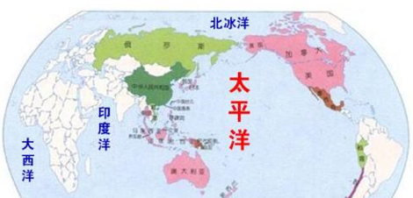
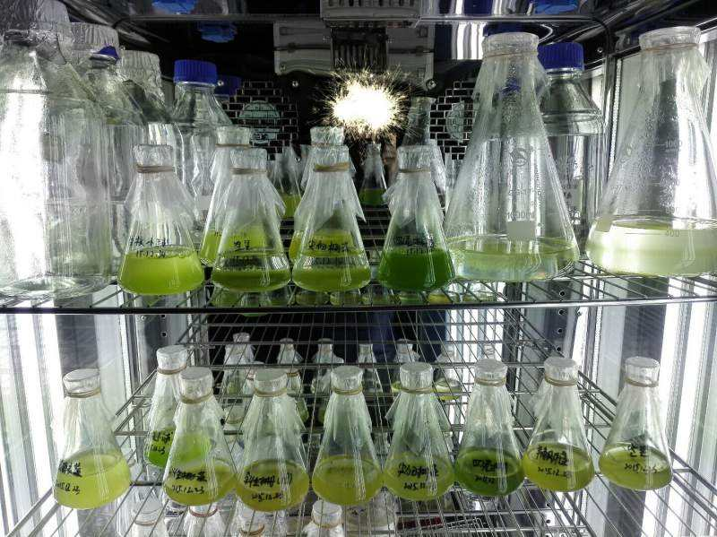
Chemical structures of ultrafiltered marine and phytoplankton-produced dissolved organic matter
ultrafiltered dissolved organic matter (UDOM)
Pacific
Ocean
Atlantic
Ocean
surface seawater of the Pacific and Atlantic Ocean
Prymnesiophyte Phaeocystis sp.
Diatom Skeletonema costatum
Notes:
The chemical and nano-sclae structures of two ultrafiltered dissolved organic matter (UDOM) samples from surface seawater of the Pacific and Atlantic Ocean were studied by various advanced solid-state NMR techniques and compared with the chemical structures of two phytoplankton-produced UDOM samples, from the prymnesiophyte Phaeocystis sp. and the diatom Skeletonema costatum.

Slide 23
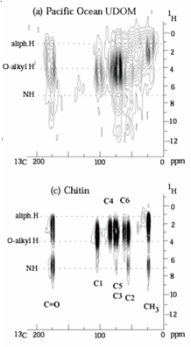
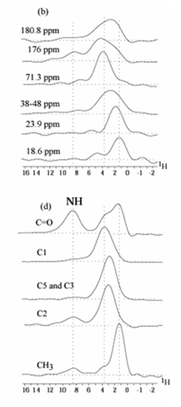
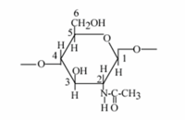
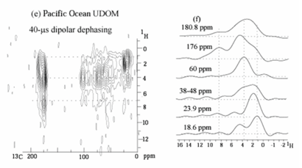
Chemical structures of ultrafiltered marine and phytoplankton-produced dissolved organic matter
Notes:
Our results indicated that (1) COO groups were bonded to OCH or NCH, not nonpolar alkyls; (2) organic N was provided by peptides and N-acetyl side groups of polysaccharides in similar proportions and sugars-bound COO groups were present in amounts similar to amino-acid residues and N-acetyl sugars; (3) no significant domains e.g. of polysaccharides were present in surface-water marine UDOMs.

Slide 24
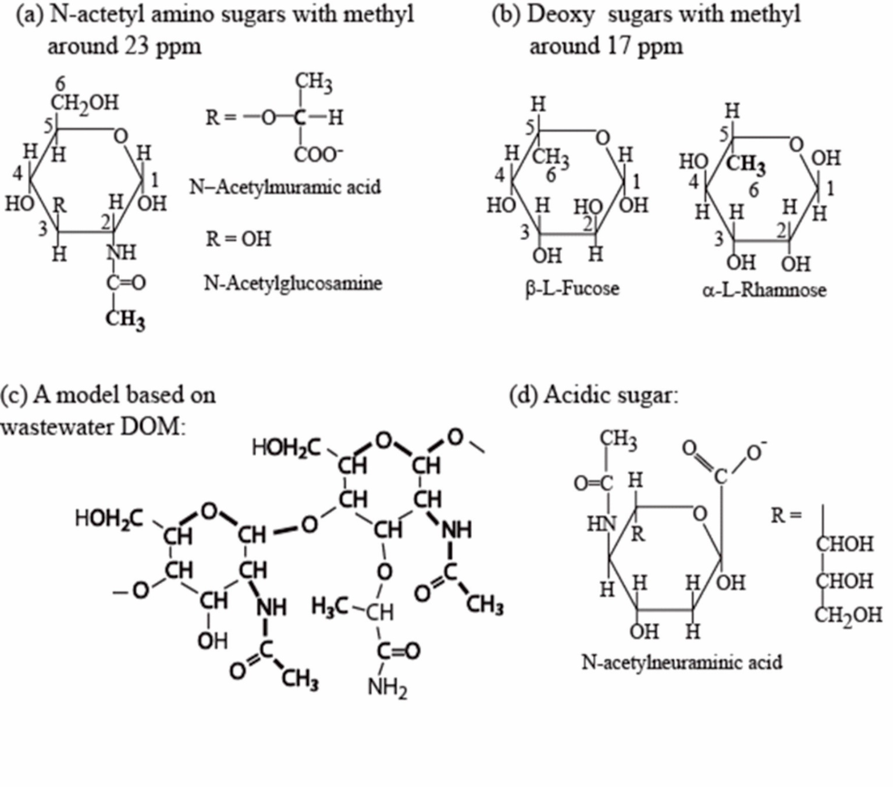
Chemical structures of ultrafiltered marine and phytoplankton-produced dissolved organic matter
This study for the first time found that sugar-bound COO groups are present in amounts similar to amino-acid residues and N-acetyl sugars.

Slide 25
Conclusions
The major sources of POM and COM are plankton, and/or soils, old NOM in the pearl river basin.
POM contained more alkyl, and COM contained more O-alkyl C.
This study provides the evidence that the chemical structures of COM and POM are largely influenced by eutrophication, and by their modern (or labile) and aged (or refractory) OM sources.
This study for the first time found that sugar-bound COO groups are present in amounts similar to amino-acid residues and N-acetyl sugars.

Slide 26
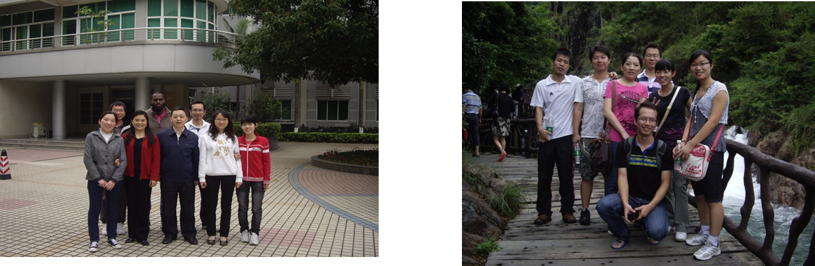
Acknowledgement
Professor R. Benner, University of South Carolina
National Natural Science Foundation of China
Chinese Academy of Sciences

Slide 27
Thank you for your attention!

Slide 28
Distribution of organic carbon and its variation with eutrophication
Notes:
珠江流域水体中有机质主要小分子溶解态为主，约占总有机制的50%以上，POC和COC各占20到30%。一般认为溶解有机碳小于2.5为寡营养话水体，在寡营养话水体DOC:poc比值一般大于10:1，而富营养化水体，藻类大量繁殖，产生丰富的颗粒碳，因此富营养化水体中DOC：POC比值一般小于6:1.这几个点主要位于石龙和博罗，主要是河道交叉和淘沙，造成了POC升高。

Slide 29
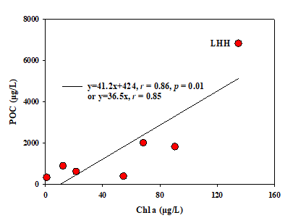
Sources and chemical structures of COM and POM
1.17-135 μg/L
Oligotrophic (Chl a: 0–5 µg/L) Mesotrophic (Chl a: 5–20 µg/L) Eutrophic (Chl a: 20–60 µg/L) Hypereutrophic (Chl a >60 µg/L)
C:Chl a=25 (Gosselain et al., 2000)
phytoplankton may contribute 12.2–71.4% of POC, with an average of 36.7% in the PRD (Li et al., 2014).
Notes:
Previously, it has been reported that Chl a values can be converted to the concentrations of phytoplankton organic carbon using a C to Chl a ratio of 25. The previous result from our group with a relatively larger sample set in this area suggested that phytoplankton contributed 12.2–71.4% of POC, with an average of 36.7% in the PRD.

Slide 30
Sources and chemical structures of COM and POM
Significant contribution of phytoplankton and aged OM to COM and POM.
Notes:
The C/N ratios and δ¹³C values indicated that plankton and soil organic matter (SOM) were two major sources of COM and POM, whereas Chl a and radiocarbon analyses were suggestive of the significant contribution of phytoplankton and aged organic matter (OM) to them.

Slide 31
Molecular compositions of lacustrine COM
Sample | Number of formulas | CHO | CHON | CHOS | CHONS | MW_{w} | H/C_{w} | O/C_{w} | DBE_{w} | AI_{mod,w}
HG-COM | 1426 | 896 | 367 | 162 | 1 | 373.8 | 1.241 | 0.506 | 8.10 | 0.285
LA-COM | 1660 | 1031 | 501 | 125 | 3 | 380.6 | 1.214 | 0.539 | 8.20 | 0.296
LHH-COM | 1554 | 877 | 459 | 214 | 4 | 374.7 | 1.268 | 0.531 | 7.50 | 0.261
ZT-COM | 1894 | 1092 | 624 | 174 | 4 | 391.9 | 1.178 | 0.546 | 8.64 | 0.316
Notes:
The above figure showed the relative abundances of the four compound groups. CHO typically represented the highest abundance fraction (67.8%−74.5%) of all the formulas in negative ion mode. CHON was the second highest group (17.6%−21.4%) in the COM samples. This indicated that CHO and CHON compounds were the major subcategories in the COM of lacustrine water. In addition，LHH COM showed higher S contents and lower DBE values. Because LHH lake is an urban ornamental park, municipal sewage discharge and urban runoff may promote secondary reactions of S-containing compounds.

Slide 32
Molecular compositions of lacustrine COM
Notes:
In general, oxidized species cluster in the lower right part of the VK plot, while reduced/saturated species populate the upper left part of the diagram. In the present study, the four COM samples had similar VK patterns. Most of the compounds had O/C ratios <1.0 and H/C ratios in the 0.5 to 2.0 range, which are similar to those obtained by FT-ICR MS for DOM in cloud water, glacier, lake, and aerosols.

Slide 33
Molecular compositions of lacustrine COM
Notes:
By using AI and element ratios of H/C and O/C, all the detected molecules displayed in the VK diagram were divided into six groups. For all the COM, the majority (∼80%) of the compounds were polyphenols and highly unsaturated organic acids, typical of soil-derived DOM. In addition, COM in lacustrine water were enriched (40.5–44.1%) in highly unsaturated, high oxygen formulas, indicating greater microbial and/or photochemical oxidation of lake DOM. The condensed aromatic structures contents in the present study were much higher than DOM from Namtso and Yamdrok lake, which was only observed 1%, and is likely due to the inputs of terrigenous organics and/or in situ production of aromatics. The lacustrine COM in the present study contained lower percentages of peptide-molecular formulae (0.8-4.6%) than glacier and glacier stream DOM (8-10%), indicating that lacustrine COM being more biodegraded and less biolabile.

