Slide 1
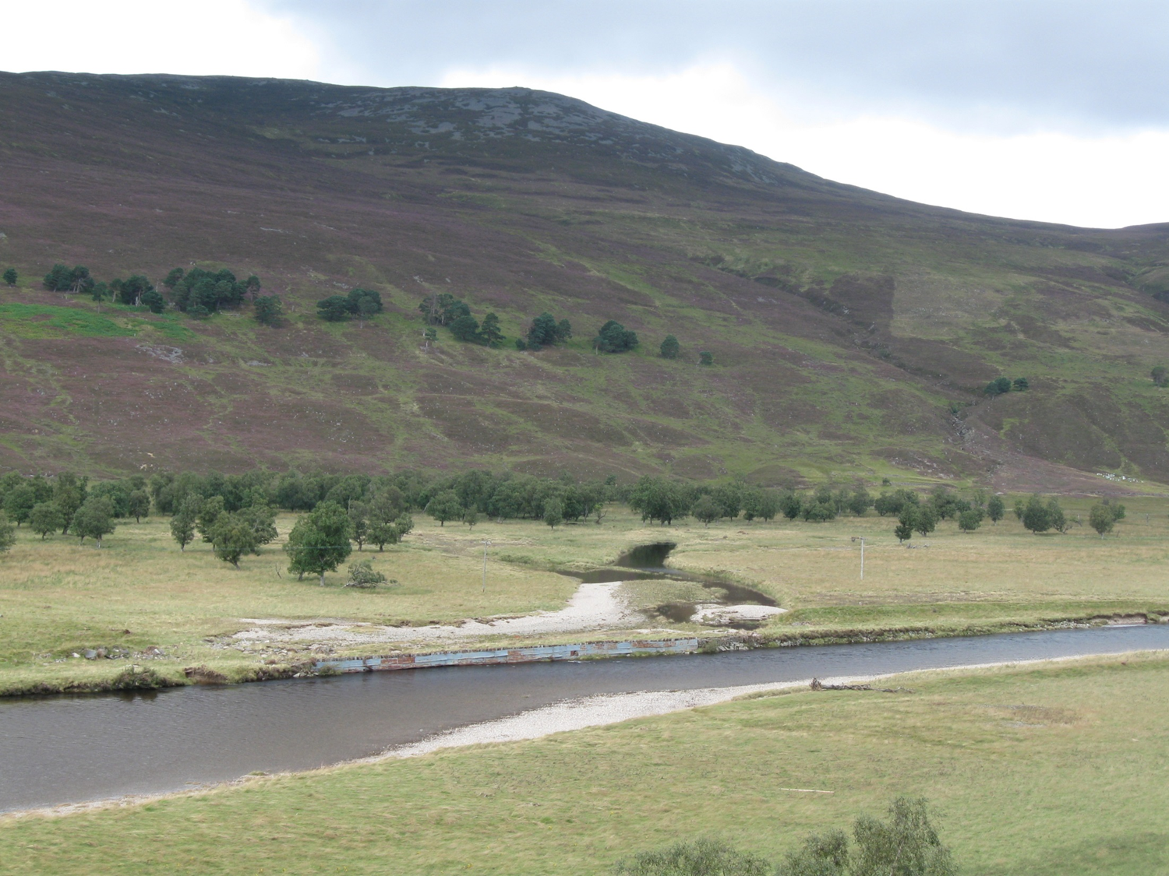
The geomorphic and hydrological responses to flood embankment lowering on a medium sized gravel-bed river.
Addy, S. and Wilkinson, M.E.
Aberdeen, Scotland, UK

Slide 2
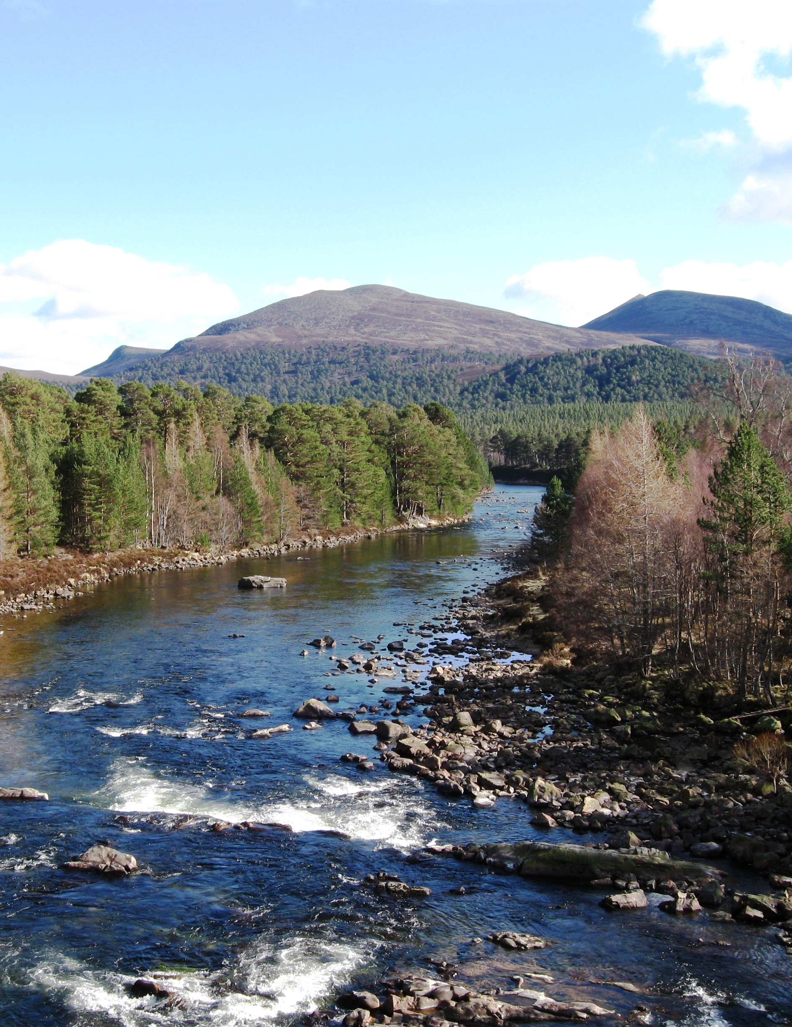
Background
Naturally functioning floodplains are important for river ecosystem integrity (e.g. Tockner and Stanford, 2002).
Floodplain reconnection is needed to restore functions but case studies remain rare.
River Dee: good ecological status but morphology often unnatural due to engineering. Flooding is also an issue.
Upper River Dee, NE Scotland

Slide 3
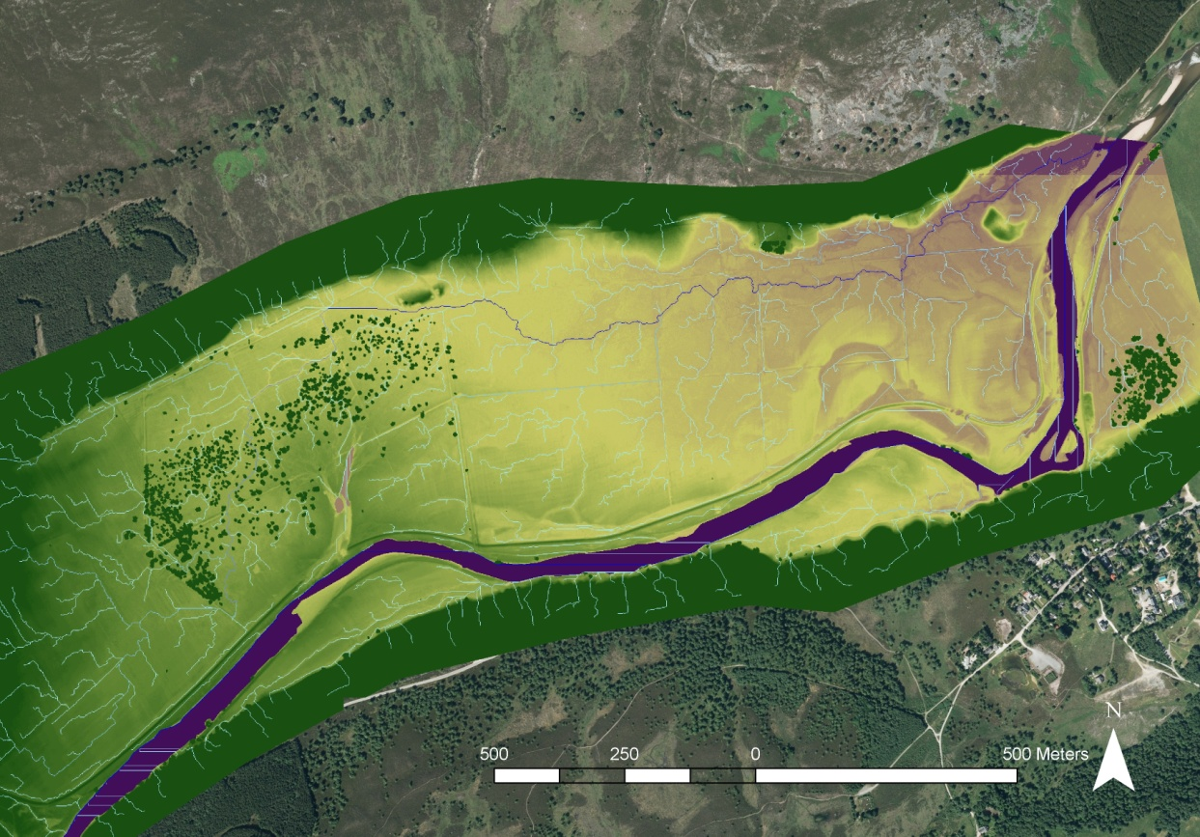
Study site
18th C. drainage network
18th C. embankment
River Dee
BRAEMAR
Restoration site
Upstream catchment area: 370 km²
Aerial imagery: Corpyight Getmapping plc. 2010 DSM map courtesy of Aberdeenshire Council.

Slide 4
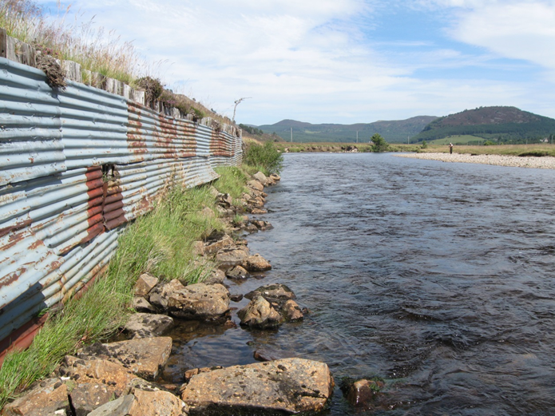
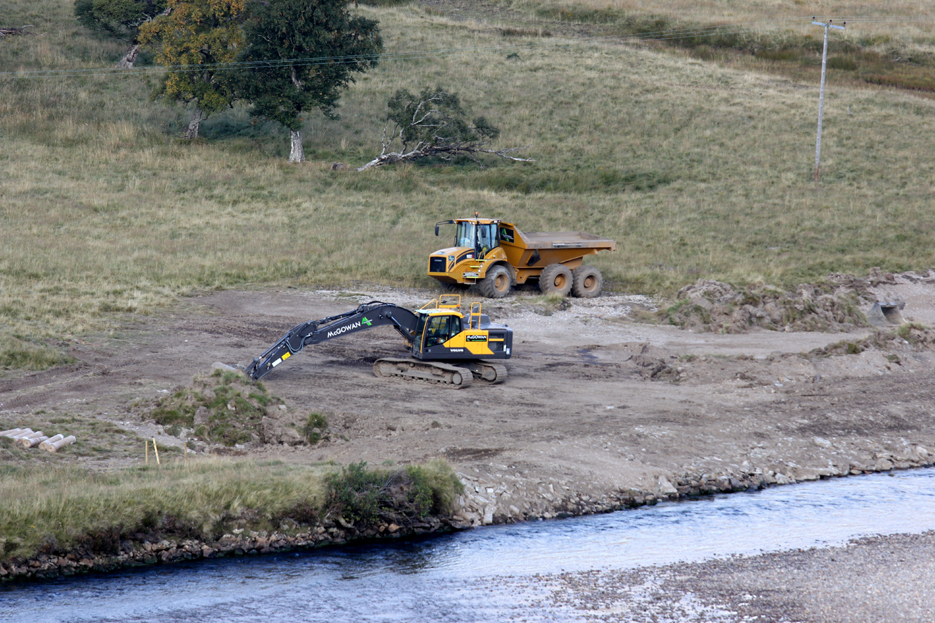
Restoration project and research aims
Project aims
To reduce flooding and erosion, improve water supply during low flows, and diversify riverine habitats.
Removal of waste and visual impact.
Research questions
How does the morphology of the main channel, floodplain and backwater change through re-connection?
How does the floodplain hydrological connectivity and water storage compare pre- and post barrier removal?
Aug. 2015 (pre-reconnection)
2 m
Sept. 2015 (during works)
Anke Addy

Slide 5
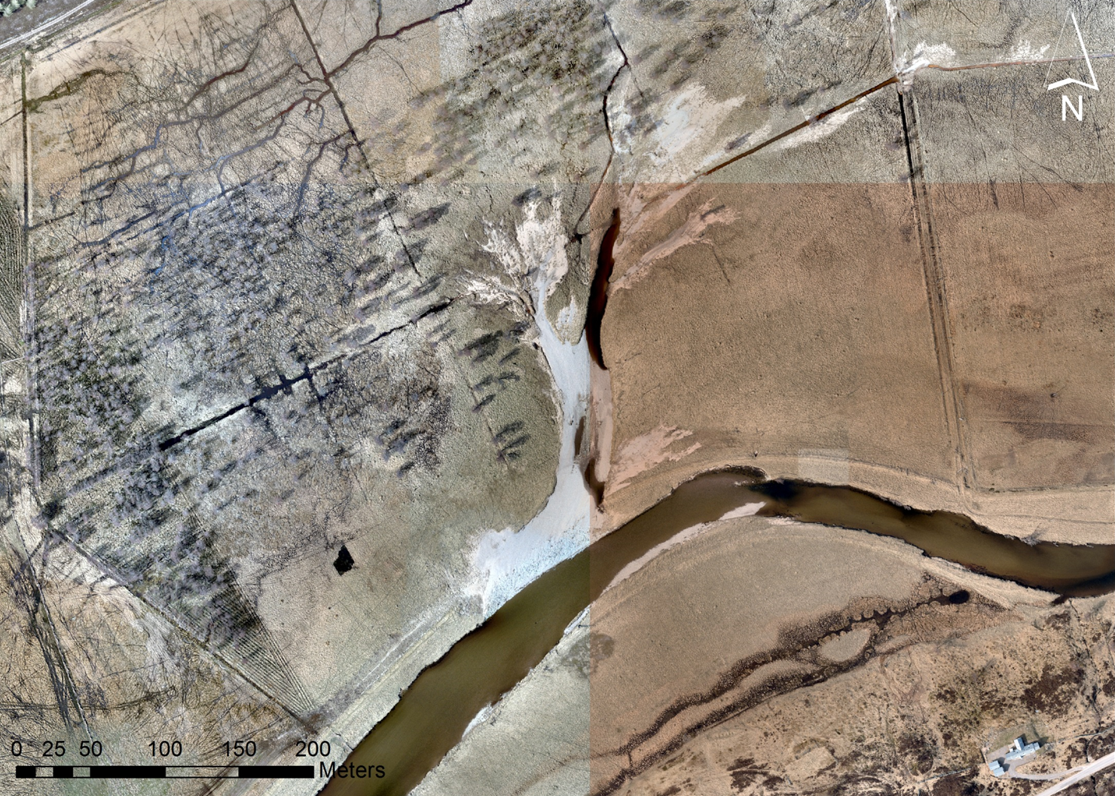
Monitoring (2013-onwards)
2016 (post-restoration)
ML1 (ditch WL sensor)
Backwater
ML2 (floodplain WL sensor)
XS surveys
ML3 (backwater WL sensor)
River Dee
Time-lapse camera
Mar Lodge SEPA gauging station 3 km upstream
XS surveys

Slide 6
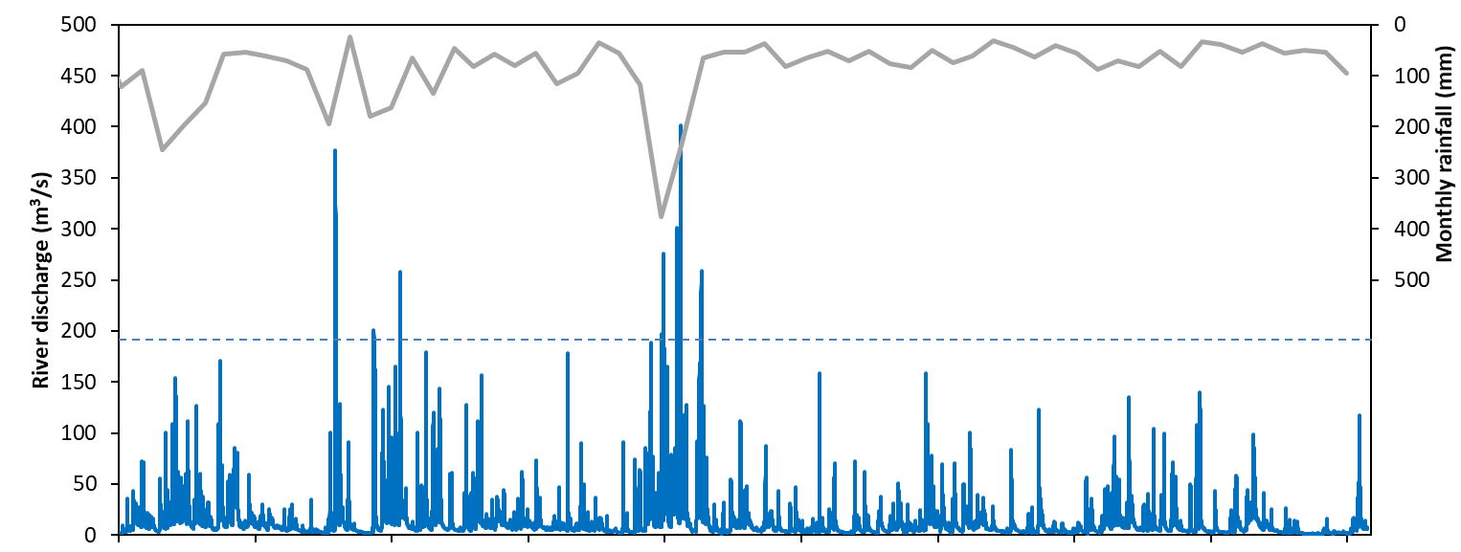
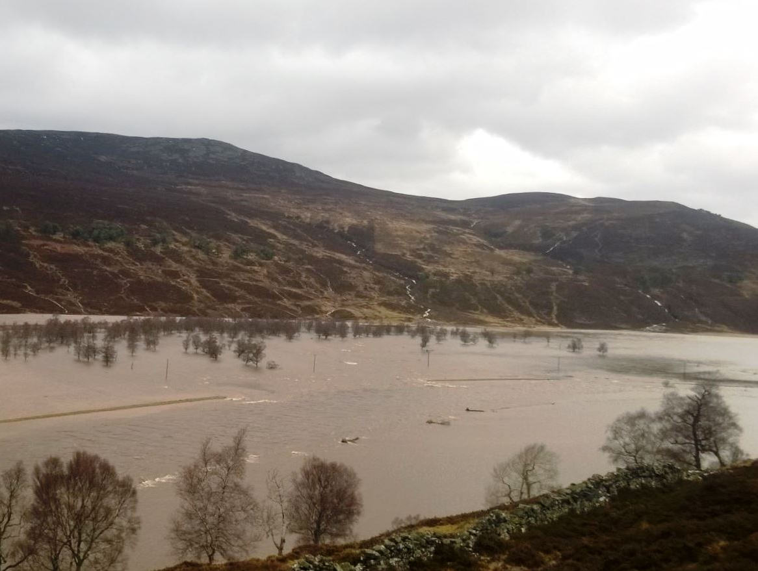
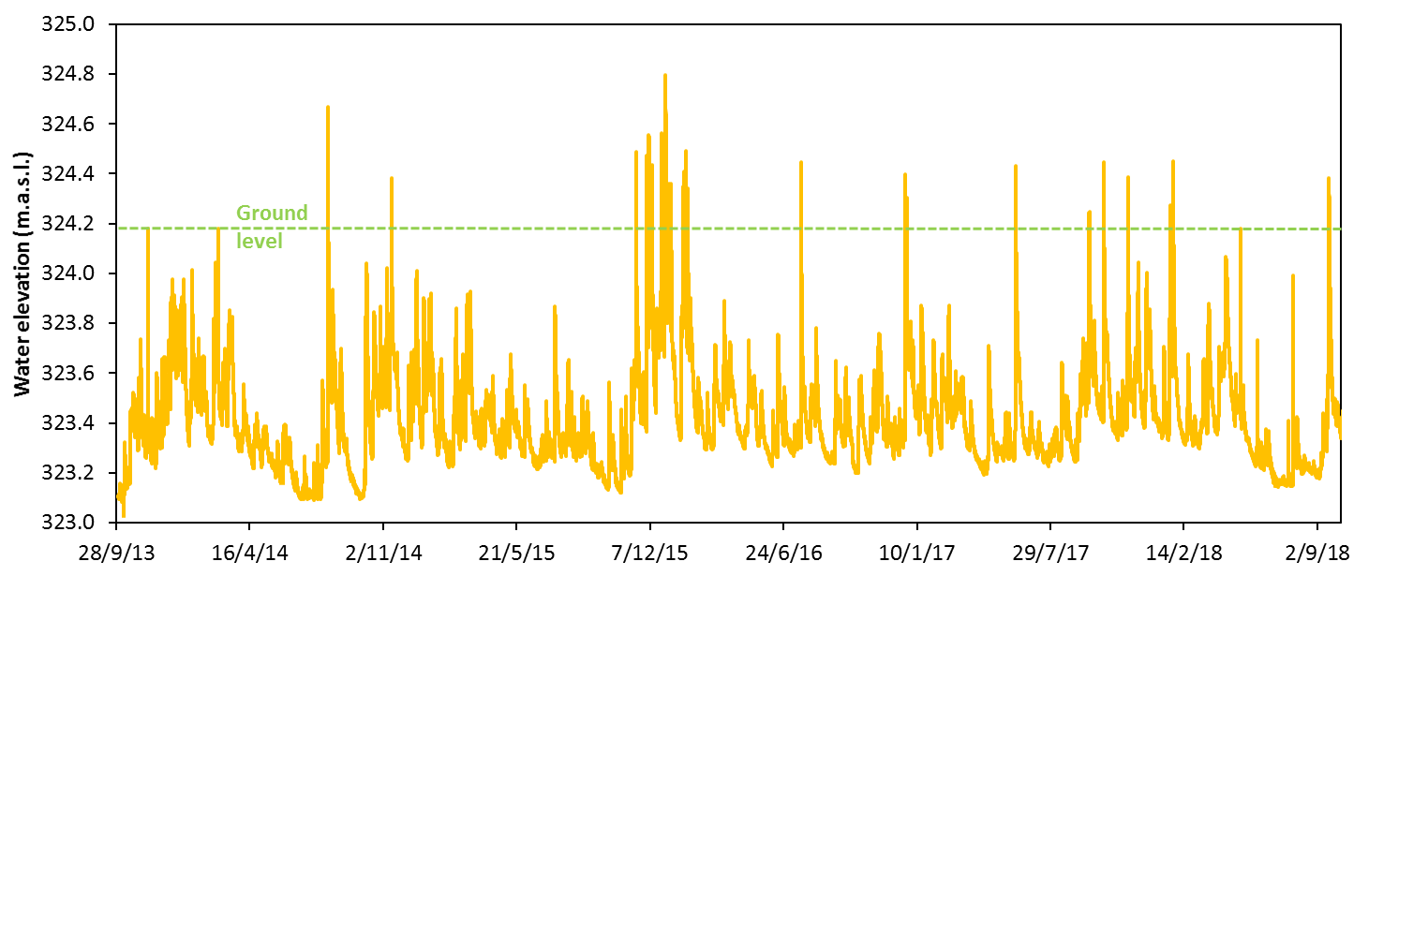
Hydrology (2013-2018)
30/12/2015 ‘Storm Frank’ (post-restoration)
RESTORATION
Median annual peak Q
Reconnection
site
ML2 (floodplain WL sensor)
Joanna Dick, River Dee Trust

Slide 7
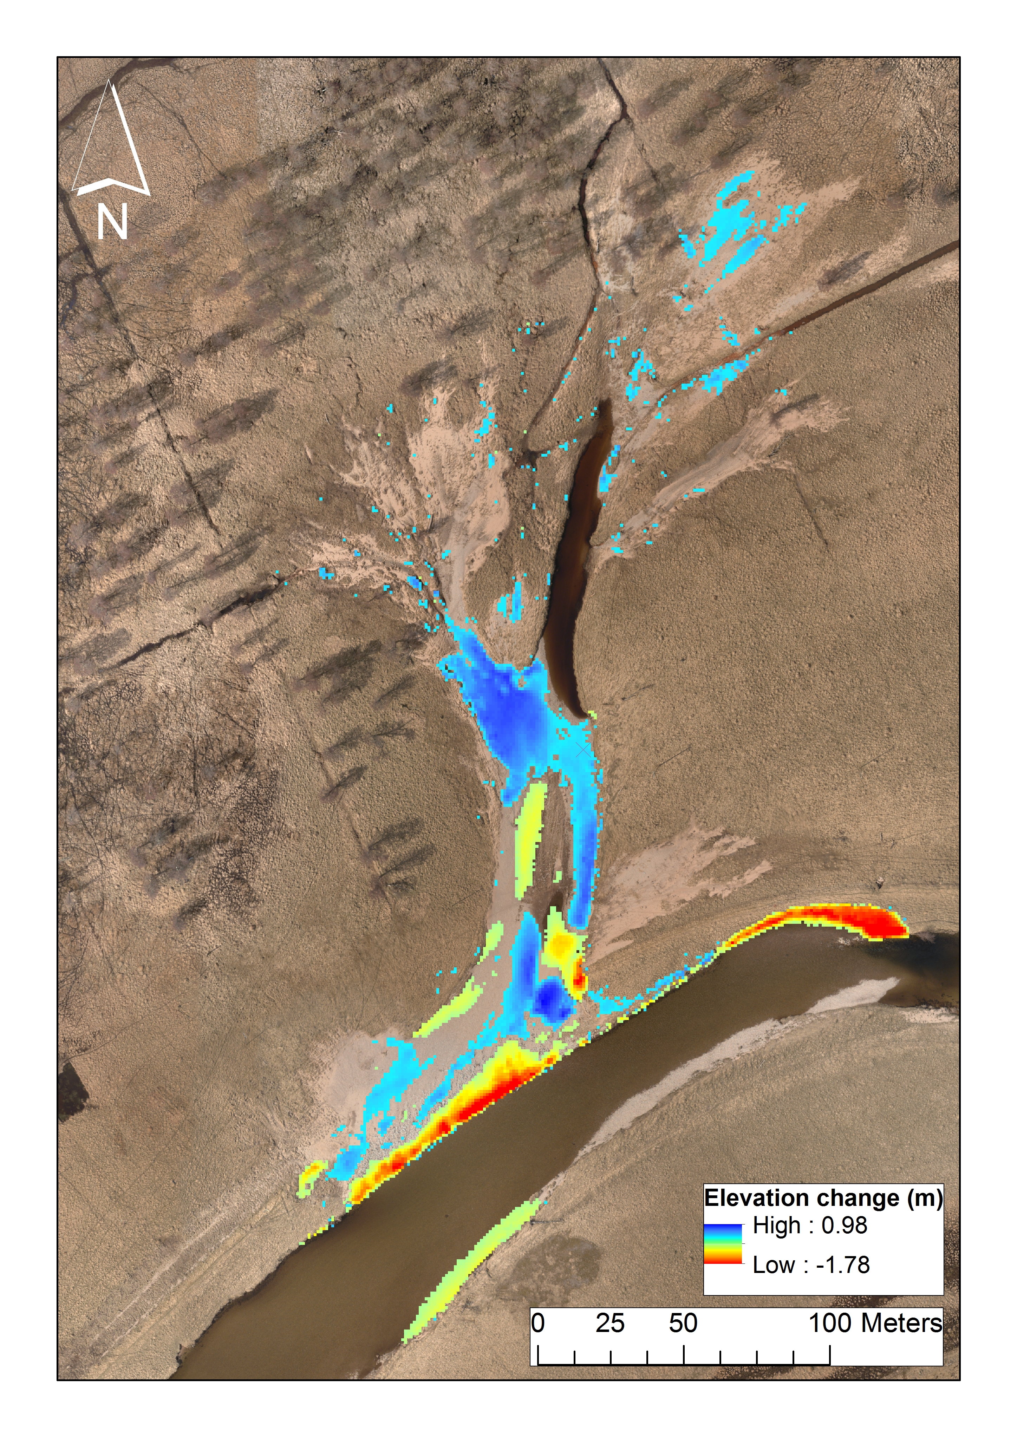
Morphological responses: floodplain & backwater
2014 (pre-restoration)
2016 (post-restoration)
2015-2018 Σ volumetric response: 477.2±24 m³
Δ Cross section area: -8.5 m² (-26%)

Slide 8
Morphological responses: channel
EMBANKMENT
2015-2018 Σ volumetric response: 1030±51 m³
ΔCross section: -5.4 m² (-13%)
XS

Slide 9
Floodplain hydrology annual responses
ML2
ML2 (floodplain WL sensor)
2013/2014 vs 2015/2016
Mann-Whitney U-test: p= 0.000

Slide 10
Event response magnitudes
ML1 (ditch)
ML2 (floodplain)
ML3 (backwater)
Distance
from river: 400 m 250 m 70 m

Slide 11
Event response times
ML1 (ditch)
ML2 (floodplain)
ML3 (backwater)
Distance
from river: 400 m 250 m 70 m

Slide 12
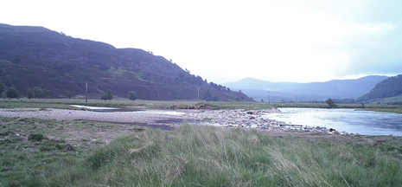
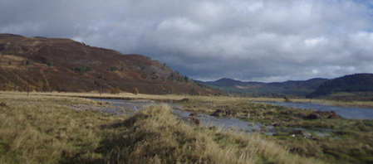
Overspill threshold
Period | Overspill floodplain discharge threshold (m³/s) | Bank threshold height (m.a.s.l.) | Overspill events N (post-restoration threshold) | Overspill events N (pre- restoration threshold)
Post-restoration (2015-2018) |  | 324.3 | 39 | 6
Pre-restoration (2013-2015) |  | 324.5 | 32 | 9
~40
~150

Slide 13
Conclusions
Post-restoration responses:
Channel aggradation, erosion of lowered embankment and development of a more natural shape.
Overspill threshold discharge for backwater connection is ~70% lower.
For a given discharge, overspill WSE is higher due to improved connectivity. Event response times are site-dependant.
Annual median water table levels were 4-9 cm higher despite lower annual median river flows.
Improved floodplain connectivity could affect floodplain hydro-ecology, maintain baseflows and attenuate moderate floods.

Slide 14
Thank you for your attention stephen.addy@hutton.ac.uk
Acknowledgements This study was funded by the Rural and Environmental Science and Analytical Services (RESAS) division of the Scottish Government. Mar Lodge Estate are thanked for access. SEPA supplied discharge and rainfall data. Numerous students and staff from the James Hutton Institute assisted with fieldwork. Restoration funded by EU Life Project: ‘Pearls in Peril’.

