Slide 1
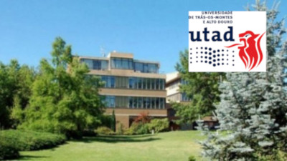
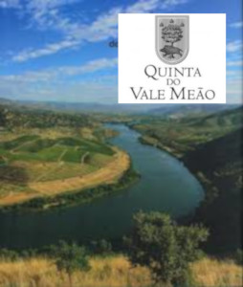
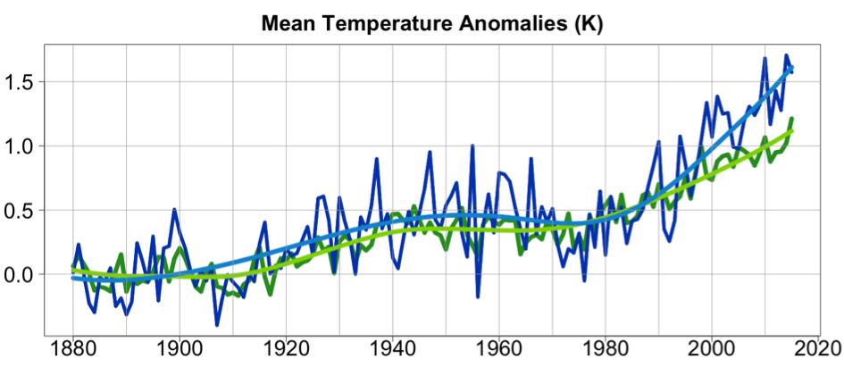
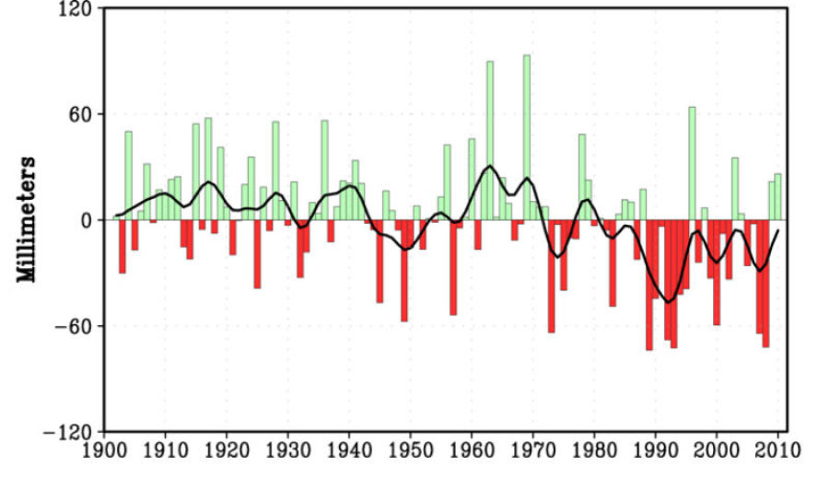
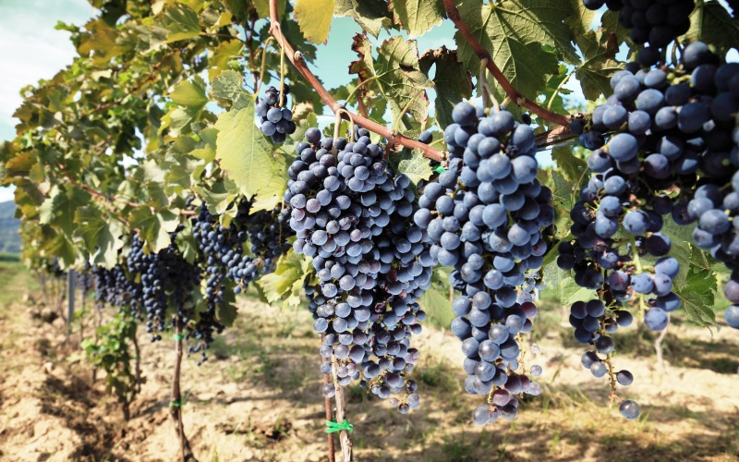
Increased Abiotic Stress and Vineyard Diminishing Production: Climate Change?
A Case Study
Manuel T. Oliveira
Pedro Barbosa
André Guedes
According to projections to a near future, the Mediterranean Basin will experience a shift in climatic conditions with tendency to
Higher temperatures
Lower and more erratic precipitation
http://www.medecc.org/?p=1086
Some agricultural systems are very vulnerable to changes in weather patterns
Viticulture is one of those systems
The most valuable grape varieties only thrive in more specific climates

Slide 2
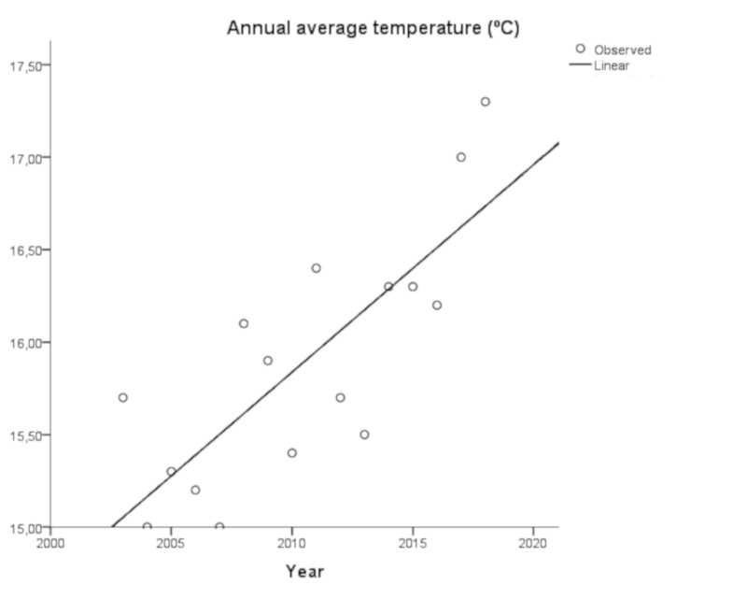
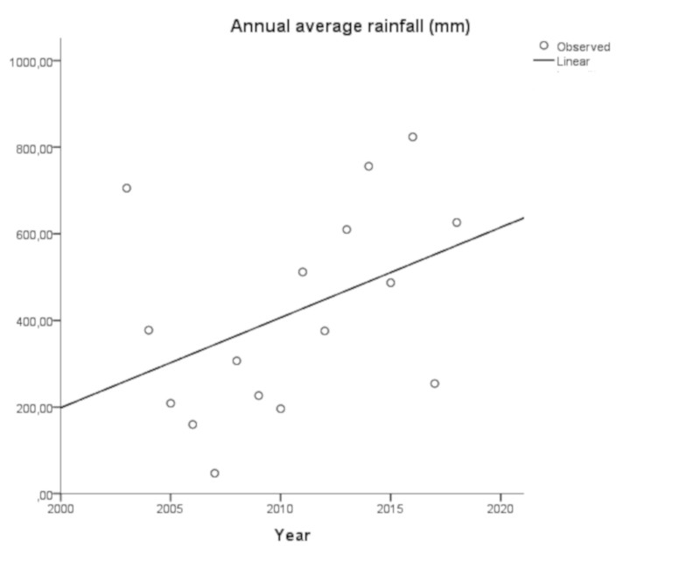
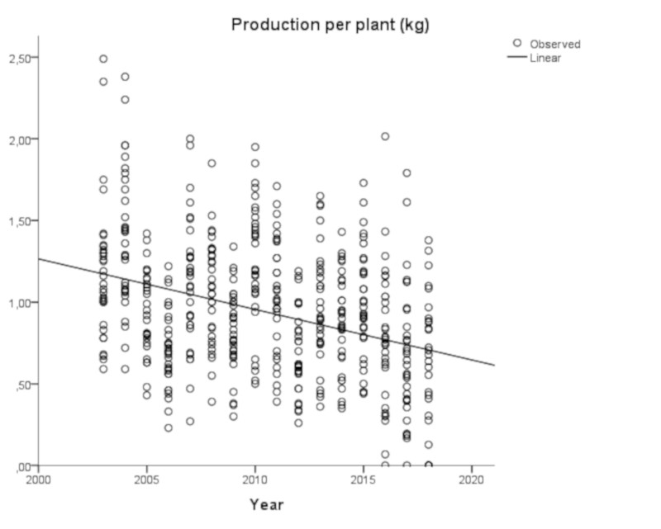
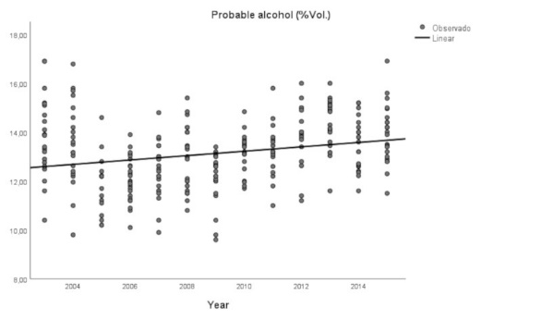
We analyzed a 15 years series of production, the probable alcohol and the pH of the most and compared them with the temperature and rainfall of the same period
Meteorological data from 2013 to 2018 in Alto Douro, Portugal, suggest a clear tendency for increasing temperatures in accordance to IPCC forecasts
The weather changes observed are statistically related to lower grapevine yields, higher sugar concentration and pH of the must
These alterations would be expected under the observed changes in meteorological conditions
Caution is advisable on reading the results given the short period of time covered by the observations.
There was more rainfall in the same period that is contrary to predictions
But the augmented rainfall is also coupled to what looks like more intensive precipitation events that are unfavorable to water infiltration and water soil storage

Slide 3
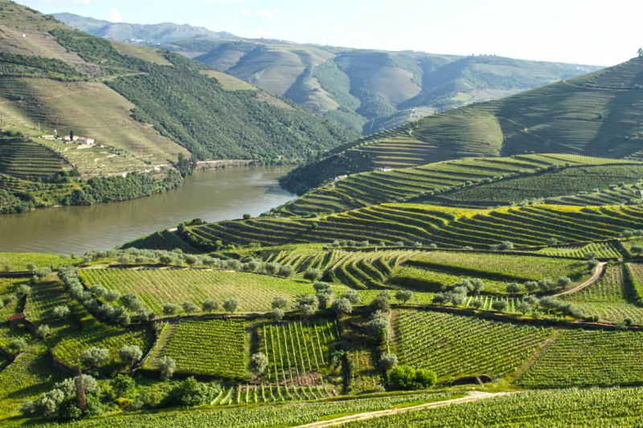
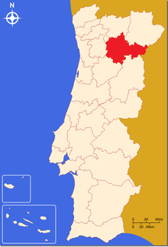
Douro Demarcated Region (DDR) where vineyards are monoculture systems over large areas, is strongly dependent on wine producing as the best known Port Wine but also high-end table wines
http://www.cruzeiros-douro.pt/pt/douro-blog/dicas
DDR, one of the oldest wine regions of the world, is located in Northeastern Portugal along the Douro river valley and its unique landscape and natural resources has been considered World Heritage by the UNESCO since 2001

Slide 4
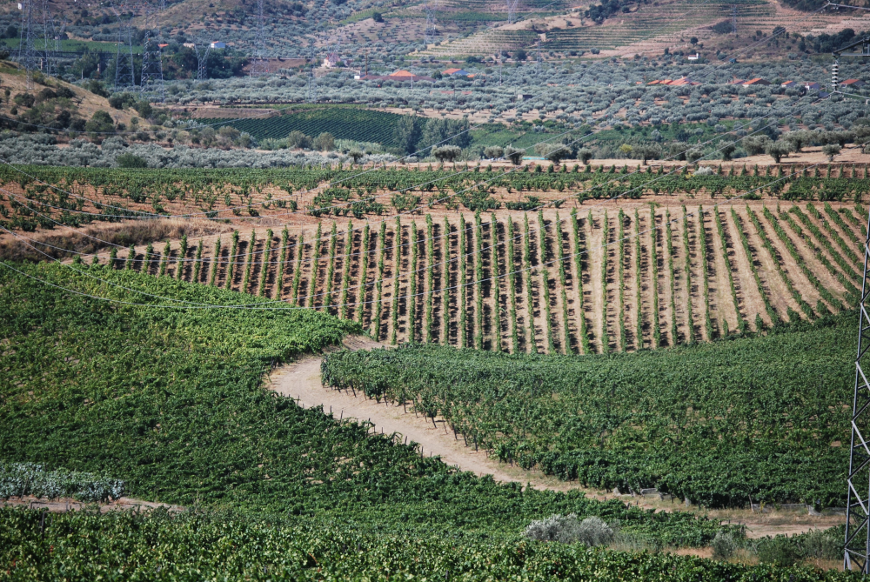
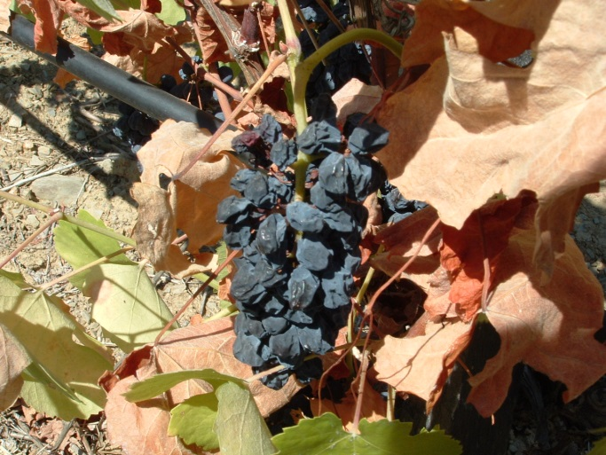
Both grape and wine production in the DDR suffers a strong inter-annual variability that is related to the prevailing meteorological conditions of each producing season
DDR, like most wine regions of the world, is located in a narrow latitudinal band with temperature during the growing season varies between 13 and 21ºC and most premium grape varieties have even narrower temperature adaptation
It is clear that warming will affect grapevine physiology and biochemistry and the production methods used to make wine will change too, thus, viticulture managers and wine producers must plant the more adaptable varieties and adopt mitigation methods to preserve their economic activity

Slide 5
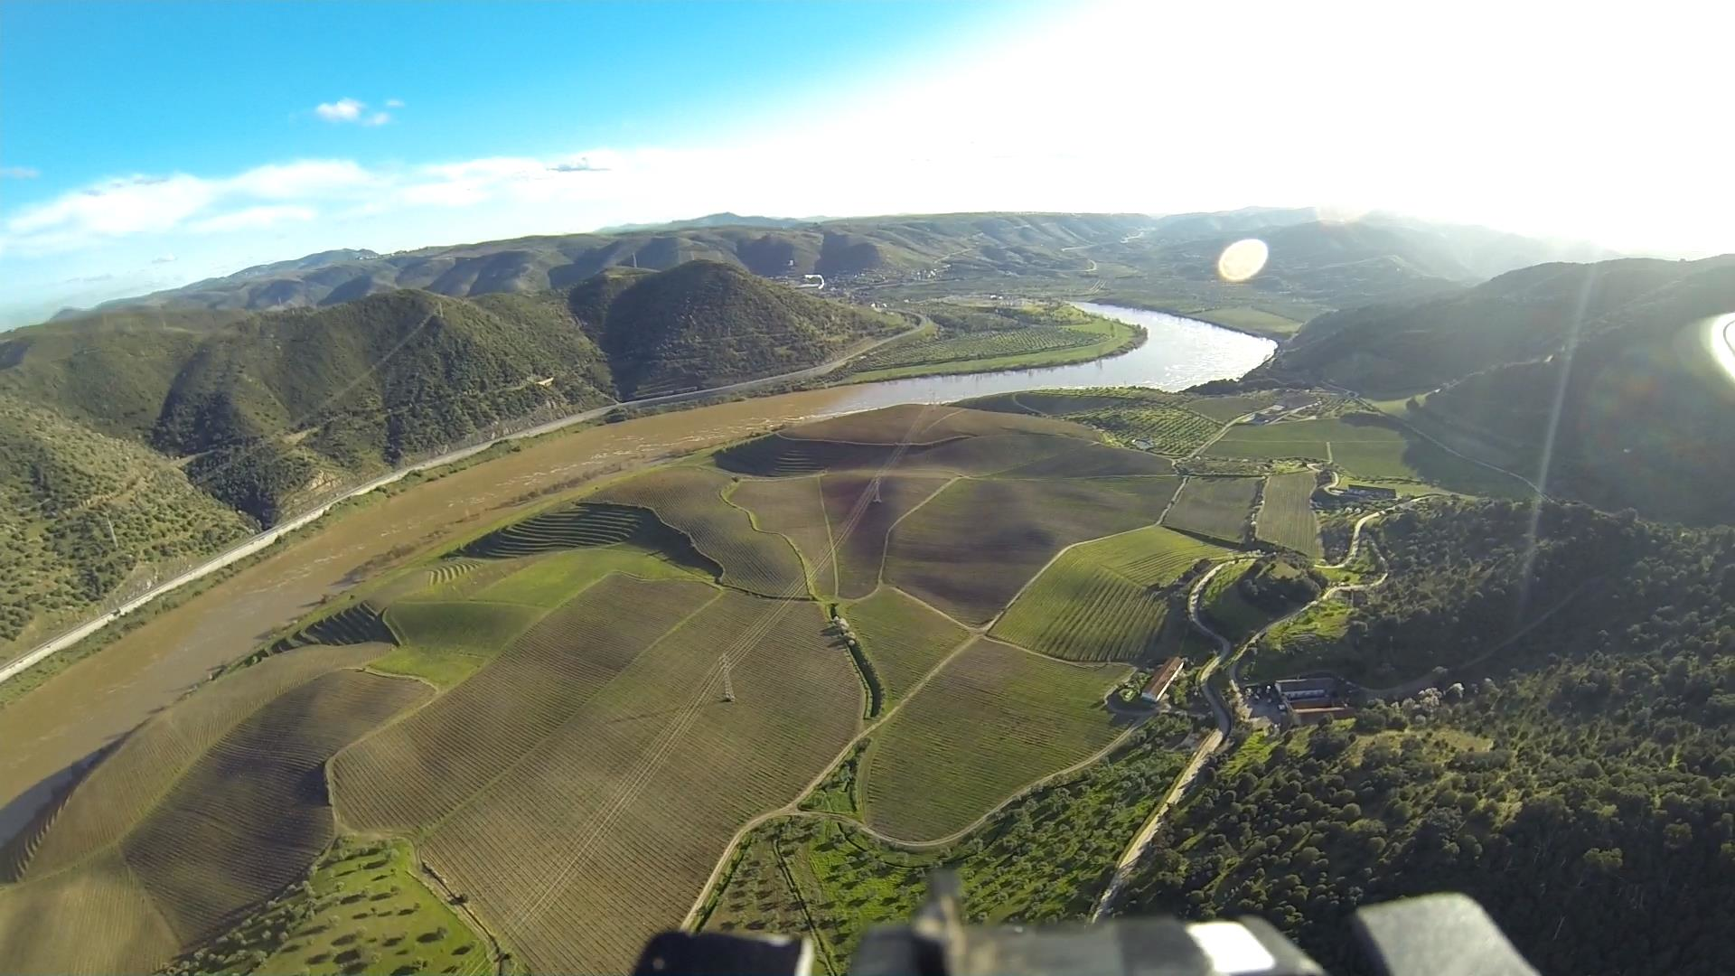
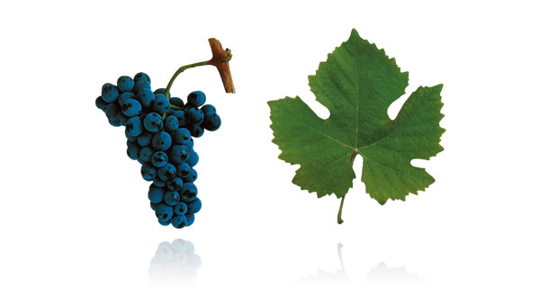
Quinta do Vale Meão
The production data of a 100 ha farm and top quality wine producer located in DDR was followed for 15 years
The temperature and precipitation of the same period was paired with the production
The grape varieties planted were all autochthonous from Portugal or Spain:
Touriga Nacional
Touriga Franca
Tinta Roriz
Tinto Cão
Tinta Amarela
Tinta Francisca
Tinta Barroca

Slide 6
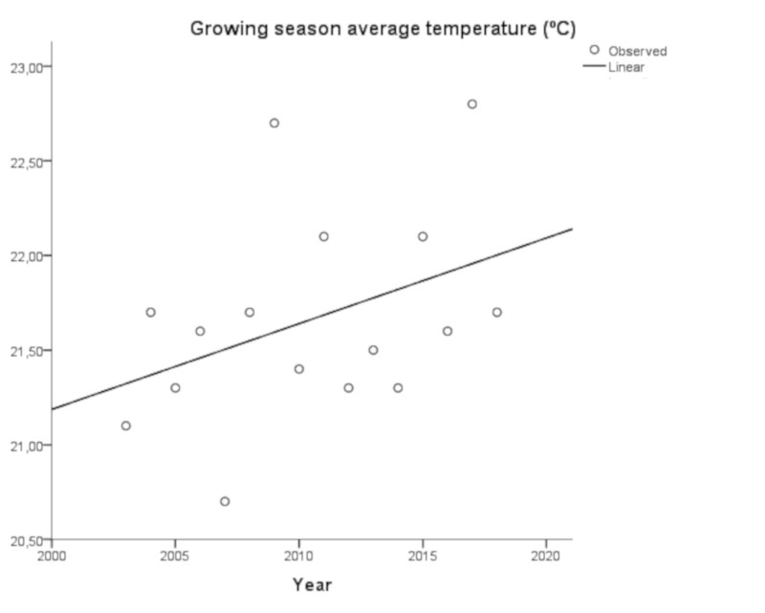
The annual average temperature and the average for the growing season show a tendency for a steady rise
The increasing rate of annual temperature of about 2 ºC in 15 years is far higher than the rate mentioned by IPCC that such increase should be reached sometime in 2050
The average temperature for the growing season (Abril to September) has been well above 21ºC, considered the upper limit for producing high quality wines

Slide 7
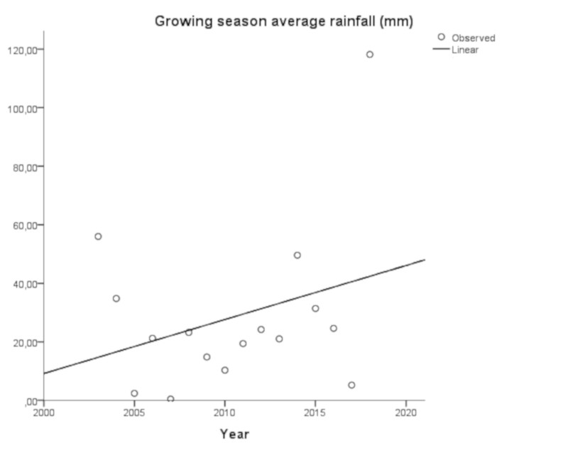
Rainfall, on other hand, is predicted to decrease but that has not been verified
The irregularity of rainfall shown is typical of Mediterranean areas

Slide 8
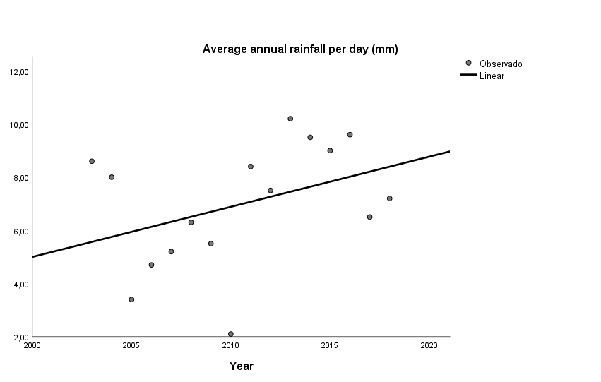
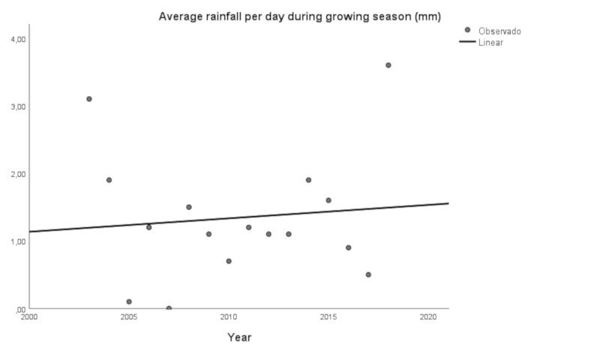
Both annual and growing season trends show an augmenting in precipitation but the amount of rain per precipitation event is also increasing
Both annual and growing season trends show an augmenting in precipitation but the amount of rain per precipitation event is also increasing a phenomenon that favors runoff at expense of water infiltration and soil water storage

Slide 9
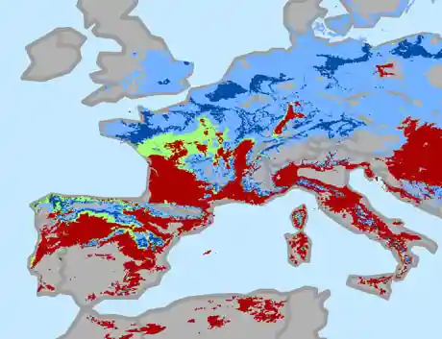
Rising temperatures can increase grapevines yields in cooler regions like the Northern Europe but in regions already warm and that may also experience lower soil water availability the tendency is to reduced yields
https://www.theguardian.com/environment/2013/apr/08/climate-change-wine-production

Slide 10
Grape production per plant is falling for all varieties but interaction between variety production and years is not significative
Tinto Cão and Tinta Amarela are the least productive with a 15 years average of 0.82 and 0.84 kg plant⁻¹, respectively
Touriga Franca and Tinta Roriz 0.93 and 0.94 kg plant⁻¹, respectively
The most productive are Touriga Nacional and Tinta Barroca, both 1 kg plant⁻¹
The effect of temperature on yield is cultivar dependent

Slide 11
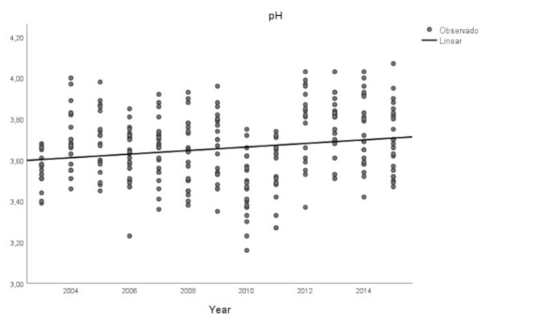
Warmer weather, in particular during the growing season, will have a profound effect upon the berry composition
Berries produced under rising temperatures will increase the sugar concentration and pH but with lower acidity as organic acids degrade rapidly, thus wines will have higher alcohol content unbalanced with their acidity, and higher pH augments the risk of spoilage and organoleptic degradation

Slide 12
Conclusions
Meteorological data from 2013 to 2018 in Alto Douro, Portugal, suggest a clear tendency for increasing temperatures in accordance to IPCC forecasts but more rainfall in the same period that is contrary to predictions. But the augmented rainfall is also coupled to what looks like more intensive precipitation events that are unfavorable to water infiltration and water soil storage
The weather changes observed are statistically related to lower grapevine yields, higher sugar concentration and pH of the must. These alterations would be expected under the observed changes in meteorological conditions
Nevertheless, caution is advisable on reading the results given the short period of time covered by the observations

Slide 13
THANK YOU
FOR ATTENDING THIS PRESENTATION
That was possible by the support of
Olazabal & Sons, Quinta do Vale Meão
UTAD - CITAB
Download this presentation and click below to get a PDF
Get a PDF document – Complete Report

Slide 15
Warming of the atmosphere (annual mean temperature anomalies with respect to the period 1880-1899), in the Mediterranean Basin (blue lines, with and without smoothing) and for the globe (green line). In the Mediterranean region, average annual temperatures are now 1.4 °C higher than during the period 1880-1899, well above current global warming trends. Data from Berkeley Earth available at http://berkeleyearth.org/
http://www.medecc.org/?p=1086

Slide 16
Winter precipitation trends in the Mediterranean region for the period 1902 - 2010. Credit: NOAA
https://www.sciencedaily.com/releases/2011/10/111028115342.htm

Slide 17
Annual average temperature from 2003 to 2018. Alto Douro, DDR

Slide 18
Annual average growing season temperature from 2003 to 2018. Alto Douro, DDR

Slide 19
Production per plant, all varieties from 2003 to 2015. Alto Douro, DDR

Slide 20
Probable alcohol, all varieties from 2003 to 2015. Alto Douro, DDR

Slide 21
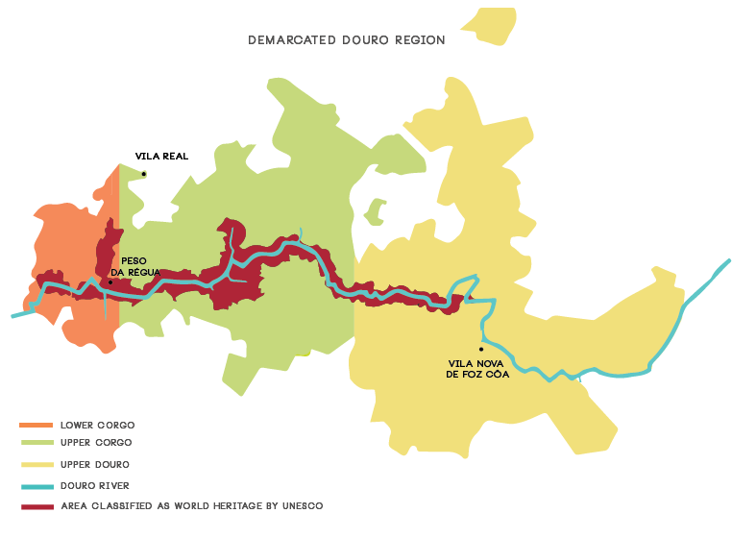
http://www.nlcwines.com/our-portugal-1

