Slide 1


Public outreach for the EC
Carbon-14 Source Term project
Name: Erika Neeft & Simon Norris
Organisation: COVRA & RWM
Date: 8 April 2019

Slide 2
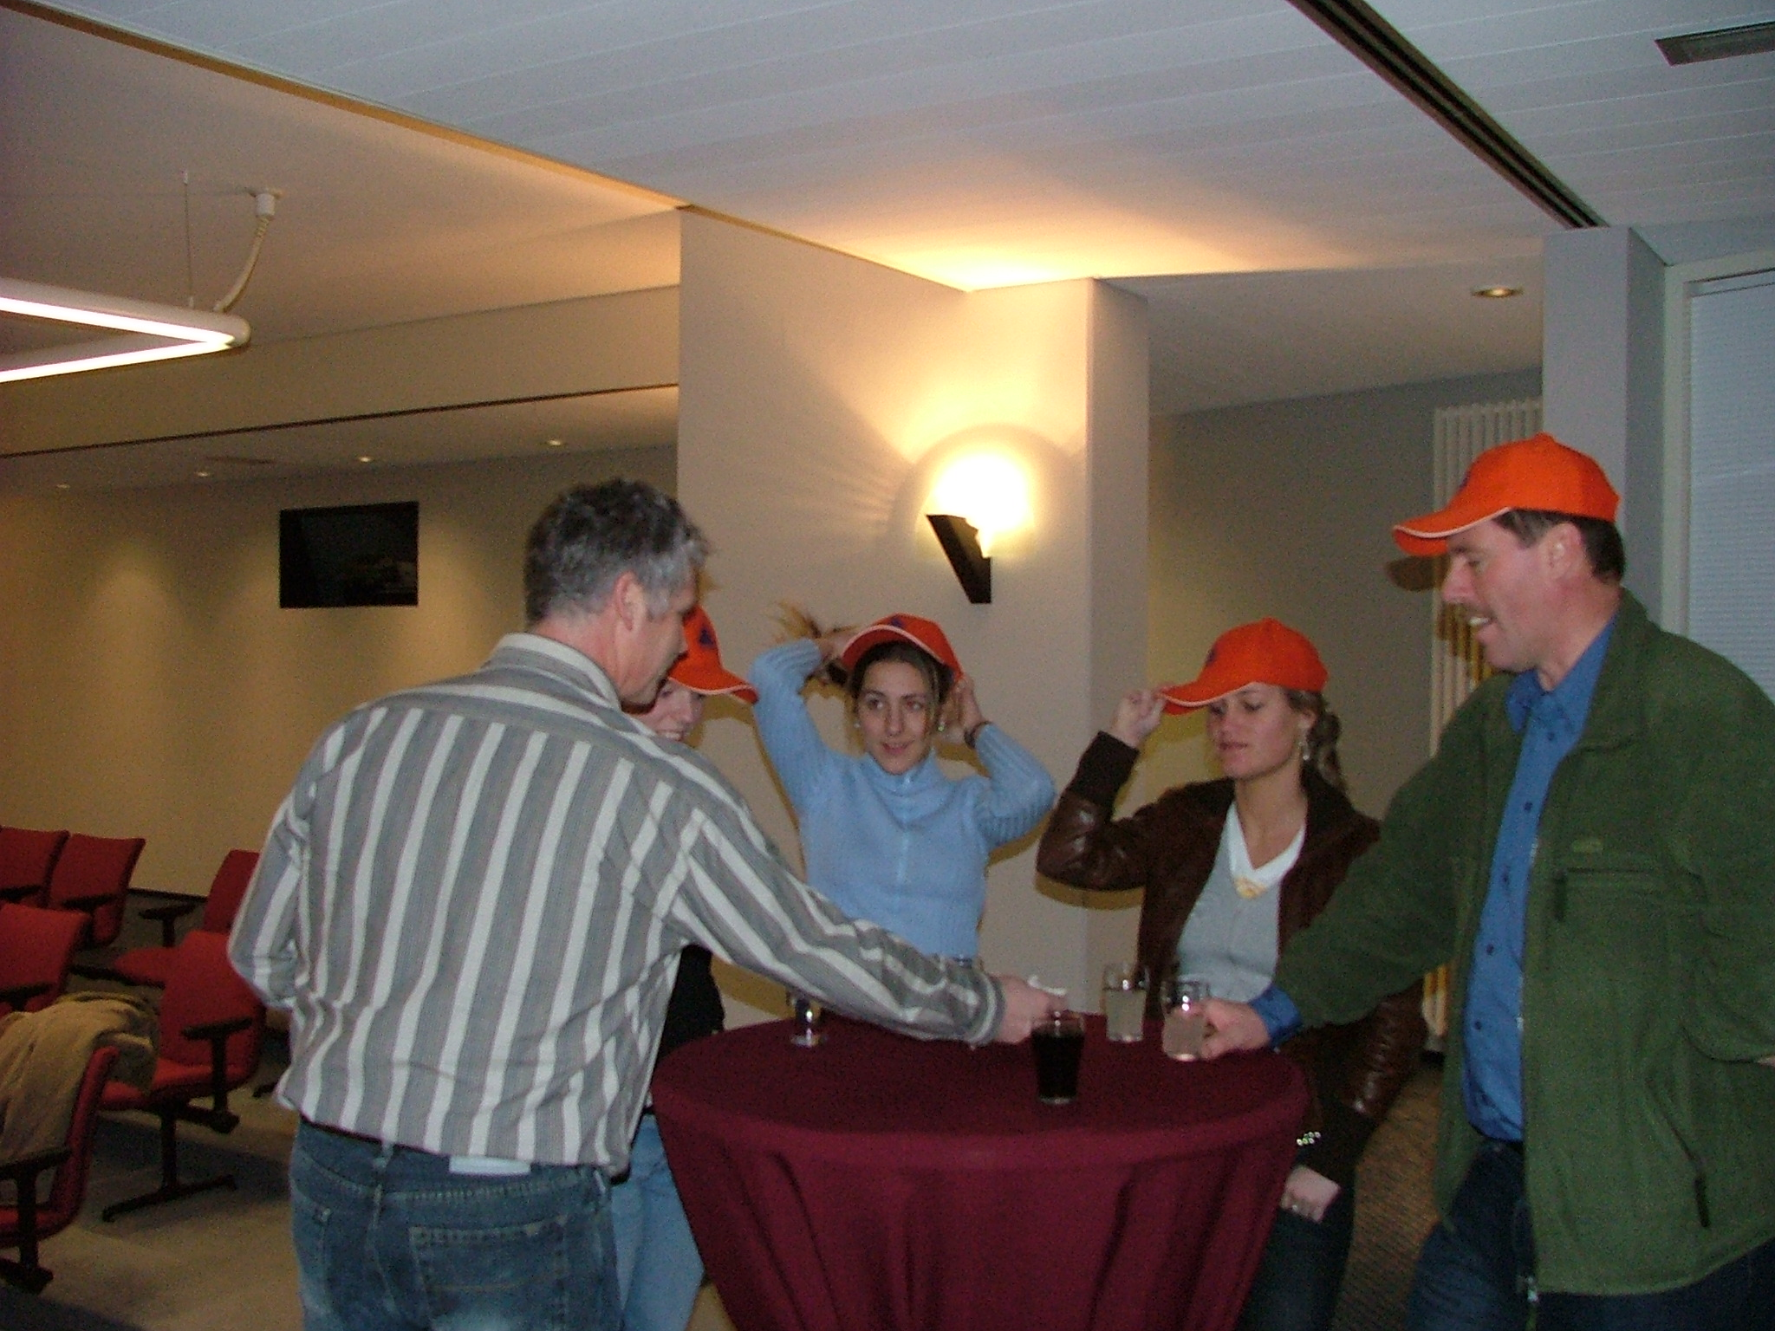
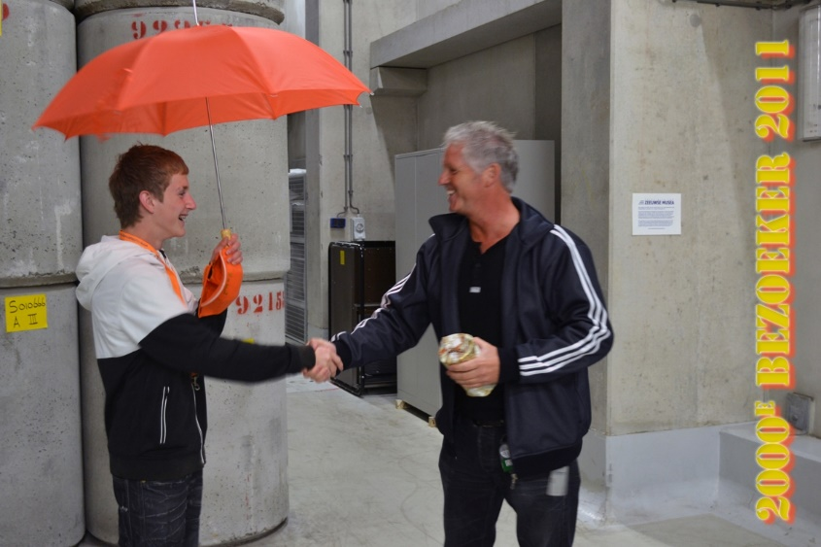
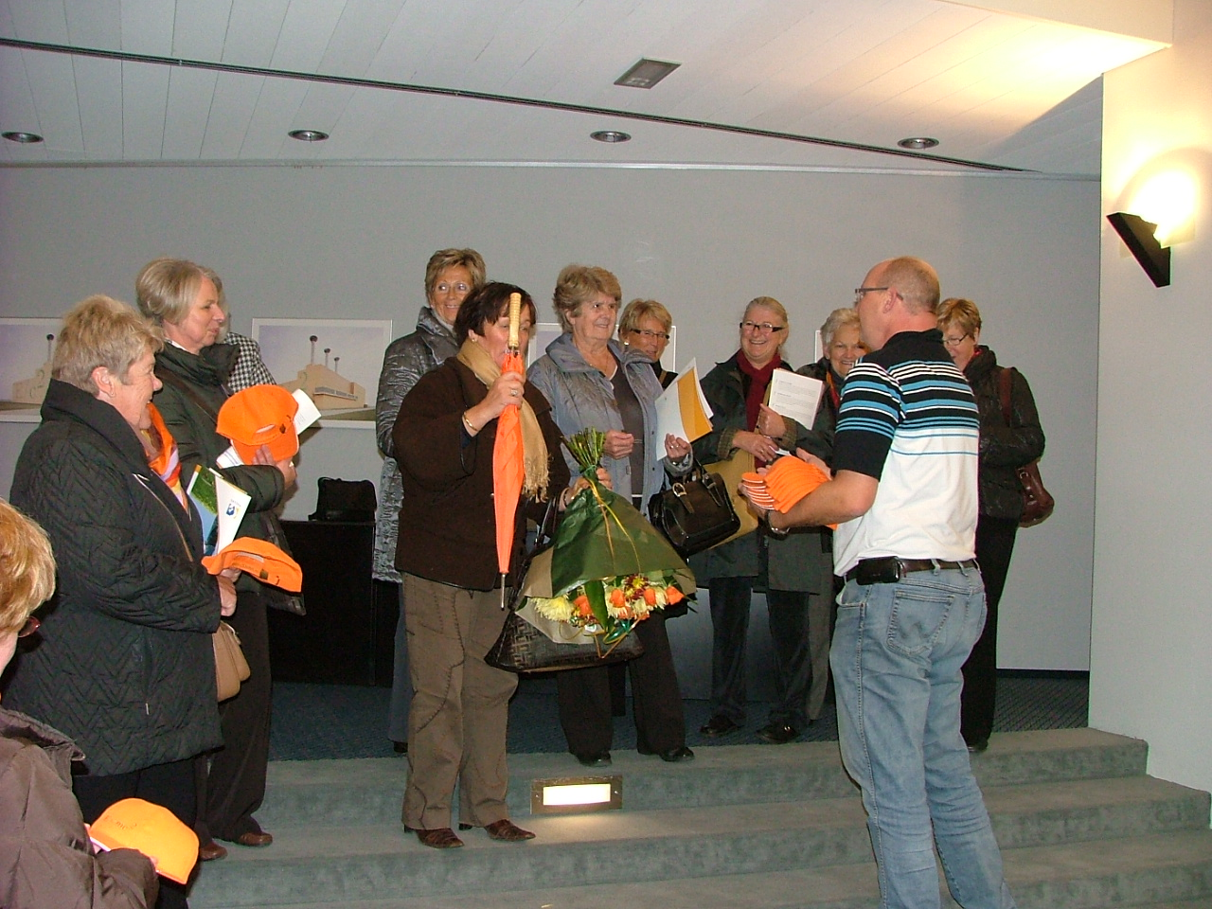

Slide 3
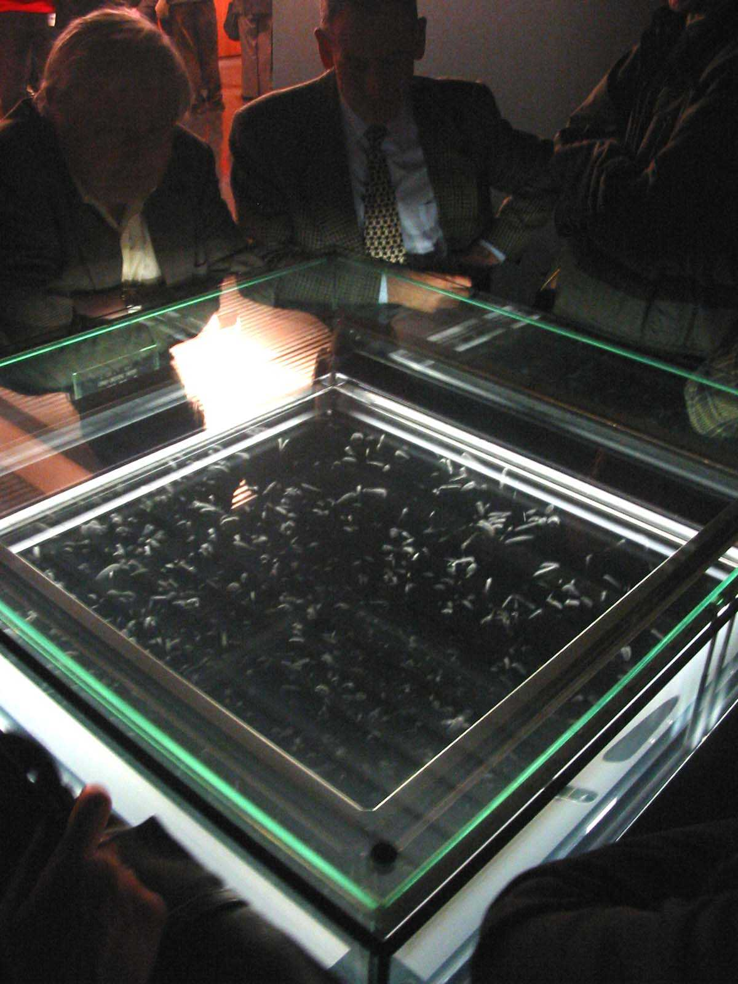
Familiarisation
Radiation?
Not only radioactive waste
Carbon-14?
Not only radioactive waste

Slide 4
Newsletters
Audience: Public
  No knowledge concerning radiation protection
  Unfamiliar to carbon-14 containing waste
Dissemination plan
  Topics based on scheduled publications
    A3 infographic each Newsletter
    With a carbon-14 analogue of cosmic origin

Slide 5
Aim
CAST (Carbon-14 Source Term) was an EU research project that aimed to develop understanding of the potential release of carbon-14 from radioactive waste materials under conditions relevant to waste packaging and disposal to underground geological disposal facilities. The project focussed on the release of carbon-14 as dissolved and gaseous species from irradiated metals (steels, Zircaloys), irradiated graphite and spent ion-exchange resins.

Slide 6
Generation of carbon -14
Visualization of EU research project in one picture,
origin of carbon-14 for the types of waste investigated in CAST

Slide 7
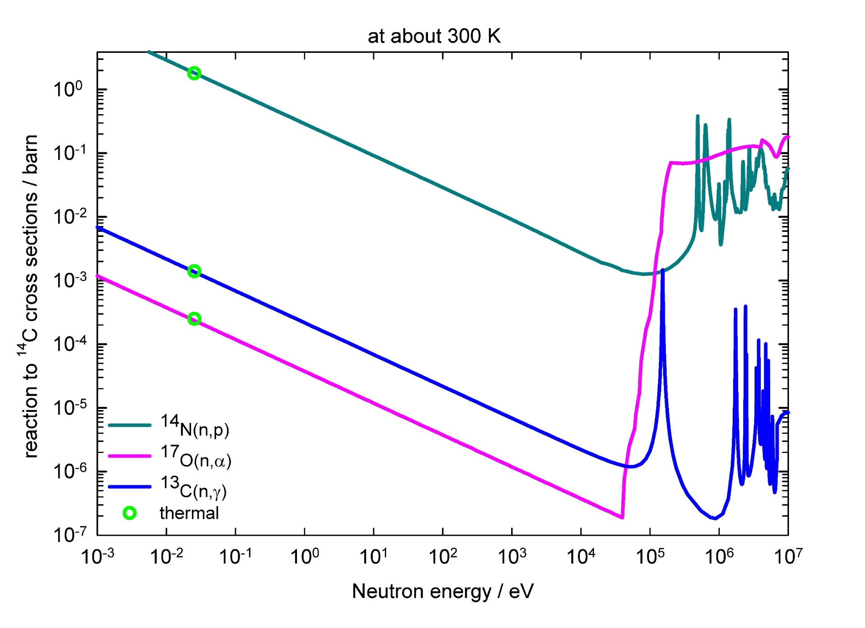
Generation of carbon -14
σ + natural abundance ⇨ 10,000 times C and 10,000,000 times O

Slide 8
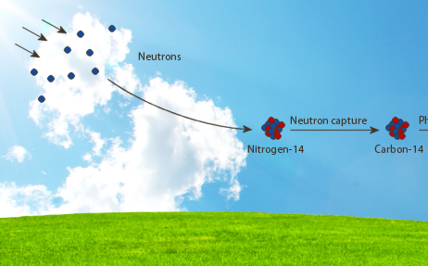
Generation of carbon-14
Natural carbon-14
80% nitrogen
environmental neutron flux: 0.001 neutrons per cm² per s
Artificial carbon-14
nitrogen in ppm in materials
Thermal neutron flux in core NPP: 100,000,000,000,000 neutrons per cm² per s
Carbon-14 concentrations in waste larger than 1 Bq per gram

Slide 9
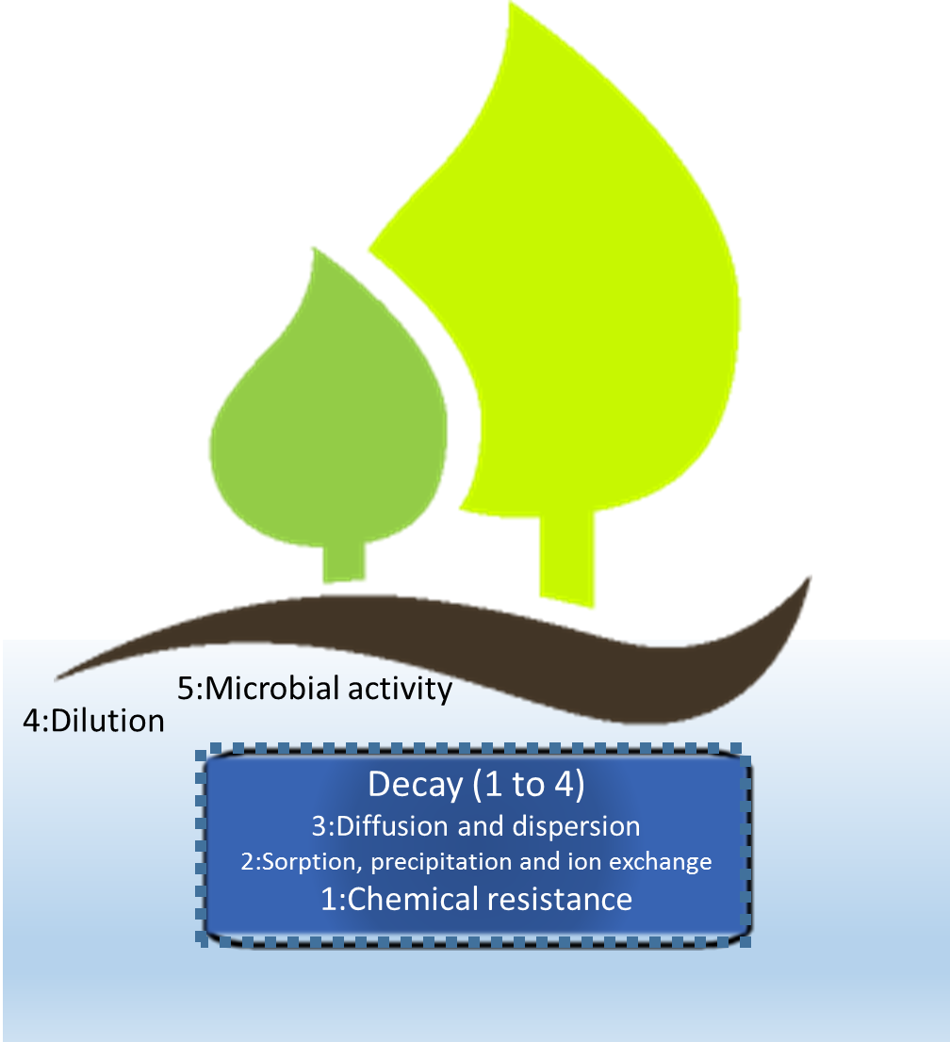
Release of carbon-14
5: Any reduced carbon species will be oxidised to carbon dioxide by microbes
4: A common value for dilution for geological disposal is 10,000
3: E.g. period to pass clay or salt host rock may take several half-lives of carbon-14
2: carbon-14 release as gas, non-ionic or anionic dissolved carbon-14 species
1: Chemical corrosion rates for steel and Zircaloy are small in alkaline, reducing environments
1: No chemical degradation rate for graphite and ion exchange resins

Slide 10
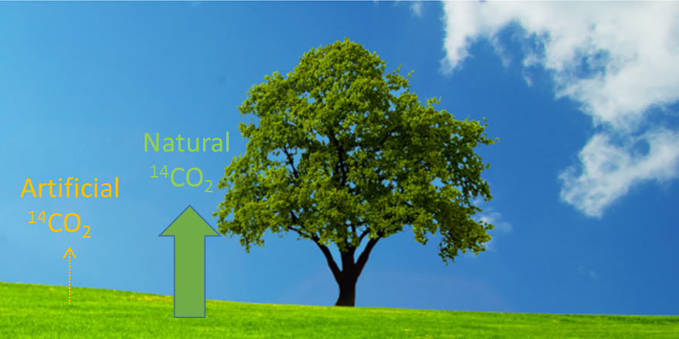
Comparison
Natural: 1,000,000,000 carbon-14 molecules per cm² per year
Artificial if chemical resistance waste form, diffusion clay host rock
and dilution in surrouding rock formations are included

Slide 11
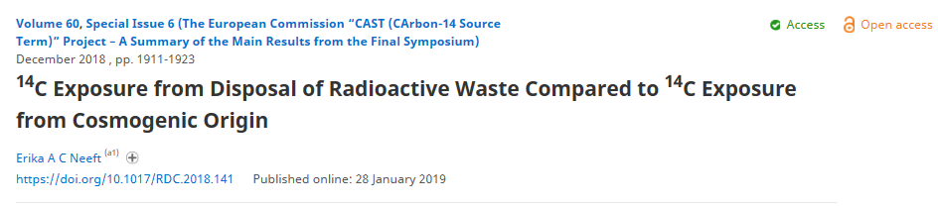
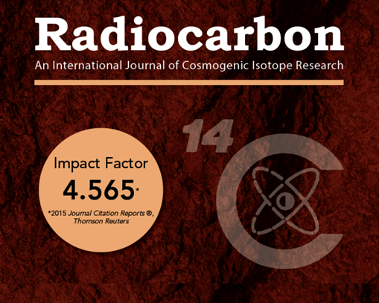
Public outreach for CAST
Newsletters and other CAST deliverables can be downloaded at https://www.projectcast.eu until March 2023
References and justification of assumptions used in this presentation:
Thank you for your attention
Any questions?

