Slide 1
Alison Prior & Prof. Iain-Colin Prentice
Evapotranspiration: The Invisible Water Source
Coupling the Carbon & Water Cycles
01
Invisible Water
02
Today’s ET Models
03
The Plant Perspective
04
Initial Results
05
Learn More
Evaporation & transpiration are critical parts of the water cycle
Source: NASA JPL, 2019

Slide 2
Alison Prior & Prof. Iain-Colin Prentice
Evapotranspiration: A Need for Reliable Data
Coupling the Carbon & Water Cycles
ALEXI
CMRSET
SSEBop
MODIS
01
Invisible Water
02
Today’s ET Models
Variation in satellite-based ET estimates in the Mékrou River Basin, Niger tributary, Africa Source: A. Prior (2016). Masters Thesis.
03
The Plant Perspective
Total ET Error: 35 - 49% r²: 0.61 - 0.75
Transpiration Error: 54 - 114%, r²: 0.33 - 0.55
Evaporation Error: 90 - 114%, r²: 0.14 - 0.25
Interception Error: 62 - 181%, r²: 0.39 - 0.85
04
Initial Results
05
Learn More
Global error in satellite-based ET estimates against Source: Talsma et al. (2018) DOI: 10.1016/j.agrformet.2018.05.010

Slide 3
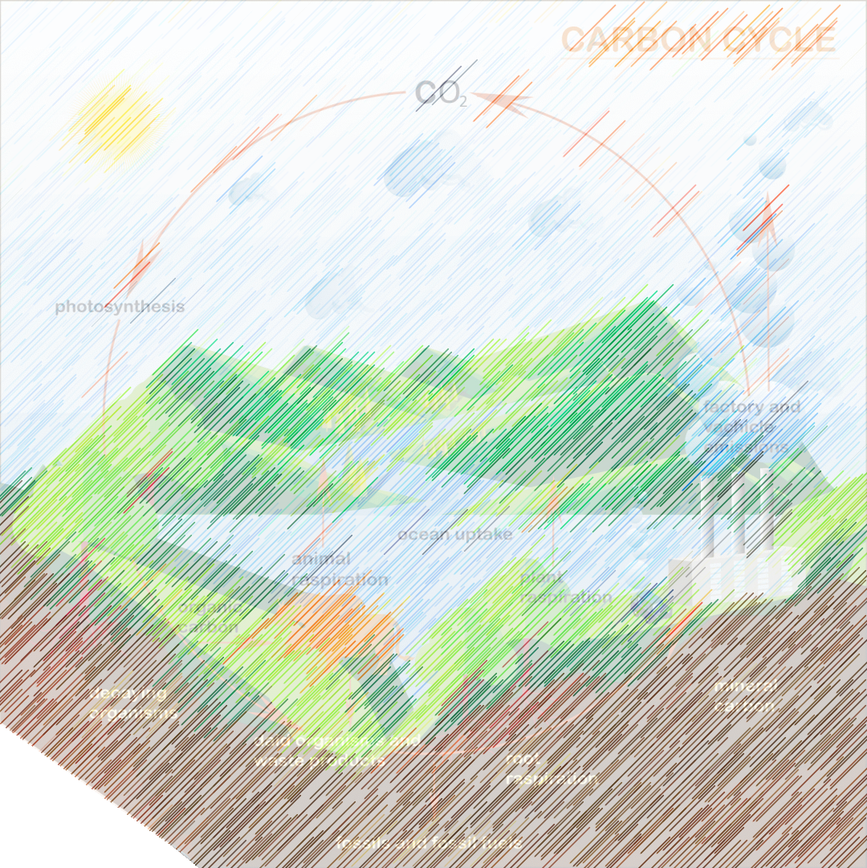
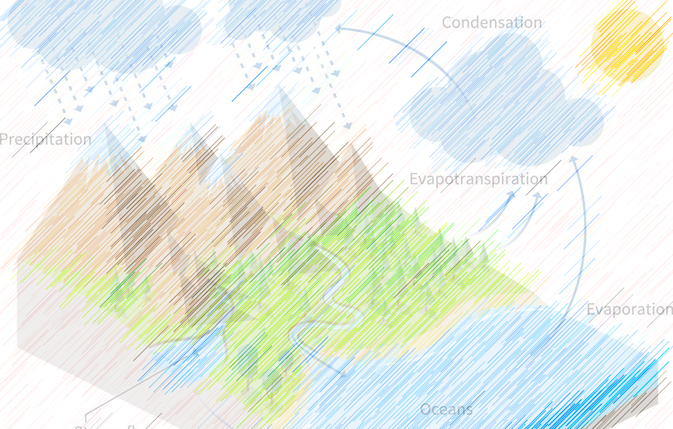
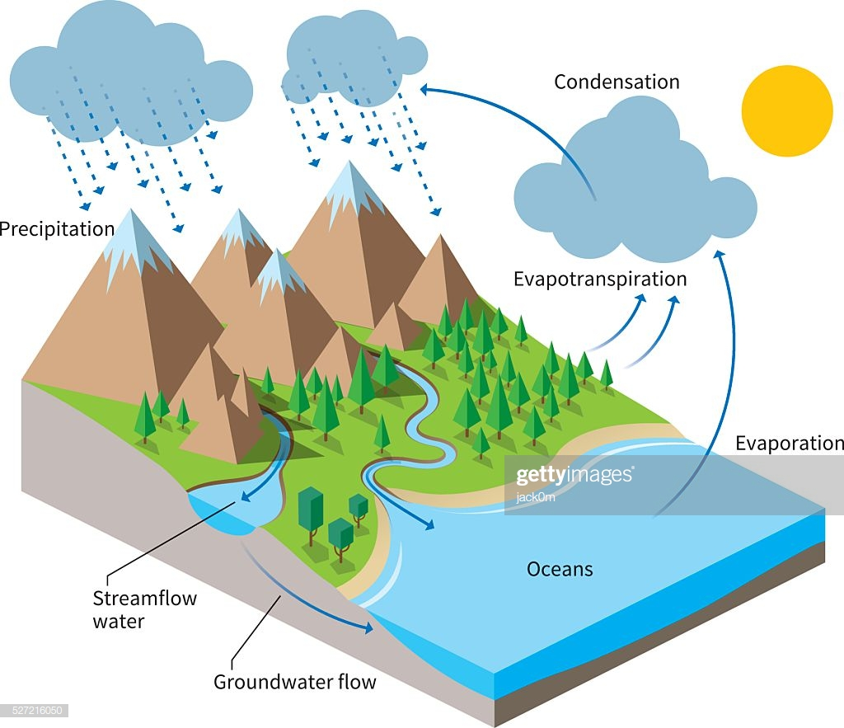
Alison Prior & Prof. Iain-Colin Prentice
Plants: Exchanging Carbon & Water
Coupling the Carbon & Water Cycles
01
Invisible Water
02
Today’s ET Models
03
The Plant Perspective
04
Initial Results
05
Learn More
Click ‘next’ or tap screen to see more!

Slide 4
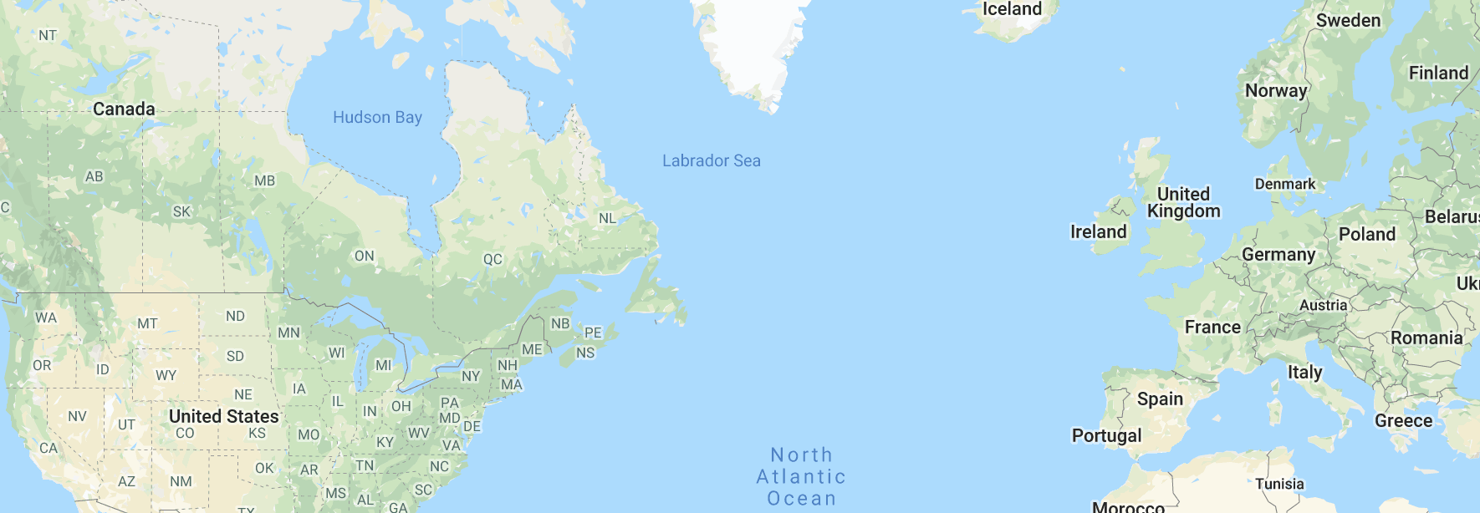
Alison Prior & Prof. Iain-Colin Prentice
A Coupled Model: Initial GPP & Transpiration Results
Coupling the Carbon & Water Cycles
Tap & Explore! Model Test Sites
01
Invisible Water
02
Today’s ET Models
Initial Results
03
The Plant Perspective
Transpiration
GPP
Average daily transpiration estimates (mm) for all displayed sites for the period 2002 to 2012 showing [a] annual variation for the period and [b] seasonality.
Daily GPP estimates for all displayed sites for the period 2002 to 2012.
04
Initial Results
05
Learn More

Slide 5
Learn More about this research!
Alison Prior & Prof. Iain-Colin Prentice
PICO Screen 5b.3
Coupling the Carbon & Water Cycles
More information about the P model
Next steps in this research
Limitations
Preliminary results: Simultaneous prediction of Transpiration (T) & Global Primary Production (GPP)
The P Model Team
01
Invisible Water
02
Today’s ET Models
03
The Plant Perspective
04
Initial Results
05
Learn More

Slide 6
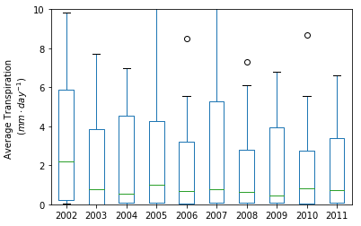
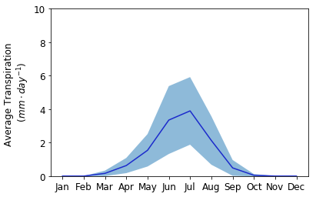
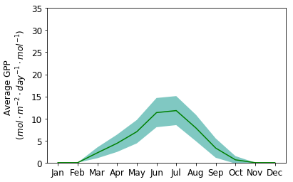
Alison Prior & Prof. Iain-Colin Prentice
A Coupled Model: Initial GPP & Transpiration Results
Coupling the Carbon & Water Cycles
Site Information
Tap & Explore! Model Test Sites
“FI-Hyy” | Hyytiala, Finland
Elevation: | 185 m
Landuse: | Evergreen Needleleaf Forest
Period: | 2002 - 2012
Initial Transpiration & GPP calculations complete
USA
Validated against FLUXNET latent heat flux (converted to ET)
Transpiration too high. Input data needs pre-formatting.
01
Invisible Water
GPP: LOW
Calculation time step to be reviewed. Consider soil moisture effects.
Transpiration: MEDIUM
02
Today’s ET Models
Initial Results
03
The Plant Perspective
Transpiration
GPP
Average daily transpiration estimates (mm) for Finland’s Hyytiala FLUXNET site for the period 2002 to 2012 showing [a] annual variation and [b] seasonality.
Average daily GPP estimates at Hyytalia for the period 2002 to 2012.
04
Initial Results
05
Learn More

Slide 7
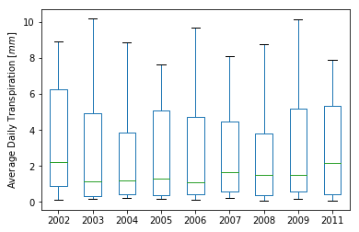
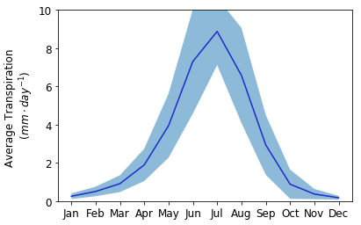
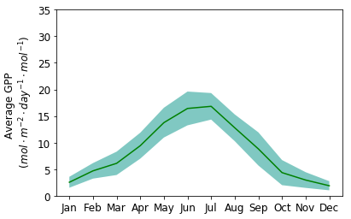
Alison Prior & Prof. Iain-Colin Prentice
A Coupled Model: Initial GPP & Transpiration Results
Coupling the Carbon & Water Cycles
Site Information
Tap & Explore! Model Test Sites
“FR-Pue” | Puechabon, France
Elevation: | 211 m
Landuse: | Mixed Forests
Period: | 2002 - 2012
Initial Transpiration & GPP calculations complete
USA
Validated against FLUXNET latent heat flux (converted to ET)
Transpiration too high. Input data needs pre-formatting.
01
Invisible Water
GPP: MEDIUM
Calculation time step to be reviewed. Consider soil moisture effects.
Transpiration: HIGH
02
Today’s ET Models
Initial Results
03
The Plant Perspective
Transpiration
GPP
Average daily transpiration estimates (mm) for France’s Puechabon FLUXNET site for the period 2002 to 2012 showing [a] annual variation and [b] seasonality.
Average daily GPP estimates at Puechabon for the period 2002 - 2012.
04
Initial Results
05
Learn More

Slide 8
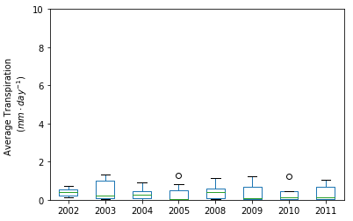
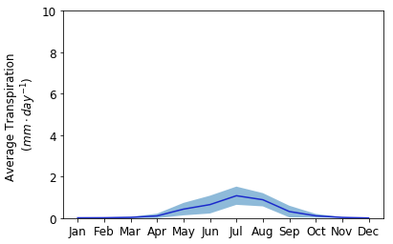
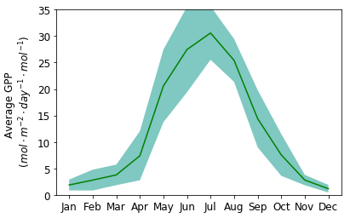
Alison Prior & Prof. Iain-Colin Prentice
A Coupled Model: Initial GPP & Transpiration Results
Coupling the Carbon & Water Cycles
Site Information
Tap & Explore! Model Test Sites
“IT-Col” | Collelongo, Italy
Elevation: | 1,645 m
Landuse: | Deciduous Broadleaf Forest
Period: | 2002 - 2012
Initial Transpiration & GPP calculations complete
USA
Validated against FLUXNET latent heat flux (converted to ET)
GPP too high (compared with obs). Input data needs pre-formatting.
01
Invisible Water
GPP: HIGH
Try with alternative input data to cross-check output.
Transpiration: VERY LOW
02
Today’s ET Models
Initial Results
03
The Plant Perspective
Transpiration
GPP
Average daily transpiration estimates (mm) for Italy’s Collelongo FLUXNET site for the period 2002 to 2012 showing [a] annual variation and [b] seasonality.
Average daily GPP estimates at Collelongo for the period 2002 to 2012.
04
Initial Results
05
Learn More

Slide 9
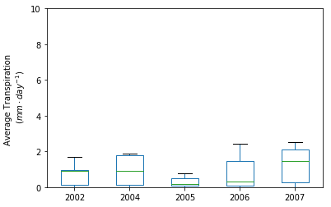
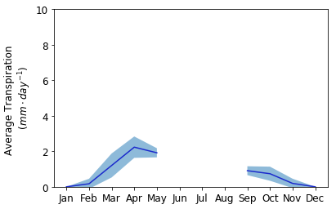
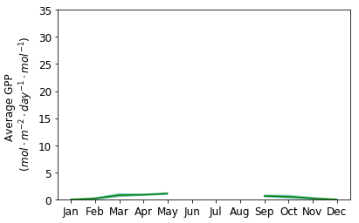
Alison Prior & Prof. Iain-Colin Prentice
A Coupled Model: Initial GPP & Transpiration Results
Coupling the Carbon & Water Cycles
Site Information
Tap & Explore! Model Test Sites
“BE-Bra” | Brasschaat, Belgium
Elevation: | 15 m
Landuse: | Mixed Forests
Period: | 2002 - 2012
Initial Transpiration & GPP calculations failed.
USA
Re-run model and assess input data for suitability.
Transpiration and GPP cannot be assessed. Failed model run.
01
Invisible Water
GPP: ERROR
Data missing. Possible error occurred in PPFD calculation.
Transpiration: ERROR
02
Today’s ET Models
Initial Results
03
The Plant Perspective
Transpiration
GPP
Average daily transpiration estimates (mm) for Belgium’s Brasschaat FLUXNET site for the period 2002 to 2012 showing [a] annual variation and [b] seasonality.
Average daily GPP estimates at Brasschaat for the period 2002 to 2012.
04
Initial Results
05
Learn More

Slide 10
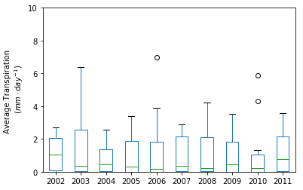
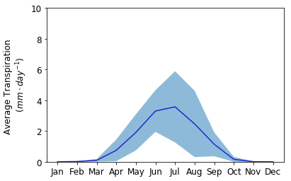
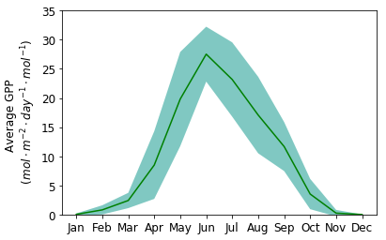
Alison Prior & Prof. Iain-Colin Prentice
A Coupled Model: Initial GPP & Transpiration Results
Coupling the Carbon & Water Cycles
Site Information
Tap & Explore! Model Test Sites
“DE-Hai” | Hainich, Germany
Elevation: | 433 m
Landuse: | Mixed Forests
Period: | 2002 - 2012
Initial Transpiration & GPP calculations complete
USA
Validated against FLUXNET latent heat flux (converted to ET)
Predicted transpiration fits well to observations. GPP high.
01
Invisible Water
GPP: HIGH
GPP prediction significantly higher than observation data. Run with alternative fAPAR input.
Transpiration: MEDIUM
02
Today’s ET Models
Initial Results
03
The Plant Perspective
Transpiration
GPP
Average daily transpiration estimates (mm) for Germany’s Hainich FLUXNET site for the period 2002 to 2012 showing [a] annual variation and [b] seasonality.
Average daily GPP estimates at Hainich for the period 2002 to 2012.
04
Initial Results
05
Learn More

Slide 11
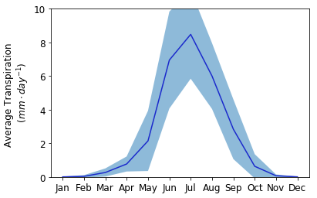
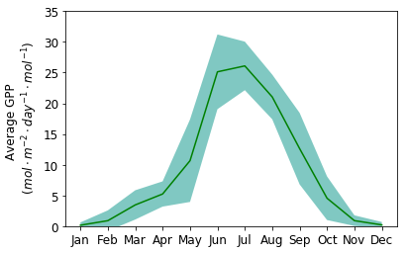
Alison Prior & Prof. Iain-Colin Prentice
A Coupled Model: Initial GPP & Transpiration Results
Coupling the Carbon & Water Cycles
Tap & Explore! Model Test Sites
Site Information
EU
‘US-UMB’ | Uni of Michigan, USA
Elevation: | 228 m
Landuse: | Deciduous Broadleaf Forest
Period: | 2002 - 2012
Initial Transpiration & GPP calculations complete.
Validated against FLUXNET latent heat flux (converted to ET).
Values are higher than expected and higher than observations.
01
Invisible Water
GPP: HIGH
Re-run model with alternative meteorological and fAPAR data.
Transpiration: HIGH
02
Today’s ET Models
Initial Results
03
Transpiration
GPP
The Plant Perspective
Average daily transpiration (mm) for the Uni of Michigan Biological Station from 2002 to 2012 showing [a] annual variation for the period and [b] seasonality.
Daily average GPP for the University of Michigan FLUXNET site, 2002 to 2012.
04
Initial Results
05
Learn More

Slide 12
Alison Prior & Prof. Iain-Colin Prentice
P Model: Effectively Predicting CO2
Go back
Coupling the Carbon & Water Cycles
Did you know? The ”P” in P model stands for production!
Light Use Efficiency (LUE)
Standard model of photosynthesis
The P model calculates stomatal conductance to determine photosynthetic trade-offs. This can be modified to estimate transpiration.
One model to simulate Global Primary Production (GPP) & Transpiration (T).
The P Model effectively predicts CO2 uptake by plants
Based on fundamental scientific knowledge:
Readily available input data: No land use or vegetation map required!
01
Invisible Water
02
Today’s ET Models
03
The Plant Perspective
04
Initial Results
05
Learn More
Example GPP Results
See the Algorithm
Required Input Data
Press the buttons to learn more!

Slide 13
Alison Prior & Prof. Iain-Colin Prentice
Next Steps: Planning & Dreaming
Go back
Coupling the Carbon & Water Cycles
The basis for a new global satellite product to predict T and GPP?
Test new input data ( e.g. Sentinel 3) to obtain live T & GPP estimates
Testing P Model results in hydrological models
Benchmark new product against others for quality control
Improve ET Partitioning & analyse results by vegetation type
01
Invisible Water
02
Today’s ET Models
03
The Plant Perspective
04
Initial Results
05
Learn More

Slide 14
Alison Prior & Prof. Iain-Colin Prentice
P Model: The Algorithm
Go back
$$GPP= IPAR×fAPAR×{LUE}_{max}$$
$$GPP= IPAR×fAPAR×{LUE}_{max}$$
Coupling the Carbon & Water Cycles
$$GPP= IPAR×fAPAR×{LUE}_{max}$$
$GPP= I_{abs}∙φ_{0}∙m\sqrt{\left[1−{\left(c^{∗}/m\right)}^{2/3}\right]}$
$GPP= I_{abs}∙φ_{0}∙m\sqrt{\left[1−{\left(c^{∗}/m\right)}^{2/3}\right]}$
$GPP= I_{abs}∙φ_{0}∙m\sqrt{\left[1−{\left(c^{∗}/m\right)}^{2/3}\right]}$
$GPP= I_{abs}∙φ_{0}∙m\sqrt{\left[1−{\left(c^{∗}/m\right)}^{2/3}\right]}$
C3
$$m=\frac{(C_{a}−Γ^{∗})}{\left\{C_{a}+2Γ^{∗}+3Γ^{∗}\sqrt{\left[1.6{∙η}^{∗}∙{D_{0}{∙β}^{−1}\left(K+Γ^{∗}\right)}^{−1}\right]}\right\}}$$
$$m=\frac{(C_{a}−Γ^{∗})}{\left\{C_{a}+2Γ^{∗}+3Γ^{∗}\sqrt{\left[1.6{∙η}^{∗}∙{D_{0}{∙β}^{−1}\left(K+Γ^{∗}\right)}^{−1}\right]}\right\}}$$
01
Invisible Water
02
Today’s ET Models
C4
$$GPP= I_{abs}∙φ_{0}$$
$$GPP= I_{abs}∙φ_{0}$$
$$GPP= I_{abs}∙φ_{0}$$
03
The Plant Perspective
$φ_{0}$ is the intrinsic quantum yield (1.02 g C / mol),
$I_{abs}$ is the absorbed photosynthetic photon flux density (PPFD, mol /m²/s),
$Γ^{∗}$ is the photorespiratory compensation point (Pa),
K is the effective Michaelis-Menten coefficient of Rubisco (Pa),
$η^{∗}$ is the viscosity of water relative to its value at 25 degrees Celsius,
$β≈$240 from the constant C in the equation for optimal leaf internal to external carbon dioxide ratio ($χ_{0}$),
$c^{∗}≈\text{0.41}$is estimated from observed $J_{max}:{Vc}_{max}$ ratios proportional to the unit carbon cost for the maintenance of electron transport capacity.
04
Initial Results
05
Learn More
Example GPP Results
Required Input Data
See: Han et al. (2017) Towards a universal model for carbon dioxide uptake by plants. Nature Plants volume 3, pages 734–741. https://www.nature.com/articles/s41477-017-0006-8

Slide 15
Alison Prior & Prof. Iain-Colin Prentice
P Model: Input Data Requirements
Go back
Coupling the Carbon & Water Cycles
01
Invisible Water
02
Today’s ET Models
03
The Plant Perspective
04
Initial Results
05
Learn More
Check out the code & try the model yourself!
Example GPP Results
github.com/stineb/rsofun
See the Algorithm
bitbucket.org/labprentice

Slide 16
Alison Prior & Prof. Iain-Colin Prentice
P Model: Sample Global GPP Result
Go back
Coupling the Carbon & Water Cycles
01
Invisible Water
02
Today’s ET Models
03
The Plant Perspective
04
Initial Results
05
Learn More
See the Algorithm
Required Input Data
Work by Shirley Wenjia Cai.
Learn more at her talk @ EGU!

Slide 17
Alison Prior & Prof. Iain-Colin Prentice
P Model: Limitations & Potential Challenges
Go back
Coupling the Carbon & Water Cycles
Validation: verification of transpiration estimates at global scale is difficult due to scarcity of high quality observations.
Uptake: how could this knowledge and potential new product be implemented into ESMs, Hydrological Models, etc?
The P model works effectively on land, but has difficulty accurately predicting GPP over water bodies and in very arid areas.
The team are busy testing new features, like how soil moisture impacts GPP and what happens when $φ_{0}$becomes temperature-dependent?
The team are busy testing new features, like how soil moisture impacts GPP and what happens when 𝜑_0 becomes temperature-dependent?
01
Invisible Water
02
Today’s ET Models
03
The Plant Perspective
04
Initial Results
05
Learn More

Slide 18
Alison Prior & Prof. Iain-Colin Prentice
P Model: Related Research
Go back
Coupling the Carbon & Water Cycles
Global GPP Product Shirley Wenjia Cai EGU2019-15713: Wednesday 16:30 ■ Room 2.31
GPP Predication at Altitude David Sandoval EGU2019-10436: Tuesday 10:45 am ■ Hall X5
Tree Ring Validation of GPP Alienor Lavergne EGU2019-11197: Friday 10:45 am ■ Hall A
P Model Development Prof. Iain-Colin Prentice EGU2019-7806: Thursday 14:15 ■ Room 2.44
★see example!★
01
Invisible Water
02
Today’s ET Models
03
The Plant Perspective
04
Initial Results
This research is funded by the Reinventing Ecosystem And Land Surface Models (REALM) project
More information: a.prior18@imperial.ac.uk
05
Learn More

