Slide 1
The impact of biomass burning emissions on sub-seasonal prediction: a study using the ECMWF’s coupled Ensemble Prediction System
Angela Benedetti, Frédéric Vitart, Francesca Di Giuseppe and Rossana Dragani
EGU session AS.1.7, Thursday, 11 April 2019

Slide 2
Motivation
In recent years the impact of aerosols in numerical weather prediction has received more attention at operational centres
Thanks to developments funded by the European Commission, ECMWF has been in a unique position to test the impact of aerosols in its complex Earth-System model
Recent efforts have been aimed at investigating the aerosol impacts in the coupled Ensemble Prediction System (EPS) at the sub-seasonal (S2S) time scales.
Results show a substantial impact of the aerosols at week 3-4, due to the interaction of the Madden-Julian oscillation with the aerosol fields
There is also potential to predict large aerosol events associated to wild-fires with strong seasonality – this could be the next frontier in the field, provided that a dynamical fire emission model is developed

Slide 3
AEROSOL & WEATHER
Sulfate aerosols
Natural
emissions
Heterogeneous
chemistry
CCN
Anthropogenic
emissions
Organic
matter
Ash
Smoke
Black
carbon
Sea salt
Dust
Biomass
burning

Slide 4
Experiment set-up
Period 2003-2015
Interactive aerosol simulations use fully prognostic aerosols in the radiation scheme – only aerosol direct effects are included
Free-running aerosols with observed emissions for biomass burning
Ensemble size is 11 members, T255 (about 60km) resolution, 91 levels
5 different start dates around May 1, 55 cases in total
6 months simulations
CONTROL1 | Tegen et al (1997) climatology in the radiation
CONTROL2 | Bozzo et al (2017) climatology in the radiation
PROG1 | Interactive aerosols initialized from the CAMS Interim Reanalysis (Flemming et al 2017)
PROG2 | Interactive aerosols initialized from a free-running aerosol simulation

Slide 5
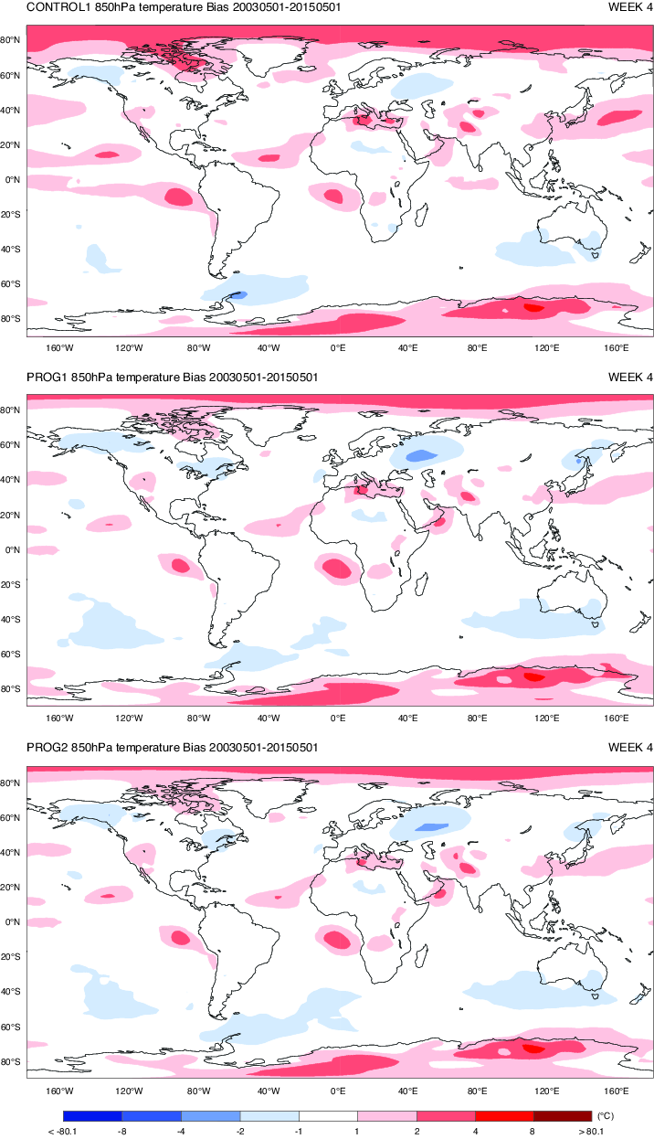
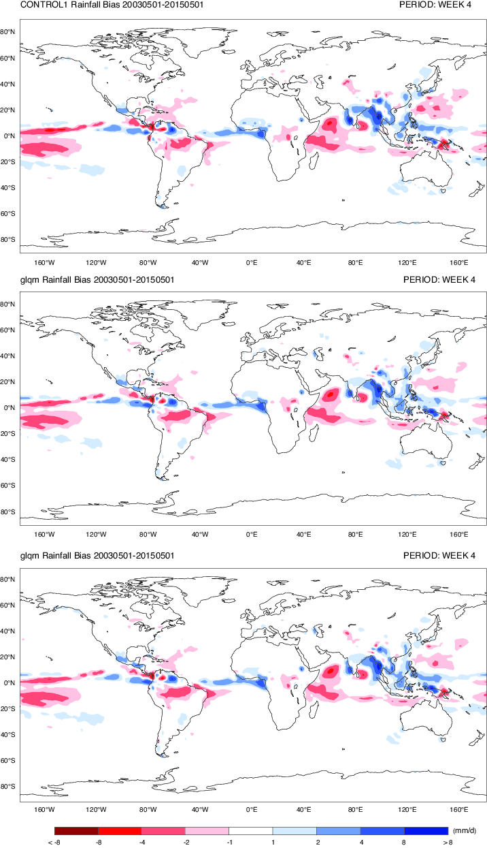
Aerosol impacts on the monthly forecasts: bias
Temperature bias – week 4
Precipitation bias – week 4
Areas impacted: Mediterranean basin,, the Asian dust belt in the Northern Pacific Ocean and the North Atlantic dust belt.
In some areas the temperature bias is reduced between -0.5 and 2.0 degrees
Precipitation biases are also reduced over several tropical regions
Precipitation bias reduction in East Asia amounts to 0.5-1 mm/day.
CONTROL1
PROG1
PROG2
Benedetti and Vitart, MWR 2018

Slide 6
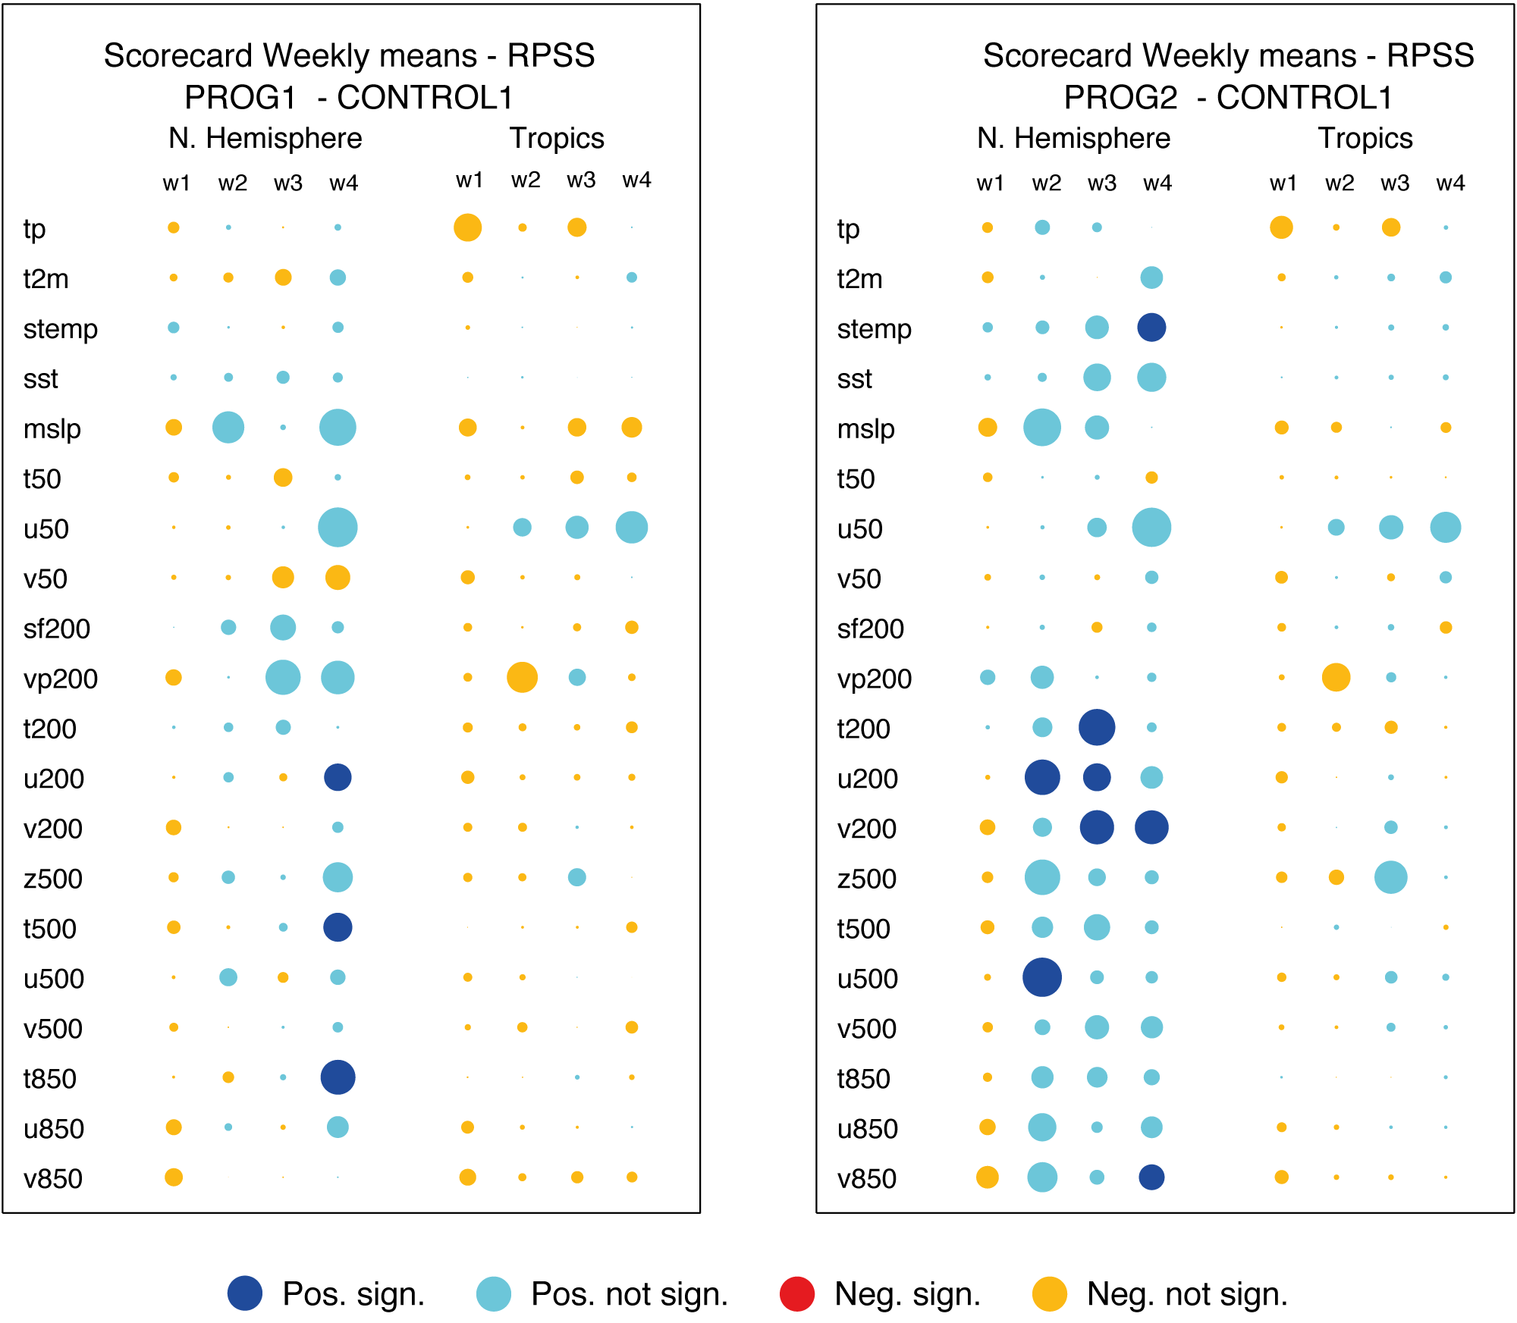
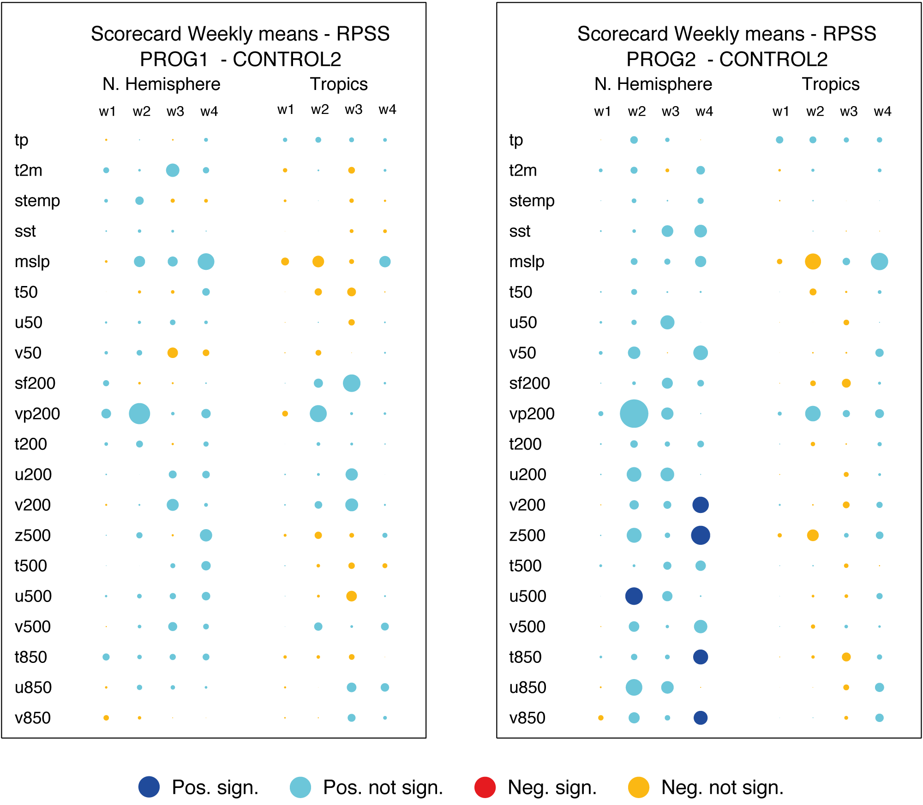
Aerosol impacts on the monthly forecasts: Rank probability skill scores
Scorecard measures the performance of interactive aerosol experiment with respect to a control run for several meteorological parameters.
Overall the experiments with prognostic aerosols perform better if compared with the CONTROL1 and CONTROL2 experiments, particularly PROG2
CONTROL1 | Tegen et al (1997) climatology in the radiation
CONTROL2 | Bozzo et al (2017) climatology in the radiation
PROG1 | Interactive aerosols initialized from the CAMS Interim Reanalysis (Flemming et al, 2017)
PROG2 | Interactive aerosols initialized from a free-running aerosol simulation
Better
Benedetti and Vitart, MWR 2018

Slide 7
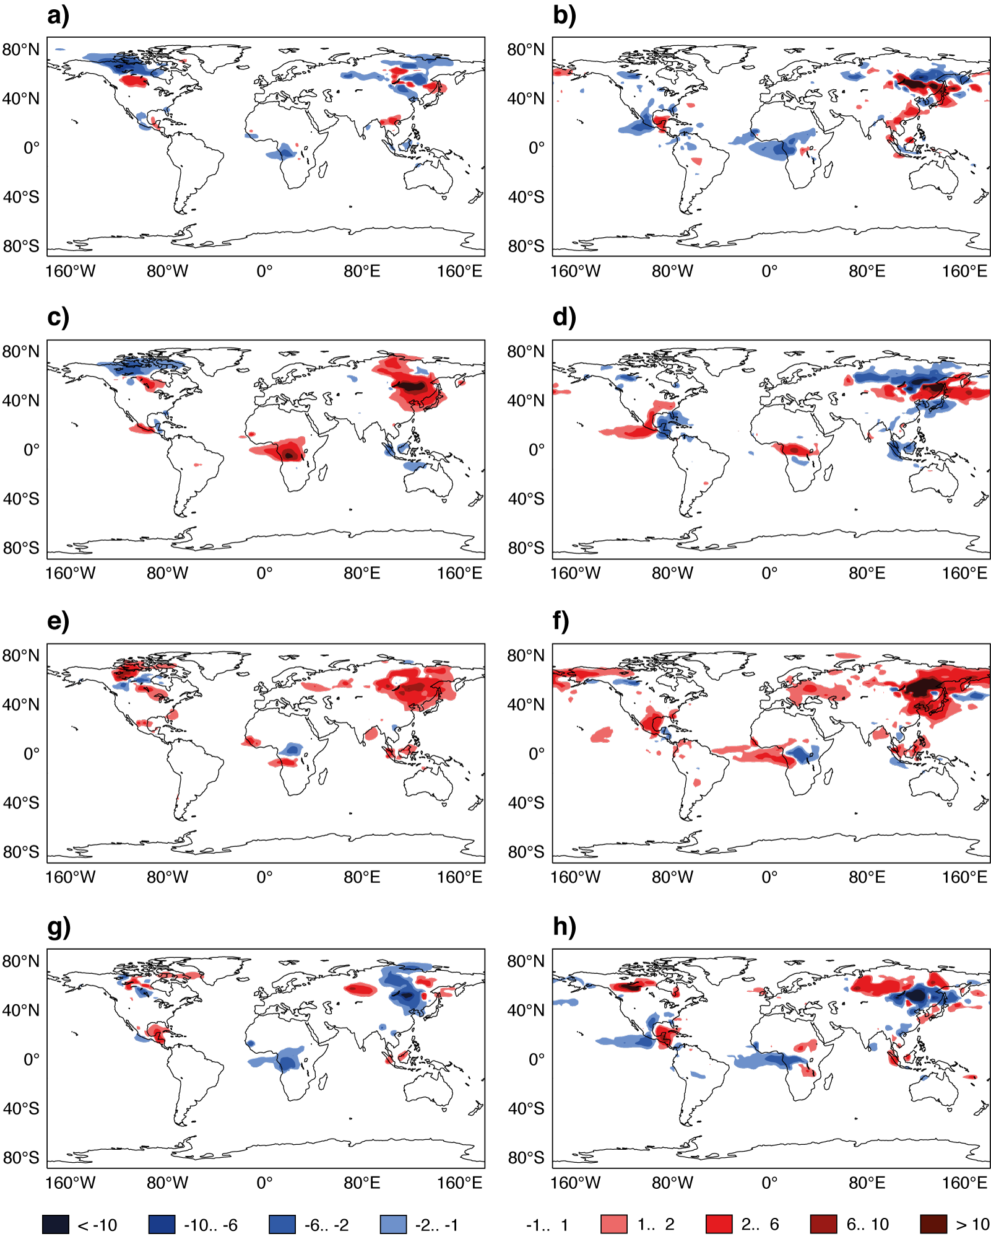
Aerosol modulation by the MJO
Anomaly of carbonaceous aerosol optical depth
PROG1
CAMS INTERIM REAN
Composites of carbonaceous optical depth anomalies, relative to the model climatology, have been produced in the different phases of the MJO
Close similarity of patterns in the PROG1 experiment and in the CAMS Interim Reanalysis
Opposite phases of the MJO (for instance phase 2-3 and phase 6-7) have opposite impacts on the aerosol variability suggesting that the MJO modulation is a robust signal.
Phase 2-3
Phase 4-5
Phase 6-7
Phase 8-1
Notes:
In order to assess the impact of the MJO on aerosols in the model simulations as well in CAMSira, composites of dust and carbonaceous optical thickness anomalies, relative to the model climatology, have been produced when the active phase of the MJO is located over the Indian Ocean (Phases 2 and 3, see Wheeler and Hendon (2004) for the definition of MJO phases), Maritime Continent (Phases 4 and 5), western North Pacific (Phases 6 and 7) and western Hemisphere (Phase 8 and 1).

Slide 8
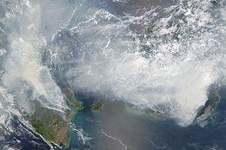
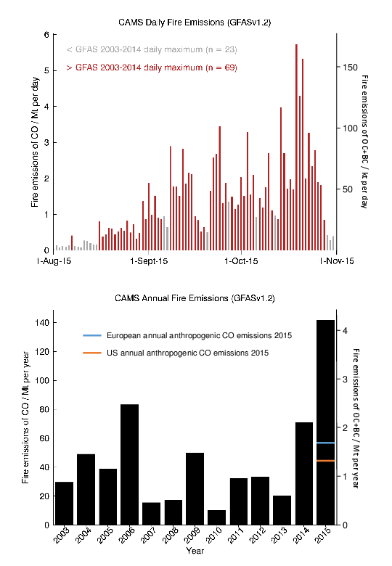
Indonesian Fires of 2015
2015 was a record-breaking year for Indonesia.
During the burning season of August-October, wildfires spread widely across the region creating a humanitarian crisis due to the high levels of air pollution induced by the smoke.
Around 600 million tonnes of greenhouse gases were emitted, an amount described as 'roughly equivalent to Germany's entire annual output'.
A NASA satellite image showing the extent of the haze on 24 September 2015.
Copernicus Atmospheric Monitoring Service (CAMS) daily Fire emissions
Biomass burning AOD anomaly
Benedetti et al, in State of Climate 2016, BAMS.

Slide 9
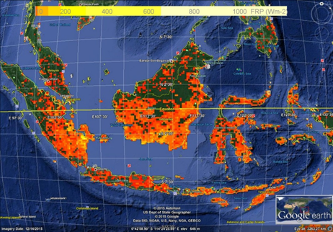
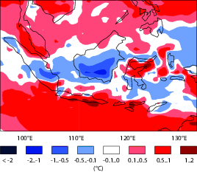
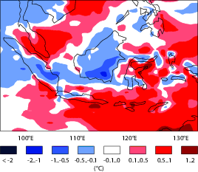
Indonesian Fires of 2015 (cont.)
Fire radiative power Aug-Oct 2015
2m Temp anomaly Oct 2015 - Forecast started 1st Aug
Cooling due to smoke
aerosols predicted
3 months ahead
The EPS system re-forecasts with interactive aerosols was able to simulate the temperature anomalies corresponding to the fire-affected area up to 6 months ahead
Prescribed observed fire emissions derived from Fire Radiative Power were used
Inherent high predictability of these events connected to El-Nino (and agricultural practices in the area)
If a dynamical fire emission model were developed, it would be possible to predict these extreme episodes a season in advance
2m Temp anomaly Oct 2015 - Forecast started 1st May
Cooling due to smoke
aerosols predicted
6 months ahead

Slide 10
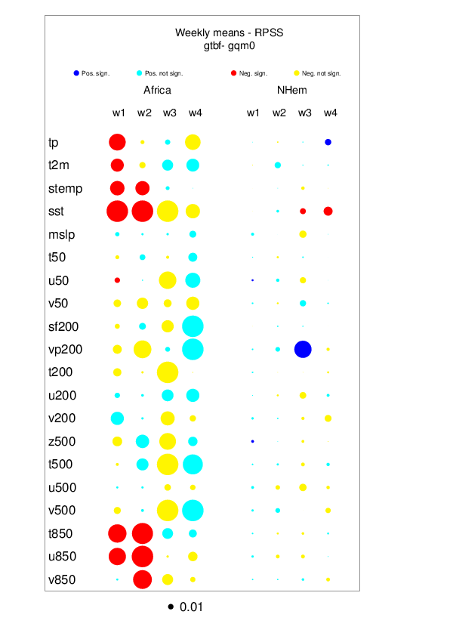
Sensitivity to biomass burning aerosols
A further experiment with the coupled EPS system was designed to understand the role of (interactive prognostic) biomass burning
Same set-up as previous runs using interactive prognostic aerosols with start date of May 1
Control run with Tegen at al (1997) climatology
All emissions from wildfires were set to zero
Scores for West Africa (15N 0S 10W 10E)
Some key variables such as SST, surface temperature, total precipitation and lower-level winds are significantly degraded when biomass burning aerosols are not included in the system
The global impact is less severe due to the spatial distribution of the biomass burning
Positive
significant
Negative
Non significant
Positive
Non significant
Negative
significant

Slide 11
Summary and perspectives
Using prognostic aerosols interactively in the radiation results in increased model skill at the sub-seasonal range for various meteorological parameter, the extent of the improvement being dependent on the aerosol model initialization.
MJO modulation of aerosol fields seems the most likely mechanism through which this aerosol impact is delivered as it explains most of the aerosol variance at the monthly scale.
Extreme events like the Indonesian fires of 2015 can only be captured with prognostic aerosols (and fire emissions) – these events are connected to El Niño and have a high degree of predictability at the seasonal scale.
Sensitivity to biomass burning aerosols is regionally very large

Slide 12
Thanks for your attention! Any questions?
©johnlund.com
Angela.Benedetti@ecwmf.int
Visit my blog at: https://womanscientific.blogspot.com/
Acknowledgements: this research was partly funded under the DACCIWA project, funded from the European Union 7th Framework Programme (FP7/2007-2013) under Grant Agreement no. 603502

