Slide 1
Rapid Adjustment of Forecast Trajectories: Improving short-term forecast skill through statistical post-processing
Nina Schuhen, Thordis L. Thorarinsdottir and Alex Lenkoski
11.04.2019
nina.schuhen@nr.no

Slide 2
Status Quo
Most forecasts are not revisited once issued
Newest forecast run is usually the best
RAFT: correct a forecast trajectory while it verifies

Slide 3
RAFT: Concept

Slide 4
Data Set: UK Met Office
MOGREPS-UK
2.2 km 70 Levels
36 hourly forecast 4 times/day
12 members
Interpolated to 150 observation sites in UK and Ireland
Training period: Jan to Dec 2014
Evaluation period: Jan 2015 to Jul 2016
Surface temperature and wind speed

Slide 5
Initial Calibration: EMOS / NGR
Raw ensemble output is calibrated using EMOS (NGR)
Removal of deterministic and probabilistic biases
Performed after the ensemble run is completed, based on a rolling training period
16% reduction in CRPS
Here: adjust EMOS mean, keep calibrated EMOS spread
Gneiting, T., A.E. Raftery, A.H. Westveld, and T. Goldman, 2005: Calibrated Probabilistic Forecasting Using Ensemble Model Output Statistics and Minimum CRPS Estimation. Mon. Wea. Rev., 133, 1098–1118

Slide 6
Correlation of Forecast Errors
03 UTC run at Heathrow Airport
Significant at 90% level
Correlation between lead times varies
Depends strongly on diurnal cycle

Slide 7
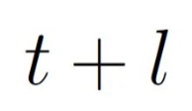
RAFT Framework: Error Correction
At any time a new forecast is issued for the next 36 hours: with
Observations become available while this forecast trajectory is valid
Observed forecast error at :
Correct the next forecast(s) using a function of this error:

Slide 8
RAFT Framework: Estimating the Error
Estimate future errors by linear regression
Previous forecasts’ errors as predictors:
Correct forecasts by adding the estimated error:
Adjustment period: find earliest lead time, where is significantly different from 0

Slide 9
Adjustment Period Length

Slide 10
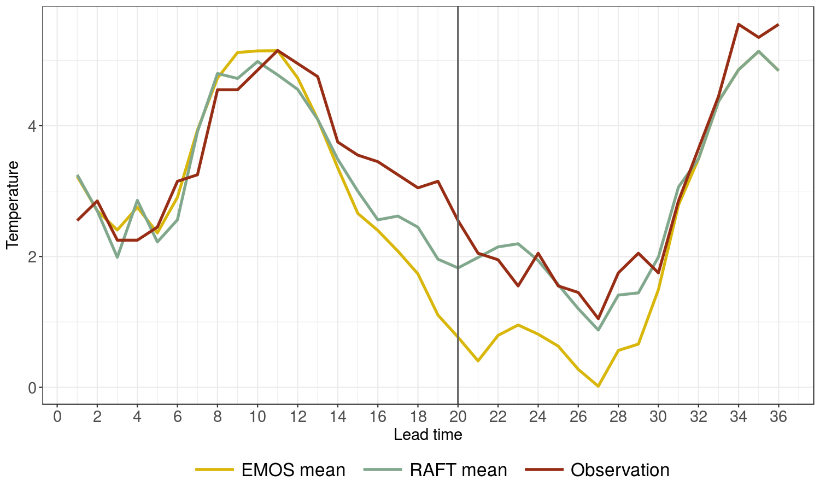
Heathrow, 14.01.2016 03 UTC

Slide 11
Results for Surface Temperature
iStock.com/Zbynek Pospisil

Slide 12
RMSE (All Sites): At Lead Time 1

Slide 13
RMSE (All Sites): At Lead Time 35

Slide 14
Rank and PIT Histograms
Coverage of 84.62% prediction interval:
52.24% 79.29% 87.31%

Slide 15
Results for 10m Wind Speed (ongoing work)
iStock.com/photoschmidt

Slide 16
RAFT for Wind Speed
EMOS: truncated Gaussian distribution
Adjust mean of truncated distribution
Length of adjustment period is slightly «jumpy»
Wind profiles differ widely between stations
Thorarinsdottir, T. L. and T. Gneiting, 2010: Probabilistic Forecasts of Wind Speed: Ensemble Model Output Statistics by Using Heteroscedastic Censored Regression. J. Royal Stat. Soc. A, 173, 371-388

Slide 17
RMSE (All Sites): At Lead Time 35

Slide 18
Conclusions 1
Strong correlation between errors at different lead times allows us to adjust the forecasts a few hours ahead
Temperature: predictability depends heavily on the time of day
Wind speed: more location-dependent, need local approach
Regression model reduces forecast error overall, with a big margin for short-term corrections
Should prefer RAFT forecasts from a previous model run to the first forecasts from the current one

Slide 19
Conclusions 2
RAFT naturally applies to any weather forecasting setting, only needs correlation structure between lead times
Did not take into account the time it takes to run the NWP model => older forecasts become even more valuable
Higher observation frequency can bring additional benefits
Rapid ensemble update cycles: Can also be used to level out differences in skill between lagged ensemble members

Slide 20
Outlook and Future Work
RAFT only corrects the mean forecast
Spread should be updated to reflect the larger deterministic skill
Can we spread parameters spatially to non-observation locations?
Take into account seasonal effects (more data needed)
Apply RAFT to seasonal temperature forecasts

Slide 21
Rapid Adjustment of Forecast Trajectories (RAFT)
Bias correction of forecast trajectory while it verifies
Define adjustment period based on correlation between forecast errors
Predict future error with linear regression
Large reduction in RMSE a few hours ahead
Older forecasts can have more skill than the newest
RAFT/EMOS predictive distributions are still calibrated

Slide 22
RMSE (Heathrow): All Runs, Lead Time 35

Slide 23
RMSE and CRPS for Different Site Types

