Slide 1

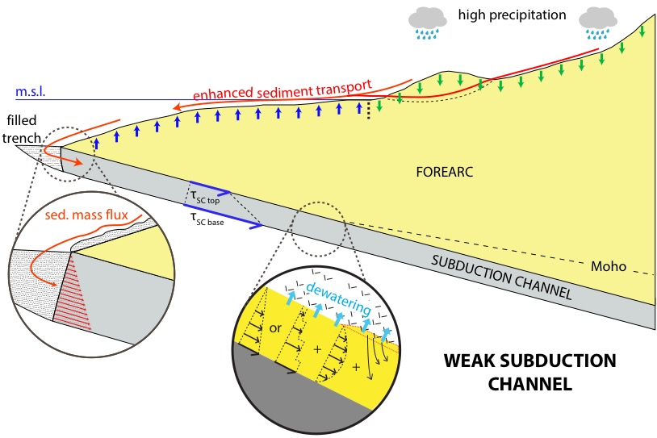





Role of subducted sediments in plate
interface dynamics and forearc topography:
Observations and modelling constraints for the Andes
NJ Cosentino, JP Morgan, FA Aron, JGF Crempien, TE Jordan
EGU2019-90, TS4.2/GM4.4

Slide 2
MOTIVATION: Anomalously high Andean forearc (19-21.5°S).
Coincides with the only hyperarid segment.
Tectonic-climate link?
E
Western Cordillera and Altiplano Plateau (3.8-4.5)
W
Western Andean Slope
Central Depression (0.8-1.5)
Coastal Cordillera (0-1.1)
Western Andean Slope
Forearc platform
Forearc platform (0-1.5 km.a.s.l.)
Offshore forearc (7.5-0 km.b.s.l.)
Offshore forearc
???
Notes:
20.5-21.5

Slide 3
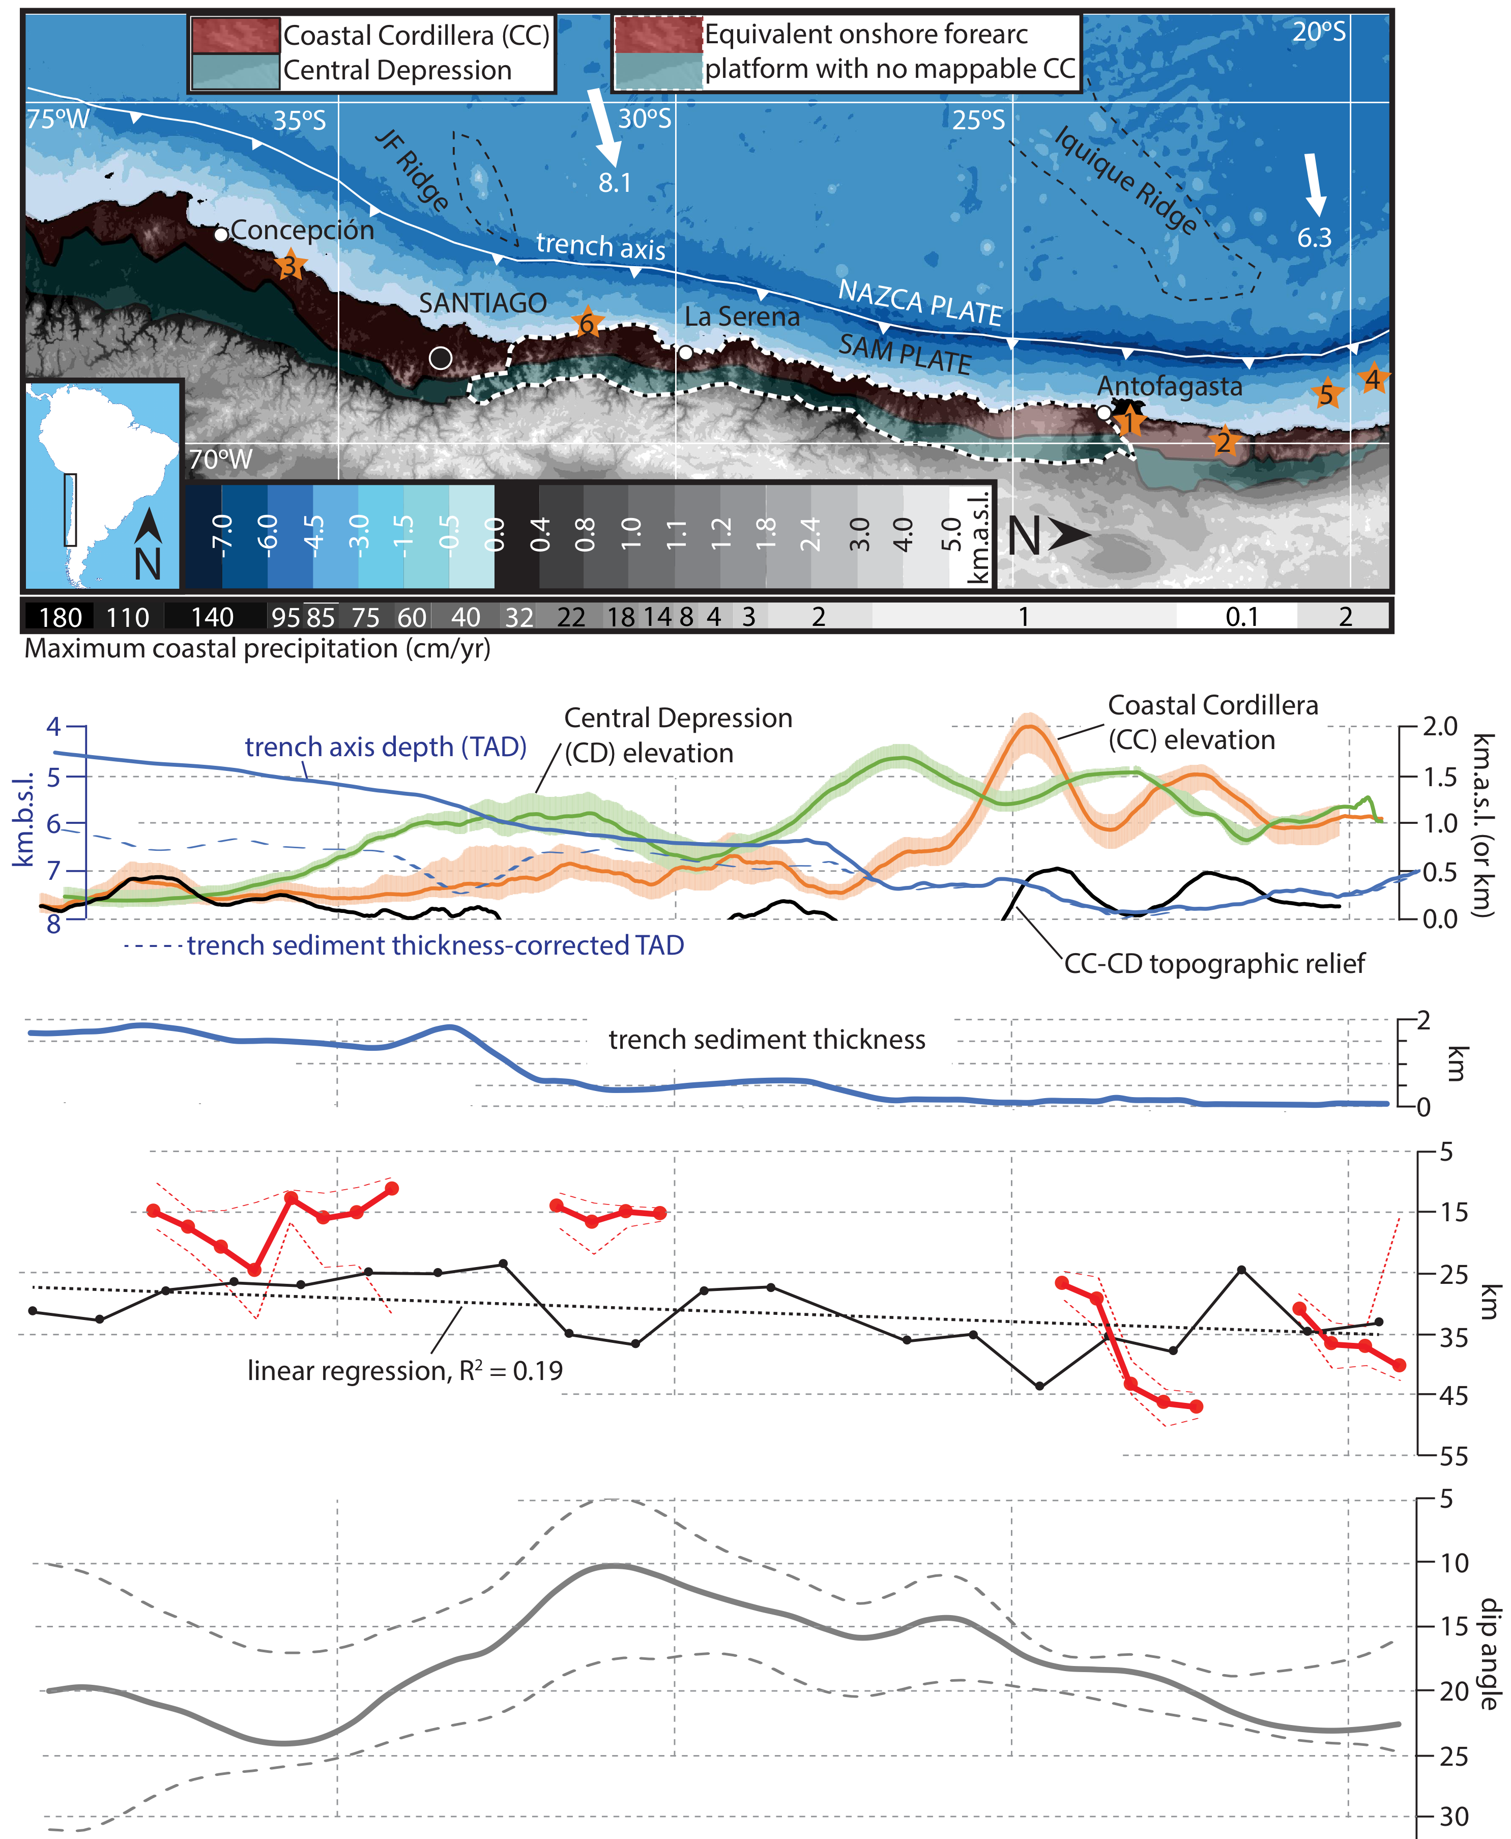
RESULTS:
(19.5-39.5ºS)
- Forearc elevation
- Trench sediment thickness
- Megathrust seismicity depth distribution
- Subduction angle
Cosentino et al., 2018a (GSA Special Papers)

Slide 4
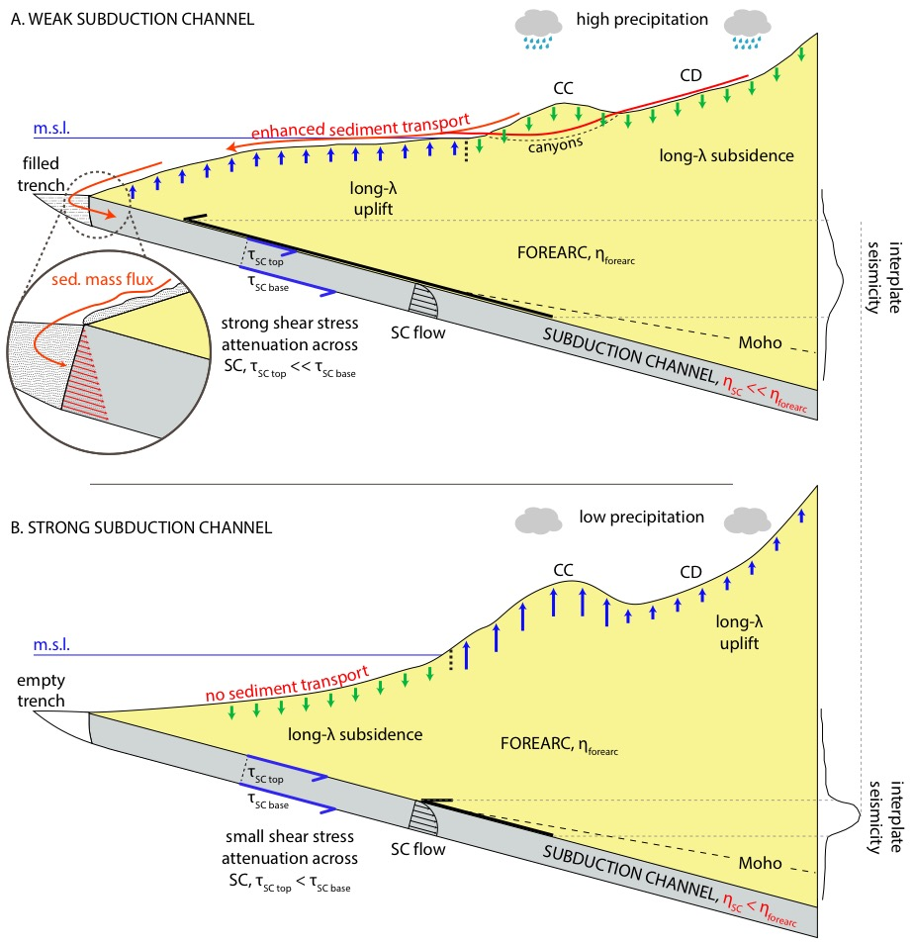
WEAK SUBDUCTION
CHANNEL
CONCEPTUAL
MODEL
greater aridity
less sediment to the trench
stronger
subd. channel
greater long-λ
forearc topo relief
+
short-λ coastal uplift
STRONG SUBDUCTION
CHANNEL
Cosentino et al., 2018b
(JGR: Solid Earth)

Slide 5
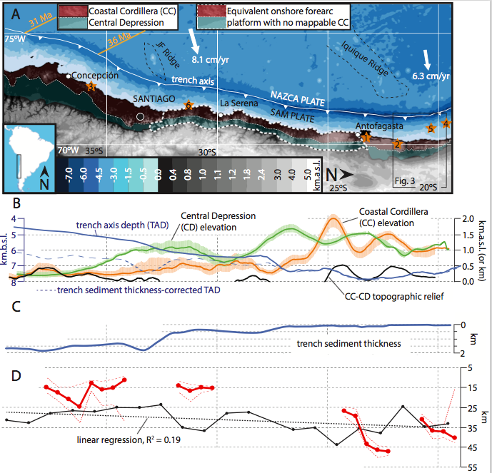
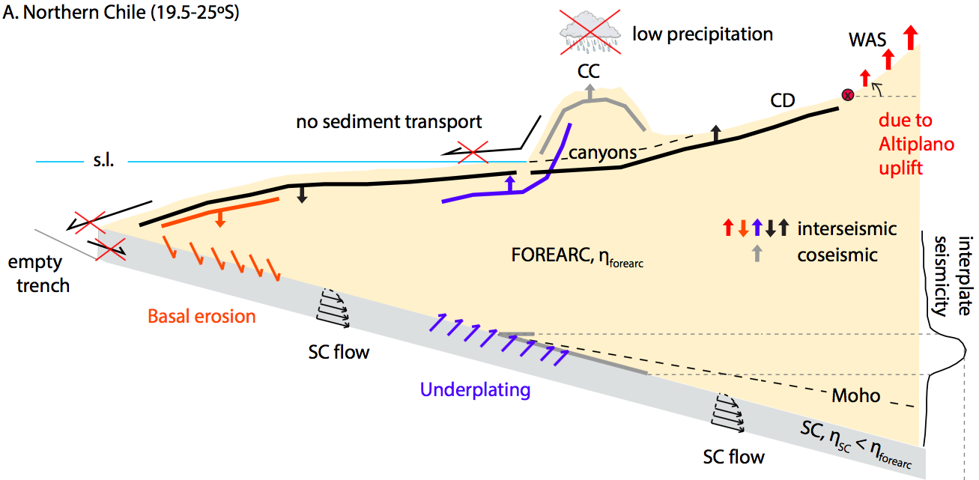
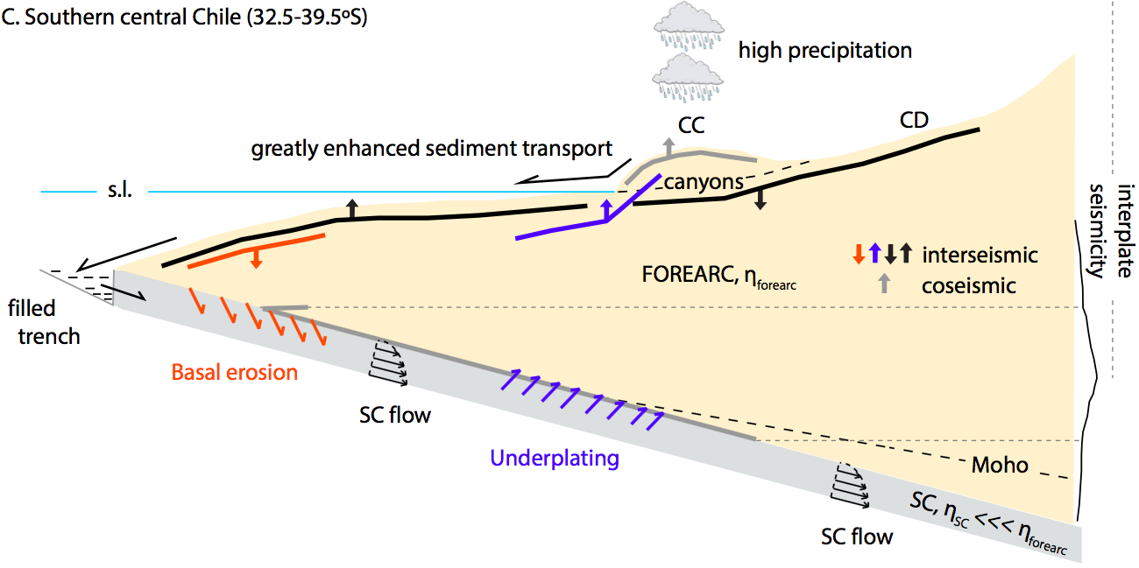
Northern Chile = strong subduction channel
Southern Chile = weak subduction channel
Cosentino et al., 2018a (GSA Special Papers)

Slide 6
CONCLUSIONS
Links between Andean forearc elevation, plate interface dynamics and subducted sediments (19.5-39.5ºS):
Looked at along-strike distribution of relevant data sets along >2000 km of the margin.
Long-λ latitudinal inverse correlation between trench sediment thickness and both forearc elevation and trench depth.
Good correlation between Coastal Cordillera – Central Depression topographic relief, where it exists (20-25ºS, 32.5-39.5ºS), and depth of historical coseismic megathrust slip and moment release.
Latitudinal band where Coastal Cordillera–Central Depression relief is mostly nonexistent (25°S–32.5°S) coincides with extent of the Chilean-Pampean flat-slab.
Observations consistent with subducted sediments exerting a control on both interface dynamics and forearc long-λ and short-λ topography

Slide 7
Modelling subduction channel flow and the interseismic topographic signal
Cosentino et al., 2018b
(JGR: Solid Earth)

Slide 8
RESULTS: Modelling subduction channel flow and the interseismic topographic signal
Cosentino et al., 2018b
(JGR: Solid Earth)

Slide 9
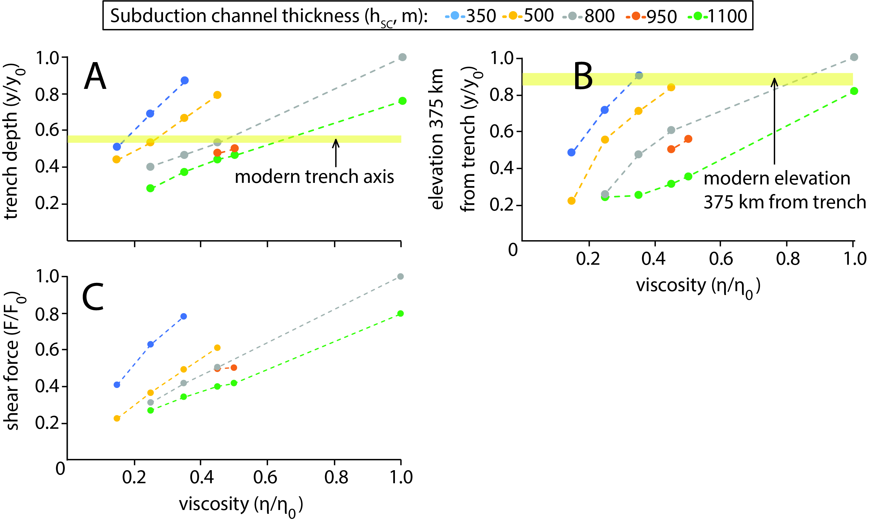
RESULTS: forearc topographic relief vs. subduction channel
parameters
Cosentino et al., 2018b
(JGR: Solid Earth)

Slide 10
RESULTS: 1-myr-long pulses of packets of differing viscosity
Central Depression
Cosentino et al., 2018 (JGR: Solid Earth)

Slide 11
CONCLUSIONS
Numerical modelling constraints for the effect of subduction channel (SC) flow on forearc topography
Viscoelastic flow in a strengthening SC is a numerically plausible geodynamic mechanism that explains coupled long-λ offshore forearc subsidence and onshore forearc platform uplift in subduction margins.
SCs act to modulate the shear force applied by the subducting slab to the upper plate: When a thick and weak SC is sustainable, it can significantly reduce the slab shear available to generate topographic relief.
Small variations in SC viscosity have a considerable impact on forearc topography.
Perturbations from a quasi steady-state system have a transient effect on topography (but multi-million-year in length)

Slide 12
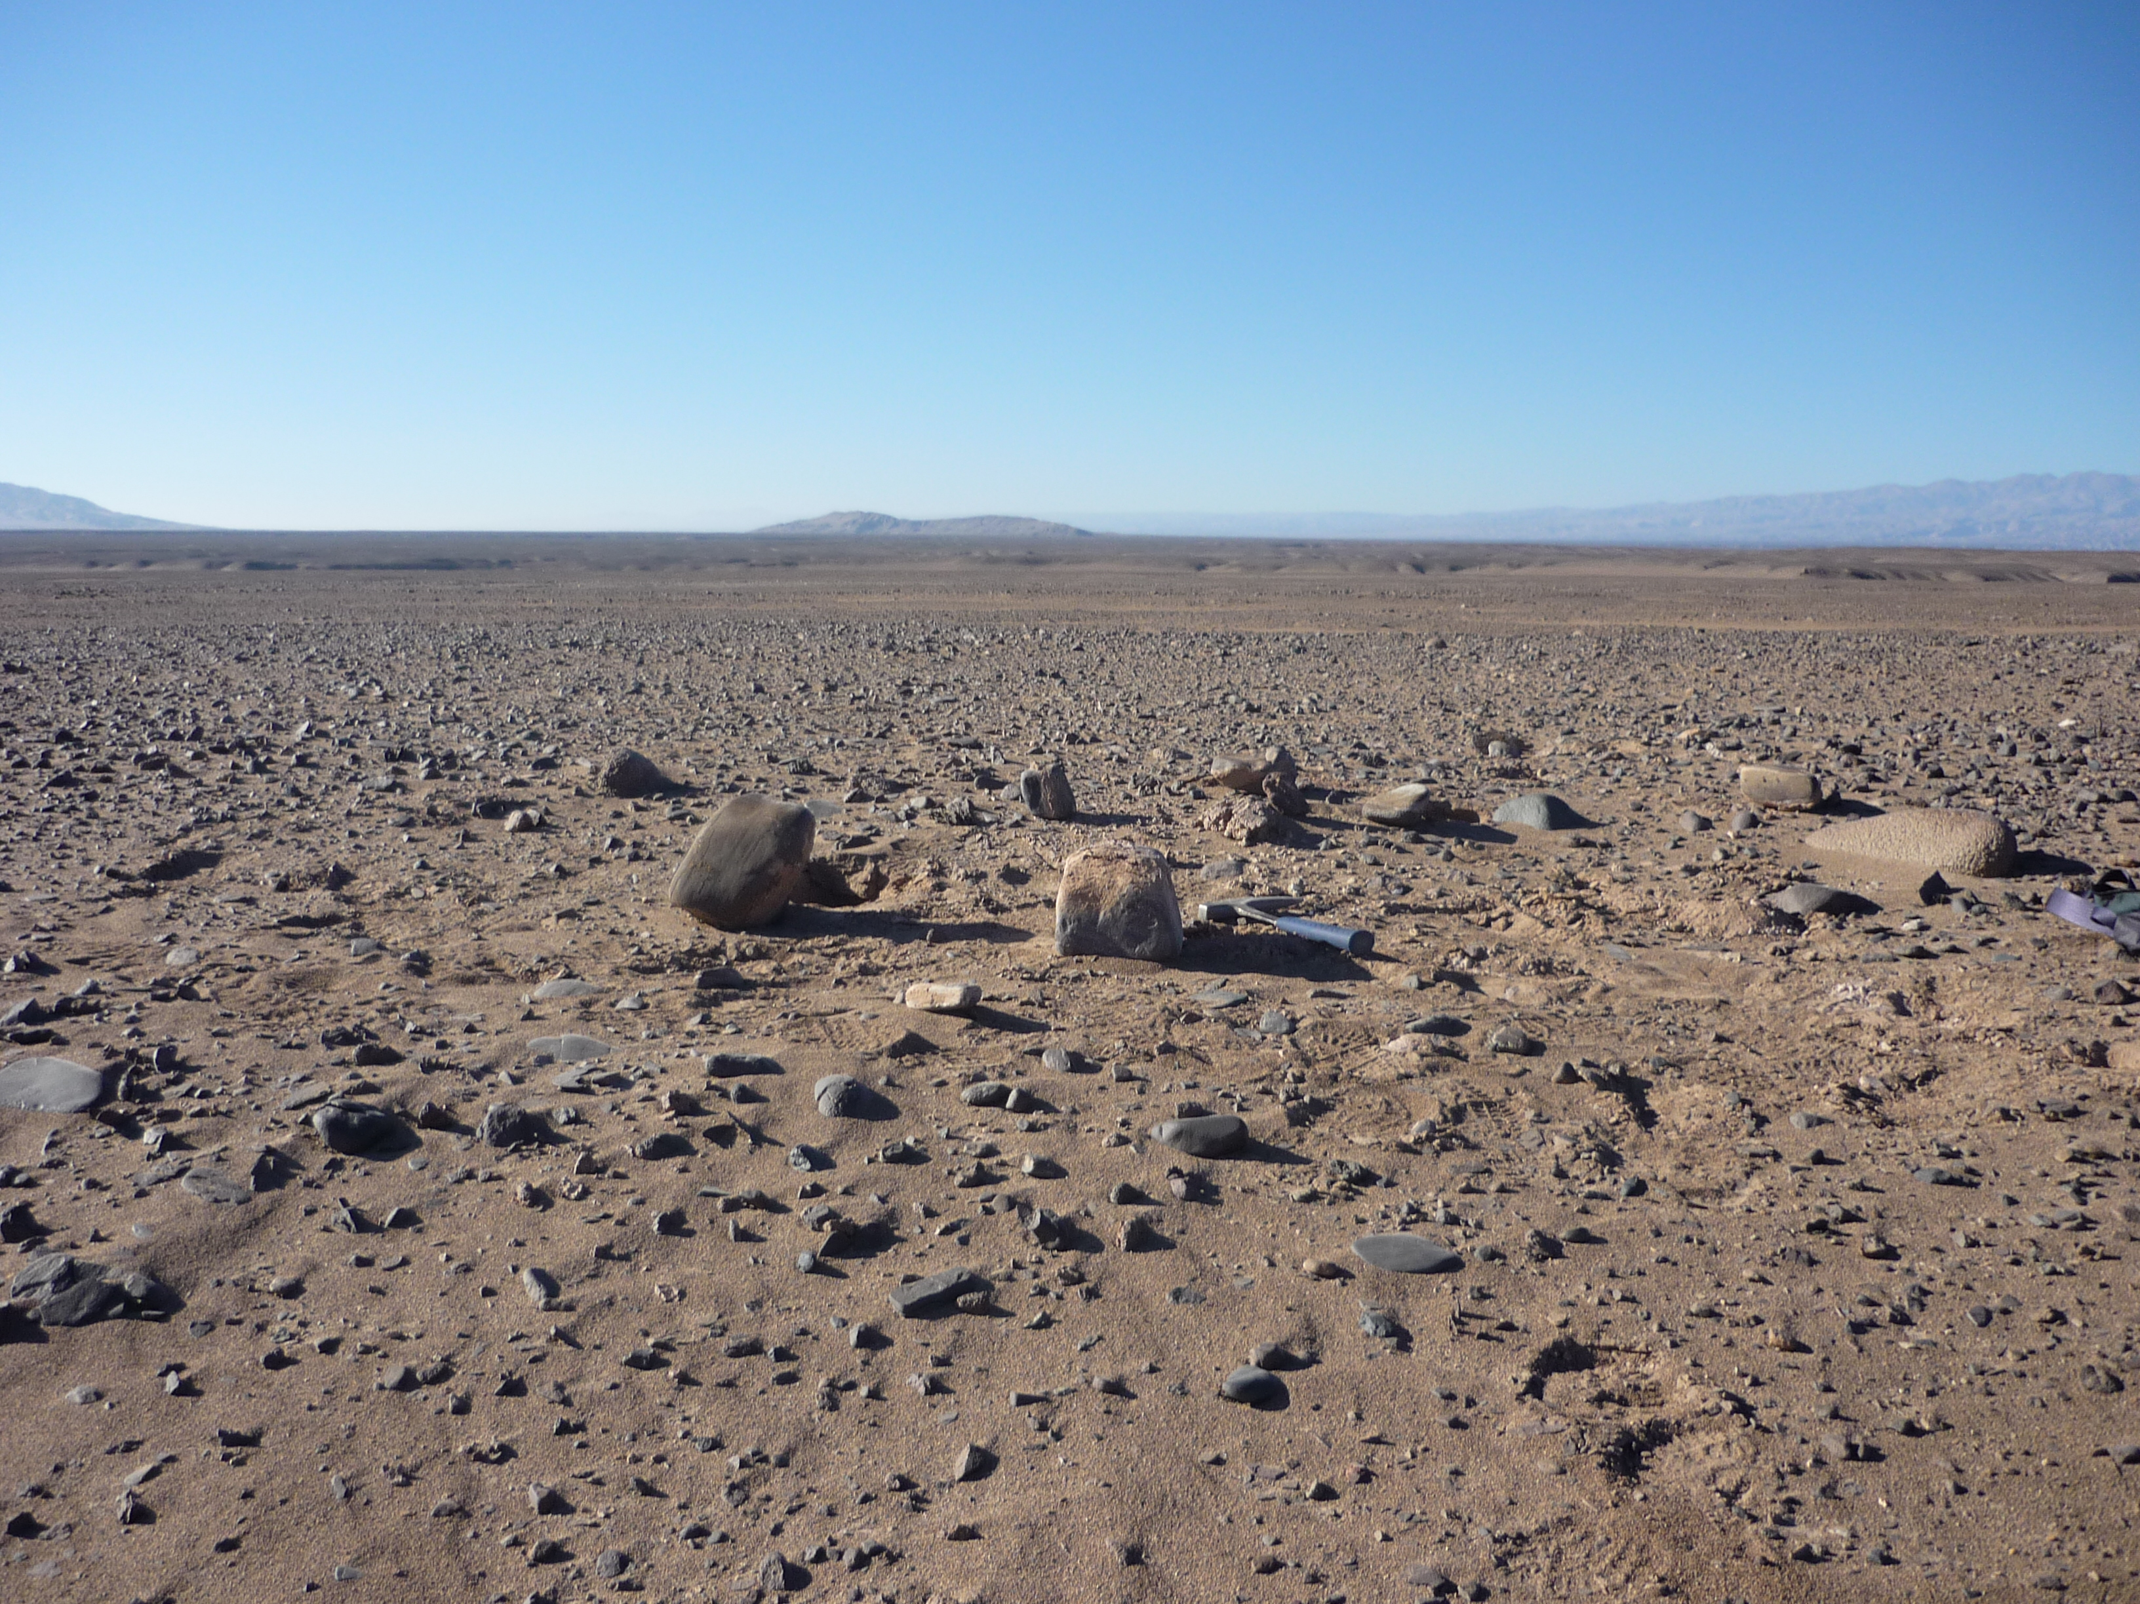
Thanks!

