Slide 1
Rupture complexity of earthquakes in a narrow seismogenic zone controlled by the volcano-rooted Flores Thrust
Shengji Wei
EGU online meeting
May, 2020
Karen Lythgoe
Kyle Bradley
Muzli Muzli
Teng Wang
Andri Dian Hugraha
Zulfakriza
Acknowledgement to Aurelie COUDURIER-CURVEUR for early discussion
© Authors. All rights reserved

Slide 2
What controls the fundamental properties (location, size, rupture process etc.) of large earthquakes?
© Authors. All rights reserved

Slide 3
Tectonic setting
and
volcanos
© Authors. All rights reserved

Slide 4
Rapid deployment
Sensors:
- 6 Short period (Zland nodes 3 Comp, EOS)
- 7 Broadband (ITB): 2018/08/04 to 2018/09/05
© Authors. All rights reserved

Slide 5
To understand the earthquake sequence, we did:
Relocation of seismicity with high quality data (quality control is important!)
Determine focal mechanisms of M>5 events using teleseismic and regional stations
Determine fault geometry by jointly modeling seismic reflection and seismicity data
Determine finite fault models using joint inversion of InSAR and teleseismic waveforms
Find repeating/similar earthquakes and compared with the slip models
Model the distribution of the seismicity for a thermal model
Combine these results to make a self-consistent interpretation
© Authors. All rights reserved

Slide 6
Spatial and temporal distribution of the hypocenters
© Authors. All rights reserved

Slide 7
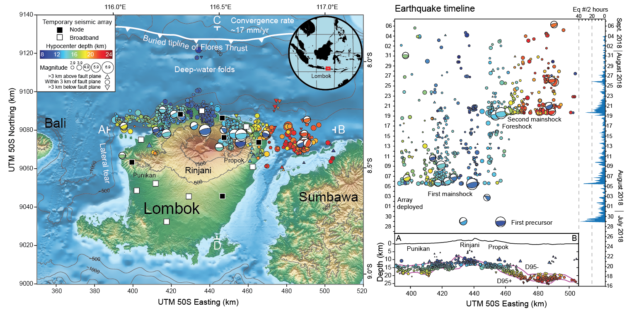
Focal mechanism results
© Authors. All rights reserved

Slide 8
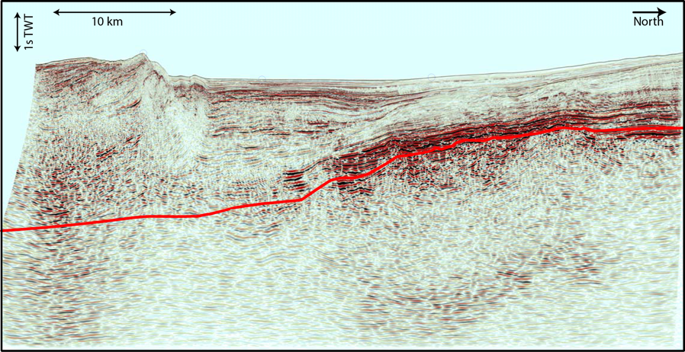
Combine seismic and seismicity data to constrain the fault geometry
20
40
60
80
100
© Authors. All rights reserved
Notes:
Are these earthquakes on the same fault?

Slide 9
Differences of rupture between the two Mw6.9 earthquakes from joint inversion
1. Exactly the same inversion parameters
2. Almost the same teleseismic data
3.Similar InSAR data
Shallower, more patchy
Deeper (~5m), single asperity
© Authors. All rights reserved

Slide 10
Thermal modeling result
Centered at the Rinjani Volcano
4 ºC/km at the surface
60 ºC/km at the volcano
19 ºC/km at the far-field
Decay distance: 50 km
© Authors. All rights reserved

Slide 11
Overlapping between coseismic-slip and postseismic-slip
Repeating/Similar earthquakes
The largest family
Assuming 3MPa stress drop
© Authors. All rights reserved

Slide 12
Summary of the story
© Authors. All rights reserved

Slide 13
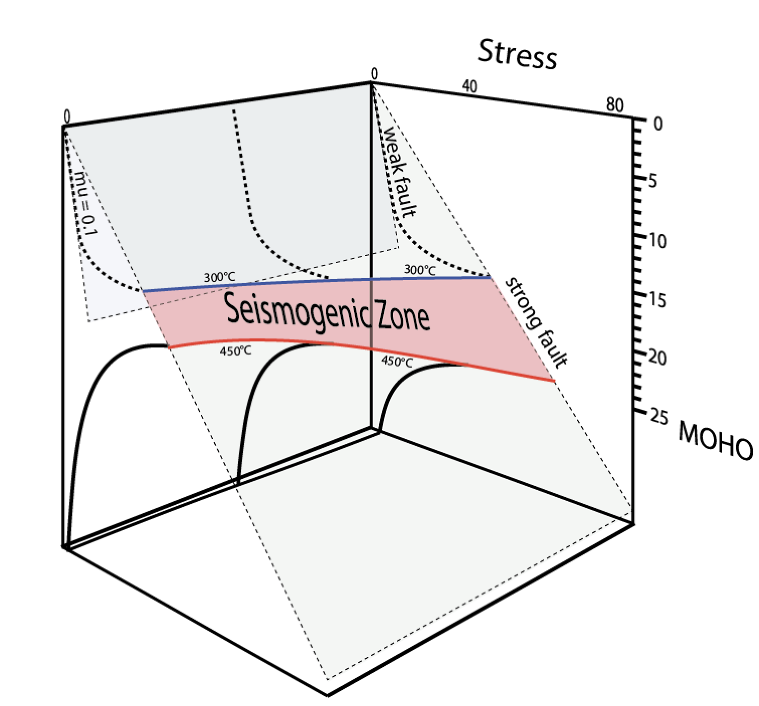
Conclusion remarks
The strong thermal gradient squeezes the seismogenic zone width on Flores Fault.
The coseismic slip (very compact) and seismicity agree well with the seismogenic zone define by 450ºC-300ºC.
Both events show clear rupture directivity, Rupture speed of the two events is ~2km on average.
High overlapping between coseismic and postseismic slip, or very strong post-seismic slip
?
A05
A19
© Authors. All rights reserved

