Slide 1
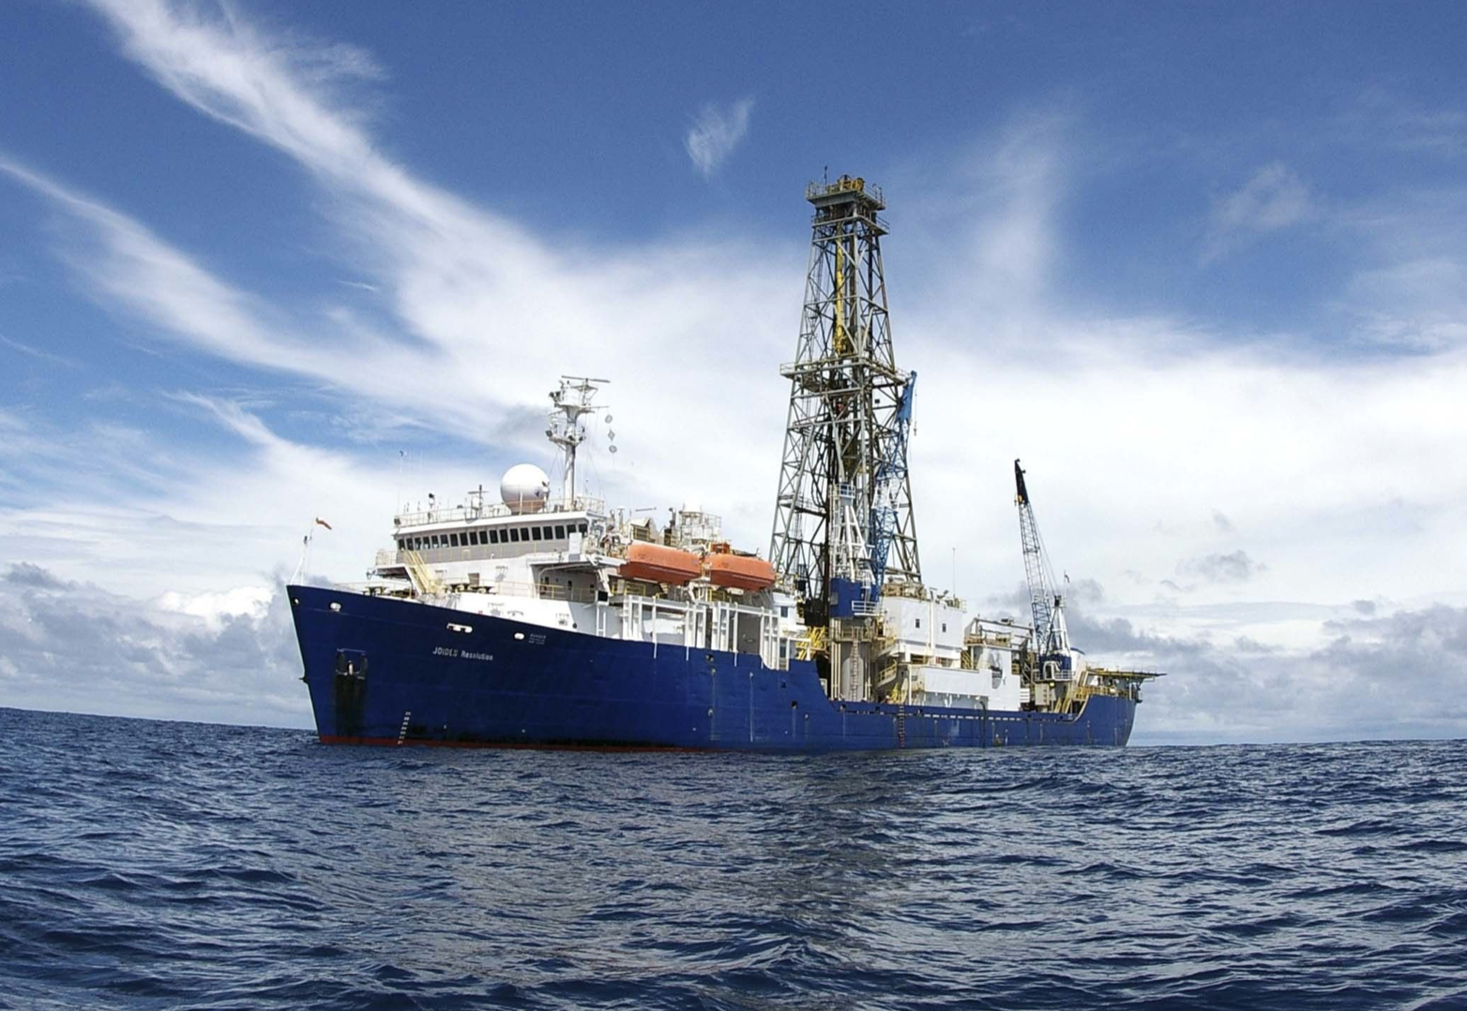
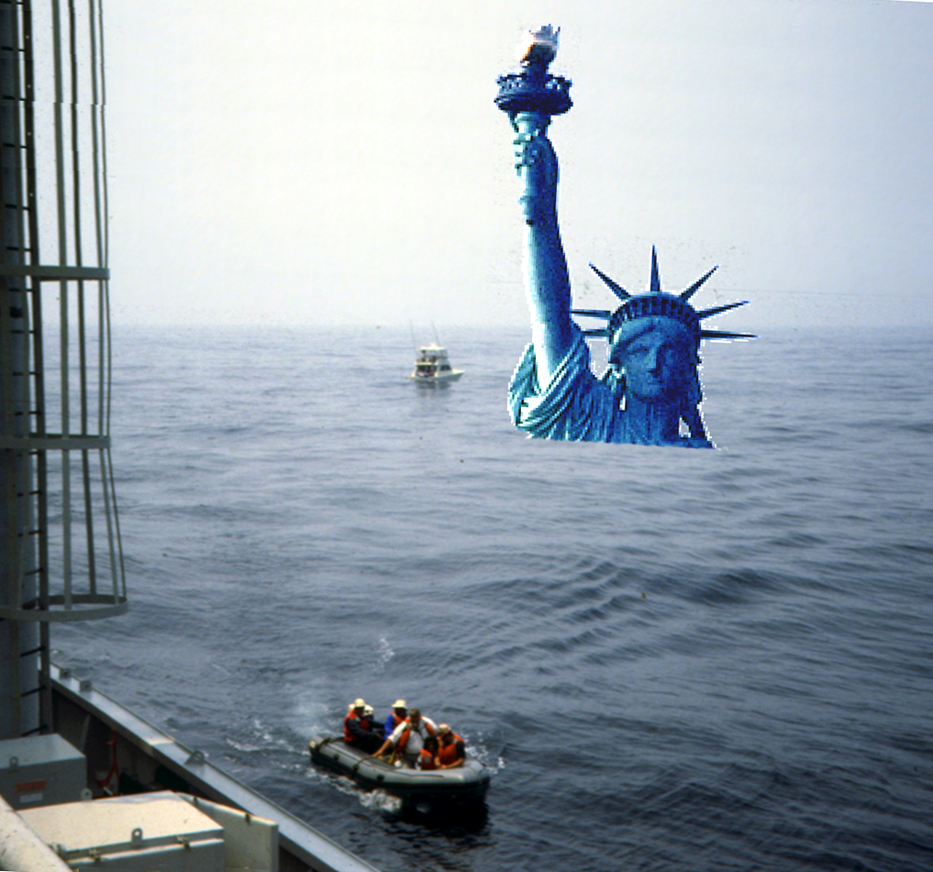
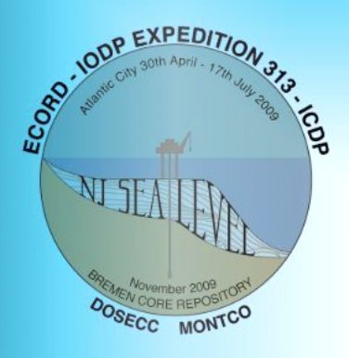
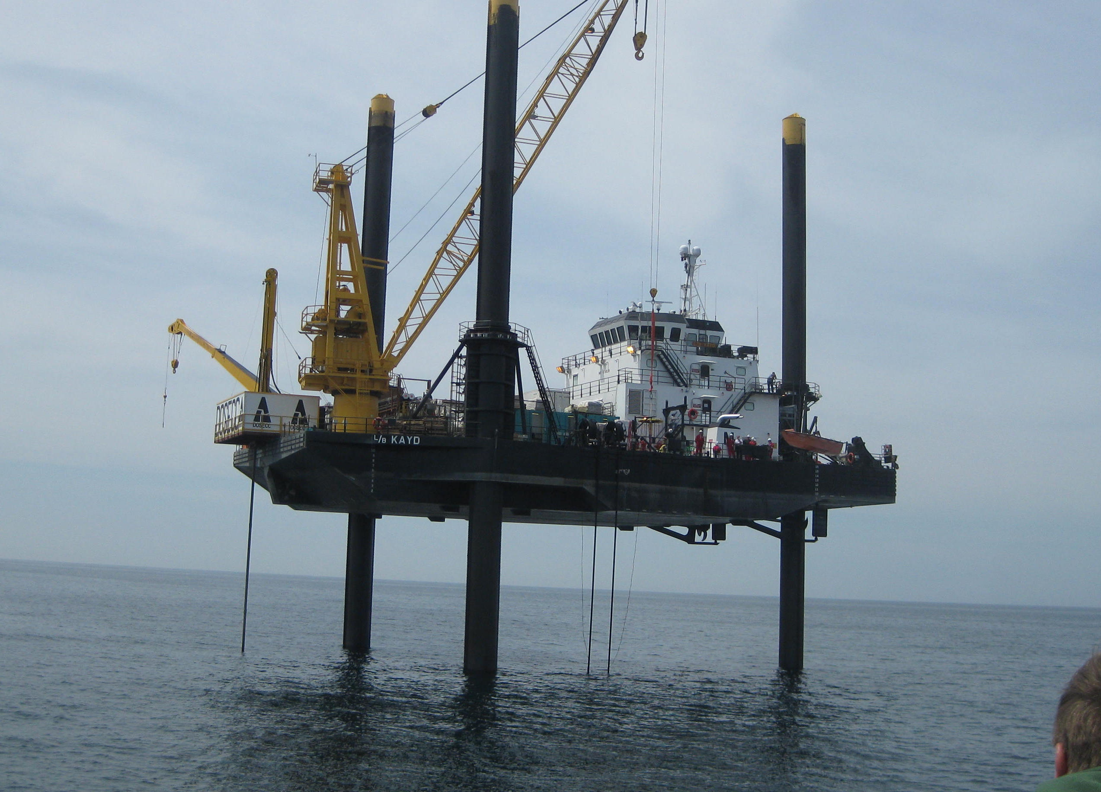
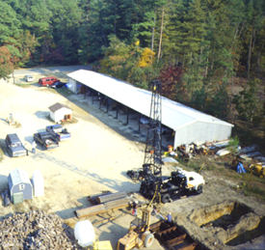
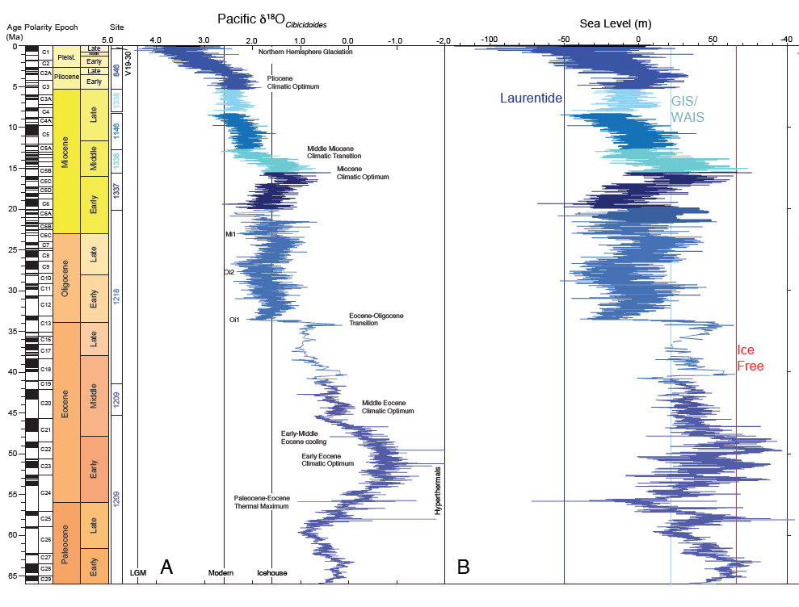


Cenozoic sea-level and cryospheric evolution from deep-sea geochemical and continental margin records
Kenneth G. Miller, J.V. Browning, G.S. Mountain, W.J. Schmelz, R.E Kopp, & J. D. Wright
Department of Earth & Planetary Sciences, Rutgers University
NJ shallow shelf
IODP/ICDP Exp 313
L/B Kayd
ODP/IODP
Legs 150 & 174A
JOIDES Resolution
An ice free world
L/B Kayd Exp 313
Onshore NJ ODP-EAR-ICDP
Legs 150X & 174AX
View of NY harbor from the
JOIDES Resolution in an ice-free world (66 m rise)
New δ¹⁸O & sea-level

Slide 2

© K.G. Miller, J.V. Browning, G.S. Mountain, W.J. Schmelz, R.E Kopp, & J. D. Wright
Material may be reproduced only with permission of authors
All data files will be uploaded to NGDC NOAA Paleoclimate database after publication in May 2020
https://www.ncdc.noaa.gov/paleo-search/study/29130
Please contact Dr. Kenneth Miller kgm@rutgers.edu with questions

Slide 3
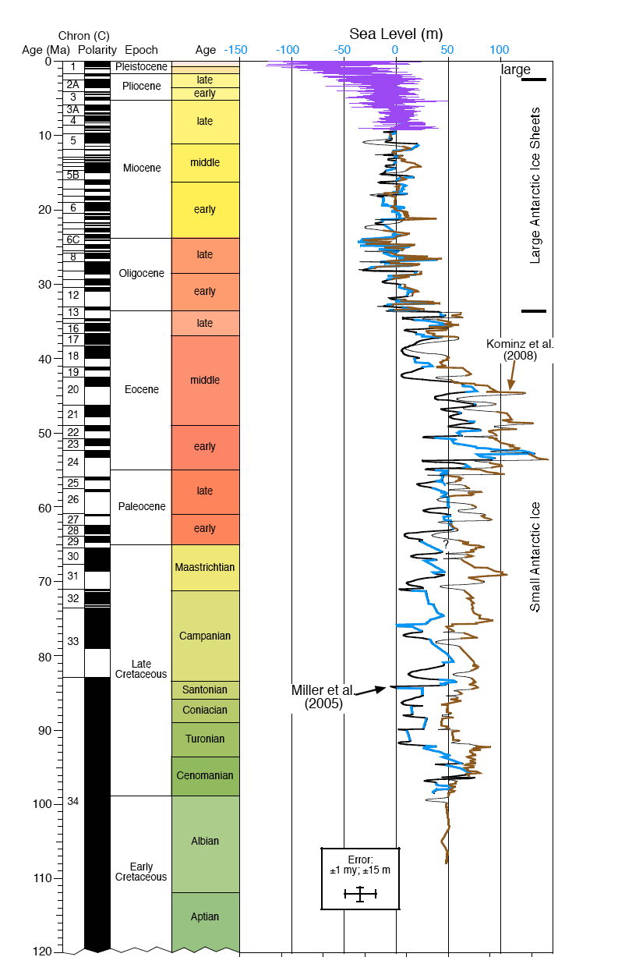
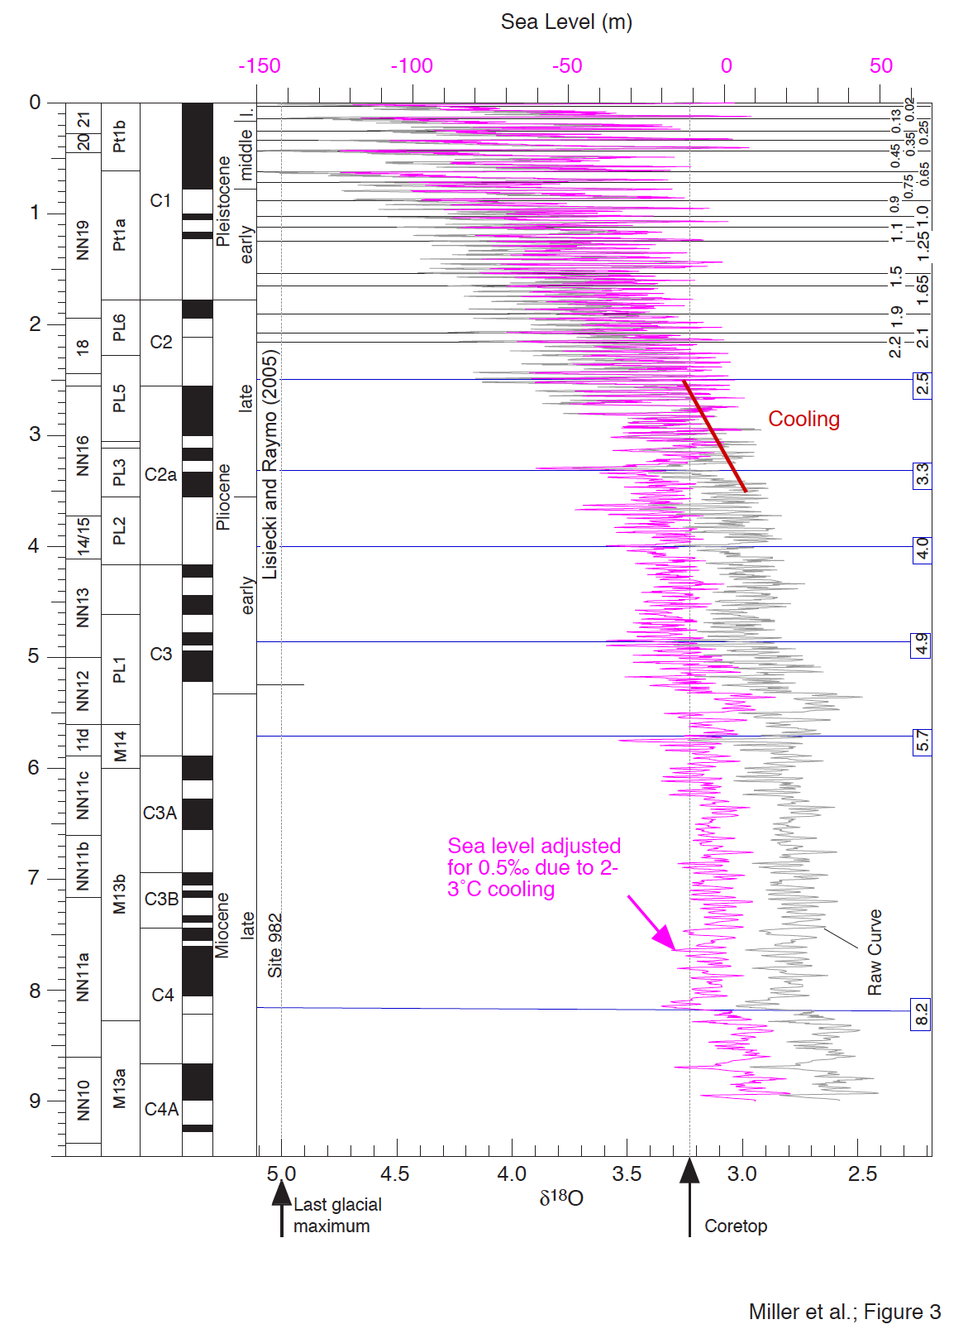
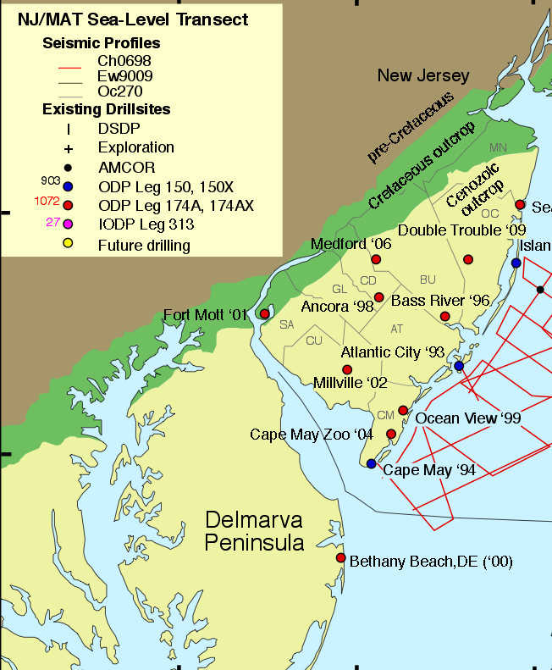
Previous Cenozoic sea-level records Miller et al. (2011)
Left: backstripped estimates from onshore NJ cores
Miller et al. (2005) Kominz et al. (2008)
Right: scaling of deep-sea δ¹⁸O_{benthic} Lisiecki & Raymo (2005) stack
Colder more ice
Warmer
less ice

Slide 4
Overview of Approach for new sea level estimates
Cenozoic (past ~66 Myr) sea-level history reflects temperature changes and cryospheric evolution of the Earth from essentially ice-free Early Eocene conditions in to bipolar Quaternary ice sheets
We derived a global mean sea level (GMSL) estimate for the Cenozoic using a new astronomically calibrated Pacific benthic foraminiferal δ¹⁸O splice from published records and a 2 Myr-smoothed Pacific bottom water temperature record based on published benthic foraminiferal Mg/Ca data
Our GMSL estimates from δ¹⁸O-Mg/Ca are statistically similar to sea-level estimates derived from “backstripping” (progressively accounting for compaction, loading and thermal subsidence) from the mid- Atlantic U.S. continental margin

Slide 5
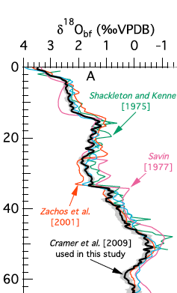
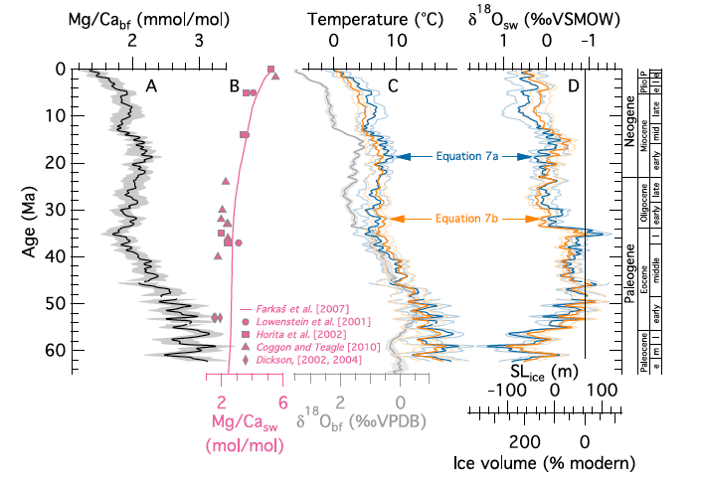
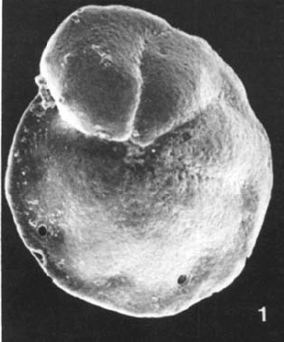
Sea level (δ¹⁸O_{seawater}) from δ¹⁸O & Mg/Ca
Cramer et al. (2011) smoothed Mg/Ca T > 2 Myr
δ¹⁸O_{sw} / 0.13‰/10 m (Winnick & Caves, 2013)
Concluded that NJ sea level estimates agreed with deep sea on time scales >2 Myr
+
Mg/Ca
=
Cramer et al. (2011)
But what about Myr and higher frequency sea level changes?
Notes:
Average d18Oice = -30 then the 0.08‰/10m
d18Oice = -38 then the 0.10‰/10m
d18Oice = -50 then the 0.132‰/10m

Slide 6
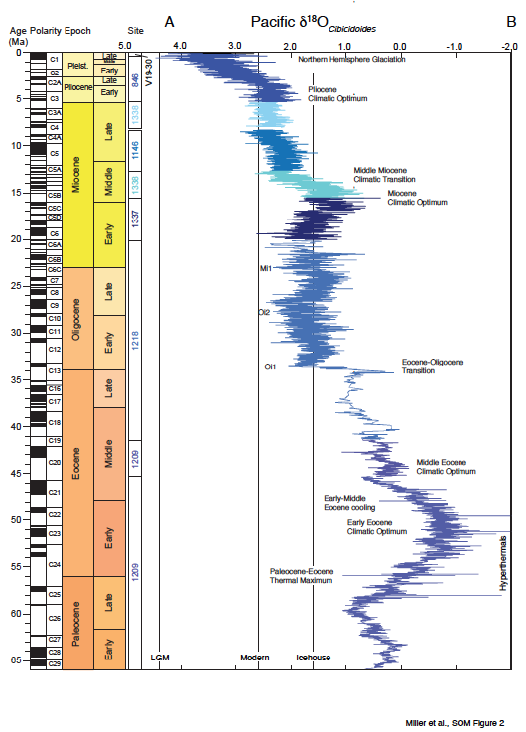
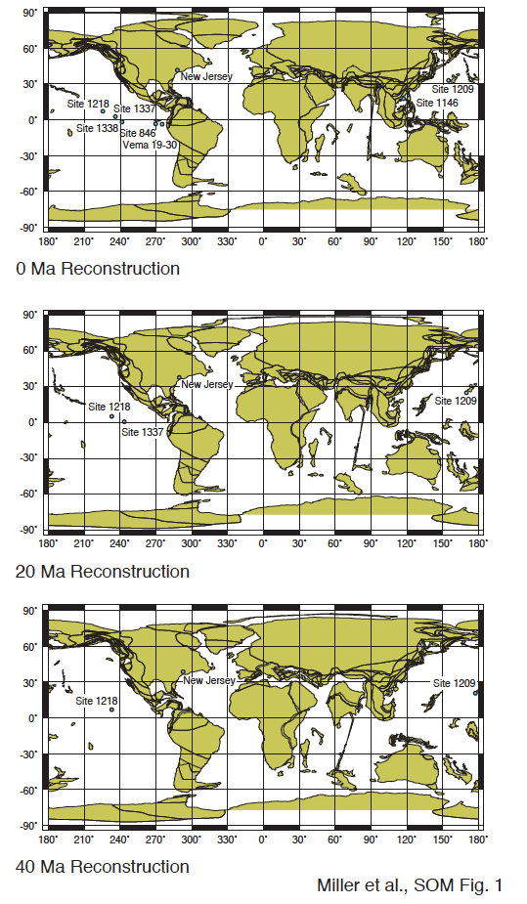
New deep sea benthic foraminiferal δ¹⁸O synthesis (splice)
Benthic foraminiferal δ¹⁸O splice reported to Cibicidoides spp. values. Modern is the core top value for δ¹⁸O_{Cibicidoides}; LGM is the last glacial maximum δ¹⁸O_{Cibicidoides} value; the Icehouse line is placed at 1.8‰ in Cibicidoides, with values greater than 1.8‰ requiring major ice sheets; vertical line at -0.5‰ separates Cool Greenhouse from Hothouse worlds. Each site has a contrasting shade of blue, with the site number indicated on the left column in the corresponding color.
Astronomically tuned Cibicidoides
records all Pacific data
Icehouse
<1.8‰ Cib
Continent scale ice sheets
Hothouse
Cool greenhouse
1.8-1.0‰ Cib
15-35 m sea level equiv.
Icehouse
Hothouse
<1‰ Cib.
Largely ice free

Slide 7
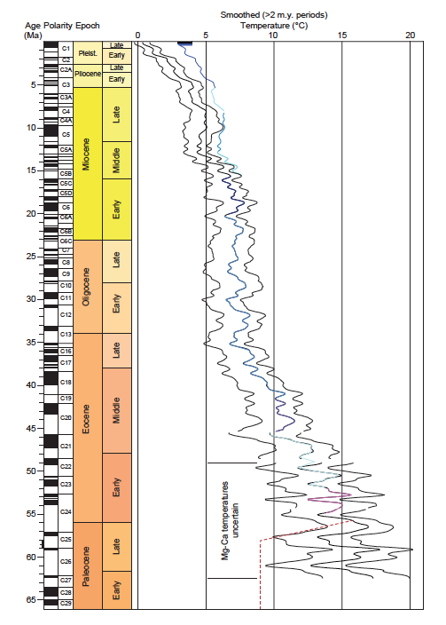
Mg/Ca deep sea temperature estimates °C
Pacific bottom water temperature estimates & errors from Cramer et al. (2011) based on Mg/Ca values using their equation 7b.
Blue is the smoothed record, removing periods shorter than 2 Myr; black lines are 2 σ error estimates. Red line is temperature assumed in Paleocene-Early Eocene.
To get sea level
Mg/Ca temperatures subtracted from δ¹⁸O_{benthic} -0.21‰/°C
Assume 10⁴-10⁵ year scale T comprises ~80% of the δ¹⁸O_{benthic} changes δ¹⁸O_{seawater} converted to sea level 0.13‰/10 m
Winnick & Caves (2015)

Slide 8
A deep sea δ¹⁸O/Mg-Ca based GMSL estimate
GMSL = global mea sea level = “the global mean of the change ΔH in the thickness (or ‘depth’)” Gregory et al. (2019)
GMSL from δ¹⁸O_{benthic} splice and
Mg/Ca temperatures (T) to solve for δ¹⁸O_{seawater}
T = 16.1 – 4.64 (δ¹⁸O_{benthic} – δ¹⁸O_{seawater}) + 0.09 (δ¹⁸O_{benthic} – δ¹⁸O_{seawater})²
δ¹⁸O_{seawater} converted to sea level 0.13‰/10 m
ice-free line (magenta) drawn 66 m above present, Laurentide line drawn at -50 m
Each site has a contrasting shade of blue, with the site number indicated on the left column in the corresponding color
Permanent EAIS
No correction for long-term tectonic effects

Slide 9
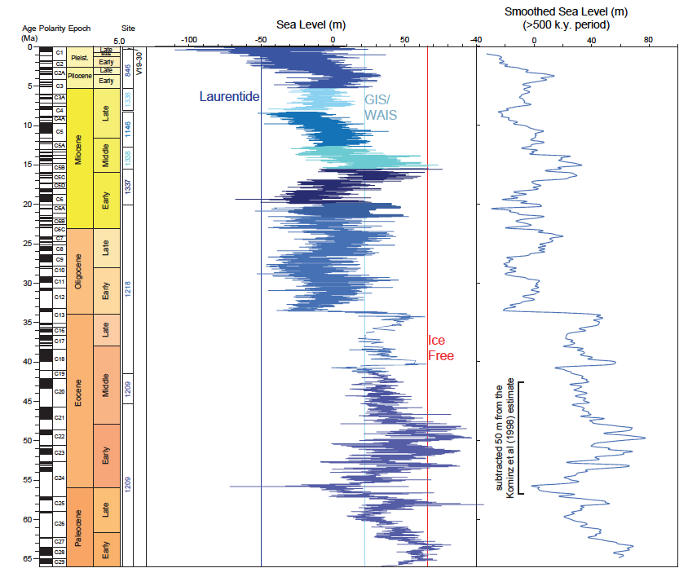
A deep sea δ¹⁸O/Mg-Ca estimates on Myr scale
GMSL estimates shown on left were smoothed (right panel) by interpolating to 20 kyr intervals and using a 49-point Gaussian convolution filter, removing periods shorter than 490 kyr
Permanent EAIS

Slide 10
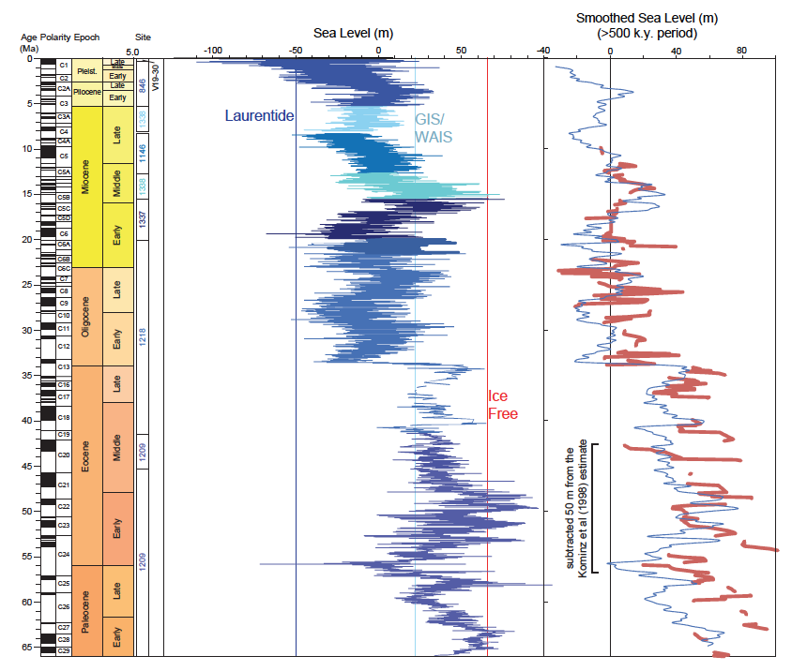
A deep sea δ¹⁸O/Mg-Ca estimates similar to NJ estimates
Continental margin sedimentation acts as a low-pass filter; most Cenozoic sea-level events are modulated by the 1.2 Myr tilt and 2.4 My eccentricity cycle
405 kyr eccentricity only resolved in high sedimentation rate areas
Therefore, we compare our New Jersey backstripped estimates (red) with the smoothed deep-sea GMSL estimate
The NJ estimates for the Early to Middle Eocene were shifted by -50 m as supported by the next figure
Permanent EAIS

Slide 11
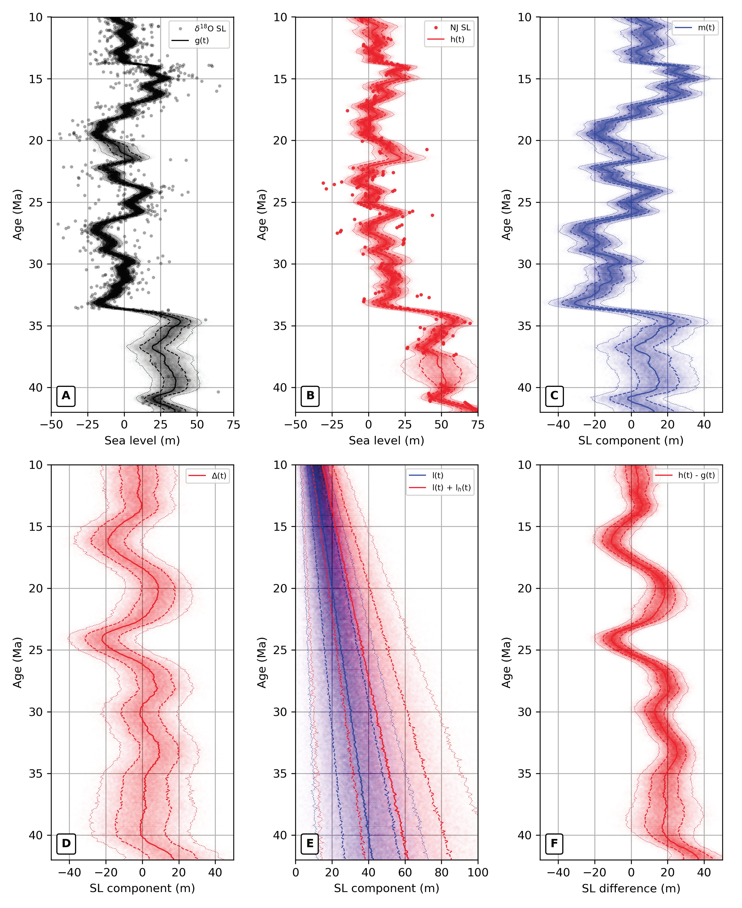
Statistical comparison: δ¹⁸O GMSL = NJ backstripped estimates
Modeled estimates of sea level recorded by the δ¹⁸O-Mg/Ca proxy panel A; g(t) and by backstripping studies of the NJ margin in panel B; h(t). Each modeled curve (g(t) and h(t)) represents a combination of component processes that were fit with Gaussian process priors.
Panel C shared non-linear term, m(t), captures a signal that is correlated at relatively short timescales and is presumably related to ice-volume sea-level change
Panel D a non-linear term that is exclusively associated with the NJ margin data, Δ(t), that captures a ±13.7 m (1σ) signal due to non-thermal tectonics
Panel E linear terms, l(t) and l_h (t), that represent long-term linear trends of 1 m/Myr (± 0.49 m/Myr) and 0.47 m/Myr (± 0.56 m/Myr) present within each SL record, respectively.
Panel F difference between h(t) and g(t), accounting for the correlated signals. The linear component within this offset decreases from 18 m ± 20 m at 42 Ma to 3.1 m ± 4.8 m at 10 Ma

Slide 12
Overview of Cenozocic sea level, climate, & CO₂
Peak global warmth, elevated GMSL, high CO₂, and largely ice-free conditions occurred during the Early Eocene “Hothouse”
During the Middle-Late Eocene “Cool Greenhouse,” small ice sheets associated with lower atmospheric CO₂ drove sea-level changes
Continental-scale ice sheets began in the Oligocene “Icehouse” (ca. 34 Ma), a permanent East Antarctic ice sheet began in the middle Middle Miocene (ca. 12.8 Ma), and full, bipolar glaciation began in the Quaternary (ca. 2.55 Ma)
Despite large uncertainties in proxies, our study reaffirms that throughout the Cenozoic, high long-term (107-year scale) CO₂ was associated with warm climates and high sea levels. However, sea level- change was dominated by periodic, astronomically controlled (10’s kyr-Myr scale) Milankovitch variations superimposed upon longer-term changes driven by CO₂.

Slide 13
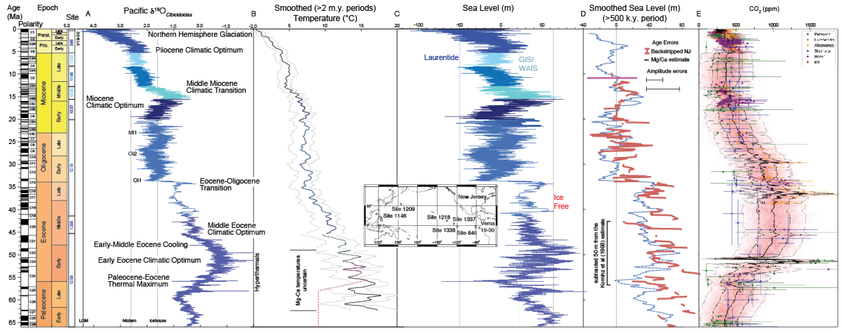
Geological perspective of sea level & CO₂ cycles
High CO₂ = ice free worlds, but Milankovitch is pacemaker of sea-level change
CO₂
Foster et al. 2017
Bayesian Hierarchical Model

Slide 14
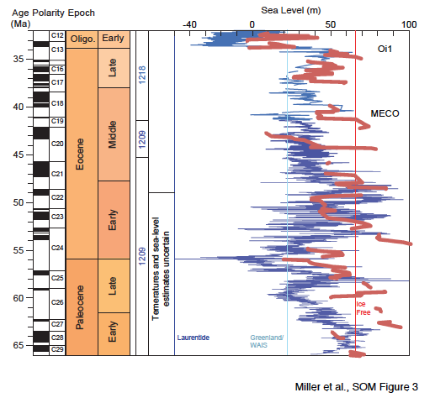
Paleocene to Eocene sea level
Pre-48 Ma record highly uncertain due to temperature and δ¹⁸O records issues
Unrealistic Paleocene ice volumes due to Mg/Ca_{seawater} known unknowns
Middle Eocene Climate Optimum (MECO) bracketed by glacial GMSL falls
35±10 m
(50-90% EAIS)
The doubthouse is in fact
a cool Greenhouse with significant ice sheets
MECO
?
?
?
?
Little faith in the δ¹⁸O-Mg/Ca sea level older than 48 Ma

Slide 15
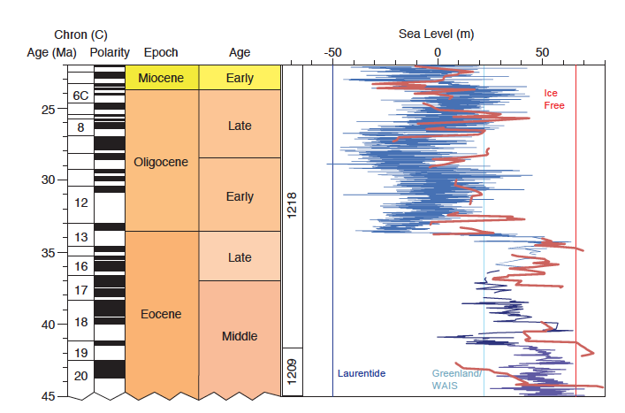
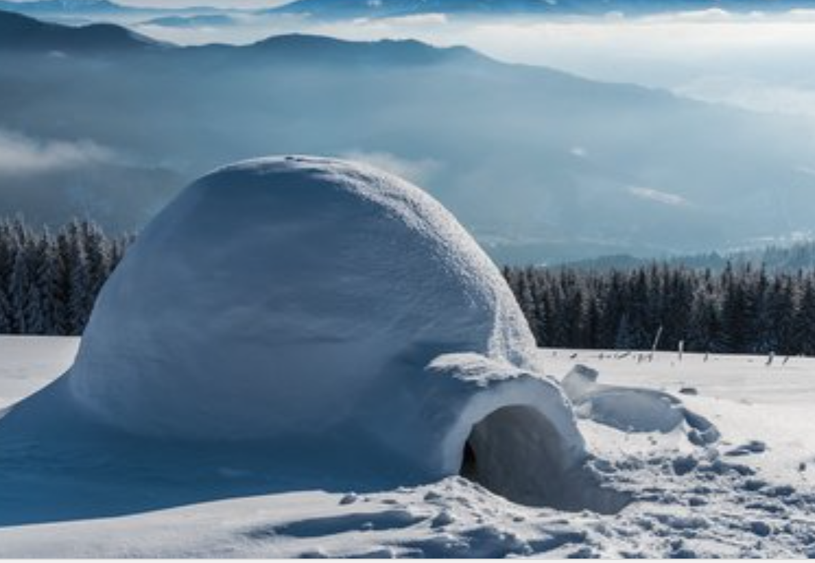
Middle Eocene to Oligocene sea level
EOT (60-70 m), mid-Oligo. Oi2, and Mi1 the major sea-level falls
sea-level curves from two fundamentally different methods agree, both with large errors (±10 m)
Mi1
“mid-Oligo”
Oi2
O-1 EOT
MECO

Slide 16
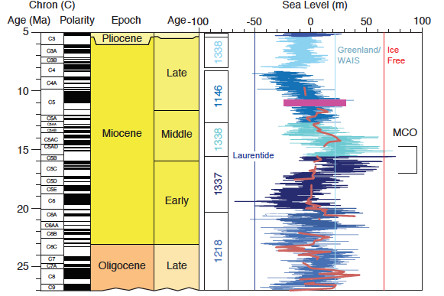
Miocene sea level: Miocene Climate Optimum ice free?
Near ice-free MCO then MMCT = “permanent” EAIS; NJ onshore record misses lowstands
Miller et al. (in prep.)
Permanent EAIS
Mi4
Mi3
Mi2a
Mi2
Mi1

Slide 17
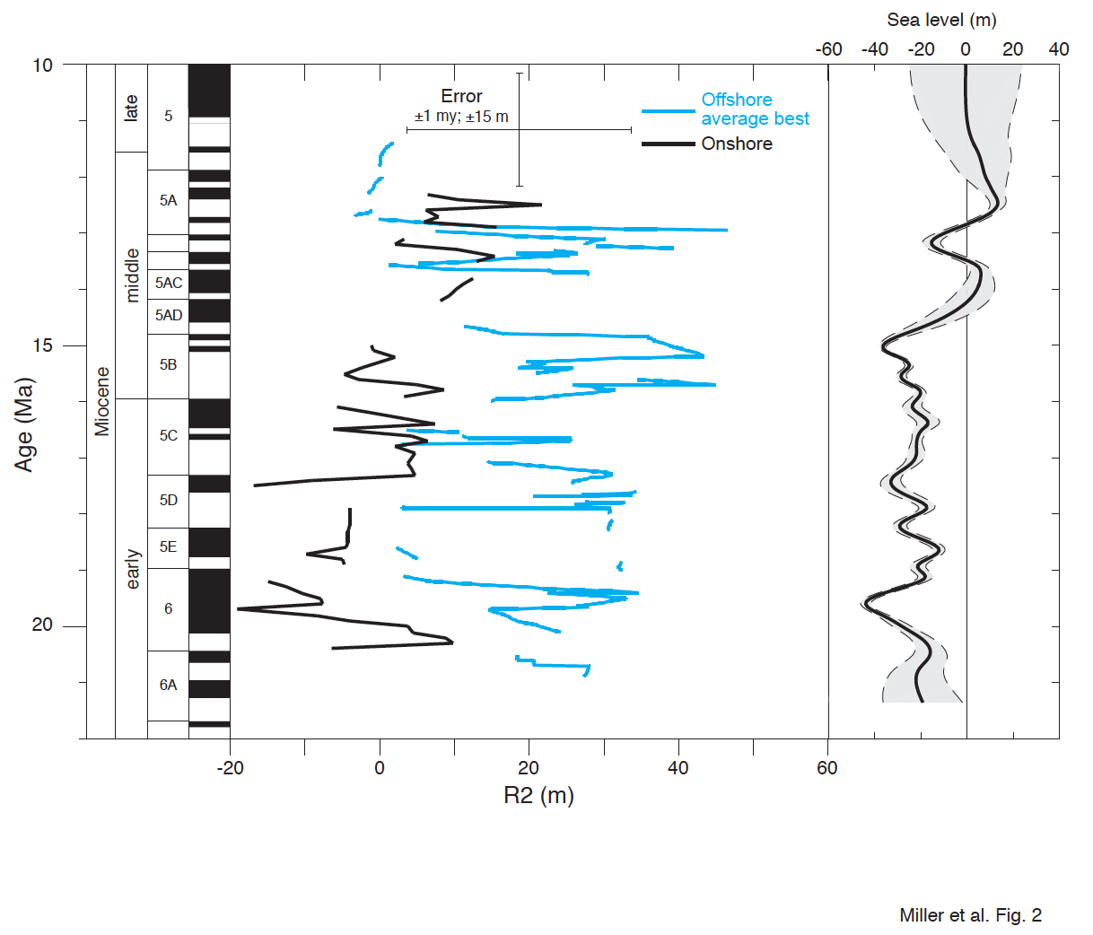
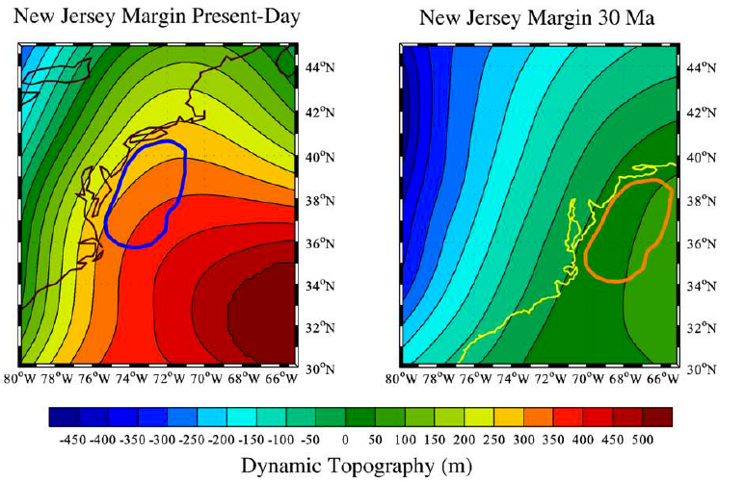
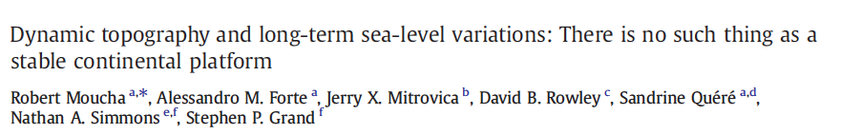
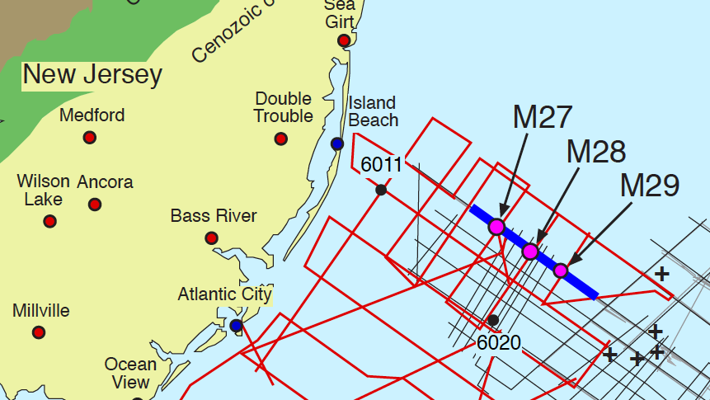
Onshore vs offshore predicted by Mantle Dynamic Topography models
Difference between onshore NJ and offshore collapses 15.0 to 13.7 Ma (-36±1.5 to 6±5 m/Myr), quantifying relative rates of differential subsidence of 25 m/Myr (modified after Kominz et al., 2016 )
Curves after Kominz et al. (2016)

Slide 18
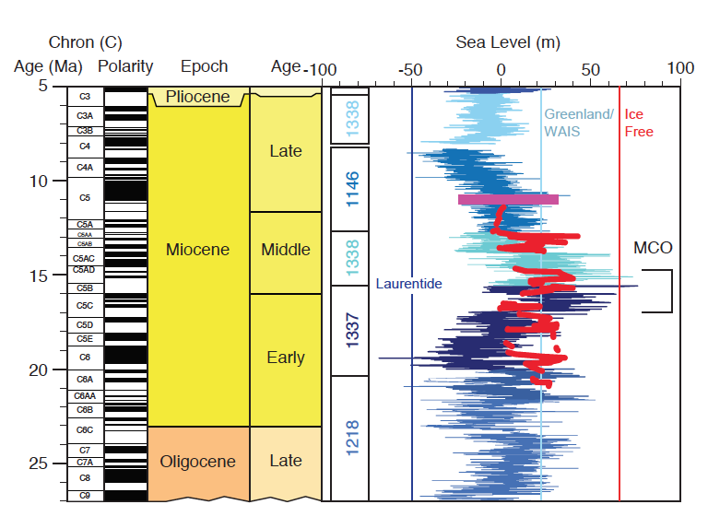
Miocene sea level
NJ onshore record misses lowstands captured offshore
NJ offshore captures lowstands
Kominz et al. (2016)
Mi2a
Permanent EAIS
Mi4
Mi3
Mi2
Mi1

Slide 19
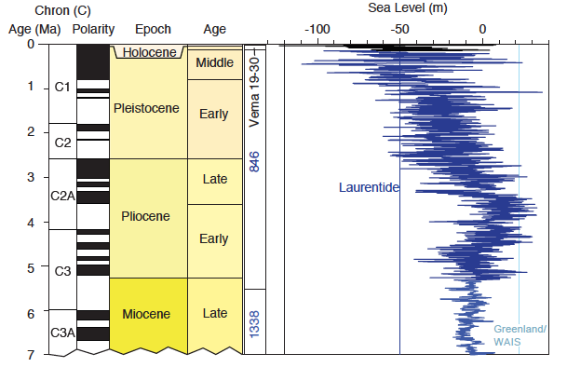
Late Neogene sea level
Laurentide last 2.7 Ma. What about warm Pliocene?
“Stage 100 initiation”

Slide 20
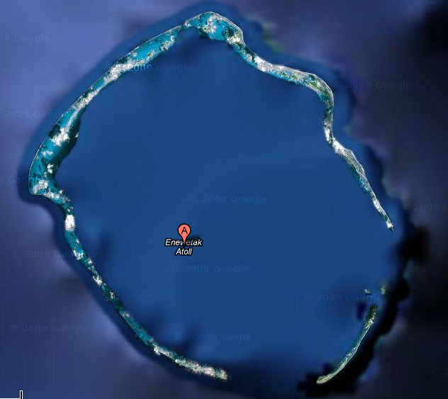
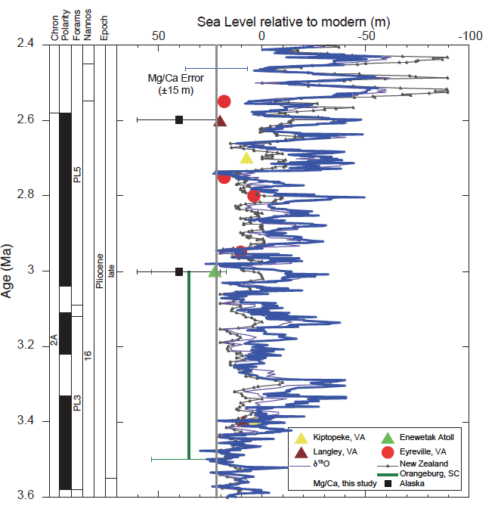
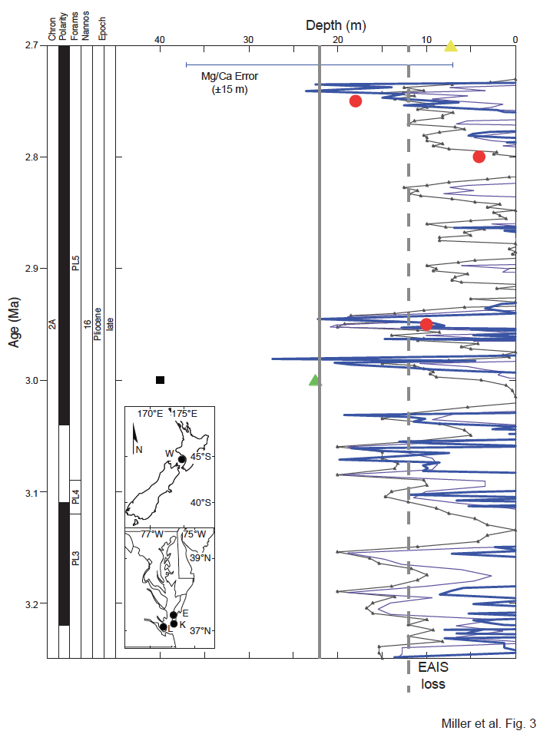
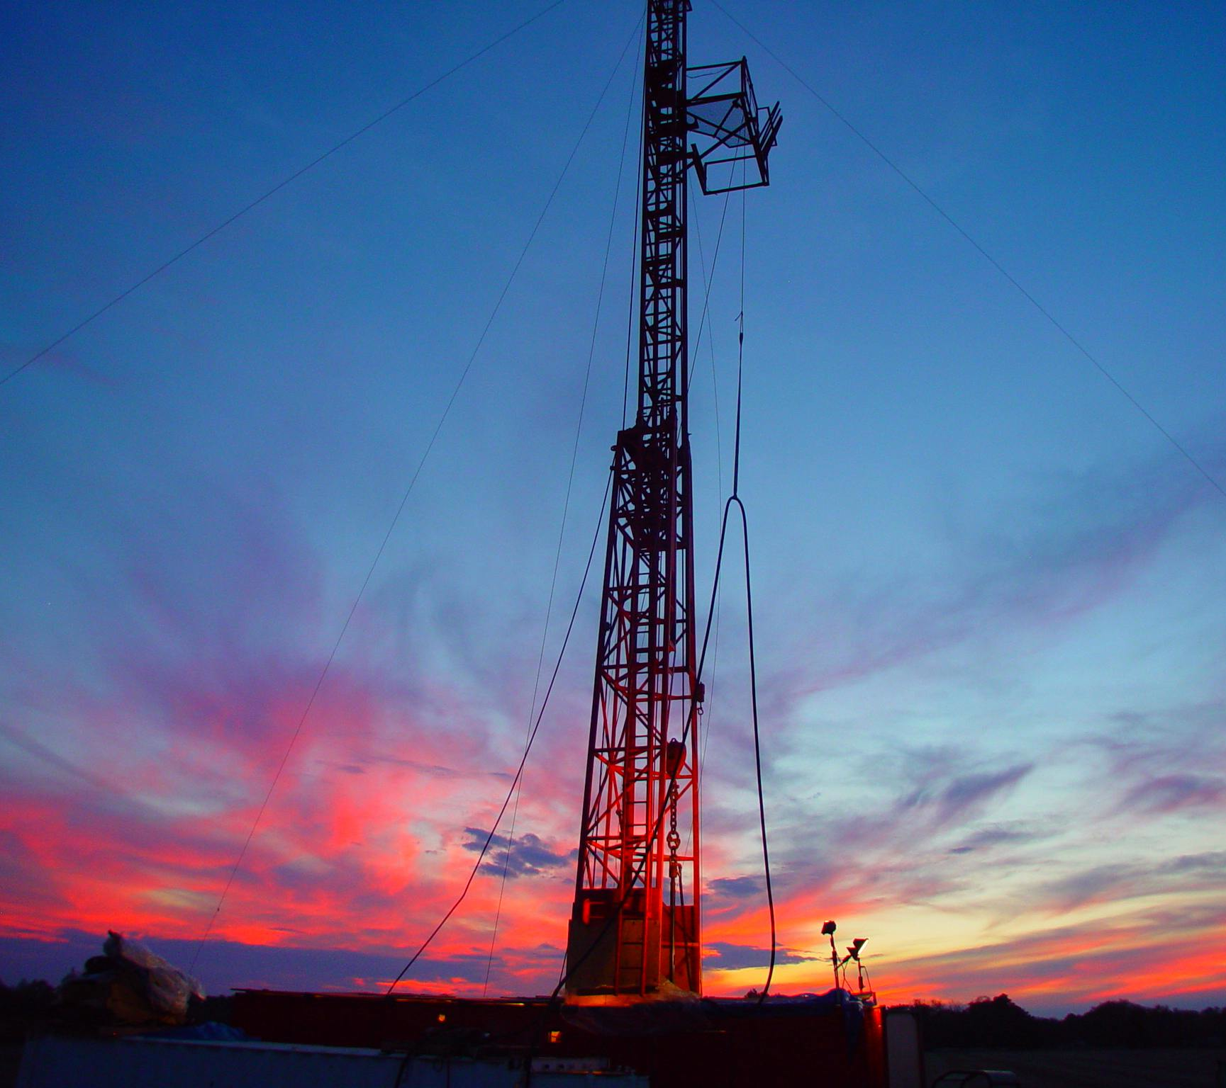
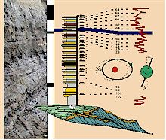
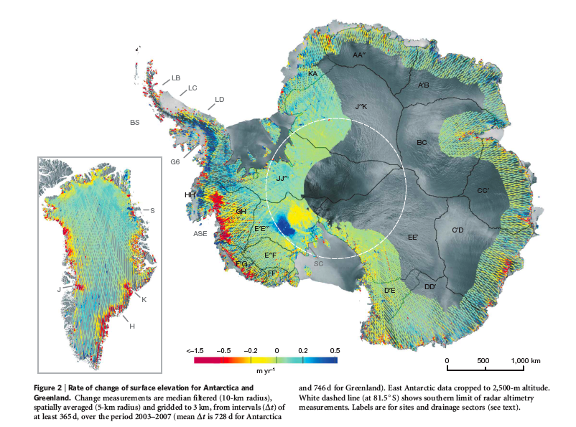
Pliocene climate optimum ca. 3 Ma
Peak sea level 22±5 m, CO₂ = 400 ppm, global T = 1-2°C warmer
(Miller et al., 2012, 2018)
2018: “Re-evaluation of mid-Pliocene sea levels… despite large errors (±10 to ±20 m), sea levels peaked at ~15-20 m above present…some EAIS ice loss”
Enewetak Atoll
Virginia
NZ
δ¹⁸O-Mg/Ca
Wanganui Basin
New Zealand
Wilkes & Aurora

Slide 21
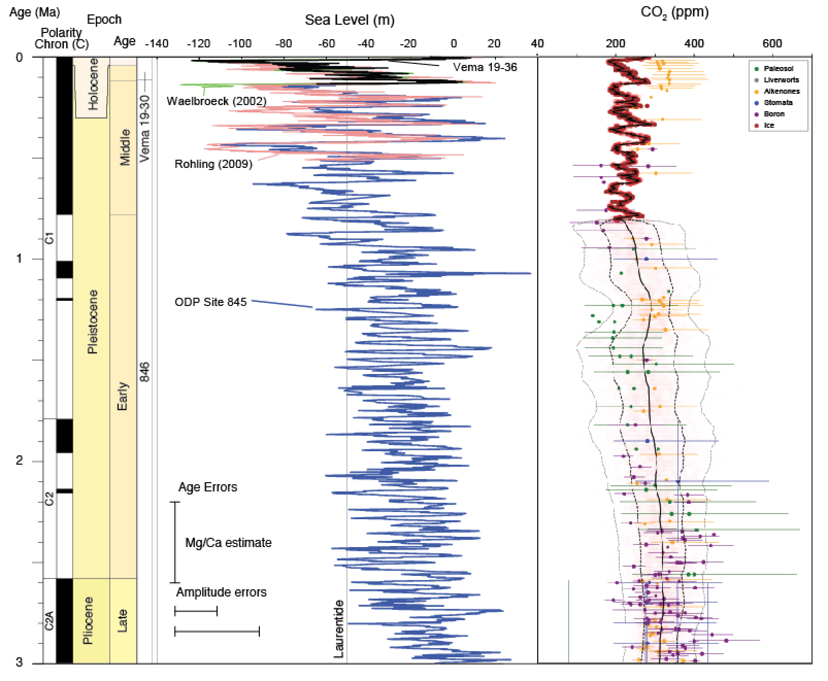
Sea level and CO₂ past 3 Million years
CO₂ changes alone cannot explain the 2.7-2.5 Ma Northern hemisphere ice ages or
ca. 1.0-0.8 Myr “mid-Pleistocene” transition (from 41 to quasi-100 kyr dominated)
MPT
“Stage 100 initiation”
NHIS

Slide 22
Frequency response of Cenozocic δ¹⁸O and sea level
We computed continuous wavelet transform (CWT) spectrograms of forcing, δ¹⁸O, and sea level for the Cenozoic
Precession (19, 23 kyr), eccentricity (95, 125, 405, and 2,400 kyr), and tilt (41, 1,200 kyr) periods are indicated
41 kyr tilt is strong in δ¹⁸O records during the Icehouse, cool Greenhouse, and surprisingly hinted at in the Hothouse worlds
Eccentricity and precession (2.4 Myr, 405 long, quasi-100 kyr, and 19/23 kyr) fade in and out; there were many “100 k” worlds

Slide 23
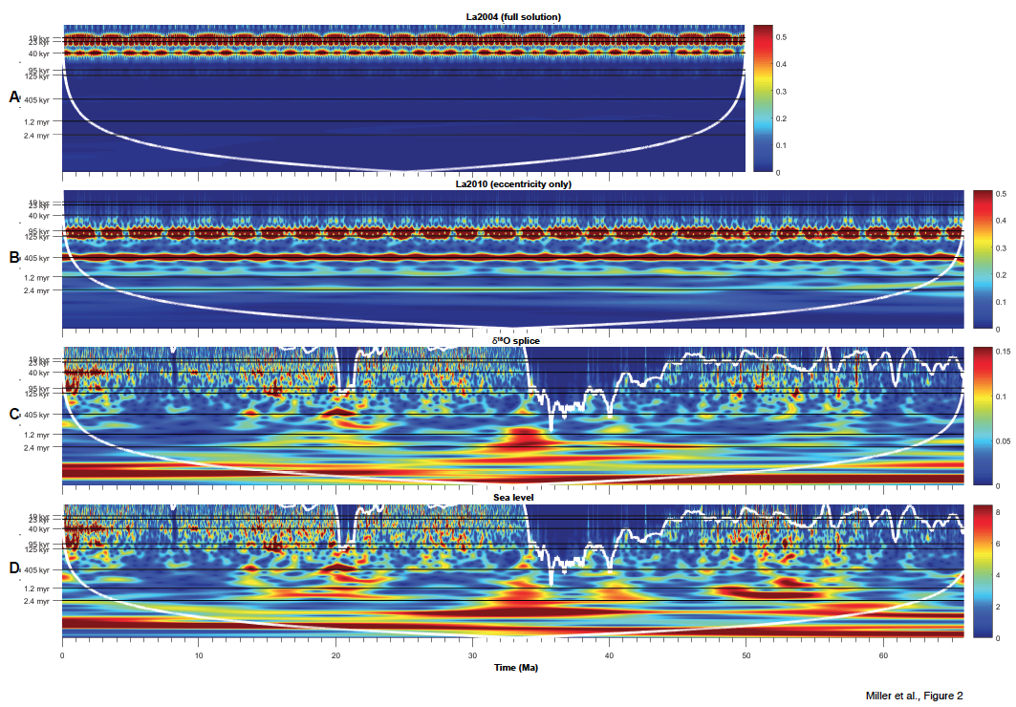
Spectral response of δ¹⁸O and sea level to astronomical forcing
color scales of relative power are used to map the temporally localized amplitudes associated with the spectral components
Continuous wavelet transform (CWT) spectrograms of forcing
Permanent EAIS
Cone of influence
La2010 Full solution to 50 Ma
La2010 eccentricity
δ¹⁸O
Nyquist
Sea level

Slide 24
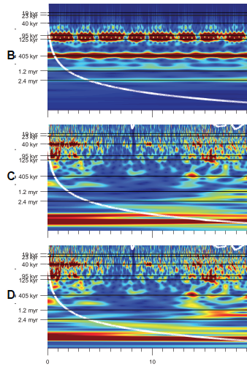
Astronomical response
Though eccentricity forcing is largely unchanged, we observe:
Decreased response of ice sheets and sea level at all orbital periods (especially eccentricity) with the development of the permanent East Antarctic ice sheet 14.8-12.8 Ma (see also de Vleeschouer et al., 2017)
Increased response of ice sheets and sea level at eccentricity periods just prior to the 2.75-2.5 Ma NHIS and 1.0-0.8 Myr MPT
The change in response at eccentricity periods is related to ice sheets growing/decaying in sensitive regions:
East Antarctica prior to 14.8 Ma,
mid-latitude NHIS last 2.7 Myr
and thus must reflect ice-sheet feedbacks
δ¹⁸O
Sea level
MPT
NHIS
MMCT

Slide 25
Overview of Quaternary sea level, climate, & CO₂
Full, bipolar glaciation with sea level below 50 m below present began in the Quaternary (ca. 2.55 Ma).
The Last Glacial Maximum (20-27 ka) was the largest lowering of GMSL (~130 m) of the Mesozoic-Cenozoic
GMSL rise during last deglaciation (ca. 19-10 ka) exceeded 40-45 mm/yr.
Sea-level rise progressively slowed from 10 ka to 2 ka
GMSL was then at stillstand until late 19th to early 20th century when rates began to rise.

Slide 26
Sea level past 150,000 years
Milankovitch orbital control
21 & 41 kyr cycles
CO₂ lags temperature on
quasi-100 kyr scale,
acts as an amplifier

Slide 27
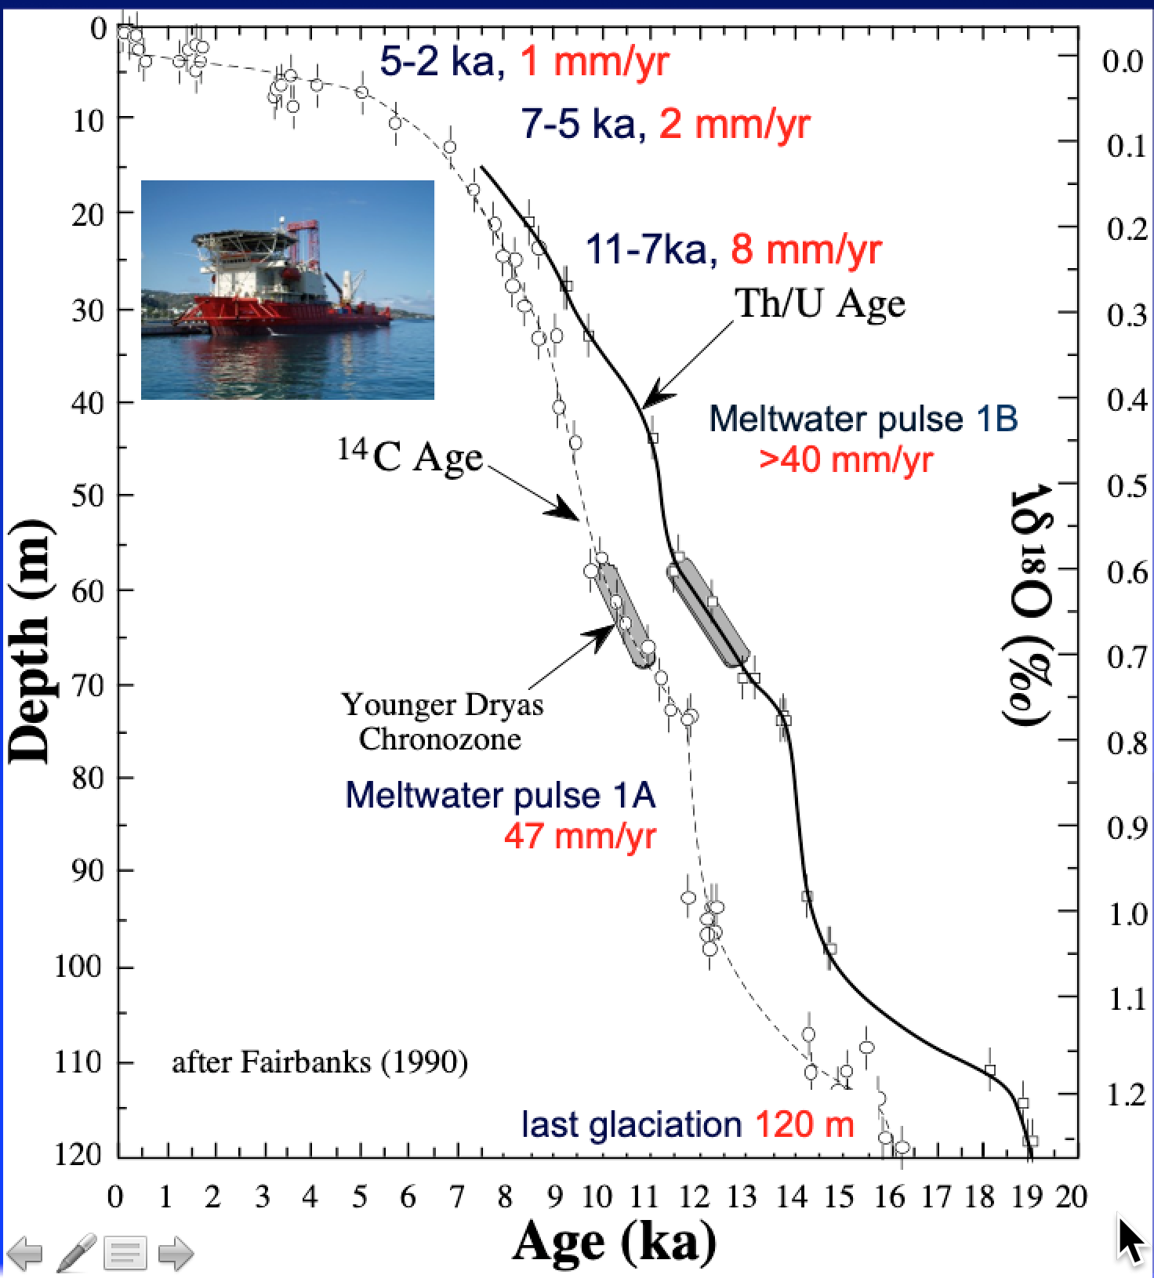
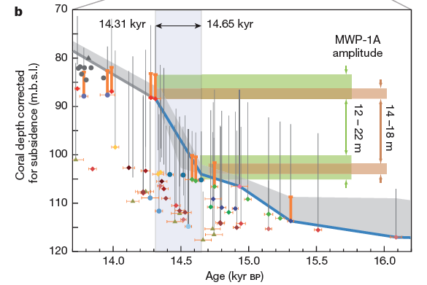
Sea level during deglaciation
Barbados 120± 5 m lowstand @ 20 ka = 127 GMSL
Last Glacial Maximum (Peltier & Fairbanks)
MWP1A rate >47 m/1000 yr
rates from Fairbanks, 1990; Stanford et al., 2006; Miller et al., 2009; Dechamps et al., 2012; Abdul et al., 2016)
Tahiti Exp 310
Deschamps et al. (2012)

Slide 28
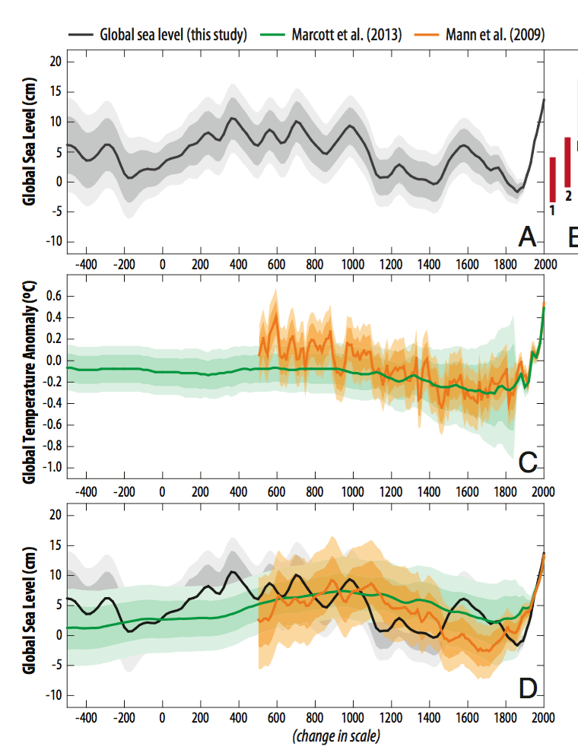
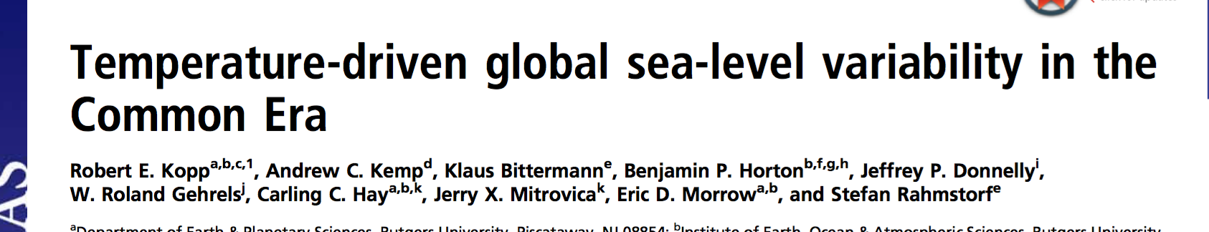
Common Era stillstand
Common Era sea level stable (0-10 cm above baseline) until 1900 CE,
1.2 mm/yr 20th century
3.2 mm/yr today
Therefore, the natural background rise only a small fraction today’s rise,
most is due to human influence

Slide 29
Conclusions
δ¹⁸O/Mg-Ca based ice volume & GMSL estimate for the past 66 Myr
δ¹⁸O/Mg-Ca glacioeustatic = NJ backstripped estimates, testifying to sea level control 1-2 Myr scale
Middle Eocene Climate Optimum (MECO) bracketed by glacial GMSL falls
Icehouse began Eocene-Oligocene (EOT) with Antarctica > modern (sea level fall >50 m)
Ice-free Miocene Climate Optimum (MCO), then MMCT = “permanent” EAIS
Pliocene Climate Optimum (PCO, ca 3 Ma): some EAIS ice loss
Laurentide ice ages last 2.7 Ma

