Slide 1
EXPERIMENTAL ANALYSIS OF SEGREGATION IN GRANULAR FLOWS
Silvia D’Agostino and Aronne Armanini
Department of Civil, Environmental and Mechanical Engineering, University of Trento, Italy
Notes:
Alternativa titolo: experimentale analysis of a binary mixture granular flows

Slide 2
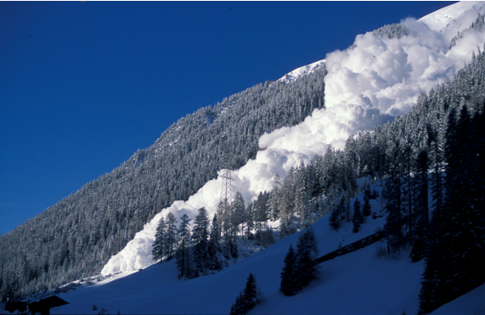
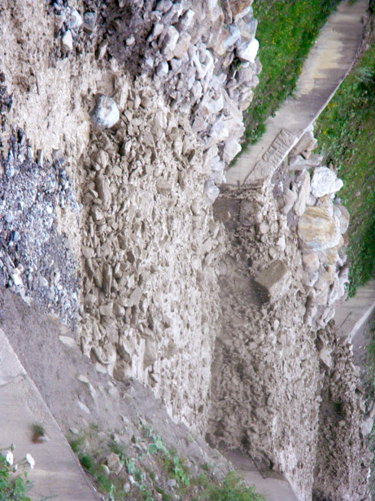
1. Definitions
Massive geophysical flows → moving mass of rocks, water and/or air flowing down a slope under the influence of gravity
Granular flows → heterogeneous mixtures of particles of different size, density and shape
SEGREGATION
vertical grading
1

Slide 3
1. Definitions
Two mechanisms responsible for particles transferring
PERCOLATION
falling into small cavities
KINETIC SIEVING
imbalances in contact forces
2

Slide 4
4. Segregation model
Mass and momentum balances for interstitial fluid and each class of particles (Cauchy equations)
$β=s,l$ solid and liquid fraction
generic component of the velocity vector
interaction among solid phase and fluid phase
weight force
internal stresses of each phase
interphases tensor
Segregation in Granular Flows
3
Notes:
following Atkine & Craine’s, 1976 approach, mass balance and momentum balance for each class of particles (granular solid) and the fluid (water or air)

Slide 5
4. Segregation model
In case of two grain size classes, the two main physical mechanisms are considered in the mass equation
DIFFUSION COEFFICENT
INFILTRATION COEFFICENT
NUMERICAL SOLUTION OF THE SEGREGATION MODEL
4
Notes:
unexpanded polystyrene spheres, density d = 1035 Kg/m³

Slide 6
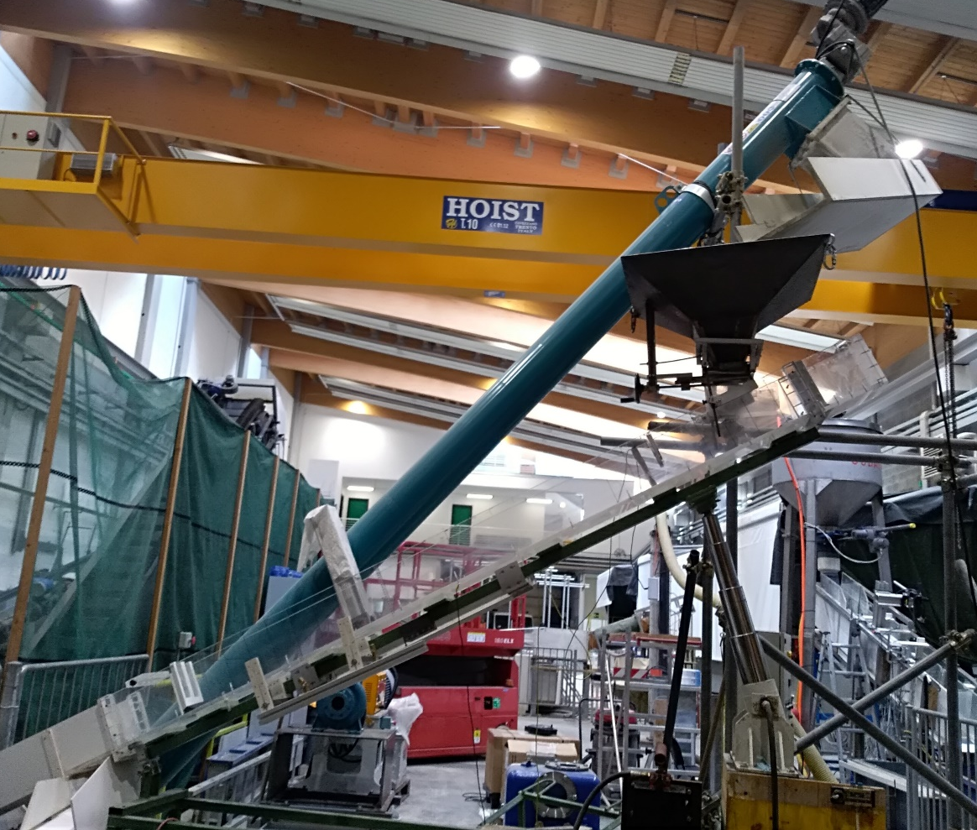
5. Experimental analysis
Experimental simulation of a two-dimensional bi-mixture flowing down an inclined chute
SMALL FRACTION
black particles
d₁ = 0.75 mm
ρ_{s} = 1035 kg/m³
LARGE FRACTION
white particles
d₂=1.40 mm
ρ_{s} =1035 kg/m³
5
Notes:
unexpanded polystyrene spheres, density d = 1035 Kg/m³

Slide 7
5. Experimental analysis
Experimental set-up
High speed camera FASTCAM X 1024 PCI
Plastic weir 100x168 cm with two openings
Auger frequency: 40 Hz
Granular flow discharge: 3.5 10 ⁻⁴ m³/s
Transparent lateral sidewalls
Flume inclination: 29.4°
System of two led lights
auger recirculation system
hopper
opening gate
weir
particles
camera section
Segregation in Granular Flows
6
Notes:
unexpanded polystyrene spheres, density d = 1035 Kg/m³

Slide 8
5. Experimental analysis
7
Notes:
unexpanded polystyrene spheres, density d = 1035 Kg/m³

Slide 9
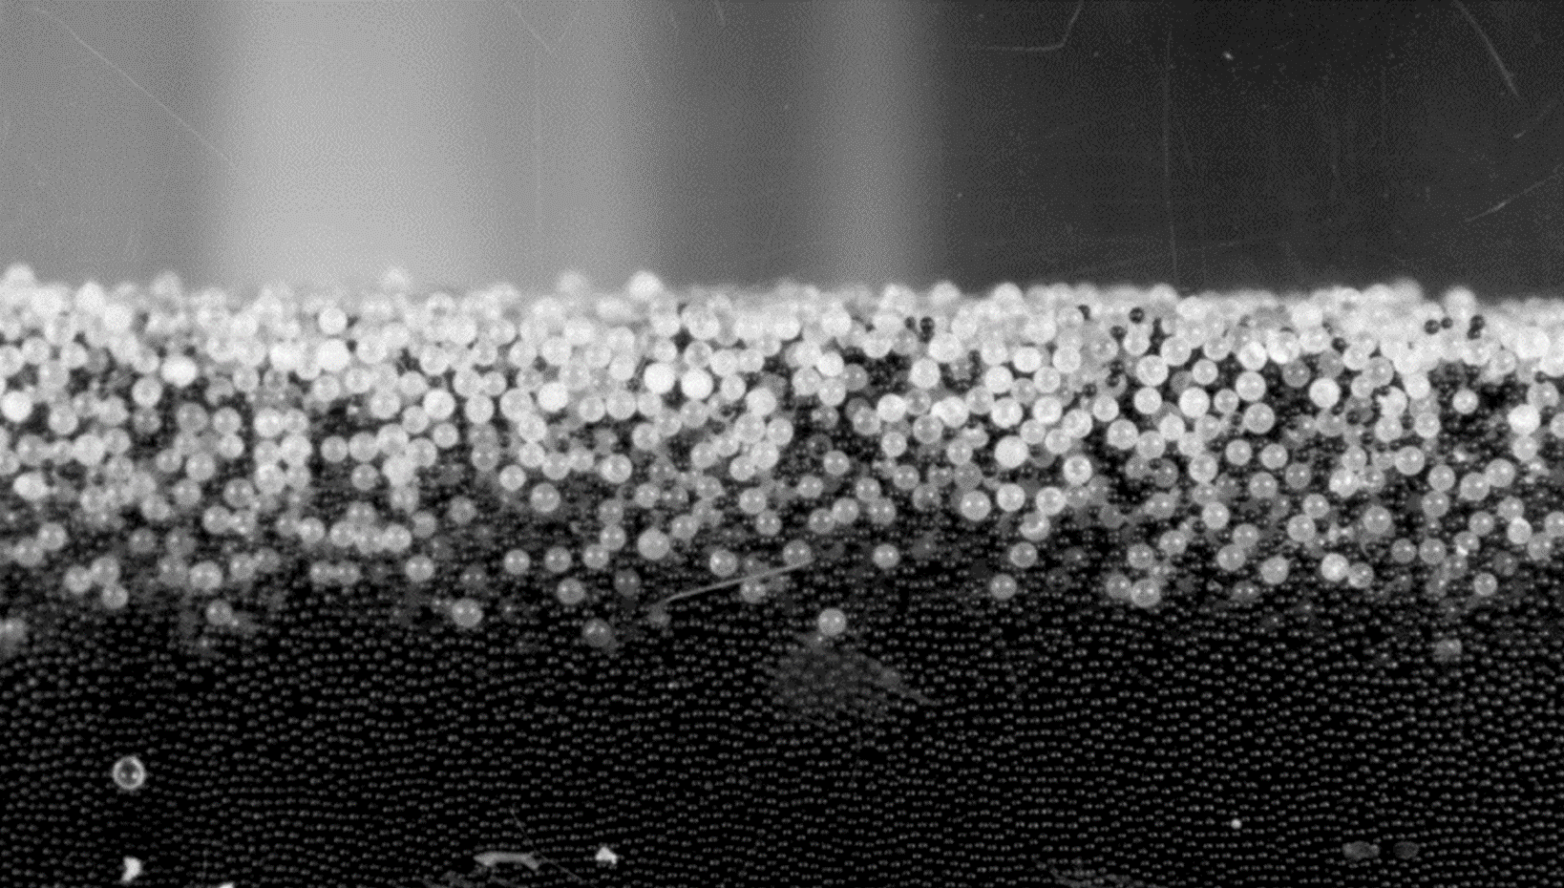
5. Experimental analysis
Region of interest
single layer
Region of measure
8
Notes:
unexpanded polystyrene spheres, density d = 1035 Kg/m³

Slide 10
5. Experimental analysis
Procedure for tracing circular particles
(a) Adaptive histogram equalization
(b) Denoising
(c) Filtering
(d) Binary mask
(e) Detected balls
(f) New image
9
Notes:
unexpanded polystyrene spheres, density d = 1035 Kg/m³
Watershed algorithm for overlapping objects and pixels detection by EDT

Slide 11
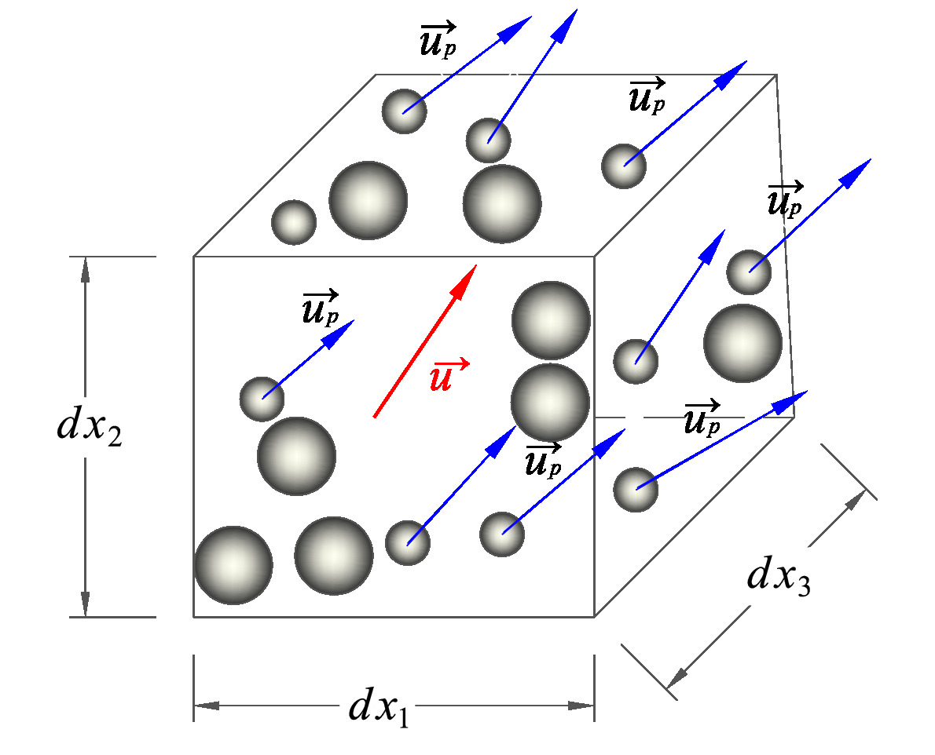
5. Experimental analysis
Velocity
$$u_{i}=\frac{\sum_{k=1}^{k=n_{p}}{{{(u}_{p})}_{k}}}{n_{p}}$$
$$u_{p}$$
velocity of the particles in the layer
number of particles in the layer
velocity of the i-layer
$$n_{p}$$
$$u_{i}$$
$$U_{i} =\frac{\sum_{1}^{n}{u_{i} }}{n}$$
average velocity over the frame
number of frame
$$U_{i}$$
$$n$$
Concentration
$$c_{i,g}=\frac{n_{g}}{n_{tot}}$$
$$n_{g}$$
pixel of the single solid phase
$$n_{tot}$$
total pixel of the solid phase
$$c_{i,g}$$
concentration of the solid phase
Granular temperature
$$u_{i}^{′}=u_{i}− <u_{i}>$$
instantaneous velocities fluctuations
$$T=\frac{u_{1}^{′2}+u_{2}^{′2}}{2}$$
$${<u}_{i}>$$
spacial average velocity
10
Notes:
unexpanded polystyrene spheres, density d = 1035 Kg/m³

Slide 12
6. Results
SEGREGATION AT TIME T1
11
Notes:
unexpanded polystyrene spheres, density d = 1035 Kg/m³

Slide 13
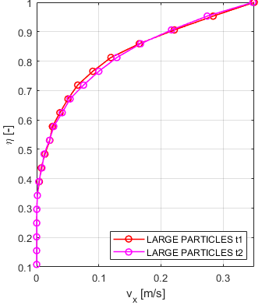
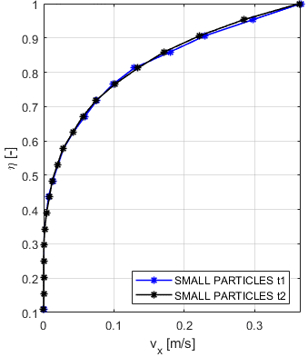
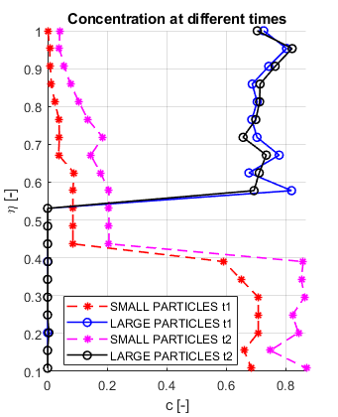
6. Results
SEGREGATION AT TIME T1=0 AND T2=30 minutes
LONGITUDINAL VELOCITIES
CONCENTRATION
11
Notes:
unexpanded polystyrene spheres, density d = 1035 Kg/m³

Slide 14
7. Conclusions
Uncertainty in the middle due to collisions between particles
Small difference in speed rates and large difference in concentrations
Uniform and statistically homogeneous conditions in segregation
Silvia D’Agostino
silvia.dagostino@unitn.it
12
Notes:
unexpanded polystyrene spheres, density d = 1035 Kg/m³

