Slide 1
Climate Change, Flood Risk Prediction and Acute Gastrointestinal Infection in the Republic of Ireland, 2008-2017
Martin Boudou, Eimear Cleary, Jean O'Dwyer, Patricia Garvey, Coilin ÓhAiseadha, Paul McKeown, Paul Hynds

Slide 2
Introduction
Methods
Results
Conclusion
Verotoxigenic E. Coli (VTEC) Enteritis and Cryptosporidiosis
Verotoxigenic Escherichia coli (VTEC)
Zoonotic bacterium
Produces verotoxins resulting in human disease
Symptoms range from diarrhea to haemolytic uraemic syndrome (HUS)
Cryptosporidium
Zoonotic, waterborne parasite
Causes cryptosporidiosis
Can trigger large outbreaks
Frequently occur in rural areas
Peaks in late Summer (VTEC) and Spring (Cryptosporidiosis)
Similar transmission pathways – mainly waterborne in the Republic of Ireland
Primary transmission by consumption or exposure to contaminated water
What is the link between flood risk exposure, hydrometeorological extremes and infections ?
Notes:
Presentation of the two infections studied, along with their main characteristics.
Two enteric diseases with different temporal patterns and a relatively similar spatial distribution (mainly rural).
Most of the cases in Ireland can be related to waterborne pathways.
Main question for the presentation, can we relate flood risk exposure and hydrometeorological extremes to cases of infections ?

Slide 3
Introduction
Methods
Results
Conclusion
Incidence rate of VTEC and Cryptosporidiosis in the EU, 2016
Incidence rate
( per 100 000)
Country
Source : ECDC Annual report 2016
Notes:
Ireland : Highest incidence rate of Cryptosporidiosis and VTEC in the European Union.
Trends show a general increase of the incidence rate from 2008 to 2017, both for Cryptosporidiosis and VTEC.
This increase is partly due to improved surveillance and laboratory protocol.

Slide 4
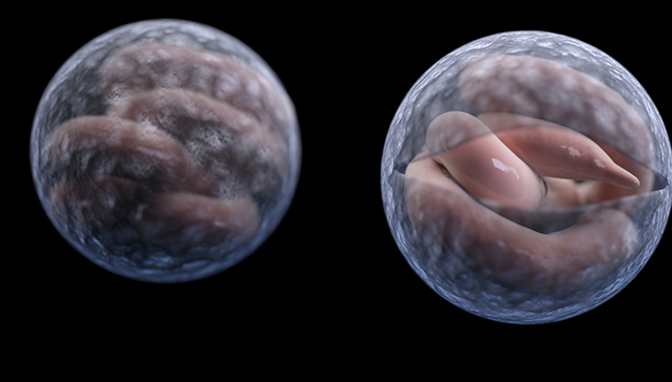
Methods
Confirmed Enteric Infection Data
Introduction
Results
Conclusion
Verotoxigenic Escherichia coli (VTEC)
Cryptosporidium
Laboratory-confirmed cases: 2755
Between 01/01/2013 and 31/12/2017
Laboratory-confirmed cases: 4509
Between 01/01/2008 and 31/12/2017
Cases geographically referenced to 3,409 CSO Electoral Divisions (EDs) and 4,991 Small Areas (18,488 SAs)
Notes:
The cases of infections were Irreversibly anonymised and obtained from the Computerised Infectious Disease Reporting (CIDR) database.
Cases were linked to both CSO Electoral divisions (EDs) and Small area division –SAs) (smallest administrative unit existing in the Republic of Ireland).
Only confirmed laboratory confirmed primary cases were reported for VTEC, whereas primary and secondary cases of infections were used for cryptosporidiosis.

Slide 5
Introduction
Methods
Results
Conclusion
The CFRAM Maps
CFRAM Maps for fluvial and costal risks
2012 – The Office of Public Works (OPW) launched the National Catchment Flood Risk Assessment and Management (CFRAM) Programme
High resolution flood maps produced for both fluvial and coastal (surge) flood risks
Three flood scenarios:
High, 10 years return period (RP)
Medium, 100 years RP (Fluvial) & 200 years RP (Coastal)
Low, 1000 years RP
Opportunity for studying the relationship between flood exposure and infections
Notes:
CFRAM maps : Developed within the framework of the Flood Directive 2007/60/CE
Flood risk maps: based on three flood scenarios linked with the occurrence probability of a flood event (return period – RP)

Slide 6
Introduction
Methods
Results
Conclusion
Small Areas, Cases of infections Vs flood risk exposure
1° Cases georeferenced to a Small Area (SA) centroid
2° Cross-mapping of flood scenarios and SA using ArcGIS
3° Binary classification of:
- SA and presence of infection (cryptosporidiosis/VTEC) > Yes/No
SA and exposure to a flood scenario (High, Medium, Low probability) > Yes/No
SA and presence of surface water (river/lake) > Yes/No
4°. Generalised linear modelling (GLM): analysis of the relationship between flood risk and confirmed human infection
Notes:
Presentation of the methodology used for assessing the relationship between flood risk exposure and cases of infection,.

Slide 7
Introduction
Methods
Results
Conclusion
Exposure to flood risk and presence of surface water
Percentage of small area (SA) exposed to flood risk
31,9% of Small Areas are exposed to a flood risk according to the CFRAM mapping
31% SA exposed to a fluvial risk
11% SA exposed to a coastal risk
16,8% SA with presence of surface water (river or lake)
Notes:
Presentation of the number of Small Areas, administrative zoning used for the analysis, linked with a flood risk exposure.
Around 32% of the national territory is exposed to a flood risk scenario according to the CFRAM mapping.

Slide 8
Introduction
Methods
Results
Conclusion
Cases of infections Vs flood risk exposure
VTEC
Percentage of cases occurring in risk area
Flood risk: 34,4 %
Fluvial risk: 33,4 %
Coastal risk: 9,8 %
Surface water: 25,4%
Cryptosporidiosis
Percentage of cases occurring in risk area
Flood risk: 34,3 %
Fluvial risk: 33 %
Coastal risk: 8,6 %
Surface water: 30, 9%
Statistical significance ?
Notes:
Slightly higher percentages than the national exposure presented previously, apart from the presence of surface water (River/Lake).
However, these results have to been statically analysed in order to assess the relationship between flood exposure and infections.
The number of cases increase along with the return period of the event (larger flood extent).

Slide 9
Introduction
Methods
Results
Conclusion
Statistical analysis of flood exposure and VTEC/Cryptosporidiosis infections
Results of the GLM analysis for fluvial, surface water and coastal risk exposure:
Odd Ratios (OR) and P-Values
 | VTEC |  | Cryptosporidiosis
 | OR | P Value | OR | P Value
Fluvial High P. | 1,84 | < 0,001 | 1,81 | < 0,001
Fluvial Medium P. | 1,89 | 0,006 | 1,88 | < 0,001
Fluvial Low P. | 1,88 | 0,016 | 1,39 | 0,002
Costal High P. | 2,09 | 0,259 ^{ns} | 2,21 | 0,049
Coastal Medium P. | 2,11 | 0,904 ^{ns} | 2,15 | 0,029
Coastal Low P. | 2,12 | 0,890 ^{ns} | 2,14 | 0,003
Surface Water (River / Lake) | 1,55 | < 0,001 | 1,83 | < 0,001
Areas within a fluvial flood risk area are, at least, 40% more likely to report a case of infection
Higher risk but less statistically significant for coastal risk exposure
Strong link between presence of surface water and infections
^{ns :} P-Value not significant
Statistical evidence of a relationship between infections and flood risk/surface water exposure
Notes:
Coastal exposure is only significant for cryptosporidiosis.
Both infections are related to fluvial risk exposure and surface water presence.

Slide 10
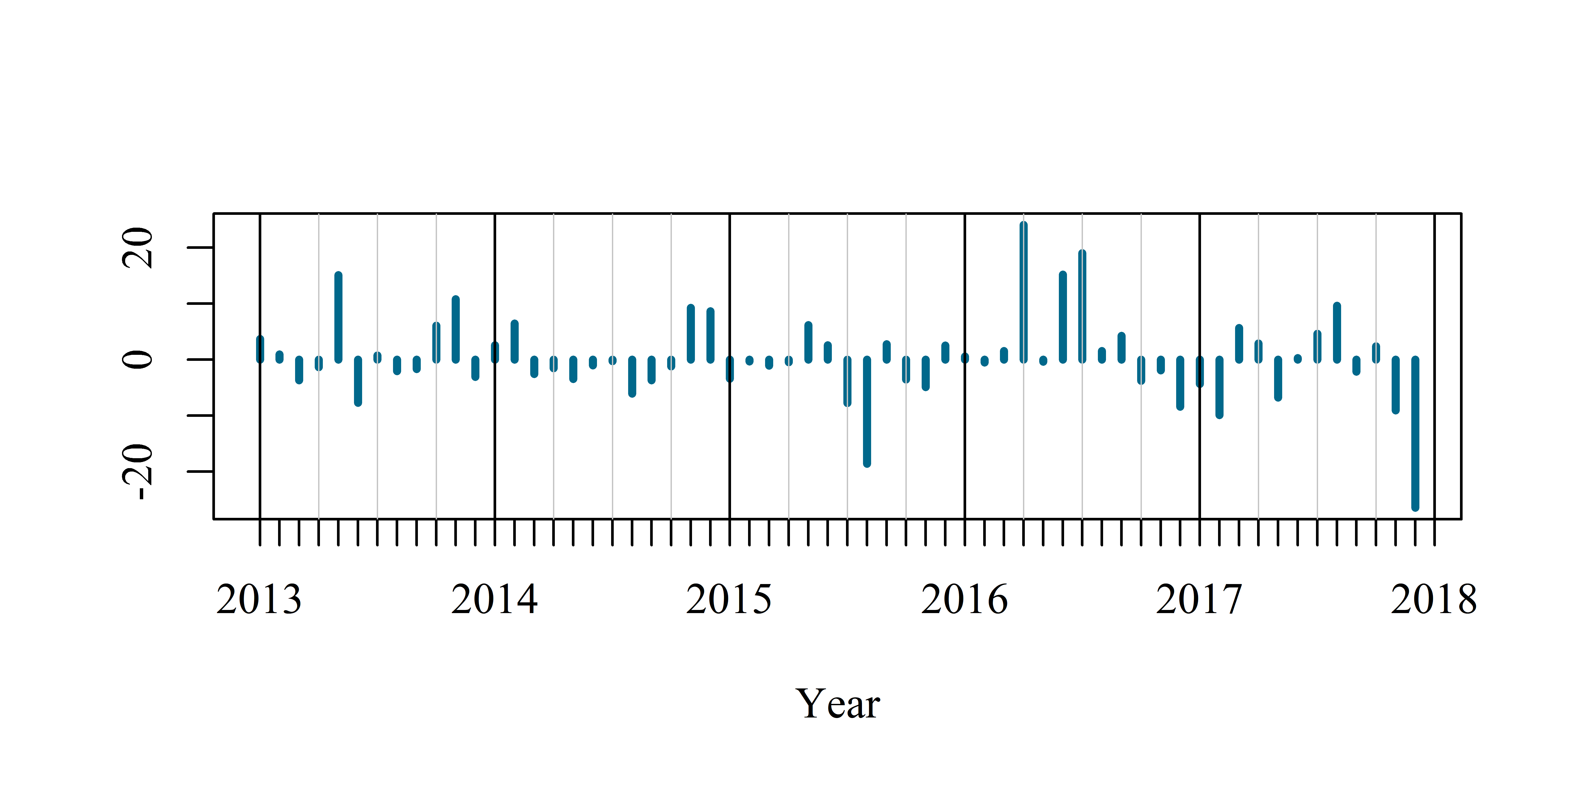
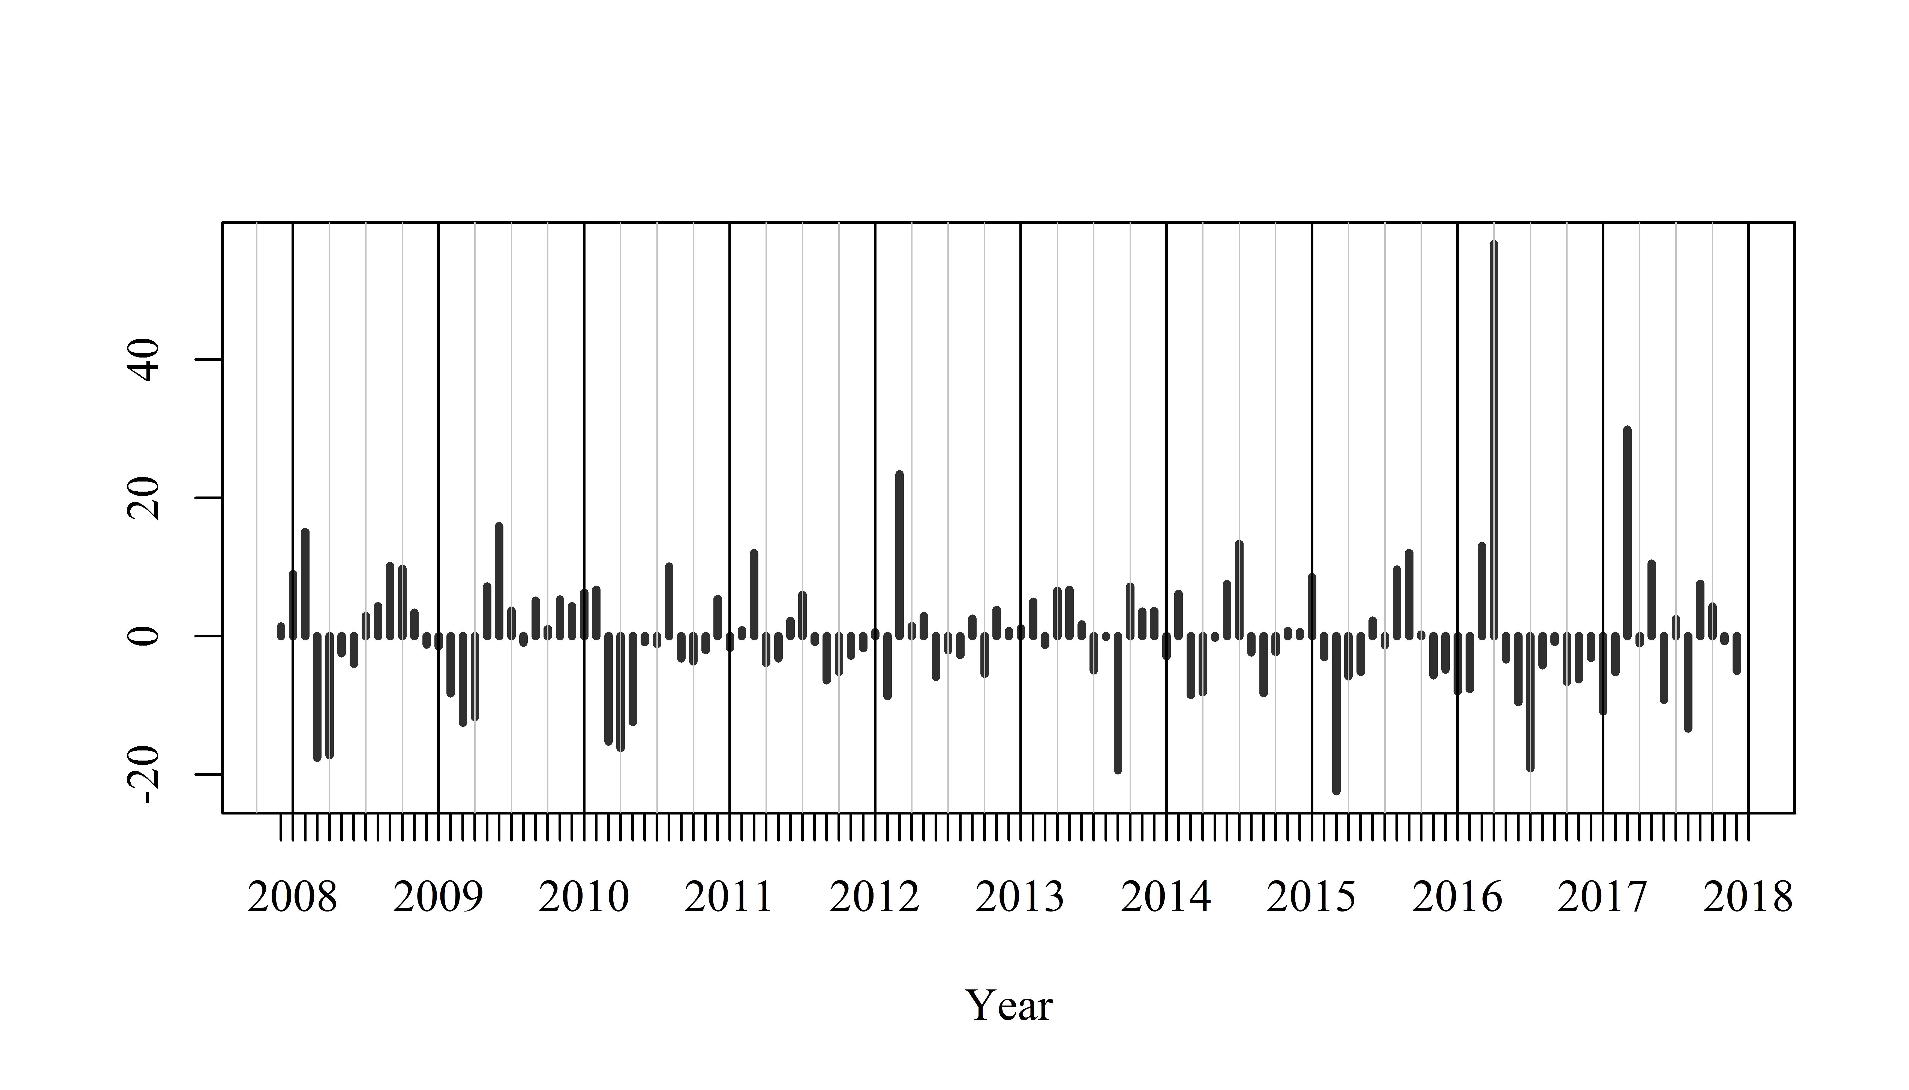
Introduction
Methods
Results
Conclusion
Cases of infection Vs flood extremes:
the 2015-2016 flood event in the Shannon catchment area
VTEC
Cryptosporidiosis
Remainders from the seasonal decomposition of VTEC and cryptosporidiosis monthly incidence reported their highest value in April 2016
3-4 months after one of the biggest flood events ever recorded in Ireland
56% of April 2016 cases were recorded in a flood risk area
Notes:
56% of cases from April 2016 occurred in Flood risk area whereas 34% of cases for the entire time period are reported in flood risk areas.
What is the link between the April 2016 peaks of infections and the 2015-2016 flood event ?

Slide 11
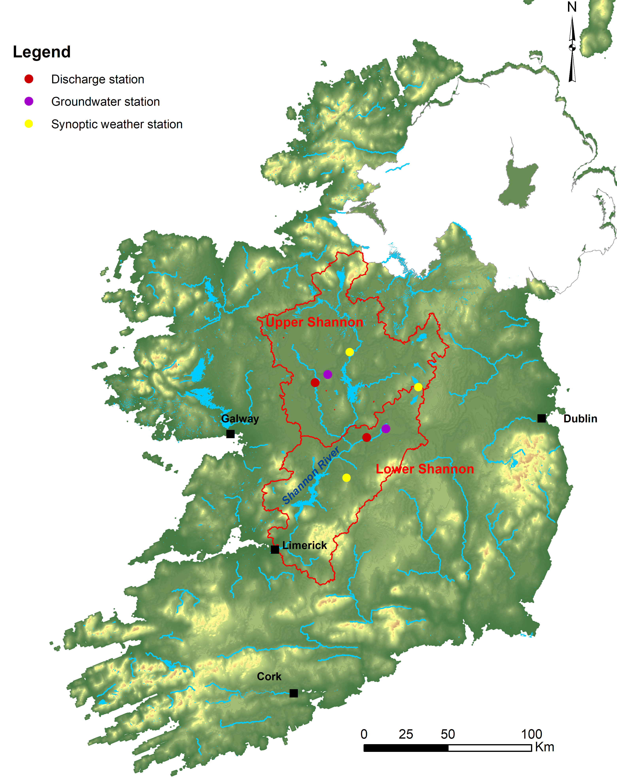
Introduction
Methods
Results
Conclusion
Cases of infection Vs flood extremes:
Presentation of the Shannon catchment area
Data extracted for rainfall, discharge and groundwater level
Stations selected according to the data duration and geographic location
Assessment of the correlation : Spearman’s Rank Correlation matrices
Study period: October 2015 to May 2016
Notes:
Presentation of the Shannon catchment area. Divided into Lower and Upper catchment
Meteorological data are provided by synoptic stations from Met Eireann.
Discharge data are provided by the OPW stations.
Groundwater level data are provided by the Environmental Protection Agency of Ireland.

Slide 12
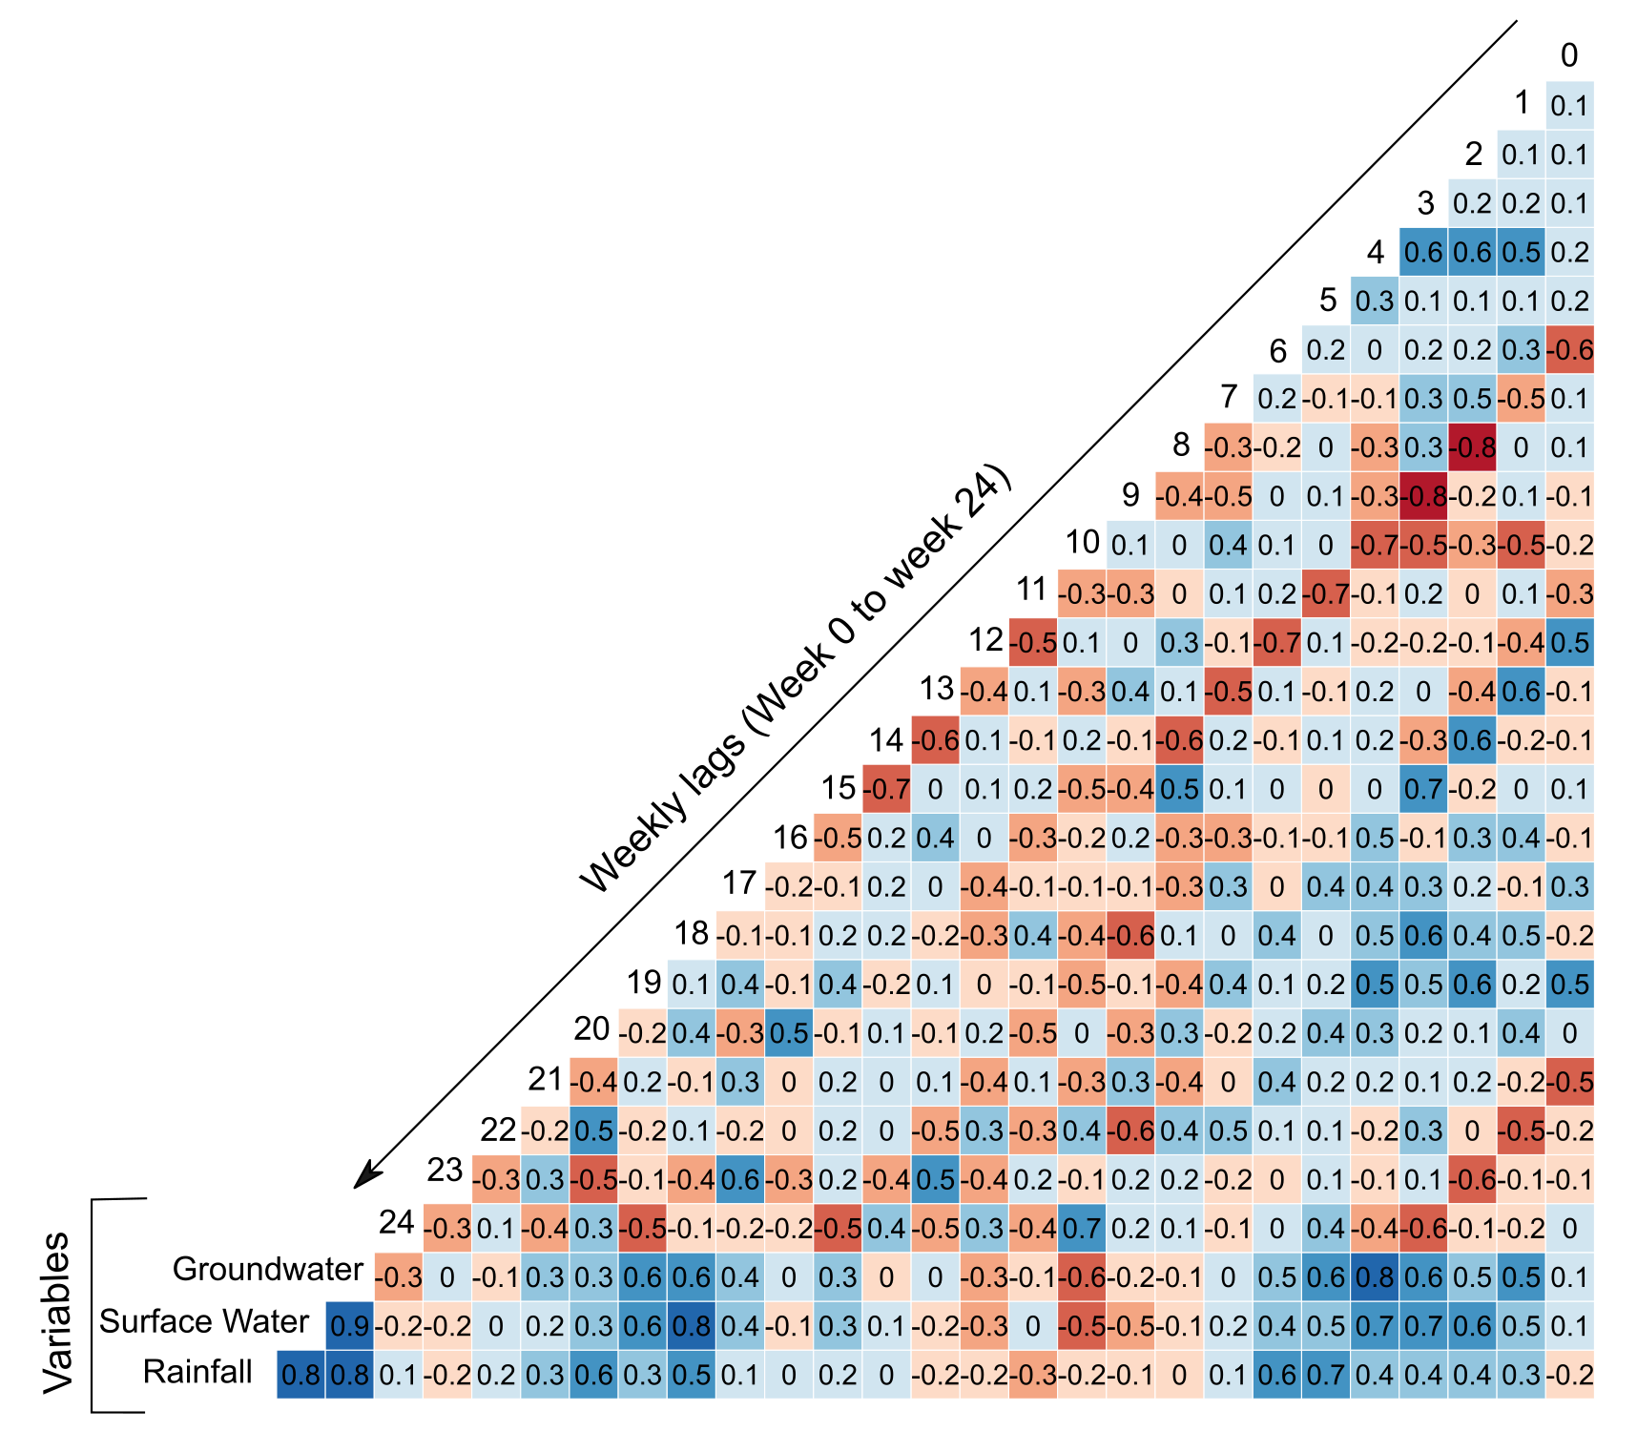
Introduction
Methods
Results
Conclusion
Spearman’s rank correlation – Shannon Lower catchment
VTEC
Cryptosporidiosis
Highest significant positive correlations (Rho):
Weeks 5, 6 (rainfall)
Weeks 18 and 4 (surface water)
Weeks 4 and 5 (groundwater)
Highest significant positive correlation (Rho):
Weeks 20, 21 (rainfall)
Weeks 15, 17 (surface water)
Weeks 15, 18 (groundwater)
Notes:
Presentation of the results provided by the Spearman’s rank correlation tests- Lower catchment.
The Rho score indicates a positive (0,1) or negative association (0,-1) and significance between hydrometeorological variables and the weekly lags of infection numbers.
The analysis used the remainders and trends provided by the seasonal decomposition of both infections.
.

Slide 13
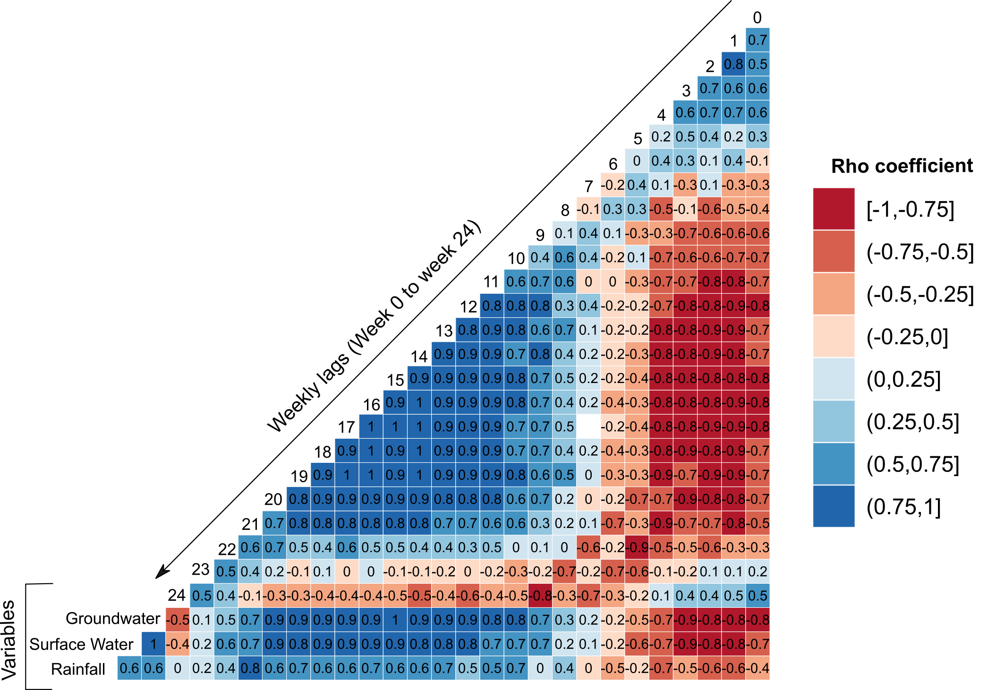
Introduction
Methods
Results
Conclusion
Spearman’s rank correlation – Shannon Upper catchment
VTEC
Cryptosporidiosis
Highest significant positive correlations (Rho):
Weeks 19, 4 (rainfall)
Weeks 3 and 5 (surface water)
Weeks 4 and 3 (groundwater)
Highest significant positive correlation (Rho):
Weeks 21, 10 (rainfall)
Weeks 20, 15 (surface water)
Weeks 15, 20 (groundwater)
Notes:
Presentation of the results provided by the Spearman’s rank correlation tests- Upper catchment.
The Rho score indicates a positive (0,1) or negative association (0,-1) and significance between hydrometeorological variables and the weekly lags of infection numbers.
The analysis used the remainders and trends provided by the seasonal decomposition of both infections.
.

Slide 14
Introduction
Methods
Results
Conclusion
Discussion & Conclusion
Flood risk mapping (CFRAM) for a human health study on infections driven by environmental factors
Results from GLM analyses : strong link between flood risk, surface water exposure and infections
Will contribute to predictive modelling of enteric infections in the Republic of Ireland
Case study on the 2015 – 2016 flood events: correlation between environmental variables and cases of infection
Varying distributed lag periods: mostly around 3-5 weeks for VTEC, 15-20 weeks for cryptosporidiosis
Contribute to a better understanding of the pathways and temporal features of both infections
Modelling prospective with climate change projections (increase of number and severity
of heavy rainfall events in the Republic of Ireland)
Notes:
The study showed the interest of using a national flood risk mapping for studying two waterborne infections.
GLM results indicate that flood risk and case of infections possess a strong relationship.
Rainfall, discharge and groundwater levels from the 2015-2016 flood event can be related to the unexpected number of infections reported during that period of time
Lags found from the Spearman’s rank correlation are in adequation with biological characteristics of both infections.

