Slide 1


HS8.1.1
Modern challenges in deterministic and stochastic subsurface modeling
across multiple scales
Estimation of distributed parameters at the regional scale by history-matching of a multi-layered sedimentary aquifer
By : Ryma Aissat¹, Alexandre Pryet¹, Marc Saltel², and Alain Dupuy¹
¹EA 4592 Géoressources & Environnement, Bordeaux INP & Univ. Bordeaux, France
² BRGM Nouvelle Aquitaine, France
By : Ryma AISSAT, Alexandre PRYET, Marc SALTEL, Alain DUPUY

Slide 2
Presentation focuses
  Problem statement
  Approach & methodology
  Preliminary results
  Conclusion

Slide 3
Problem statement
Conclusion
Preliminary results
Approach and methodology
Regional groundwater models are increasingly used for water resources management and decision-support
A robust description of the heterogeneity is crucial in the parameterization step of a model
The pilot points method is one of the most common spatial parameterization device in groundwater-model calibration that improve the identification of the heterogeneity
But
- Optimal selection of pilots points number and location can be really challenging :
    What is the optimum parametrization scheme given the level of spatial heterogeneity we aim to characterize ?
    Is there enough observation data to constrain the parameters ?
    What is the optimum trade-off between the number pilot points and computational burden

Slide 4
Problem statement
Conclusion
Preliminary results
Approach and methodology
In order to answer the previous questions, we propose to :
Use a large scale model of the sedimentary, multilayered aquifer system of North Aquitania (MONA) developed by the French Geological Survey (BRGM), as a demonstrator
Use the Gauss–Marquard–Levenberg algorithm (GLMA), implemented in the nonlinear parameter estimation software -PEST-, to estimate the distributed parameters of the model
Investigate the optimum parameterization given the level of spatial heterogeneity we aim to characterize, available observations, model run time, and computational resources. Hydraulic properties are estimated with pilot points and interpolation is conducted by kriging
Explore mainly two parametrization configurations with different number, distance and distribution method of pilot points

Slide 5
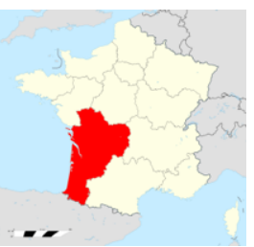
Problem statement
Conclusion
Preliminary results
Approach and methodology
  Brief presentation of the model –MONA-
The model area covers the northern part of a large sedimentary basin in Aquitania, in South-West France
It covers an area of 46 032 km²
It uses the MARTHE code (Modelling Aquifers with Rectangular cells, Transport and Hydrodynamics),which uses the finite volume approach to calculate the flow
It comprises 15 aquifers and 15 aquitards
with a uniform grid of 2 km by 2 km
https://fr.wikipedia.org/wiki/Nouvelle-Aquitaine
3D view of the aquifers represented in the MONA
(Saltel et al., 2014)

Slide 6
Problem statement
Conclusion
Preliminary results
Approach and methodology
  Parametrization configuration
  We propose to compare the effect of 2 different parametrization scheme on the estimation of 04 distributed parameters. For each configuration , two approaches are used :
  The main difference between the 2 schemes is the number and the location of pilot points : The first one is set as a regular grid with a uniform spacing, the second one consists of refining the uniform grid on the basis of an optimization criterion as the availability of observation data
Parameter | Zones of piecewise constancy | Pilot points
Horizontal hydraulic conductivity of aquifers K_{h} |  | ×
Specific yield w | ×
Vertical hydraulic conductivity of aquitards K_{v} | ×
Specific storage S_{s} |  | ×

Slide 7
Problem statement
Conclusion
Preliminary results
Approach and methodology
  Criteria for refinement
  The aim is to provide some insights into the trade-off between maximizing and restricting the number of pilot points, and offers a criteria to find the best distribution that would both :
      Limit the number of pilot points
      Achieve a successful history matching of observation data
  The refinement criteria of pilot points’ grid is defined according to the identifiability of the parameters

Slide 8
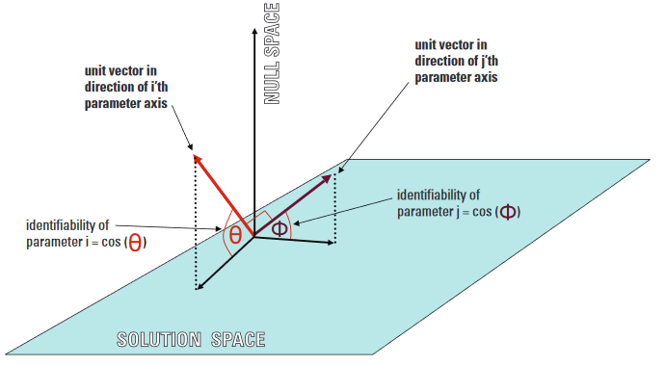
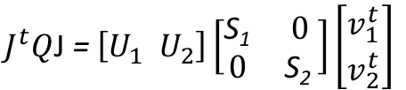
Problem statement
Conclusion
Preliminary results
Approach and methodology
  Identifiability analysis
  A parameter’s identifiability is calculated from the outcomes of singular value decomposition SVD undertaken on the Jacobian matrix that is used by PEST to linearize the model
  It is defined as the square of the cosine between a vector pointing in the direction of the parameter and the projection of that vector onto the calibration solution space
$J^{t}Q$J = $\left[U_{1} U_{2}\right]\left[\begin{matrix}\text{S}\text{1} & 0 \\ 0 & \text{S}\text{2} \end{matrix}\right]\left[\begin{matrix}v_{1}^{t} \\ v_{2}^{t}\end{matrix}\right]$
J is the Jacobian matrix
Q is the observation weighting matrix
The superscript t represents matrix transpose
The columns of the U₁ and U₂ matrices are unit vectors that span the range space of X
S₁ and S₂ are diagonal matrices containing singular values of Q^{1/2}X, higher-valued ones in S₁ and lower-valued and zero-valued ones in S₂
Schematic depiction of parameter identifiability, as defined by (Doherty et al., 2010)

Slide 9
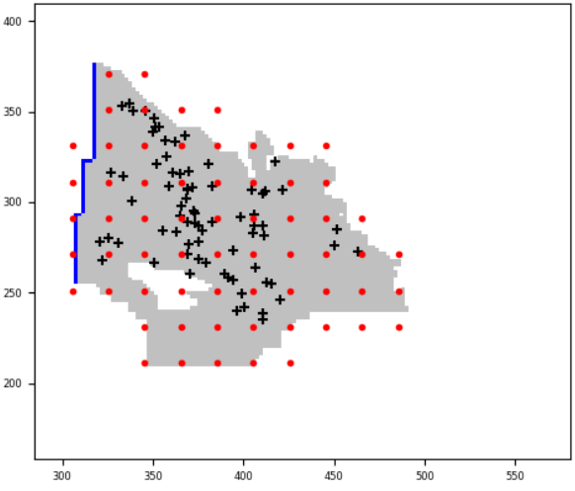

Problem statement
Conclusion
Preliminary results
Approach and methodology
  First configuration : regular grid
  Pilot points are distributed according to a regular grid with a spacing of 10 meshes
  Total number of parameters : 127 parameters

Slide 10
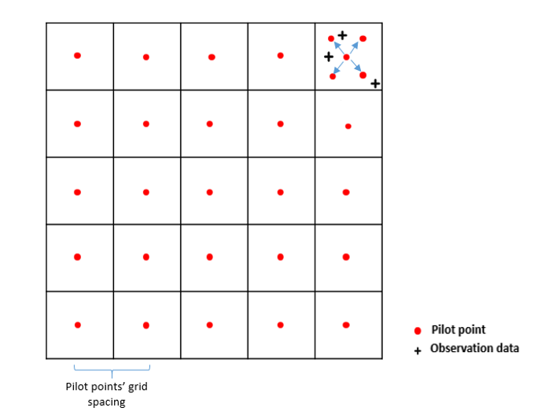
Problem statement
Conclusion
Preliminary results
Approach and methodology
  Second configuration : adaptive approach
  Pilot points are distributed according to a regular grid with a spacing of 20 km then refined to 10km when there is a minimum of 02 observation data

Slide 11
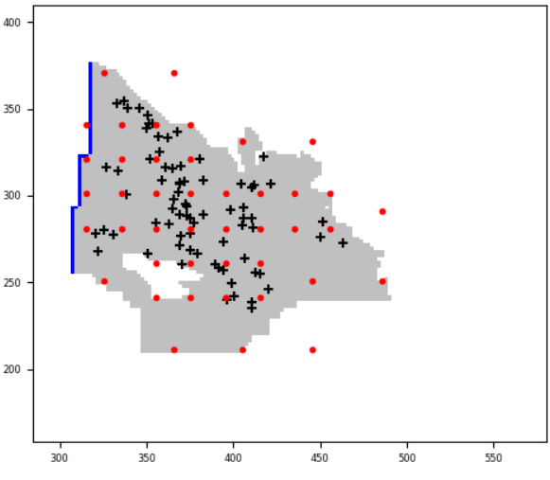
Problem statement
Conclusion
Preliminary results
Approach and methodology
  Second configuration : adaptive approach
  Total number of parameters : 88 parameters
Example of pilot points configuration set by the adaptive approach

Slide 12
Problem statement
Conclusion
Preliminary results
Approach and methodology
  Variogram definition
Kriging is used for the 2 approaches to interpolate the parameter values obtained at the pp to all model’s cells
The same exponential variogram is used for all the model domain (each layer)
It is then adjusted to insure a range three times greater than the spacing between the pilot points

Slide 13
Results

Slide 14
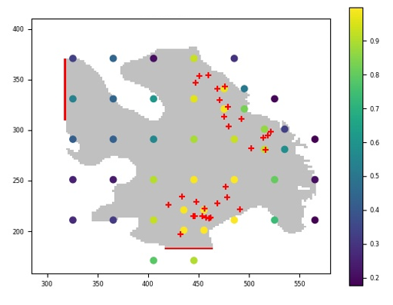
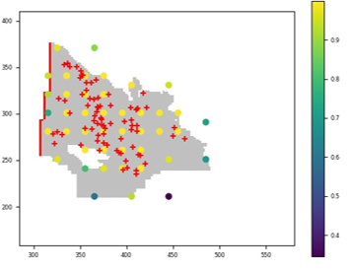

Problem statement
Conclusion
Preliminary results
Approach and methodology
  Identifiability analysis
  It shows that the parameters close to the observation data are the most identifiable by the calibration dataset
Layer 14
Layer 6
  The parameter’s identifiability -> 0 : The parameter is not identifiable
  The parameter’s identifiability -> 1 : The parameter is fully identifiable

Slide 15
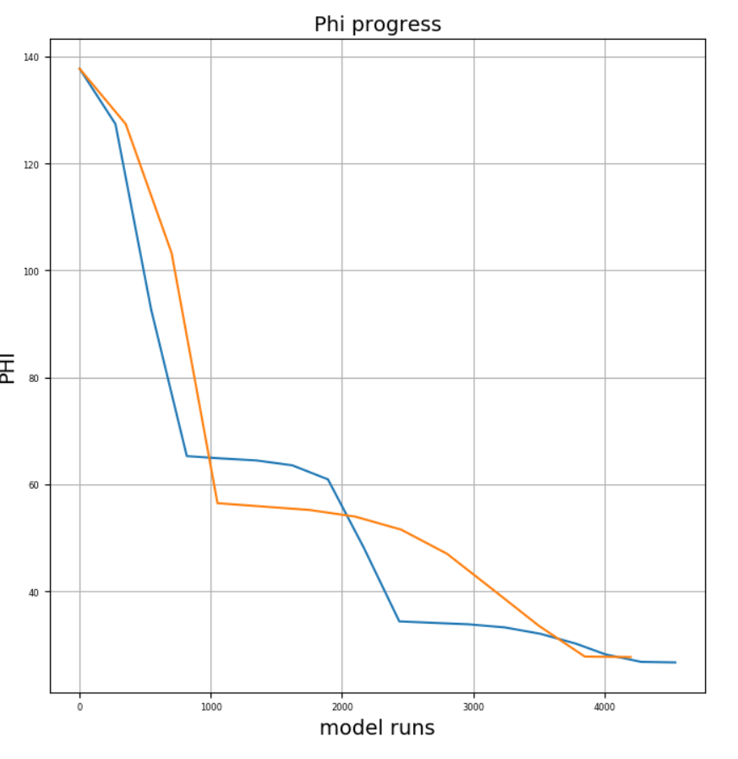

Problem statement
Conclusion
Preliminary results
Approach and methodology
Evolution of the objective function during the calibration process: comparison between the two parameterization configurations

Slide 16
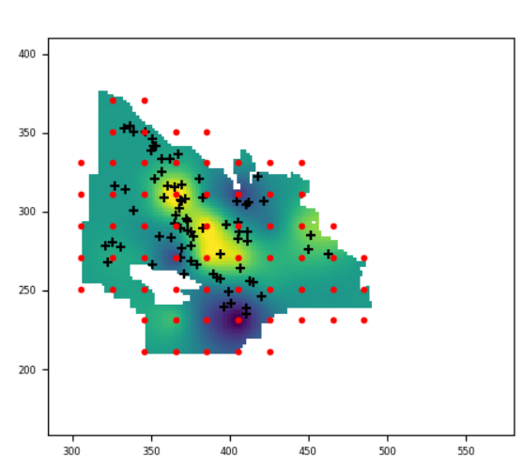
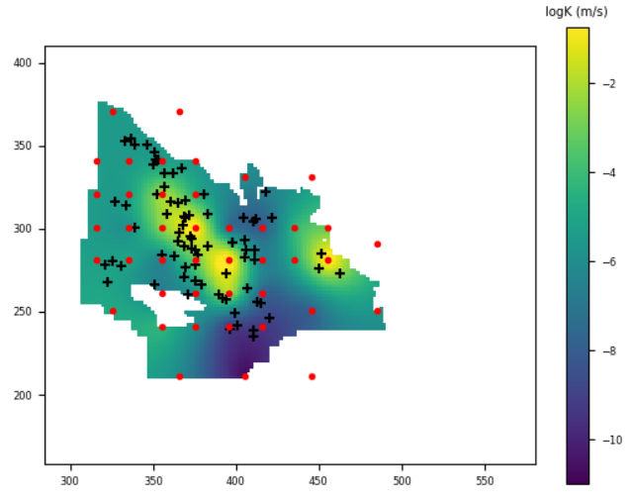
Problem statement
Conclusion
Preliminary results
Approach and methodology
Calibrated horizontal hydraulic conductivity using regular grid parametrization vs optimized location of pilot points
Regular grid approach
Adaptive approach

Slide 17
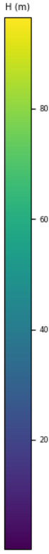
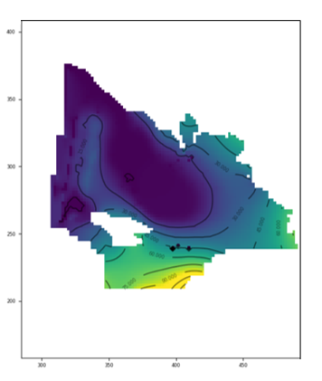
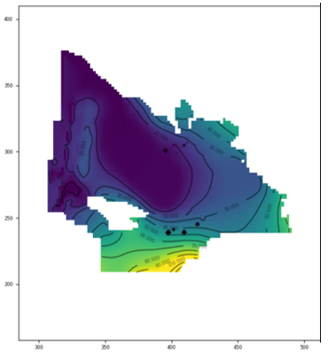
Problem statement
Conclusion
Preliminary results
Approach and methodology
Groundwater level estimated using regular grid parametrization vs optimized location of pilot points
Regular grid approach
Adaptive approach

Slide 18
Conclusion

Slide 19
Problem statement
Conclusion
Preliminary results
Approach and methodology
Conclusion
An optimization method was proposed for pilot-points placement using the location and density of observation data as criteria to refine the pilot points’ grid
It allows both a better constraint of parameters and saving in computation time
The 2 parametrization tested here caused a 78 % decrease of the initial objective function. An equivalent fit can be achieved with the adaptive approach, which requires fewer parameters than the regular grid with more parameters
The sensitivity and identifiability of the parameters can be used as refinement criteria. It would be interesting to compare the different criteria; number of observations, identifiability and sensitivity to choose the most optimal one

Slide 20
References
Doherty, J. ., Hunt, R. J. and Tonkin, M. J.: Scientific Investigations Report, Scientific Investigations Report., 2010
Saltel, M., Cabaret, O., Bourgine, B. and Loiselet, C. (2014). Gestion des eaux souterraines en Région Aquitaine -Développements et maintenance du Modèle Nord-Aquitain de gestion des nappes – Module 1 – Année 4. BRGM/RP-63381-FR, 49 p., 28 ill., 5 ann, 2014.

