Slide 1
Subduction channel vs. orogenic wedge model: numerical simulations, impact of serpentinites and application to the Alps
Lorenzo G. Candioti ¹, Stefan M. Schmalholz ², Thibault Duretz ³
¹ Institut des Sciences de la Terre (ISTE), Université de Lausanne, lorenzo.candioti@unil.ch
² Institut des Sciences de la Terre (ISTE), Université de Lausanne
³ Univ. Rennes 1, UMR CNRS 6118, France

Slide 2
ABOUT THIS PRESENTATION
2D numerical simulations of
hyper-extension – thermal relaxation – convergence cycle
Self-consistent subduction initiation (SI)
Impact of strength of the oceanic domain on
the dynamics during the convergence stage
Impact of eclogitization of continental and oceanic units on the dynamics during the convergence stage
Application to evolution of the European Alps

Slide 3
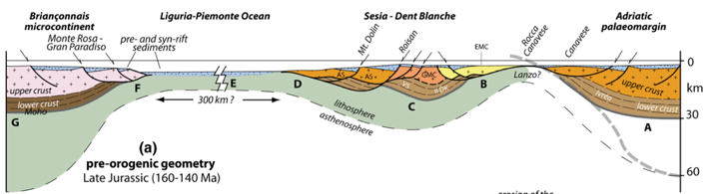
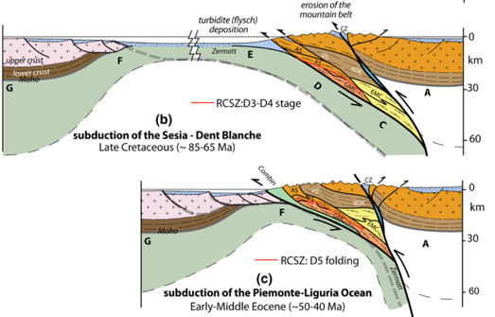
THE ALPINE CYCLE
STAGE 1: RIFTING
Opening of the Liguria-Piemonte (LP) ocean in Jurassic – Early Cretaceous(∼200-140 Ma)
Ultra-slow to slow spreading rates (<5 cm/yr)
Formation of hyper-extended magma-poor passive margins of the Briançonnais domain (European plate) and Adriatic plate
STAGE 2: THERMAL RELAXATION
FIG I. Stages of the Alpine cycle. Modified after Manzotti et al. 2014, Swiss Journal of Geosciences
Far-field tectonic inactivity (∼140-95 Ma)
STAGE 3: CONVERGENCE AND COLLISION
Subduction initiation (SI) within the hyper-extended margin of the Adriatic plate
Subduction of Sesia-Dent Blanche units indicated by eclogite facies (high pressure) metamorphism (∼84-70 Ma)
Subduction of LP and collision of Europe and Adria forming the Alpine orogenic belt (∼40-30 Ma)

Slide 4
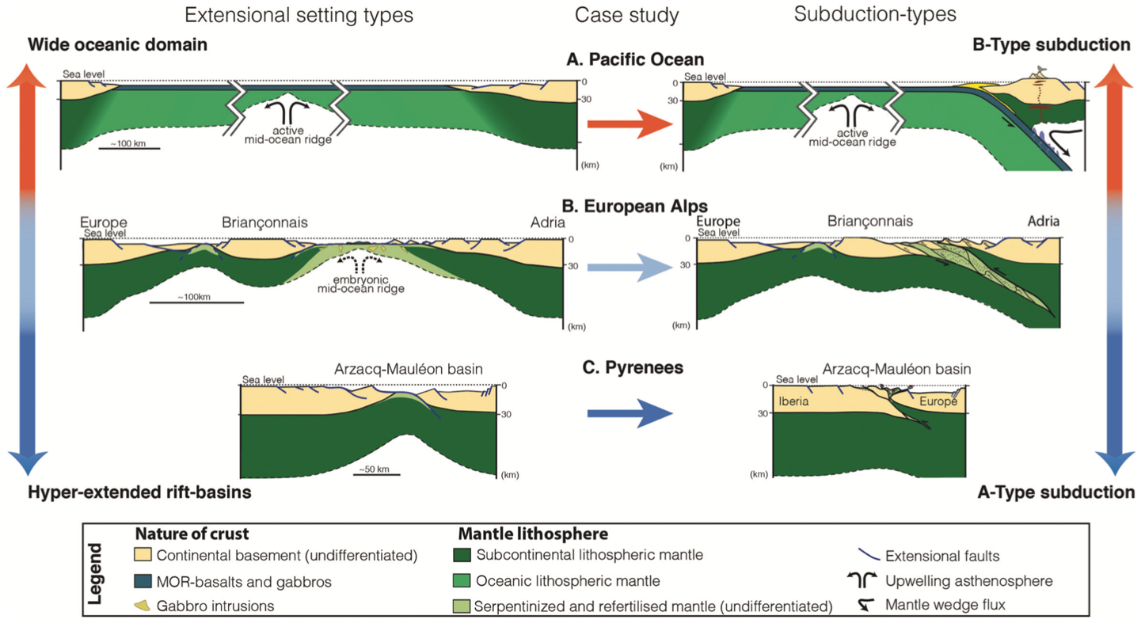
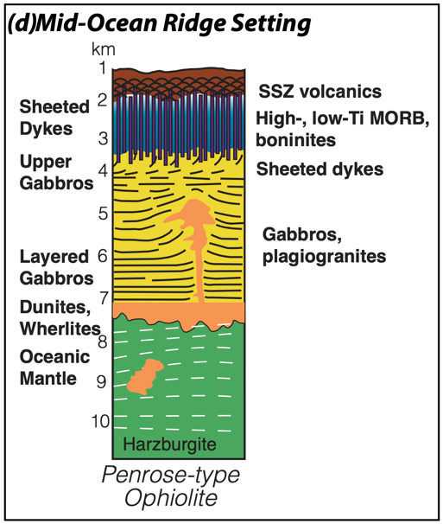
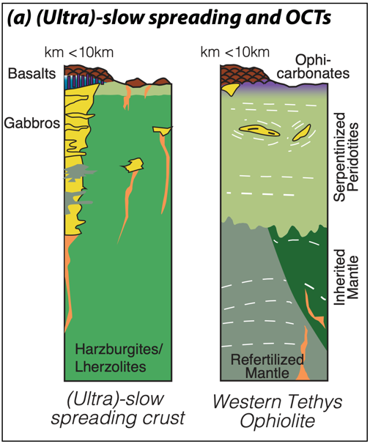
OPEN DISCUSSIONS…
1. The Liguria-Piemonte ocean - mature oceanic crust?
Benioff-type subduction
  Inversion of wide oceanic basin (∼1000 km)
  Active mid-ocean ridge: mature oceanic crust
  Magmatic SI: supra-subduction zone (SSZ) volcanism
  Example: Pacific ocean
Ampferer-type subduction
  Opening of a narrow basin (<1000 km)
  Exhumed serpentinized mantle and magma-poor
  hyper-extended margins
  Amagmatic SI: no SSZ volcanism
  Example: Pyrenees
European Alps:
Missing SSZ volcanics in the Western Tethys ophiolite
Embryonic oceanic crust
Indication that hydrous portion of subducting slab has
been sheared-off and incorporated into the orogen
FIG II. End-member types of subduction. Taken from McCarthy et al., American Journal of Science (acc. manuscript)
FIG III. Penrose type vs. Western Tethys type ophiolite. Modified after McCarthy et al., American Journal of Science (acc. manuscript)
Transitional stage between A-type & B-type

Slide 5
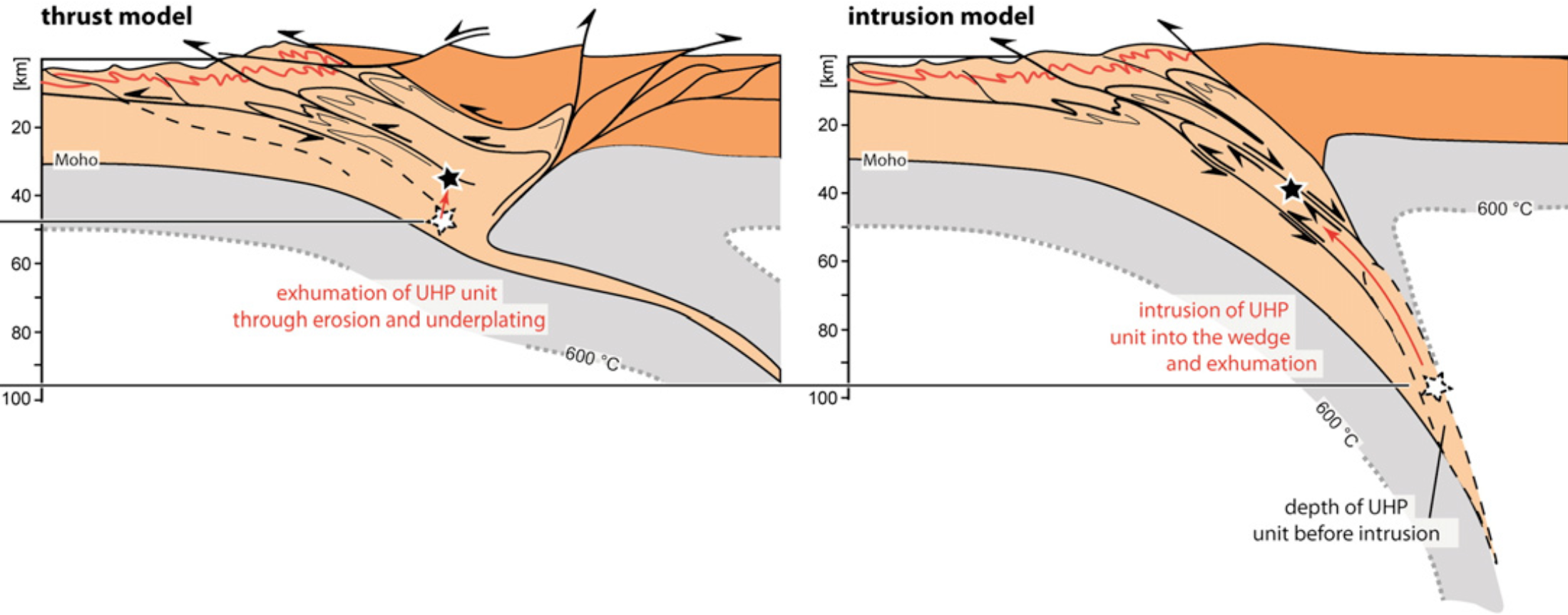
Open discussions …
2. How did the Alpine orogen form?
FIG IV. Sketch of two end-member types of UHP unit exhumation. Modified after Schmalholz et. al, 2014, Tectonophysics
End-member tectonic models
OROGENIC WEDGE (thrust model)
SUBDUCTION CHANNEL (intrusion model)
Most nappes are formed as thrust sheets in depths of <∼60 km. Ultra-High pressure (UHP) rocks are restricted to minor volumes and not representative for tectonic evolution of Central and Western (CW) Alps
Driving force: far-field tectonic forces
Tectonic nappes are emplaced in an ordered
sequence and are internally coherent
Exhumation through erosion and local extension
UHP rocks record lithostatic pressure at
great depth (>∼100 km) and are representative for burial depth of nappes. Nappes are diapirs and exhumation in a subduction channel is representative for the tectonic evolution of CW Alps
Driving force: buoyancy force
Tectonic nappes are mélanges
Intrusion and exhumation through subduction channel

Slide 6
WHAT DO WE INVESTIGATE?
The evolution of the entire Alpine cycle: hyper-extension, thermal relaxation and convergence-to-collision
What are conditions for subduction channel and orogenic wedge formation?
Impact of strength of the oceanic domain on the dynamics during the convergence stage
Impact of eclogitization of continental and oceanic units on the dynamics during the convergence stage
HOW?
2D thermo-mechanical numerical simulations of the entire Alpine cycle
Parameterization of serpentinization:
  top 7.5 km of exhumed peridotite material in the basin replaced by serpentinite material at the end of thermal relaxation period
  increasing pre-factor in front of viscosity formulation (1, 30) for serpentinite material
Eclogitization (facies): material density calculated as simplified equation of state (common approach) vs. density as pre-computed phase diagram for a given bulk rock composition (Perple_X)
FIG V. Perple_X density tables for all materials used in the numerical simulations

Slide 7
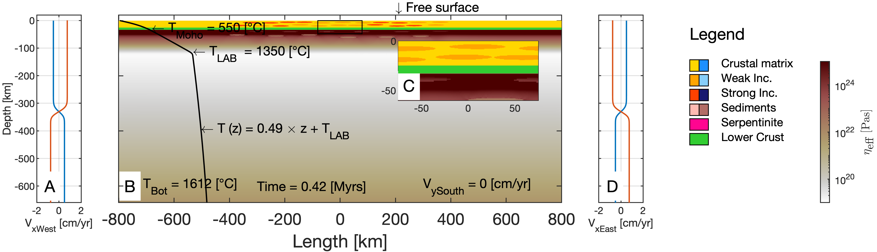
METHODS
FIG VI. Initial configuration
of the model
State of the art 2D thermo-mechanical numerical simulations
Finite difference discretization
Marker-and-cell advection
Visco-elasto-plastic rheology of material
Mechanically heterogeneous upper and middle crust (strong and
weak elliptical inclusions in intermediate strong crustal matrix)
Modelled cycle:
Rifting: 50 Myrs – 1 cm/yr extensional velocity
Cooling: 60 Myrs – 0 cm/yr boundary velocity
Convergence: 60 Myrs – 1.5 cm/yr convergence velocity

Slide 8
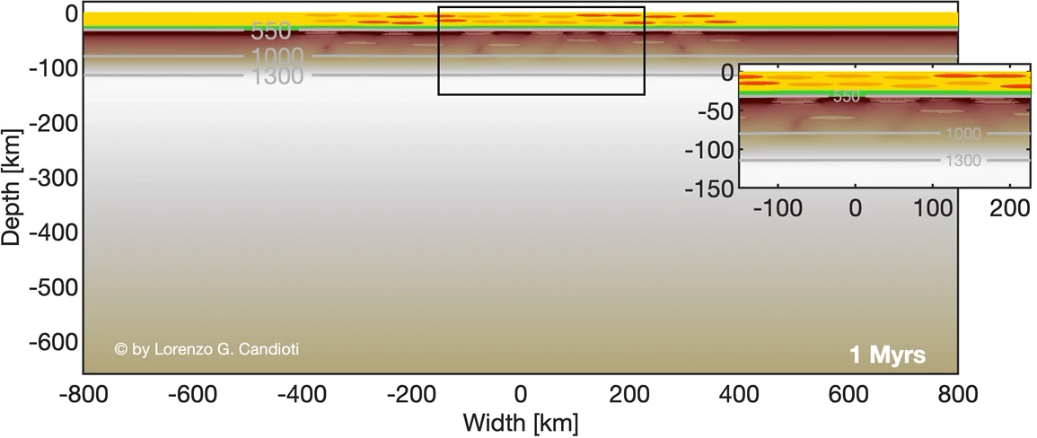
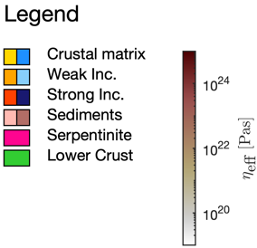
1. HYPER-EXTENSION – COOLING – CONVERGENCE
Rifting:
  Formation of asymmetric hyper-extended magma-poor margins
  No mid-ocean ridge formation (1300 °C isotherm remains at a depth of 20 km)
  Opening of a ca. 360 km wide marine basin in which peridotite is exhumed
Thermal relaxation:
  No far-field deformation induced
  Convection sets in (deflection of 1300 °C isotherm)
  Lithosphere maintains a constant thickness
  Basin is stable: no spontaneous SI
Convergence:
  Self-consistent SI via shear heating without prescribing a weak zone
  Formation of an accretionary wedge
  Ordered nappe formation during collisional stage
  Sediments are incorporated into the orogenic wedge

Slide 9
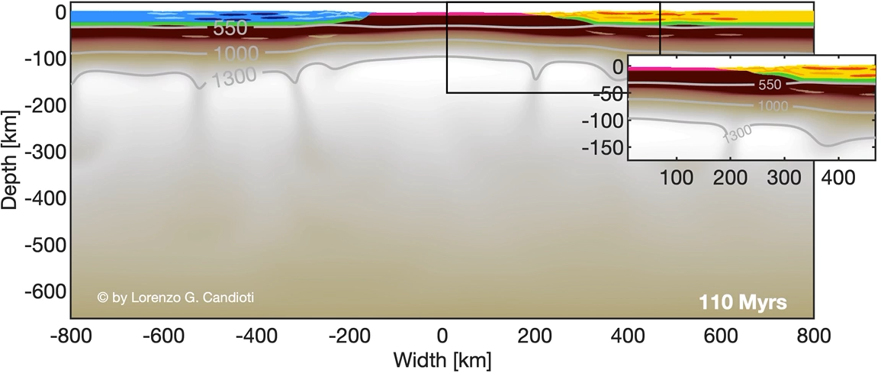
2. DEGREE OF SERPENTINIZATION: VISCOSITY PRE-FACTOR 1
PRE-FACTOR 1: weak oceanic domain. Parameterization assuming only serpentinites without stronger units such as
basalts and gabbros
Self-consistent SI via shear heating
Serpentinites are sheared-off the subducting slab
Formation of a serpentinite subduction channel
Crust of subducting plate is buried to large depth (ca. 100 km)
Subducted crust is exhumed rapidly through the lubricated subduction channel
No coherent oceanic unit is incorporated into the wedge
No ordered nappe emplacement

Slide 10

3. DEGREE OF SERPENTINIZATION: VISCOSITY PRE-FACTOR 30
PRE-FACTOR 30: oceanic domain of intermediate strength. Parameterization of serpentinites including small volumes of
stronger units such as basalts and gabbros
Self-consistent SI via shear heating
Serpentinites are only partly sheared-off the subducting slab
Accretion of sediments in the trench
Formation of a coherent oceanic unit which is incorporated into the orogenic wedge; no subduction channel forms
Ordered nappe emplacement

Slide 11
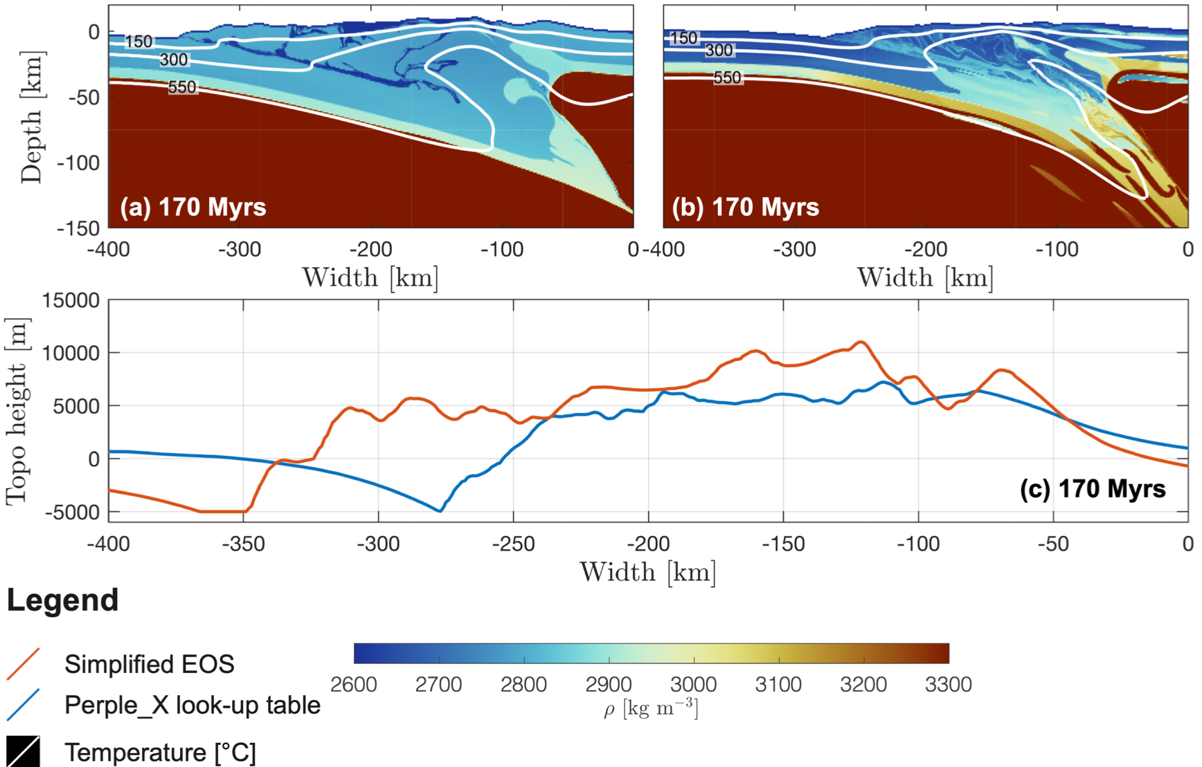
4. IMPACT OF ECLOGITIZATION – SIMPL. EOS vs. PERPLE_X DENSITY
When eclogitization is considered:
Density variation within the wedge
Dimensions of the wedge are more realistic
(a) 100 km thick, (b) 60 km thick
Topography is reduced by a factor 2 for the same applied erosion rate due to less buoyant crustal material
Zones of local density variation indicate metamorphic reaction
FIG VII. Density field within the orogenic wedge. (a) Simplified EOS for all materials except the mantle, (b) Perple_X density tables for all materials, (c) topographic evolution of models (a) and (b)

Slide 12
CONCLUSION
Modelling of an entire, continuous extension – thermal relaxation – convergence cycle
Self-consistent SI via shear heating without prescription of a weak zone or an already inclined subducting slab from the onset of convergence
Weak oceanic domain:
  Serpentinite subduction channel
Intermediate strength of oceanic domain:
  Incorporation of oceanic domain into the orogenic wedge
Simplified EOS vs. Perple_X density:
  Significant reduction of topography
  More realistic wedge geometries
  Map of metamorphic reactions in the wedge
Acknowledgements
References
All colormaps presented in this study are provided by:
Crameri, F. (2018). Geodynamic diagnostics, scientific visualisation and StagLab 3.0. Geoscientific Model Development, 11(6), 2541-2562.
Manzotti, P., Ballevre, M., Zucali, M., Robyr, M., & Engi, M. (2014). The tectonometamorphic evolution of the Sesia–Dent Blanche nappes (internal Western Alps): review and synthesis. Swiss Journal of Geosciences, 107(2-3), 309-336.
Schmalholz, S. M., Duretz, T., Schenker, F. L., & Podladchikov, Y. Y. (2014). Kinematics and dynamics of tectonic nappes: 2-D numerical modelling and implications for high and ultra-high pressure tectonism in the Western Alps. Tectonophysics, 631, 160-175.

