Slide 1




Integrating LCLM feedbacks into climate models: an emulator approach
EGU GA 2020, BG3.11, Shruti Nath, 07.05.2020

Slide 2



Objectives
Part of LAnd MAnagement for CLImate Mitigation and Adaptation (LAMACLIMA) project.
To provide the sensitivities of climate and LCLM to (agro)-economic models for building of future sustainability pathways.
Do so in a computationally cheap way to allow flexibility in scenario exploration
Use an emulator to summarise the complex relationships depicting the sensitivities of key variables to:
  Work stream 1: Impacts of climate change
  Work stream 2: Impacts of LCLM investigated in the project

Slide 3
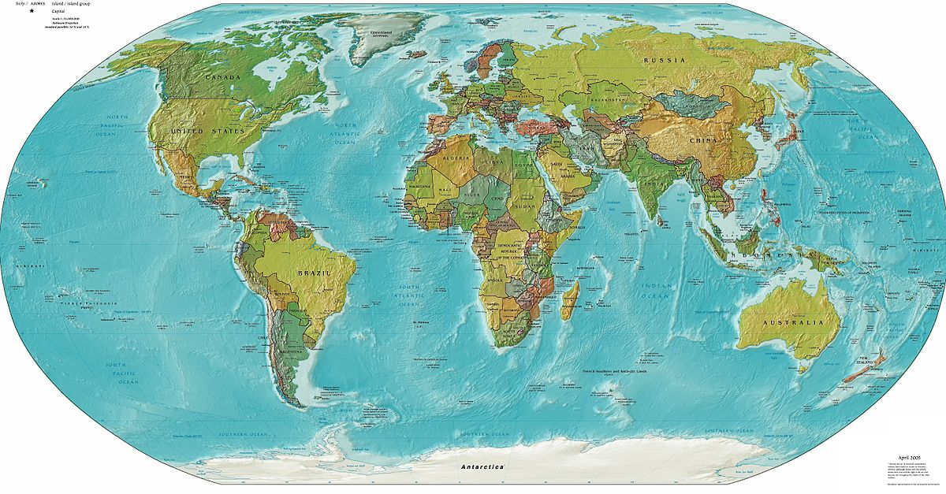
Sketch of how it could look like
Choose scenario
(or GMT level e.g. +1.5,+2)
Management options
Choose variable
Map for the selected options
Re/Afforestation
T
Precip
Runoff
Crop yields
NBP
Crop prices
…
Present-day
SSP1-RCP1.9
SSP1-RCP2.6
RCP4.5
RCP6.0
…
0
100
Irrigation
0
100
Wood Harvest
0
100

Slide 4
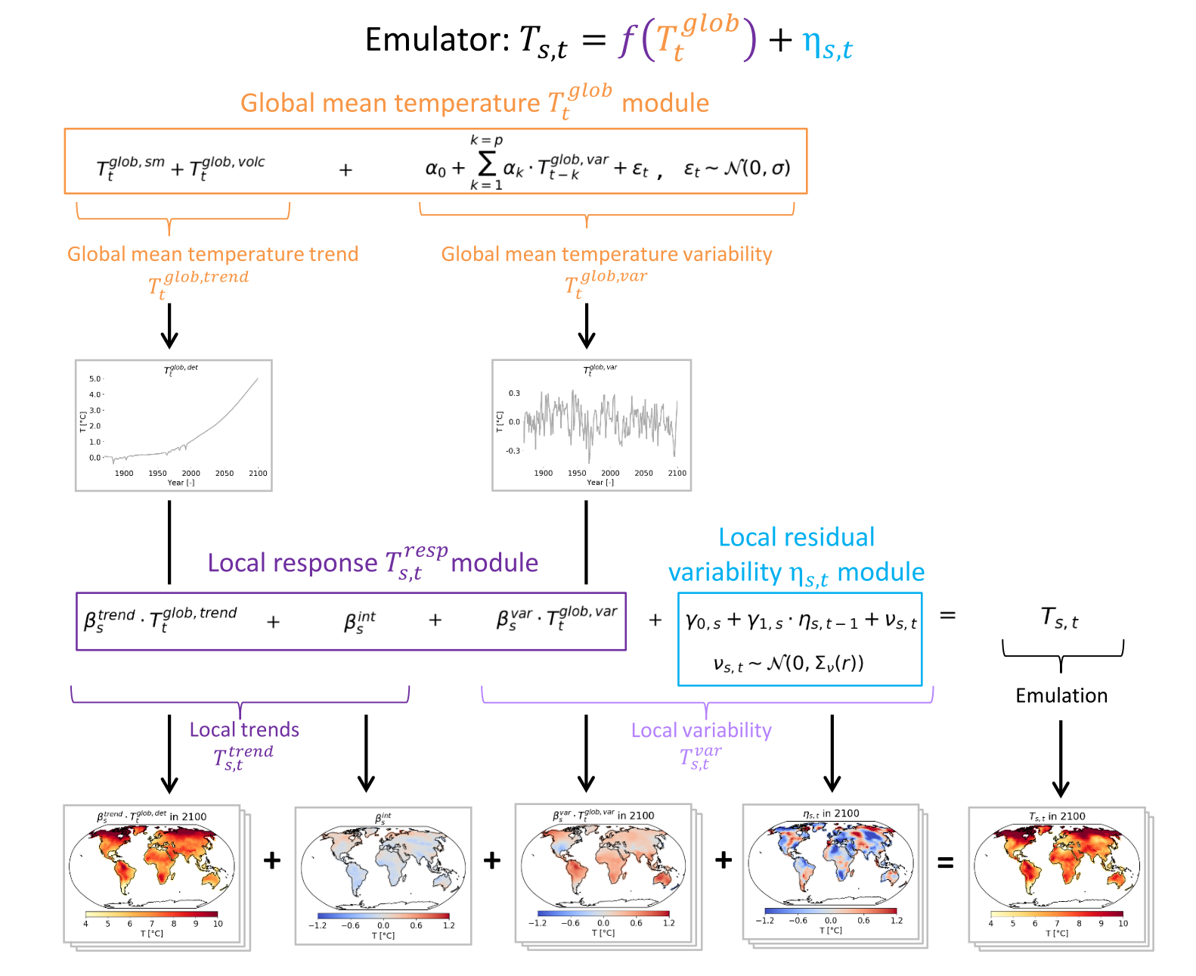


Theoretical basis (for temperature)
Climate Change Impacts
$$+ T_{s,t}^{CC}$$
$$+ T_{s,t}^{irr}+ T_{s,t}^{for}+ T_{s,t}^{wh}$$
Added in for LAMACLIMA
Beusch et al. 2019

Slide 5
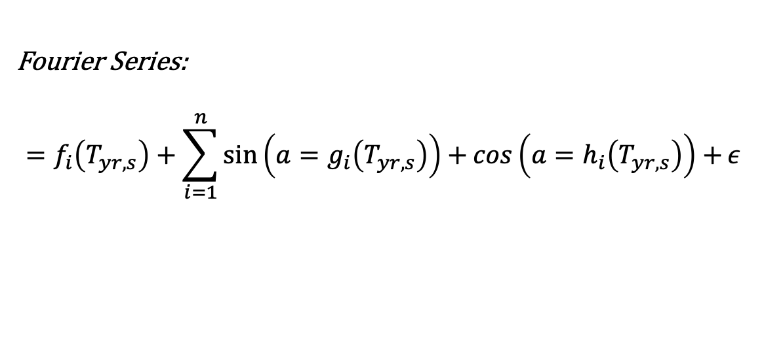

Introducing a local seasonal module
$$T_{yr,mon,s}= F_{s}\left(T_{yr,s}\right)+ε$$
Monthly temperature at grid point
Yearly temperature at grid point
Fourier Series:
$$=f_{i}\left(T_{yr,s}\right)+\sum_{i=1}^{n}{\sin\left(a=g_{i}\left(T_{yr,s}\right)\right)+\cos\left(a=h_{i}\left(T_{yr,s}\right)\right)+ε }$$

Slide 6
Preliminary Results
(CESM1-CAM5 on selected grid point)
Zoom into grid point monthly data
Green=emulation
Blue=model outputs
Residuals (model-emulator)
Yearly mean temperature
Red=emulation
Blue=model outputs

Slide 7
Linear Fit: model values vs emulated values
intercept
Slope
Underestimation:
Intercept > 0
Ideal:
Intercept=0
Overestimation:
Intercept < 0
Emulator Values
Emulator Values
Emulator Values
Model Values
Model Values
Model Values

Slide 8
Linear Fit: model values vs emulated values
intercept
B
Slope
Some Conclusions:
Bias particularly in Norther Hemisphere (NH).
Caused by a Regression to Mean problem
  Hence overestimation of cold extremes (not cold enough), and
  Underestimation of hot extremes (not hot enough)
Presence in NH indicates some non-linear process involved i.e. snow-albedo feedback
Underestimation:
Intercept > 0
Ideal:
Intercept=0
Overestimation:
Intercept < 0
Emulator Values
Emulator Values
Emulator Values
Model Values
Model Values
Model Values

