Slide 1




8th May 2020
EGU Virtual meeting
MASSIMILI
Simulating bio-optical properties in the Mediterranean Sea.
Paolo Lazzari, Eva Alvarez, Elena Terzić , Stefano Salon, Emanuele Organelli, Fabrizio D'Ortenzio, and Vincenzo Vellucci
Istituto Nazionale di Oceanografia e di Geofisica Sperimentale (Italy)
Laboratoire d'Océanographie de Villefranche-sur-Mer (France)

Slide 2
BIOPTIMOD: some major scientific questions:
Impact of different bio-optical models - and parameterizations – on novel metrics based on radiometric sensors
3) How the new multispectral information from satellite can be used to improve our understanding of the Med biogeochemistry?
2) What is the impact of CDOM on bio-optical properties of the Mediterranean Sea waters

Slide 3
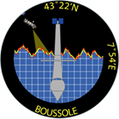
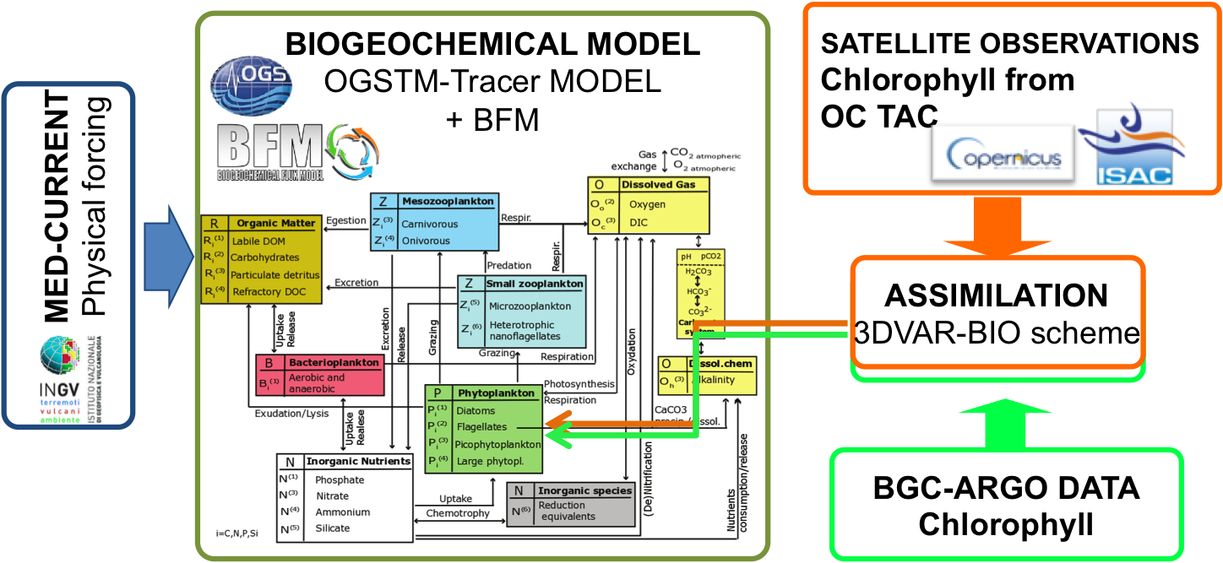
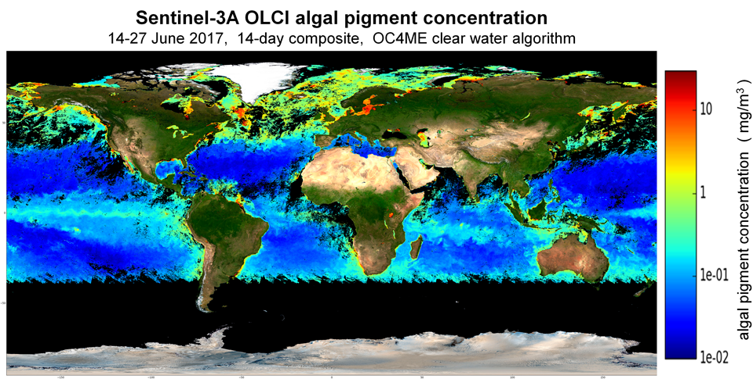
The major components:
1.DATASTREAMS BOUSSOLE, BGC-ARGO FLOAT and SENTINEL data in the Mediterranean Sea
3. New bio-optical model
2. CMEMS–MED-MFC: Mediterranean Biogeochemistry model system (MedBFM)
BGC Argo float

Slide 4

Bio-optical data and products @ BOUSSOLE
BOUSSOLE DATA
VARIABLE | DATE-FROM | DATE-TO | FREQUENCY | DEPTH (m) | NOTEs
Radiometry measurements
Irradiance Es (from buoy) | 2003-09-06 | 2012-12-31 | 15 minutes | 0⁺, 4, 9 | Bands measured (nm): 412.5,442.5, 490, 510, 555, 560, 665 , 670, 681.25
Irradiance Es (from SPMR) | 2001-07-22 | 2011-04-27 | Monthly | 1 m vertical resolution, depth range 0-150m | Bands measured (nm): 380.8, 411.2, 442.4, 455.3, 490.9, 510.3; 532.3, 560.1, 619.2, 664.3, 683.4, 704.5, 780.2
Irradiance Es (from COPS) | 2010-03-29 | 2018-08-29 | Monthly | 1 m vertical resolution | Bands measured (nm): 320, 340, 380, 395, 412, 443, 465, 490, 510, 532, 555, 565; 589, 625, 665, 683, 710, 780
Light absorption measurements
a_{phy} | 2003-02-07 | 2017-03-08 | Monthly | 5, 10, 20, 30, 50, 60, 80, 100 | CTD sampling. Spectral resolution: 300-794 nm every 1nm.
a_{CDOM} | 2011-01-19 | 2016-05-03 | Monthly | 5, 10, 20, 30, 50, 60, 80, 100 | CTD sampling. Spectral resolution: 200-735 nm every 1nm.
a_{nap} | 2003-02-07 | 2017-03-08 | Monthly | 5, 10, 20, 30, 50, 60, 80, 100 | CTD sampling. Spectral resolution: 300-794 nm every 1nm.
Pigments measurements
Total chlorophyll + 7 taxonomically-significant pigments *) | 2001-07-24 | 2017-06-12 | Monthly | 5, 10, 20, 30, 50, 60, 80, 100 | Measured using HPLC techniques
Size classes: pico, nano, micro | 2001-07-24 | 2017-06-12 | Monthly | 5, 10, 20, 30, 50, 60, 80, 100 | Derived from two statistical models as detailed in Uitz et al. (2006) and Di Cicco et al. (2017)
BIOPTIMOD

Slide 5
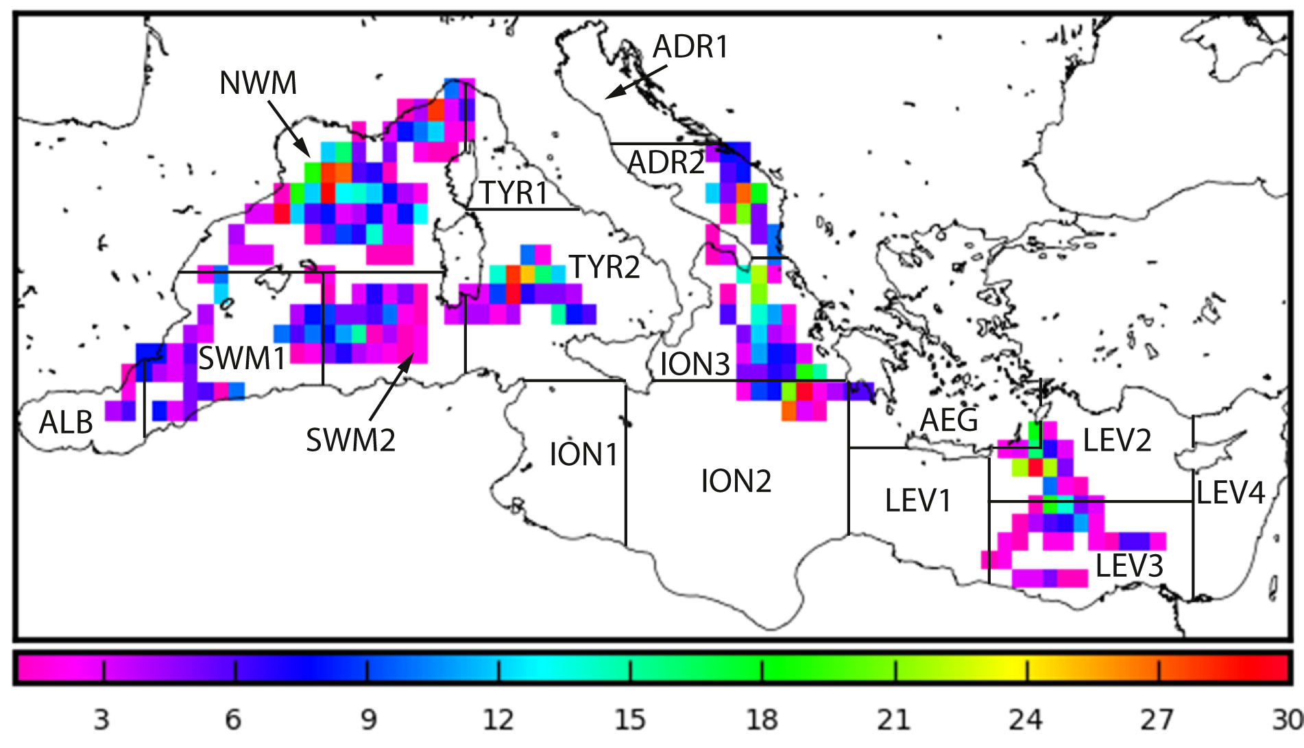
BGC-Argo floats radiometric data,
and bio-optical products
1314 quality controlled profiles from 31 floats
period between 2012 and 2016
Chlorophyll a concentration derived from fluorescence.
T and S profiles (not QC)
Downward planar irradiance Ed at 3 different wavelengths (380, 412 and 490 nm)
PAR (photosynthetically available radiation = Ed for the VISIBLE (400 - 700 nm)
BIOPTIMOD

Slide 6
OASIM: Atmospheric multispectral light propagation
Irradiance pathways in OASIM for clear skies (left) and cloudy skies (right): E_{d} is direct downwelling irradiance, E_{s} is diffuse downwelling, and ρ_{d} and ρ_{s} are direct and diffuse surface reflectances (size of the arrows approximates the relative contributions). All irradiances and reflectances are spectrally-resolved at 25 nm for the PAR range, and at variable resolution for the reminder 200 nm - 4 um range.

Slide 7
OASIM MODEL IS COUPLED WITH ERA-INTERIM
ECMWF ☺
ECMWF ☺
ECMWF ☺
ECMWF ☺
ECMWF ☺
ECMWF ☺
ECMWF ☺

Slide 8
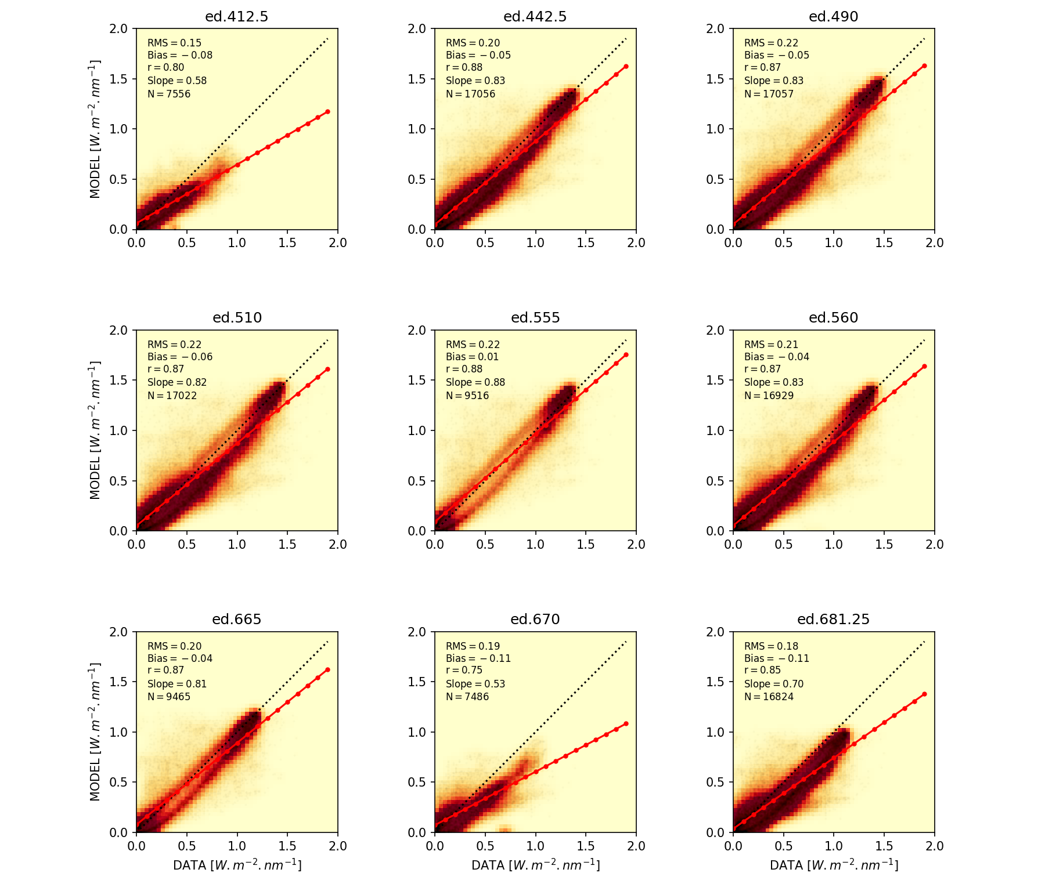
Multi-spectral downward irradiance just below the sea surface 2011 BOUSSOLE and OASIM @ 15’ frequency
Notes:
Overall good skill of OASIM Model in reproducing the multi spectral irradiance just below the sea surface measured at BOUSSOLE. Winter Months are usually the most difficult to simulate
due to the effect of cloud cover.

Slide 9
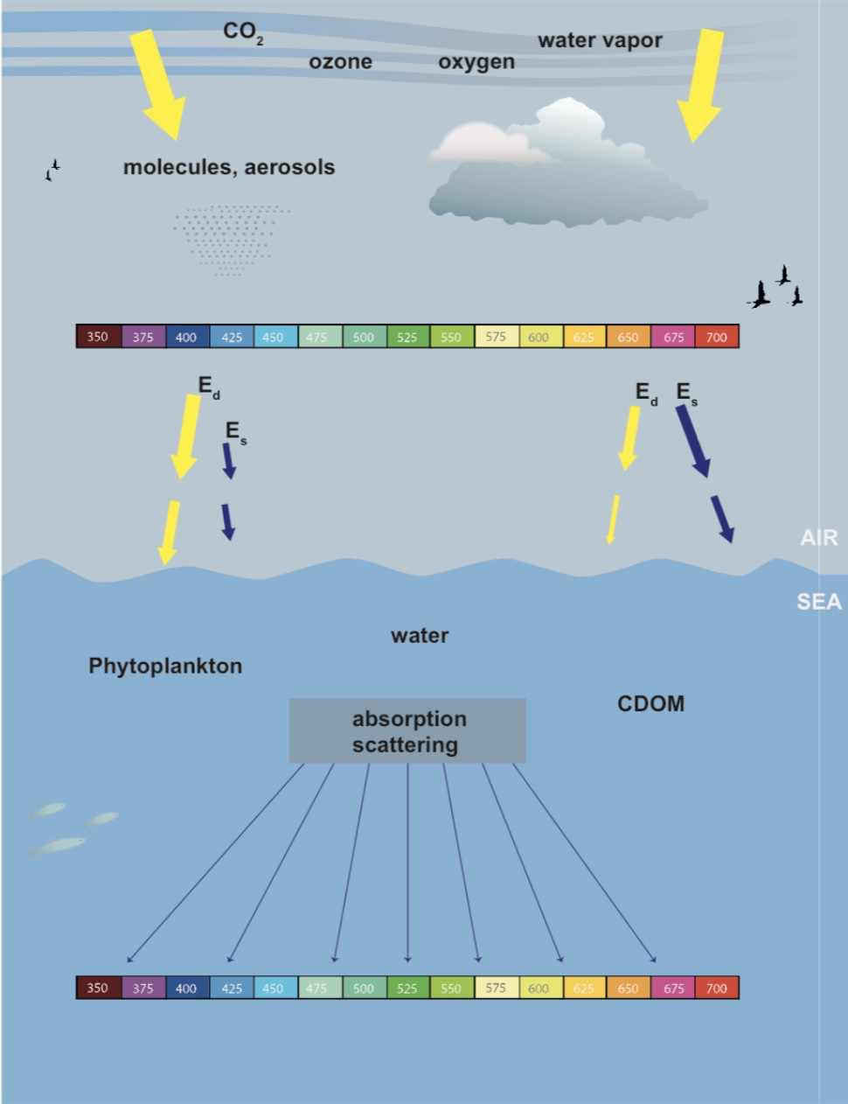
In-water BIO-optical models
MASSIMILI
Three-stream model
The three streams considered are
Ed → downward direct irradiance
Es → downward diffuse irradiance
Eu → upward diffuse irradiance
Planar sensors measure Ed+Es
R_{rs} = Eu(0-)/(Ed(0-)+Es(0-))/Q
BIOPTIMOD
Notes:
Currently we resolved the light propagation basing on a discretization of 25 nm bins. This choice is a standard in current bio-optical modules coupled with 3D biogeochemical models.
Certainly, future applications where hyper-spectral data will be available we can increase the number of wavelength considered.

Slide 10
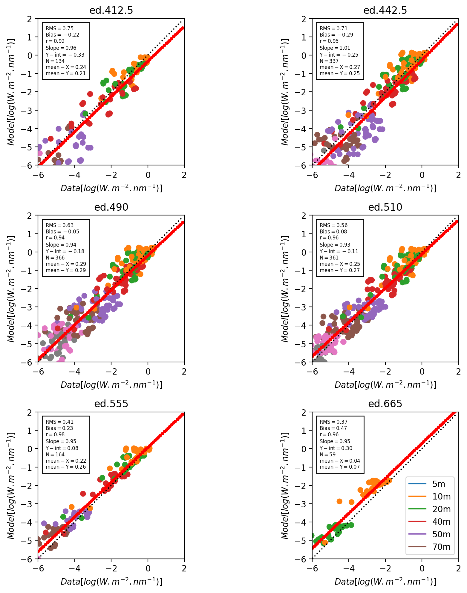
Three-stream approach
MASSIMILI
Validation of the in-water model @ BOUSSOLE
Period considered
2011-2016
Input data
Ed(0-), Es(0-) OASIM
Aphy, anap, CDOM @ BOUSSOLE
Pigments at BOUSSOLE to derive scattering
Validation Data
Ed+Es @ BOUSSOLE
BIOPTIMOD
Notes:
We validated the consistency of the bio-optical model at the BOUSSOLE mooring.
Beside this we validated the in-water radiative model comparing the results with an analytical solution considering
a water column with homogeneous bio-chemical conditions to eliminate possible coding errors.

Slide 11
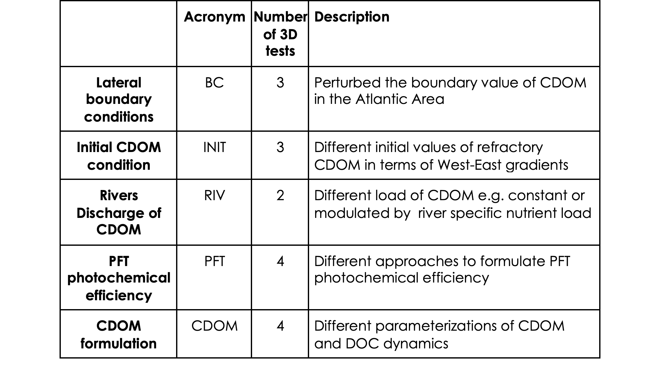
Ensemble sensitivity simulations of the Bio-Optical
model
The new tool developed in the Task 2 was coupled with the CMEMS MedBFM
Numerical tests performed with the novel 3D biogeochemical model with the multi-spectral component a total of 17 tests:
3) Feasibility test of assimilating new radiometric data from Satellite Rrs and BGC Argo floats
4) Definition of novel metrics based on radiometric data
BIOPTIMOD
Notes:
We performed a number of sensitivty tests
The horizontal model resolution is 1/16 degrees (~6km) and the model has 72 vertical levels with a refinement of the resolution in the upper layers.
The BFM model was further upgraded with respect to task 2 version introducing a CDOM formulation that accounts for three additional state variables related to the different degree of lability of CDOM consistently with the three DOC state variables currently present in the BFM model (labile, semi-labile, refractory).
The set-up was spun-up from 1995 to 2011 and the sensitivity exercises were carried out from 2011 to 2017 included. The metrics considered are computed over the last year of simulation i.e. 2017.
An initial ensemble of simulations (not shown) was used to calibrate the kinetic constants in the 3D modelling framework governing the CDOM dynamics: we found that to have stable deep inventory of CDOM the temporal photobleaching degradation rates are generally slower with respect to Dutkiewicz et al. (2015) namely 30 days in place of ~ 6 days. The other degradation terms of CDOM are analogous to the corresponding DOC terms and are controlled by explicit bacteria dynamics.
With the exception of the PFT-T1, PFT-T2, PFT-T3 and PFT-T4 simulations we forced the primary production with the total PAR computed with the RT in-water model.
The default initialization of refractory CDOM used in all the simulation is 12 mgC/m3 in the Western basins and 6 mgC/m3 in the Eastern Basins.
Since we do not have access to datasets for the refractory CDOM distribution, in terms of its carbon equivalent concentration, we tested different initializations of the system with different concentrations of CDOM:
INIT-T1 CDOM concentration of 12 mgC/m3 homogenous in all the Mediterranean;
INIT-T2 W-E gradient of CDOM concentration with 12 mgC/m3 in the west and 3 mgC/m3 in the East;
INIT-T3 homogeneous concentration of CDOM equivalent to 6 mgC/m3.
We tested different values of CDOM input from the Atlantic water (Gibraltar boundary): BC-T1, BC-T2, BC-T3 are characterized respectively by concentration of CDOM of Atlantic waters of 6 mgC/m3, 3 mgC/m3 and 12 mgC/m3.
The preliminary 3D experiments we carried out (and the results of TASK 2 at BOUSSOLE mooring, see deliverable of TASK 2) evidenced the relevance of CDOM dynamics for reflectance and light propagation along the water column. Therefore, given the relevance of CDOM in characterizing the water colour we programmed 4 tests with alternative CDOM/DOC dynamics.
In the default CDOM configurations we considered that 2% of all the DOC fluxes where optically active. In the CDOM-T1 we considered as optically transparent all the DOC exudate by nutrient stress. In the other three options we tested three different hypotheses in terms of carbon routing when the phytoplankton cell is nutrient stressed: CDOM-T2 has minimum flux to dissolved organic carbon (DOC) and the other two CDOM-T3 and CDOM-T4 have intermediate values. The reference configuration, used for example in the MedBFM system, has the highest flux of carbon to DOC when the cell is nutrient limited.
All simulations related to PFT’s use PFT-specific absorption curves to calculate primary production.
Regarding other water constituents, PFT- T1 and PFT-T2 use the description of CDOM dynamics equivalent to BC-T3 test, moreover PFT-T3 and PFT-T4 use a fastest photo-bleaching of semi-refractory CDOM.
PFT-T1: uses PFT-specific absorption curves taken from (Gregg & Rousseaux, 2017) and the same value of photochemical efficiency (ɸ) for all PFT’s taken from (Dutkiewicz et al., 2015);
PFT-T2: uses PFT-specific absorption curves taken from (Gregg & Rousseaux, 2017). The value of ɸ is PFT-specific and it was computed to match the PFT-specific values of the initial slope of the PE curve in non-spectral MedBFM;
PFT-T3: equal to TEST02 regarding PFT’s. Faster dynamics of CDOM photobleaching;
PFT-T4 : uses PFT-specific absorption curves but the curve for picophytoplankton (P3) is equal to the curve for Cyanobacteria in (Gregg & Rousseaux, 2017), The value of ɸ is PFT-specific and it was computed as in PFT-T2;
The simulation perturbing river RIV-T1 and RIV-T2 consider also the river input of CDOM, in addition to the climatological river input present in the MED-MFC BIO.
In the RIV-T1 we assume a refractory CDOM concentration of 12 mgCm⁻³ in the runoff, and in the RIV-T2 the concentration of CDOM is related to nutrient discharge via the Redfield ration relating carbon to nutrients.

Slide 12
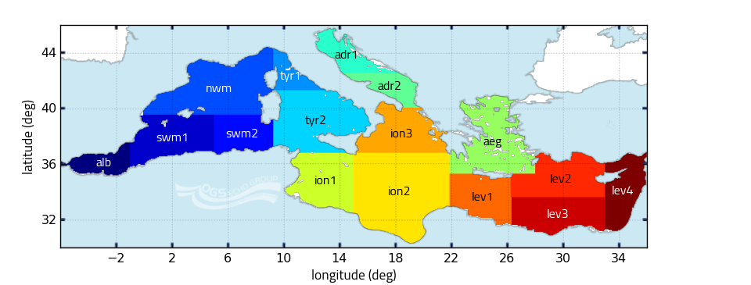
Ensemble sensitivity simulations of the new bio-optical model in 3-D configuration and definition of metrics
BIOPTIMOD
Notes:
Basin subdivision in use in the CMEMS MedMFC validation procedure and metrics definition.

Slide 13
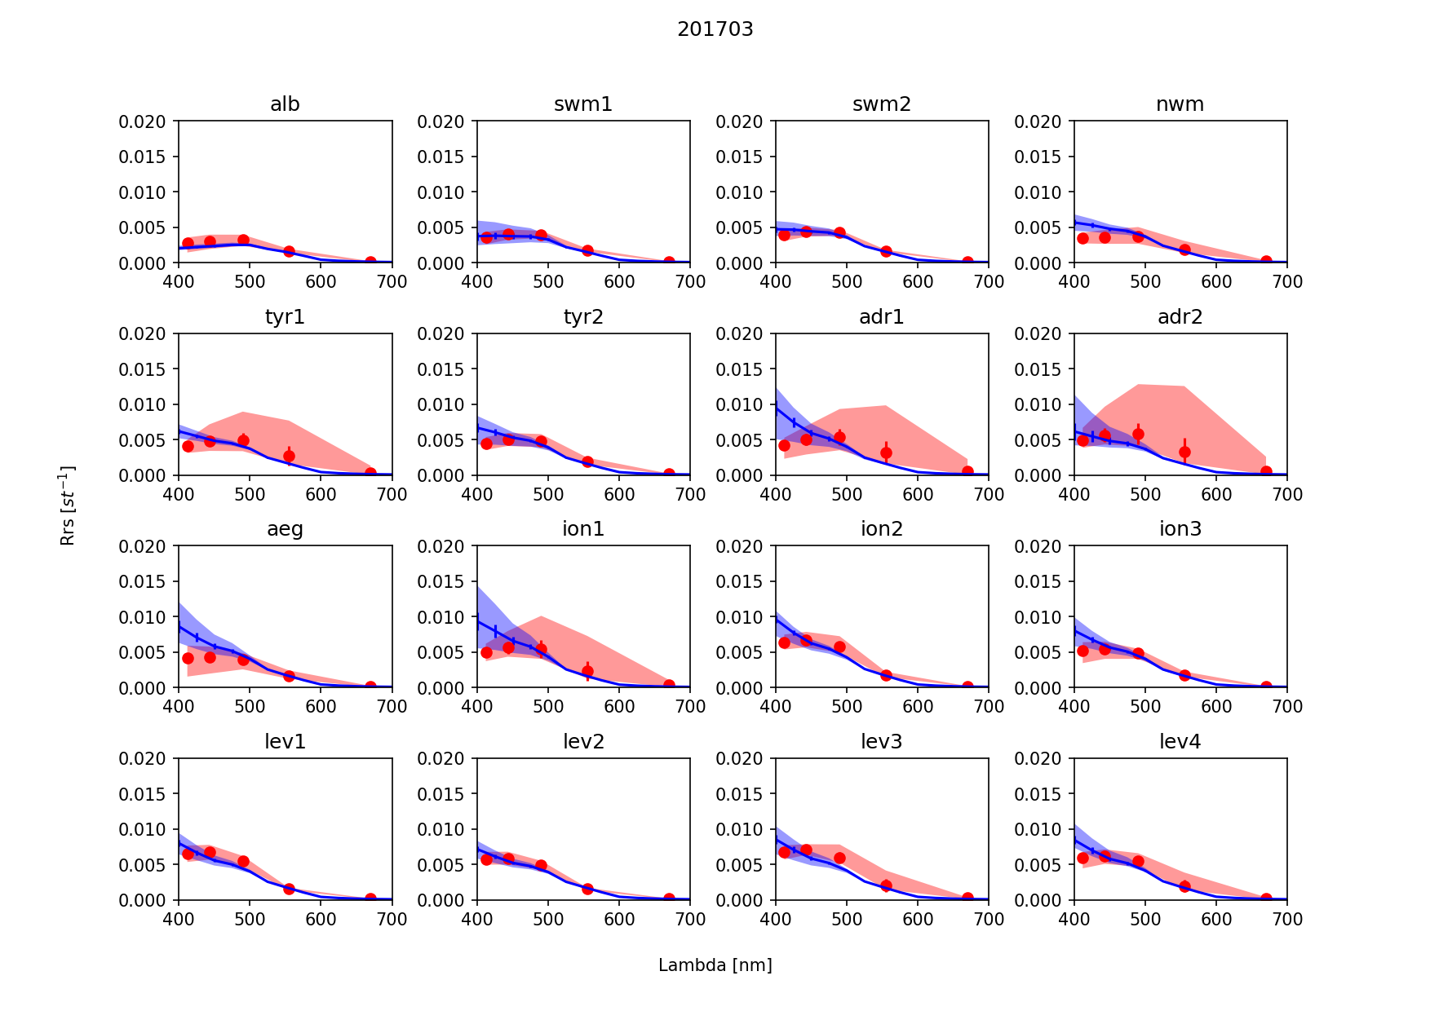
Model derivation of R_{rs} spectra
More detailed way to define metrics and evaluate model skill than chlorophyll: Rrs incorporates more processes and can be used to characterize different Mediterranean Sea
sub-basins.
red dots (CMEMS product GLO_OPTICS_L4_REP_OBSERVATIONS_009_081),
blue lines model results from sensitivity test CDOM-T2
BIOPTIMOD
Notes:
The novel bio-optical model allows to reconstruct remote sensing reflectance that essentially determine the colour of the water and can be visualized by a curve of reflectance depending on wavelength, see this slide . From the extensive visual analyses of such curves we understood that in the open ocean large part of the variability of the reflectance appears in the shorter wavelengths considered (i.e. <500 nm) where both plankton pigments and CDOM are optically significant.
The <500 nm region is also associated with the larger deviations between model and satellite, therefore it makes sense to focus on this interval to define the metrics and to perform model results analyses.
In general the water simulated by the model appear more blue with respect to the CMEMS OC product, in fact the model tend to overestimate reflectance in the <500 nm interval.
Marginal Sea (Adriatic and Aegean) and areas particularly influenced by coastal inputs present interesting reflectance variability in the range 500-600 nm. We found that satellite Rrs in the marginal sea for the 500-600 nm was higher than pure water. This suggests that the higher reflectance is probably related to higher scattering by particles, probably of terrestrial origin. Therefore, since in this work we did not consider such effects we preferred, for the moment, to focus on the < 500 nm wavelengths. Clearly, the novel bio-optical model enables the investigation of waters masses with higher optical complexity, as the cases of the marginal seas, but this will require a specific study.

Slide 14
Comparison of different formulations
Blue crosses (CMEMS GLO_OPTICS_L4_REP_OBSERVATIONS_009_081), blue lines model results from CDOM-T2 test (left column) and INIT-T1 right column. Data and model are averaged over the lev4 sub-basin. Seasonal variability of total surface chlorophyll (units mgChl/m3): Green crosses (CMEMS product) and green lines (model output). Black dots represent the modeled seasonal variability of CDOM concentration normalized to one.
BIOPTIMOD
Notes:
During winter months (January, February and March) all the tests show a minimum in Rrs. Some of the tests simulate a second minimum during early fall. According to the presence and absence of this second minimum two groups can be identified: one composed by CDOM-T2, CDOM-T3 and CDOM-T4, and the other cluster grouping all the other tests. This minimum in reflectance co-varies with CDOM dynamics: the minimum of reflectance is mirrored by a maximum of CDOM in the same period. For example, in test INIT-T1 the accumulation patterns of CDOM in the Levantine area due to nutrient limitation produces a minimum of Rrs in late summer/start of fall, this minimum is not present in CDOM-T2. The differences in the model behaviour are related to the different parameterizations of DOC exudation considered in the two cases, this in turn is reflected in the CDOM production.

Slide 15
Novel metrics based on Rrs data
Example of Rrs metrics applied to 5 selected member tests of the ensemble experiment reported in the previous slide. Data and model are spatially aggregated over the Med CMEMES sub-basins shown in previous slide. For each member we report temporal correlation for reflectance at 412nm, 443nm, 490 nm with respect to CMEMS Rrs OC product (GLO_OPTICS_L4_REP_OBSERVATIONS_009_081), and RMS (units mgCHl/m3) with respect to CMEMS chlorophyll product (OCEANCOLOUR_MED_CHL_L3_NRT_OBSERVATIONS_009_040). Entries in bold indicate that correlation is significant with p-value <0.05.
BIOPTIMOD
Notes:
This example shows how the usage of the bio-optical model offers the opportunity to validate different CDOM formulations according to radiometric-based metrics. In particular the systematic analysis of the Rrs and BGC-Argo metrics indicates that the correlation is higher and more significant in the case of the CDOM-2 (results for some members of the sensitivity are reported in this slide ). On the other hand CDOM-T2 shows higher RMSD in terms of surface chlorophyll than, for example, PFT-T1.

Slide 16
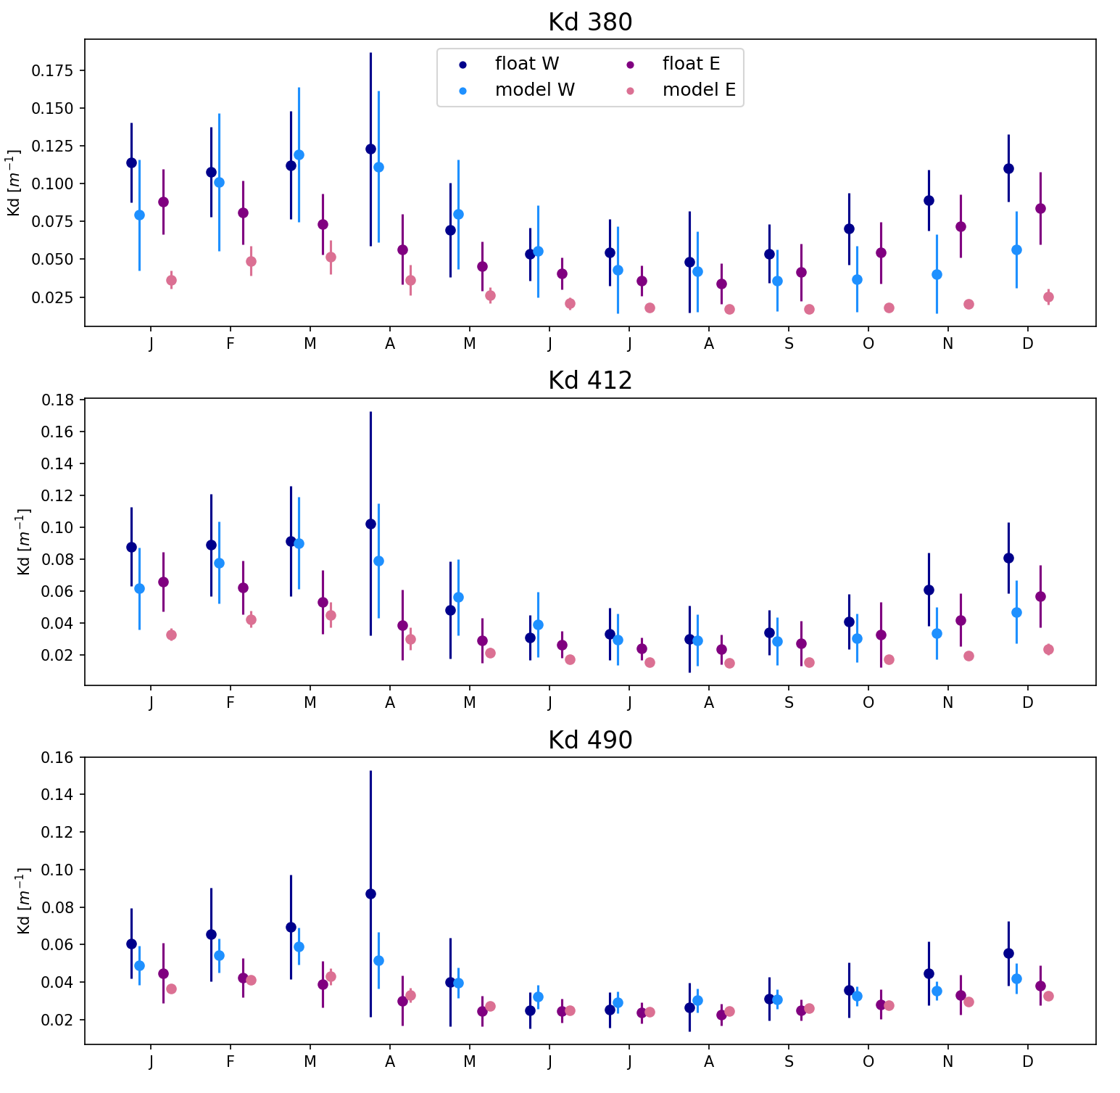
BGC-Argo radiometry metrics
Kd based metrics. Data and model are spatially aggregated over the Western and Eastern sub-basins. For each member we report temporal correlation for Kd at 380nm, 412nm, 490nm with respect to BGC Argo dataset collected in Task 1.2. Entries in bold indicate that correlation is significant with p-value <0.05.
Comparison of Kd computed considering attenuation of planar downward irradiance in the surface optical layer (1/Kd). The data are aggregated extracting co-located space-time points from BGC-Argo dataset and the model (TEST CDOM-T4). Data are clustered in two areas the West and East sub-basins. The climatologic months are constructed over the period 2012-2017.
BIOPTIMOD
Notes:
The metrics based on Kd comparison (both Model and BGC-Argo) are computed collecting space-time co-located profiles of planar downward irradiance and then fitting the attenuation coefficient over the first optical depth calculated for the specific wavelength considered.
The methodology is presented in the previous slides related to TASK 2.
Given the less uniform coverage of the BGC-Argo profiles (whit respect to Rrs) we decided to consider metrics by aggregating the profiles in two groups: the western and eastern sub-basins. Consistent results are obtained considering the metrics related to BGC-Argo floats, Table 2. The higher correlation is obtained by the CDOM-T2, CDOM-T3, CDOM-T4 simulations. In all the cases the lower correlation corresponds to the shorter wavelength (Kd380) and skill increases toward the Kd490 where all the correlations are significant. Modelled reflectance and Kd appears overestimated and underestimated (respectively) in the months of November, December and January especially for the shorter wavelengths.
From the analysis of the metrics it appears that model skill is higher in simulating chlorophyll seasonality with respect to CDOM dynamic. In particular both the Rrs metrics based on satellite data and the Kd metrics related to BGC Argo present higher correlation for the 490nm band where pigment absorption, and therefore chlorophyll dynamics, is prevalent.
For the shorter wavelength the skill of the model is generally lower, probably due to the complexity of the CDOM dynamics. This implies that lower wavelength are in some sense the most interesting because we can inject in the model more information: with respect to the definition of metrics to validate carbon cycling and biogeochemical formulations but also in the framework of the data assimilation.

Slide 17
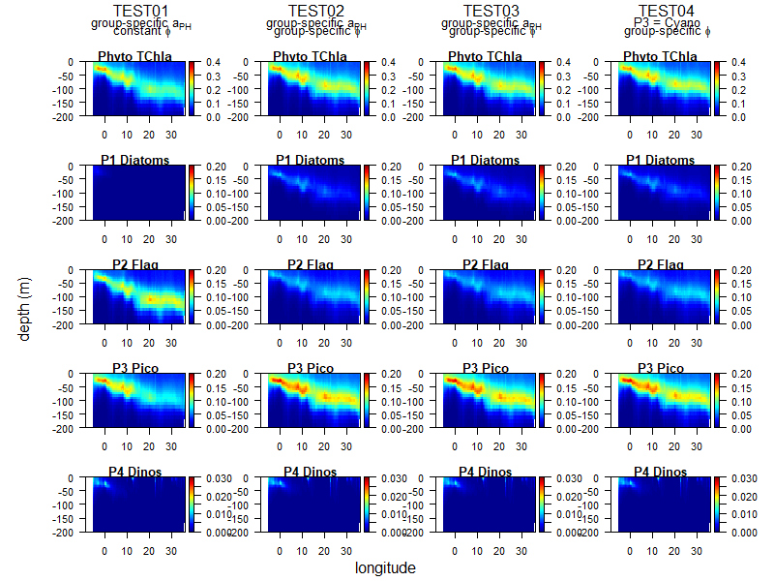
PFT DYNAMICS
DCM depth gradient is now an emergent property in the system: deeper DCM moving eastward
Different parameterizations in photochemical efficiency
produce alterations in the community composition but the system is overall stable
Depth profiles of total Chla (first row) and Chla (mg m-3) per PFT along the Mediterranean longitudinal gradient from Gibraltar Strait to Levantine Basin.
BIOPTIMOD
Notes:
The alternative PFT tests indicate that the different options considered produce alterations in the PFT community distributions.
The main difference between PFT- T1 and next simulations is that in the first one diatoms are less abundant. Even in the spring bloom in T1 they are absent in all basins and only represent up to a 15% of the phytoplankton community in the western-most basins.
In T1 phytoplankton community is dominated by flagellates and picophytoplankton almost exclusively. In the other simulations, where the photochemical efficiency is PFT-specific, although flagellates and picophytoplankton are still dominating, they do not outcompete totally the other groups.
It is important to underline how the usage of the novel bio-optical model allows to reconstruct, as a self-emerging property, the DCM gradient between West and East Mediterranean, as shown in this slide.
In this regard the distribution in the water column of the PFT’s, in T1 the DCM in the Eastern Mediterranean is dominated by flagellates whereas in T2 to T4 pico-phytoplankton have more biomass in the DCM.
Dinoflagellates distribute very similarly between simulations and diatoms show the same behaviour as in surface, they were almost absent in PFT-T1 and reappeared in next simulations.

Slide 18
CONCLUSIONS
The novel multi spectral model allows the definition on novel Metrics that can be used in the CMEMS service MedMFC model evaluation
The usage of Rrs appears a better way (rather than chlorophyll) to characterize marginal seas where the optical signature is completely different with respect to open ocean sites
The dynamic of CDOM (and DOC) appears of the same order of magnitude of the phytoplankton one in shaping the optical properties; the usage of reflectance information can be useful to test different model simulation with different CDOM and DOC formulations, we provide an example related to DOC accumulation during nutrient stressed periods.
The model equipped with the new RT model is able to reproduce as a self emergent property the well know DCM gradient present in the Mediterranean Sea.
PFT distributions appear rather stable using different the different approaches to photochemical efficiency.
Among the sensitivity tests the most impacting appear the ones perturbing DOC and CDOM dynamics and phytoplankton photochemical efficiency

Slide 19
Thank you

