Slide 1
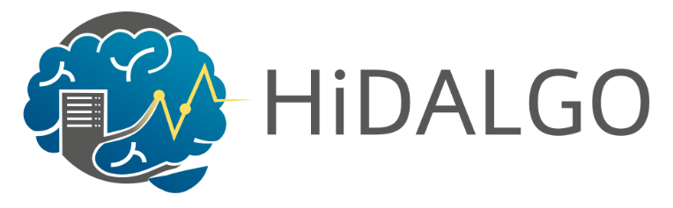
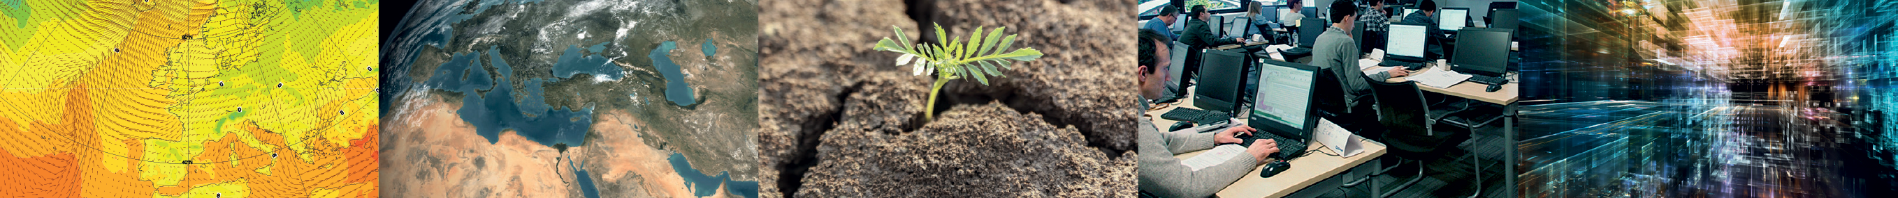
Building Cloud-Based Data Services to enable Earth Science Workflows
John Hanley, Milana Vuckovic, James Hawkes, Tiago Quintino, Stephan Siemen, Florian Pappenberger
John.Hanley@ecmwf.int

Slide 2
Overview
Introduction to ECMWF
The Data Challenge
HiDALGO & ECMWF

Slide 3
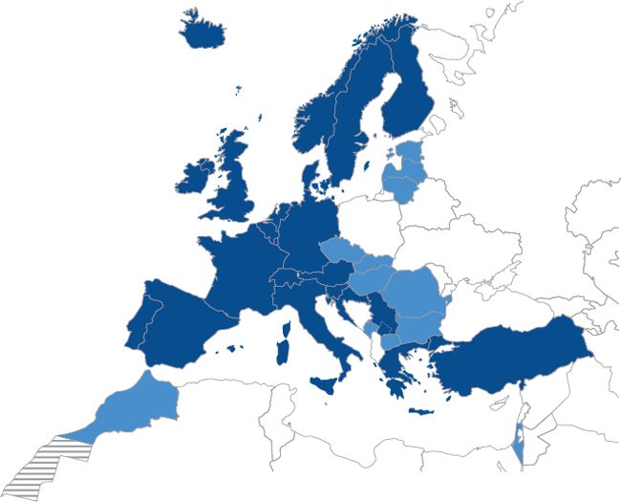
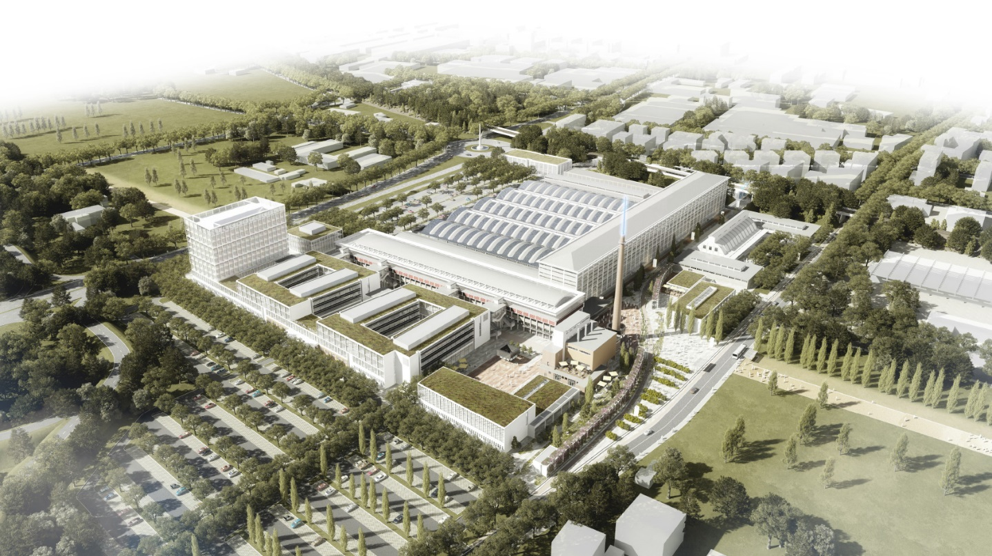

European Centre for Medium-Range Weather Forecasts
Established in 1975.
Intergovernmental Organisation
  22 Member States | 12 Cooperation States
  350+ staff
24/7 operational service
  Operational NWP centre
  Supporting NWS (coupled models) and businesses
Research institution
  Closely connected with researchers worldwide
Operates two Copernicus Services
  Climate Change Service (C3S)
  Atmosphere Monitoring Service (CAMS)
Supports Copernicus Emergency Management
Service (CEMS)
3

Slide 4

What do we do?
Short-range weather forecast
Very high resolution Regional models
1-2 hour production schedule
Medium-range weather forecast
High resolution Global models
6-12 hour production schedule
Long-range weather forecast
Predicts statistics of weather for coming month or season
1-8 times a month production schedule
Climate prediction
CO₂ doubling and other scenarios
4

Slide 5
What do we do?
Operations – Time Critical
  HRES 0-10 day, 00Z+12Z, 9km @ 137 levels
  ENS 0-15 day, 00Z+12Z, 18km @ 91 levels
  BC 06Z and 18Z, 0-5 days hourly
  120 TiB, 85 Million products
  Real-time Dissemination, 200 destinations world-wide
Research – Non Time Critical
  100s Daily active experiments to improve our models
  Reforecasts, Climate reanalysis, etc
Meteorological Archive
  > 300 PiB of data @ 5000 daily active users
  120 TiB added per day

Slide 6
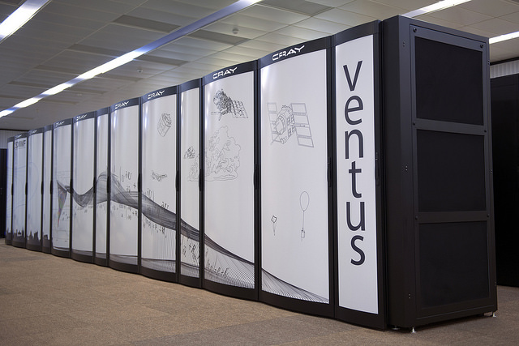
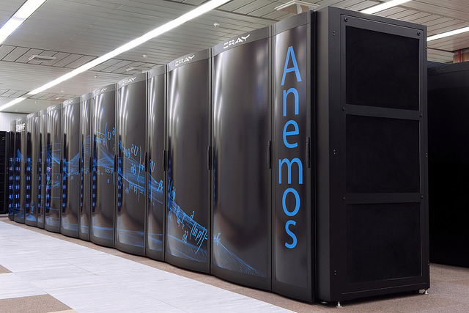
ECMWF’s Facilities
HPC
2x Cray XC40 HPC
2x 129,960 cores Xeon EP E5-2695 Broadwell
2x 10 PiB Lustre PFS storage
Top500 42nd/43rd
Cloud
[SaaS] Copernicus Data Storage (CDS) – Operational
[PaaS] European Weather Cloud – Pilot currently being setup
[XaaS] WEkEO www.wekeo.eu
Archive
Largest Meteo archive 4x Oracle (Sun) SL8500 tape libraries
~ 140 Tape drives
+ 120 TiB / day operational + 150 TiB / day other
6

Slide 7
Introduction to ECMWF
The Data Challenge
HiDALGO & ECMWF

Slide 8
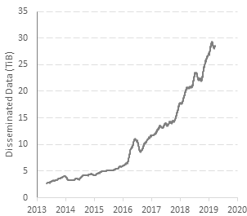
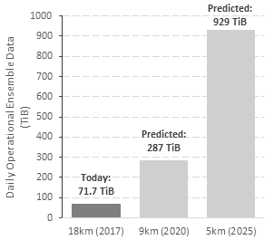
ECMWF Data Growth – History and Projections
Historical Growth of Generated Products
Model Output Projected Growth
Largest meteorological archive in the world
  Direct access from Member States
  Available to research community worldwide
Data archival and retrieval system for ECMWF data
  > 300 PB primary data
8

Slide 9
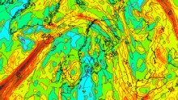
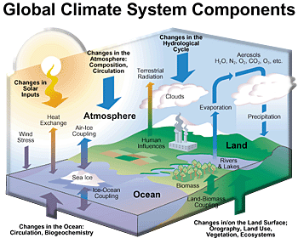



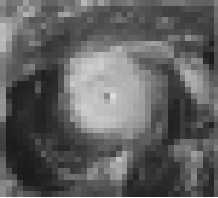

Types of data growth
➔Reliability
➔Range
Ensembles
Traditional weather science domain
Model complexity
Traditional climate science domain
Model resolution
Today: we need high-resolution, ‘Earth system’ model ensembles to perform at all scales!
➔Accuracy

Slide 10
The data challenge
No user can handle all our data in real-time
  Much of ECMWF (Ensemble) forecast stays unused!
  ECMWF always looks for new ways to give user access
  to more of its forecasts
  Not made easier by domain specific formats & conventions
The Key Challenge:
How do we improve user access
to such volumes of data?
Dissemination system
  Sophisticated push system to disseminate 30TiB in real
  time across the world
Web services
  Develop & explore (GIS/OGC) web services to allow users to request data on-demand

Slide 11
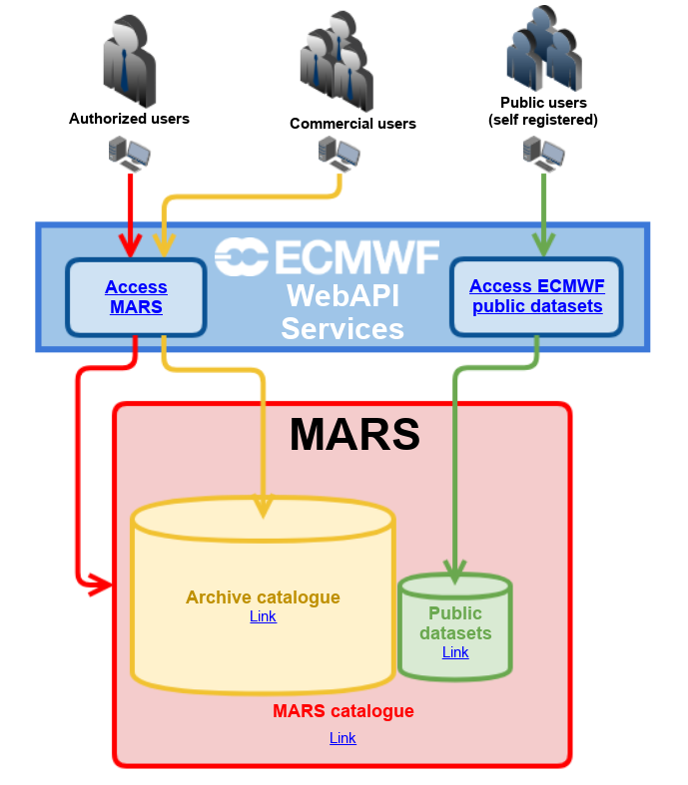
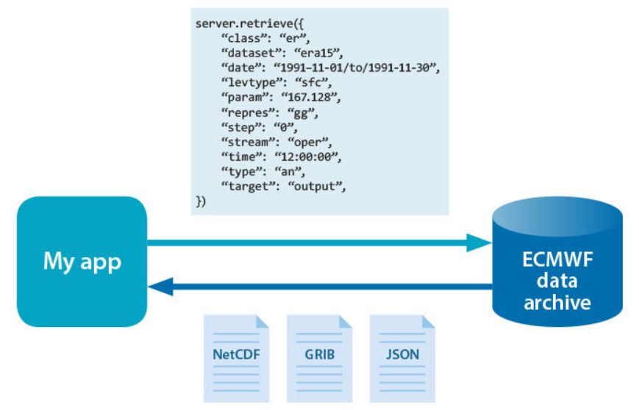
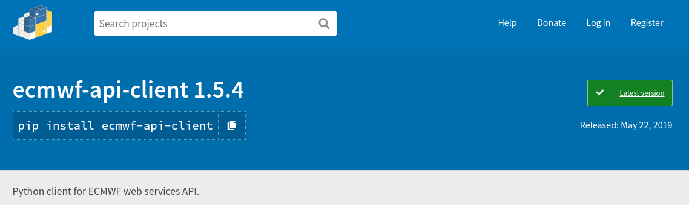
How can you access data today?
Try it out yourself:
https://pypi.org/project/ecmwf-api-client/
https://apps.ecmwf.int/datasets/

Slide 12
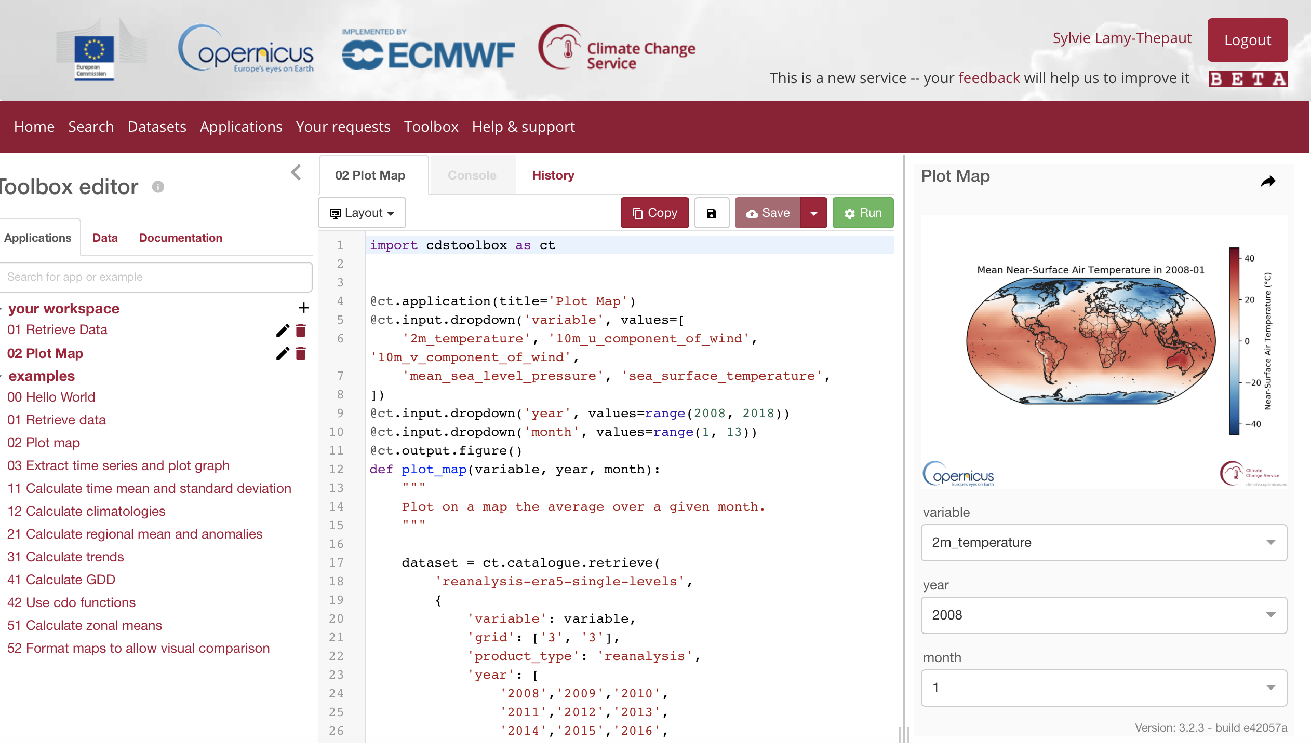
How can you access data today?
Copernicus Climate Data Store (CDS)
New portal to find / download and work
with Copernicus climate change data
Many data sets too large for users
to work locally
→ therefore it offers server side processing
High-level descriptive Python interface
  Allow non-domain users to build apps
Try it out yourself:
https://cds.climate.copernicus.eu
CDS toolbox

Slide 13
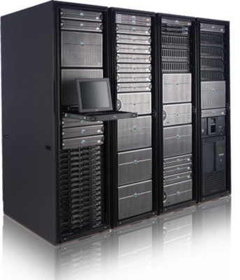
ECMWF Novel Data Flows
Cloud
Producer
Consumer
Bring users to the data
Use data while it is hot
Access using scientifically meaningful metadata
Archive
FDB
MARS
PFS
HDD
Tape

Slide 14
Introduction to ECMWF
The Data Challenge
HiDALGO & ECMWF

Slide 15














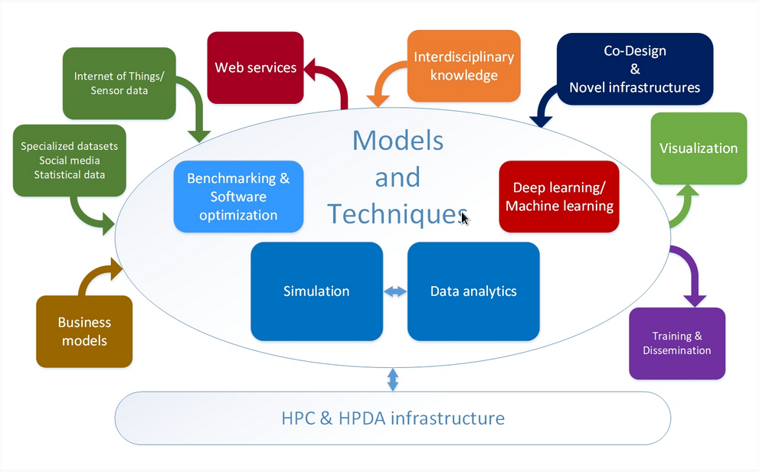

HiDALGO:
HPC and Big Data Technologies for Global Systems – European project funded by the Horizon 2020 Framework Programme of the European Union carried out by 13 institutions from seven countries.
The Vision:
To advance technology to master global challenges
The Mission:
To develop novel methods, algorithms and software for HPC & HPDA to accurately model and simulate the related complex processes. To also enable coupling of pilots to external data sources (e.g. ECMWF).
Weather & Climate coupling
Pilot Test Cases:
Migration pilot (Derek Groen, Brunel University, UK).
Air pollution pilot (Zoltán Horváth, SZE, Hungary)
Social networks pilot (Robert Elsässer, PLUS, Austria)

Slide 16
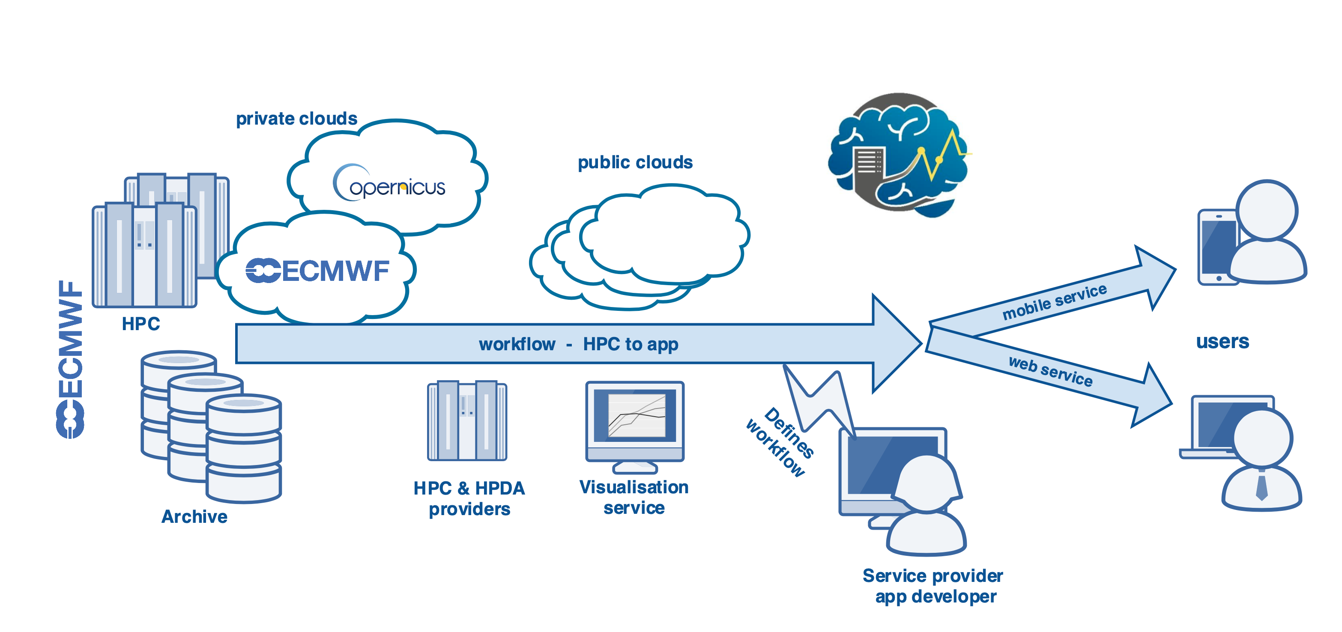
ECMWF’s role
Enable coupling as a means to build a workflow
With a "closed" HPC system, ECMWF brings in valuable experience on how these systems can be integrated in larger workflows --> this can be a model for many similar HPC systems around Europe!

Slide 17
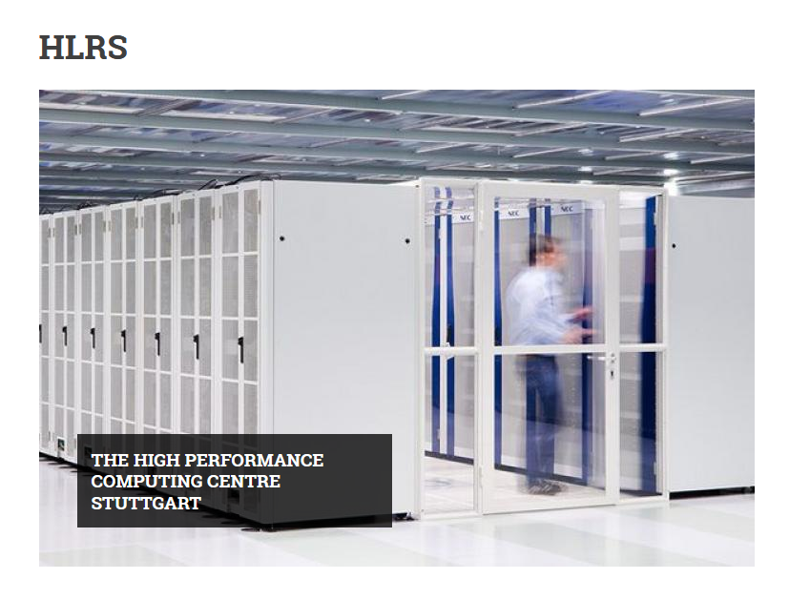

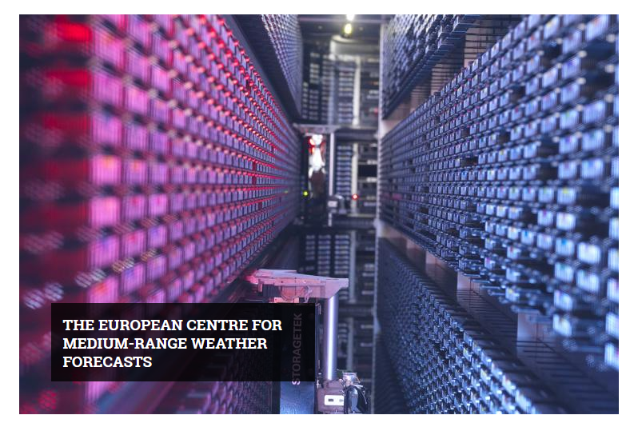
HiDALGO HPC & Cloud Facilities
Cloud
Cray XC40 “Hazelhen”
7.4 PFLOPS
185,088 cores
Huawei CH121 “Eagle”
1.4 PFLOPS
32,984 cores

Slide 18
Weather and Climate Data Coupling
Climate Data Store (CDS)
Two step approach to coupling
Step 1: Static coupling (1st year of project - 2019)
- coupling with static reanalysis (climate) data for the purposes of pilot model calibration
Completed!
Step 2: Dynamic coupling (2nd year – 2020 onwards)
- coupling with forecast data via a REST API
Cloud
Vision:
To enable users to build custom workflows utilizing ECMWF's weather forecast and climate data
Consumer
Bring users to the data
Use data while it is hot
Access using scientifically meaningful metadata

Slide 19
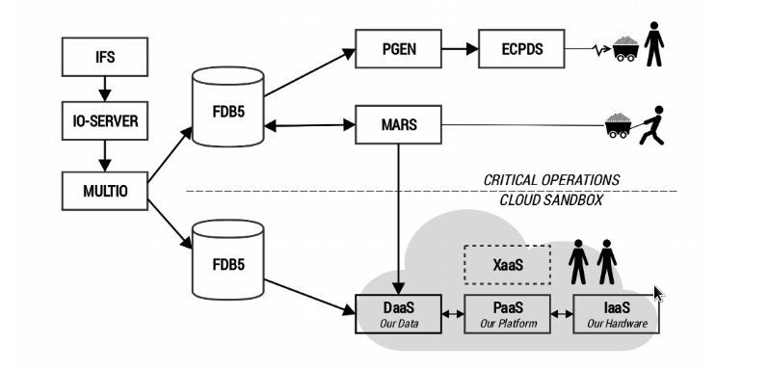
Providing ECMWF data to the pilot applications
The main requirements:
Bring users to the data and avoid moving the data out of the data centre.
Provide users with computing resources collocated directly with data.
Align with data-centric approach of “move the compute, not the data”.
How to enable this:
Mechanism to pull/push data from ECMWF.
Mechanism to run custom post-processing at ECMWF.
Mechanism to explore what data and processing options ECMWF offers.
push
pull

Slide 20
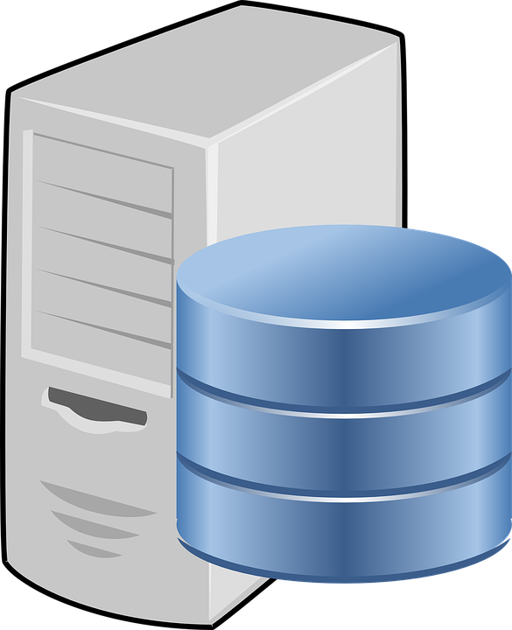

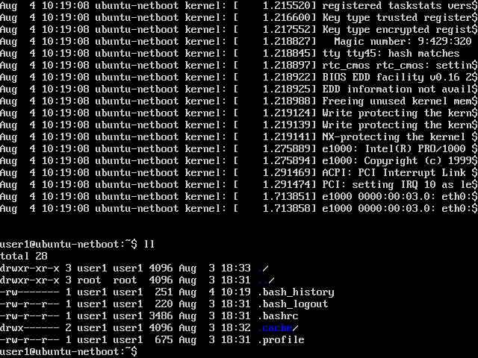

Cloud Data-as-a-Service: Polytope
For more details on Polytope: EGU2020-15048
Polytope: Serving ECMWFs Big Weather Data
Service designed for efficient provisioning of meteorological data to Cloud and HPC applications
Step 1: submit request
polytope retrieve <request> (POST)
Polytope 0.5.0 now available: http://polytope.ecmwf.int
  Deployed internally at ECMWF
  Accessible externally
  Beta-tested via European Weather Cloud
Exposes a RESTful API
A CLI and python API aid the users interacting with the Polytope API
It interfaces MARS directly
Will implement hyper-cube data access
Polytope Server
Polytope Client
{
'stream' : 'oper',
'type' : 'an',
'class' : 'ei',
'dataset' : 'interim',
'levtype' : 'sfc',
'param' : '165.128’,
...
}
.
.
.
.
.
.
.
Request ID (202 ACCEPTED)

Slide 21
Cloud Data-as-a-Service: Polytope
Service designed for efficient provisioning of meteorological data to Cloud and HPC applications
Optional step: list requests
Polytope 0.5.0 now available: http://polytope.ecmwf.int
  Deployed internally at ECMWF
  Accessible externally
  Beta-tested via European Weather Cloud
Exposes a RESTful API
A CLI and python API aid the users interacting with the Polytope API
It interfaces MARS directly
Will implement hyper-cube data access
Polytope Server
Polytope Client
polytope list requests (GET)
Request IDs (200 OK)

Slide 22
Cloud Data-as-a-Service: Polytope
Service designed for efficient provisioning of meteorological data to Cloud and HPC applications
Step 2: poll for data
Polytope 0.5.0 now available: http://polytope.ecmwf.int
  Deployed internally at ECMWF
  Accessible externally
  Beta-tested via European Weather Cloud
Exposes a RESTful API
A CLI and python API aid the users interacting with the Polytope API
It interfaces MARS directly
Will implement hyper-cube data access
Polytope Server
Polytope Client
Request ID (GET)
Data (200 OK)
Not yet available (200 OK)

Slide 23
Cloud Data-as-a-Service: Polytope
Service designed for efficient provisioning of meteorological data to Cloud and HPC applications
Step 3: delete completed request
Polytope 0.5.0 now available: http://polytope.ecmwf.int
  Deployed internally at ECMWF
  Accessible externally
  Beta-tested via European Weather Cloud
Exposes a RESTful API
A CLI and python API aid the users interacting with the Polytope API
It interfaces MARS directly
Will implement hyper-cube data access
Polytope Server
Polytope Client
polytope revoke <id> (DELETE)
(200 OK)

Slide 24
Cloud Data-as-a-Service: Polytope
The system has been developed as a set of independent services for scalability (elastic architecture, muti frontend, workers, etc.), ease of deployment (Kubernetes support), with a shallow software stack.
polytope.ecmwf.int
request store
Queue
Worker Pool
Data Sources
request (POST)
FRONTEND
api/v1/requests
|||||||||||||||||||
ID (202 ACCEPTED)
FDB
worker
api/v1/requests/<request_id>
broker
MARS
ID (GET)
Data (200 OK)
OTHER SOURCE
. . .
data staging

Slide 25


Acknowledgements
QUESTIONS ?
This work has been supported by the HiDALGO project and has been partly funded by the European Commission’s ICT activity of the H2020 Programme under grant agreement number: 824115. This paper expresses the opinions of the authors and not necessarily those of the European Commission. The European Commission is not liable for any use that may be made of the information contained in this paper.

