Slide 1
An R tool for Capturing Dynamics of Actual Evapotranspiration with MEP model and its application in Amazon
Amazon forest –
a natural laboratory of global significance
School of Hydropower & Information Engineering
Yong Yang
Huaiwei Sun, Jingfeng Wang

Slide 2
Objectives and method
Objectives:
Estimate surface energy budget(latent, sensible and ground heat) of Amazon forest region with MEP model
Test the performances of the new R tool
Method:
The maximum-entropy-production (MEP) model solves the turbulent sensible heat, latent heat and ground heat as the most probable partitioning of surface net radiation and satisfying the energy budget conservation.
The MEP model does not require data on temperature and humidity gradient, wind speed and surface roughness and therefore is an inputs parsimonious method, using fewer parameters contrast to the traditional bulk transfer models.
References: Wang, J., and R. L. Bras (2009), A model of surface heat fluxes based on the theory of maximum entropy production, Water Resour. Res., 45, W11422, doi:10.1029/2009WR007900.

Slide 3
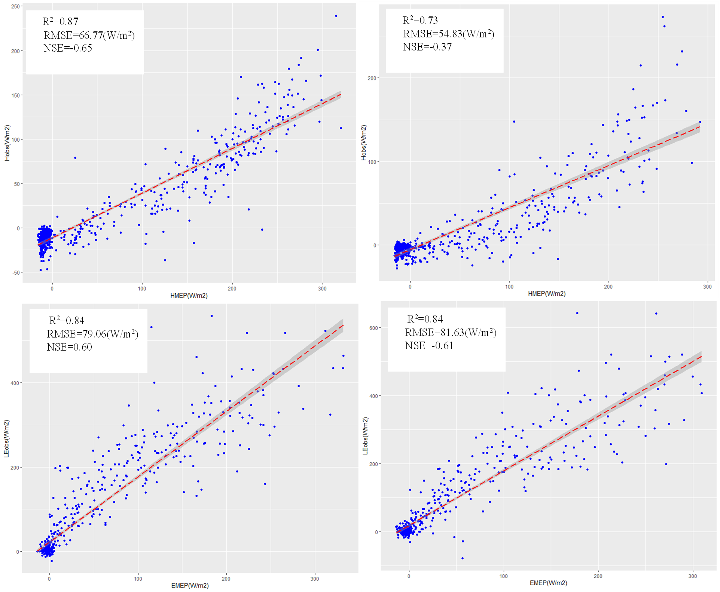
Result in site scale
Model Performance:
MEP simulated heat fluxes vs. EC observations
high R² but relative larger RMSE at half-hourly scale
Eddy Covariance (EC) FLUXNET data
Information about two sites of Amazon forest
Site name | Lat/Lon | Canopy height (m) | Biome type | Study period
BR-Sa1 | 2.85S/ 54.97W | 35-40 | Tropical rainforest | 07/01/2004- 07/31/2004
BR-Sa3 | 3.01S/ 54.58W | 35-40 | Selectively logged tropical | 07/01/2000- 07/31/2000
BR-Sa1
BR-Sa3

Slide 4
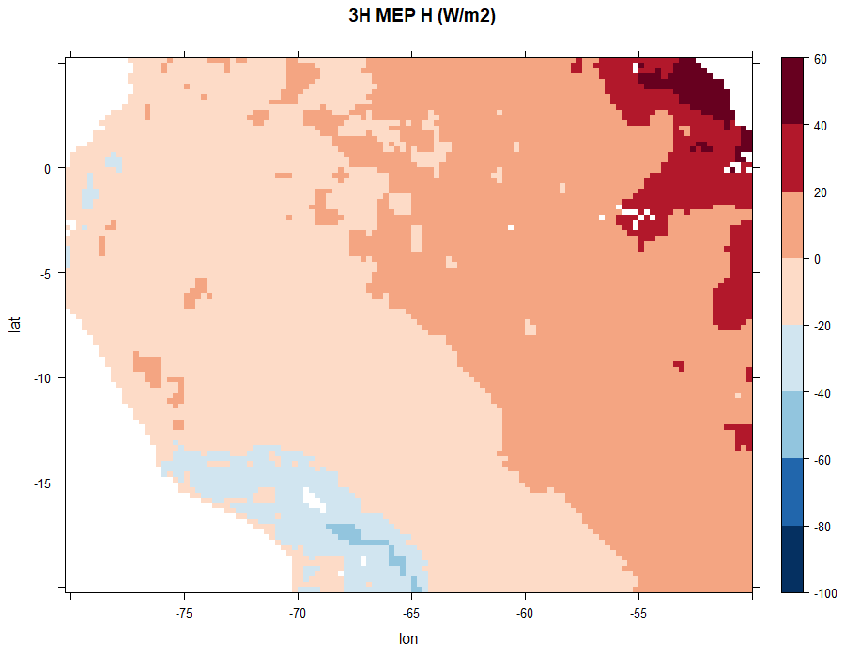
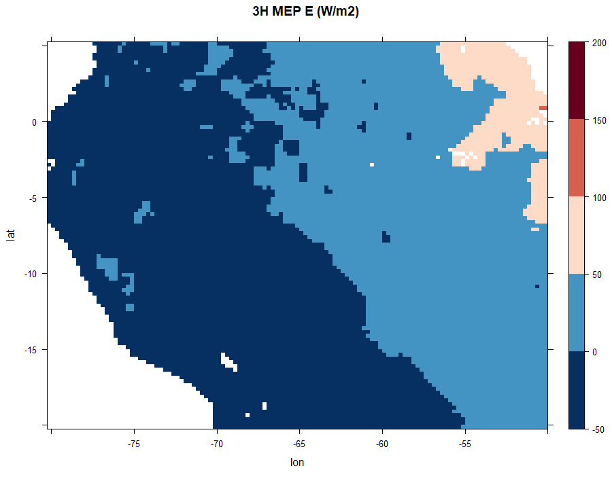
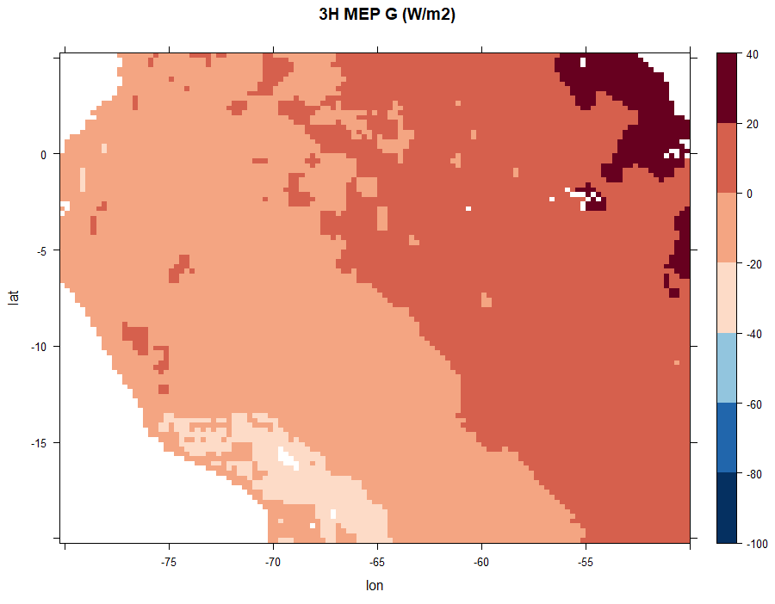
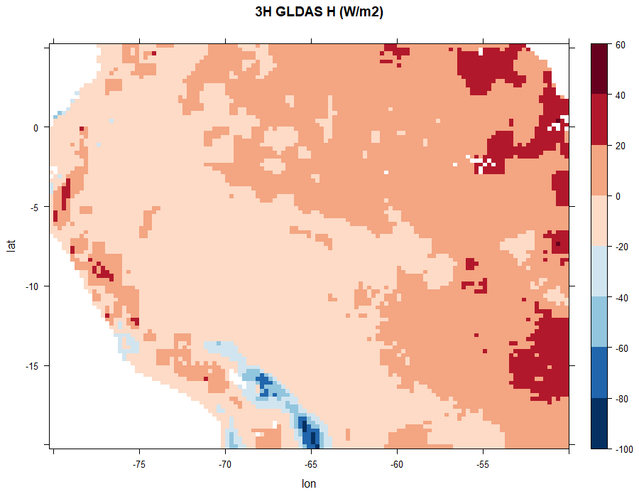
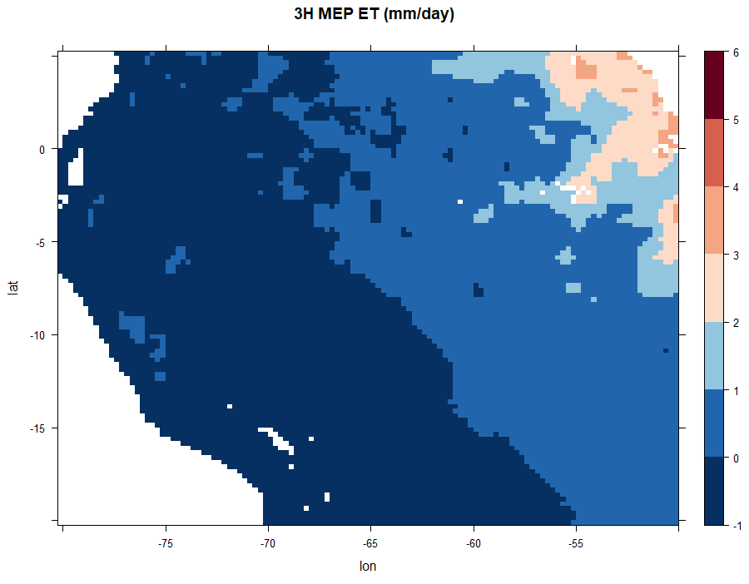
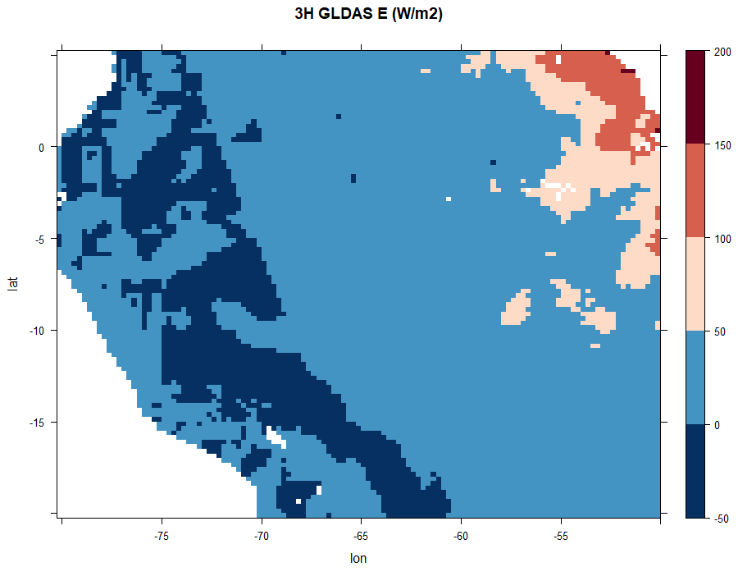
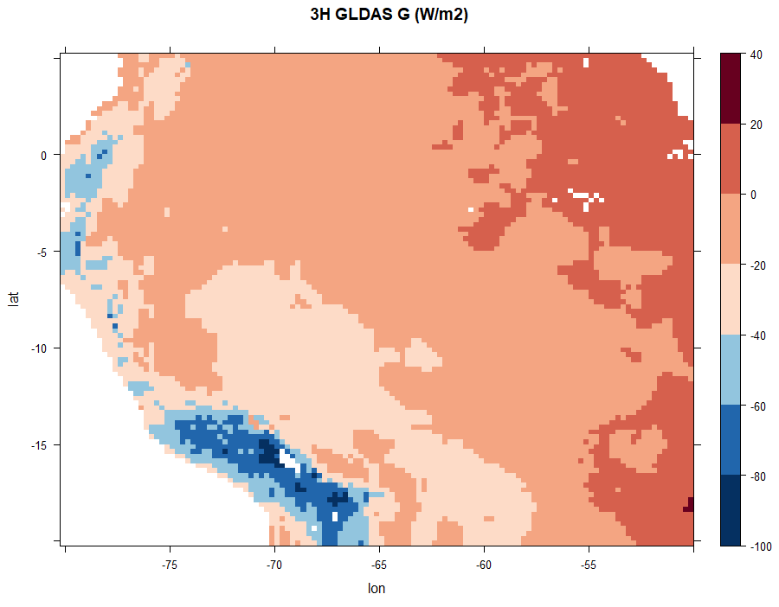
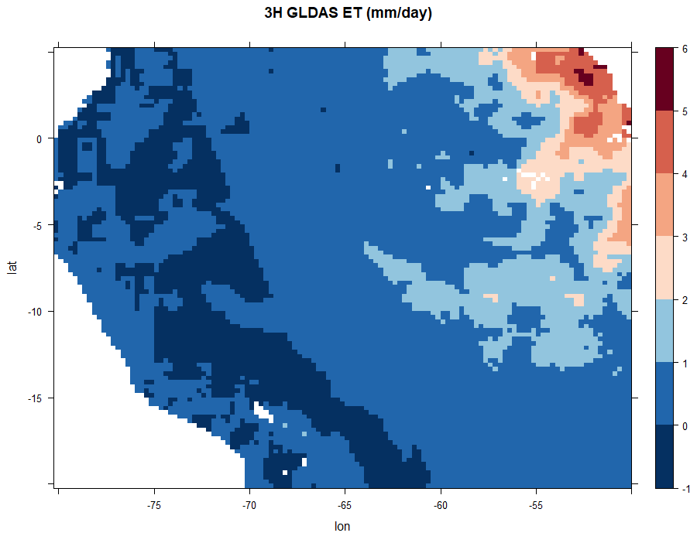
Result in Amazon region
Using Global Land Data Assimilation System (GLDAS) data for validation
Noah land surface model product (0.25°x 0.25°), July 25, 2000,12:00 pm ~ 15:00 pm.
MEP simulated
MEP simulated
VS.

Slide 5
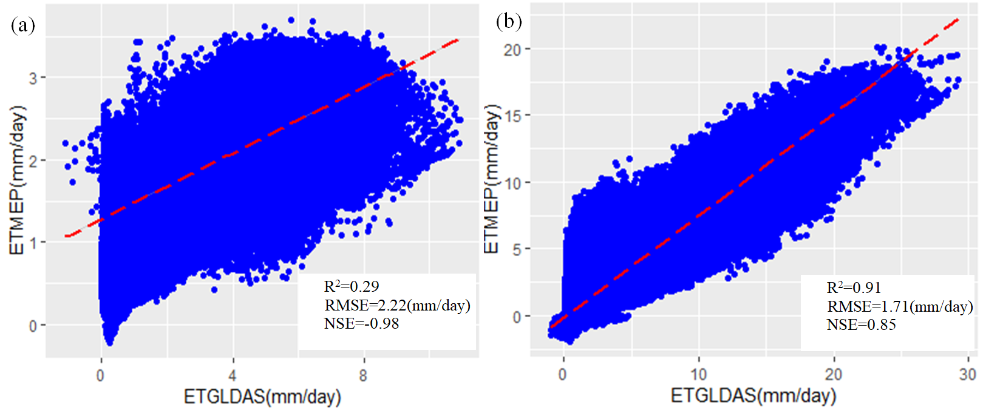
Result of statistics
July 25, 2000,12:00 pm ~ 15:00 pm.
Different temporal inputs of GLDAS data in estimating ET
MEP estimated VS. GLDAS data in Amazon
 | H (W/m²) | E (W/m²) | G (W/m²) | ET (mm/day)
R² | 0.63 | 0.90 | 0.76 | 0.90
RMSE | 8.11 | 15.56 | 16.31 | 0.53
NSE | 0.50 | 0.61 | -0.05 | 0.61
(a) monthly ET aggregated by
diurnal temporal scale
(period of 1 July to 31 July 2014),
(b) monthly ET aggregated by
3-hourly temporal scale
(1 July to 31 July 2000)
3-hourly simulations had a higher accuracy
and smaller bias than daily simulations
R²:coefficient of determination, RMSE:Root Mean Squared Error,
NSE: Nash-Sutcliffe efficiency.

Slide 6
Conclusions
Energy imbalance (about 20%) issue of energy budget(H+E+LE=Rn) explains estimation errors in Amazon forest using EC data.
The MEP model shows a high performance in simulating heat fluxes and ET in Amazon region using 3-hourly temporal input of GLDAS data, and outperforms that of daily data.
MEP model only need 3 inputs(Rn, qs, Ts) and can be implemented conveniently by our R tool.
The R tool named “RMEP”, developed by our team and be available in R platform using the following code:
install_github("Yangyonghust/RMEP")
Github access: https://github.com/Yangyonghust/RMEP

Slide 7
Amazon forest –
a natural laboratory of global significance
School of Hydropower & Information Engineering
Thank you for your attention!
Yong Yang
Contact authors : goku@hust.edu.cn
hsun@hust.edu.cn
jingfeng.wang@ce.gatech.edu

