Slide 1
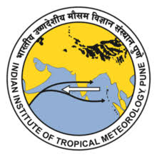
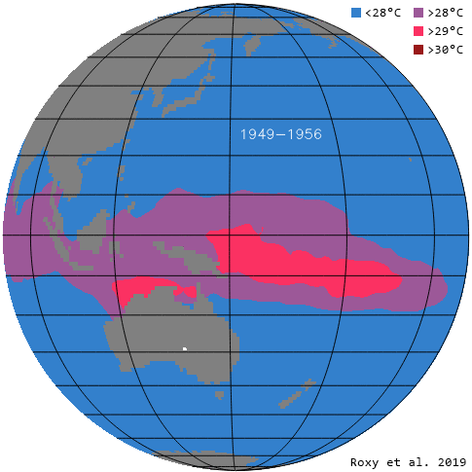
Indo-Pacific warm pool expansion modulates MJO lifecycle
Panini Dasgupta^{1,2}, Roxy Mathew Koll¹, Michael J. McPhaden³, Tamaki Suematsu⁴, Chidong Zhang³, and Daehyun Kim⁵
¹Centre for Climate Change Research, Indian Institute of Tropical Meteorology, Pune, India
²Department of Meteorology and Oceanography, College of Science and Technology, Andhra University, Visakhapatnam, Andhra Pradesh, India
³Pacific Marine Environmental Laboratory, National Oceanic and Atmospheric Administration, Seattle, WA, USA
⁴Atmosphere and Ocean Research Institute, The University of Tokyo, Kashiwa, Chiba, Japan
⁵Department of Atmospheric Sciences, University of Washington, Seattle, WA, USA

Slide 2
Indo-Pacific Warm pool : ‘heat engine’ of the globe
Characterised by permanent surface temperature >28 °C (an estimated threshold for atmospheric deep convection)
27 Million Km²
Source : Roxy et al.,2019
T_{h}
Warm SST at the Indo-Pacific Warm pool (IPWP) injects huge amount of moisture (through evaporation) and sensible heat to the atmosphere (Q_{h}).
heat engine
Q_{h}
Kinetic energy (Q_{h –}Q_{c}) is released through atmospheric circulation (Walker circulation and Hadley circulation).
W
Q_{c}
High convective clouds often reaches up to 15 km altitude release
huge amount of latent heat (through condensation) into atmosphere (Q_{c}).
This heat further influences the extratropical circulation.
T_{c}

Slide 3
Indo-Pacific warm pool expansion caused by Anthropogenic activity (Nov-Apr)
Trend in SST is maximum at the west Pacific.
Trend in November–April warm pool area for 1900–2018 (solid blue line) is 2.25 × 10⁵ km² per year and for 1981–2018 (dashed blue line) is 4.14 × 10⁵ km² per year.
The observed warm pool expansion is almost twofold, from an area of 2.2 × 10⁷ km² during 1900–1980, to an area of 4 × 10⁷ km² during 1981–2018.
Roxy et al.,2019 ; Weller et al.,2016

Slide 4
Time evolution of Indo-Pacific warm pool during November–April. Significant change in the IPWP mean state.

Slide 5
Trend in moisture during 1981-2018
Decreasing trend of moisture over Indian Ocean basin
(900-400 hPa) !!
Increasing trend of moisture over Maritime Continent and west Pacific (900-400 hPa).
Question : Why there is a decreasing trend in moisture over IO?

Slide 6
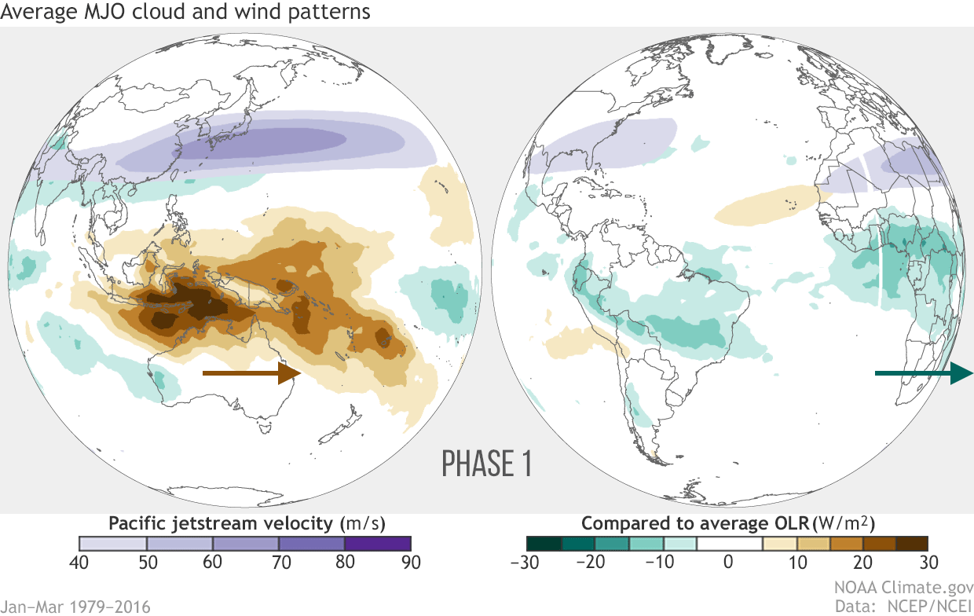
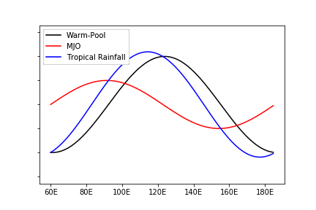
Madden Julian Oscillation (MJO)
The Madden–Julian Oscillation (MJO) (Madden and Julian,1971,1972) is the most dominant mode of sub-seasonal variability in the tropics, characterized by an eastward-moving band of rain clouds in the tropics.
Total rainfall in tropical belt is governed by the stationary warm pool and propagating MJO together.
Precipitation Anomaly
Raymond and Fuchs(2018)
Key Questions here is :
How does MJO interacts with the Indo-Pacific Warm Pool?
If there is an effect of warm pool expansion on MJO?

Slide 7
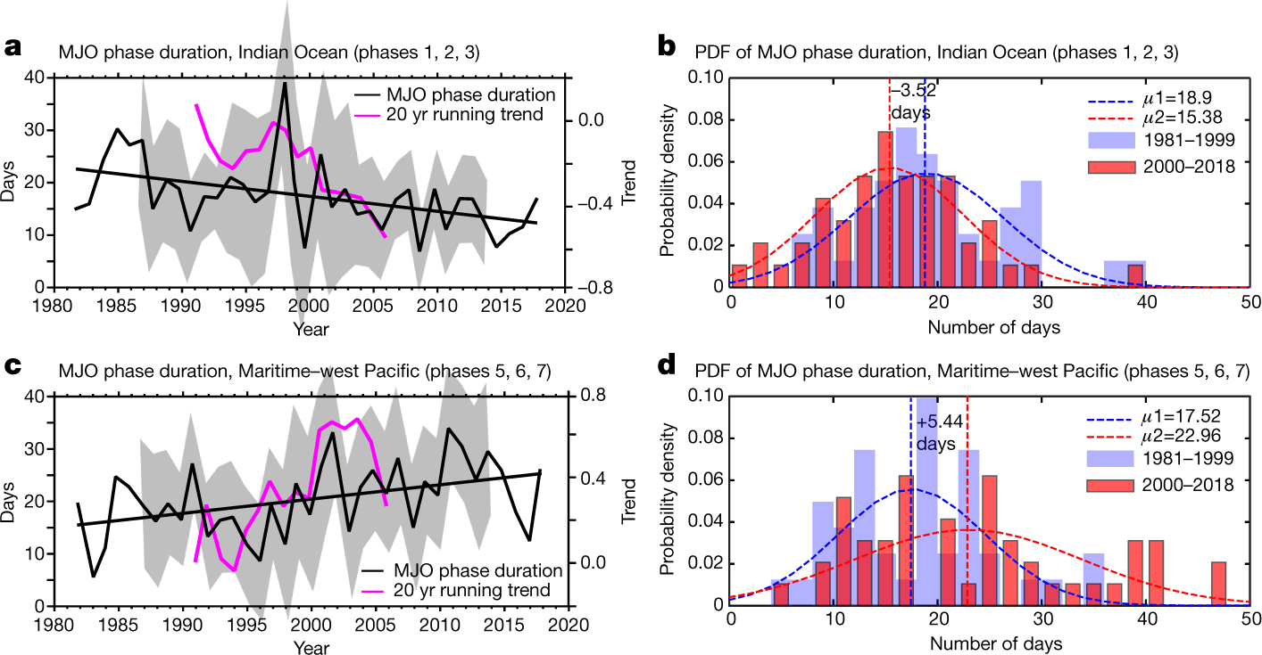
Observed changes in boreal winter MJO life cycle during 1981–2018
Method :
MJO events that exhibit prominent
eastward propagation with mean RMM amplitude (in its lifetime) greater than one are selected.
The average number of days of the selected MJO in each RMM phase is computed for each year.
Roxy et al. ,2019
Over the Indian Ocean (RMM phases 1, 2 and 3) MJO duration decreased by 3–4 days, from 19 days (during 1981–1999) to 15.4 days (during 2000–2018)
Over the Maritime Continent and the west Pacific (RMM phases 5, 6 and 7) MJO duration increases by 5–6 days, from an average of 17.5 days to 23 days

Slide 8
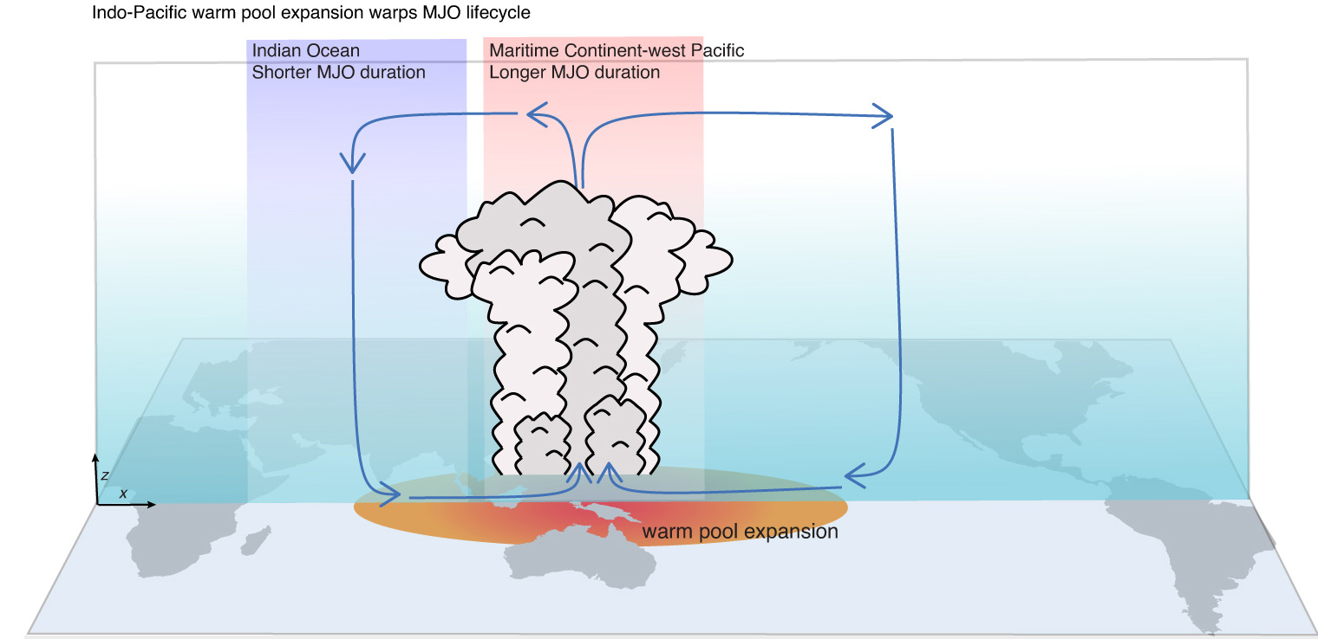
What causes the changes in MJO lifecycle?
Faster MJO propagation
Slower MJO propagation
Yoo et al.,2011; Junyi et al.,2019; Roxy et al.,2019

Slide 9
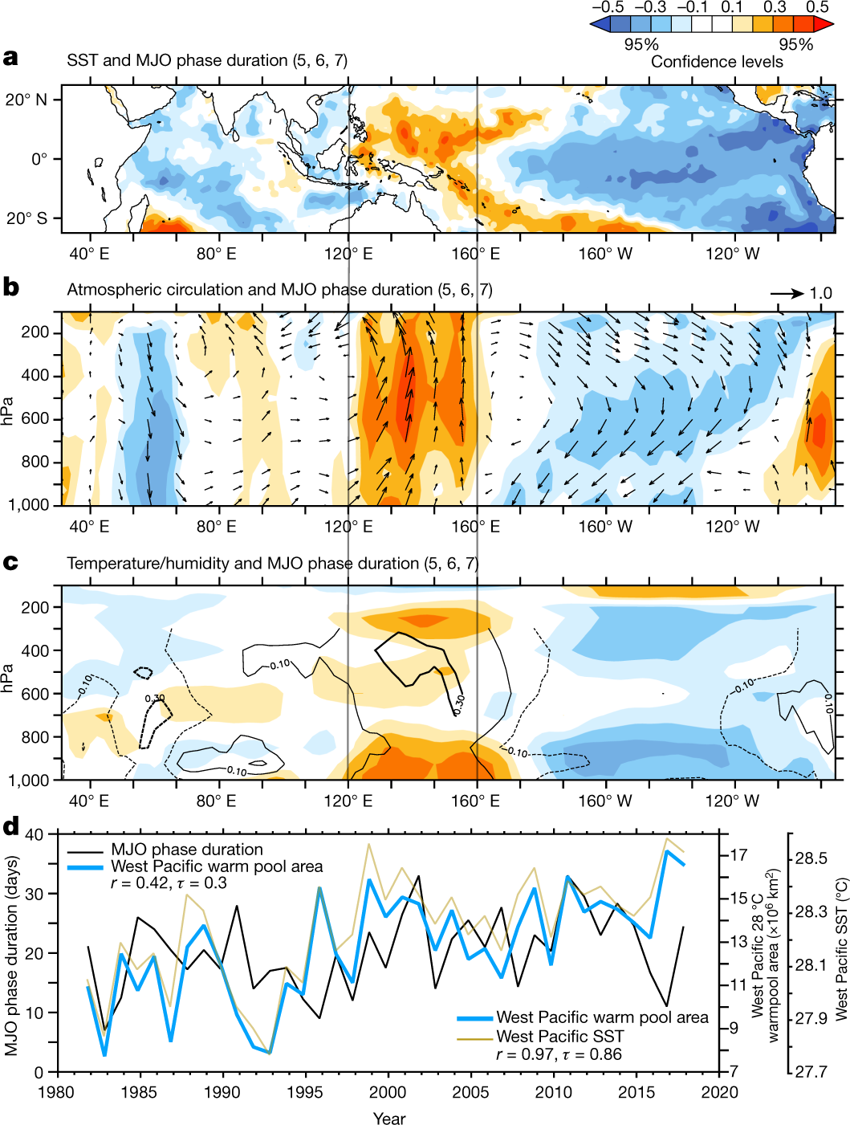
Indo-Pacific warming behind the longer MJO duration over the Maritime Continent and west Pacific
The role of Indo-Pacific warming
MJO phase duration (phases 5, 6 and 7) appears to be significantly correlated to the changes in SST collocated over the west Pacific warm pool, where the warming trends and the background mean SSTs are the largest.
Atmospheric circulation shows enhanced convective activity and a strengthening of low-level westerlies over the west Pacific (120° E to 160° E) associated with trends in the MJO phase duration. The enhanced convective activity over the west Pacific is compensated by subsidence over the central and west Indian Ocean (40° E to 70° E).
Specific humidity anomalies show a significantly negative correlation over the Indian Ocean and positive correlation over the west Pacific. Positive lower level moisture anomaly over the Maritime Continent and west Pacific is maintained by local and remote Indian Ocean sources.

Slide 10
A comparison of the MJO lifespan over the Maritime Continent and west Pacific warm pool area
Pearson correlation, r = 0.42, Kendall rank correlation, τ = 0.3
statistically significant at the 95% confidence level.
The MJO phase duration over the Indian Ocean (phases 1, 2 and 3) also shows a significant negative correlation with the west Pacific (r = −0.33), suggesting that the MJO changes over the Indian Ocean are also largely driven by SST warming over the west Pacific.

Slide 11
The mositure mode frame work of MJO:
MJO is a moisture mode. This means that sources and sinks of moist static energy control both the growth and propagation of the mode. (Source :Adam Sobel)
** Advection of the mean moisture through intra-seasonal wind helps MJO to propagate eastward.
Wind induced surface heat flux is maximum at the west of MJO convection.
Cloud-radiative feedback
helps MJO convection
to grow/intensify.
Sobel and Maloney(2012)
Image Background :Ángel F. Adames-Corraliza

Slide 12
Cloud-radiative feedback and enhanced moisture over MCWP intensify the MJO convection .
Enhanced convection
Dry subsidence over IO inhibits deep convection
Anomalous low
moisture content
over 900-400 hPa
Anomalous high moisture content
over 900-400 hPa
Prolonged residence time of MJO supported by moisture supply from both local (west Pacific) and remote (Indian Ocean)
Moisture advected away from the basin
Horizontal Moisture gradient
Advection of mean moisture from the east leads to
Decreased static stability over MCWP leads to
Faster MJO propagation
Slower MJO propagation
Warm pool expansion modulating the MJO lifecycle.

Slide 13
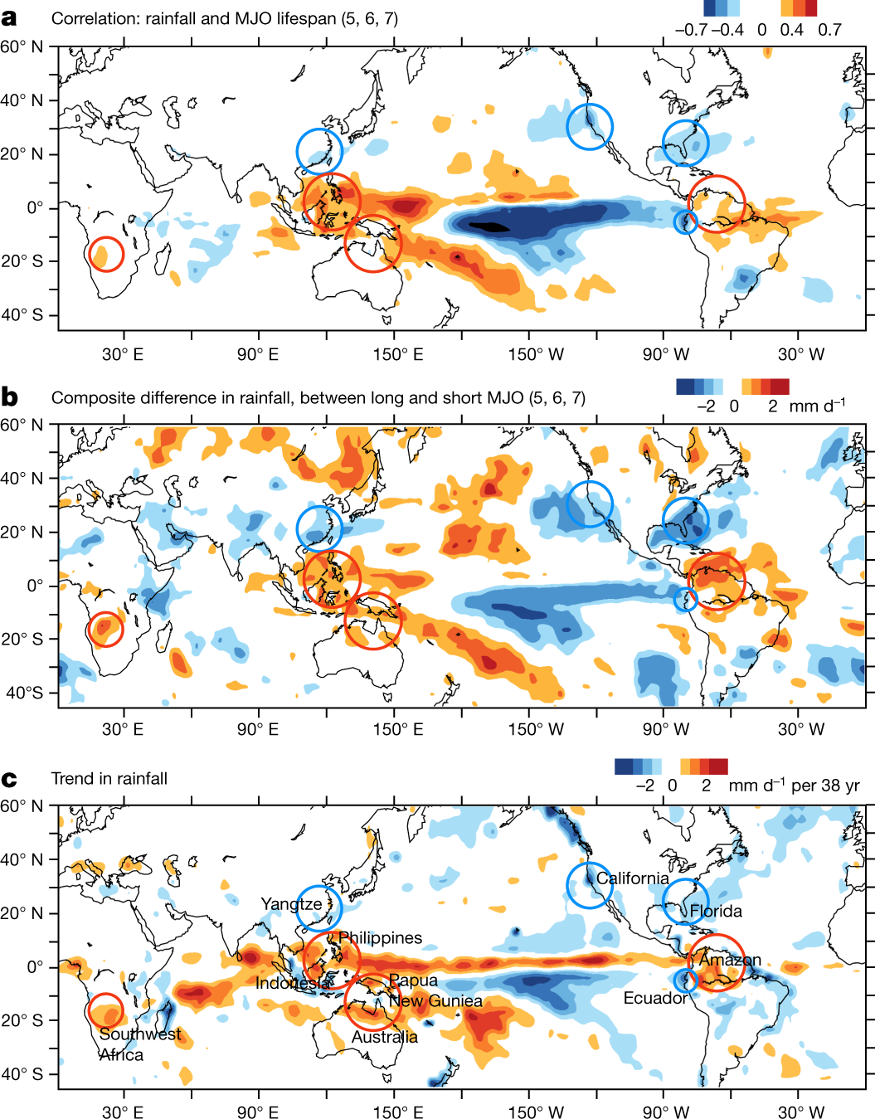
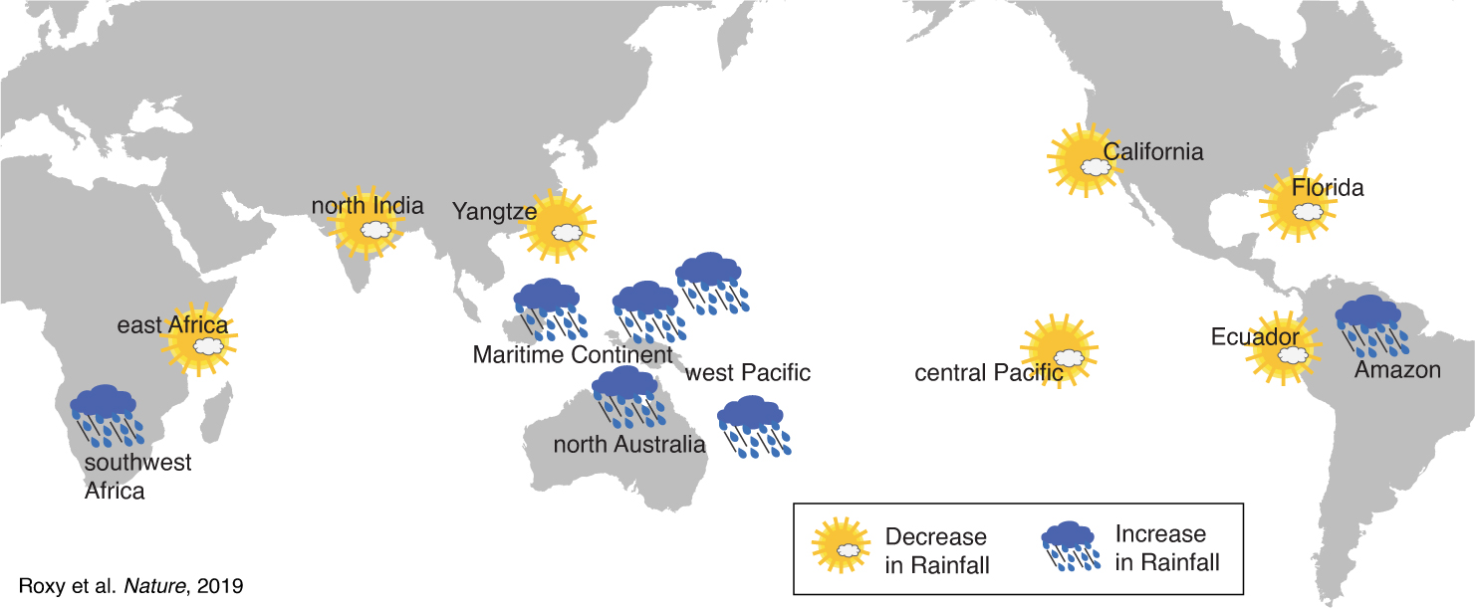
Impacts on global climate :
IPWP mean state change + change in MJO lifecycle

Slide 14
Summary
The rate of warm pool expansion has doubled in recent periods (2.3 × 10⁵ km² per year during 1900-2018 to 4 × 10⁵ km² per year during 1981-2018).
The rapid warming over the tropical oceans during 1981–2018 has warped the MJO life cycle, with its residence time decreasing over the Indian Ocean by 3–4 days, and increasing over the Indo-Pacific Maritime Continent by 5–6 days
The changes in the Indo-Pacific warm pool and the MJO are related to increased rainfall over southeast Asia, northern Australia, Southwest Africa and the Amazon, and drying over the west coast of the United States and Ecuador

Slide 15
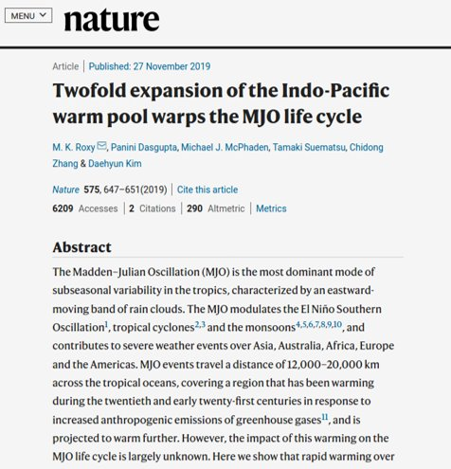
References
Roxy, M. K., et al. "Twofold expansion of the Indo-Pacific warm pool warps the MJO life cycle." Nature 575.7784 (2019): 647-651.
Weller, Evan, et al. "Human-caused Indo-Pacific warm pool expansion." Science advances 2.7 (2016): e1501719.
Sobel, Adam, and Eric Maloney. "Moisture modes and the eastward propagation of the MJO." Journal of the Atmospheric Sciences 70.1 (2013): 187-192
Xiu, Junyi. "Interdecadal Variation of the MJO Propagation During the Boreal Winter in the Context of Global Climate Change." Geophysical Research Abstracts. Vol. 21. 2019.
Yoo, Changhyun, Steven Feldstein, and Sukyoung Lee. "The impact of the Madden‐Julian Oscillation trend on the Arctic amplification of surface air temperature during the 1979–2008 boreal winter." Geophysical research letters 38.24 (2011).

