Slide 1
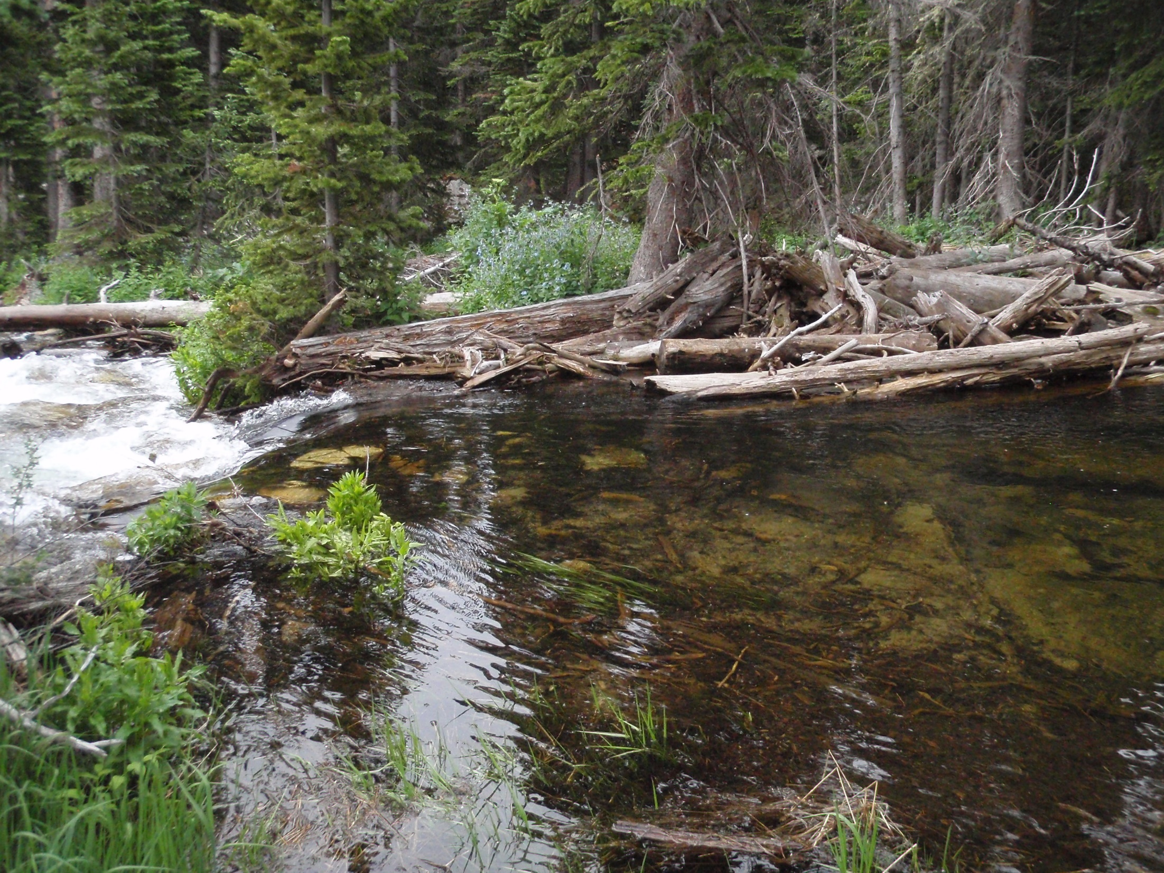
Large Wood & Stream Longitudinal Disconnectivity
Ellen Wohl, Juli Scamardo,
& Emily Iskin
Colorado State University

Slide 2
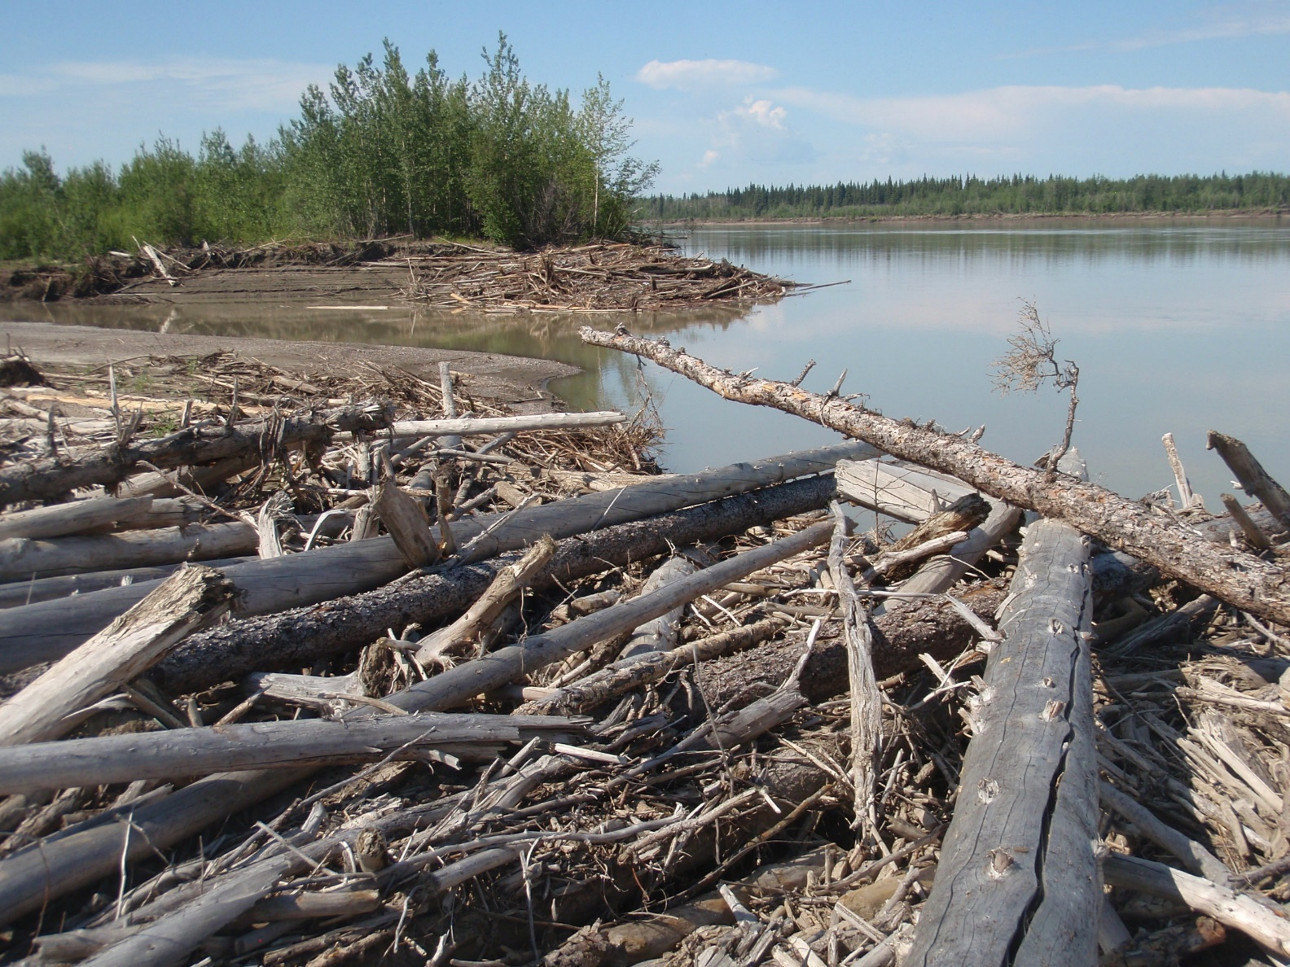
Large Wood (> 10 cm diameter & 1 m length)
historically, influenced geomorphic & ecological processes
in river corridors from headwaters to large rivers
Yukon River,
Alaska

Slide 3
Centuries of deforestation & anthropogenic wood removal
Note the unfortunate
choice of cover photo by
the journal staff in the
issue featuring a paper on
natural wood regimes.
This river has clearly
been modified and wood
has been removed from it.

Slide 4
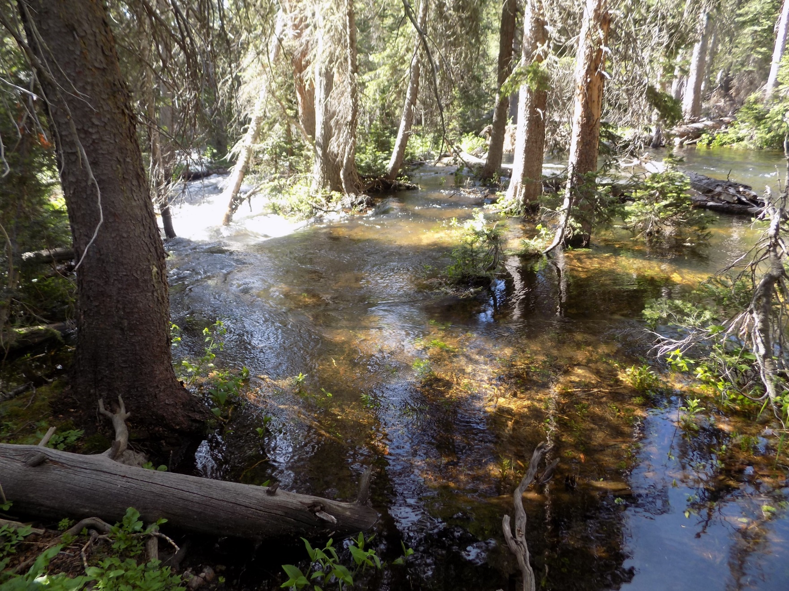
Large wood & logjams
Logjams influence diverse forms of connectivity by promoting
hyporheic exchange, bank erosion, lateral channel migration, formation of
secondary channels, and retention of water, solutes, & particulate material
-- longitudinal connectivity
++ vertical connectivity
++ lateral connectivity

Slide 5
Non-uniform LW accumulation: river beads are wide, low gradient
reaches that accumulate more LW & jams & have greater retention
red boxes
highlight
examples of
beads &
greater wood
load & jam
volume
Wohl & Cadol,
2011,
Geomorphology

Slide 6
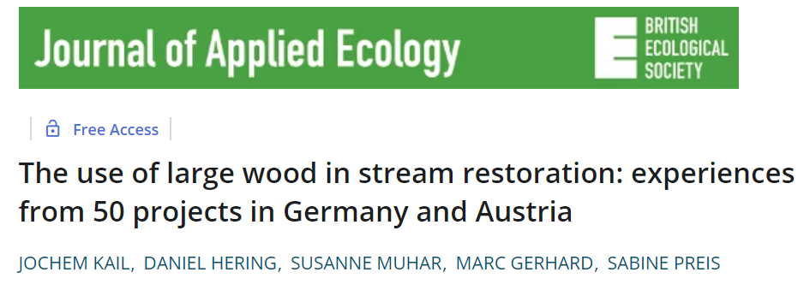
Large wood & engineered logjams increasingly used in river restoration,
but little information on longitudinal distribution & persistence
2007
Canadian J Fish Aquatic Sci 2015
We document the longitudinal distribution & persistence of logjams in the US Southern Rocky Mountains over a period of a decade

Slide 7
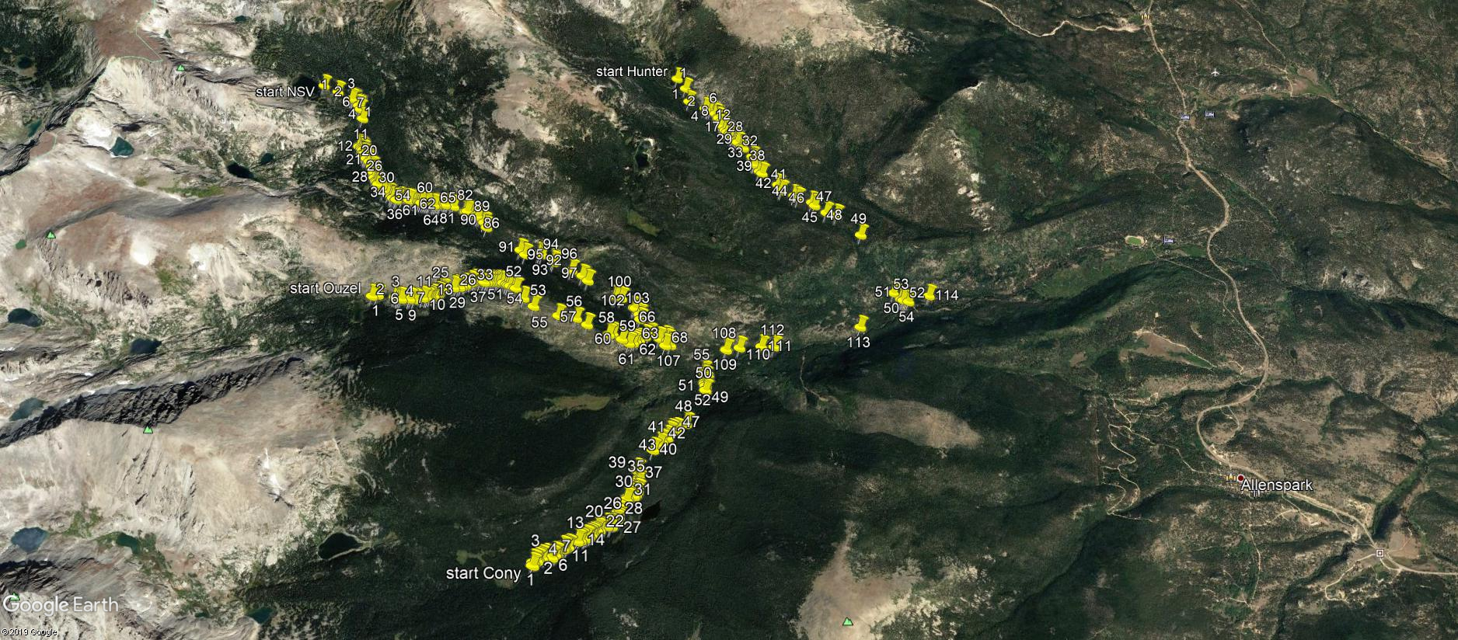
North St. Vrain Creek catchment in Colorado, USA
88 km²
total length 21.2 km
4 channels (38 segments, 10²-10³ m long)
avg 1.5 jams/100 m
3 km
study period: 2010-present
major flood in 2013
yellow pins mark location of a channel-spanning logjam

Slide 8
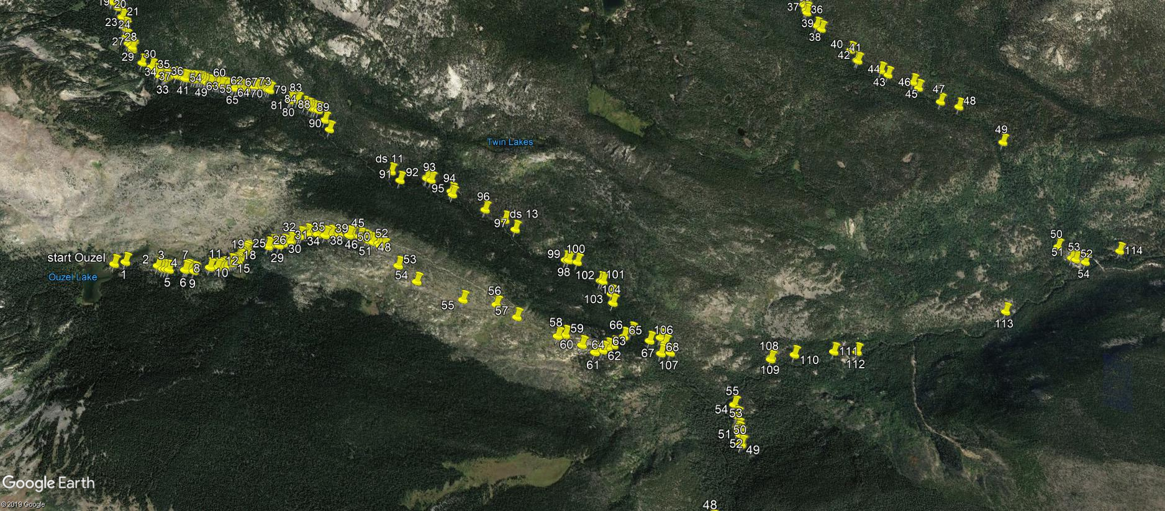
Zooming in …

Slide 9
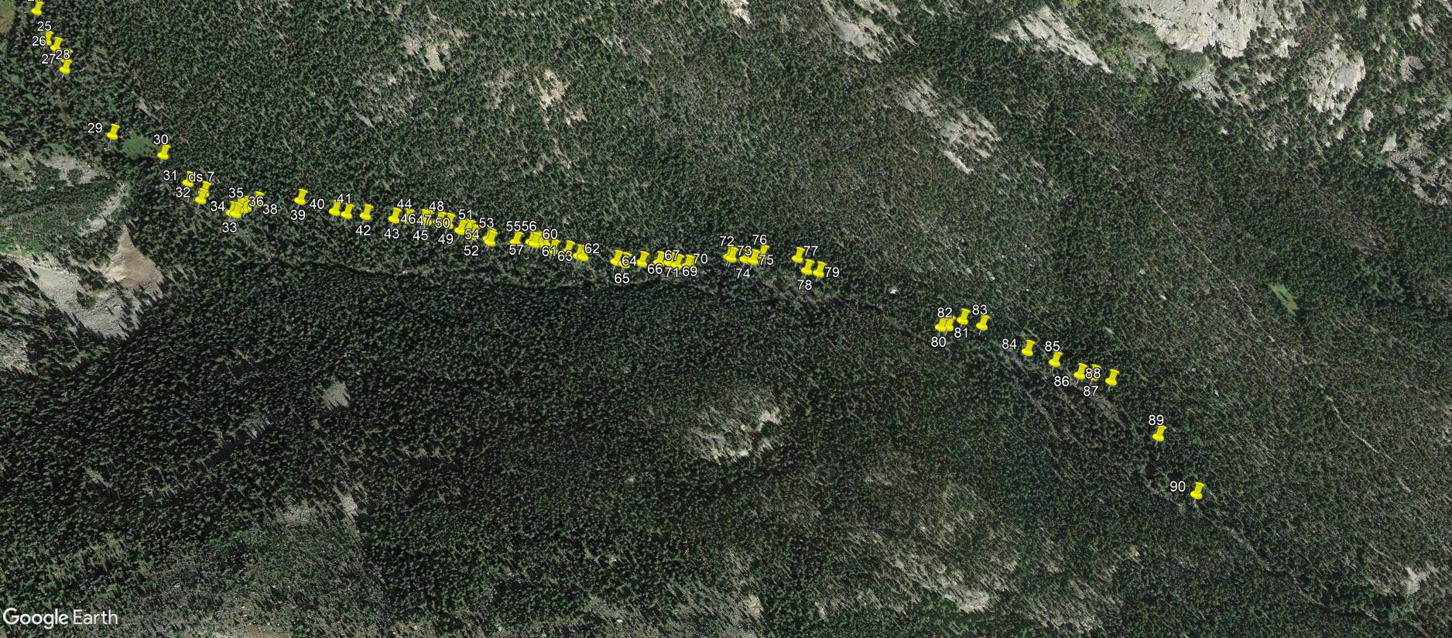
300 m
alternating beads (wide, low gradient, anastomosing)
& strings (steep, narrow) reaches

Slide 10
Preliminary Results
The longitudinal distribution of logjams varies significantly between successive stream reaches. (Stream reaches chosen to have homogeneous channel & valley geometry.)
downstream

Slide 11
(2) Individual logjams change on an annual basis and typically persist less than a decade, although new logjams form frequently.
large
snowmelt
peak
large
peak
minimal
peak
flood
Number of logjams on each channel by year
flood
annual
snowmelt
hydrographs
shown above

Slide 12
Much of the interannual variability in number of logjams shown on the previous
slide is associated with substantial change in a limited number of stream reaches.
Ouzel reach 6, for example, lost many logjams during the 2013 floods. This reach is
in an area that burned in 1978 and, because it is near timberline, tree growth and
soil development since the fire have been very slow.

Slide 13
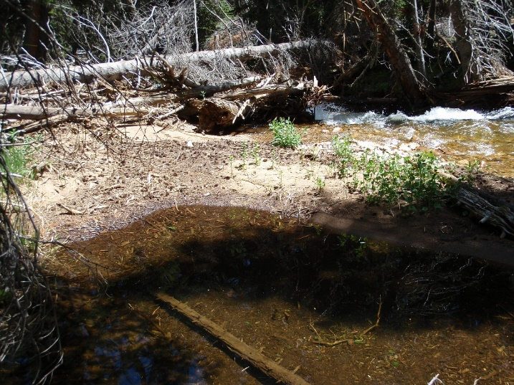
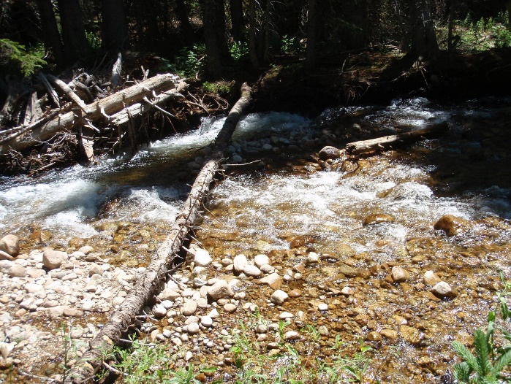
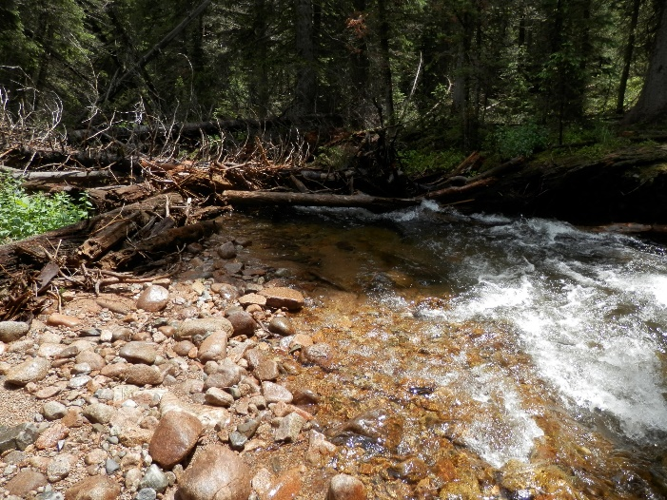
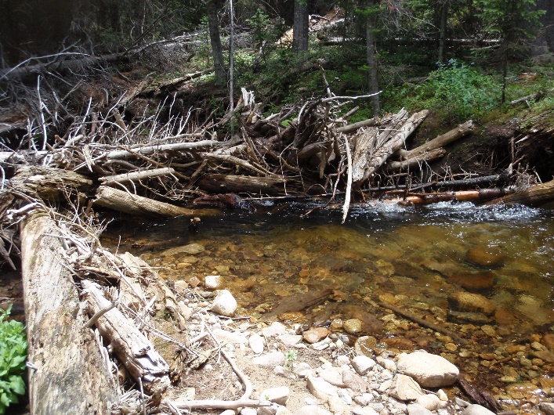
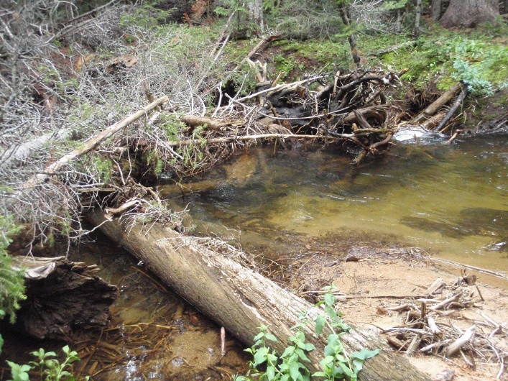
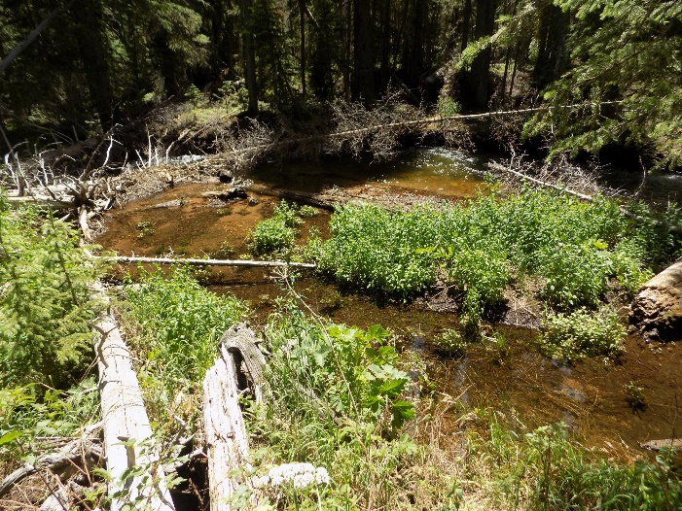
(3) Individual logjams are more persistent in wide, low gradient reaches.
The Fall & Rise of a Logjam (flow is right to left in all photos)
2010
2012
2014
2015
2017
2019

Slide 14
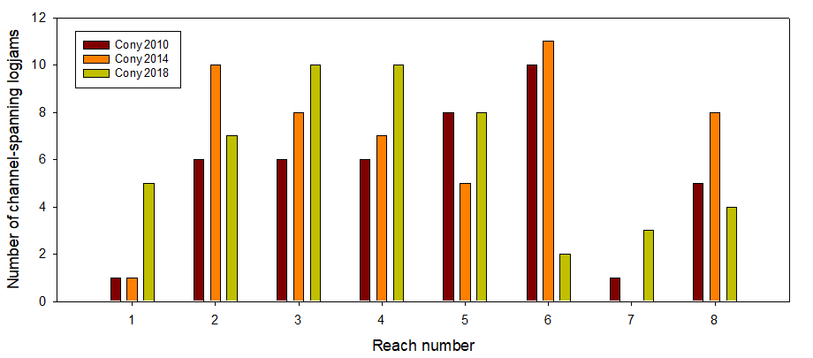
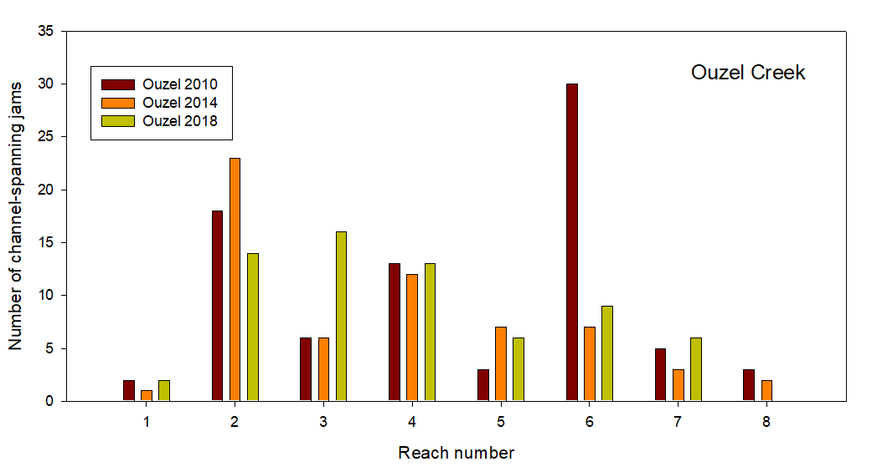
(4) The population of logjams within a reach is more resilient to major floods in wide, low gradient reaches.
Cony Creek
Ouzel Creek
highlighted reaches are
examples of wide,
low-gradient beads

Slide 15
Ongoing research indicates that longitudinal disconnectivity associated
with logjams in river beads significantly enhances
particulate organic matter retention & OC stock
Wohl et al., 2012, Nature Communications
Beckman & Wohl, 2014, Water Resources Research
Livers et al., 2018, Earth Surface Processes & Landforms
Sutfin & Wohl, 2019, Nature Communications
habitat abundance & diversity
Richmond & Fausch, 1995, Canadian J Fisheries & Aquatic Sciences
Livers et al., 2018, ESPL
stream metabolism & nitrate uptake
Day & Hall, 2017, Freshwater Science
biomass & biodiversity
Herdrich et al., 2018, Ecology of Freshwater Fish
Venarsky et al., 2018, Oecologia
hyporheic exchange
Doughty et al., in press, J Hydrology

Slide 16
Continuing breakup of jams & formation of new jams underscores the importance of ongoing wood recruitment in a natural river corridor
Alternative states for river beads
with mature forest & abundant LW
with disturbed forest & minimal LW

Slide 17
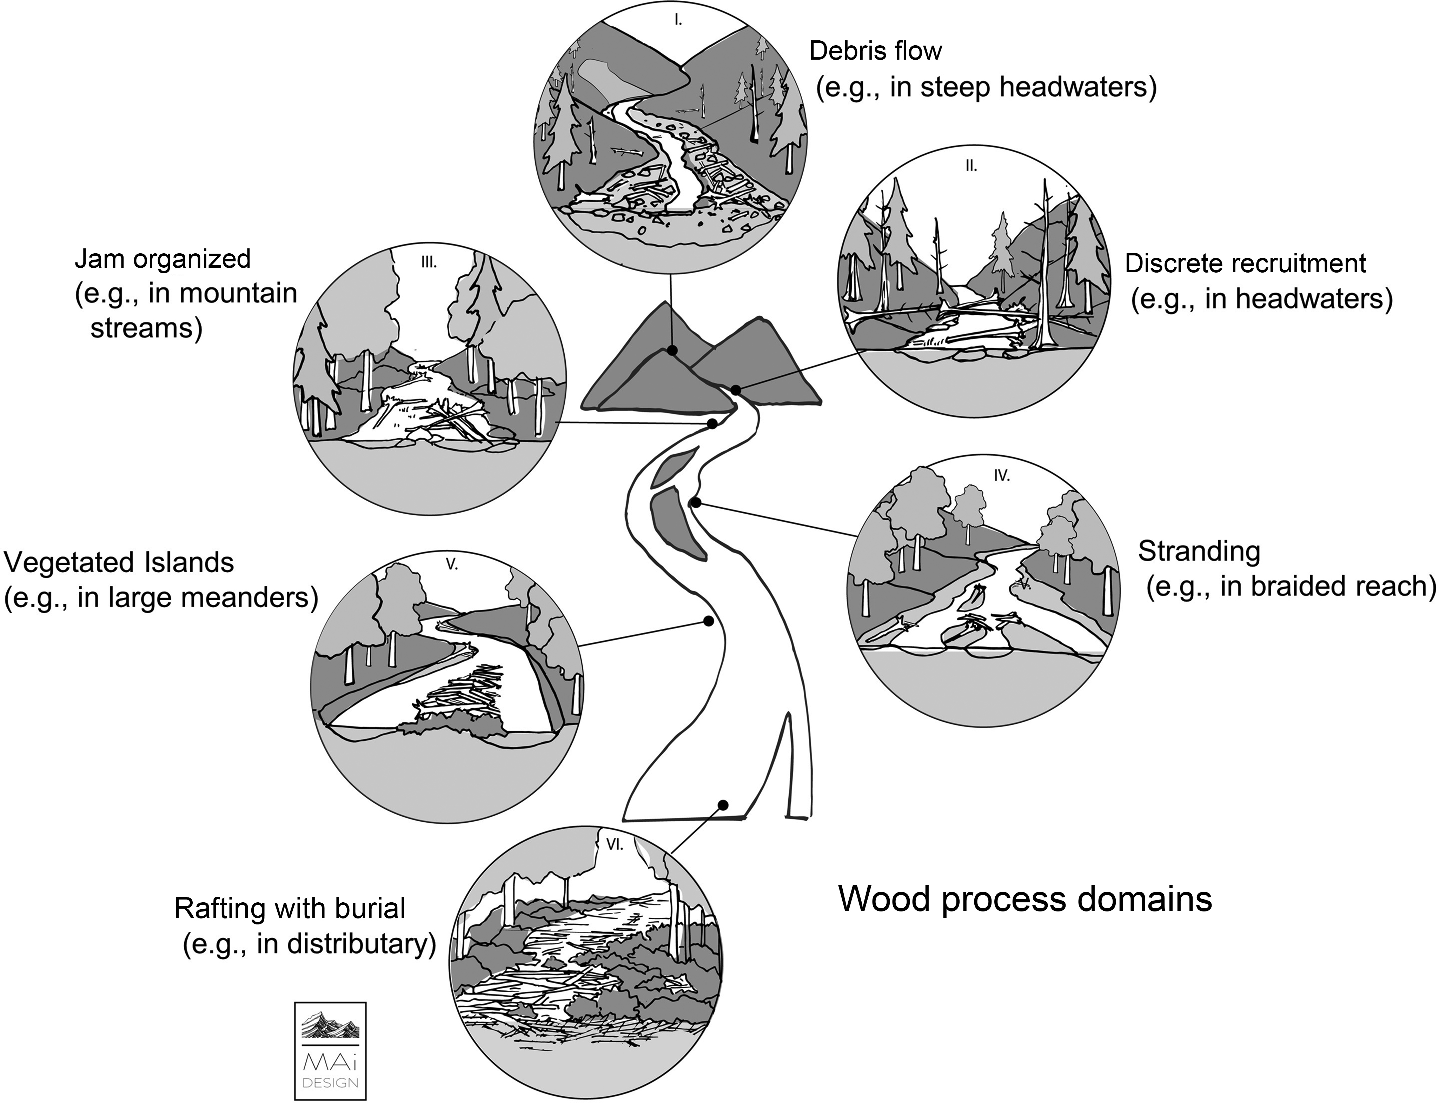
Results imply that large wood reintroduction (including restoration designed to limit longitudinal connectivity) may be most effectively focused on specific types of wood process domains where the persistence & geomorphic effects of large wood are enhanced
Wohl et al., 2019, Bioscience

