Slide 1
Earth Science Phenomena Portal: From Deep Learning-based event detection to visual exploration
Manil Maskey¹, Rahul Ramachandran¹, Iksha Gurung², Muthukumaran Ramasubramanian², Aaron Kaulfus², Georgios Priftis², Brian Freitag², Drew Bollinger³, Ricardo Mestre³
¹NASA Marshall Space Flight Center, ²University of Alabama in Huntsville, ³Development Seed
EGU General Assembly, May 2020

Slide 2
Motivation
Increasing Earth science data archives
Earth science data systems have not taken advantage of data driven technologies to provide advanced search capabilities
Machine learning-based approach, an enabling data driven technology, to detect Earth science events from image archives
Catalog of events to provide a novel way to explore large archives of data
Visual exploration of data facilitated by a phenomena portal

Slide 3
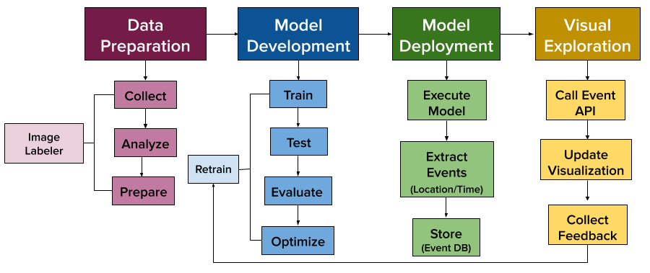
ML lifecycle for phenomena portal

Slide 4
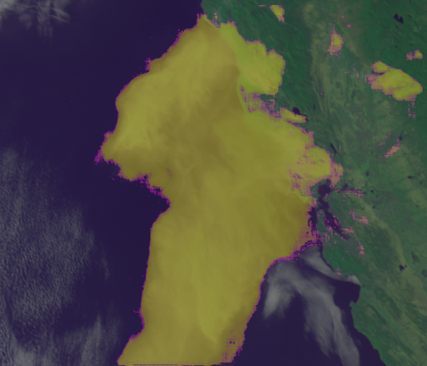
Event Detection Model: Smoke
Detect smoke plumes from shortwave reflectance for the Geostationary Operational Environmental Satellite (GOES) R series
Training data:
Using a hand-labelled, past instances of smoke plumes.
Quality controlled for spatiotemporal accuracy by a subject expert.
A custom CNN trained on a number of smoke events with varying optical thicknesses, geographical locations and visually similar non smoke phenomena.
Smoke detection for 2019 California where, detected pixels are shown with yellow color.

Slide 5
Event Detection Model: High latitude dust
Dust has implications on the energy budget, ocean biodiversity, and economy on regional and global scales.
Dust detection relies on spectral sensitivity at visible (RGB) and infrared wavelengths.
Radiative properties of high latitude dust and the background surface albedo in these regions complicate current dust detection methods.
Training data: True color MODIS images of high latitude dust 94.24 million
A pixel-based CNN was developed
High latitude dust detection in Copper Valley, AK

Slide 6
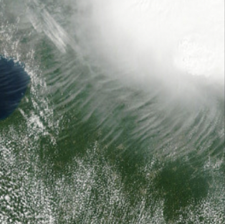
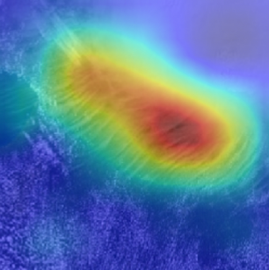
Event Detection Model: Transverse cirrus bands
Transverse cirrus bands (TCBs) are ice clouds that often form in association with other weather phenomena such as mesoscale convective systems, hurricanes, and jet streaks TCBs are often associated with clear air turbulence.
Training data: 5579 True color MODIS and VIIRS imagery (data augmentation)
Adaptation of Visual Geometry Group (VGG-16) and transfer learning
Transverse cirrus band detection

Slide 7
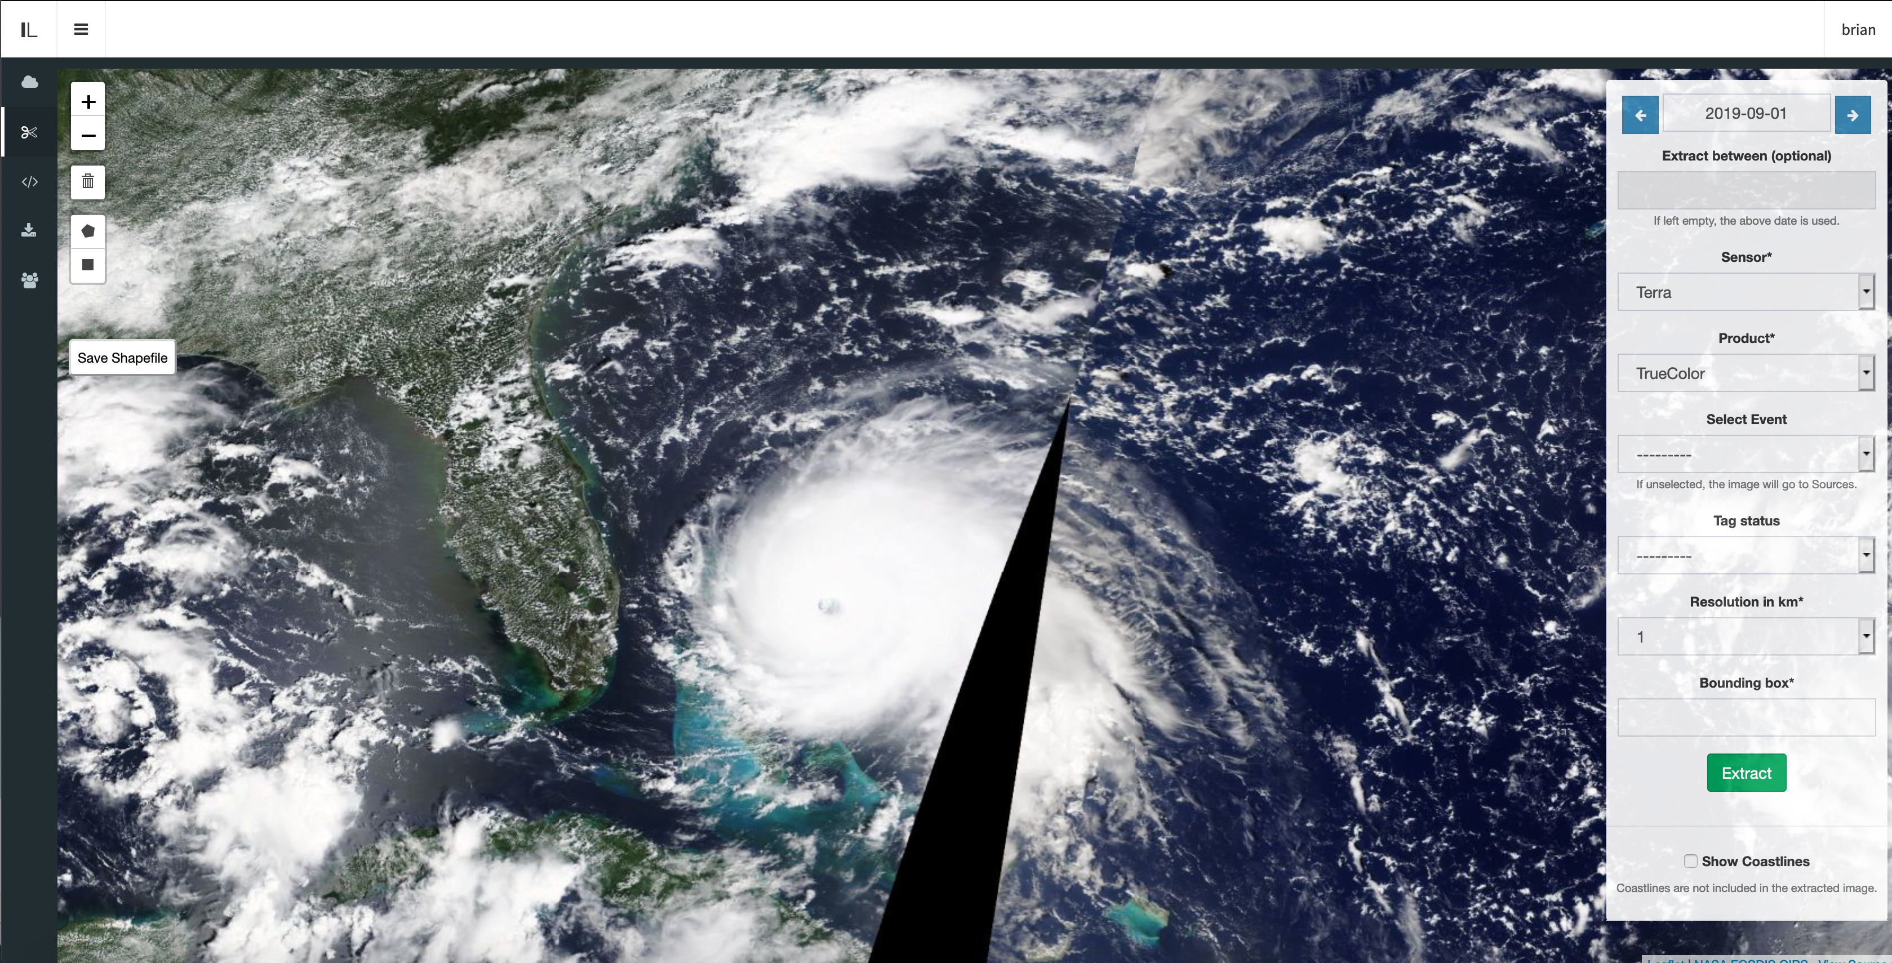
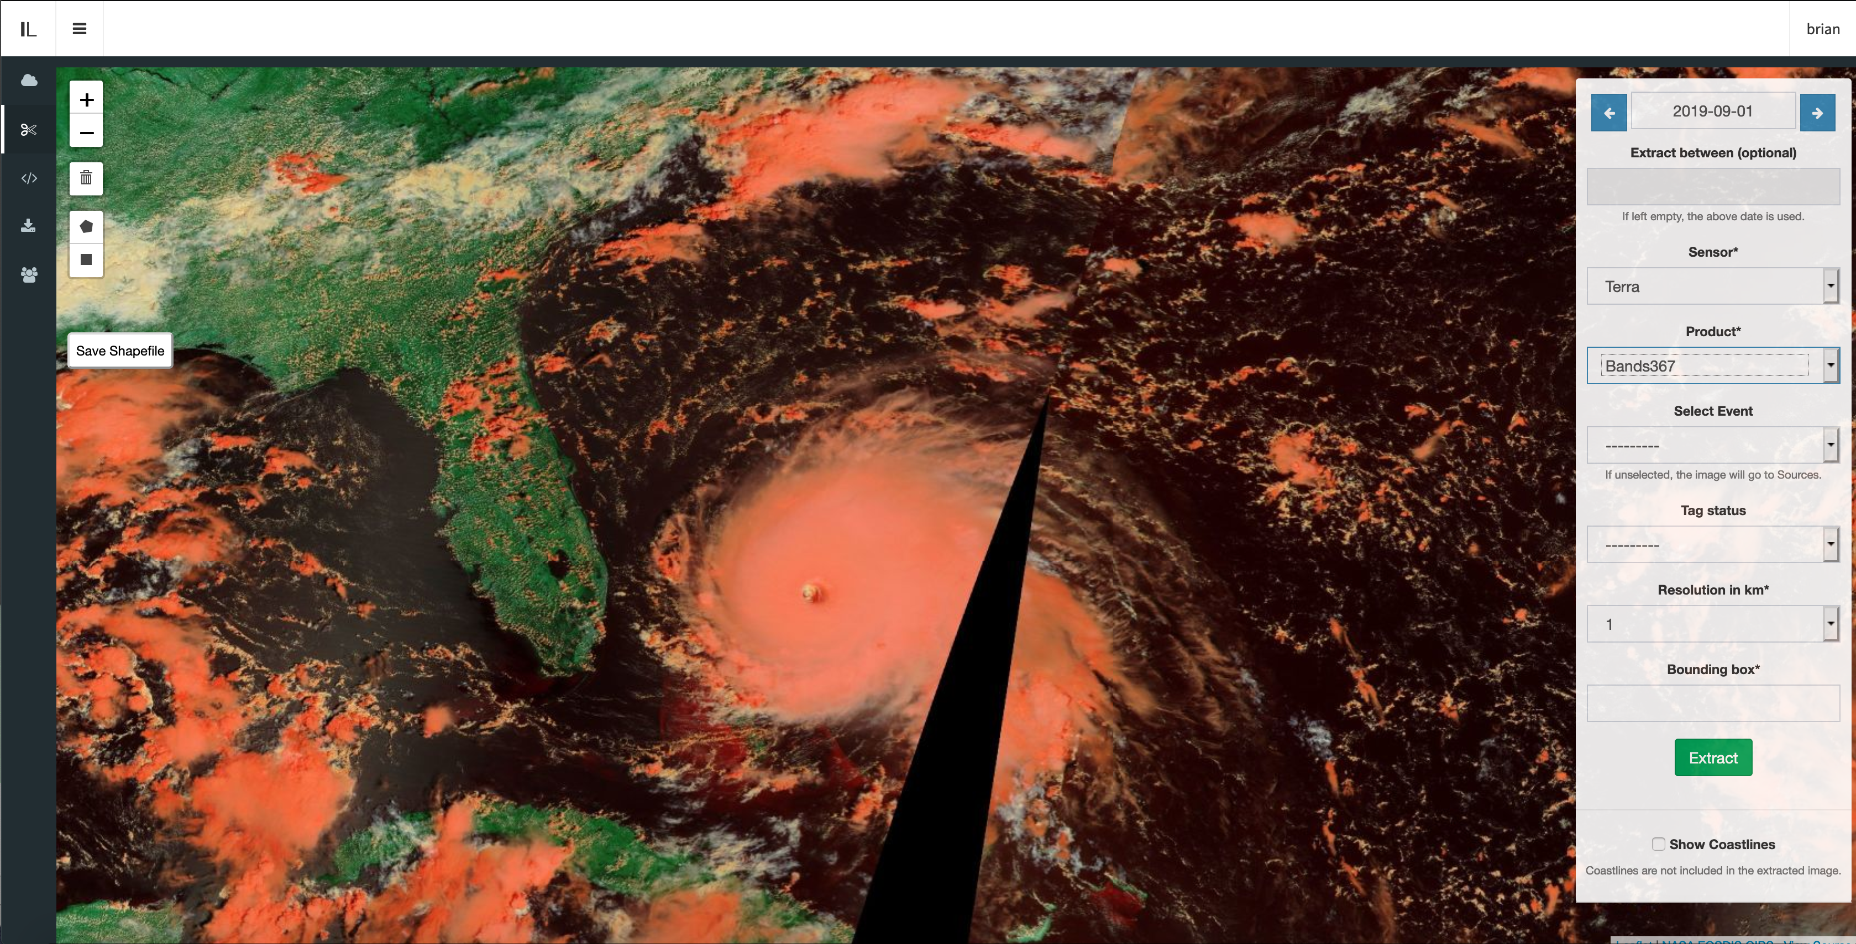
Data Collection, Preparation, Structure
Image Labeler
Scalable image labeling tool for Earth science events
Approach:
Build a multi-user image labeler
Integrate directly with GIBS
Maintain a database of images for Earth science events
Output data in ML ready structure
https://labeler.nasa-impact.net

Slide 8
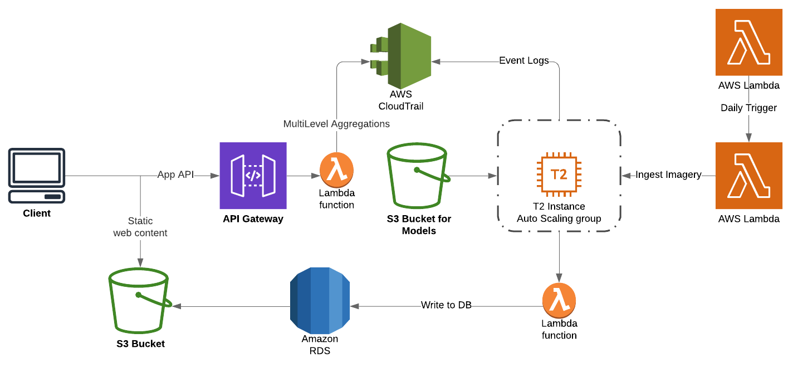
Cloud-based scalable ML pipeline in production

Slide 9
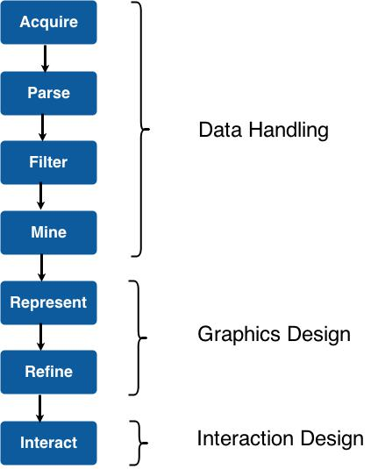
Visual Exploration
Dynamic Information Visualization
Tasks

Slide 10
Information Visualization Mantra
Overview first, zoom and filter, then details-on-demand
Overview first, zoom and filter, then details-on-demand
Overview first, zoom and filter, then details-on-demand

Slide 11
User Interface (UI) Design
Clarity
Interaction
Attention
User in control
Consistency
Smart organization
Information Visualization principles
All devices….

Slide 12
Phenomena portal: Visual exploration of events

Slide 13
Conclusion
ML-based event detection to augment data search based on Earth science events
ML detected events are presented to users in a phenomena portal.
Portal allows users to visually explore the events with spatiotemporal context and corresponding images used for detection
Event information is stored in a database and accessed via an API, which can be used for long-term analysis and for consumption by other applications
A framework for scaling ML-based end-to-end Earth science applications using cloud technologies

Slide 14
Thank you.
Manil Maskey
manil.maskey@nasa.gov

