Slide 1
Turbidity current signature on consecutive turbidity current modelling
Azpiroz-Zabala, M. ^{1*}, Storms, J. ¹, Eggenhuisen, J.T. ², van der Vegt, H. ³, Jagers, B. ³, Walstra, D.J. ³, Obradors-Latre, A. ⁴ and Pontén, A. ⁴
*m.azpirozzabala@tudelft.nl
¹
²
³
⁴

Slide 2
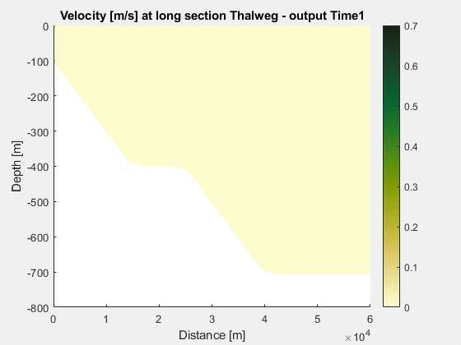
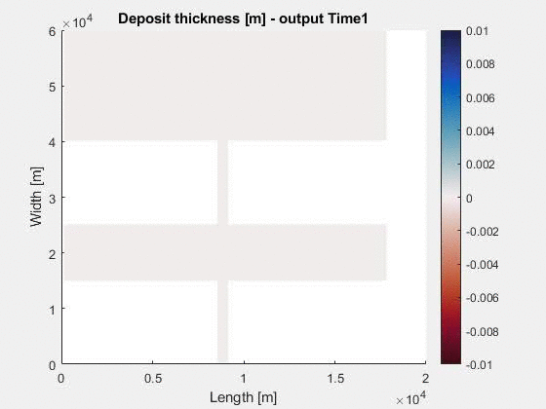
Flow
0
Multiple flows
Simulation in Delft3D
Confining channel
400
Basin
Simulation of 10 runs of 3D turbidity currents
Two groups with same input parameters…
Discharge: 2,200 m³/s
Initial thickness: ~15 m
c₀ = 1.5%
Slope = 1.15°
… except from grain size
(flow and seafloor):
Group 1
50 % 150 µm + 50 % 25 µm
Group 2
25 % 150 µm + 75 % 25 µm
Depth [m]
Confining channel
Plain
Lateral view
800
0
30
60
Length [km]
60
Plain
30
Confining channel
Plan view
Length [km]
Basin
0
Flow
Confining channel
0
1
2
Width [km]

Slide 3
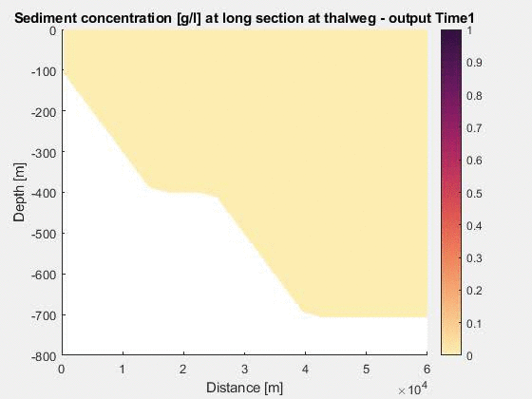
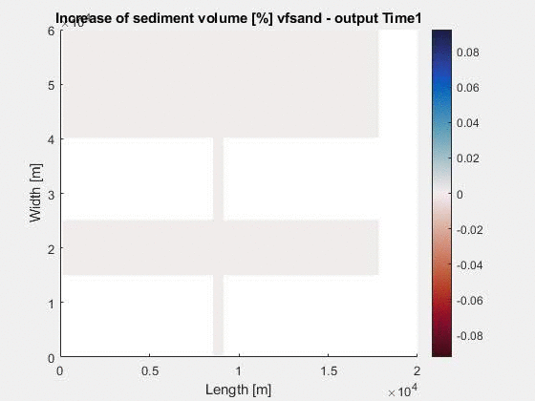
Multiple flows
Simulation in Delft3D
Group 1
50 % 150 µm + 50 % 25 µm
Run1
40
Length [km]
20
Velocity [m/s]
ΔBedLev
[m]
Erosion
40
Length [km]
20
Sed conc [g/l]
ΔSand
[%]
Coarser
10
30
50
5
10
15
Length [km]
Length [km]

Slide 4
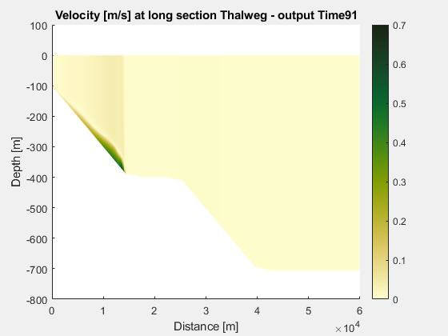
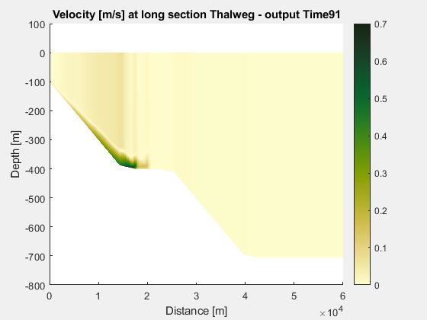
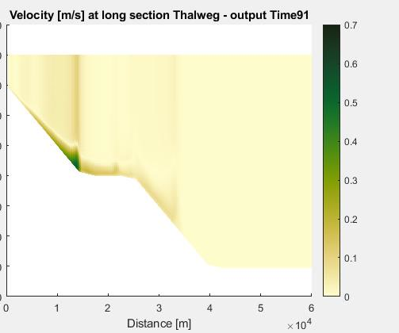
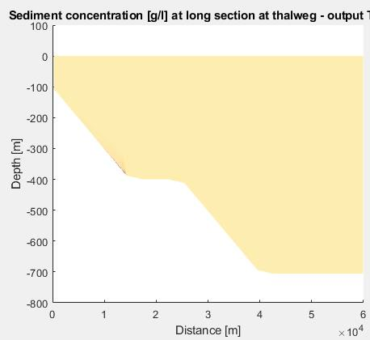
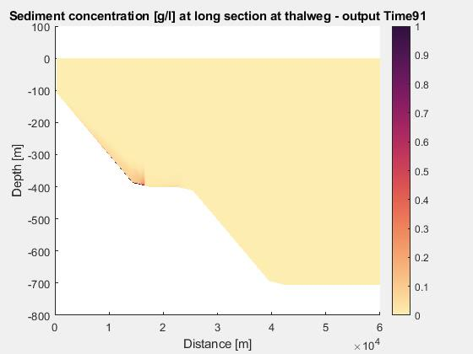
Multiple flows
Simulation in Delft3D
Group 1
50 % 150 µm + 50 % 25 µm
All runs
Run1
Run2
Last simulation Tstep
Run3
Run6
Run10
Velocity [m/s]
Run1
Run2
Last simulation Tstep
Run3
Run6
Run10
Sed conc [g/l]
10
30
50
Length [km]

Slide 5
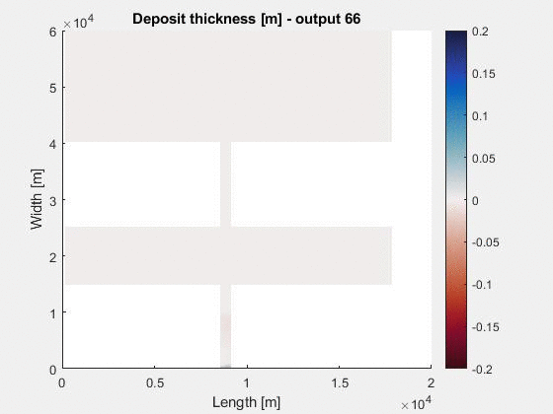
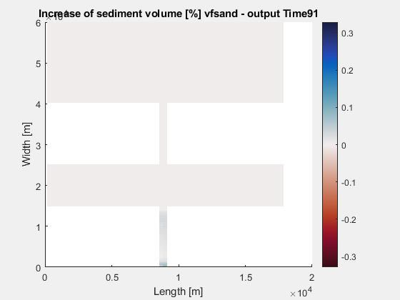
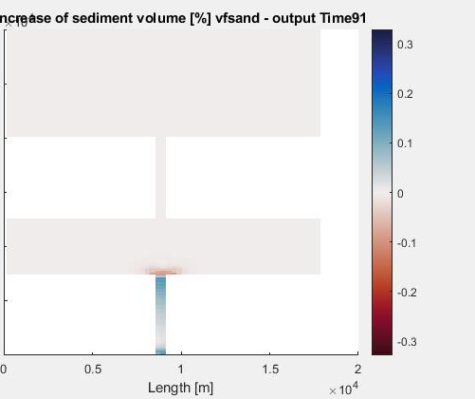
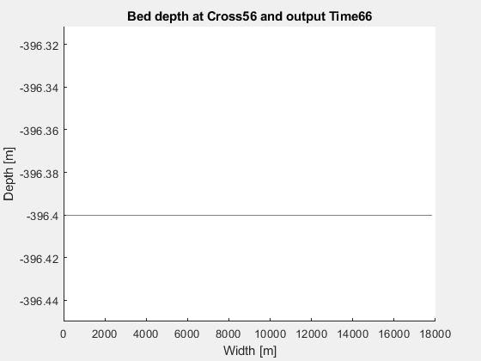
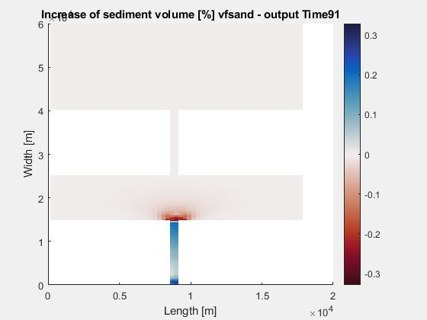
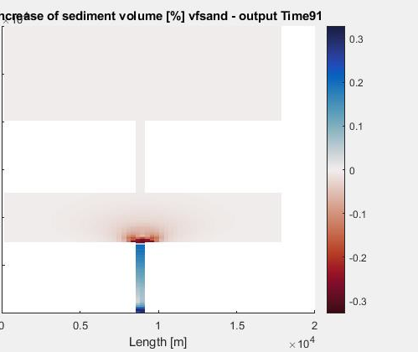
Multiple flows
Simulation in Delft3D
Group 1
50 % 150 µm + 50 % 25 µm
Δsand content @ last Tstep [%]
All runs
Run1
Run2
Deposit
thickness
[m]
Deposition
Erosion
Deposit thickness [m]
Run6
Run10
Deposition
Finer
Coarser

Slide 6
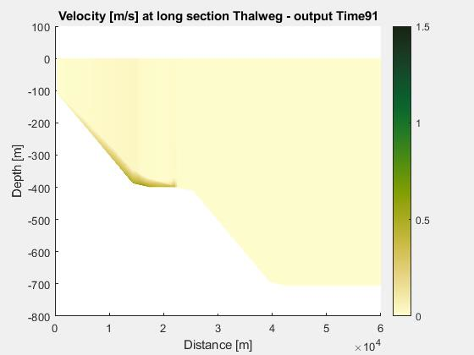
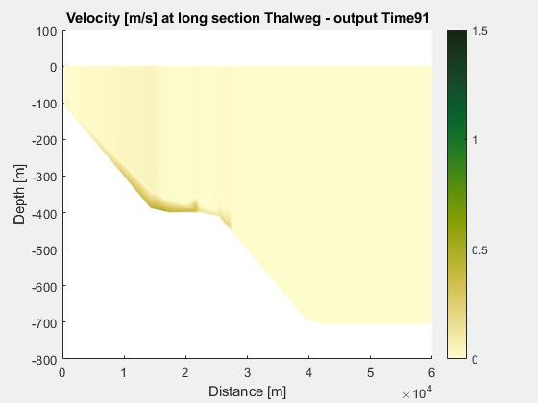
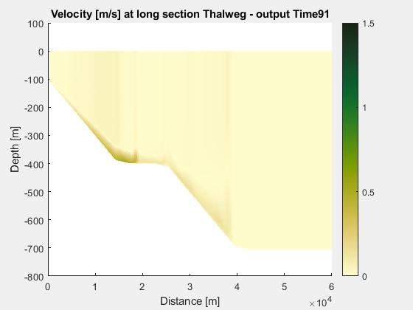
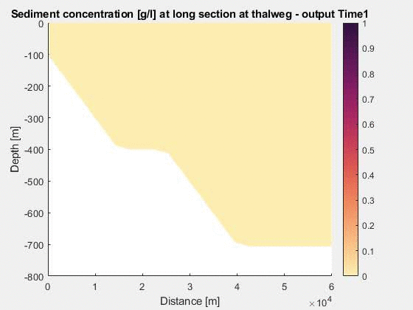
Multiple flows
Simulation in Delft3D
Group 2
25 % 150 µm + 75 % 25 µm
All runs
Run1
Run2
Last simulation Tstep
Run3
Run6
Run10
Velocity [m/s]
Run1
Run2
Last simulation Tstep
Run3
Run6
Run10
Sed conc [g/l]
10
30
50
Length [km]

Slide 7
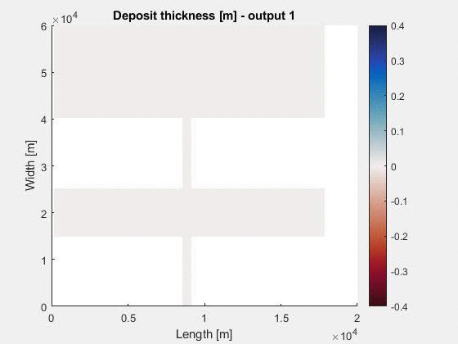
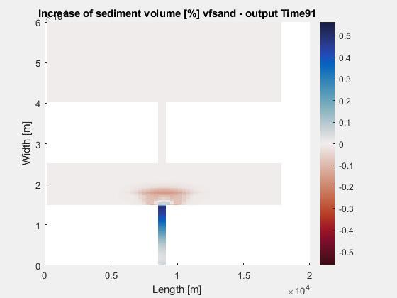
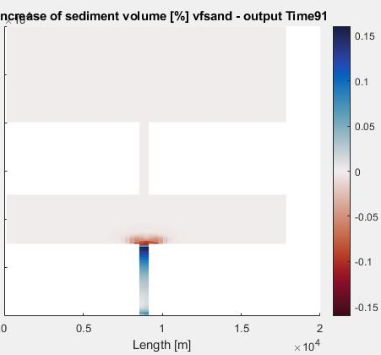
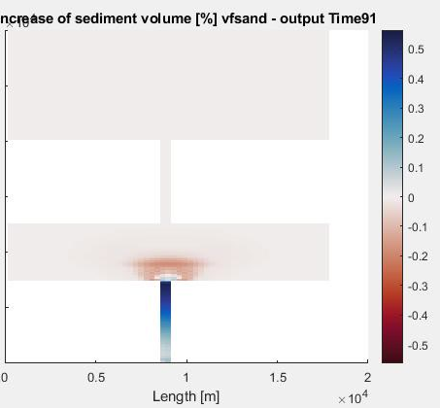
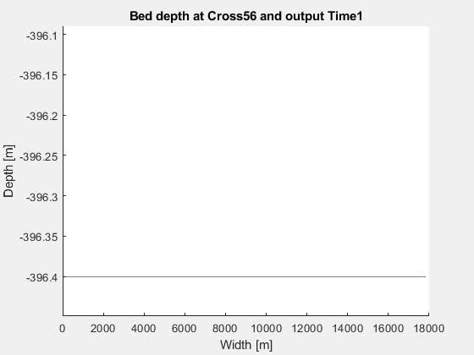
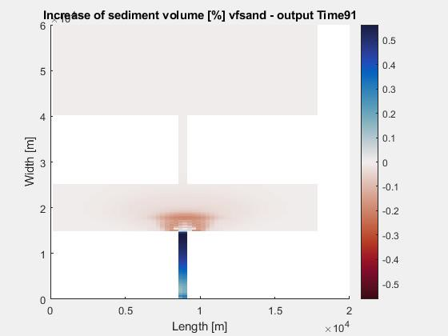
Multiple flows
Simulation in Delft3D
Group 2
25 % 150 µm + 75 % 25 µm
Δsand content @ last Tstep [%]
All runs
Run1
Run2
Deposit
thickness
[m]
Deposition
Erosion
Deposit thickness [m]
Run6
Run10
Levee formation
Finer
Coarser
Incision

Slide 8
Summary of results
Solid tool
Outgoing work - suggested hypotheses from results
Simulated flow velocity and sediment concentration replicate values measured (in field and laboratory)
Simulated flow erosion/deposition behaviours corresponds to previously observed/suggested behaviours
Coarsening of canyon and fining of basin agrees with flushing down of suspended sediment by consecutive flows
Impact of seabed grain size on flow dynamics in consecutive runs of turbidity currents: coarsening promotes slow flows, thick flow fronts and shorter run outs?
Sediment in suspension promotes flow acceleration and longer runouts?

