Slide 1

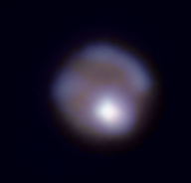
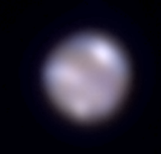
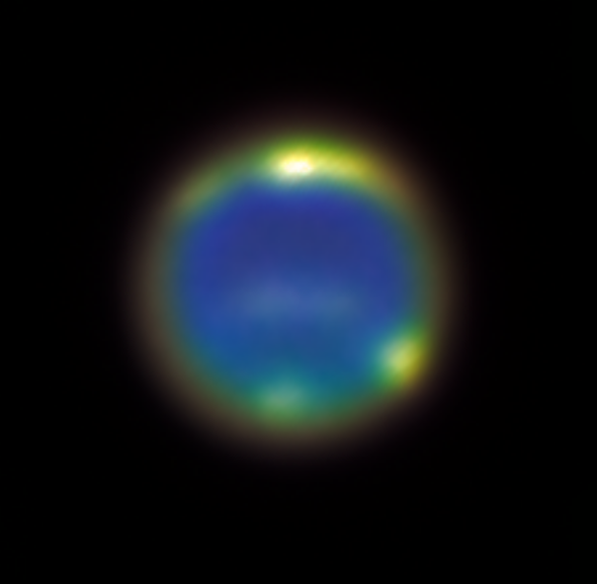
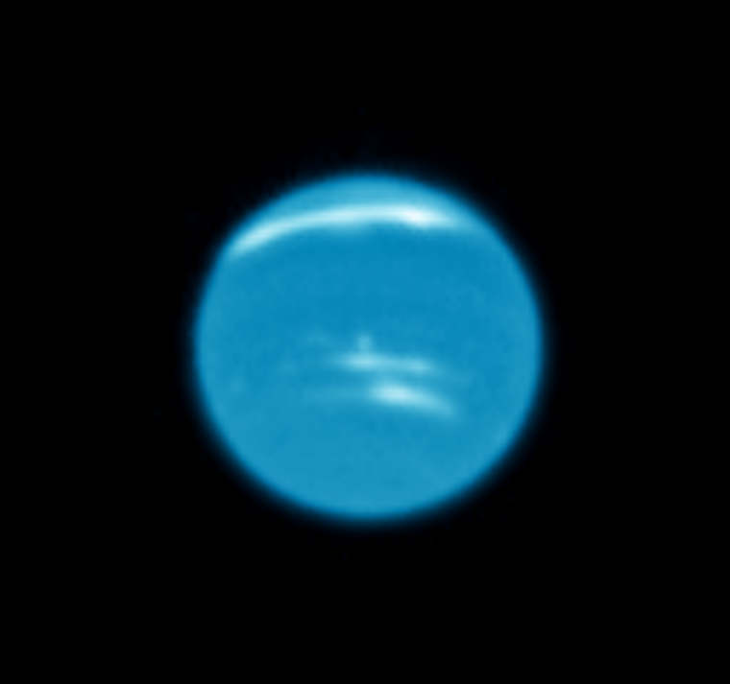


Monitoring Neptune's atmosphere with a combination of small & large telescopes
Ricardo Hueso¹,
Imke de Pater², Amy Simon³, Mike Wong², Larry Sromovsky⁴, Erin Redwing², Erandi Chavez², Agustín Sánchez-Lavega¹, Vik Dhillon⁵, Patrick Fry⁴, Stuart Littlefair⁵, Joshua Tollefson², Marc Delcroix⁶, Iñaki Ordonez-Etxeberria¹, Peio Iñurrigarro¹, Jorge Hernández-Bernal¹, Santiago Pérez-Hoyos¹, Jose Félix Rojas¹, and Tom Marsh⁷
1. Universidad del País Vasco (UPV/EHU),
Bilbao, Spain (ricardo.hueso@ehu.es)
2. University of California at Berkeley, Berkeley, USA
3. Goddard Space Flight Centre Washington, USA
4. University of Wisconsin–Madison, Madison, USA
5. University of Sheffield, Sheffield, United Kingdom
6. Societe Astronomique de France, Paris, France
7. Warwick University, Warwick, United Kingdom
This online talk does not contain material under embargo.
This talk contains an audio description of the talk. Please activate sound
1/14
Notes:
Cover slide.
Abstract of this talk:
Neptune’s atmosphere is covered by tropospheric clouds and elevated hazes that are highly
contrasted in hydrogen and methane absorption bands that dominate the red and near-infrared
spectrum of the planet. The major cloud systems observed in these wavelengths evolve in timescales
of days, months and years. However, the differential rotation of the atmosphere, and the
vertical wind shear implied by the motion of some of these systems, result in challenges in
identifying common cloud systems observed in images obtained with a time difference of only a
few weeks. Given the small apparent size of Neptune’s disk (2.3 arc sec at best) there are
outstanding difficulties in obtaining sufficient high-resolution data to trace Neptune’s atmospheric
dynamics and study the variability in the atmosphere.
In 2019 Neptune has been observed by a battery of different large telescopes and techniques
including: Adaptive Optics observations from the Keck, Lick and other telescopes, observations
from Hubble Space Telescope in two different dates, and lucky-imaging observations with the
GranTeCan 10.4m, Calar Alto 2.2m and the 1.05m Pic du Midi telescope. In addition, some groundbased
observers using small telescopes of 30-40 cm have been successful to image Neptune’s
major clouds completing a dense time-line of observations. We will present comparative results of
Neptune’s major cloud systems observed with these facilities at a variety of spatial resolutions and
long-term drift rates of some of these cloud systems. These will be compared with similar multitelescope
results obtained in the past with several of these telescopes since 2015. Future punctual
observations achievable with new observational facilities such as the JWST will benefit from
ground-based coordinated campaigns and will require a combination of several telescopes to
understand drift rates and evolutionary time-lines of major cloud systems in Neptune.

Slide 2
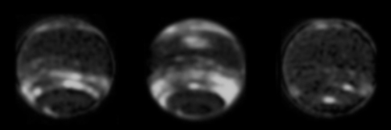


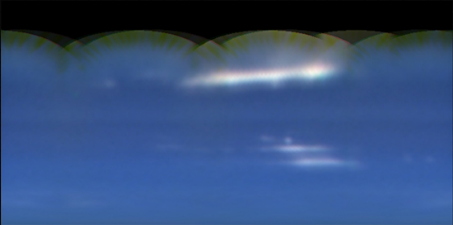
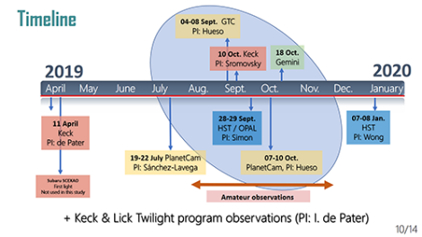
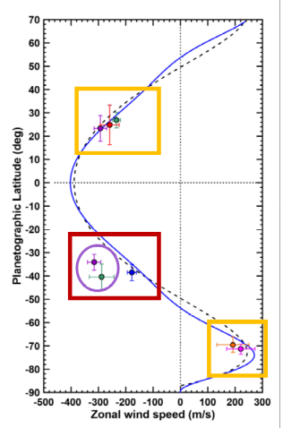
Outline of this talk
Motivation for this study
Neptune in 2019: Many different data sets
(high-resolution and more frequent small-resolution images)
Timeline of observations
Tracking the long-lived systems in 2019:
Results, winds & problems
Conclusions
Due to the COVID-19 situation this report is only a “Work in progress” and we will have better results in the near future
2/14
Notes:
OUTLINE OF THIS TALK

Slide 3
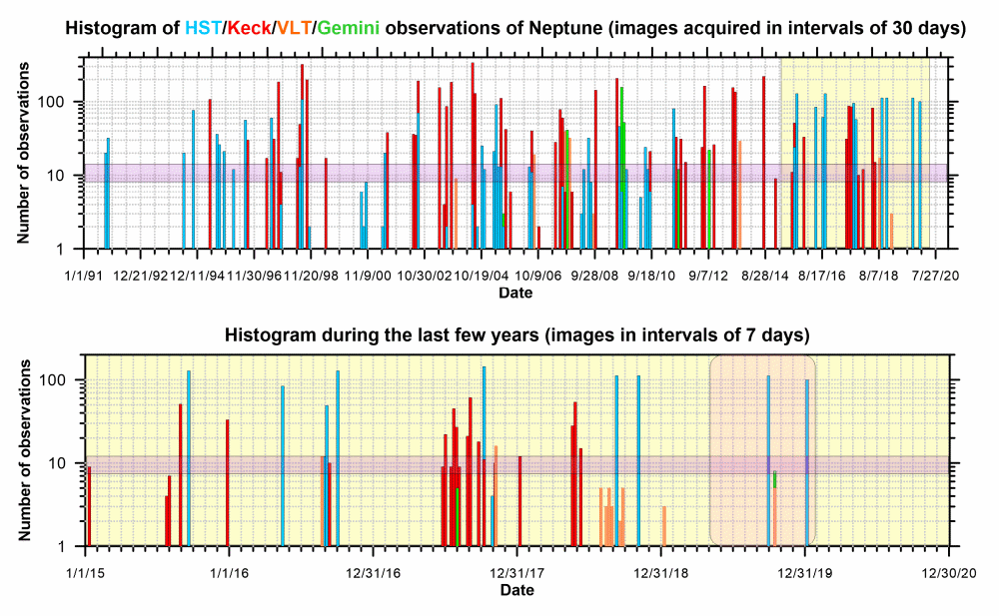
Motivation
Neptune is not observed enough to understand its global atmospheric activity
Small target
(2.3-2.35 arc sec at most)
Histogram
AO or HST observations able to resolve Neptune atmospheric features and study its dynamics
Full are
more probable
No full maps
3/14
Notes:
MOTIVATION
Neptune is not observed frequently enough to understand its global atmospheric activity

Slide 4
Motivation
Neptune is not observed enough to understand its global atmospheric activity
Small target
(2.3-2.35 arc sec at most)
Histogram
AO or HST observations able to resolve Neptune atmospheric features and study its dynamics
Full are
more probable
No full maps
This work (2019)
Previously
2015: Hueso et al. Icarus, 2017
2017: Molter et al. Icarus, 2019
Notes:
MOTIVATION
We focus the current study on observations obtained during 2019

Slide 5
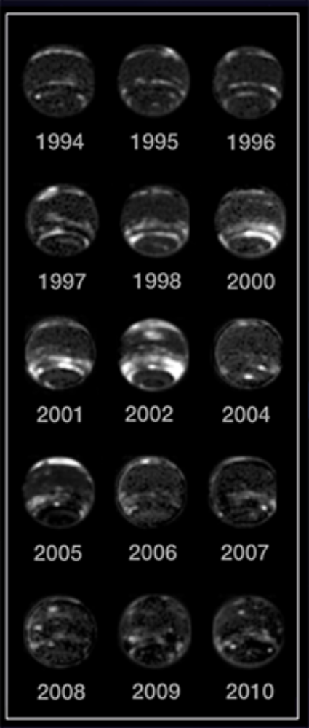
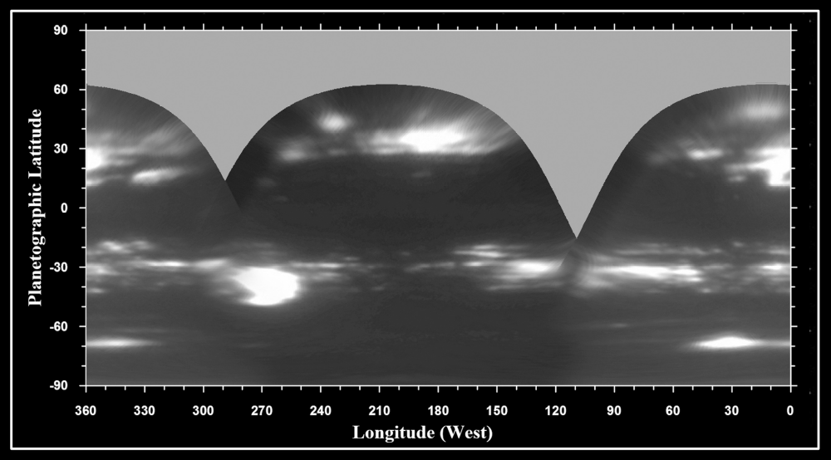
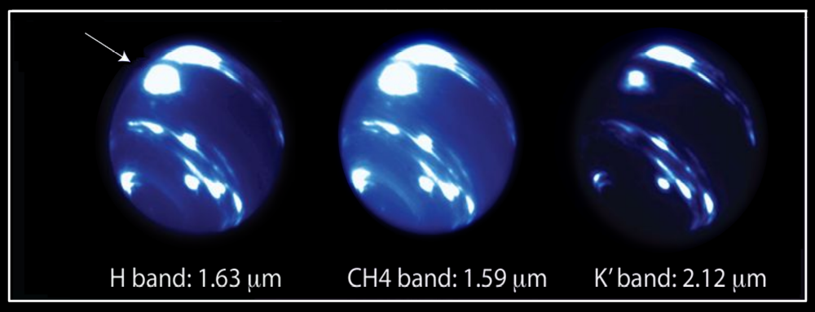
An extremely dynamic planet
2015
Neptune’s cloud systems evolve in time-scales of years to days and a survey of its meteorology requires many more observations than those available to most observing programs or with most facilities.
A combined analysis of several sources is needed just to understand the dynamical history of the features observed.
Hueso et al. 2017
2017
Molter et al. 2019
Karkoschka 2011
4/14
Notes:
MOTIVATION: Neptune is an extremely dynamic planet with an atmospheric activity that changes in time-scales from days to years. In many cases it is difficult to relate observations of cloud systems separated by a few weeks.

Slide 6
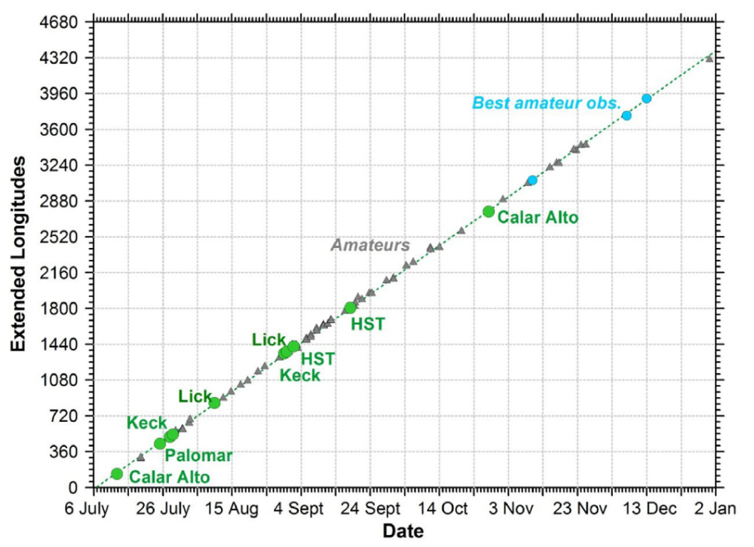
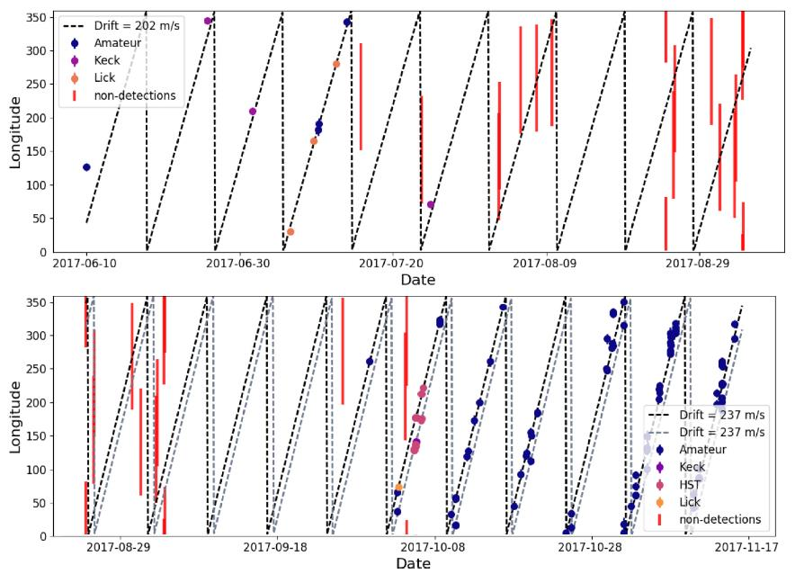
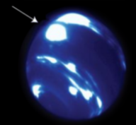
Long-term studies
Fill the gaps with small telescopes including amateur observations. Study motions & changes
Hueso et al. 2017
Molter et al. 2019
Tracking the bright mid-latitude feature in 2013-2015 and other long-lived features in 2015.
Systematic study of the Bright Equatorial Storm in 2017
Similar motions to Voyager but the mid-latitude features displaced in latitude and companions to the NDS-2015 (Wong et al., 2017)
No dark vortex companion, several cases of storm splitting
Detailed radiative transfer models & posible convective system
Equatorial vertical wind shear required
5/14
Notes:
MOTIVATION: Long-term studies demostrate that some atmospheric systems can survive for several months. Previous studies (Hueso et al., 2017, Molter et al., 2019) followed large and bright cloud systems observable also with small telescopes for months. These studies analyzed observations of mid-latitude features in 2013-2015 and of equatorial bright clouds in 2017.

Slide 7
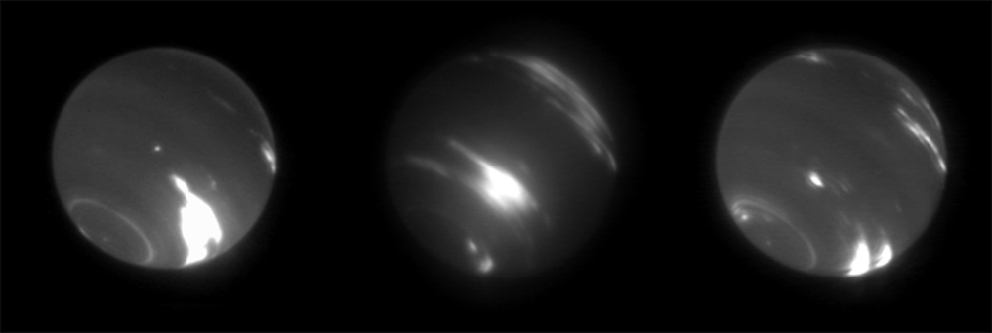
Outstanding individual images (but not long-term data sets)
Neptune in 2019
H Band
11/04/2019
H Band
10/09/2019
H Band
11/09/2019
PI: Imke de Pater
PI: Larry Sromovsky
PI: Larry Sromovsky
6/14
Notes:
2019: Outstanding data sets were acquired in 2019 with observations of Neptune acquired on a limited number of dates by the Keck Telescope. The Adaptive Optics observations allowed high-resolution images of the planet in April and September showing a very different overall cloud systems than in 2013-2017.

Slide 8
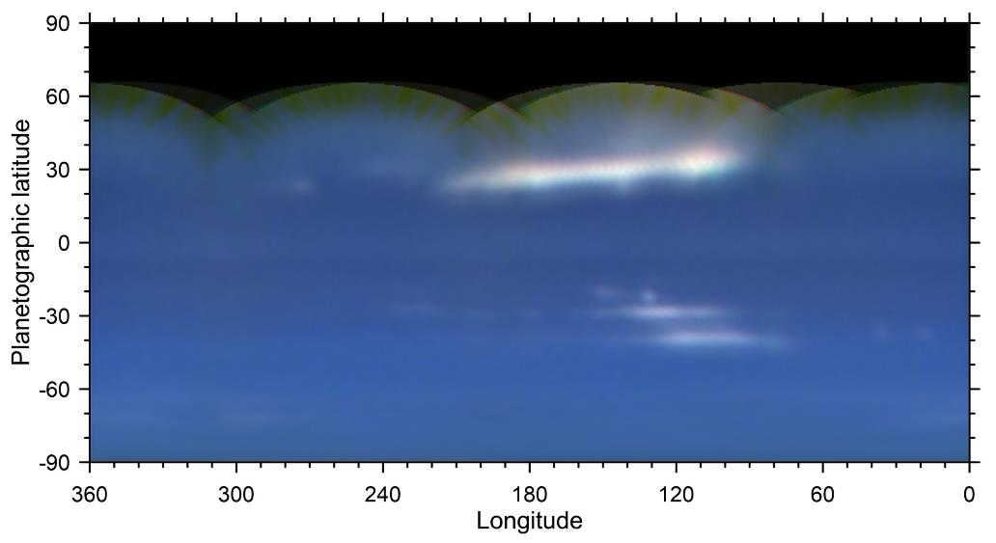
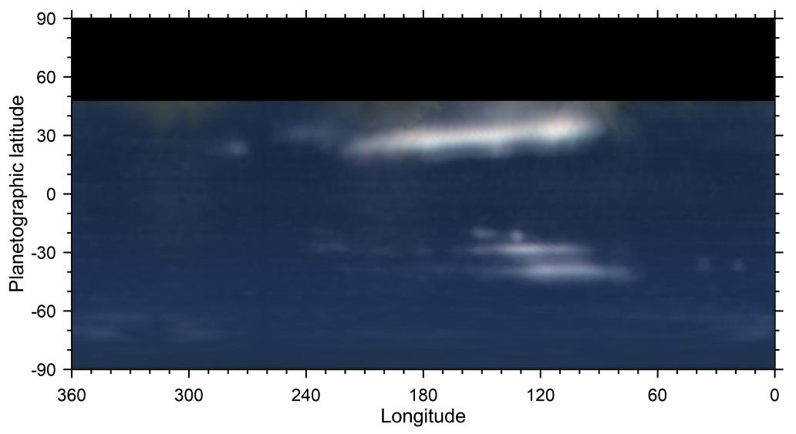
Outstanding data sets
HST/OPAL images in 28-29 September
PI: Simon
Two full maps in several filters
False color composition in methane-band filters
R F845M
G F657M
B F763M
Luminosity: 727N+F845M
Differential image
Highlighting cloud systems
Additional HST maps in January 2020
(PI: Wong)
CAVEAT: None of these cloud ystems is very bright (except the North tropical cloud system) making difficult their observation with small telescopes
5/10
Notes:
Additional observations in this work were provided by the Hubble Space Telescope which observed Neptune in September 2019 and January 2020. The January 2020 observations are separated too much in time to be analyzed in the context of this research. Hubble observed many of the cloud systems present in the Keck observations.

Slide 9
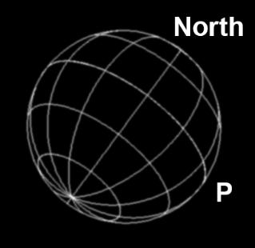
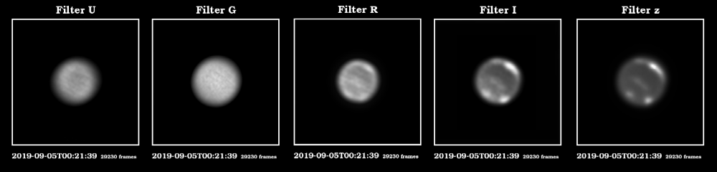
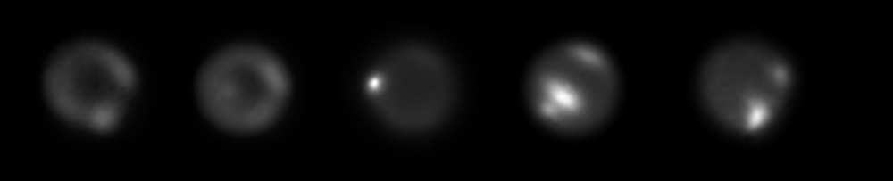
GTC 10.4m doing lucky-imaging with HyperCam
1 hour each night in 4-8 September: 5 cameras running in parelel from U (365 nm) to z (900 nm)
Calar Alto 2.2-m telescope with PlanetCam (VIS & SWIR: 0.4-1.7 μm)
Low spatial resolution but only data set with sustained observations over several hours each night for 4 consecutive nights in 2 rounds (July & October). Sensitivity to different absorption bands
All “small” images navigated with the position of Triton
8/14
Notes:
We also observed Neptune with the Gran Telescopio Canarias in 4 nights with a lucky-imaging instrument called HyperCam: Hypercam is a system of 5 fast cameras that observe simultaneously from the Ultraviolet to the Near Infrared at 900 nm. The contrast of cloud features in Neptune increases at longer wavelengths where methane absorption brings contrast to the upper clouds.
An additional set of observations was obtained by the PlanetCam instrument at the Calar Alto Observatory with the 2.2m telescope. These observations were acquired in 8 nights where we could observe Neptune for many hours studying the rotation of atmospheric features.

Slide 10
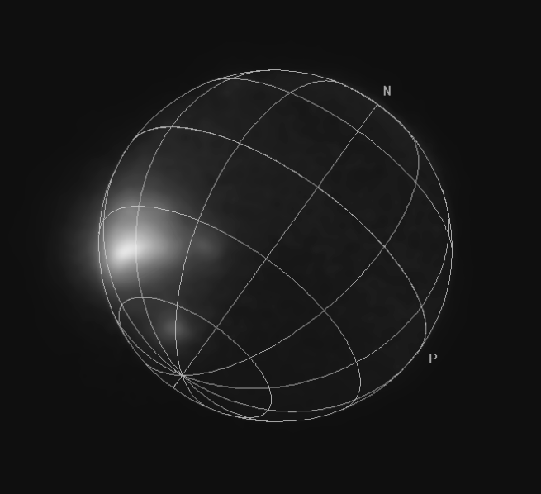
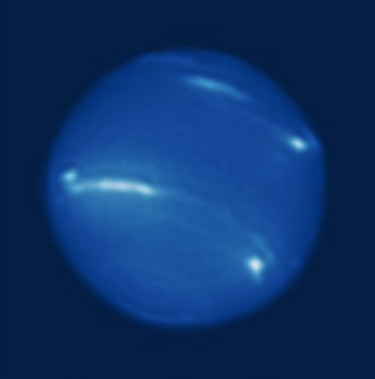
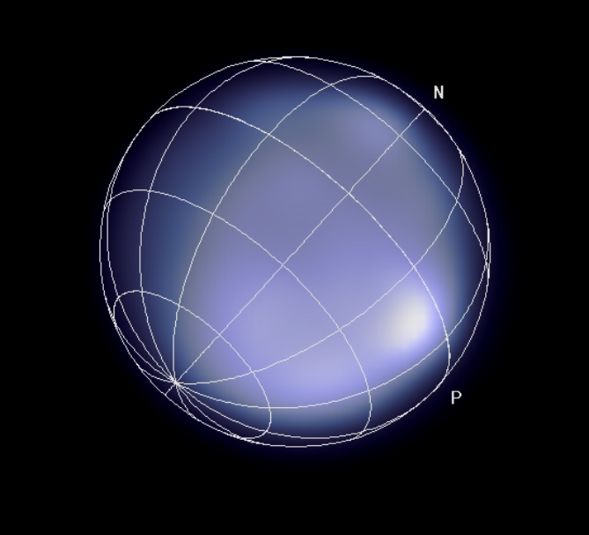
Subaru SCEx AO
April 2019
First light images, not yet used in this study
An additional Gemini AO image
Ks band (only sensitive to the brightest cloud systems at highest elevations)
18 October 2019
25 Sept. 2019
And many observations with small telescopes!
provided by many amateur astronomers: Martin Vinicius, John Sussenbach, Marc Delcroix, Luigi Morrone, Roberto Sedrani, Anthony Wesley, Richard Christensen, Walter Martins, Darryl Milika, Pat Nicholas, Tiziano Olivetti
(images available at http://pvol2.ehu.es/ and/or ALPO Japan)
Image by Anthony Wesley (Australia)
9/14
Notes:
We also looked for additional public datasets. We found Neptune had been observed with the Gemini and Subaru telescopes in tests of different Adaptive Optics systems. These images are only snapshots but they have enough quality to show many of the atmospheric features in the previous data sets. To maximize our time coverage of Neptune we also examined observations acquired by many amateur astronomers and available in open databases such as the PVOL and ALPO Japan sites. Succesfull observations were obtained by several observers. These include: Martin Vinicius, John Sussenbach, Marc Delcroix, Luigi Morrone, Roberto Sedrani, Anthony Wesley, Richard Christensen, Walter Martins, Darryl Milika, Pat Nicholas, Tiziano Olivetti. We are very grateful to these observers for their uploads of data in public databases allowing to do this research.

Slide 11
Timeline
04-08 Sept. GTC
PI: Hueso
10 Oct. Keck
PI: Sromovsky
18 Oct.
Gemini
2019
2020
April
May
June
July
Aug.
Sept.
Oct.
Nov.
Dec.
January
28-29 Sept.
HST / OPAL
PI: Simon
07-08 Jan.
HST
PI: Wong
11 April
Keck
PI: de Pater
19-22 July PlanetCam
PI: Sánchez-Lavega
07-10 Oct.
PlanetCam, PI: Hueso
Subaru SCEXAO
First light
Not used in this study
Amateur observations
+ Keck & Lick Twilight program observations (PI: I. de Pater)
10/14
Notes:
In this slide we present the complete timeline of observations that we want to analyze. Observations cluster around September 2019 close to Neptune’s opposition. Early observations in April or late in January 2020 can not be easility compared with the obsevations in July to October. In addition. Telescopes in the Keck and Lick observatories observed Neptune frequenty as part of the TWILIGHT observing program in which the telescopes observe Neptune in twilight sky conditions. These observations have not been analyzed together with the rest of data sets here described but will complete the data analysis in the near future.

Slide 12
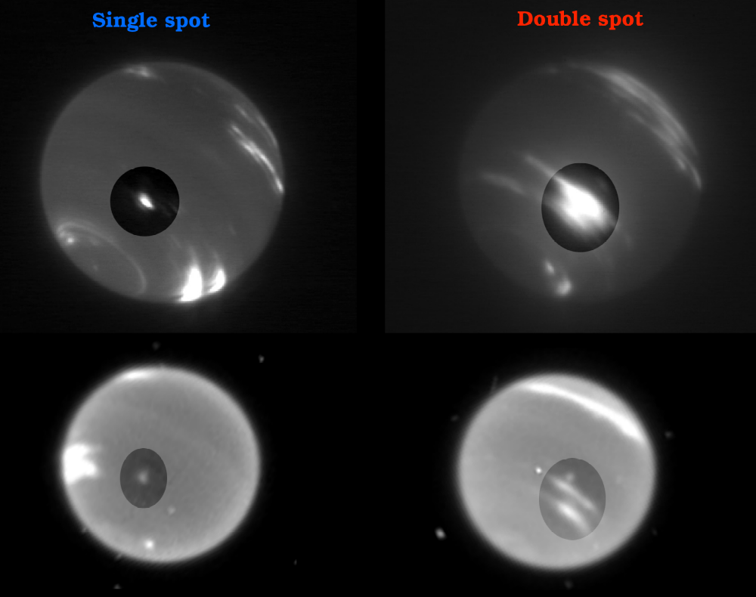
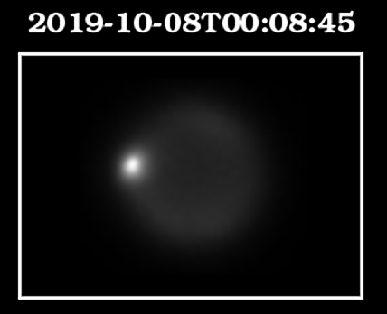
Results
Only 2 well-defined long-lived systems matching linear drift rates with some confidence & consistent with the linear drift rates of other features observed with PlanetCam & HiperCam on 2.2m and 10.5 m telescopes.
Keck
10-Sept.
HST
28-29 Sept.
The double system may have altered its brightness and drift rate transforming into a possible third cloud system or they might drift at different speeds
Follows Voyager winds
Does not follow Voyager winds
PlanetCam (left)
July, October (8 nights)
GTC/HiperCam (right)
04-08 September
Notes:
Results: We identified some of the long-lived cloud systems in many different images. The most conspicuous cloud systems were located in the mid-latitudes in the south hemisphere and were either a single small bright spot in Keck AO images or a large double cloud system. The combination of Keck and HST images separated by 18 days allowed to put other observations in context. Additional observations that show these systems are those obtained at Calar Alto and GranTeCan.

Slide 13
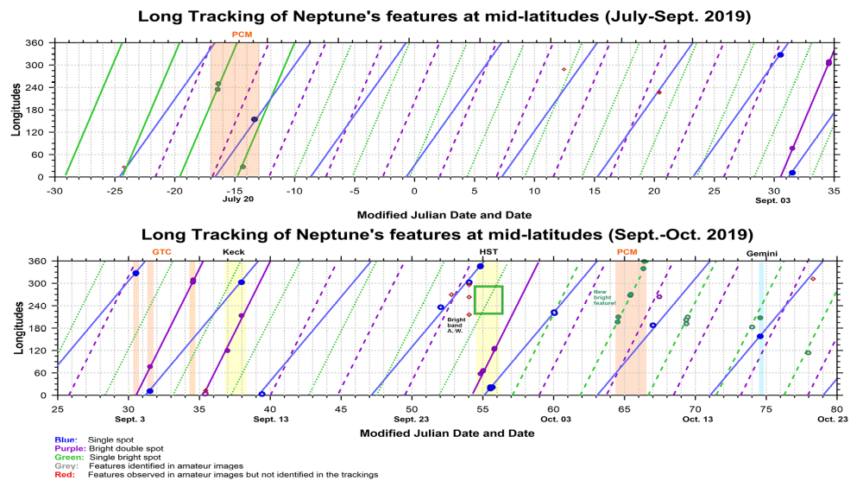
Results
An extremely complex tracking.
HST, GTC & Keck fit well
HST/& PlanetCam
do not fit well
Changes in the single
or the double system in October
12/14
Notes:
We identified the positions of these cloud systems and attempted to obtain their drift rate by plotting their longitude as a function of time. The time range of the observations make these cloud systems to rotate several times around Neptune and difficult an unambiguous identification. In particular, observations in October are difficult to reconcile with observations in September and may indicate changes in one of these cloud systems.

Slide 14
Results
These results will significantly improve
once we add more data to the analysis.
9/14
Notes:
Amateur observations were not able to put many additional constraints but we are confident that once we add here the position of bright features in the observations obtained as part of the TWILIGHT program we will be able to solve all motions and the possible changes in the drift rate of these features.

Slide 15
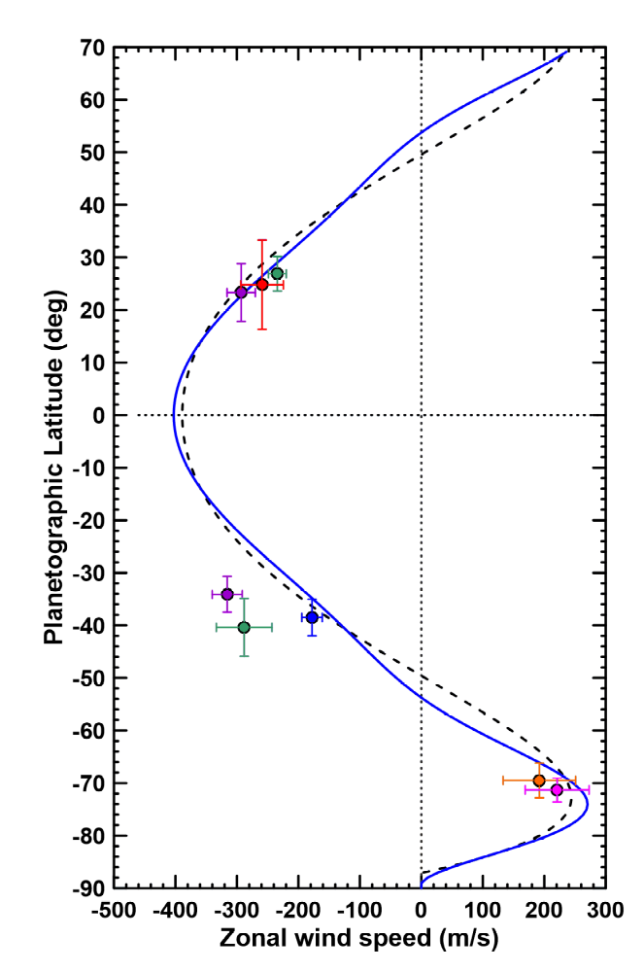
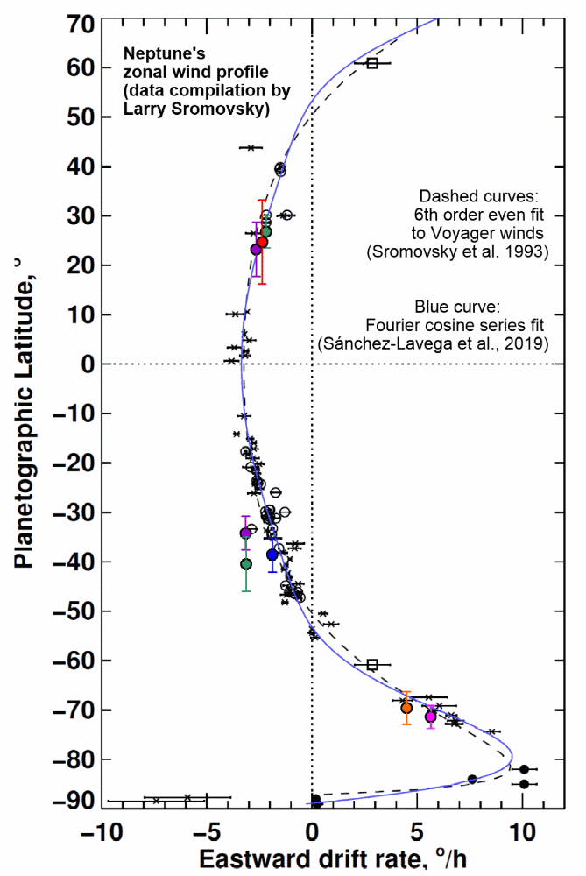
Results
These three main systems have drift rates that when compared with Voyager zonal winds only match for one of them
(the single bright & small spot)
The Double Cloud System with changes in time does not fit the Voyager winds by a long distance. It might be the manifestation of a deeper feature (a dark vortex not visible in HST image).
A slower drift rate is expected contrarily to what this analysis suggests.
Features in the South Polar Bright Feature and in the North Tropical Bright cloud can also be tracked (tracks not shown in this presentation) and fit the Voyager zonal winds.
13/14
Notes:
When our preliminar drift rates are transformed into zonal winds and compared with zonal winds we can extract a few consequences:
1. These three main systems have drift rates that when compared with Voyager zonal winds only match for one of them
(the single bright & small spot)
2. The Double Cloud System with changes in time does not fit the Voyager winds by a long distance. It might be the manifestation of a
deeper feature (a dark vortex not visible in HST image).
A slower drift rate is expected contrarily to what this analysis suggests.
3. Features in the South Polar Bright Feature and in the North Tropical Bright cloud can also be tracked (tracks not shown in this presentation) and fit perfectly the Voyager zonal winds.

Slide 16
Conclusions
The current analysis of observations in 2019 does not solve the motions of the main cloud systems as successfully as in previous years. More work is needed.
A comparison with observations gathered by the TWILIGHT programs at Keck and Lick observatories should be able to fully resolve the inconsistencies in drift rates here shown.
Future: More observations from small-telescopes will be helpful in years where Neptune presents bright cloud systems but the 2019 campaign did not contain these “easy targets”. An alert system for observers is being developed through the Europlanet 2024 Research Infrastructure, so that we can communicate efficiently with them when Neptune observations will be most helpful.
Future: Observations with new facilities (James Webb Space Telescope, ELT,…)
will only be obtained once or a few times per year. Advancing in the study of Neptune’s dynamic atmosphere will benefit more coordinated analysis of observations from many different observatories and groups.
14/14
Notes:
We conclude this presentation by stating the limitations of this study:
The current analysis of observations in 2019 does not solve the motions of the main cloud systems as successfully as in previous years. More work is needed. In particular, we feel that a comparison with observations gathered by the TWILIGHT programs at Keck and Lick observatories should be able to fully resolve the inconsistencies in drift rates here shown.
We also consider that in the near Future: More observations from small-telescopes will be helpful in years where Neptune presents bright cloud systems but the 2019 campaign did not contain these “easy targets”. An alert system for observers is being developed through the Europlanet 2024 Research Infrastructure, so that we can communicate efficiently with them when Neptune observations will be most helpful. In particular observations with new facilities (James Webb Space Telescope, ELT,…). will only be obtained once or a few times per year. Thus, advancing in the study of Neptune’s dynamic atmosphere will benefit more coordinated analysis of observations from many different observatories and groups.

