Slide 1
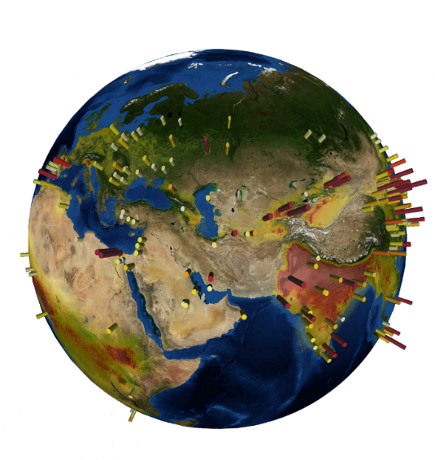
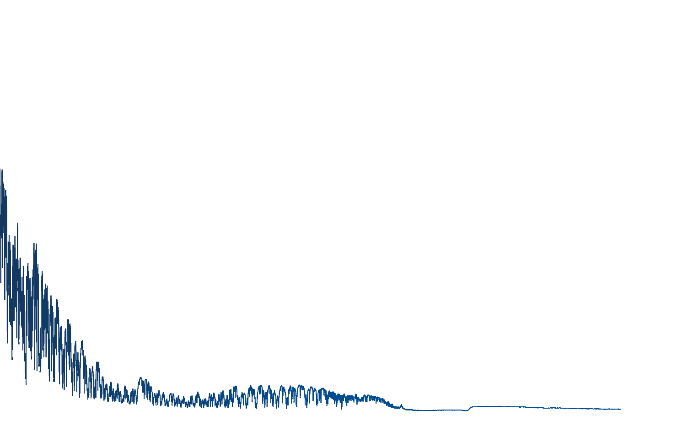


Satellite Monitoring of Ammonia:
From Point Sources to Long-Term Trends
IASI-NH₃ point source emissions
Picture:GoogleEarth
L. Clarisse, M. Van Damme, B. Franco, S. Whitburn, J. Hadji-Lazaro, D. Hurtmans, C. Clerbaux and P.-F. Coheur
© Authors. All rights reserved
EGU General Assembly, May 2020

Slide 2





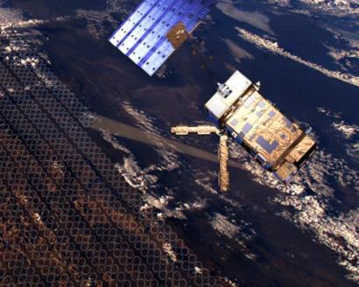
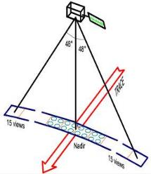
Infrared Atmospheric Sounding Interferometer (IASI)
Picture: eumetsat.int
Picture: esa.int
MetOp: Polar orbiting satellite
IASI: Thermal IR nadir sounder
SAMPLING
Relatively small pixel size: 12 km on-ground at nadir
Global coverage & high sampling:
global measurements twice daily
~1.3 millions spectra/day
INSTRUMENTAL
Broad spectral range : 645-2760 cm⁻¹ (15.5-3.62 μm), without gaps
Relatively high spectral resolution: 0.5 cm⁻¹ apodized
Low noise: 0.1 – 0.2 K in the regions of interest
Key points :
~ 9:30
~ 21:30
Clerbaux et al., ACP 2009

Slide 3

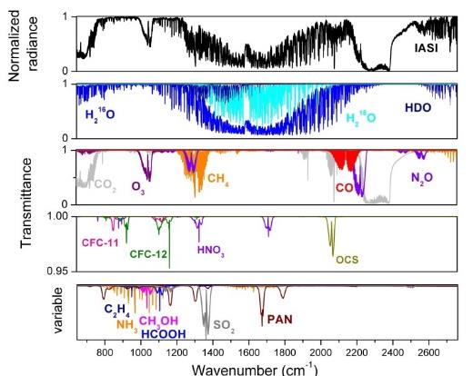
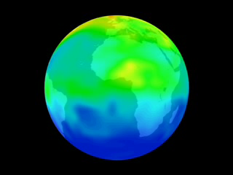
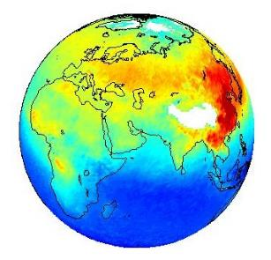
Infrared Atmospheric Sounding Interferometer (IASI)
IASI operational and science processing
Radiance
Measurements
IASI spectrum
IASI species
CFC12
CFC11
N₂O
CO₂
CH₄
OCS
CO
O₃
HNO₃
SO₂
H₂O + Iso
VOCs
years
Radiative transfer
Retrievals
lifetime
Weeks
Weather
Atmospheric chemistry
Climate
days
hours
NH₃
Local-to global atmospheric concentrations
Clerbaux et al., ACP 2009

Slide 4

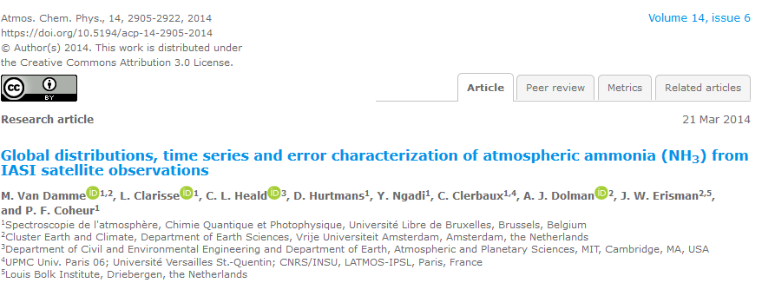
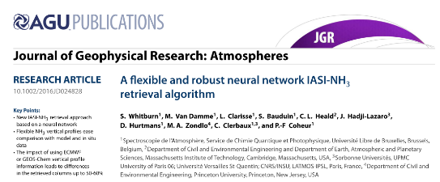
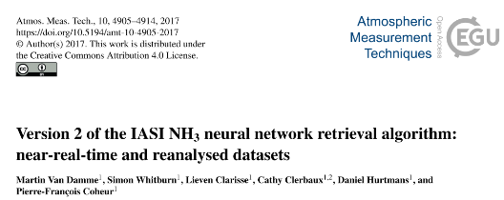
IASI-NH₃ retrieval
Clarisse et al., Nature Geo
2009
2014
2016
Algorithms and methods development
2017
ANNI v3

Slide 5
IASI-NH₃ retrieval
Artificial Neural Network for IASI - ANNI
Near-real time processing of IASI radiances at ULB/LATMOS
Level 1C
EumetCast distribution
calibrated, apodized, geo-localised radiances
Thermodynamic Level 2 from IASI PPF
or ERA-Interim / ERA5 re-analysis
ECMWF
ANNI
Artificial Neural Network for IASI
Artificial Neural Network – based retrievals
1
Hyperspectral Range Index (HRI) calculation
2
Neural Network
Total columns NH₃, VOCs
Aerosol Optical Depth
Dust
errors (no averaging kernels)
Whitburn et al., JGR-Atm 2016
Van Damme et al., AMT 2017
Franco et al., JGR-Atm 2018

Slide 6
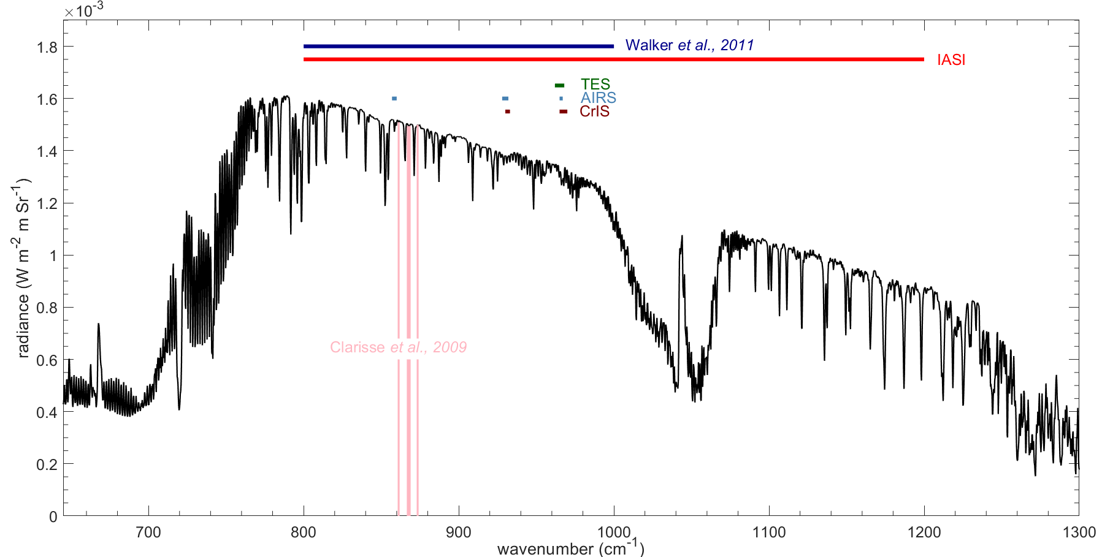
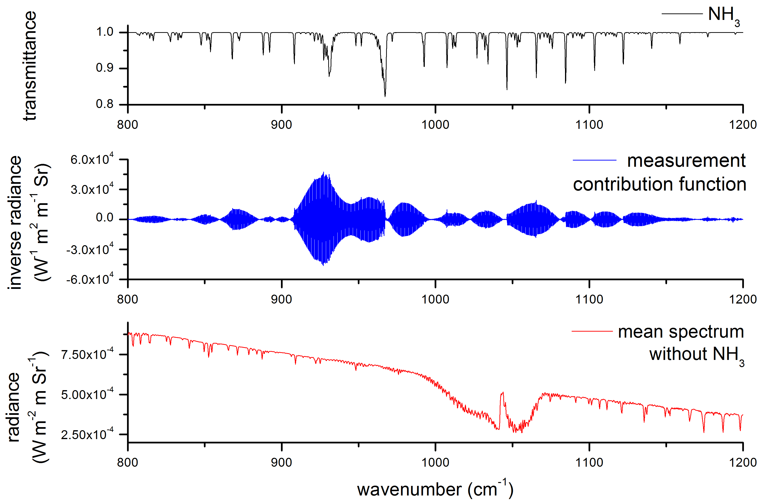


IASI-NH₃ retrieval
Calculation of an Hyperspectral Range Index (HRI)
1
quantity representative of the NH₃ abundance
$$y$$
measured spectra
HRI = $G ( y − \overline{y} )$
NH₃ ν₂ vibrational band
Van Damme et al., ACP 2014
Whitburn et al., JGR-Atm 2016
Van Damme et al., AMT 017
Franco et al., JGR-Atm 2018
  (Van Damme et al., ACP 2014)

Slide 7
IASI-NH₃ retrieval
Near-real time processing of IASI radiances at ULB/LATMOS
Level 1C
EumetCast distribution
calibrated, apodized, geo-localised radiances
Thermodynamic Level 2 from IASI PPF
or ERA-Interim / ERA5 re-analysis
ECMWF
ANNI
Artificial Neural Network for IASI
Artificial Neural Network – based retrievals
1
Hyperspectral Range Index (HRI) calculation
2
Neural Network
Total columns NH₃, VOCs
Aerosol Optical Depth
Dust
errors (no averaging kernels)
Whitburn et al., JGR-Atm 2016
Van Damme et al., AMT 2017
Franco et al., JGR-Atm 2018

Slide 8
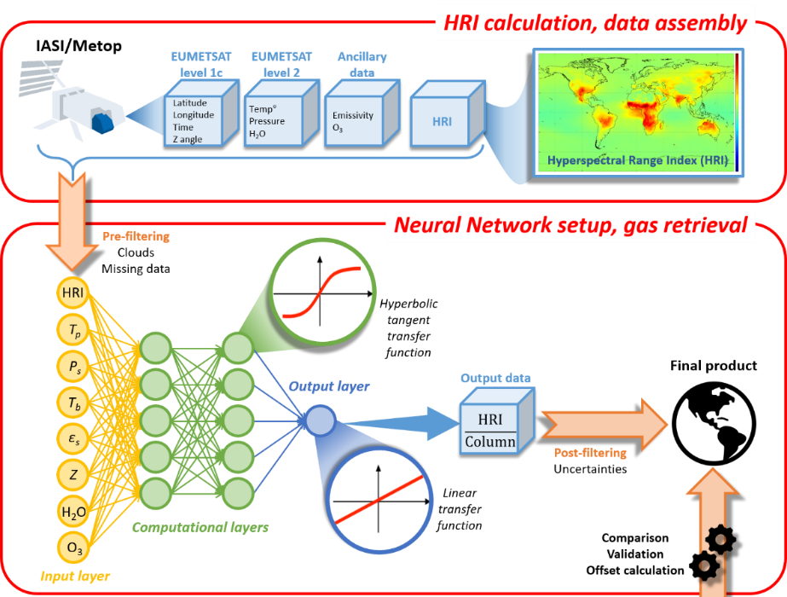
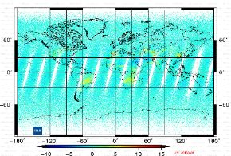
Artificial Neural Network for IASI - ANNI
Processing of IASI Level1C
Hyperspectral Range Index (HRI) calculation
1
Single pixel retrieval
HRI setup
2
Neural network
Total columns
+ errors
Training sets
Near-real time: ANNI-NH₃-v3
2 datasets
Reanalysed: ANNI-NH₃-v3R-ERA5
Whitburn et al., JGR-Atm 2016
Van Damme et al., AMT 2017
Franco et al., JGR-Atm 2018

Slide 9
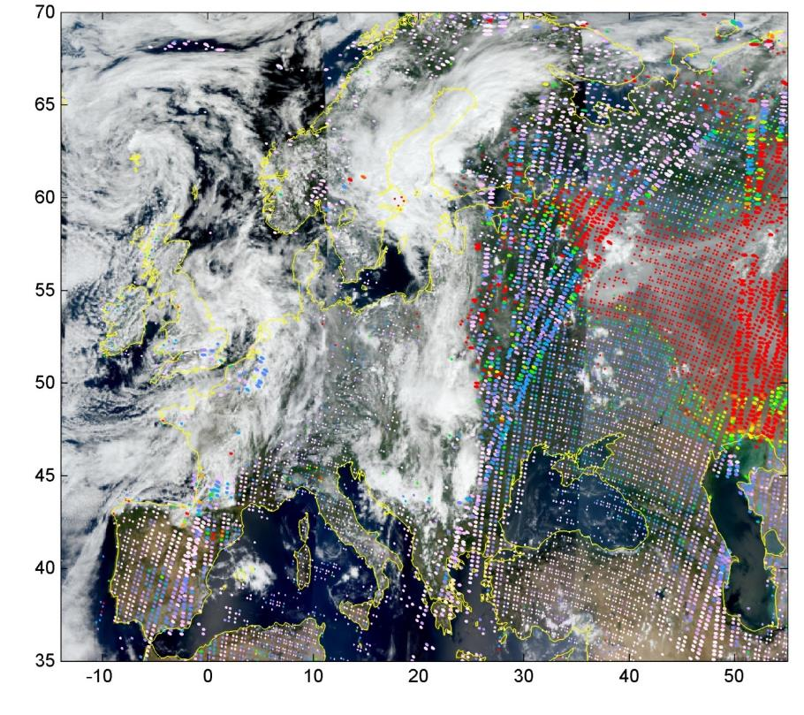
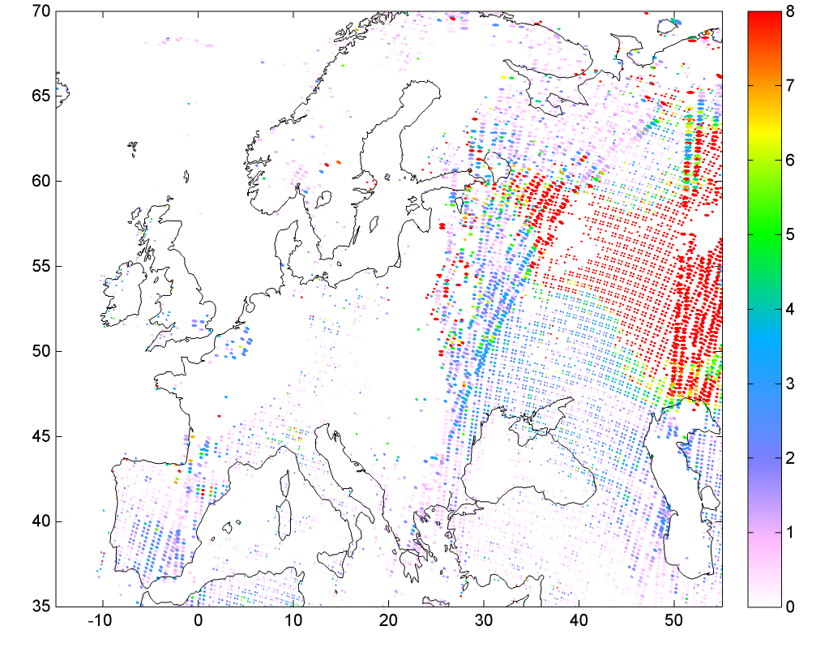
Making the most of current satellite datasets
Spatial oversampling approach
Exploits the fact that the location, shape and orientation of the satellite footprint on the ground varies from one orbit to another
mg/m²
  Van Damme et al., ACP 2014
  Van Damme et al., Nature 2018
  Sun et al., AMT 2018
IASI-NH₃ superimposed on a MODIS image
20100804 morning overpass

Slide 10
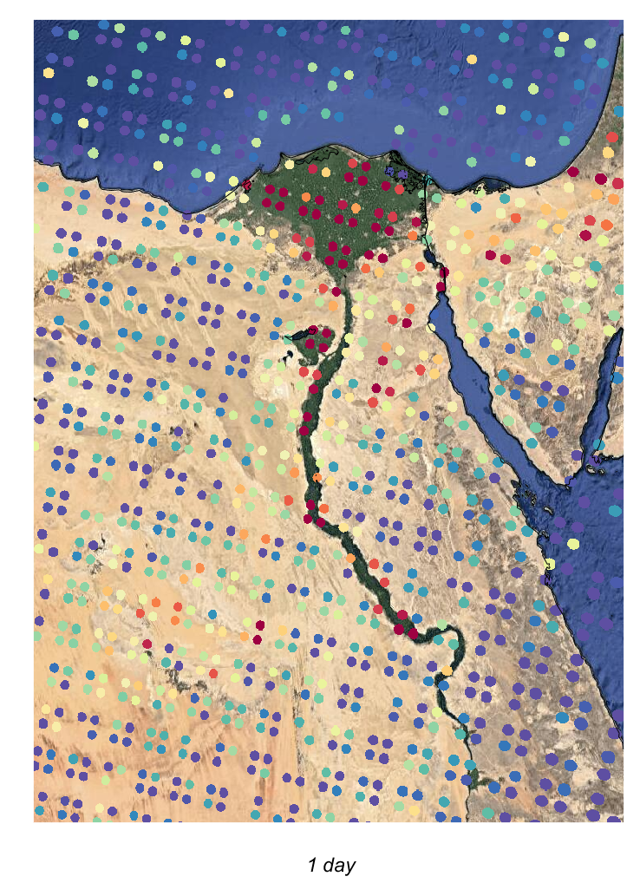
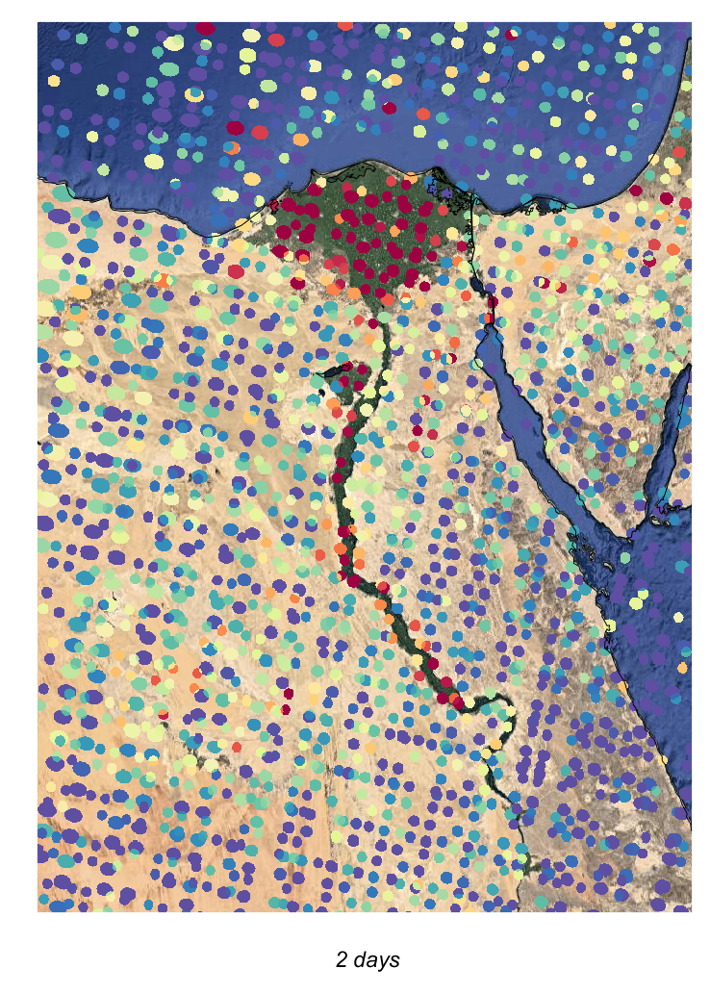
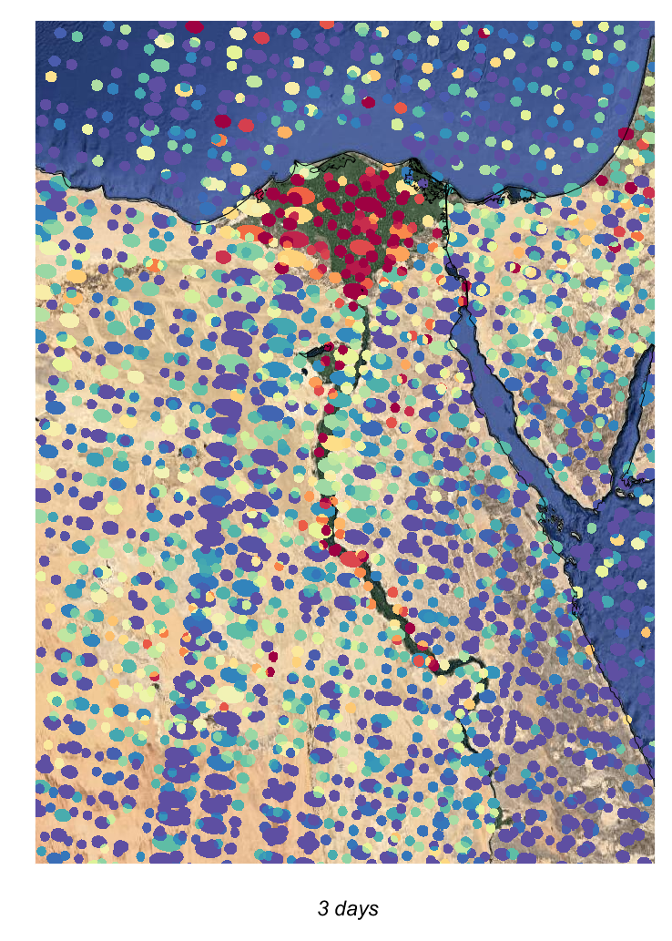
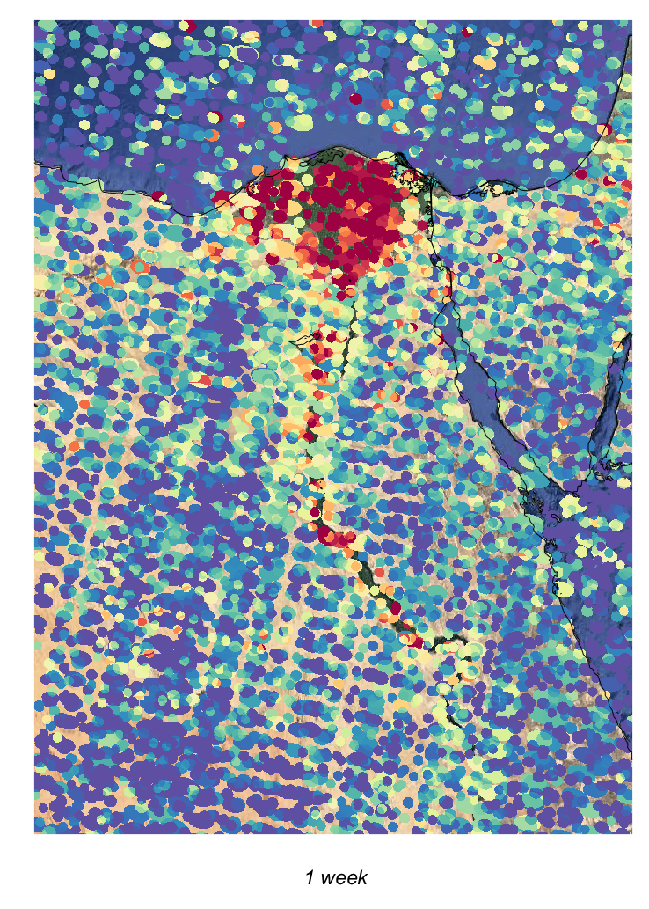
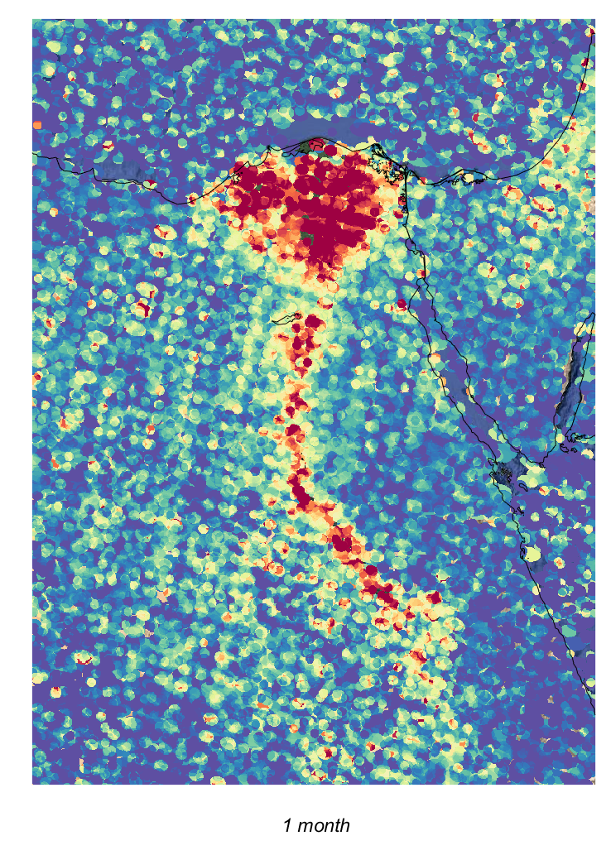
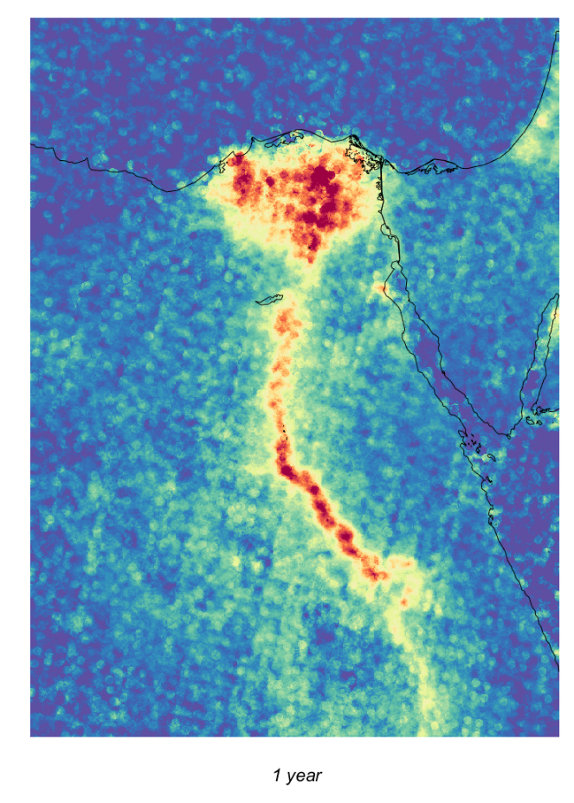
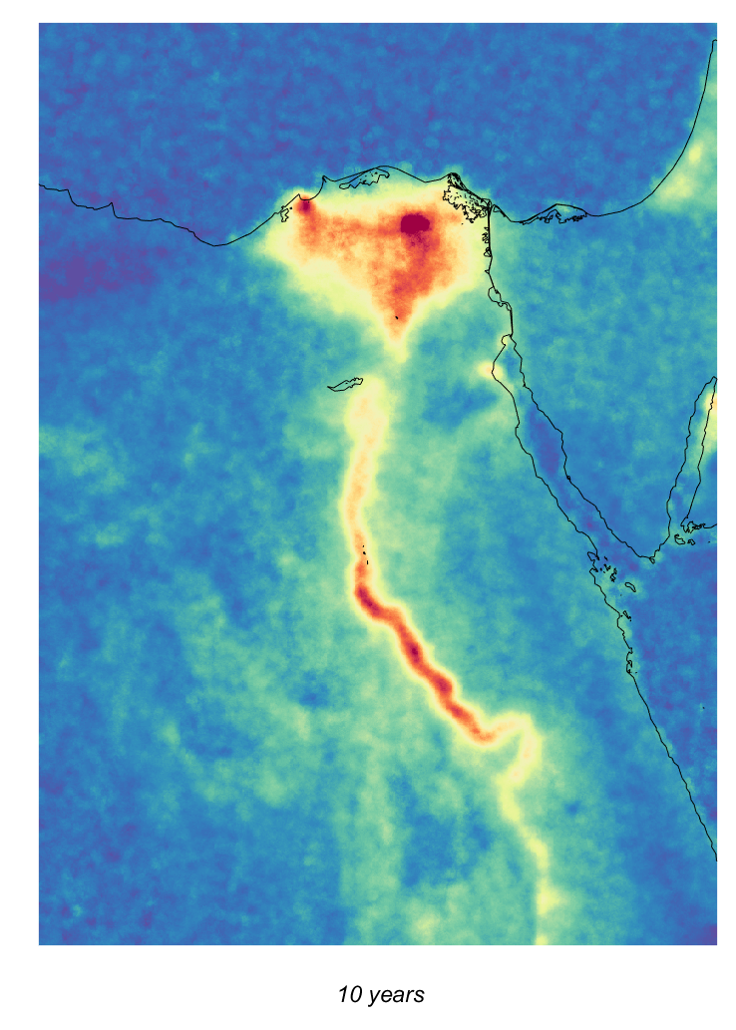
Making the most of current satellite datasets
Spatial oversampling approach
The elliptical footprints of IASI are averaged on a 0.01° × 0.01° high-resolution grid and weighted by the inverse of their footprint area
  Van Damme et al., ACP 2014
  Van Damme et al., Nature 2018
  Sun et al., AMT 2018

Slide 11
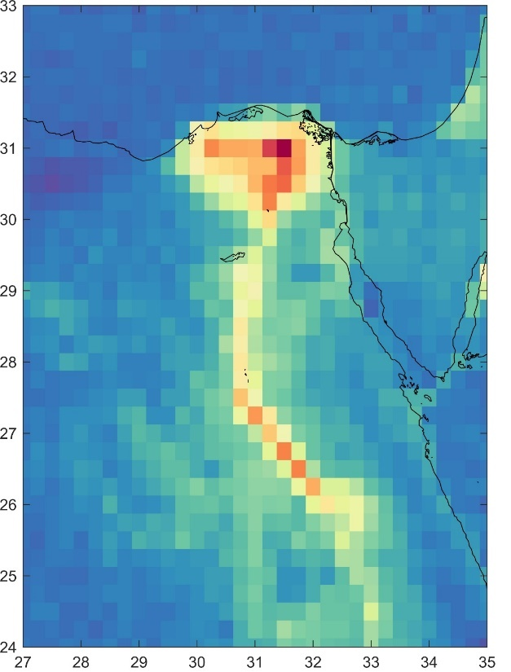
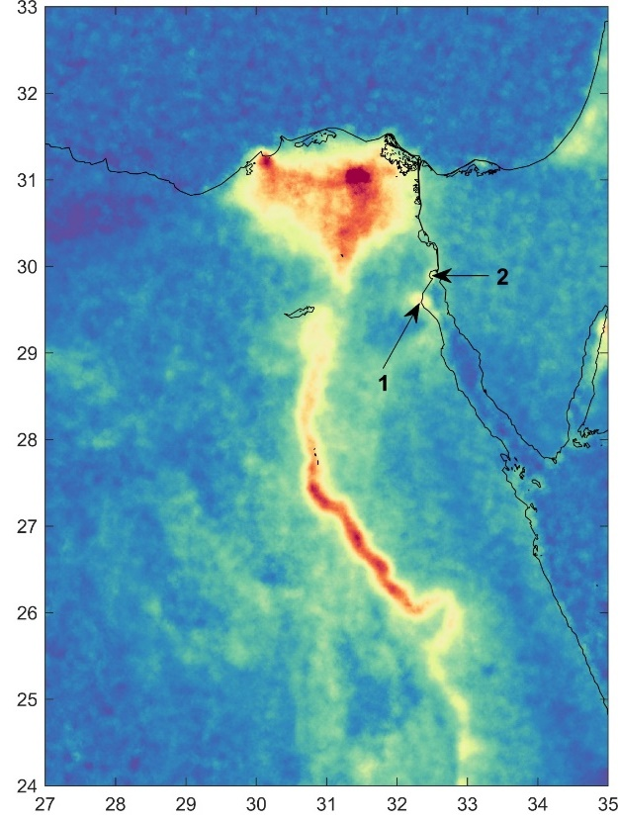

Making the most of current satellite datasets
Spatial oversampling approach
No artificial post-smoothing!
Binned
(0.25°×0.25°)
Oversampled
(0.01°×0.01°)
A considerable increase in resolution is achieved with oversampled averages
1 = Ain Sukhna; 2 = Al-Adabiya
Van Damme et al., Nature 2018

Slide 12
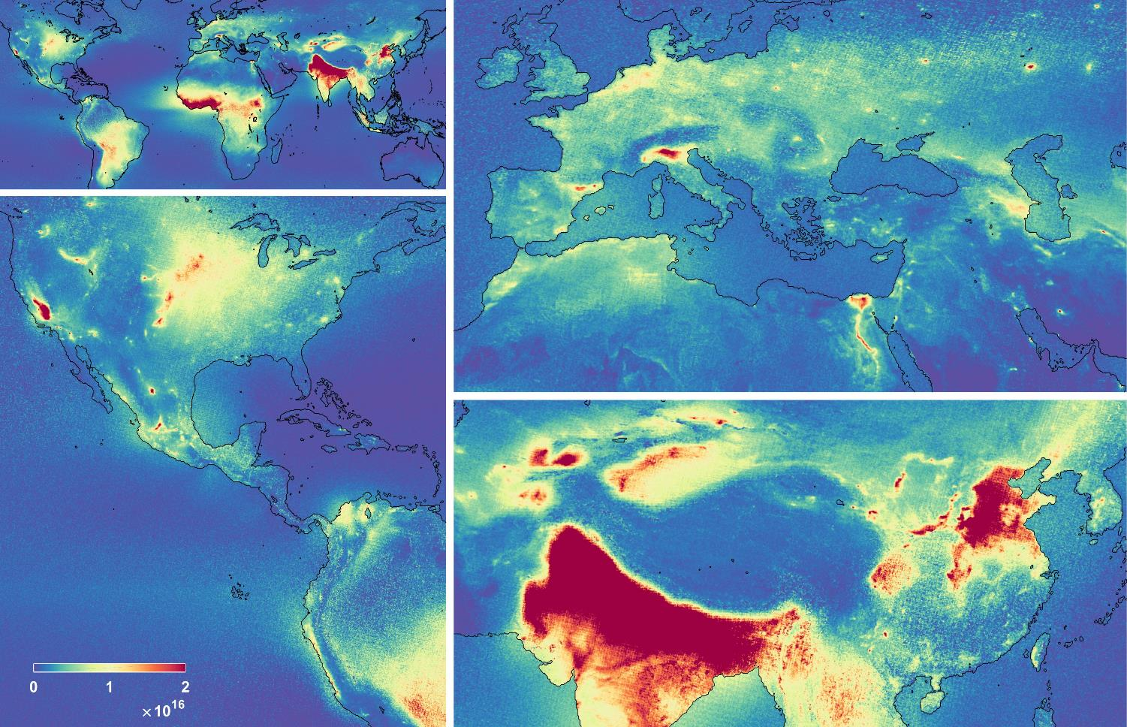
NH₃ hotspot identification & source attribution
Spatial oversampling approach
molec/cm²
Van Damme et al., Nature 2018

Slide 13
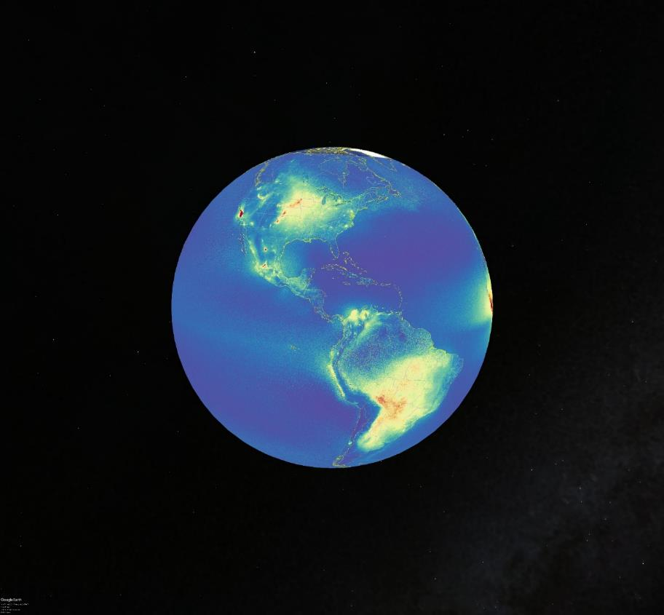
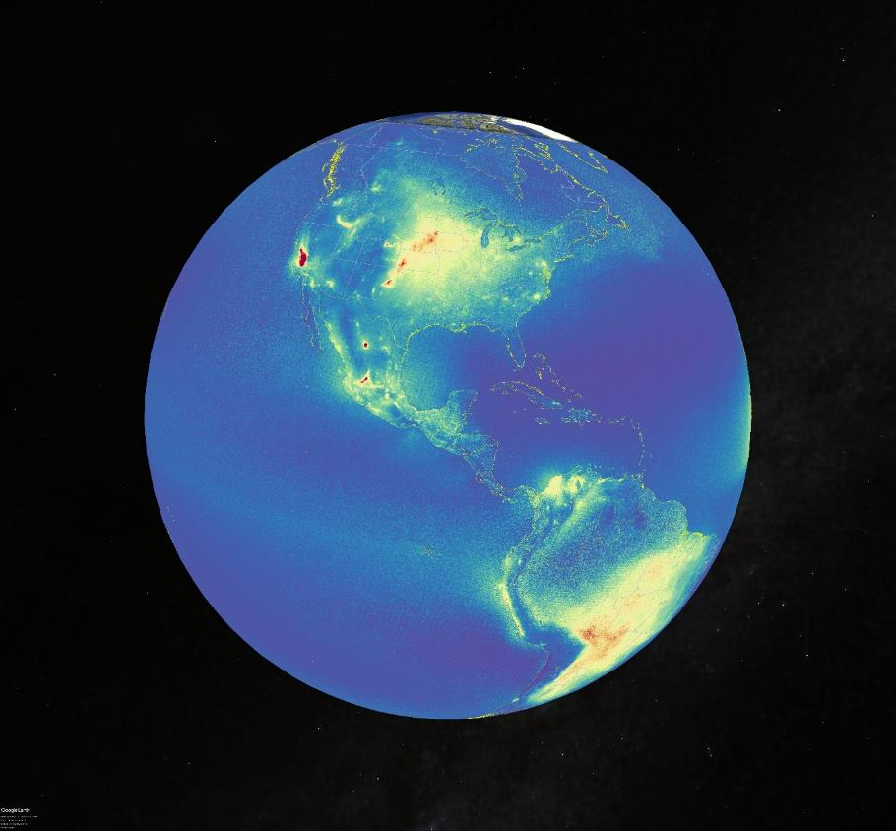
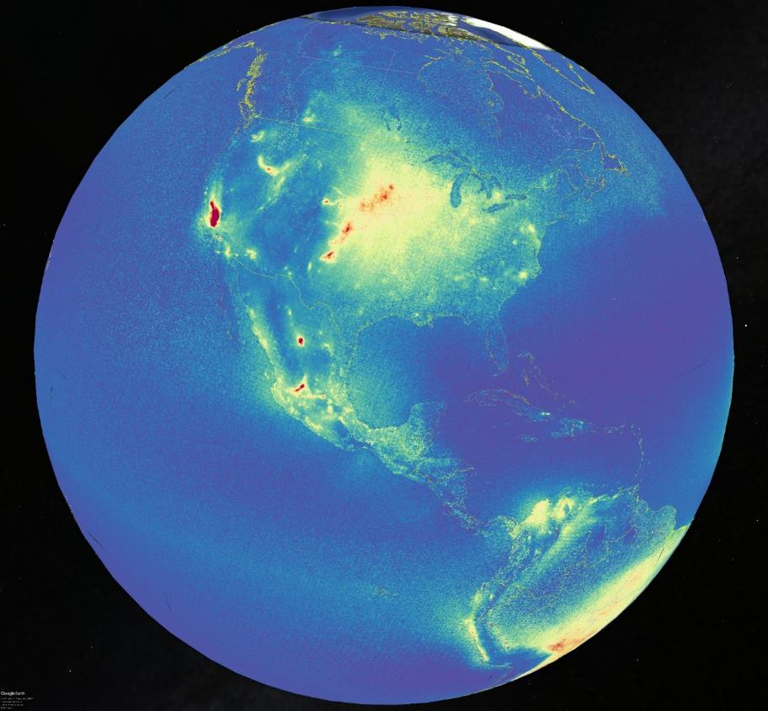
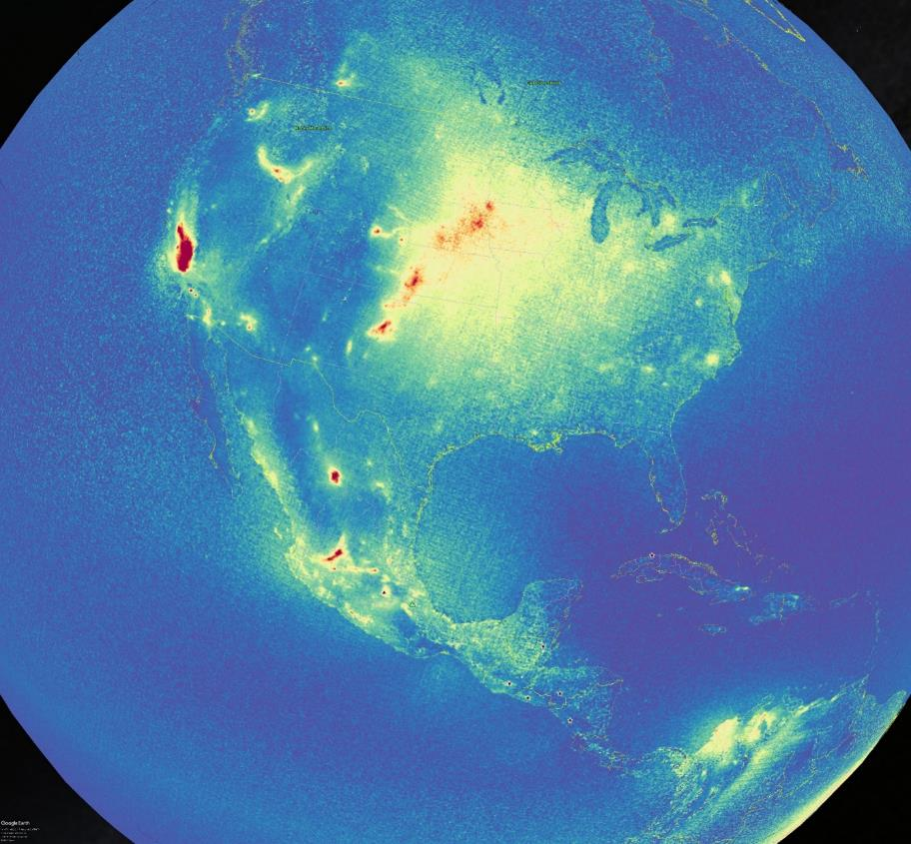
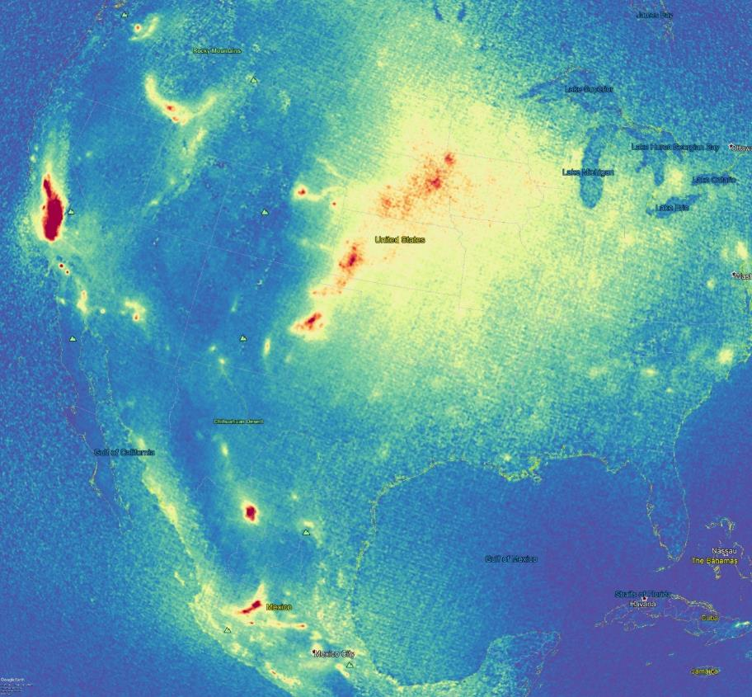
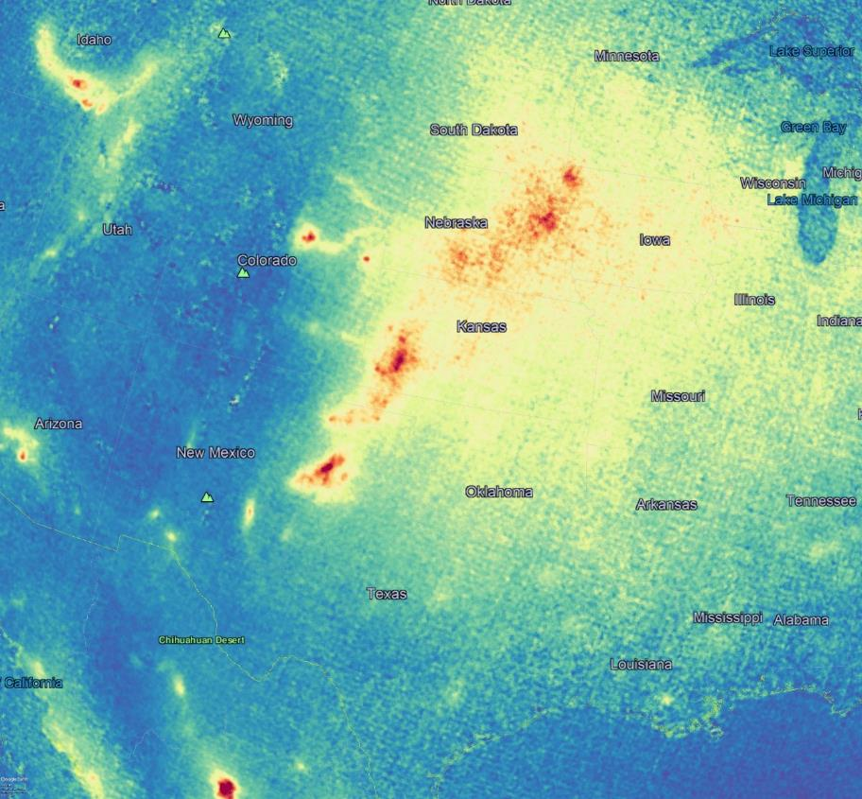
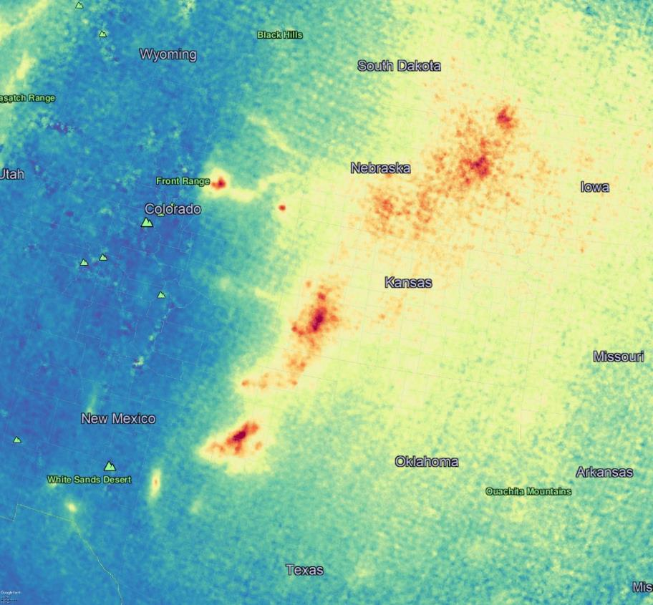
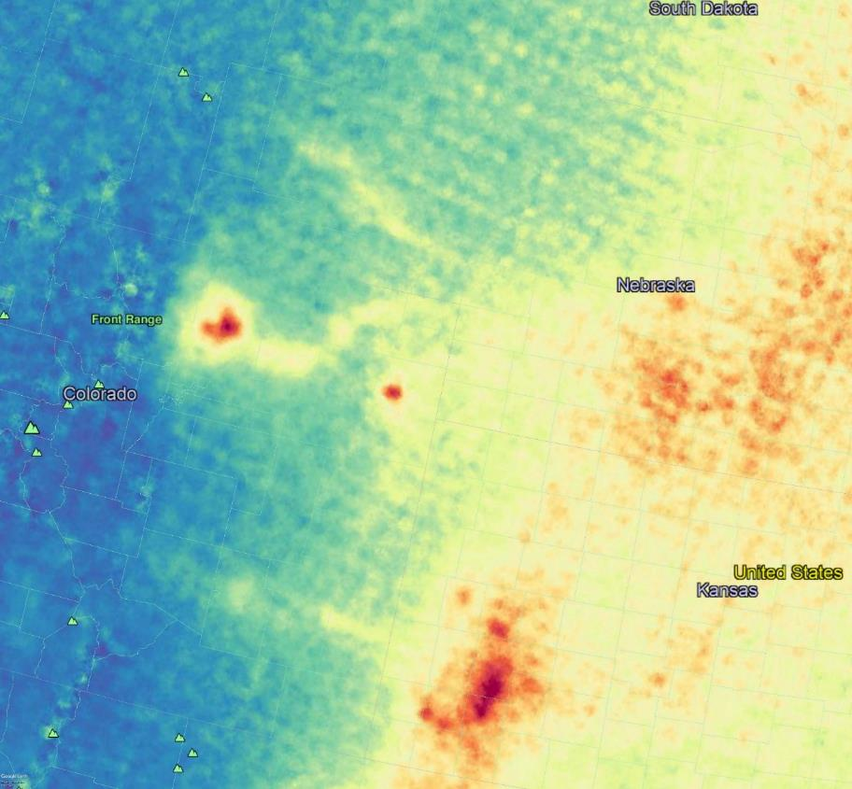
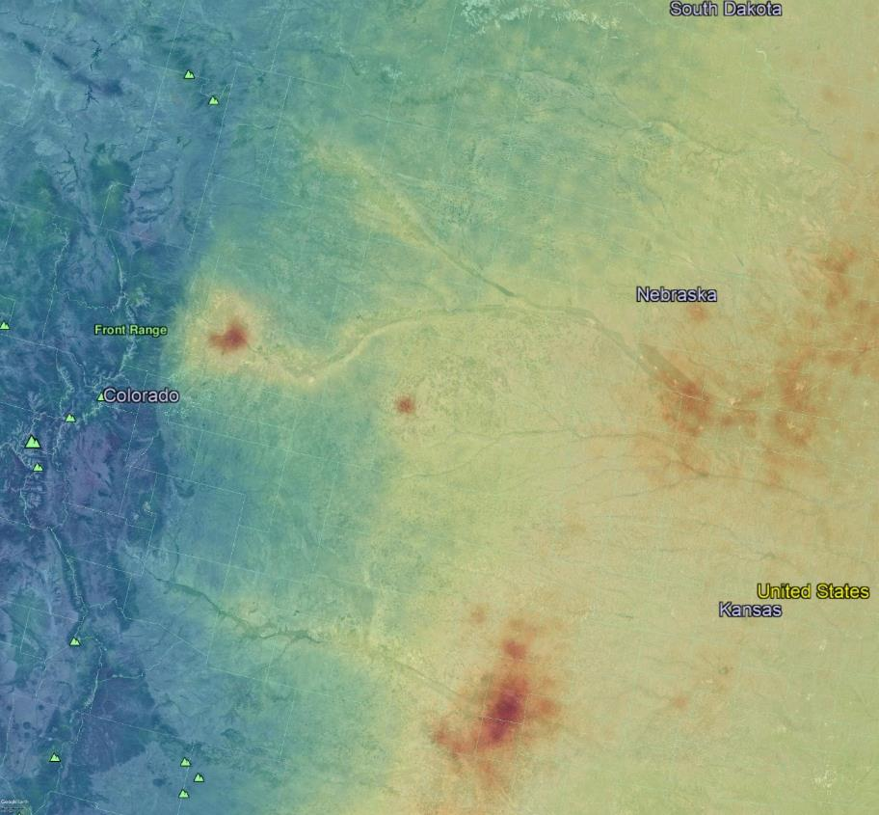
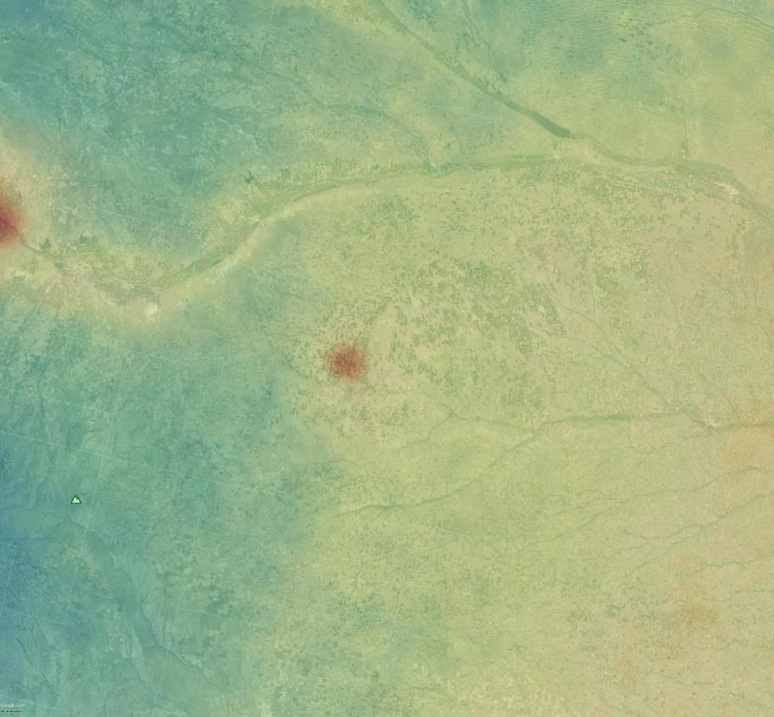
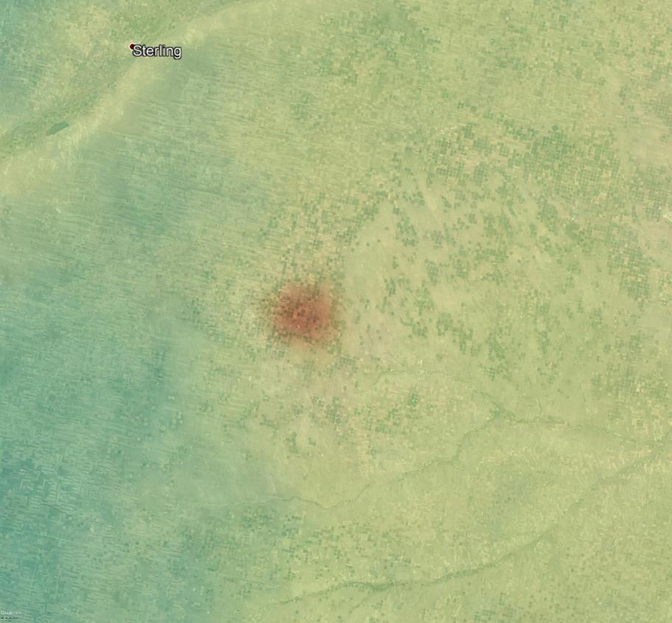
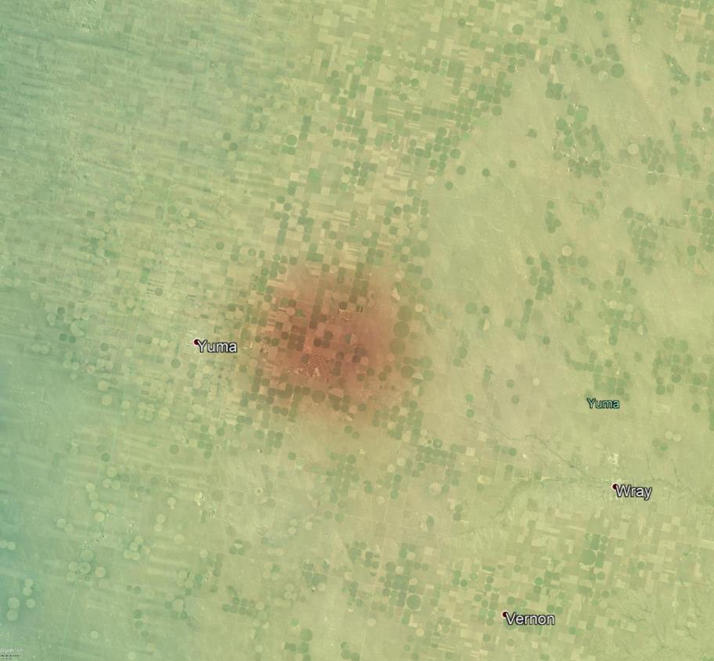
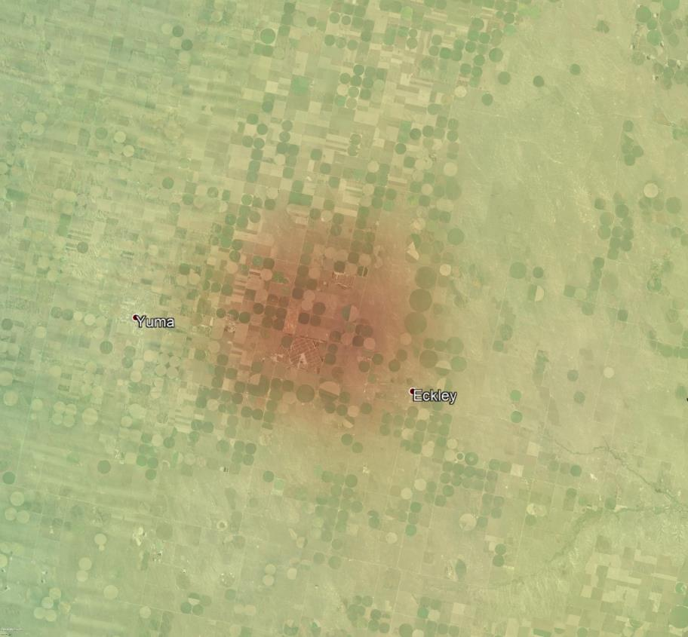
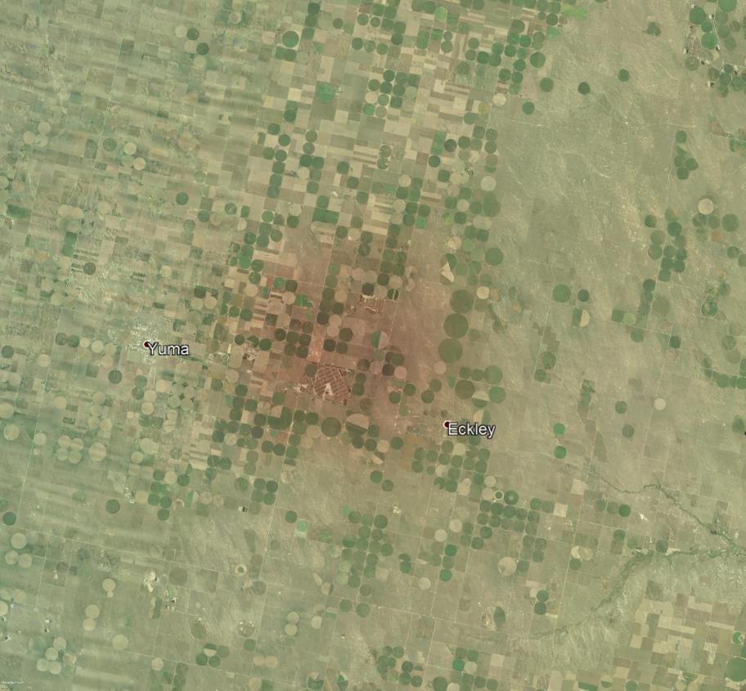
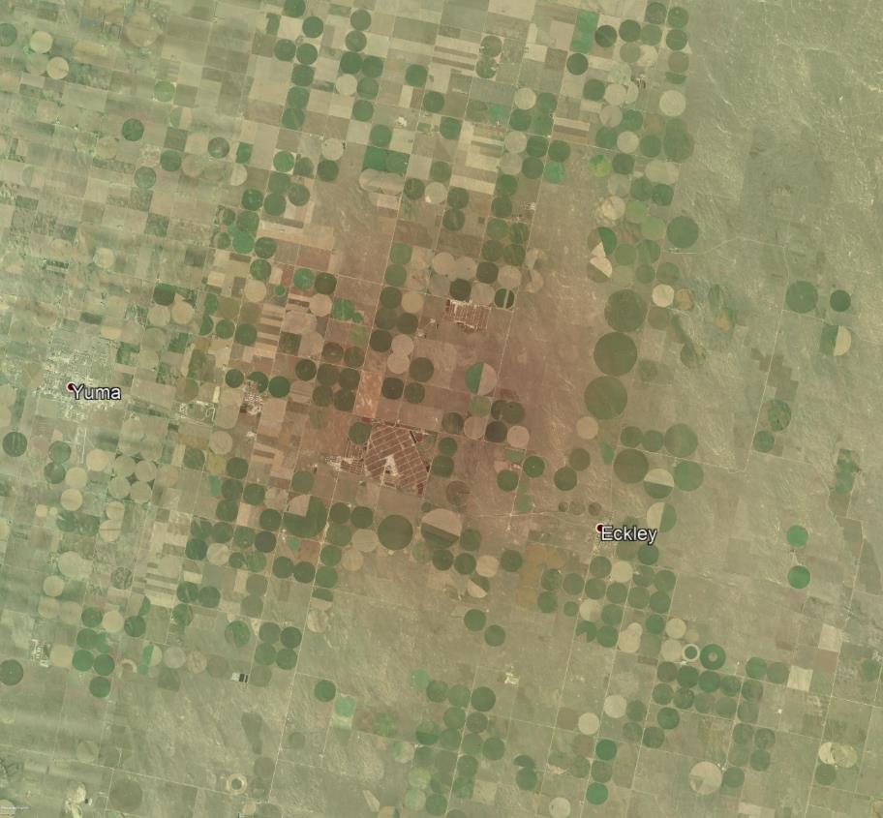
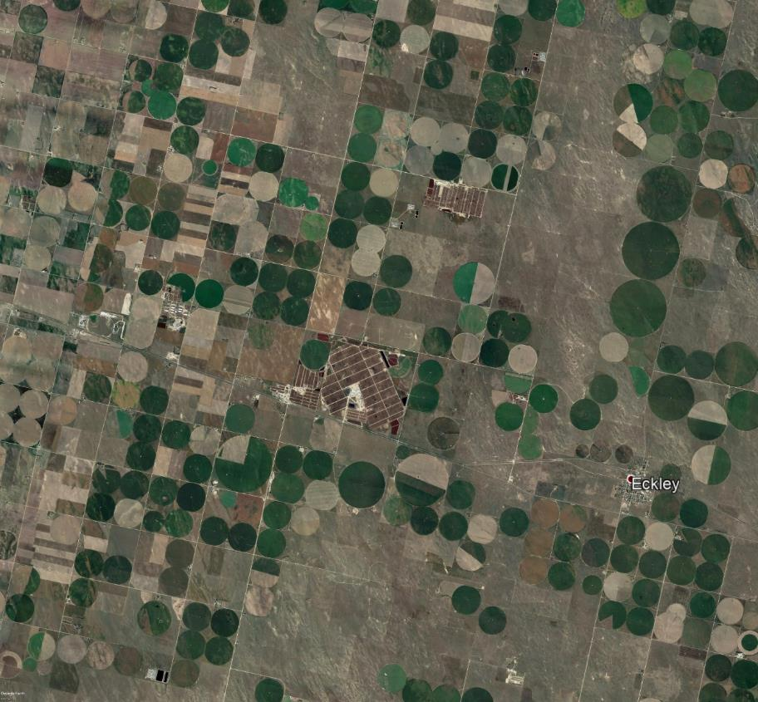
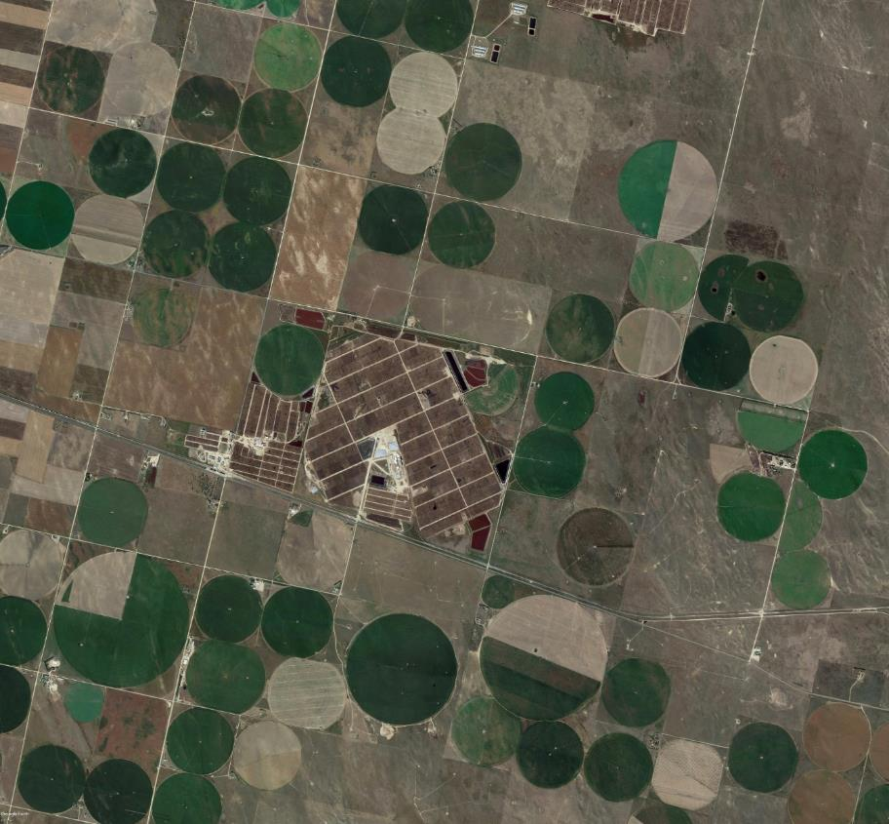
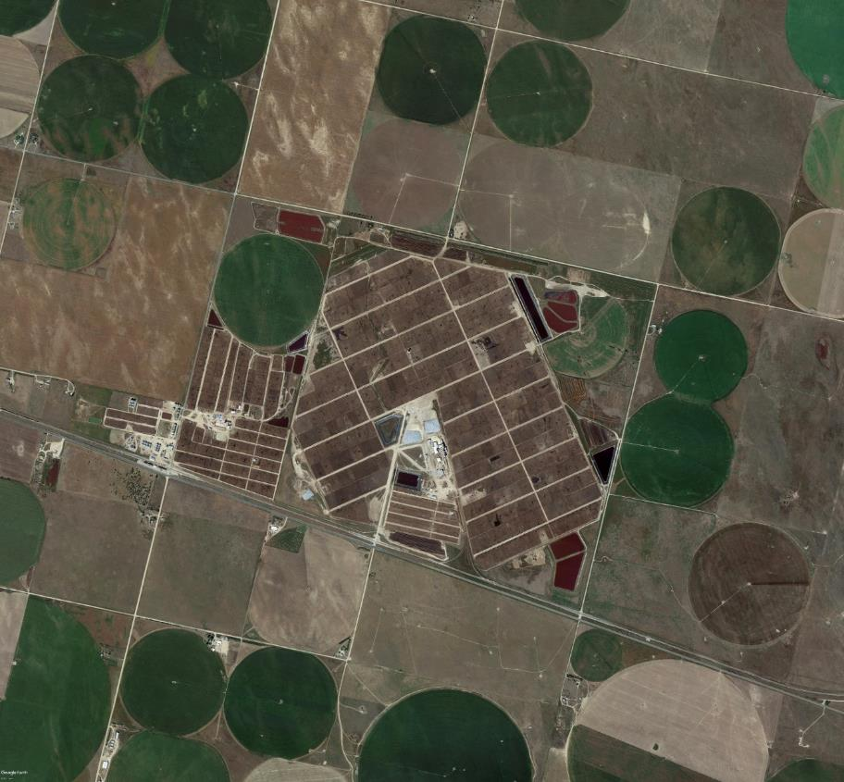
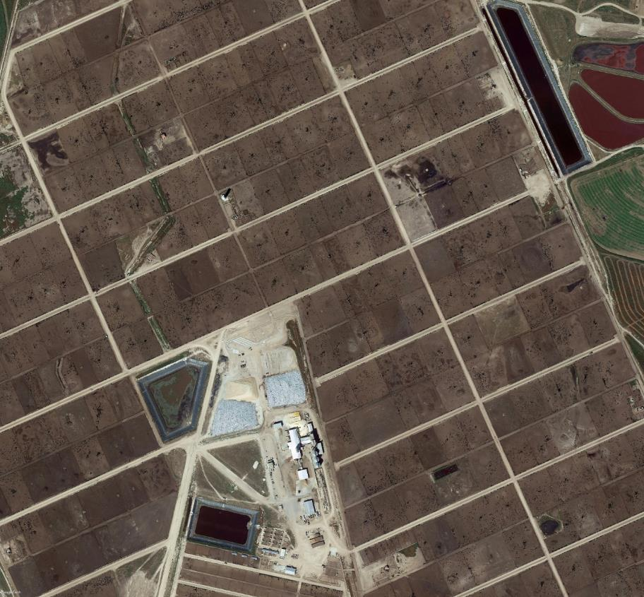
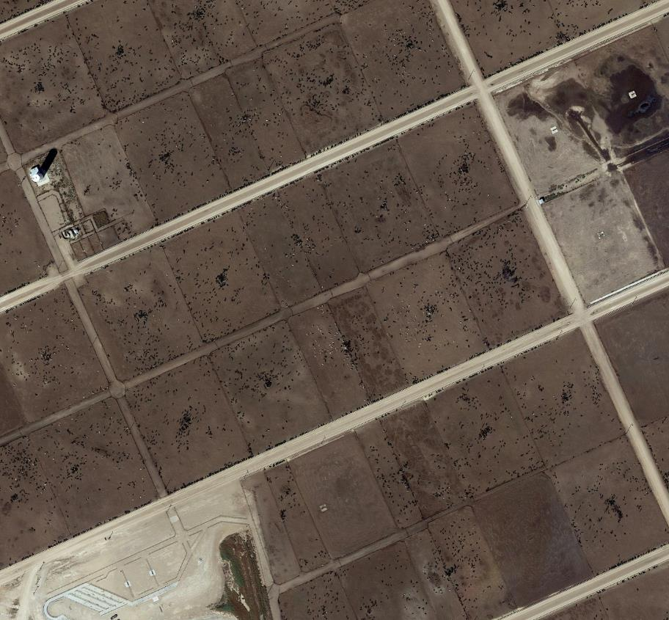
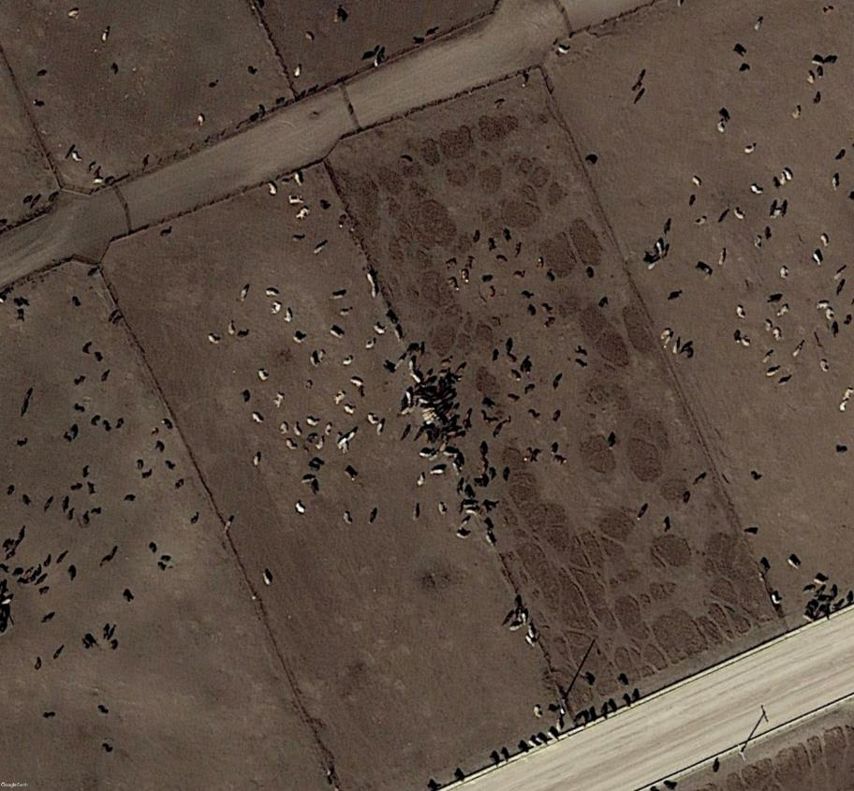
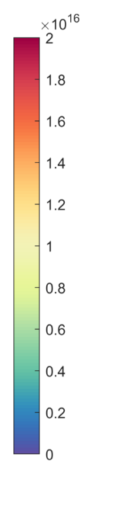
NH₃ hotspot identification & source attribution
Agricultural
molec/cm²
Picture: GoogleEarth

Slide 14
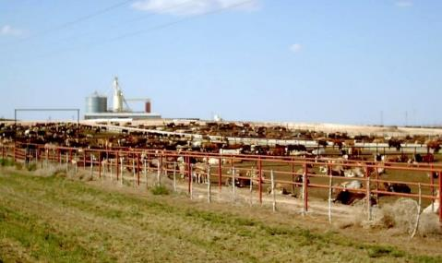
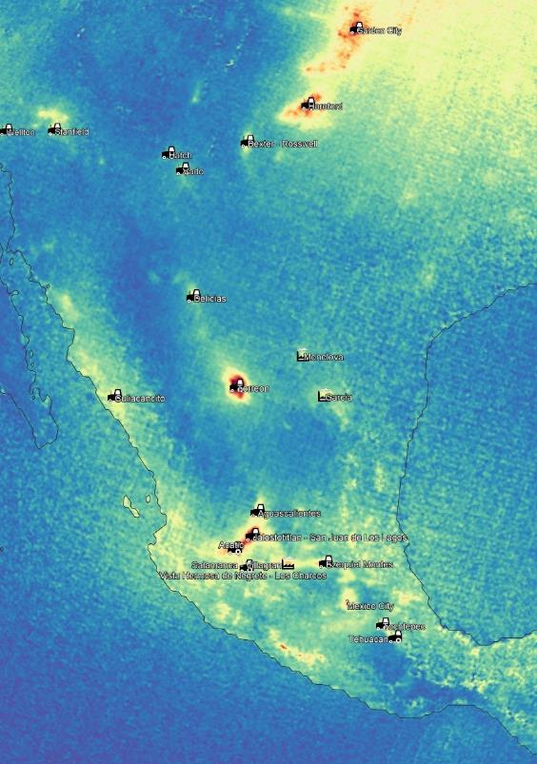




NH₃ hotspot identification & source attribution
Agricultural
Picture: en.wikipedia.org/wiki/Feedlot
Torreon (Mexico)
Bakersfield (USA)
Picture: GoogleEarth
Tulare (USA)
Picture: GoogleEarth
Chino (USA)
Picture: GoogleEarth
Picture: GoogleEarth
Van Damme et al., Nature 2018

Slide 15




NH₃ hotspot identification & source attribution
Agricultural
Milford (USA)
Picture: shankanad.org
Picture: GoogleEarth
Picture: usda.gov
Van Damme et al., Nature 2018

Slide 16





NH₃ hotspot identification & source attribution
Agricultural
Alto Laran District (Peru)
Picture: www.huachos.com
Basmakci (Turkey)
Picture: GoogleEarth
Picture: GoogleEarth
Van Damme et al., Nature 2018

Slide 17
















NH₃ hotspot identification & source attribution
Industrial
molec/cm²
molec/cm²
Picture: GoogleEarth

Slide 18




NH₃ hotspot identification & source attribution
Industrial
Marvdasht (Iran)
Sur Industrial Estate (Oman)
Picture: www.hirbodan.com
Picture: GoogleEarth
Picture: GoogleEarth
Van Damme et al., Nature 2018

Slide 19





NH₃ hotspot identification & source attribution
Industrial
Shizuishan (China)
Zezhou - Gaoping (China)
Picture: GoogleEarth
Pingsongxiang (China)
Picture: GoogleEarth
Wucaiwan (China)
?
Picture: GoogleEarth
Picture: GoogleEarth
Van Damme et al., Nature 2018

Slide 20




NH₃ hotspot identification & source attribution
Industrial
Moa (Cuba)
Picture: www.cadenagramonte.cu
Nicaro (Cuba)
Picture: GoogleEarth
Picture: GoogleEarth
Van Damme et al., Nature 2018

Slide 21



NH₃ hotspot identification & source attribution
Industrial
The Geysers (USA)
Picture: www.energy.ca.gov
Picture: GoogleEarth
Van Damme et al., Nature 2018

Slide 22



NH₃ hotspot identification & source attribution
Natural
Clarisse et al., Sci. Rep. 2019
Lake Natron
Picture: http://animalia-life.club/other/lesser-flamingo-lake-natron.html
Typical Natron conditions: pH of 10 / T° of 35°C / 92% of ammoniacal N in solution is present as NH₃

Slide 23




NH₃ hotspot identification & source attribution
Natural
Lake Natron
NH₃
contour min=0.8 10¹⁶ molec/cm²
contour max=1.1 10¹⁶ molec/cm²
Massive NH₃ emissions occur over Natron’s main mudflat
NH₃ volatilization linked to the drying processes of the lake may be related to the decay of algae (but series of natural processes at play)
NH₃
(molec/cm²)
Lake area
(normalized)
Clarisse et al., Sci. Rep. 2019

Slide 24



NH₃ hotspot identification & source attribution
>240 hotspots identified (+ >170 source regions) categorized in 3 classes:
  Agricultural (83)
  Industrial (158)
  Natural (1)
Flux quantification with a box model:
NH₃ mass inside box
Effective lifetime
(first order loss term)
Van Damme et al., Nature 2018

Slide 25

Quantification of NH₃ emission fluxes
Comparison with EDGAR emission inventory
Fair agreement for the large majority of source regions
Satellite-derived (kg.s⁻¹)
Very large underestimation of emissions in EDGAR for almost all identified hotspots
2/3 by at least 1 order of magnitude
EDGAR v4.3.1 (kg.s⁻¹)
1 agricultural and 69 industrial hotspots completely absent!
Van Damme et al., Nature 2018

Slide 26



Quantification of NH₃ emission fluxes
Comparison with EDGAR emission inventory
Agriculture – Chino, USA–
Industry – Marvdasht, Iran–
Picture: GoogleEarth
Picture: GoogleEarth
IASI
IND AGR
IND AGR
EDGAR
Van Damme et al., Nature 2018

Slide 27


Tracking down global NH₃ point sources
Varying footprint size
(7-13 km²)
Clarisse et al., AMT 2019

Slide 28


Tracking down global NH₃ point sources
Supersampling technique
Varying footprint size
(7-13 km²)
Video: https://www.youtube.com/watch?v=n-KWjvu6d2Y
Super-resolution
Widely used in
image processing
and
super-resolution microscopy:
e.g. License plate recognition
Clarisse et al., AMT 2019

Slide 29

Tracking down global NH₃ point sources
Supersampling technique
First-time applied to measurements of an atmospheric sounder!
Iterative Back-Projection algorithm (IBP, Irani and Peleg (1993))
footprint size
Clarisse et al., AMT 2019

Slide 30

Tracking down global NH₃ point sources
Supersampling technique
First-time applied to measurements of an atmospheric sounder!
Iterative Back-Projection algorithm (IBP, Irani and Peleg (1993))
footprint size
Application to Horlivka (Gorlovka, Ukraine)
→ One of the main NH₃ plant in Ukraine
Picture: GoogleEarth
Clarisse et al., AMT 2019

Slide 31


Tracking down global NH₃ point sources
Supersampling technique
First-time applied to measurements of an atmospheric sounder!
Iterative Back-Projection algorithm (IBP, Irani and Peleg (1993))
footprint size
Application to Horlivka (Gorlovka, Ukraine)
→ One of the main NH₃ plant in Ukraine
a. Gridded (0.15°×0.15°) average
b. Oversampled average
→need of a “constant”
underlying distribution
Clarisse et al., AMT 2019

Slide 32


Wind-adjusted superresolution
Wind rotation
Togliatti (Russia)
Wind data: Mid-BLH from ERA-5 (ECMWF)
Distance from the rotation centre (km)
NH₃ (molec/cm²)
Distance from the rotation centre (km)
wind direction
Clarisse et al., AMT 2019

Slide 33

Tracking down global NH₃ point sources
Supersampling technique
footprint size
Application to Horlivka (Gorlovka, Ukraine)
a. Gridded (0.15°×0.15°) average
b. Oversampled average
c. Wind-rotated oversampling
wind direction
Clarisse et al., AMT 2019

Slide 34


Tracking down global NH₃ point sources
Supersampling technique
footprint size
Application to Horlivka (Gorlovka, Ukraine)
a. Gridded (0.15°×0.15°) average
b. Oversampled average
c. Wind-rotated oversampling
d. Wind-adjusted supersampling (i)
e. Wind-adjusted supersampling (ii)
wind direction
Clarisse et al., AMT 2019

Slide 35



Tracking down global NH₃ point sources
Regular oversampling
Saskatchewan, Canada
High Plains Aquifer, US
Clarisse et al., AMT 2019

Slide 36


Tracking down global NH₃ point sources
Point source map
Saskatchewan, Canada
High Plains Aquifer, US
Clarisse et al., AMT 2019

Slide 37


Tracking down global NH₃ point sources
Feedlot
Picture: GoogleEarth
Fertilizer industry – Belle Plaine Ammonia Plant
Picture: GoogleEarth
Clarisse et al., AMT 2019

Slide 38

Tracking down global NH₃ point sources
Regular oversampling
Wind-rotated oversampling
Wind-rotated supersampling
Point source map
*
New detections (and less false detections)
More accurate determination of the source location
Easier and automatic
>500 hotspots identified and categorized in 11 classes !
NH₃ plant
*
Picture: GoogleEarth
Clarisse et al., AMT 2019

Slide 39

Tracking down global NH₃ point sources
Point source map
Clarisse et al., AMT 2019

Slide 40

NH₃ point sources catalogue
New webpage: https://www2.ulb.ac.be/cpm/NH3-IASI.html

Slide 41


NH₃ point sources catalogue
New webpage: https://www2.ulb.ac.be/cpm/NH3-IASI.html

Slide 42







NH₃ Trends
Point sources monitoring
Marvdasht (Iran)
constant industrial emission
Nicaro (Cuba)
Bacau (Romania)
Alto Laran District (Peru)
Anju (North Korea)
Wucaiwan (China)
Onset or discontinuation of anthropogenic activities unambiguously detected and monitored
2008
2009
2010
2011
2012
2013
2014
2015
2016
Van Damme et al., Nature 2018

Slide 43



NH₃ Trends
Point sources monitoring
Picture: GoogleEarth
2006-2013: 7 years of expansion of the Namhung Youth Chemical Complex → increased fertilizer production (urea)
North Korea’s Namhung Youth Chemical Complex expansion
Picture: www.zoominlorea.org [Photo: Kim Soobok]
Van Damme et al., Nature 2018

Slide 44

NH₃ Trends
Point sources monitoring
Picture: GoogleEarth
North Korea’s Namhung Youth Chemical Complex expansion
Picture: GoogleEarth
?
Van Damme et al., Nature 2018

Slide 45














NH₃ Trends
Point sources monitoring
IASI-NH₃
(molec/cm²)
LANDSAT
imagery
-5 (2008-2009)
-7 (2010-2012)
-8 (2013-2016)
1 band – Grayscale
Van Damme et al., Nature 2018

Slide 46

NH₃ Trends
Global trends
Bootstrap resampling method (Gardiner et al., 2008)
Daily time-series (0.5°×0.5°)
ANNI-NH₃-v3R-ERA5 2008-2018 IASI/Metop-A
. = not significant at 2σ
(not published)

Slide 47






NH₃ Trends
Monthly time-series
(not published)

Slide 48



NH₃ Trends
The Netherlands
2018 is an outstanding year for atmospheric NH₃
LML ground-based network (RIVM)
35%
Meteorological conditions (warm & dry) favoured NH₃ volatilization
5°C warming
  → ↗ emissions by 42 % (Sutton et al., 2013)
Other source processes?
IASI-A
IASI-B
44.75%
(44.8%)
(not published)

Slide 49
Conclusions, current limitations and perspectives
Current satellite missions offer an unprecedented view of global atmospheric NH₃
The oversampling method and the availability of accumulated data allow us to reveal point sources, which are mainly associated with high-density animal farming and industrial fertilizer production
Wind-adjusted superresolution techniques enable an even better detection of point source emitters and their automatic localisation
The online catalogue now consists in over 500 point sources classified in 11 categories
Our results point to the need to completely revisit the emission inventories for anthropogenic NH₃ sources and indicate that satellite measurements will be crucial in doing so
IASI can be used to monitor discontinuation of anthropogenic activities (opening/closure of factories) at the point source scale and to analyse atmospheric ammonia trends from a local to a global scale

Slide 50








Thank you for your attention!
References:
Clerbaux et al., ACP 2009 https://doi.org/10.5194/acp-9-6041-2009
Whitburn et al., JGR-Atm 2016 https://doi.org/10.1002/2016JD024828
Van Damme et al., AMT 2017 https://doi.org/10.5194/amt-10-4905-2017
Franco et al., JGR-Atm 2018 https://doi.org/10.1029/2018JD029633
  Van Damme et al., ACP 2014 https://doi.org/10.5194/acp-14-2905-2014
  Van Damme et al., Nature 2018 https://doi.org/10.1038/s41586-018-0747-1
  Sun et al., AMT 2018 https://doi.org/10.5194/amt-11-6679-2018
  Clarisse et al., Sci. Rep. 2019 https://doi.org/10.1038/s41598-019-39935-3
  Clarisse et al., AMT 2019 https://doi.org/10.5194/amt-12-5457-2019
IASI-NH₃ point source emissions
IASI-NH₃ datasets (near-real time and reanalysed products) available at : http://iasi.aeris-data.fr/NH3
Global NH₃ point source map available at : https://www2.ulb.ac.be/cpm/NH3-IASI.html

