Slide 1
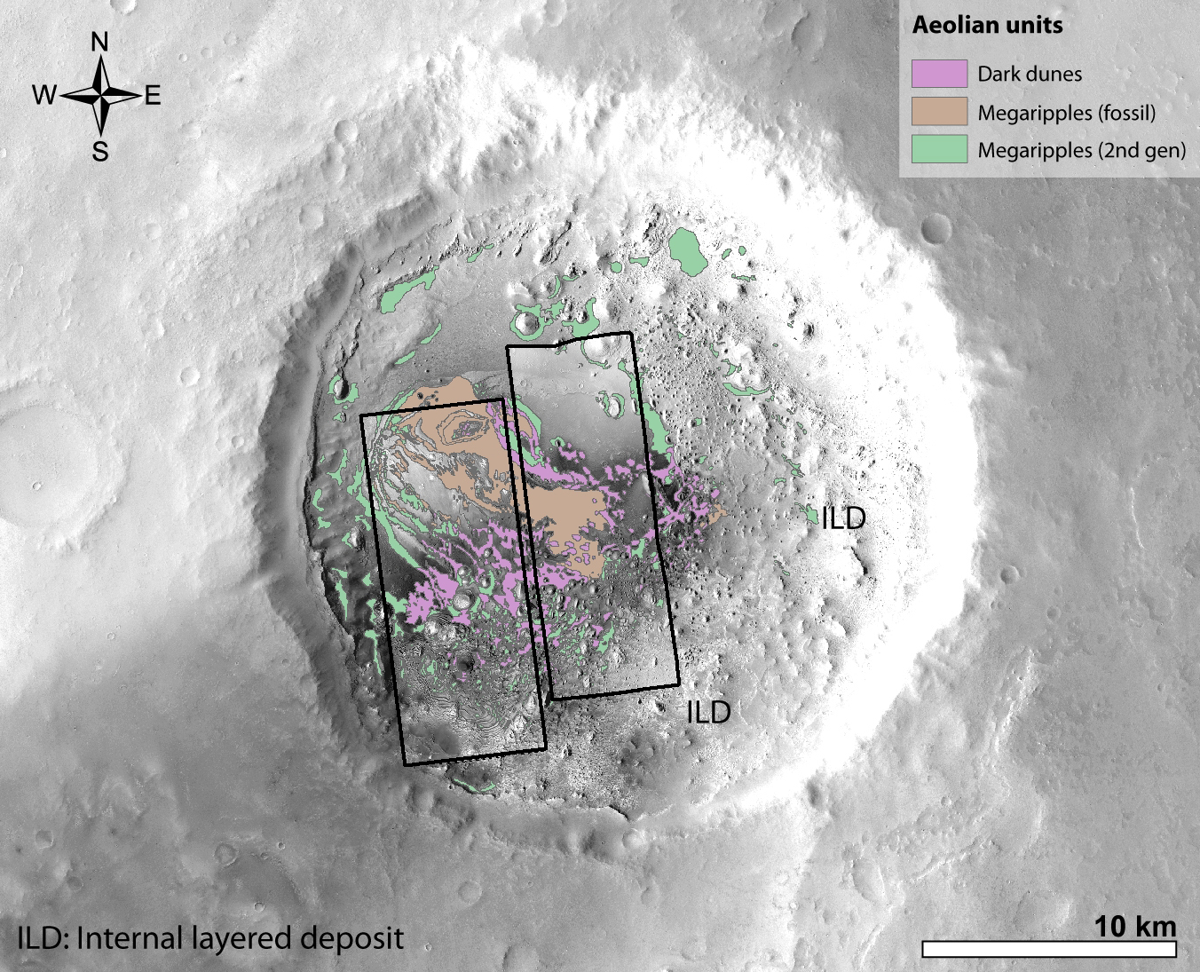
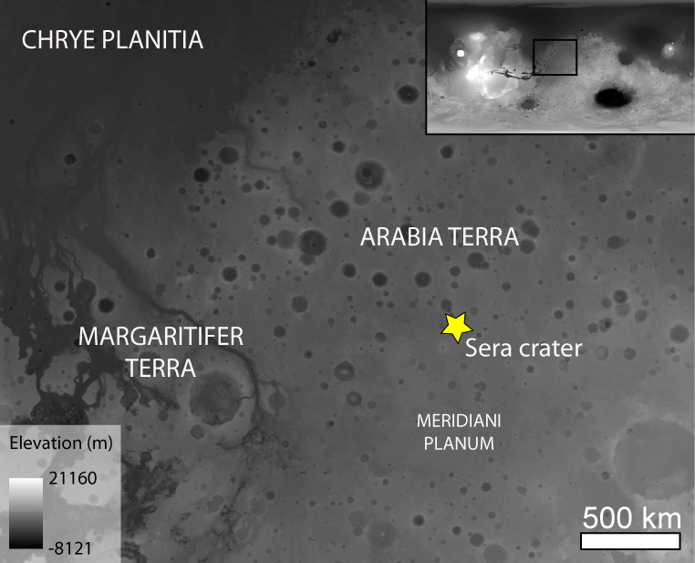
Active and fossil aeolian bedforms in Arabia Terra (Mars): climate and sedimentological implications
S. Silvestro^{1,2}, F. Salese^{3,4}, D.A. Vaz⁵, J. Davis⁶, H. Yizhaq⁷, G. Franzese¹, F. Esposito¹
¹INAF Osservatorio Astronomico di Capodimonte, Napoli, Italy. ²SETI Institute, Mountain View, CA, USA. ³Faculty of Geosciences, Utrecht University, Utrecht, The Netherlands. ⁴International Research School of Planetary Sciences, Università Gabriele D’Annunzio, Pescara, Italy. ⁵Centre for Earth and Space Research of the University of Coimbra, Coimbra, Portugal. ⁶Department of Earth Sciences, Natural History Museum, London, England. ⁷Department of Solar Energy and Environmental Physics, BIDR, Ben-Gurion University of the Negev, Israel.
Sera crater, three distinct aeolian units: Dark dunes (top) – Megaripples 2nd gen (middle) – Fossil megarippels (bottom)

Slide 2
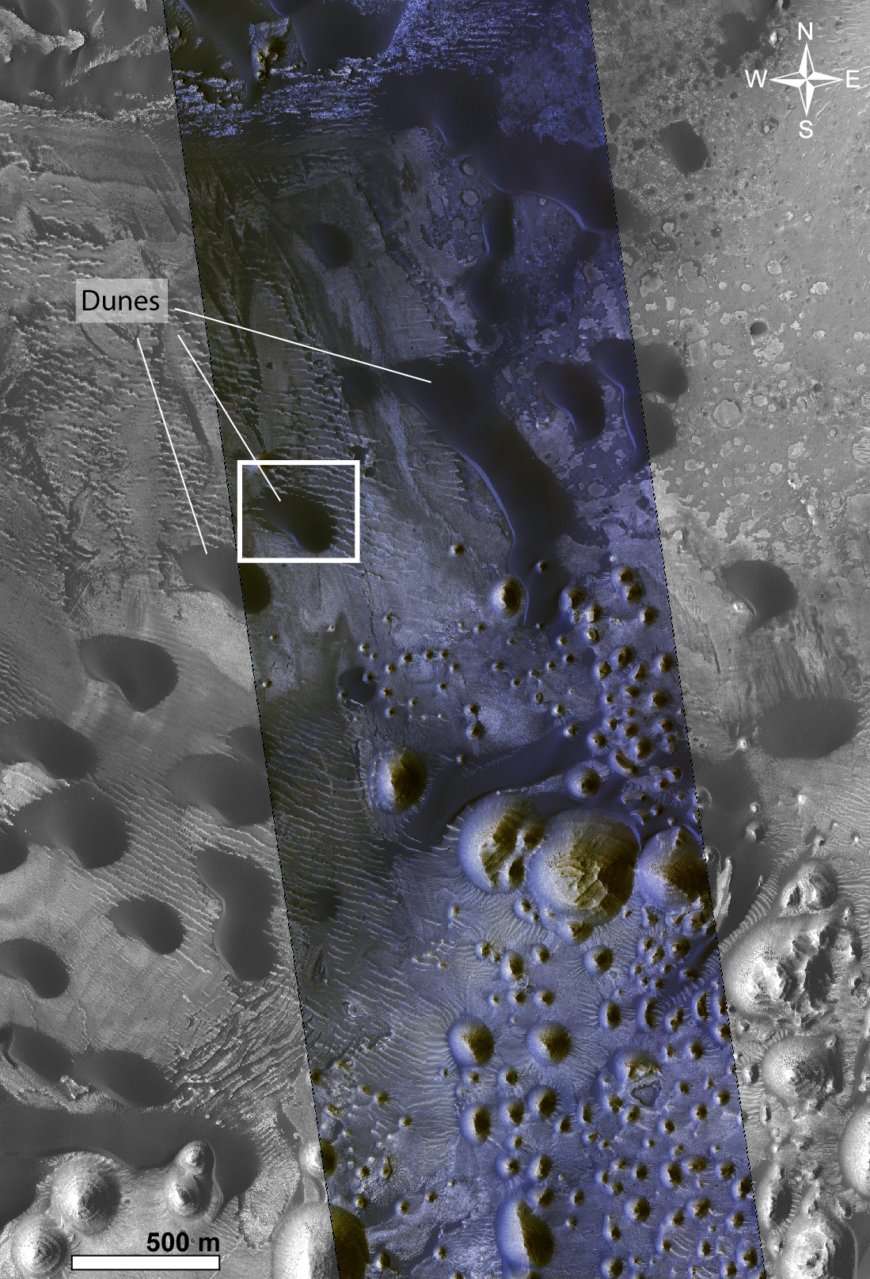
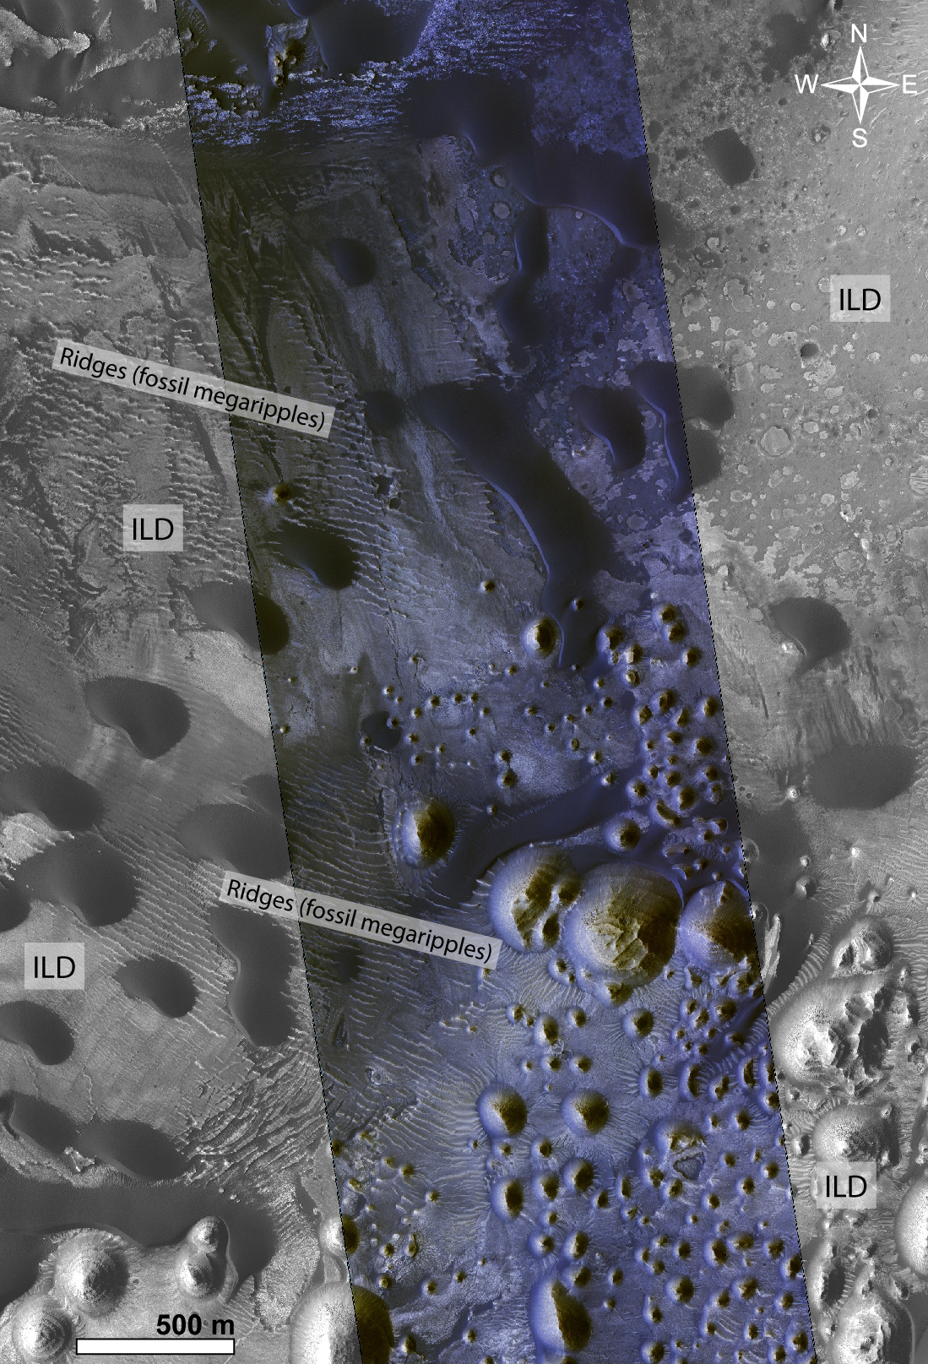
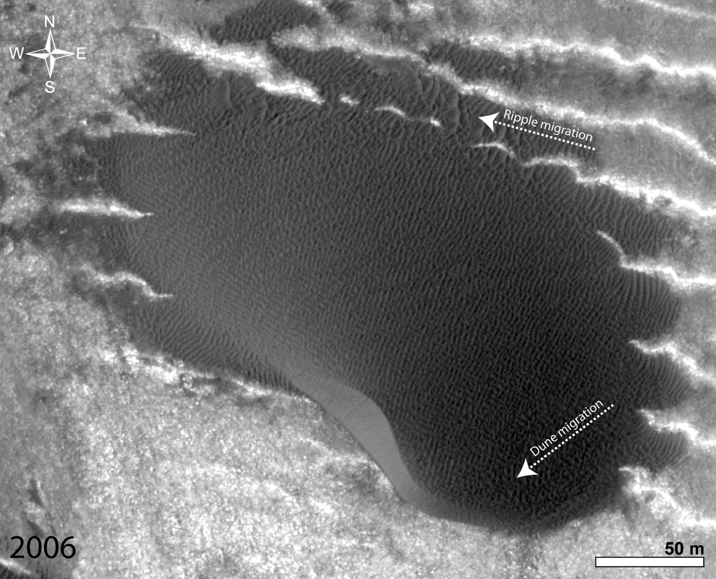
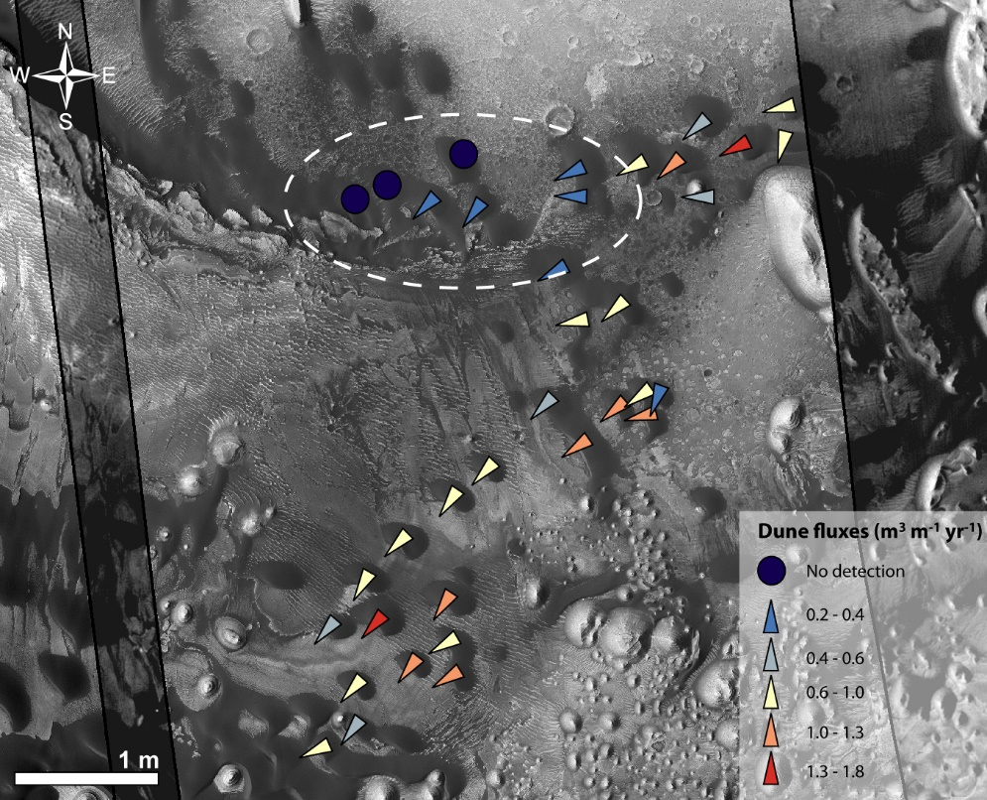
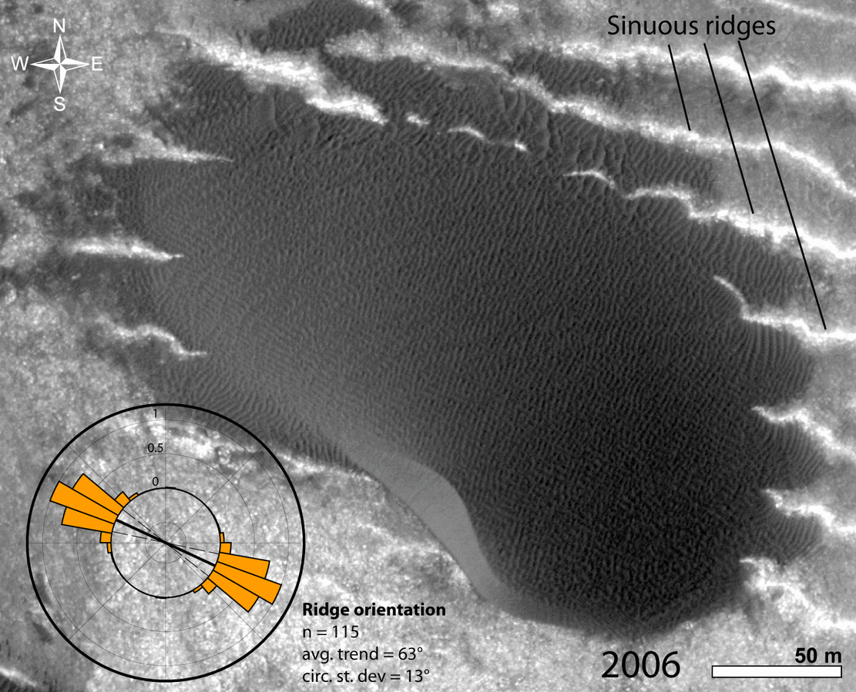
Dark dunes: sculpted by wind ripples, dunes moved toward the SW (0.12 m/yr).
Lower flux dunes are located in topographic lows (encircled).
Dunes move above a bright-toned surface (internal layered deposit – ILD) sculpted by sinuous ridges that we interpreted as fossil megaripples (PBRs – periodic bedrock ridges^{1,2}).

Slide 3
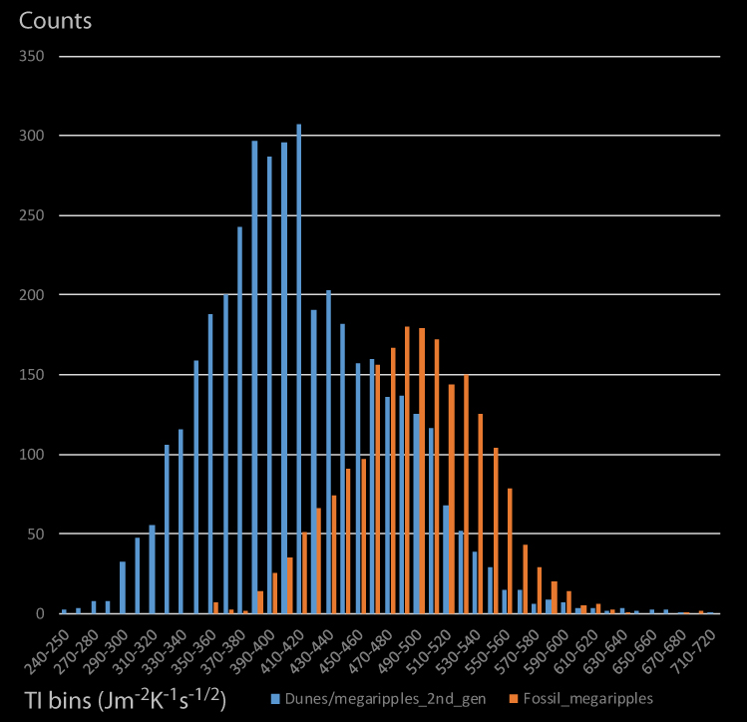
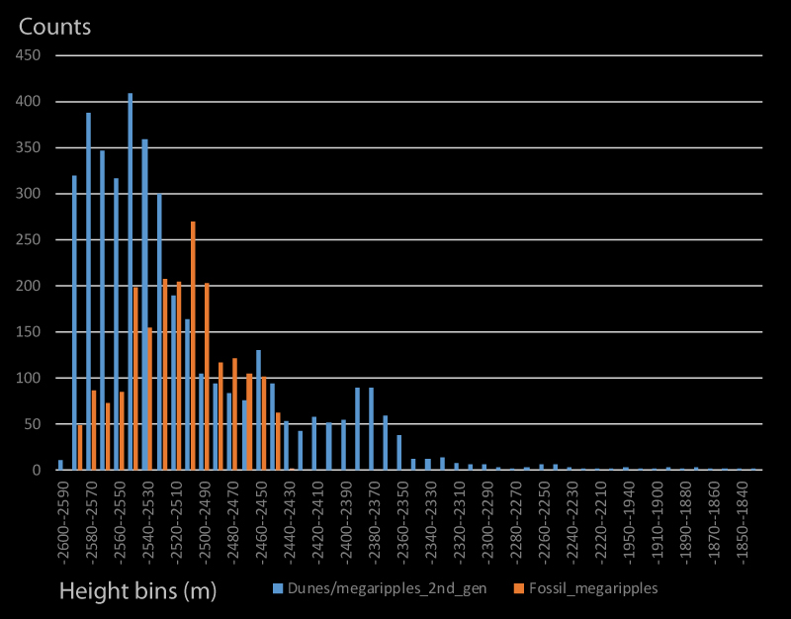
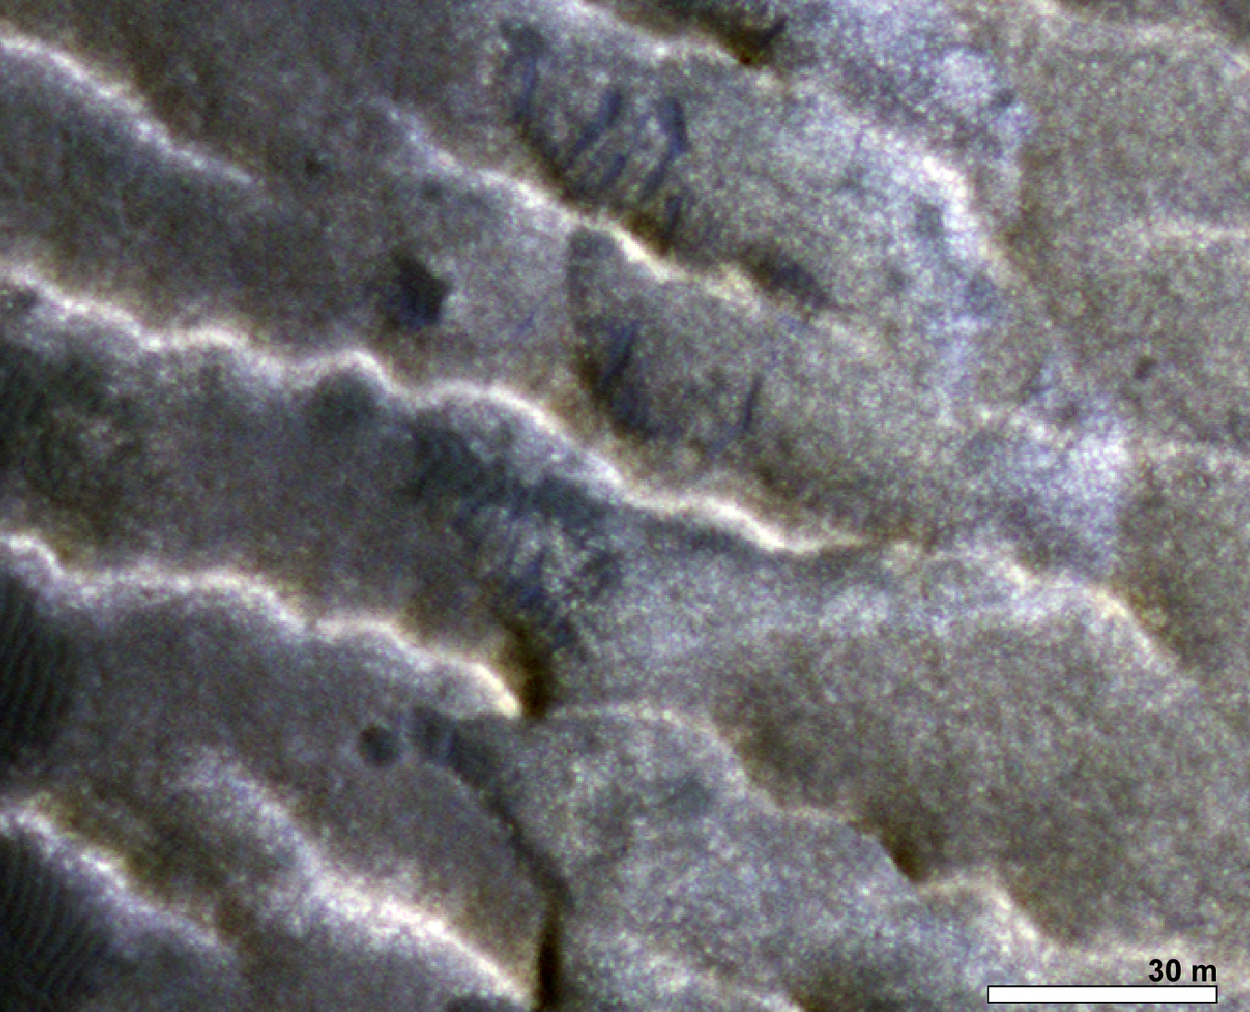
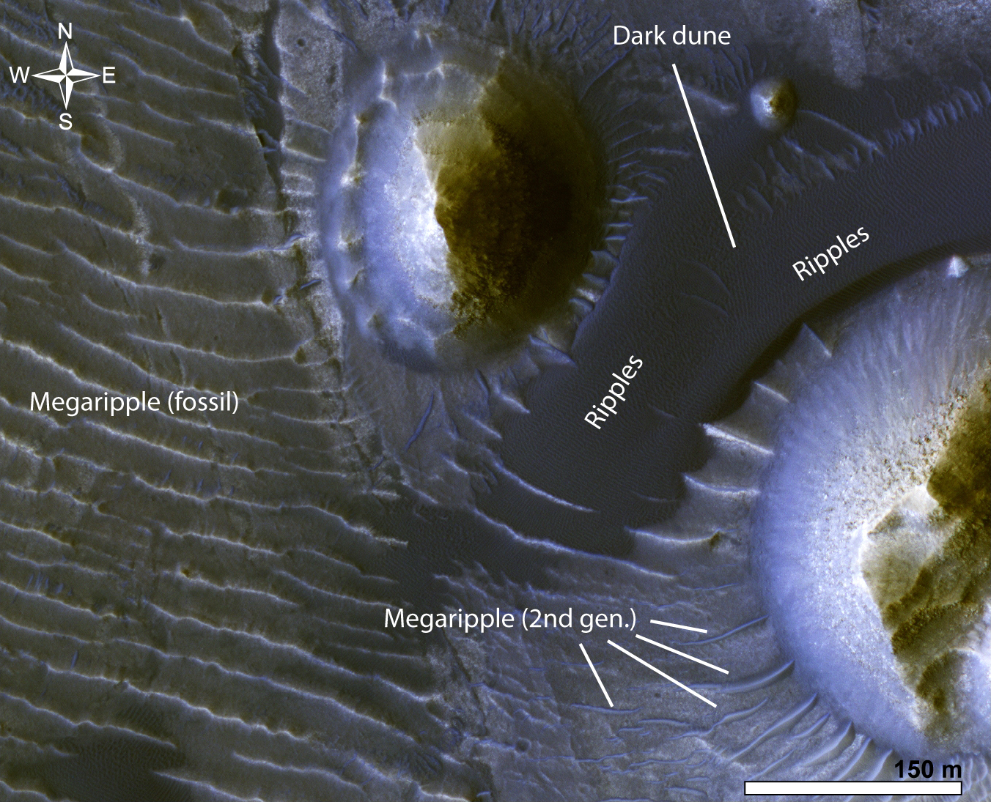
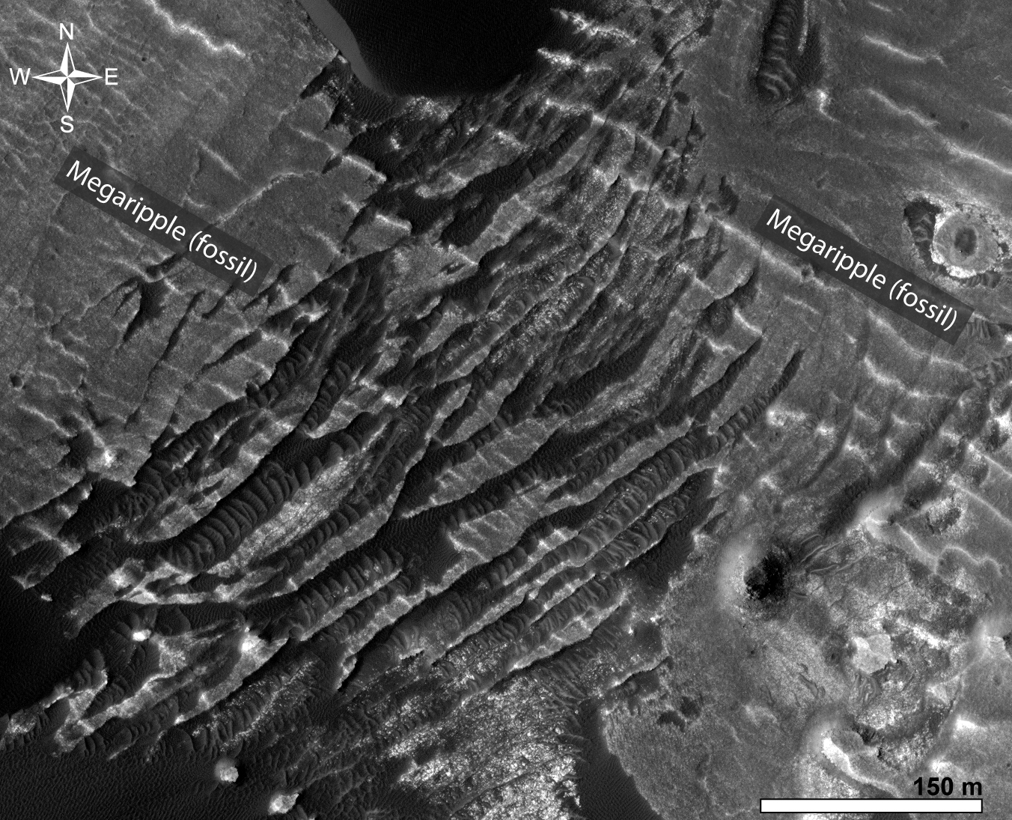
Fossil megaripples (orange) have higher thermal inertia than dunes/megaripple 2nd gen (blue)
Fossil megaripples (orange) spread over a narrower range of heights than dunes and megripple 2 gen (blue)
How do we know they are fossil megaripples?
Wavelength (22 m on average - ripples are larger on Mars) and sinuosity (like megaripples on Earth they are sinuous suggesting grain size bimodality - transverse megaripples are not stable^{3,4}).
They are fractured (cementation).
Fossil megaripple unit shows higher thermal inertia (TI) than dunes and younger megaripples above.
Finally, fossil megaripples are carved on the bright-toned ILD (source) in a narrower range of elevations compared to dunes and younger megaripples that, as expected for younger aeolian material, mantle a wider range of geologic units and heights.

Slide 4
Conclusions:
Sera crater presents distinct aeolian units (top to bottom)
Active dark ripples over dune slopes give information about the seasonal/local (dune scale) winds. Important to understand present-day wind conditions at the surface!
Active dark dunes (barchans) shaped by airflows coming from the NE give wind information at broader spatial (dune field – crater - region) and temporal (10 – 100 years) scales. Variation in fluxes for individual dunes are related to the local topography. Important to understand present-day wind conditions at the surface and precious for testing atm. models!
Megaripple 2nd gen., together with dunes they mantle several aeolian units. Active on present day Mars? If so, at higher temporal scales than dunes (no detection visible on a 10 yrs image baseline).
Fossil megaripples, probably really ancient (cemented by a rise in the water table?) same orientation as dunes = wind regime did not change in the geological time. Carved into the bright-toned ILD that outcrop in mesas showing strata of different resistance to erosion. ILD erosion likely provided the bimodal sand that originated the megaripples.

Slide 5
References:
Montgomery, D. R., J. L. Bandfield, and S. K. Becker (2012), Periodic bedrock ridges on Mars, J. Geophys. Res., 117, E03005, doi:10.1029/2011JE003970.
Hugenholtz, C. H., T. E. Barchyn and E. A. Favaro (2015), Formation of periodic bedrock ridges on Earth, Aeolian Research, 18, 135-144, 10.1016/j.aeolia.2015.07.002.
Yizhaq, H., I. Katra, J. F. Kok and O. Isenberg (2012), Transverse instability of megaripples, Geology, 40, 5, 459-462, doi:10.1130/G32995.1
Yizhaq, H., G. Bel, S. Silvestro, T. Elperin, J. F. Kok, M. Cardinale, A. Provenzale and I. Katra (2019), The origin of the transverse instability of aeolian megaripples, Earth and Planetary Science Letters, 512, 59-70, DOI: 10.1016/j.epsl.2019.01.025.

