Slide 1
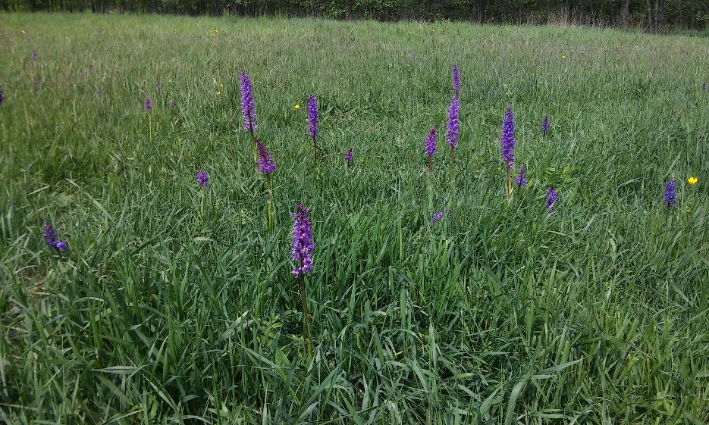
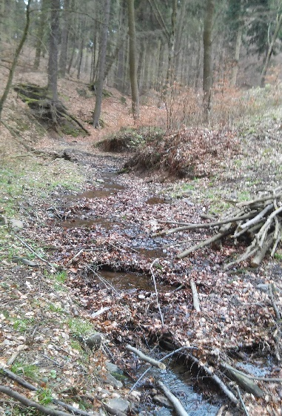
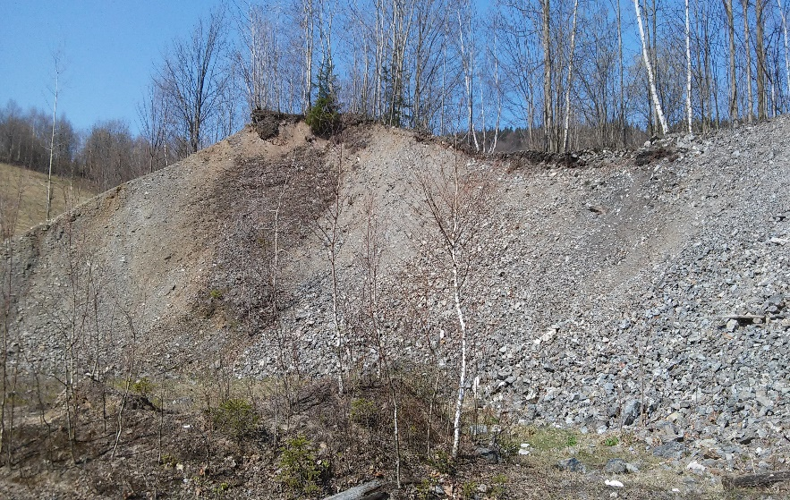
The effects of waterlogging on the solubility of arsenic and ecotoxicity of soil pore water in non-fertilized and fertilized soils in historical mining sites
Szopka K., Karczewska A., Dradrach A., Gałka B.

Slide 2
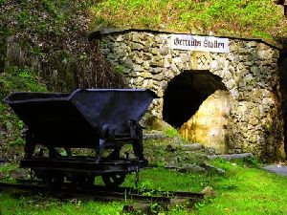
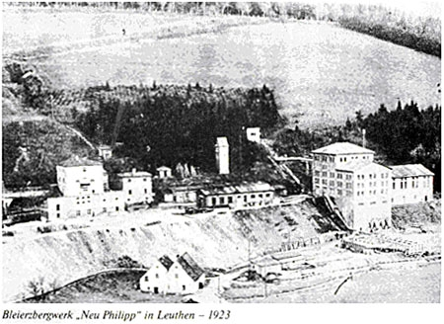
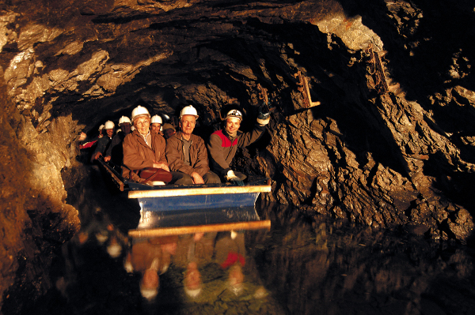
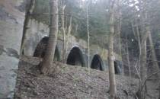
High concentrations of As in soils occur in the areas of contemporary or historical mining and processing of arsenic ores in the Sudetes

Slide 3
Soil material were collected from the tailings-affected floodplain of the Tująca river in Złoty Stok, a historical As mining centre (from lowland hay meadow, dry grassland and Błotnica grassland).

Slide 4
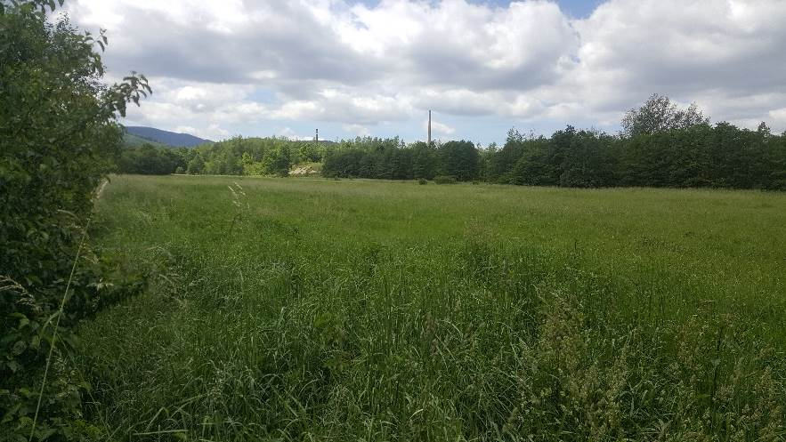
Soil contamination with arsenic in historical mining sites is a matter of considerable environmental concern, as the concentrations of As in those soils are locally as high as thousands mg/kg.
Some of soils, particularly those affected in the past by tailings that were released from impoundments, are located in floodplains and used as grasslands.
Those lands are periodically flooded, and the frequency and duration of flooding will probably increase in the future with changing climatic conditions.

Slide 5
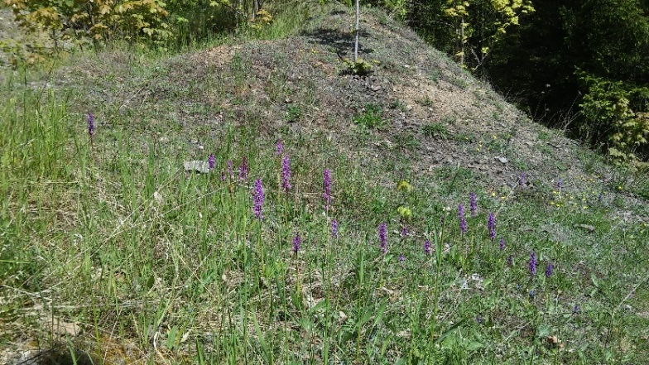
The aim of this study
To examine the pore water collected from As-rich soils in terms of As concentrations and ecototoxicity determined in a standard Microtox ® and Phytotoxkit® assay
To examine the effects of soil treatment with organic matter (manure) and mineral fertilization on As solubility and ecototoxicity.

Slide 6
Materials and methods
Untreated (0) soil samples as well as those treated with manure (M) and mineral fertilization (F) were incubated for 90 days at various moisture (70% and 100% of maximum water capacity).
Pore water was collected 5 times, using the MacroRhizon suction samplers.

Slide 7
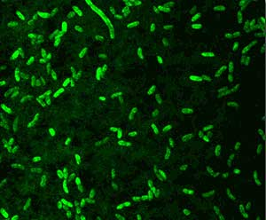
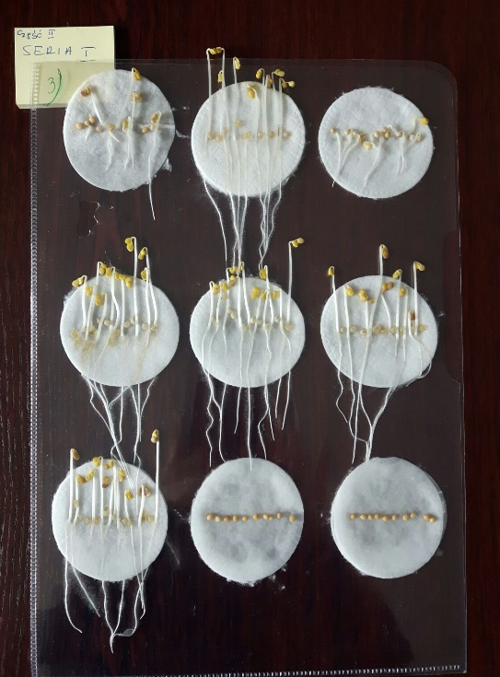
Materials and methods
Microtox® - acute toxicity test is based on the inhibition of bioluminescence of the marine bacterium Vibrio fischeri, reclassified as Allivibrio fischeri, when exposed to a toxic chemical
Phytotoxkit® assay - a test of chronic toxicity to plants based on inhibition of seeds germination and elongation of roots and shoot (seeds of Sinapis alba).

Slide 8
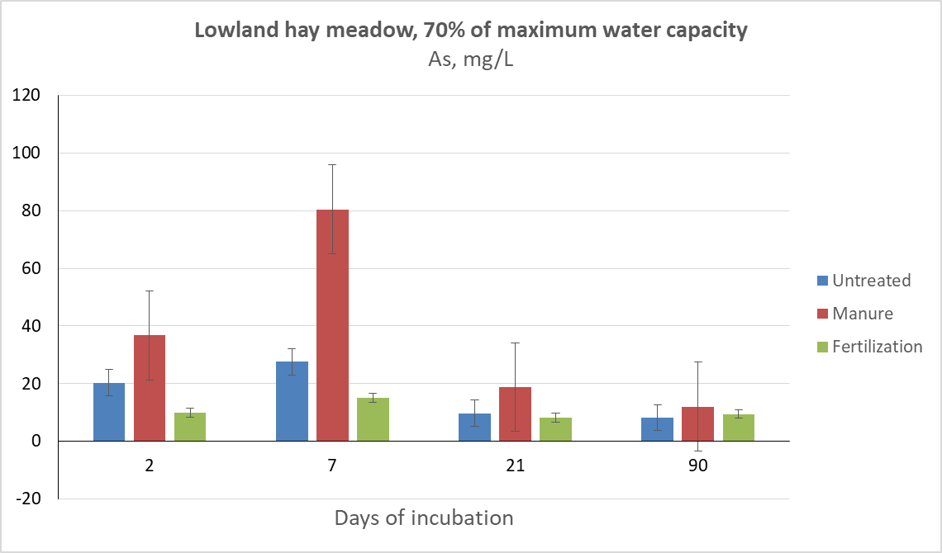
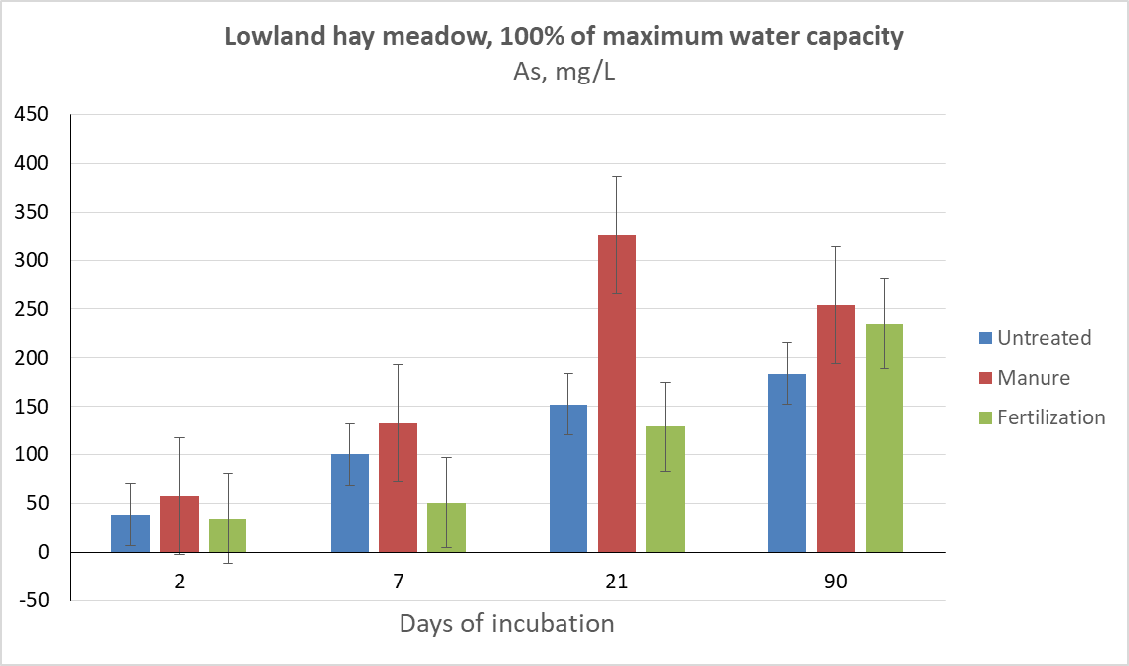
Results (1)
Organic materials cause an increase in As solubility (This effect decreases during prolonged incubation).
The processes associated with soil treatment manure (M), particularly at 100% moisture, caused an intensive release of As into soil pore water
Drinking water: 0,01 mg/L
Solubility of As
The soil from lowland hay meadow

Slide 9
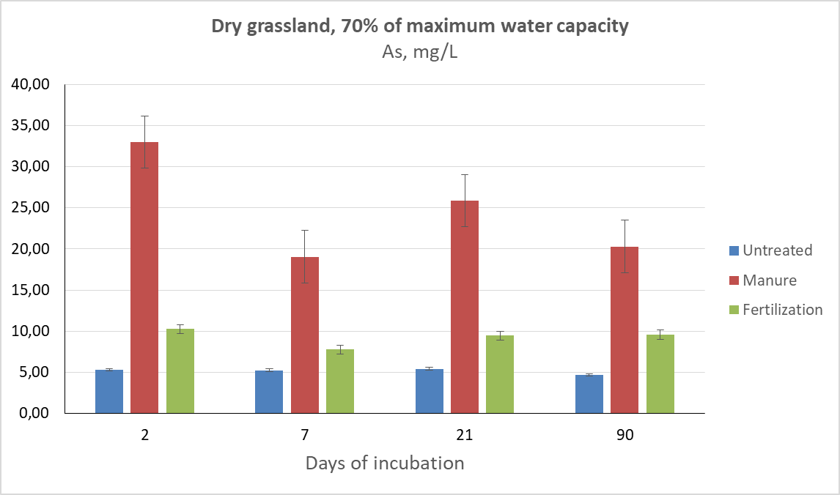
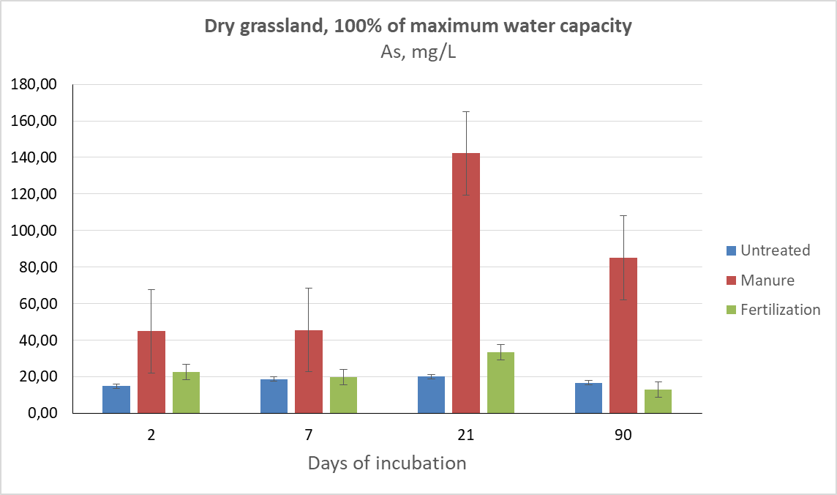
Results (2)
Soil flooding resulted in a rapid release of As from soil solid phase. As concentrations in soil pore water in all samples exceeded 10 mg/L
Solubility of As
The soil from dry grassland

Slide 10
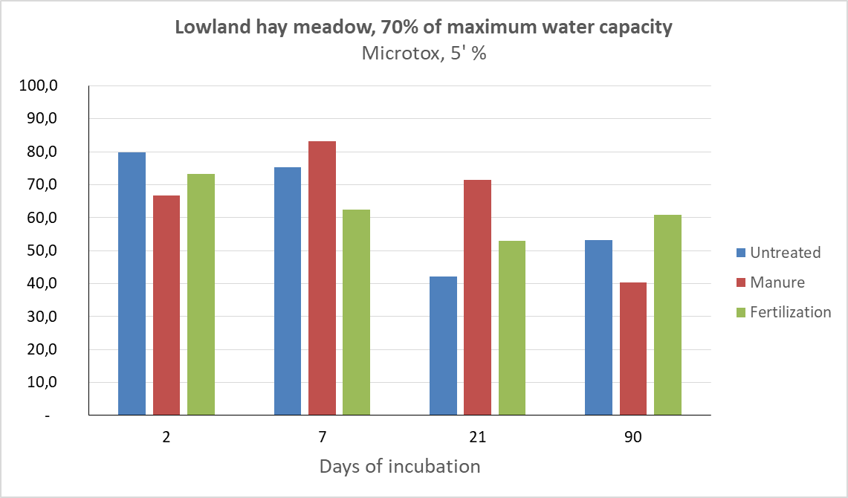
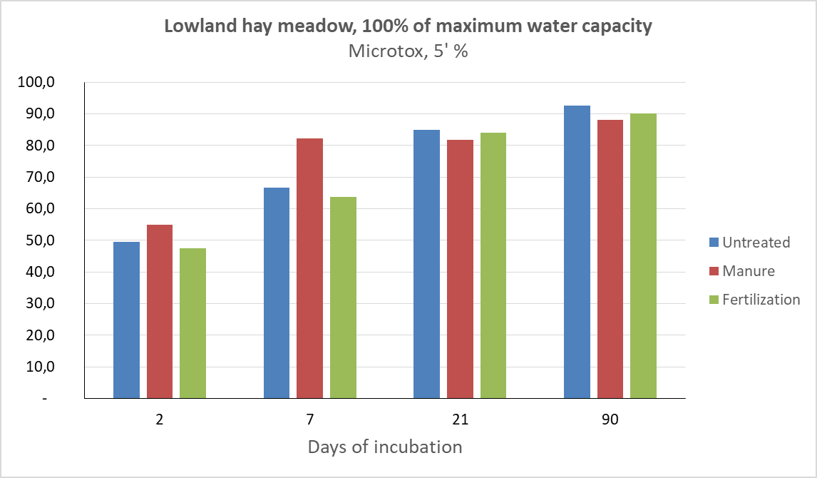
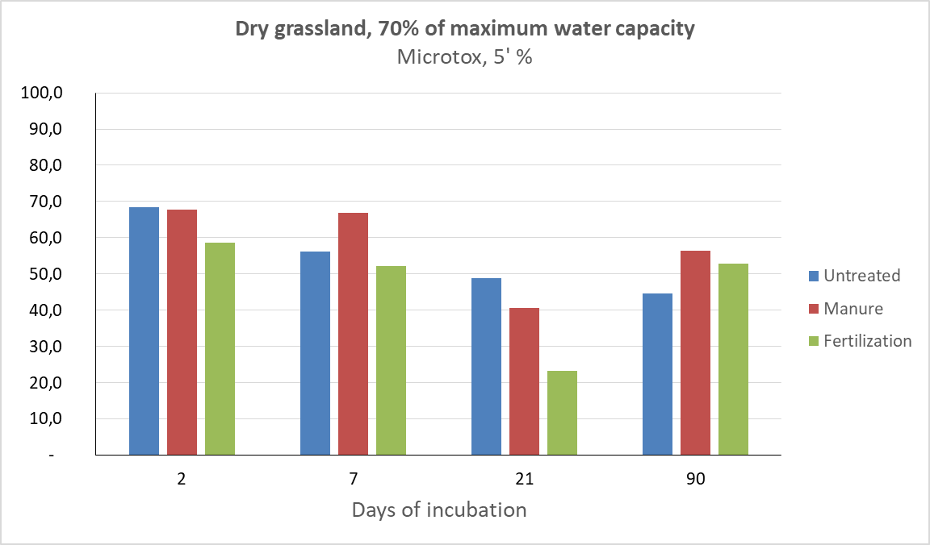
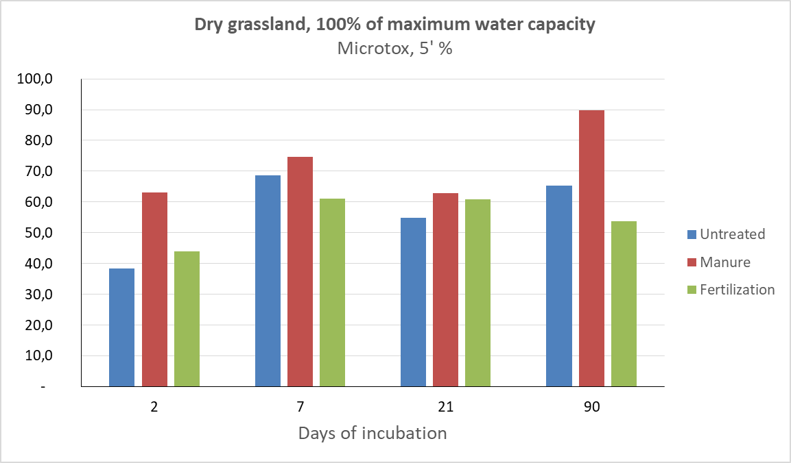
Results (3) As concentrations in pore water effects resulted in a very high ecotoxicity of pore water, caused lethal effects to bacteria

Slide 11
Conclusions
Soil flooding resulted in a rapid release of As from soil solid phase.
Soil amendment with manure was a factor that significantly enhanced ecotoxicity effects
The results provided by Phytotox, despite the relatively poor precision, were highly correlated with the concentrations of As in soil pore water. In the Microtox bioassay, similar relationships were also recorded
The presence of manure can be a factor that increases the toxicity of pore water to Allivibrio fischeri in soils rich in As.

Slide 12
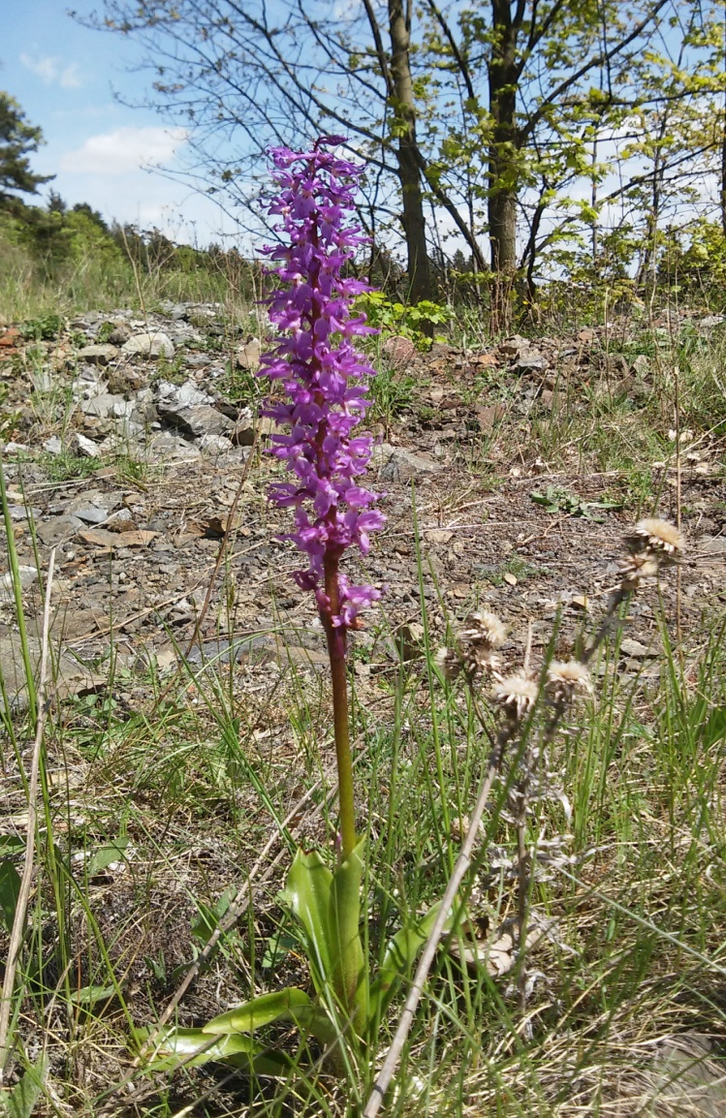
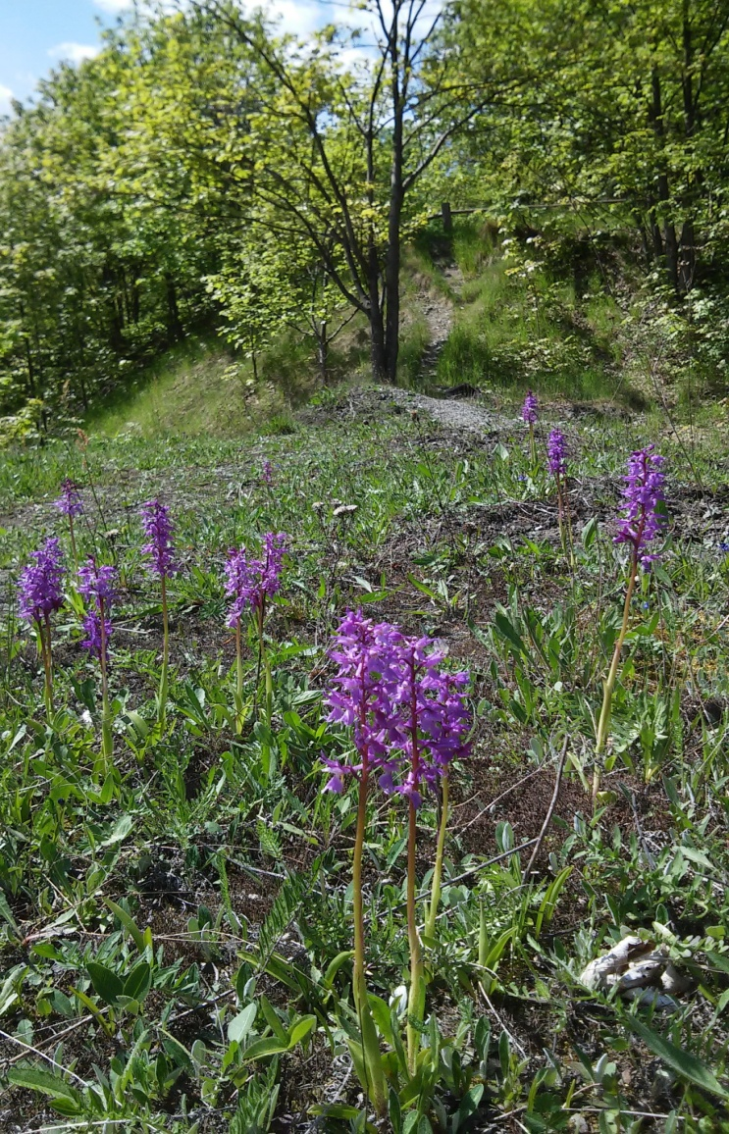
This research was funded by National Science Centre of Poland; Projects No. 2016/21/B/ST10/02221
Dziękuję ! Thank you!

