Slide 1

Drought-induced rapid subsidence in the Central Valley and its impact on the California Aqueduct
D1719 | EGU2020-10733
Megan M. Miller & Cathleen Jones
May 7th, 2020
Notes:
Good morning from California! I am Megan Miller, working with Cathleen Jones at JPL.
I am presenting our work studying rapid subsidence along the California Aqueduct during a recent drought period in the Central Valley

Slide 2
Central Valley
Semi-arid
Drought prone
Agriculture
Surface water transport
Heterogeneous aquifer system
Central Valley
Watereducation.org
Notes:
The climate of the Central Valley is semi-arid and prone to drought. It is hot and dry during the summer and cool and damp in winter.
Agriculture is very productive in the valley.
But surface water availability is variable, so it is dependent on surface water transport and irrigation and groundwater.
The aqueduct transports water southeast through the valley - more than 700 km total.
Water flows by a series of RISES via pumping stations, then steady declines along gently graded segments until reaching the next pumping station.
It’s typically lined with concrete and ranges from ~12-34 m wide at the base and 9-10 m deep.
In times of drought in the valley, surface water availability drops and groundwater usage increases.

Slide 3
Subsidence and the California Aqueduct
Reduced flow rates
Reduced flow capacity
Reduced storage
Reduced erosion protection
Delivery reliability concerns
Increased risk of breach
Increased maintenance costs
DWR image
Notes:
When subjected to subsidence, the aqueduct can experience
Slower flow rates
Lower flow capacity
Lower storage
More susceptibility to erosion
Supply reliability concerns
Potential for breaches,
and all the repairs needed in rectify these problem are very expensive.

Slide 4

UAVSAR
Frequency | L-band
Wavelength | 23.8 cm
Operating altitude | 12.5 km
Swath width | 22 km
Range resolution | 1.7 m
Azimuth resolution | 0.6 m
Look angle | 22-66°
Notes:
To detect and monitor subsidence, JPL’s UAVSAR (Uninhabited Aerial Vehicle Synthetic Aperture Radar) is deployed.
It acquires repeat pass, radar imagery with an L-band instrument
Operating at twelve and a half km altitude, with a ~22km wide swath.
The acquisition image resolution is 1.7m x 60 cm and look angles are from 22-66 degrees. This is an example of an Central valley acquisition.

Slide 5

InSAR
Pass 1
Pass 2
Notes:
To very concisely describe radar interferometry – insar -
From multiple passes along the same flight path, the differential phase of the reflected radiation relates to, among other effects, to changes in line of sight (LOS) distances to the ground.
A change in LOS distance can contain a displacement component due to land subsidence.
Processing steps and particulars are detailed in our publication presently in review.
There are multiple processing considerations, such as removing topography, orbital effects, unwrapping the phases, and reducing noise.

Slide 6
UAVSAR Dataset
Images | 31
Interferograms | 106
Median repeat interval | 55 days
Range resolution | 5.1 m
SLC azimuth resolution Analyzed with Giant | 7.2 m
Notes:
Wrapped interreference fringes, like this Central Valley example, are expressed in radians and can be noisy.
We do multilooking (3x12) to reduce speckle noise, which decreases spatial resolution to ~5m by ~7m.
We also ‘unwrap’ the phase by n*2pi to derive height values and project from LOS to the vertical direction using the look angles.
31 images forming 106 interferograms are then used to generate a time series of displacement – with a median temporal frequency of 55 days.

Slide 7
May 29, 2013 to November 27, 2018
Notes:
Here is the final timestep in the time series of our study.
To orient us, in the California inset, the aqueduct is the blue line. The UAVSAR path is the rainbow map in the largest image ‘A’.
Of particular interest in ‘B’ is what we call the ‘Avenal feature’ which has the most cumulative subsidence in the scene.
Maximum subsidence is measured about 70 meters from the aqueduct and totals 103.75 cm from May 29, 2013 to November 27, 2018.
The displacement is relative to the reference location – a black square – and an extensometer is also in our study area – the magenta circle.

Slide 8
Notes:
Here we look closely at the location of maximum subsidence and compare it to the local drought conditions.
Drought conditions for our study area are estimated by the US Drought Monitor by quantifying the percentage of the area in a particular drought classification.
The scale ranges from None to abnormally dry to Exceptional
The USDM classification is determined by synthesizing precipitation, fire conditions, soil moisture, vegetation health, surface water, and snowpack.
As the drought worsens, notice how subsidence speeds up after the first few timesteps, then it continues though the exceptional drought period until early 2017 when drought conditions alleviate.

Slide 9
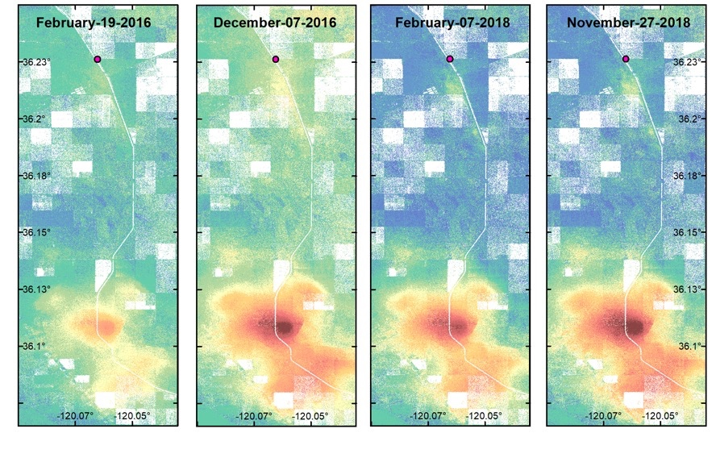
430 m
1.9 km
4.2 km
6.8 km
7.3 km
11.2 km
10.3 km
10.5 km
Distance along the California Aqueduct showing subsidence greater than 10 cm
Notes:
Looking at selected scenes from the time series:
May 2013 to April 2014, measures very little subsidence is measured (< 10cm).
Along the aqueduct, subsidence greater than 10 cm emerges by June 2014 ~400m
Then is increases steadily over time with greatest subsidence adjacent to the aqueduct on the east side. The Avenal feature bowl progresses…growing in size and depth and nearby connecting lobes
The approximate distance along the aqueduct experiencing greater than 10 cm of subsidence is shown under each scene.
This all continues Until February 2018, when it shrinks briefly, then resumes growth again by the final step.

Slide 10
Notes:
The Avenal feature modeled as a continuous surface is here for selected timesteps.
These circular markers represent newly installed pumping wells according to state records.
The reports contain well information collected by drillers, including location, dates of construction, planned use, well depth, borehole logs, and well yield.
However, there are known database issues include missing and duplicate records, missing values, incorrect values, and limited spatial resolution.
Although the records may be incomplete or inexact, the coincident available data can provide subsurface characteristics and details of newly installed sites.
By the conclusion of the time series on November 27, 2018, the surface area of the subsidence feature exhibits lower magnitude subsidence (10 cm or more) was 4452 hectares. To aid in visualization, consider that the maximum international rugby union field size including the in-goal area is just over 1(.008) hectares

Slide 11
Pumping well installations
Notes:
What the records do show:
Here is what we have. The small markers are unknown capacity wells. The larger sizes refer to wells with capacity data available from 8k to 16 k m3/day.
Wells without a completion date are white. Wells containing that information are colored according to the colorbar on the right.
The wells on the right coinciding with our study. The wells with complete enough data for our purpose are labeled.
However…

Slide 12
Pumping well installations
Notes:
Several lobes seem to have phantom withdrawal sites, highlighting one aspect of the extent of the incomplete well records issue. However…

Slide 13
Monitoring via some pumping wells
Notes:
We do have some water level monitoring going on. In lieu of dedicated monitoring wells,
The California Statewide Groundwater Elevation Monitoring program was developed by DWR. In this program, levels from pumping wells at a static level are used.
The Westlands Water District collect a minimum of biannual measurements for in June and December, but did not begin readings until 2015. This captures the sever drought period in our study from 2013 to 2016 (lavender background).
Notice subsidence bowl center is…

Slide 14
Monitoring via some pumping wells
Notes:
…and several lobes are not represented with well level measurement locations.
At this high deformation detection resolution, the spatial and temporal sparsity of water level data precludes detailed modelling for features like this.
In our upcoming paper, we take advantage of the fractured data we have to estimate what we can.

Slide 15
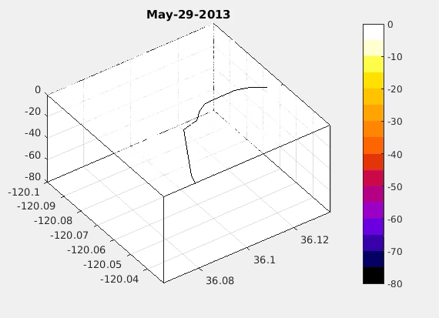
What’s next?
N
Rapid subsidence in drought
  Over a meter in 5.5 years
Significant impact to aqueduct
  10.5 km subsided 10 cm or more
Inadequate reporting and monitoring of groundwater data
Publication in review Remote Sensing of Environment
  Inelastic and elastic storativity
  Models to improve groundwater monitoring.

Slide 16
Surface area (hectares)
Hectares
Hectares / year
Notes:
The progression of the Avenal feature over time series is important to quantify for hazard assessment and groundwater storage loss volume estimation. So we model each step of the vertical displacement time series as a continuous surface by interpolating via inverse-distance and median filtering in two dimensions to reduce noise (results in some spatial smoothing). The results are on the left.
In 5 cm subsidence incremental intervals, total hectares deformed (on the right) increases in mid-2014, then dramatically increases starting in 2016. These patterns pop out when looking at the number of hectares deformed by incremental intervals over time. This display also highlights the decreasing rate starting in later 2016.

Slide 17
Aqueduct focus
Best methods for evaluating subsidence along the aqueduct?
Agreement between methods?
  Leveling surveys
  Extensometers
  Sentinel

Slide 18
Leveling Survey

Slide 19
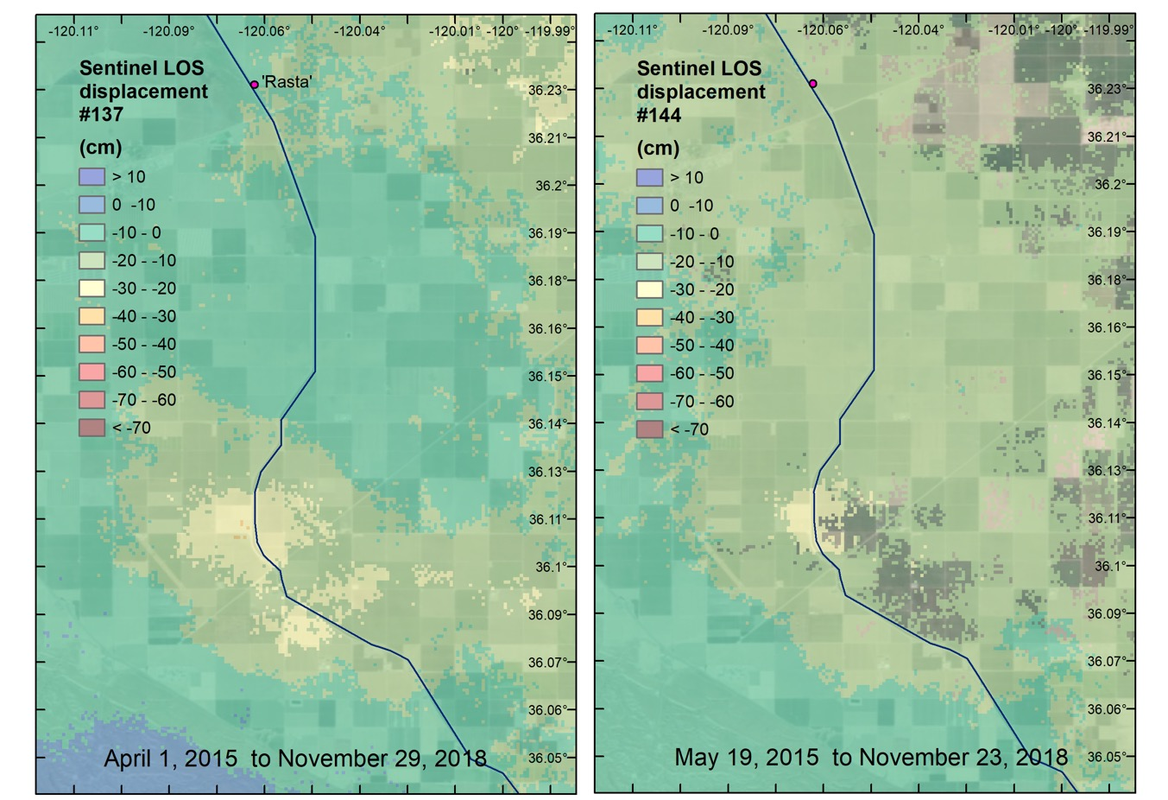
Sentinel

Slide 20
Extensometer

Slide 21

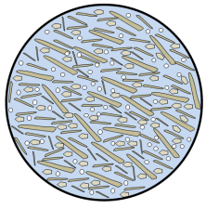
Aquifer system materials & mechanical properties
aquifer
Composition, arrangement, and structure governs poroelastic response
Storativity
    Elastic storage coefficient
    Inelastic storage coefficient
Modeling and resource management
Coarse-grained
sands
gravels
aquitard
Fine-grained
clays
silts
Notes:
This aquifer system contains heterogeneous aquifer and aquitard materials, and some areas contain an impermeable layer, relatively continuous called the Corcoran clay.
Up close, aquitards are fine-grained, while aquifers are coarse grained.
What’s down there and how it is arranged determines the system response to pumping, recharging, storing, and flowing underground and is expressed with mechanical properties.
To manage the resources, the mechanical properties must be determined.
For example, storativity. Elastic storage coefficient tells us what can be pumped without causing permanent compaction. It’s in the elastic range, it will bounce back. An nelastic storage coefficient tells what is released while the system permanently deforms. Together these reveal storage capacity of system.

Slide 22
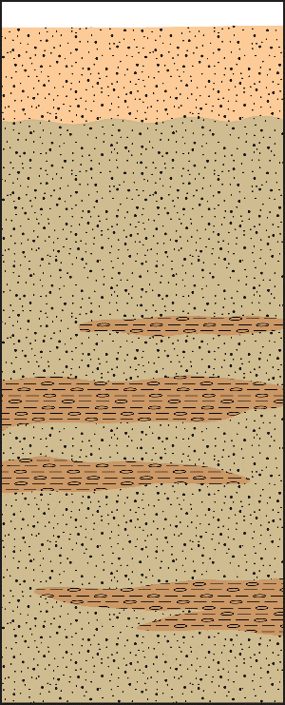
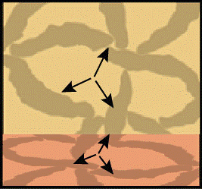

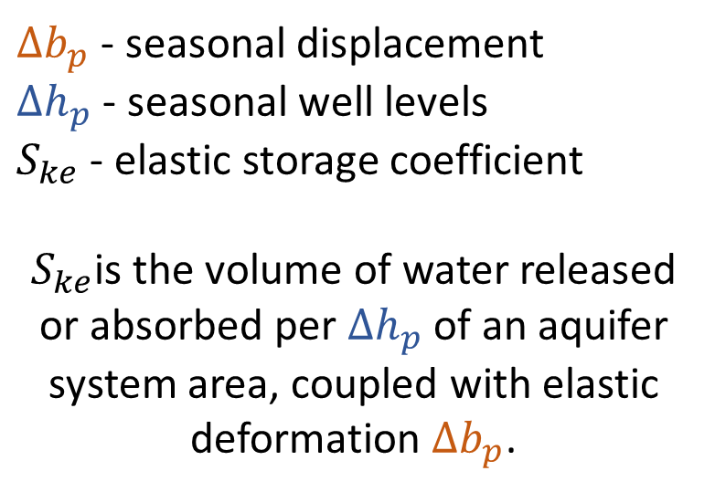
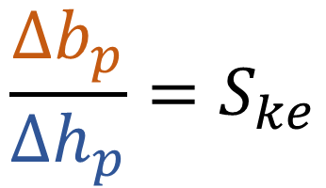


Elastic storage coefficient ($S_{ke}$)
$$∆b_{p}$$
$${\frac{∆b_{p}}{∆h_{p}}=S}_{ke}$$
$$∆h_{p}$$
$∆b_{p}$ - seasonal displacement
$∆h_{p}$ - seasonal well levels
$S_{ke}$ - elastic storage coefficient
$S_{ke}$is the volume of water released or absorbed per $∆h_{p}$of an aquifer system area, coupled with elastic deformation $∆b_{p}$.
Notes:
How do I find the elastic storage coefficient? Ske characterizes the volume of water expelled or absorbed per change in well level per unit area of aquifer.
One way is to measure the ratio of seasonal deformation of the land surface (delta B) to seasonal well fluctuations, (delta H), like in the rectangle.
The deformation of the land is due to changes in pore pressure at depth (like in the box) and takes place within the elastic range of deformation in both the sandy, coarse grained aquifer material (yellow) and the silty, fine grained aquitard material (orange).
The is what we can take out without causing permanent reduction in pore space and grain rearrangement.

Slide 23
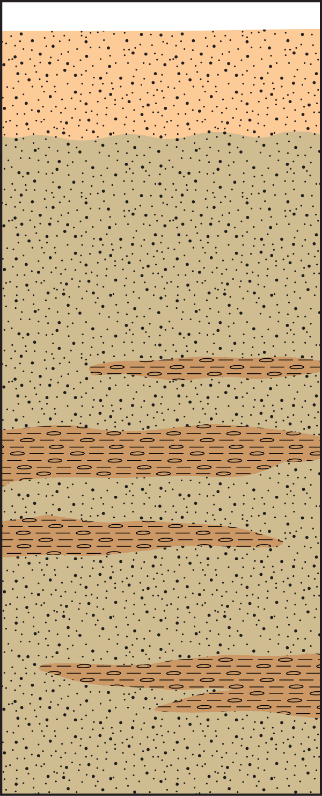
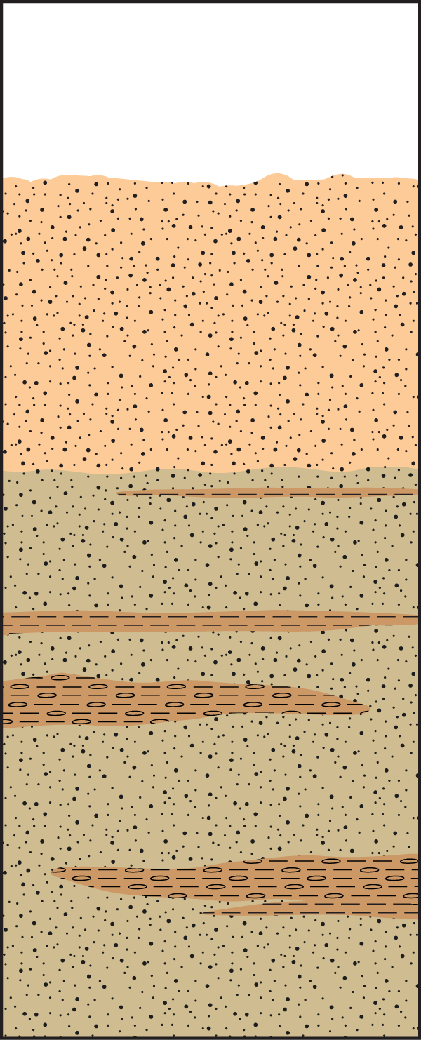




Inelastic deformation
$${∆b}_{l}$$
$${∆h}_{l}$$
$$Before$$
$$After$$
Notes:
On the other hand, inelastic, permanent land subsidence occurs when grains are rearranged of the fine grained material.

Slide 24
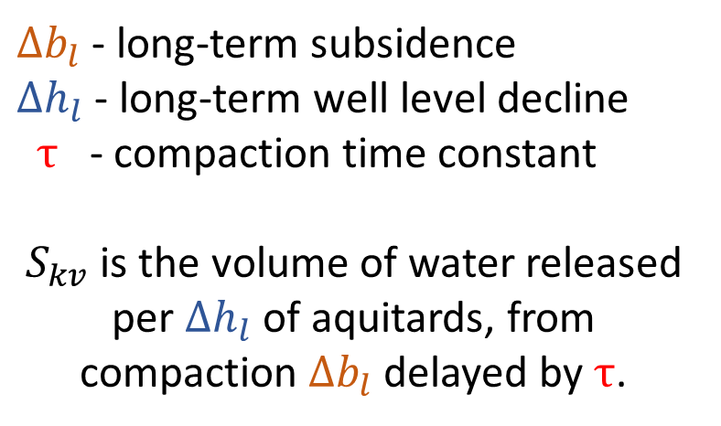

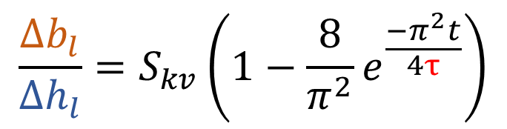

Inelastic storage coefficient $(S_{kv}$ )
$${∆b}_{l}$$
$${∆h}_{l}$$
$$\frac{{∆b}_{l}}{{∆h}_{l}}=S_{kv}\left(1−\frac{8}{π^{2}}e^{\frac{−π^{2}t}{4τ}}\right)$$
$∆b_{l}$ - long-term subsidence
$∆h_{l}$ - long-term well level decline
$τ$ - compaction time constant
$S_{kv}$ is the volume of water released per $∆h_{l}$of aquitards, from compaction $∆b_{l}$delayed by $τ$.
Notes:
The inelastic storage coefficient is the volume of water released per change in well level from compressed aquitards, with a time delay. The time between onset of pumping and the vertical long-term subsidence.
This time instead of seasonal data, we look at long term declining trends, so falling water levels and land surface.

