Slide 1
Integrated, operational water availability estimates for the conterminous United States: transdisciplinary data and modelling successes and challenges
Jessica M. Driscoll, William H. Farmer
USGS Integrated Modeling and Prediction Division
Water Resources Availability Program

Slide 2
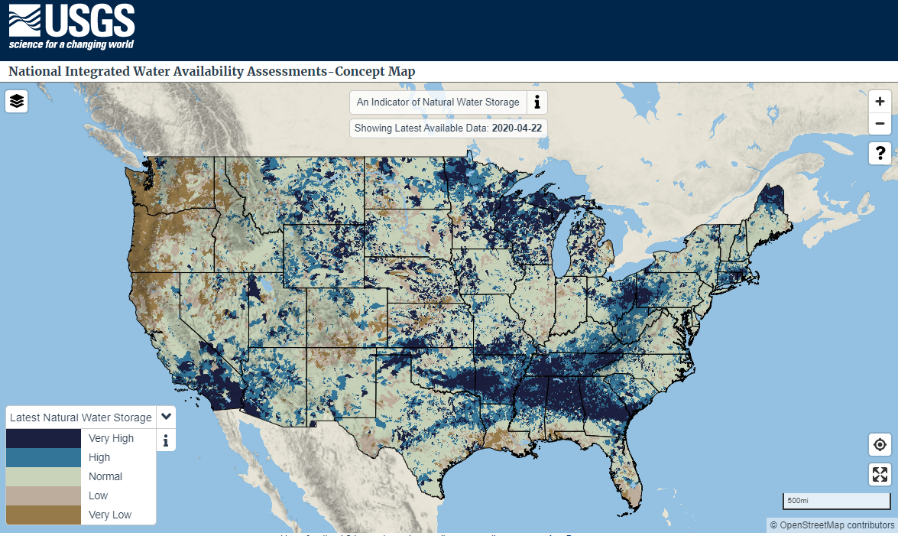
Goal: National Water Census
Map of spatially distributed quantitatively-derived water availability estimates for the Nation, automated and updated daily.
https://labs.waterdata.usgs.gov/estimated-availability/#/

Slide 3
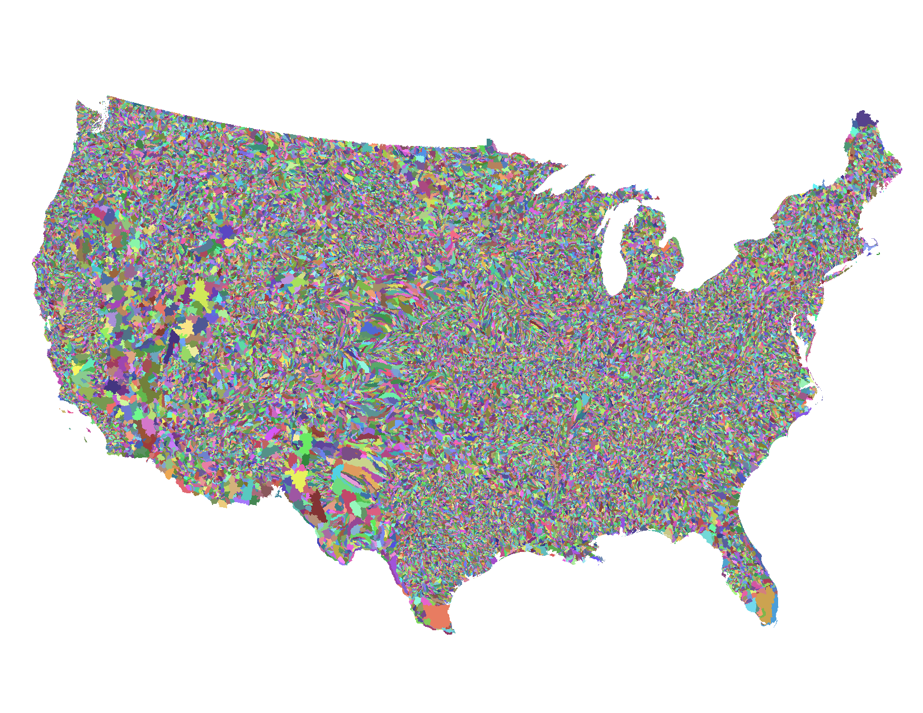
Tools: National Hydrologic Model (NHM) Infrastructure
Physical Model
Daily (Precipitation Runoff Modeling System)
Monthly (Thornthwaite Monthly Water Balance Model)
Geospatial Fabric
Spatial modeling unit delineation
Parameter values
Model Input Data
Precipitation
Stream network
Temperature
NHM
https://usgs.gov/nhm

Slide 4
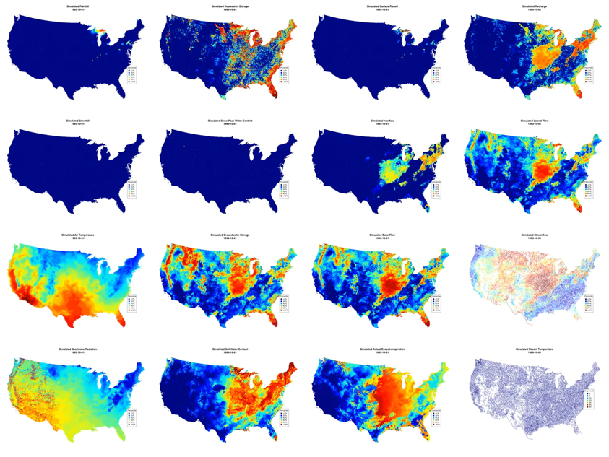
Rainfall
Depression Storage
Surface Runoff
Recharge
Snowfall
Snowpack Storage
Interflow
Lateral Flow
Air Temperature
Groundwater Storage
Base Flow
Streamflow
Solar Radiation
Soil Water Storage
Actual ET
Stream Temperature
https://usgs.gov/nhm

Slide 5
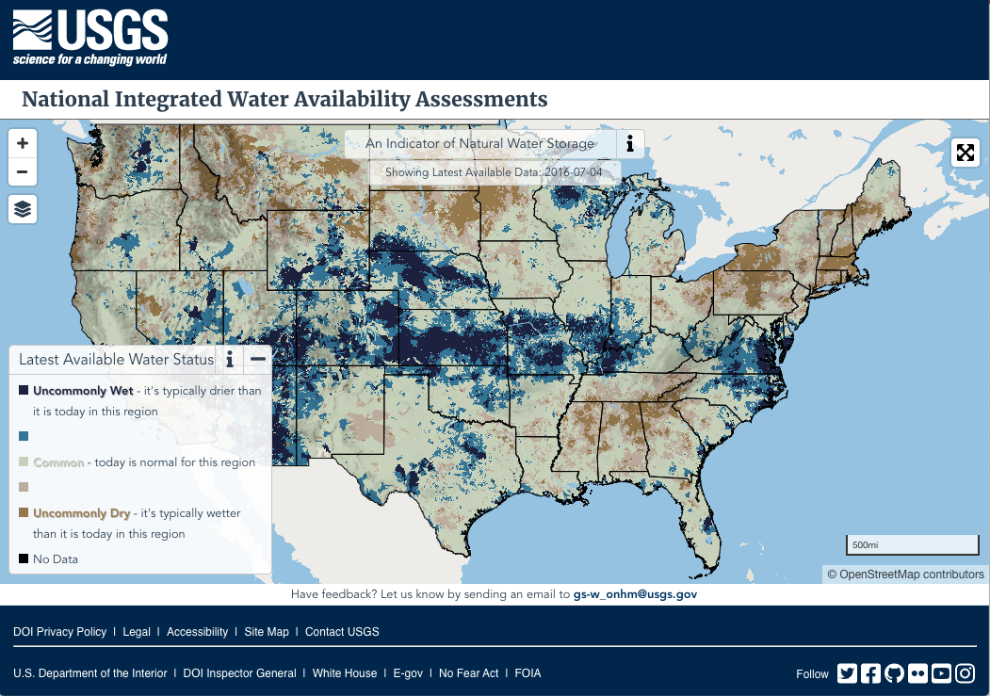
Tools: Operational Pipeline
Climate Forcing Data
Model Geospatial Fabric [HRUs]
Daily Fetching and Parsing Forcing Data
Calibrated Parameters
Daily Model Run
Docker containers
Automated runs with Jenkins
Cloud-hosted
Retrospective Model Run Daily Output
Quantiles
Daily Water Availability Color Bins & Visualization

Slide 6
Outreach & Communication

Slide 7
Challenges: Communication
Technical Audience
General Audience
Model configuration
Understandable terms (“natural water storage”
Calibration
Code version and access
Output certainty and access
Latency
Specific location history/details

