Slide 1
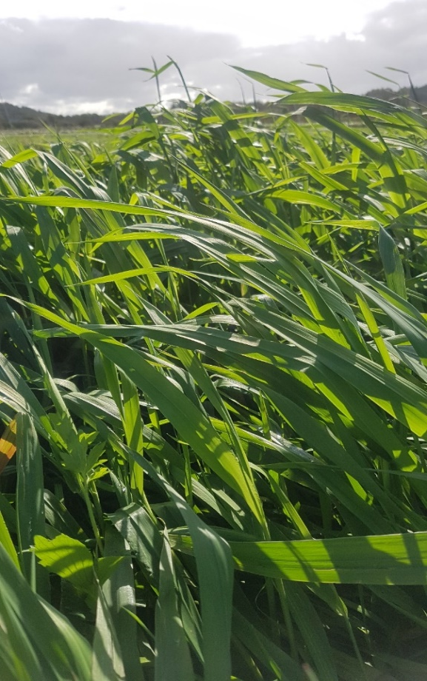




Protein Yield and extractability of flood-tolerant perennial grasses
C. Kalla (claudia@agro.au.dk)¹, L. Stødkilde², U. Jørgensen¹, P. E. Lærke¹
1) Aarhus University - Department of Agroecology, 2) Aarhus University - Department of Animal Science
1.2: Background
Paludiculture, and the production of biomass feedstock from flood-tolerant perennial grasses for green biorefining to protein and other value-added products may be a viable economic and environmentally sustainable mitigation strategy for agriculturally used peatlands.
1.3: Main Research Question
How does harvest frequency of fertilised reed canary grass affect annual biomass and protein yields as well as protein extractability ?

Slide 2
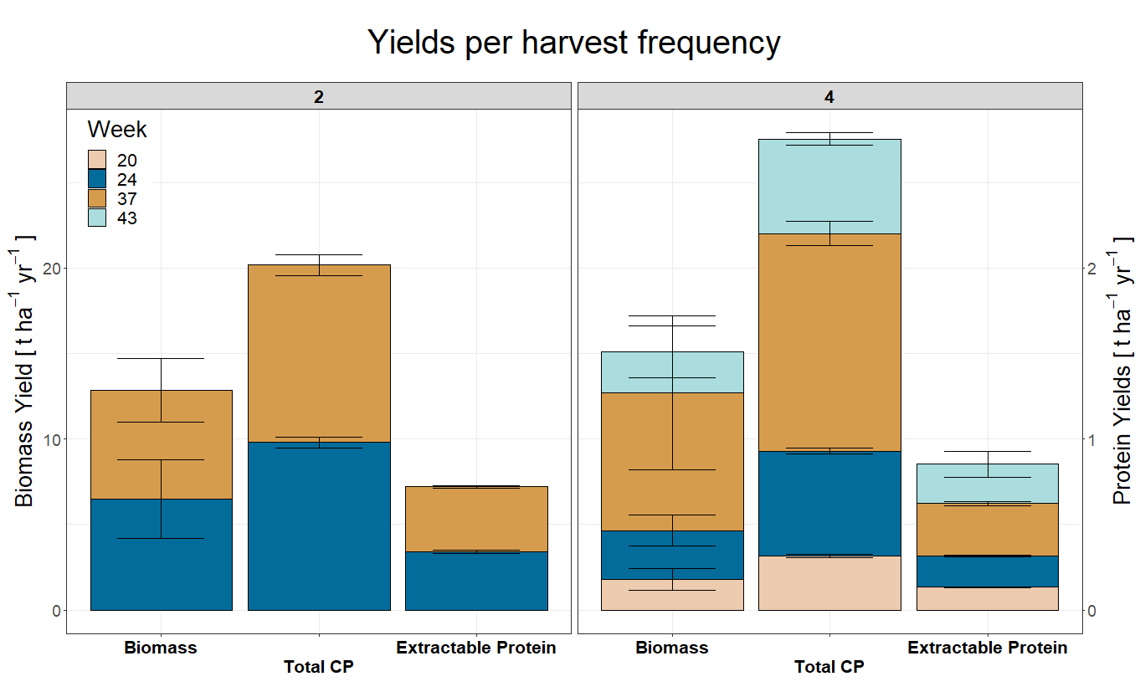
2.1: Methods
Reed canary grass (RCG) biomass was established on an agricultural fen peatland (DK) in plots, each divided into subplots with 2 or 4 cuts yr⁻¹, and a split-fertilizer application of 200 kg NK ha⁻¹).
Determination of biomass and crude protein (CP) yields in dry matter (DM).
Protein extractability of the biomass was assessed using a screw press, followed by precipitation of protein in the resulting juice (figs. 2 and 3).
2.2: Preliminary Main Results
Fig.1: Preliminary results shown for RCG treatments with two and four cuts per year. Annual yields are cumulative averages per cut. Harvest dates are indicated by calender weeks. Total CP and extractable protein yields are indicated by the right axis. All yields in dry matter.

Slide 3
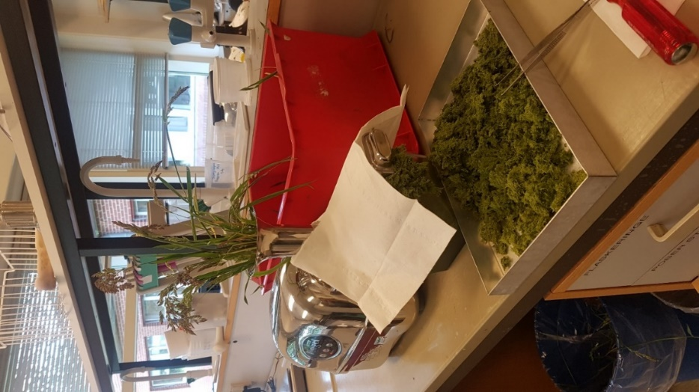
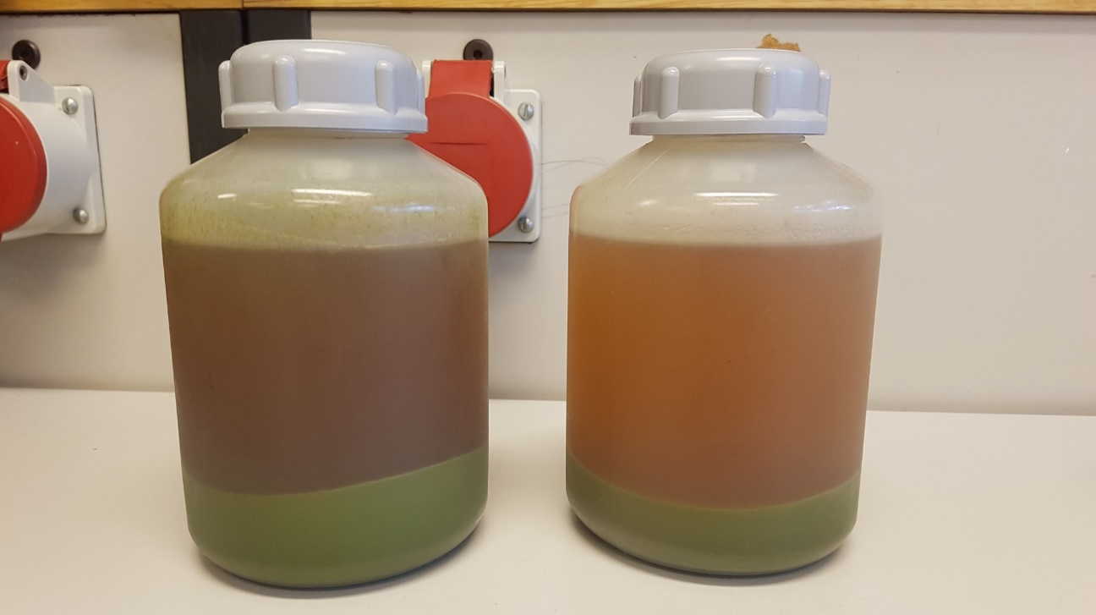
3.1: Preliminary Conclusions:
The four-cut management option yielded with 15.1 (± 1.5) t ha⁻¹ yr⁻¹ 18 % more biomass than the two-cut treatment with 12.8 (± 1.9) t ha⁻¹ yr⁻¹. Further, it provided total CP yield of 2.8 (± 0.4) t ha⁻¹ yr⁻¹ as compared to 2.0 (± 0.6) t ha⁻¹ yr⁻¹for the two-cut management.
Precipitated protein paste yield by lab-scale biorefinery ranged between 2.0 (± 0.3) t ha⁻¹ yr⁻¹ with a CP content of 0.72 (± 0.4) t ha⁻¹ yr⁻¹ (two cuts), respectively 2.4 (± 0.1) t ha⁻¹ yr⁻¹ with a CP content of 0.85 (± 0.8) t ha⁻¹ yr⁻¹ (four cuts).
Fig. 2: Lab-scale screw press for separation of grass into juice and pulp.
3.2: Feedback / Discussion:
Any input and questions welcome!
Fig. 3: Precipitated true protein (bottom) and brown juice (top) following centrifugation.

