Slide 1
Reconstructing the Early Eocene Sediment Routing System of the south-eastern Pyrenees
This process ultimately resulted in the partitioning of the foreland basin and the isolation of the Ripoll Basin from the Tremp-Graus and Ainsa-Jaca basins.
Our aim is to focus on the process of basin partitioning and discuss the response of sediment routing systems. To achieve this, paleogeographic maps are constructed from a revised chronostratigraphy and the integration of existing balanced cross-sections.
The Early Eocene was the period of most intense plate collision during the building of the Pyrenees. Loading of the overriding European plate caused flexure of the Iberian plate and formation of an elongated foredeep connected westward with the Atlantic Ocean. The uneven distribution of the Triassic evaporites caused the formation of a thrust salient in the central Pyrenees related to tectonic inversion of the pre-existing Mesozoic rift basins.
M Garcés, M López-Blanco, E Beamud,
J A Muñoz, P Arbués, L Valero*, A Vinyoles.
Geomodels Research Institute
Universitat de Barcelona
*now at Department of Earth Sciences, Univ Geneva

Slide 2
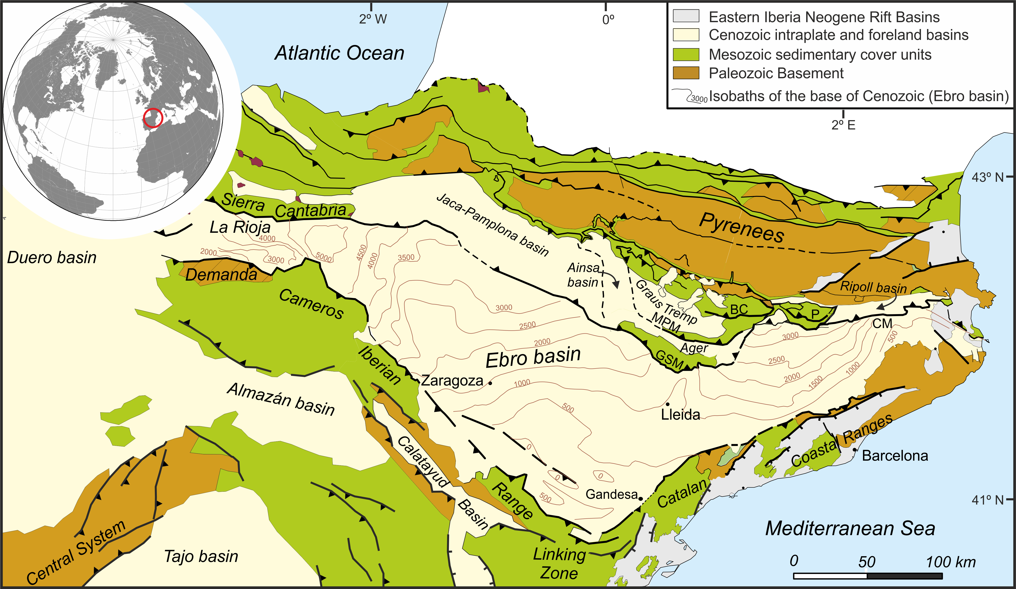
The setting
The northwards directed Iberia-Europe collision led to the formation of the South Pyrenean pro-foreland system. A set of imbricate thrust sheets developed in a piggy-back sequence from Late Cretaceous to Early Miocene. Restored cross-sections show minimum total shortening of 125km in the Eastern Pyrenees (Vergés, 1993) and 150km at the Central Pyrenees (Muñoz, 1992).
The transect reveals the complete Stratigraphy of the eastern South Pyrenean foreland. See a scheme in NEXT SLIDE
Map modified from Vergès et al. (2002)

Slide 3
Chronostratigraphy of the Ripoll and the Eastern Ebro basins
Ripoll basin
The sediment fill of the Ripoll basin consists of 5km of sediments organised in an overall regressive sequence. More details in NEXT SLIDE
The Coronas Fm. represents the first entry of siliciclastics sourced from the rising of the Eastern Pyrenees

Slide 4
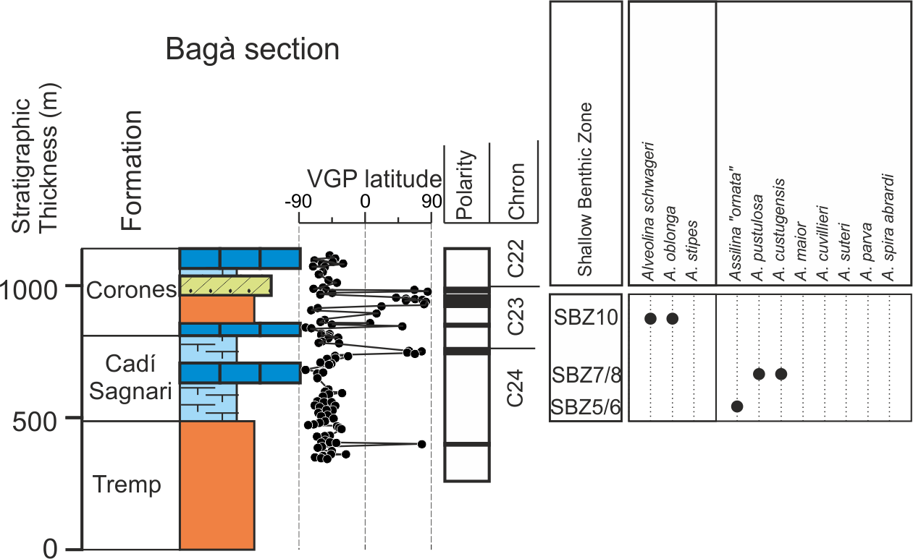
Revised chronostratigraphy of the Ripoll sequence
The pioneering work of Burbank et al., (1992) has been revisited, resampled in some intervals, such as the Bagà section (below). A correlation with the time scale is shown in the next slide.
lacustrine carbonates remagntized upon burial
Normal magnetozone not matching with biochronological constraints for SBZ13
Biostrat data from Tosquella, 1995 (PhD thesis)
Tosquella & Samsó, 1996

Slide 5
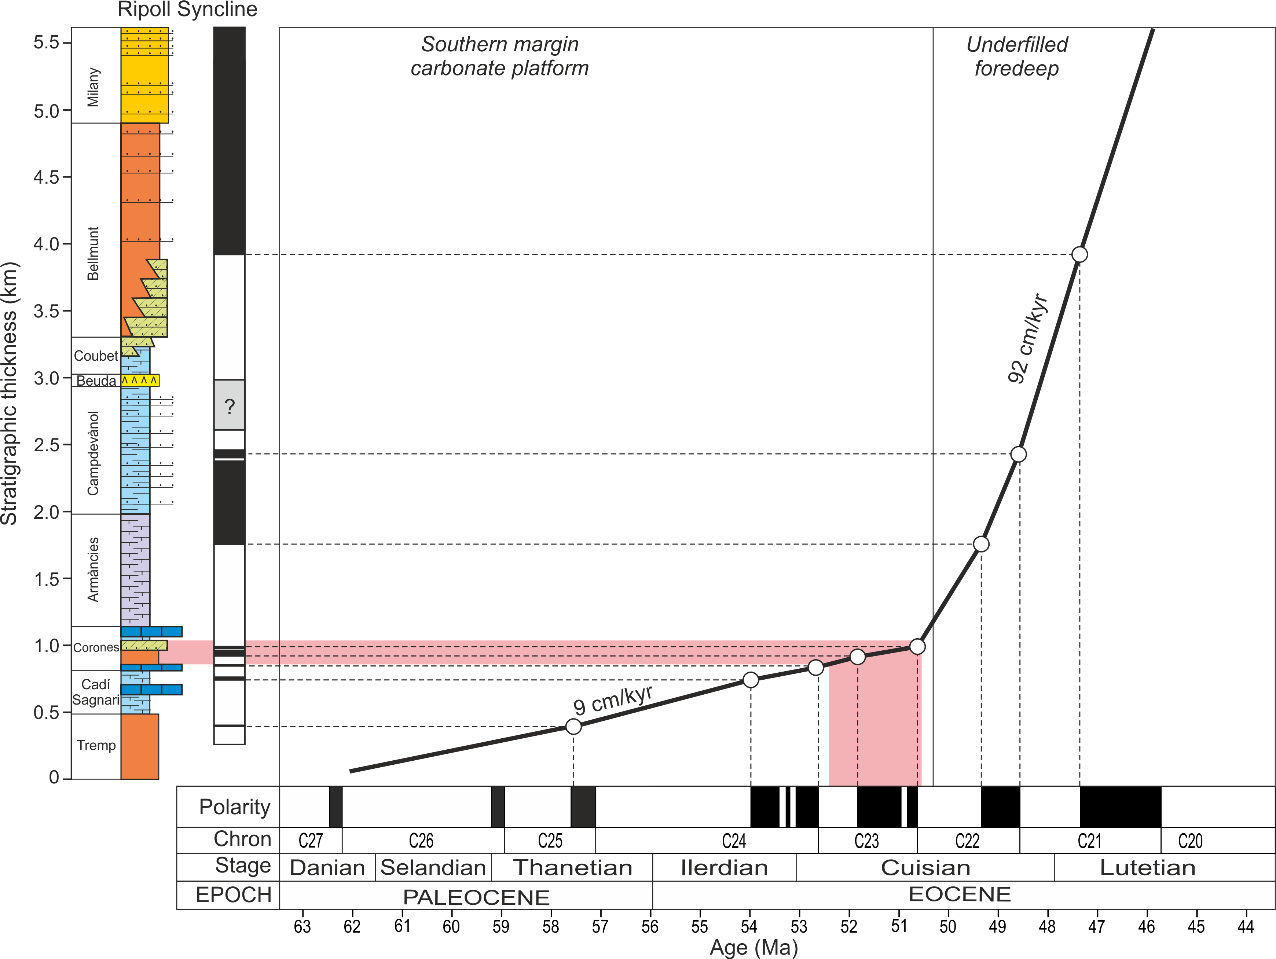
The rapid filling of the Ripoll basin
The Ripoll basin underwent rapid deepening at 50Ma, marked by the transition from coastal (Coronas Fm.) to deep marine environments (Armàncies Fm.). Very high sedimentation rates led to accommodation overfilling as early as Early Lutetian (46Ma).
The progradation of the siliciclastics of the Coronas Fm. occurred just before the rapid deepening of the Ripoll basin.

Slide 6
The Tremp-Graus, Ainsa and Jaca basins formed an ESE-WNW elongated trough that drained sediments of the central and western Pyrenees towards the abyssal plains of the Atlantic ocean in the Bay of Biscay. Since the Bartonian, the whole region was transported piggy-back on the Gavarnie-Sierras Exteriores thrust-sheet.
Thrust sheets:
BC: Boixols-Cotiella
P: Pedraforca
MPM: Montsec-P. Montañesa
GSM: Gavarnie-Serres Marginals
CM: Cadí-Montgrí
A chronostratigraphic scheme along this transect in NEXT SLIDE.

Slide 7
Chronostratigraphy of the Tremp-Jaca-Pamplona basin
Facies belts are organized in a transgressive-regressive sequence from Paleocene to late Eocene. The lower transgressive trend represents the southwards migration of the plate flexure, with shallow-water carbonate platforms (Guara, Boltaña, etc.) being replaced by deep marine (foredeep) environments (Hecho Group). This is then followed by a progressive filling of the foredeep and westwards progradation of the axially fed fluvio-deltaic system (Montañana, Montllobat, Capella, Escanilla, Campodarbe).
Similarly to the Ripoll basin, the sediment fill of the Jaca basin consists of >5.5km of sediments organised in an overall regressive sequence.
Soon after the deposition of the Coronas Fm in the Ripoll basin, a sharp progradation of the fluvial environments occurred in the Tremp-Graus basin (Castissent Fm.)
Garcés et al. (2020)

Slide 8
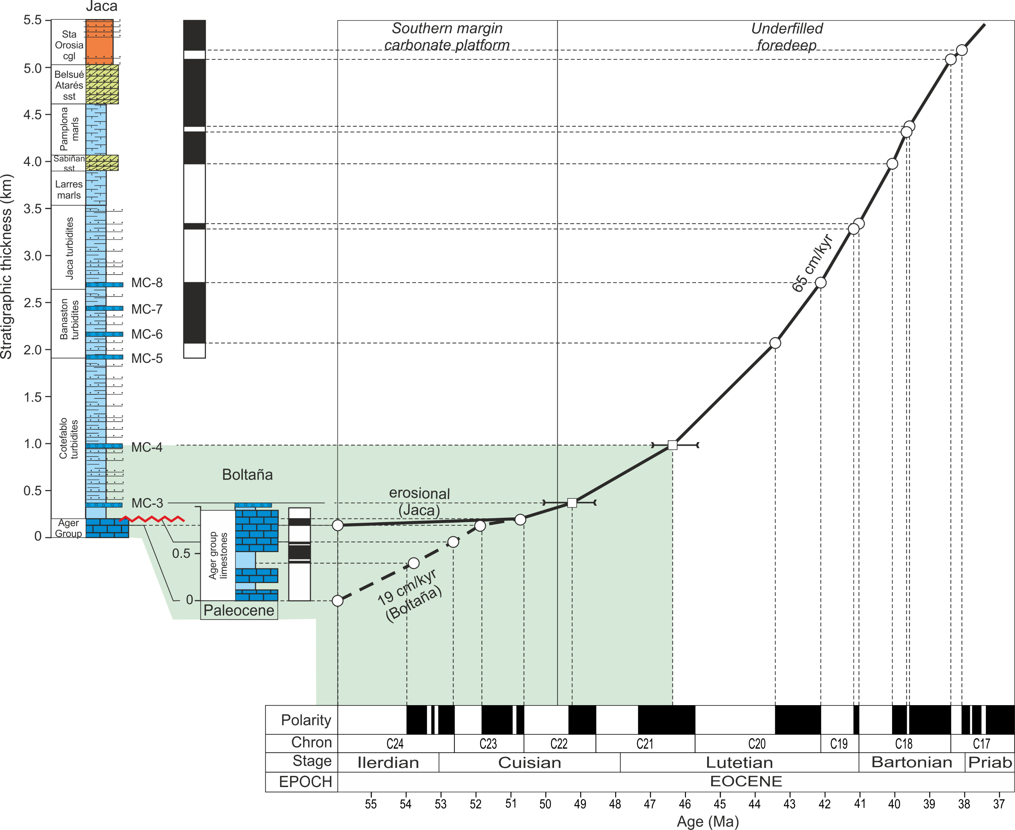
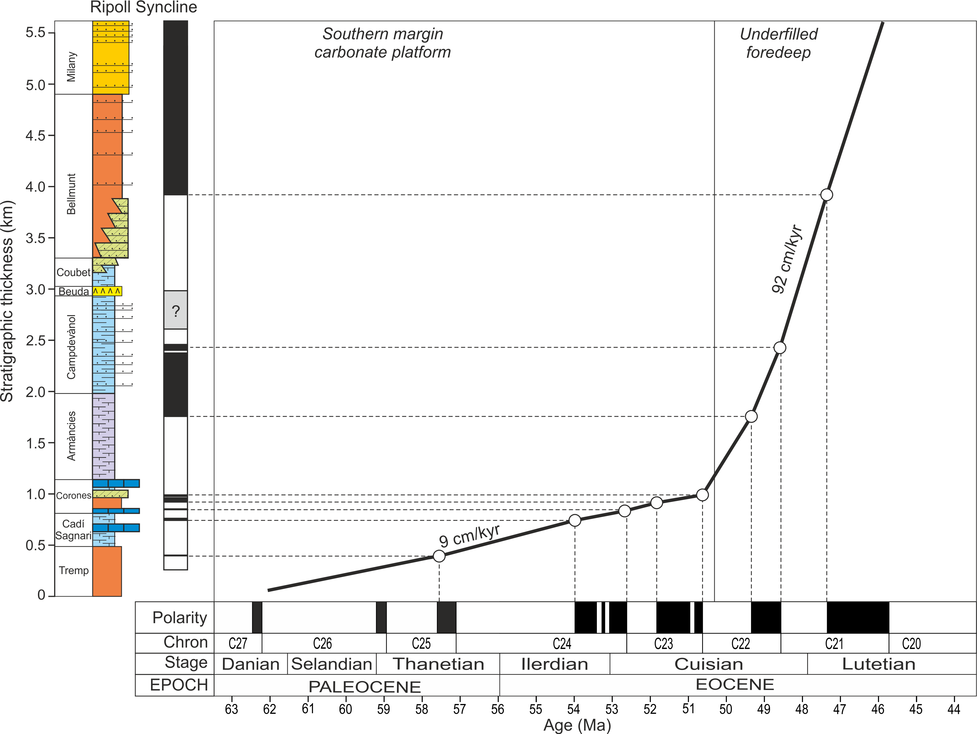
Jaca Basin
1. The initiation of a foredeep dates to 50Ma in both the Jaca and Ripoll basins...
Ripoll Basin
2. But, the Ripoll basin underwent overfilled with 5km of sediments only 4Myr later (46Ma).
3. At 46Ma the Jaca basin was an underfilled deep trough with only 1km of sediments accumulated

Slide 9
Restoring the Paleogeography of the south Pyrenean foreland
2. Paleogeographic maps shown in NEXT SLIDES are made by restoring the south-pyrenean thrust-sheets relative to a fixed Iberian plate. Data was compiled from all balanced cross-sections available (see refs LAST SLIDE).
1. To asses the relationship (connections?) between sediment routing systems of the Ripoll, Graus-Tremp and Ager basins, a restoration of allocthonous units to their original location is required
3. The Serres Marginals thrust-sheet has since the Lutetian accumulated a displacement relative to the iberian plate of 80 km.

Slide 10
Early Eocene (Cuisian) paleogeography
1. Provenance studies (petrographic and thermo/ geochronologic) indicate that catchment areas of sediment in the Tremp-Graus and Ager basins were different (Thomson et al., 2019).
2. Provenance analyses of sediments of the Ripoll basin reveal striking similarities with data from the Ager basin (Odlum et al., 2019), which suggests a common catchment area in the eastern Pyrenees.
Tremp-Graus
Ager
4. Sediments to the Ager basin could be routed from the eastern Pyrenees along the hangingwall of the Lower Pedraforca thrust. Salt accumulation to the front of the Montsec thrust could build the divide between the Ager and Ripoll basins, preceding the rise of the Serres Marginals thrust in the Lutetian.
3. The overall distribution of environments in the south-pyrenean realm do not favour an scenario where sediments filling the Ager basin were transported across the deep and rapidly subsiding Ripoll basin.

Slide 11
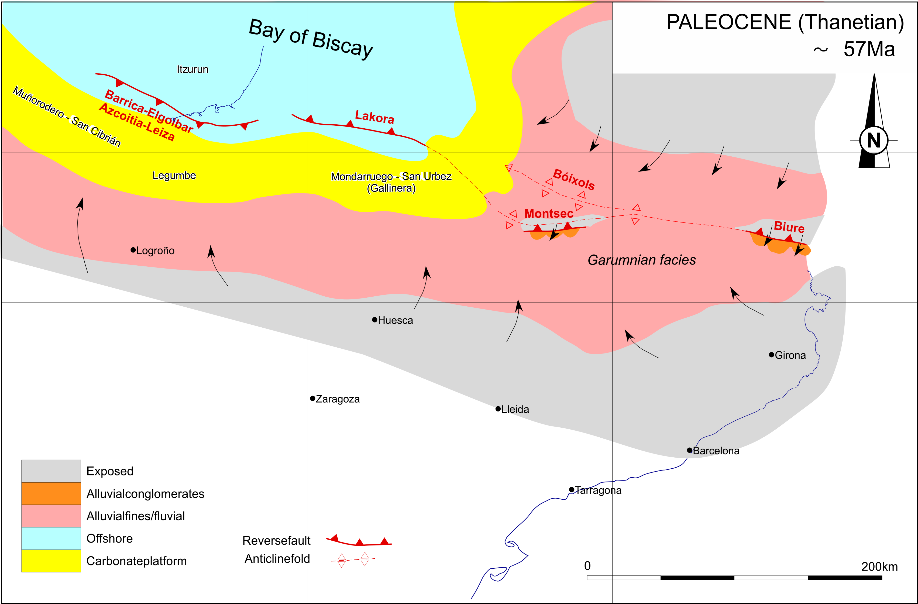
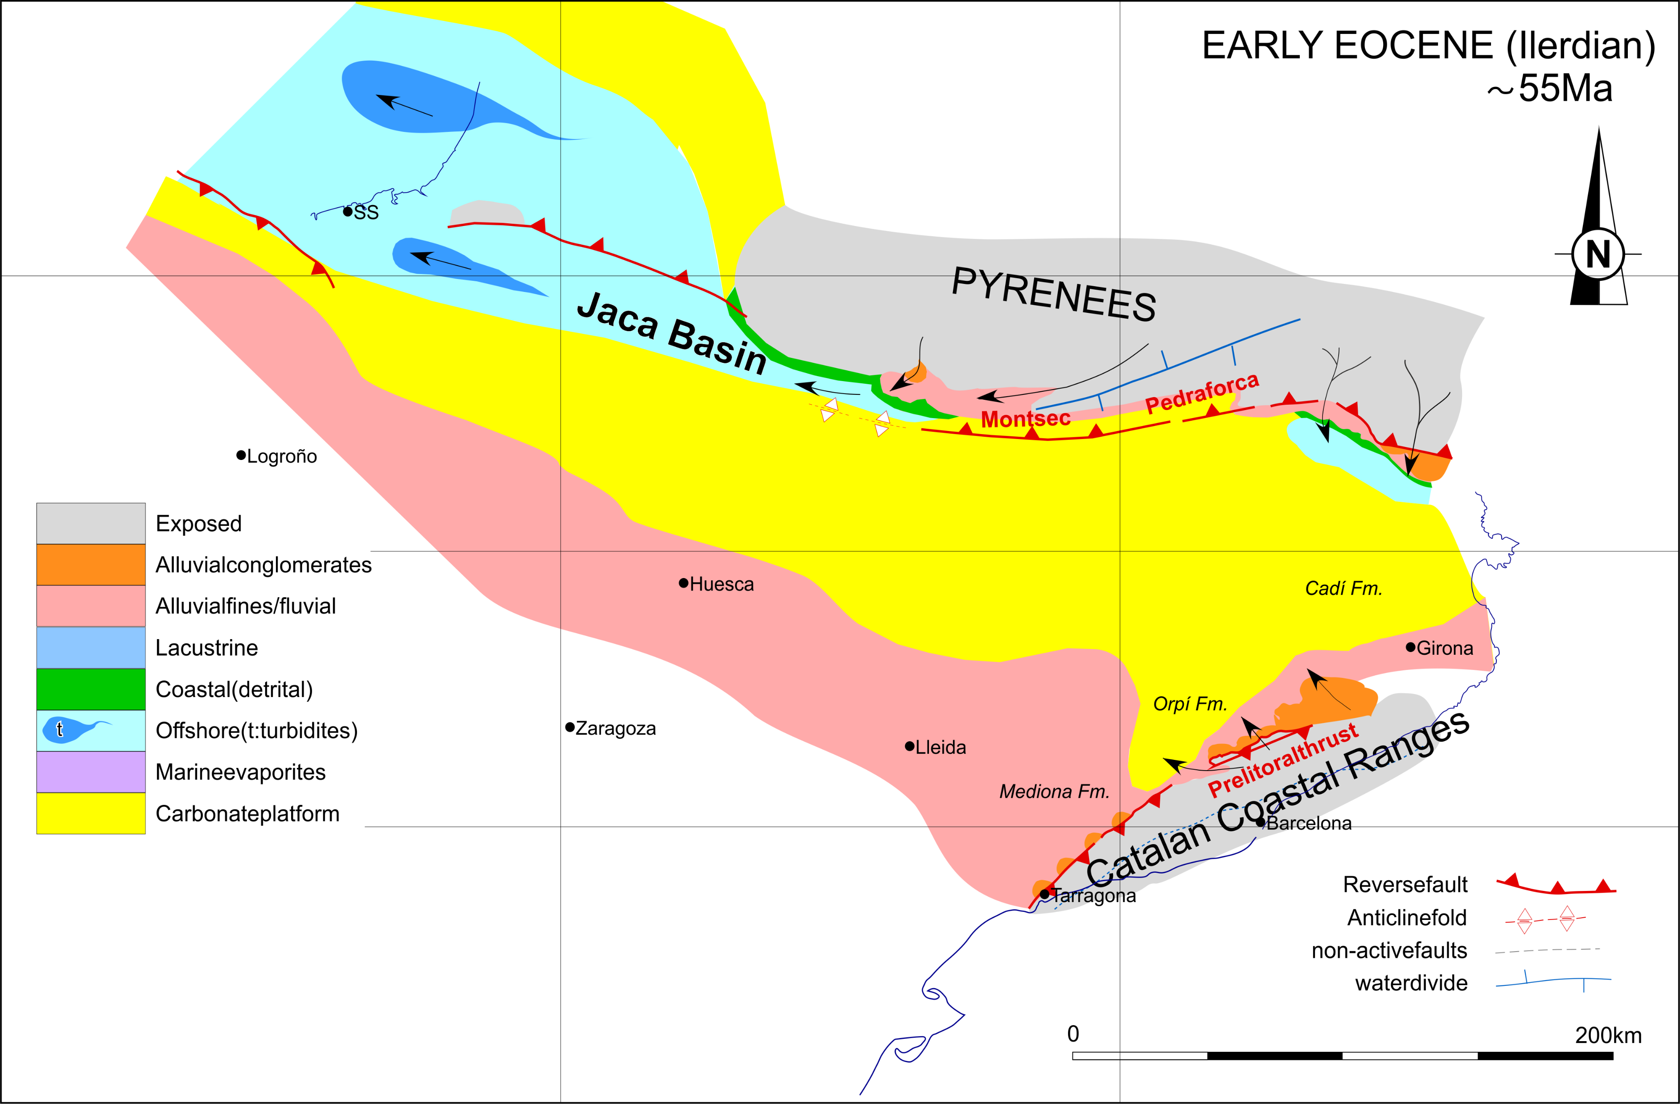
3. During the CUISIAN the foredeep developed with two separated turbiditic troughs. Wide shallow platforms in the central region developed linked to salt migration and accumulation at the front of the advancing Montsec thrust. Sediments to the Ager basin were routed between the Montsec and the lower Pedraforca thrusts.
4. The Tremp-Graus basin was transported piggy-back on top of the Serres Marginals thrust-sheet since the early LUTETIAN. During the BARTONIAN a rapid regressional episode led to the filling of the Tremp-Graus basin with fluvial sediments sourced from the central pyrenean Axial Zone and transported WNW parallel to the basin axis.
An evolution of the sediment routing system from Paleocene to Late Eocene would be as follows:
1. The PALEOCENE represent a period of relative tectonic quiescence and low-relief in the Pyrenean domain. Sediments were sourced from the interior of the Iberian plate and the Corsica- Sardinian block, with paleocurrents directed north-westward towards the Atlantic ocean.
2. During the ILERDIAN, accelerated plate collision led to flexure of the Iberian plate and the rise of the eastern Pyrenees. The south-pyrenean foredeep is formed and filled with sediments sourced from the north. Maximum expansion of carbonate platforms along the southern margin developed in concurrence with a sea level rise during the Ilerdian. The rise of the Montsec thrust delineated the southern límit of the Tremp-Graus basin.

Slide 12
Conclusions [1/3]
Palinspastic restorations provide key constraints for the reconstruction of the sediment routing system of a partitioned foreland basin.
The evolution of the Southern Pyrenean sediment dispersal differs from a typical orogen-parallel principal routing system that efficienly transfered sediments to the peripheral oceanic basin.

Slide 13
Conclusions [2/3]
The Tremp-Graus, Ainsa and Jaca basins formed an elongated trough that efficiently transferred sediments to the Atlantic ocean.
The Ripoll basin evolved as a rapidly filling sink for sediments sourced from the Eastern Pyrenees..
A shallow platform in the central region was sustained by salts migration and accumulation in front of the Montsec thrust-sheet.
Tremp-Graus
Ainsa
Salt pillows

Slide 14
Conclusions [3/3]
Provenance analyses showed that sediments of the Ager basin were sourced in the Eastern Pyrenees. Best plausible scenario is that sediment routing to the Ager basin ran on the hangingwall of the Serres-Marginals and Lower Pedraforca thrust sheets.
Ager

Slide 15
Selected References
Burbank, D.W., Puigdefàbregas, C., Muñoz, J.A., 1992. The chronology of the Eocene tectonic and stratigraphic development of the eastern Pyrenean foreland basin, northeast Spain. Geol. Soc. Am. Bull. 104, 1101–1120.
Garcés, M., López-blanco, M., Valero, L., Beamud, E., Anton, J., Oliva-urcia, B., Vinyoles, A., Arbués, P., Cabello, P., Cabrera, L., 2020. Paleogeographic and sedimentary evolution of the south-pyrenean foreland basin. Mar. Pet. Geol. 113, 104105. https://doi.org/10.1016/j.marpetgeo.2019.104105.
Michael, N.A., Carter, A., Whittaker, A.C., Allen, P.A., 2014. Erosion rates in the source region of an ancient sediment routing system: comparison of depositional volumes with thermochronometric estimates. J. Geol. Soc. London. 171, 401–412. https://doi.org/10.1144/jgs2013-108
Mochales, T., Barnolas, a., Pueyo, E.L., Serra-Kiel, J., Casas, a. M., Samsó, J.M., Ramajo, J., Sanjuán, J., 2012. Chronostratigraphy of the boltaña anticline and the Ainsa Basin (southern pyrenees). Bull. Geol. Soc. Am. 124, 1229–1250. https://doi.org/10.1130/B30418.1
Muñoz, J.A., Beamud, E., Fernández, O., Arbués, P., Dinarès-Turell, J., Poblet, J., 2013. The Ainsa Fold and Thrust Oblique Zone of the Central Pyrenees: Kinematics of a Curved Contractional System from Paleomagnetic and Structural Data. Tectonics 32, 1142–1175. https://doi.org/10.1002/tect.20070
Muñoz, J.A., Mencós, J., ROCA, E., Carrera, N., Gratacos, O., Ferrer, O., Fernández, O., 2018. The structure of the South-Central Pyrenean fold and thrust belt as constrained by subsurface data. Geol. Acta 16, 439–460. https://doi.org/10.1344/GeologicaActa2018.16.4.7
Odlum, M.L., Stockli, D.F., Capaldi, T.N., Thomson, K.D., Clark, J., Puigdefàbregas, C., Fildani, A., 2019. Tectonic and sediment provenance evolution of the South Eastern Pyrenean foreland basins during rift margin inversion and orogenic uplift. Tectonophysics 765, 226–248. https://doi.org/10.1016/j.tecto.2019.05.008
Plaziat, J., 1981. Late Cretaceous to late Eocene paleogeographic evolution of southwest Europe. Palaeogeogr. Palaeoclimatol. Palaeoecol. 36, 263–320.
Puigdefàbregas, C., Muñoz, J.A., Vergés, J., 1992. Thrusting and foreland basin evolution in the Southern Pyrenees, in: McClay, K.R. (Ed.), Thrust Tectonics SE - 22. Springer Netherlands, pp. 247–254.
Puigdefàbregas, C., Muñoz, J.A., Marzo, M., 1986. Thrust Belt Development in the Eastern Pyrenees and Related Depositional Sequences in the Southern Foreland Basin, in: Allen, P.A., Homewood, P. (Eds.), Foreland Basins, Spec. Publs. Int. Ass. Sediment. 8. Blackwell Publishing Ltd., Oxford, UK, pp. 229–246.
Thomson, K.D., Stockli, D.F., Odlum, M.L., Tolentino, P., Puigdefàbregas, C., Clark, J., Fildani, A., 2019. Sediment provenance and routing evolution in the Late Cretaceous–Eocene Ager Basin, south-central Pyrenees, Spain. Basin Res. 1–20. https://doi.org/10.1111/bre.12376
Thomson, K.D., Stockli, D.F., Clark, J.D., Puigdefàbregas, C., Fildani, A., 2017. Detrital zircon (U-Th)/(He-Pb) double-dating constraints on provenance and foreland basin evolution of the Ainsa Basin, south-central Pyrenees, Spain. Tectonics 36, 1352–1375. https://doi.org/10.1002/2017TC004504
Tosquella, J., Samsó, J.M., 1996. Bioestratigrafía y litoestratigrafia del paleoceno superior-eoceno inferior del sector oriental de la cuenca surpirenaica. Acta Geol. Hipanica 31, 3–21.
Vacherat, A., Mouthereau, F., Pik, R., Huyghe, D., Paquette, J.L., Christophoul, F., Loget, N., Tibari, B., 2017. Rift-to-collision sediment routing in the Pyrenees: A synthesis from sedimentological, geochronological and kinematic constraints. Earth-Science Rev. https://doi.org/10.1016/j.earscirev.2017.07.004
Vergés, J., Millán, H., Roca, E., Muñoz, J.A., Marzo, M., Cirés, J., Bezemer, T. Den, Zoetemeijer, R., Cloetingh, S., 1995. Eastern Pyrenees and related foreland basins: pre-, syn- and post-collisional crustal-scale cross-sections. Mar. Pet. Geol. 12, 903–915. https://doi.org/10.1016/0264-8172(95)98854-X
Vergés, J., Fernàndez, M., Martínez, A., 2002. The Pyrenean orogen : pre- , syn- , and post-collisional evolution. J. Virtual Explor. 8, 55–74.
Vergés, J., Marzo, M., Santaeulària, T., Serra-Kiel, J., Burbank, D.W., Muñoz, J.A., Giménez-Montsant, J., 1998. Quantified vertical motions and tectonic evolution of the SE Pyrenean foreland basin, in: Mascle, A., Puigdefàbregas, C., Luterbacher, H., Fernández, M. (Eds.), Cenozoic Foreland Basins of Western Europe. Geological Society Special Publications, 134, pp. 107–134.

