Slide 1
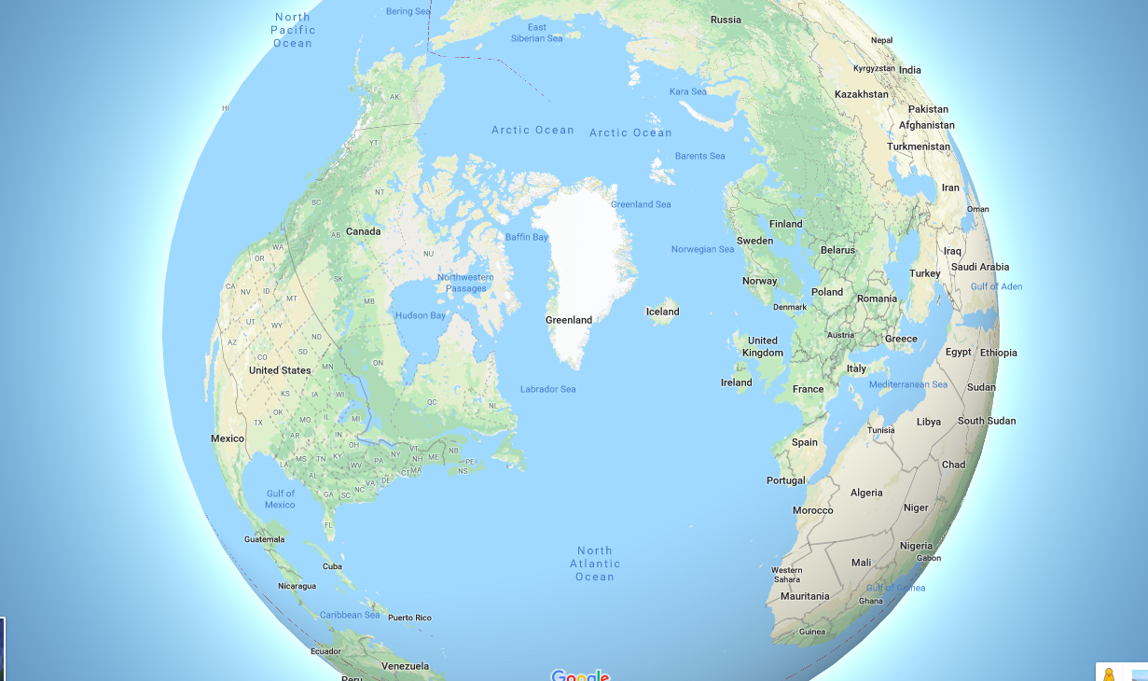




THE TIMING OF EARLY GLACIATIONS AND FJORD FORMATION IN
NORTH AND NORTHEAST GREENLAND
NB: These are talking slides. Play the slide show and remember to turn up the volume
VIVI KATHRINE PEDERSEN
NICOLAJ KROG LARSEN
DAVID LUNDBEK EGHOLM
FEBRUARY 28 , 2019

Slide 2
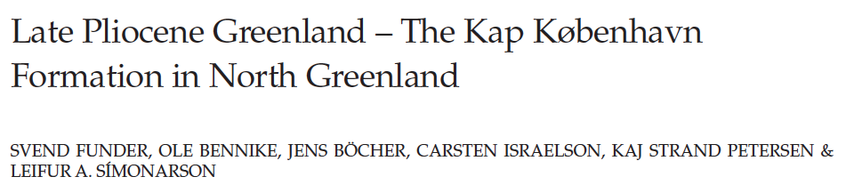
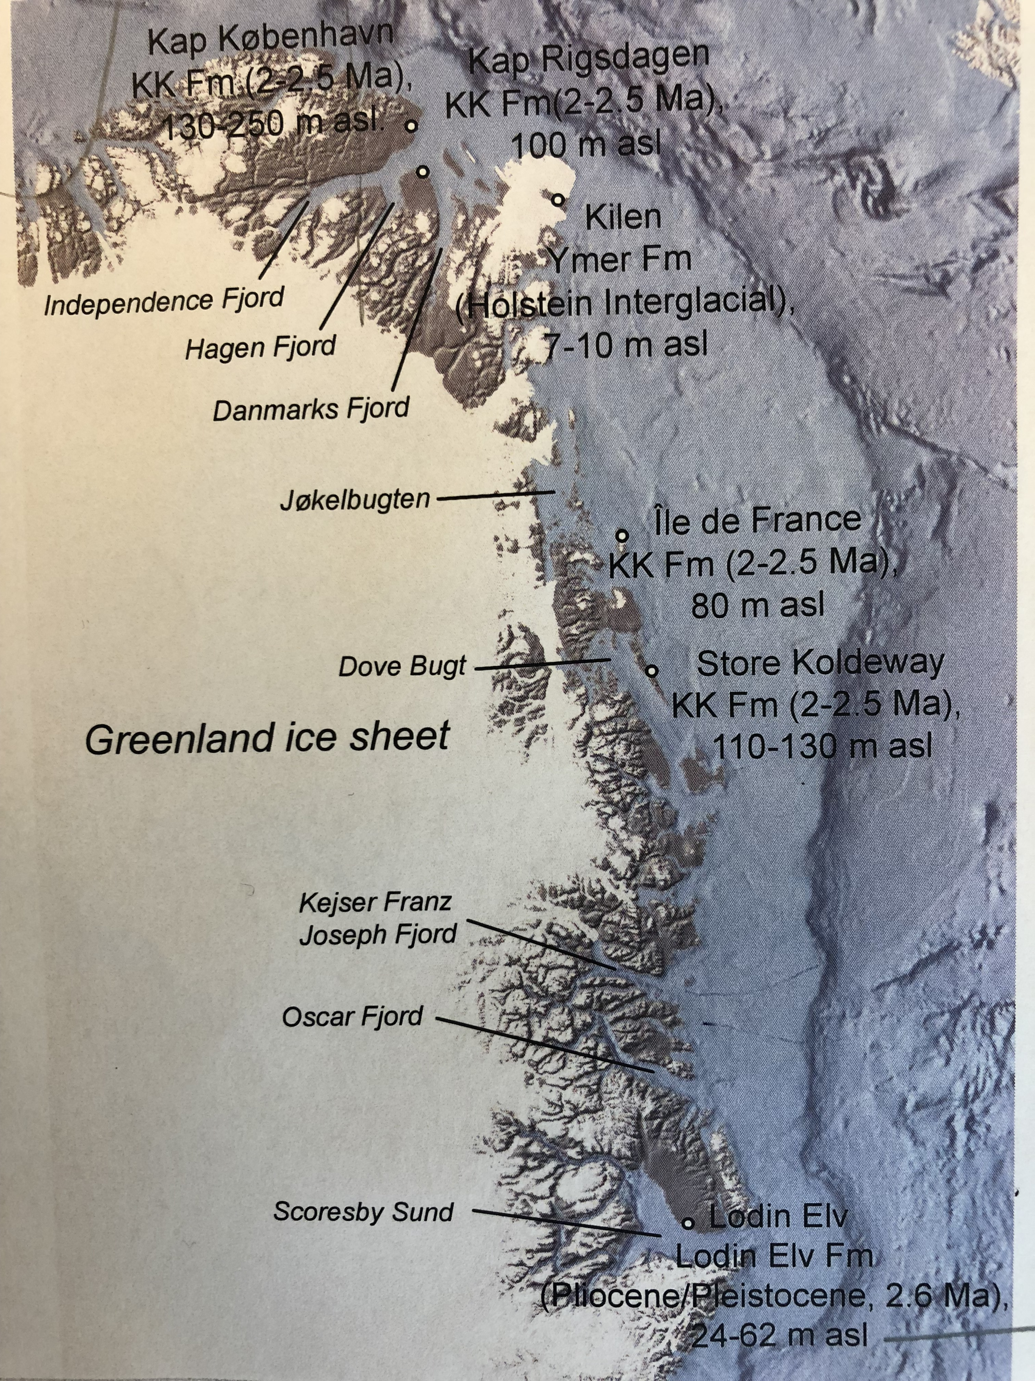

KAP KØBENHAVN FORMATION
NORTH GREENLAND
KAP KØBENHAVN FORMATION
SHALLOW MARINE, ~2.5 MA
MINIMUM ~130-250 M OF UPLIFT FROM SEA LEVEL SINCE 2.5-2.0 MA
NO ICE (+~6 DEGREES)

Slide 3
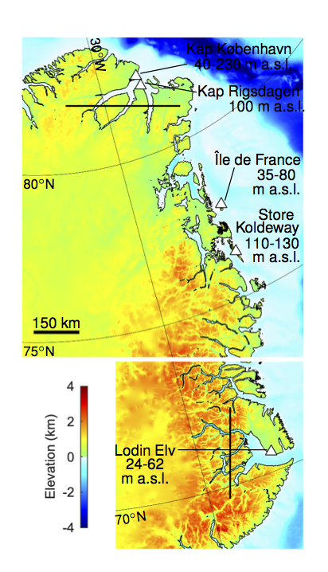
KAP KØBENHAVN FORMATION AND SIMILAR SUCCESSIONS
NORTH AND NORTHEAST
GREENLAND
UPLIFT CONSTRAINED BY SEDIMENTS DECREASE NORTH TO SOUTH
OPPOSITE TOPOGRAPHIC TREND AND PREDICTIONS OF DYNAMIC TOPOGRAPHY
Steinberger et al. (2015)

Slide 4
EROSION-DRIVEN FLEXURAL ISOSTATIC UPLIFT
NORTH/NORTHEAST
GREENLAND
1. REMOVE PRESENT DAY ICE
2. REBOUND TOPOGRAPHY
3. DEFINE EROSION:
“FILL FJORDS ALGORITHM”
4. LOAD TOPOGRAPHY

Slide 5
EROSION-DRIVEN FLEXURAL ISOSTATIC UPLIFT
NORTH/NORTHEAST
GREENLAND
1. REMOVE PRESENT DAY ICE
2. REBOUND TOPOGRAPHY
3. DEFINE EROSION:
“FILL FJORDS ALGORITHM”
4. LOAD TOPOGRAPHY
5. COMPARE WITH ELEVATED
MARINE SEDIMENTS

Slide 6
EROSION-DRIVEN FLEXURAL ISOSTATIC UPLIFT
NORTH/NORTHEAST
GREENLAND
1. REMOVE PRESENT DAY ICE
2. REBOUND TOPOGRAPHY
3. DEFINE EROSION:
“FILL FJORDS ALGORITHM”
4. LOAD TOPOGRAPHY
5. COMPARE WITH ELEVATED
MARINE SEDIMENTS

Slide 7
EROSION-DRIVEN FLEXURAL ISOSTATIC UPLIFT
1. REMOVE PRESENT DAY ICE
2. REBOUND TOPOGRAPHY
3. DEFINE EROSION:
“FILL FJORDS ALGORITHM”
4. LOAD TOPOGRAPHY
5. COMPARE WITH ELEVATED
MARINE SEDIMENTS

Slide 8
SUMMARY
EXTENSIVE GLACIATION AND FJORD FORMATION HAS BEEN LIMITED TO THE LAST ~2.5 MA IN NORTH GREENLAND.
EXTENSIVE GLACIATION AND FJORD FORMATION STARTED PRIOR TO ~2.5 MA IN NORTHEAST GREELAND
(EOCENE-OLIGOCENE BOUNDARY AND LATE MIOCENE)
EXPLAIN EARLY OFFSHORE IRD RECORDS AND ONSHORE EVIDENCE FOR RECENT ICE FREE CONDITIONS

