Slide 1




Using WRF-Chem Volcano to model the in-plume halogen chemistry of Etna’s 2018 eruption
Modelling: Luke Surl^{1,2}, Tjarda Roberts^{1,2}, Slimane Bekki²
TROPOMI: Simon Warnach^{3,4}, Thomas Wagner⁴
¹CNRS, LATMOS Paris, France; ²CNRS, LPC2E Orléans, France; ³MPIC, Mainz, Germany, ⁴Insitut für Umweltphysik, Universität Heidelberg, Germany
luke.surl@latmos.ipsl.fr
This project has received funding from the European Union's Horizon 2020 research and innovation programme under grant agreement No 800062

Slide 2
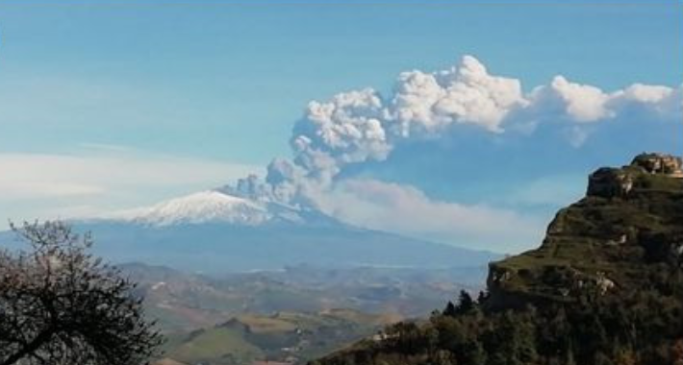
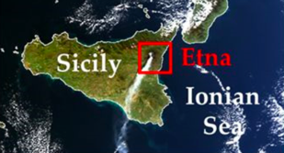
Etna’s 2018 Christmas eruption
VEI 2 flank eruption, beginning in the morning of 2018-12-24
Images: Corradini et al. (2020), Remote Sens., 12, 1336; doi:10.3390/rs12081336
Notes:
In the downloadable PowerPoint presentation, we present satellite measurements and modelling of the halogen chemistry within the plume of Mount Etna’s Christmas 2018 eruption.

Slide 3
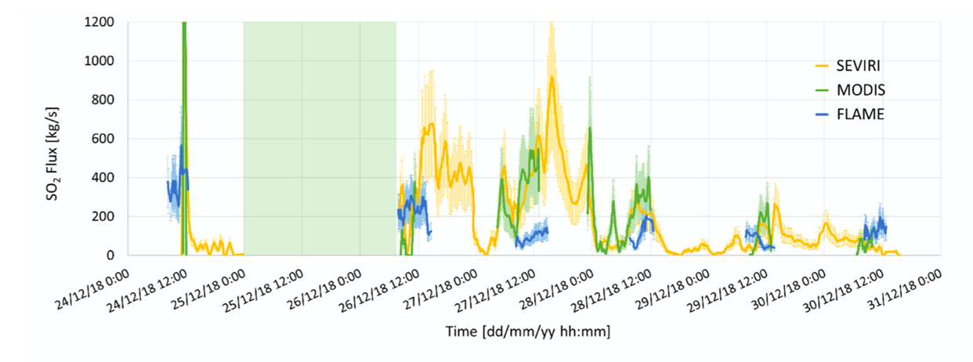
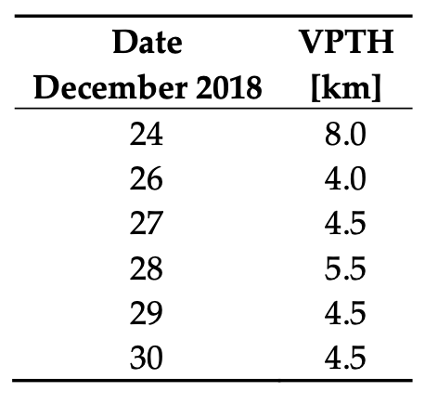
Etna’s 2018 Christmas eruption
Large event at ~1115 the 24th, moderate activity for the next week
No data due to poor weather
Volcanic Plume Top Height
Chart & table: Corradini et al. (2020), Remote Sens., 12, 1336; doi:10.3390/rs12081336

Slide 4
TROPOMI detection of plume
TROPOMI overpass at ~12h each day.
  Best observation on the 25th !
Detect SO₂, BrO and their ratio.
  BrO/SO₂ ratios common measurement of Br-chemistry in plumes
Notes:
The satellite measurements from TROPOMI show that on Christmas day the SO2 plumes travels south-east from Etna. BrO is also detected within the plume.

Slide 5
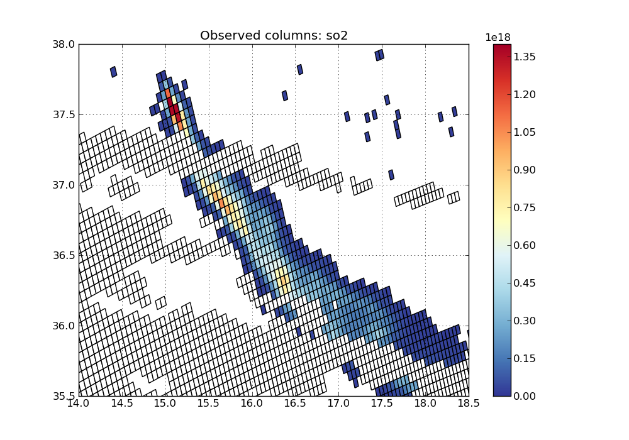
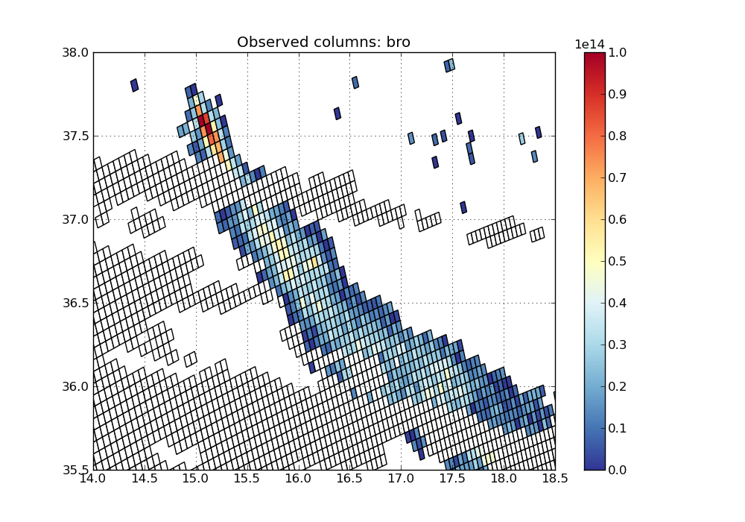
TROPOMI detection of plume : SO₂, BrO
Cloud filter, cloud fraction > 0.5 and top height >4km. Only pixels with SO2 VCD > 2e16 molec.cm⁻² plotted

Slide 6
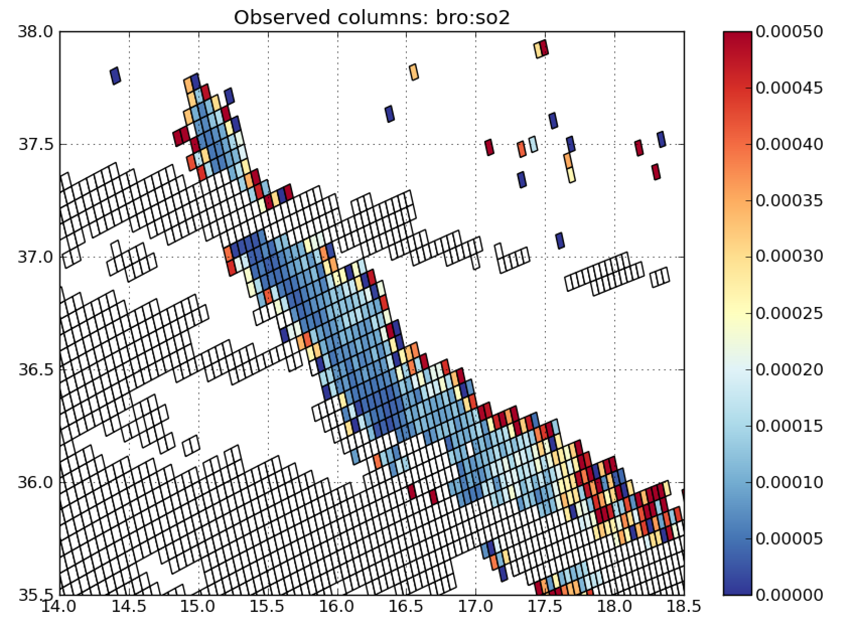
TROPOMI detection of plume : BrO/SO₂
BrO production
Across-plume variation.
  High at edges (~4 x 10⁻⁴)
  ”Core” of plume lower values (~1 x 10⁻⁴)
Notes:
The BrO/SO2 column ratios are typical of those measured in volcanic plumes (a few 10^-4); however the high spatial resolution of TROPOMI reveals a cross-plume variation of this ratio – where the ratio within the core of the plume is less than at the edges.

Slide 7
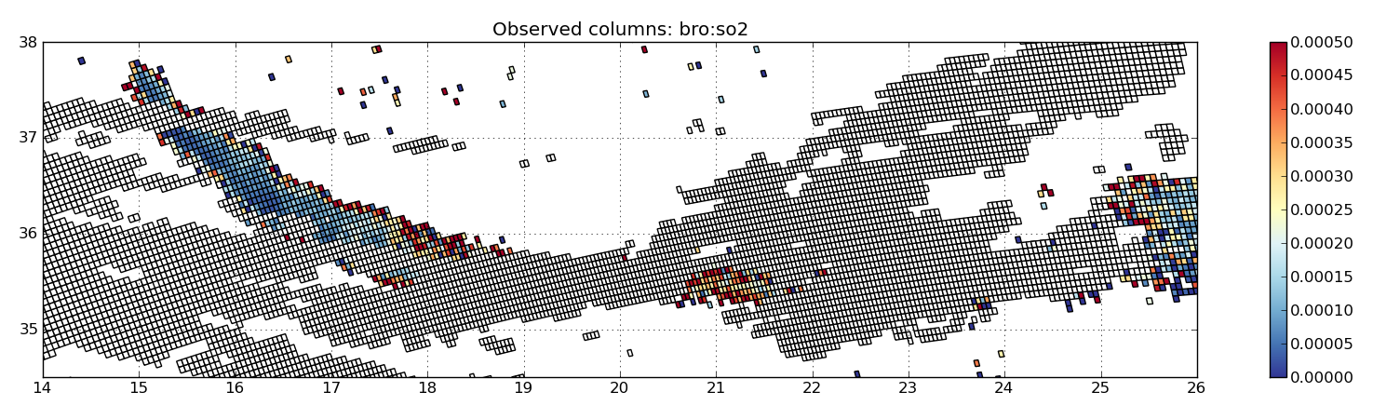
TROPOMI detection of plume : BrO/SO₂

Slide 8
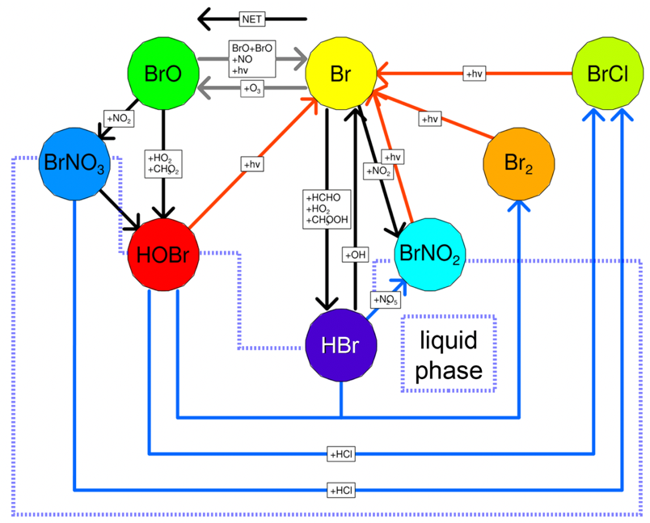
Bromine chemistry
Bromine chemistry – converts HBr to other forms and continually cycles bromine
Several requirements:
  Sunlight for photolysis
  Acidic aerosol for liquid phase steps
  Oxidants (esp. O₃) for gas-phase reactions
    Consumes these oxidants
Heterogenous reaction: HOBr uptake (rate limiting), followed by reaction with Br⁻ or Cl⁻ (from aqueous phase HBr or HCl)
  Br₂ vs. BrCl product ratio dependant on ratio of HBr and HCl. Br₂ production ’preferred’ unless bromide mostly depleted.

Slide 9
Can we model this?
WRF-Chem Volcano (WCV) is our custom version of WRF-Chem [v4.1.5] that includes:
  Bromine, chlorine and mercury chemistry in reaction mechanism
  Volcanic emissions (pre-processed with modified version of PREPCHEM-SRC)
  On-line calculation of aerosol surface areas and heterogenous reaction rates.
    Includes calculation of wet area, incorporating aerosol water.
    Includes gas-phase diffusion limitation of heterogenous reactions
Run in multiple-nested mode, up to 1 km * 1 km resolution
Notes:
Modelling is performed using “WRF-Chem Volcano” (WCV), our development of the 3D atmospheric chemistry and transport model WRF-Chem. This development adds Br, Cl and Hg chemistry to the mechanism, including heterogenous chemistry. We run this model in nested mode, at 1km x 1km resolution at maximum.

Slide 10
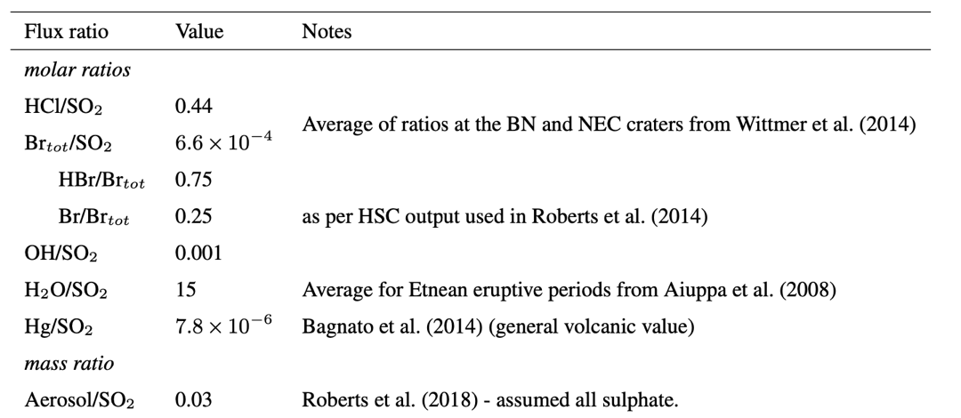
Model setup
320 kg SO₂/s flux rate
  based on inversions from preliminary runs
  Within range for fluxes estimated for 26th and 27th in Corradini et al.,
4 km injection height, into single model layer (317m thick)
Other species emitted at fixed ratio to SO₂.
Corradini et al. (2020) doi:10.3390/rs12081336 ; Wittmer et al (2014) doi:10.1002/2013GC005133; Roberts et al. (2018) doi:10.1016/j.gca.2017.09.040; Aiuppa et al. (2008) doi:10.1029/2008GL035871; Bagnato et al. (2014) doi:10.1144/SP410.2; Roberts et al. (2014) doi:10.5194/acpd-14-5445-2014
Notes:
Several species (SO2, H2O, HCl, HBr, Br, OH, Hg) are emitted into the model to simulate the eruption.

Slide 11
Modelled columns: SO₂
SO₂ column
Model time
2018-12-25
12:00:00
Notes:
To compare with the observations, we compute “model columns” The model shows similar transport to the observations, and the bromine cycle appears to be well-simulated as indicated by BrO/SO2 ratios also of the order 10^-4. A cross-plume“coring” effect can be seen in the modelled BrO/SO2 ratios, albeit narrower than observed.

Slide 12
Modelled columns: BrO
BrO column
Model time
2018-12-25
12:00:00

Slide 13
Modelled columns: BrO:SO₂ ratio
BrO/SO₂ column ratio
Model time
2018-12-25
12:00:00

Slide 14
Br speciation variability
In the core of the plume BrO:SO₂ ratios are much less than at the edges.
In this core Br atom is modelled to be a significant species, >50% of the bromine.
Br:Br_{total}
Notes:
Investigating the model further, we find that in the low-BrO/SO2 plume core, a substantial fraction of the bromine in the plume is present as Br.

Slide 15
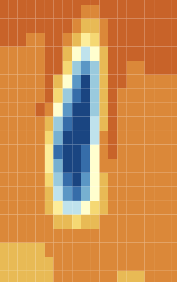
Cause of “coring” effect : O₃ depletion
Bromine chemistry depletes O₃
In the core of the plume, O₃ is destroyed faster than it mixes in from background.
  More total bromine in denser plume
  O₃ destroyed in surrounding region before reaching core
O₃ depletion shifts BrO:Br steady-state towards Br.
O₃ vertical cross-section 2-6km
O₃ horizontal cross-section at 4 km
Notes:
We also find that O3 levels are substantially reduced in the core – having been destroyed by bromine chemistry. This explains the coring effect – if O3 is destroyed faster than it can mix in from outside the plume, the Br-cycling is interrupted at the Br + O3 -> BrO reaction.

Slide 16
Coring in OClO
WCV also shows production of OClO
  OClO/SO2 column ratio 1-3 x 10⁻⁶
BrCl is produced via chloride reaction in aerosol
Photolysis of this produces reactive Cl
OClO Even more of an “edge species” than BrO
  Need both Br-cycling, and bromide absence so chloride reaction occurs
OClO/SO₂ column ratio
Notes:
We find an interesting result for OClO. This turns out to be even more of an edge species than BrO. This is because, for OClO to be produced, not only does Br cycling need to occur, but also HBr has to be depleted allowing the HCl heterogenous reaction to occur and liberate reactive Cl.

Slide 17
Bulk BrO:total bromine ratio
What % of total bromine is observed in a ground based or satellite observation?
Use BrO/total bromine ratio.
  Directly proportional to BrO/SO₂ ratio
Here looking at bulk numbers, averaged over all parts of plume at a particular age.
  Most observational techniques likely to be effectively bulk observations due to lack of spatial resolution
Notes:
Here we investigate what fraction of modelled bromine in the plume (overall) is present as BrO – this is needed to estimate volcanic bromine emissions from BrO measurements. We find that this value varies over time being mostly controlled by O3 levels, however it seems to settle at around half once the O3 depletion effect has faded.

Slide 18
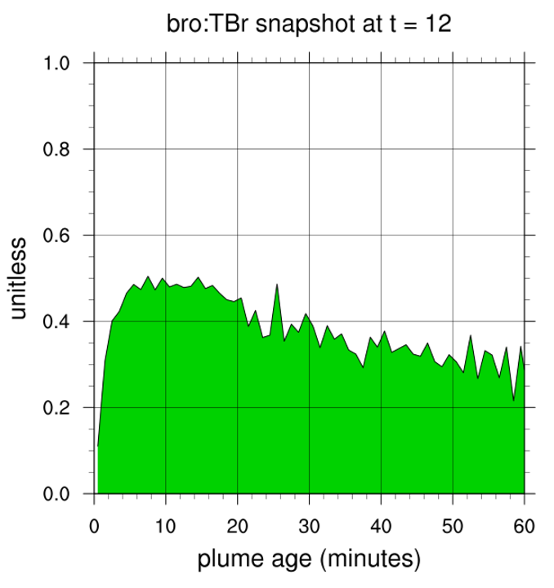
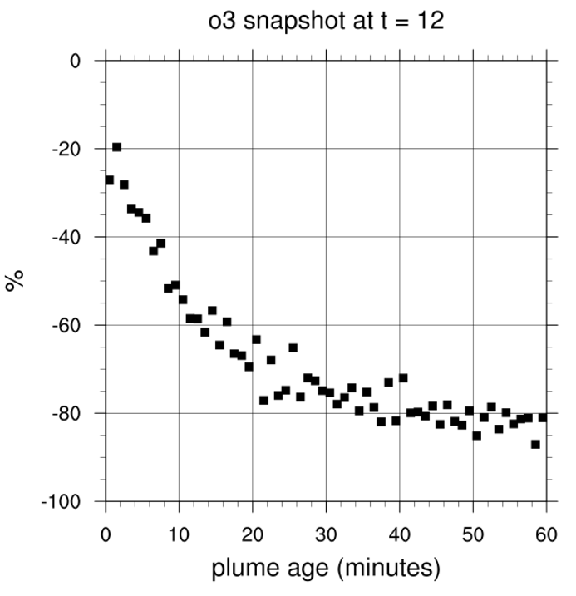
Bulk BrO:total bromine ratio – first hour
In first few minutes ratio rapidly increases.
Then decline as O₃ depletion impacts
Fraction of in-plume bromine as BrO
O₃ relative to
model run without volcanic emissions

Slide 19
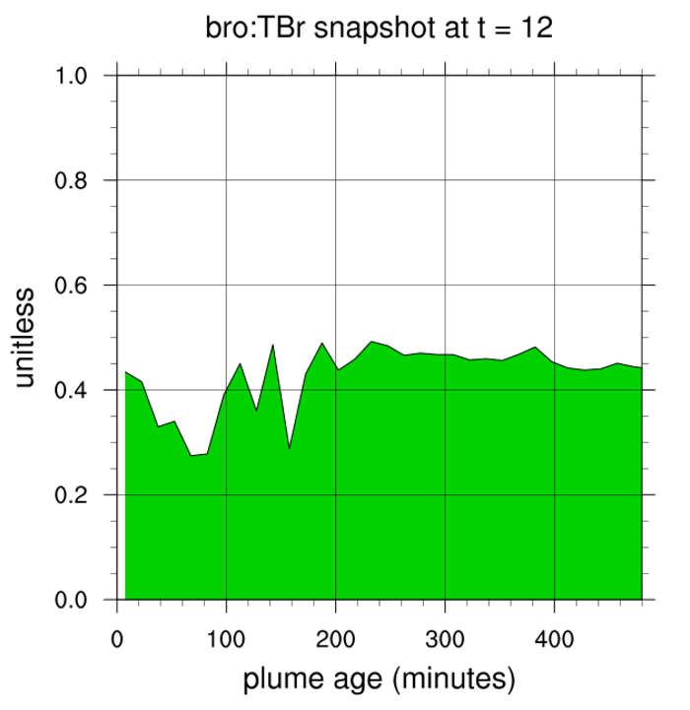
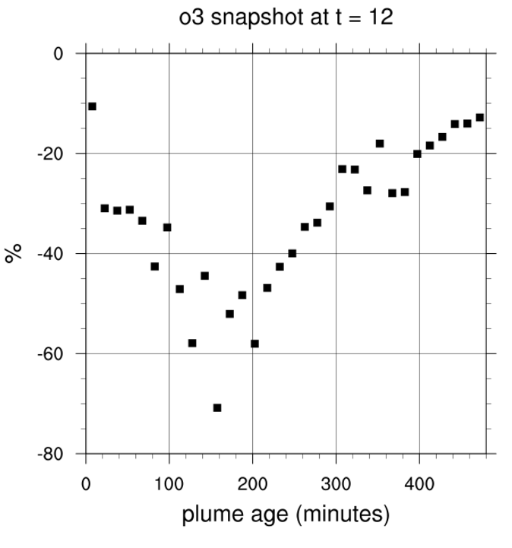
Bulk BrO:total bromine ratio – longer term
Longer term, O₃ eventually recovers if core “fades”
BrO reaches approximately stable fraction
  Stability at ~50% of total Br in this model
Fraction of in-plume bromine as BrO

Slide 20
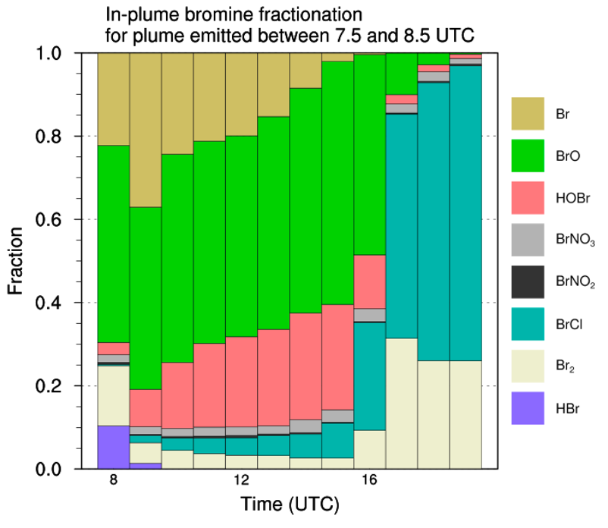
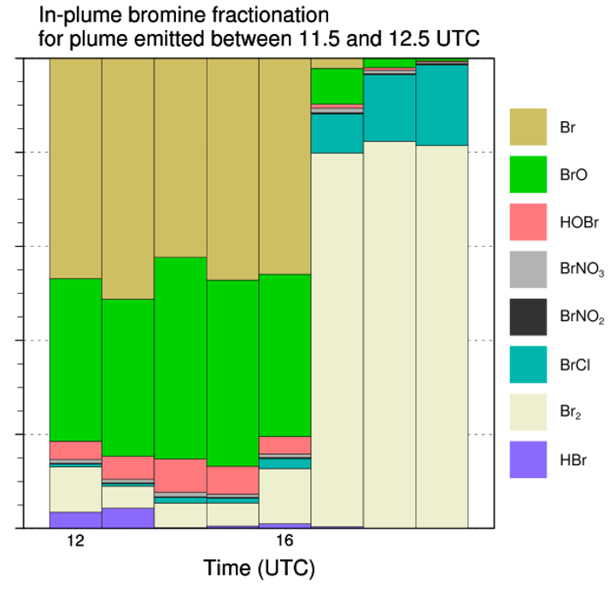
Br fractionation
Dispersing core
Persistent core
Tracking bromine fractionation in one piece of plume over the day…
  Psuedo-lagrangian trace
~50% BrO
night
Notes:
If the core remains stable this will impact Br-fractionation.

Slide 21
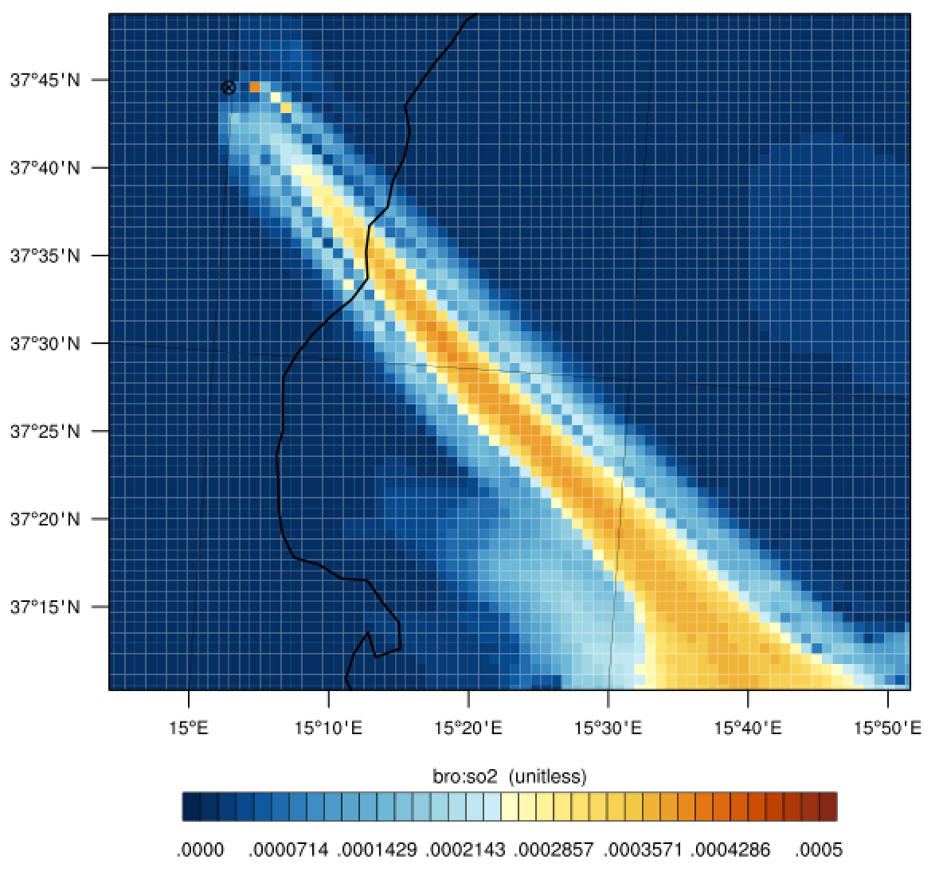
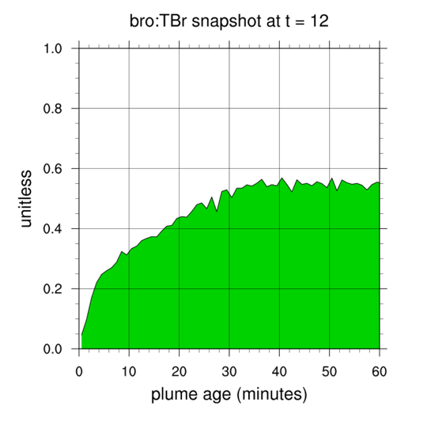
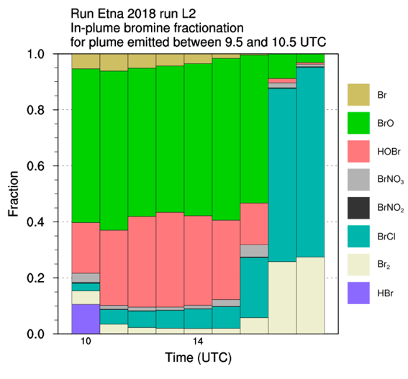
Weaker plume
For a plume 1/8 of the strength:
  No coring - Initial redistribution of bromine slower - then stability
BrO / SO₂
column ratio
Fraction of in-plume bromine as BrO
Notes:
A weaker modelled plume has a slower initial redistribution of bromine, but within 10s of minutes reaches a steady BrO fraction with no coring effect.

Slide 22
Conclusions
SO₂ and BrO in the plume of Etna’s Christmas 2018 eruption was detected by TROPOMI
The BrO/SO₂ ratio was of order a few 10⁻⁴, with significant cross-plume variation
WRF-Chem volcano (WCV) can replicate BrO formation within a volcanic plume, and the “coring” effect
  OClO formation also modelled
This ”coring” is caused by bromine chemistry depleting ozone, which interrupts the bromine cycling
As O₃ chemistry recovers, BrO reaches a steady state as a fraction of total bromine
Modelling suggests a daytime bulk observation of BrO in aged plume, should observe approximately half of total bromine
  Most reliable once O₃ depletion effect faded
  O₃ depletion detectable by coring spatial pattern
luke.surl@latmos.ipsl.fr
Notes:
Thank you for your attention. Please let me know if you have any questions. We hope for WRF-Chem Volcano to become a community tool, so please let me know if you are interested in its development. I can be reached at luke.surl@latmos.ipsl.fr

