Slide 1
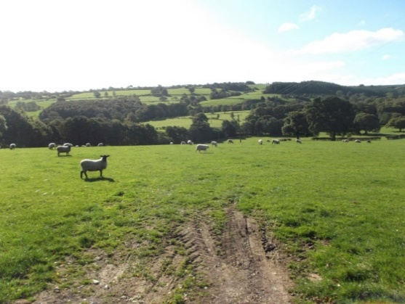





Nature Based Solutions: Dependency of Effectiveness on Spatial Configuration
Dr Ian Pattison
Institute of Infrastructure and Environment, Heriot Watt University, Edinburgh
i.Pattison@hw.ac.uk @GoWithTheF1ow

Slide 2
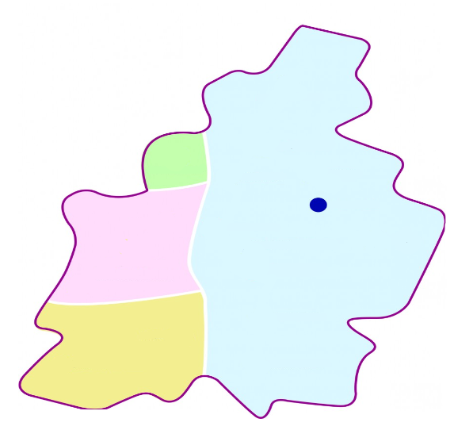
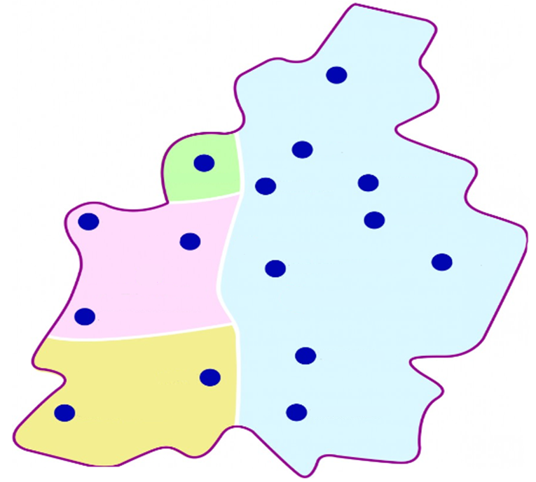
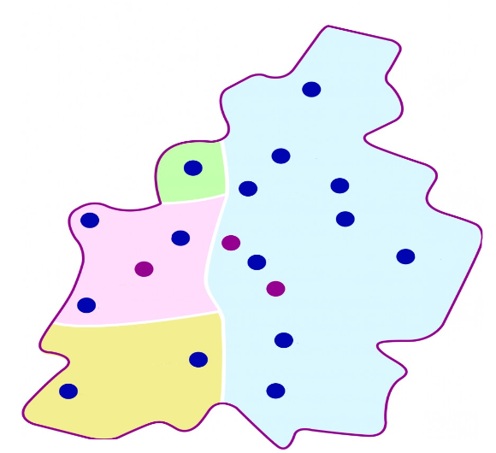
Problem of Upscaling
Knowledge of the impact of NBS at local scale is good. However, the larger scale impact (catchment) is highly uncertain.
We cannot simple extrapolate from the plot scale to the catchment scale is not possible
WHY?
1) Individual intervention impact reduces (attenuates)
2) Interventions are Diffuse, and we need to understand
combined impact
3) Different practices (amplify/balance out)
1)
2)
3)
Catchment Scale Result = Non-Linear relationship
e.g. volume of storage ≠ peak reduction
Pattison I, Lane SN. (2012). The link between land use management and flood risk: a chaotic conception?, Progress in Physical Geography.

Slide 3
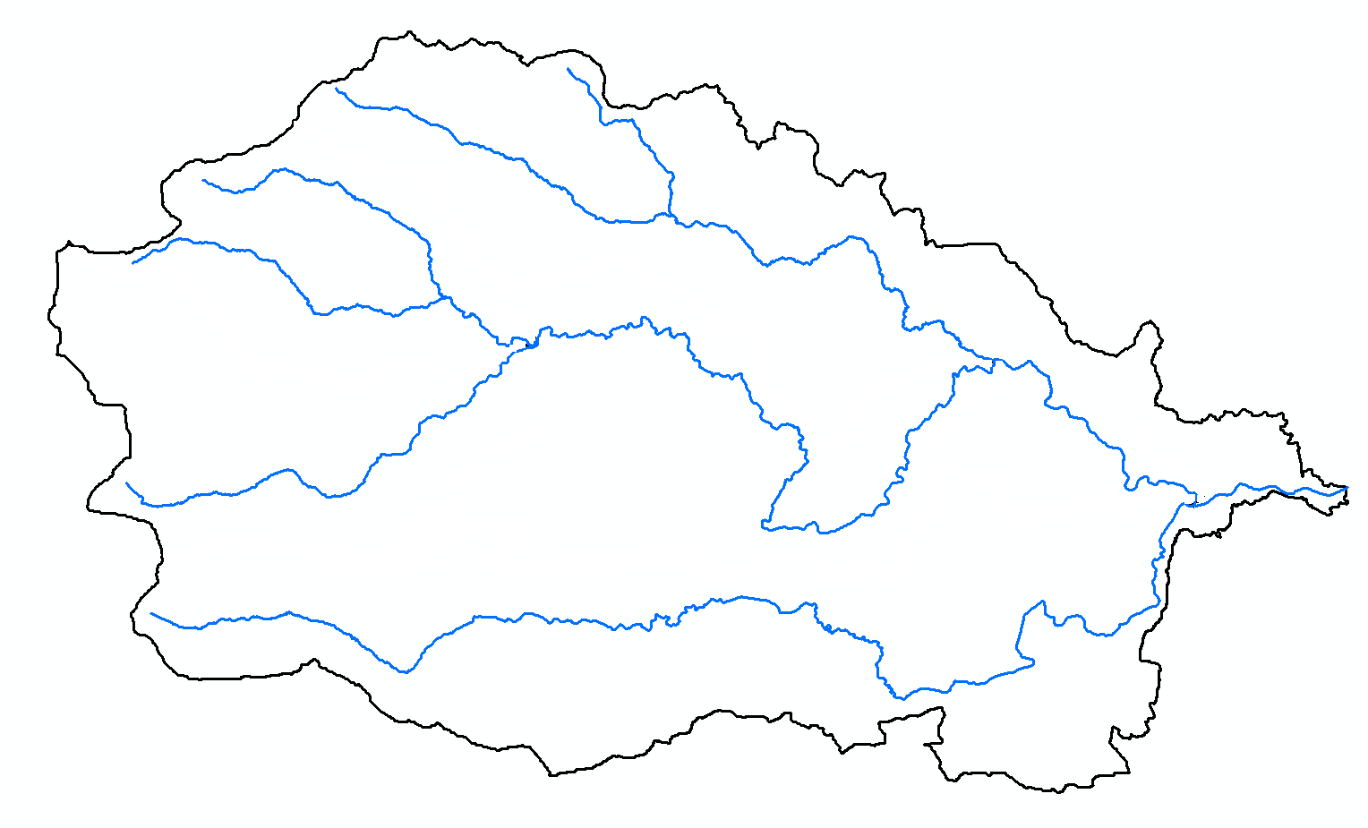
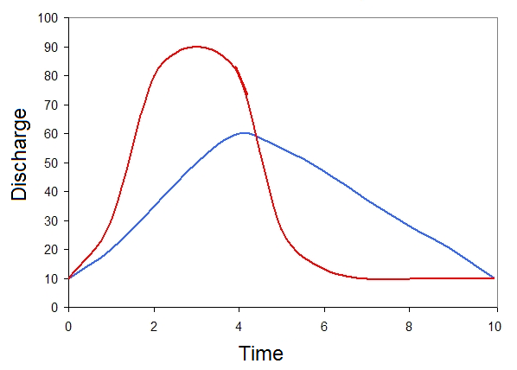
Where you do NFM effects the result
3) Slowing the flow may reduce peak in some locations but increase peak downstream
Drivers of flooding vary over Space and Time
Slowing the flow
1) Where you do NFM matters
2) Effect of NFM in same place varies for different Storm Tracks
Therefore, this heterogeneity within catchments needs to be accounted for, when designing NFM schemes.

Slide 4
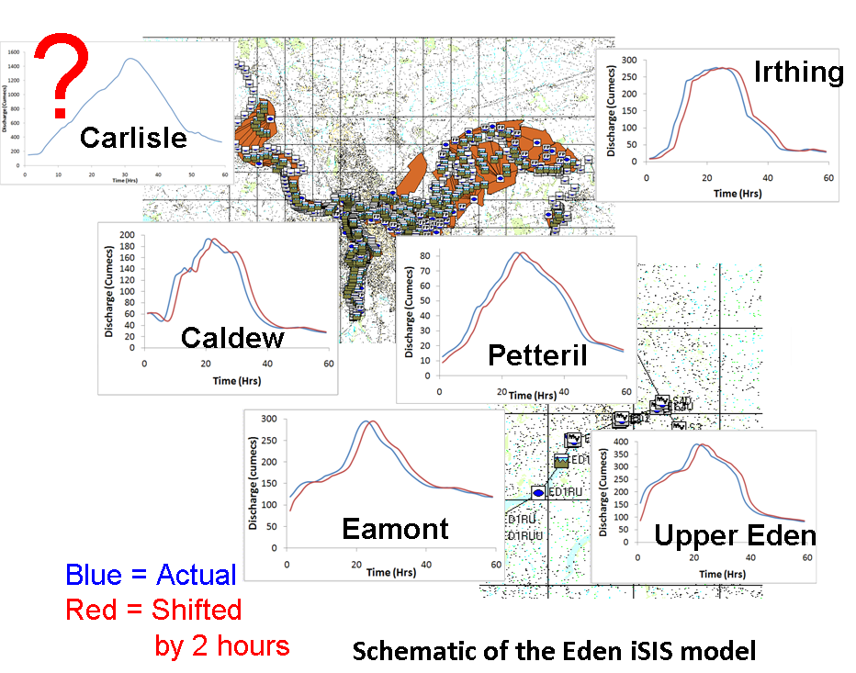
Role of Sub-Catchment / Tributary Interactions
What drives flooding in Carlisle?
Convolution of tributary hydrographs
Sensitivity of flooding to tributary hydrographs in terms of magnitude and relative timing
Tested using a Hydraulic model of January 2005 Carlisle (UK) flood

Slide 5
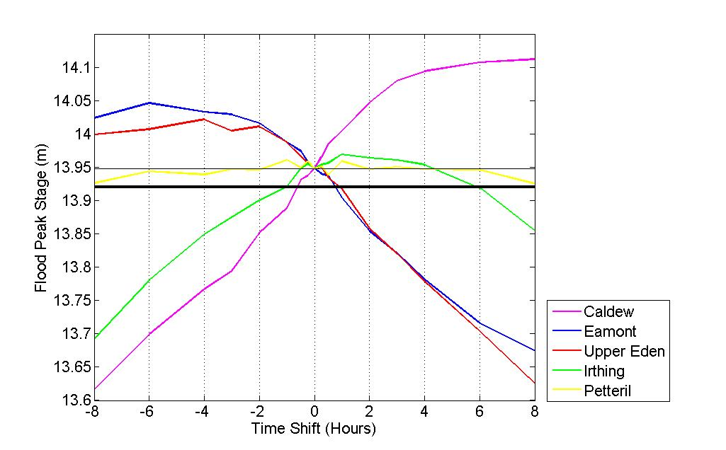
Targeting Sub-Catchments to Focus NFM
Magnitude
Relative Timing
Earlier Delayed
Delaying upstream tributaries has beneficial
impact (U.Eden = 0.32m)
Speeding up lowland tributaries reduces
downstream peak (Caldew = 0.33m)
Reducing tributary flows has differing
impacts downstream
Upper Eden (0.33m), Petteril (no impact)
Pattison I, Lane SN, Hardy RJ, Reaney SM , (2014), The role of tributary relative timing and sequencing in controlling large floods, Water Resources Research, 50, 5444-5458.

Slide 6
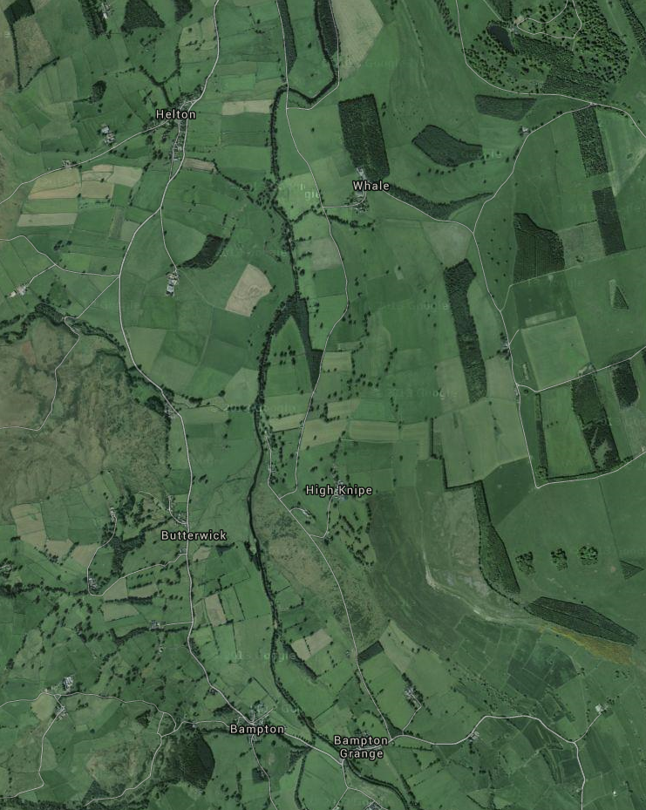
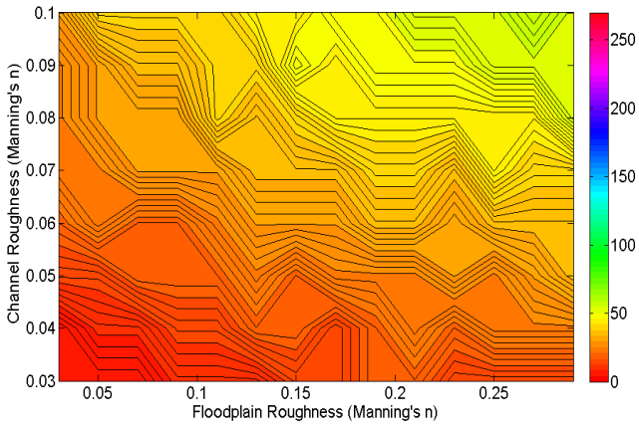
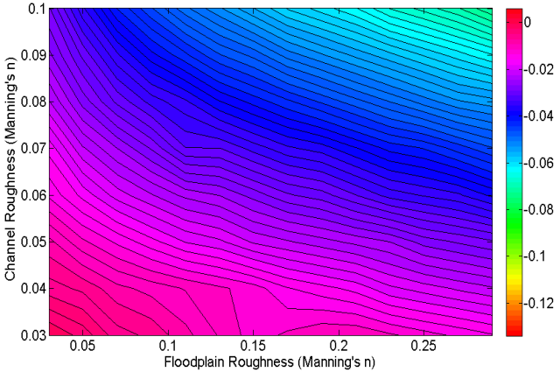
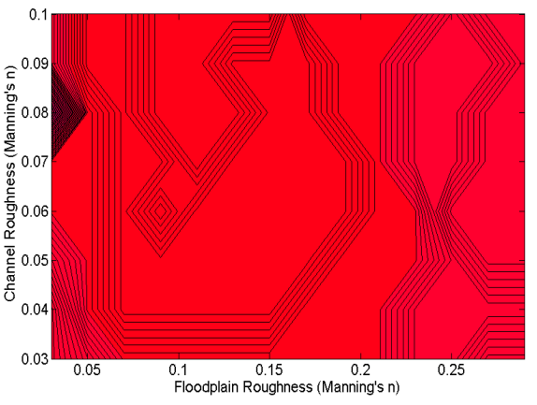
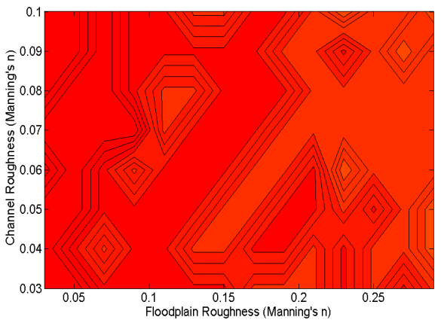
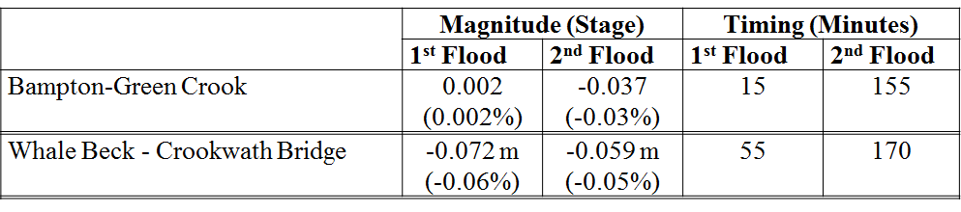
Effectiveness of NFM (Wet Woodland) depends
-7cm
Whale Beck to Crookwath Bridge
55 min
on Location
1.6 km
<6mm
15 min
Bampton to Green Crook
1.5 km
And Event

Slide 7
Being Strategic about NFM
Where you do things matters!
Currently NFM is far to opportunistic, it needs designed (like any other flood management scheme) at a catchment scale.
Otherwise
NFM may, at best, fail to achieve the optimum flood reduction benefit downstream, or, at worst, actually make flooding more severe
We run the risk that NFM is not effective simply because it has not been applied in;
(a) the most effective measures for the specific catchment characteristics;
(b) enough locations (scale); and
(c) the optimum set of locations. (magnitude, storm track, antecedent conditions, locations)
A positive impact on downstream flooding cannot be guaranteed for all possible events in all locations. = NFM Optimisation

