Slide 1
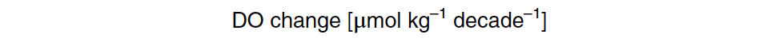
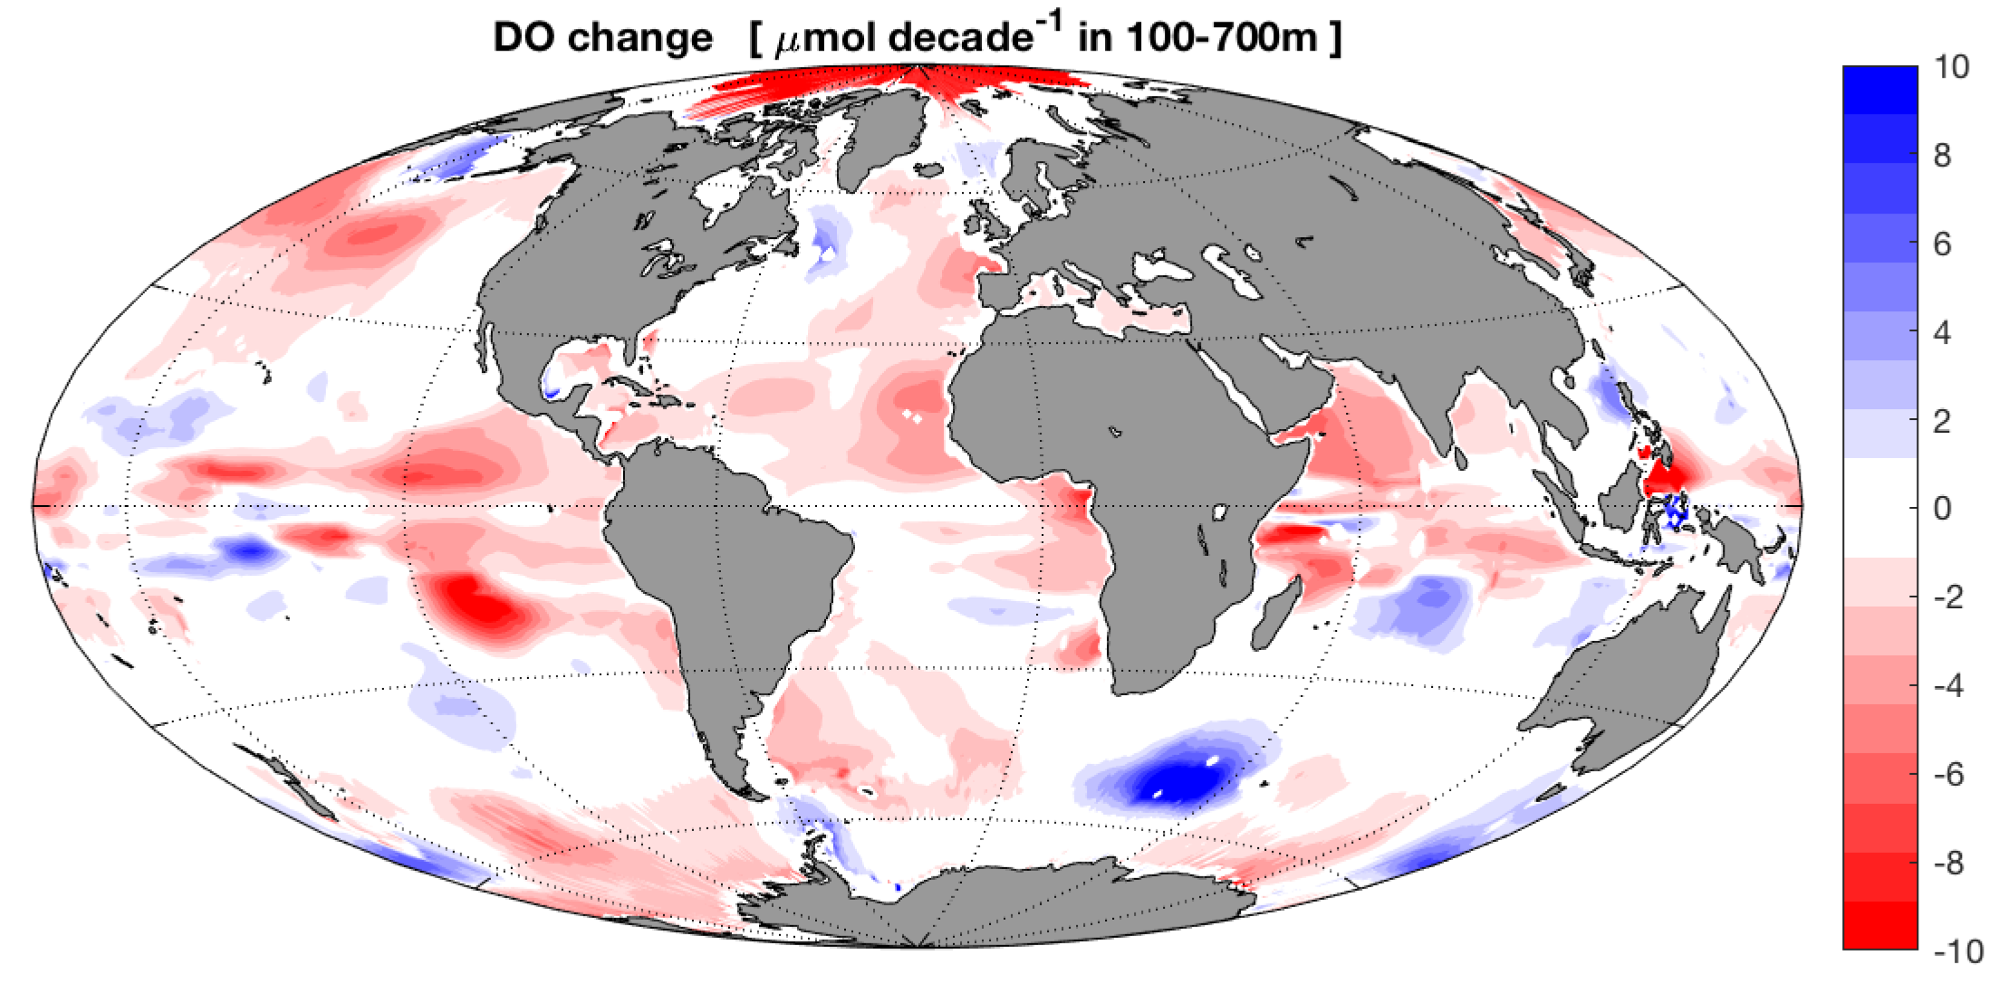

Decadal variability of circulation and oxygen in the upper equatorial Atlantic
Oxygen change along 23°W (2006-2016)
Oxygen change (1960-2010)
100m – 700m
Peter Brandt (GEOMAR, Kiel, Germany), Johannes Hahn, Sunke Schmidtko, Franz Philip
Tuchen, Robert Kopte, Rainer Kiko, Bernard Bourlès, Rena Czeschel, Marcus Dengler

Slide 2

Oxygen change along 23°W (2006-2016)
Oxygen change (1960-2010)
100m – 700m
During SFB754 enhanced measurements along 23$°$W;
Oxygen increase in the upper equatorial Atlantic and deep OMZ, decrease above the OMZ
Widespread deoxygenation particularly strong in oxygen minimum zones (OMZs) of the tropical oceans;
Globally, 2% oxygen loss

Slide 3
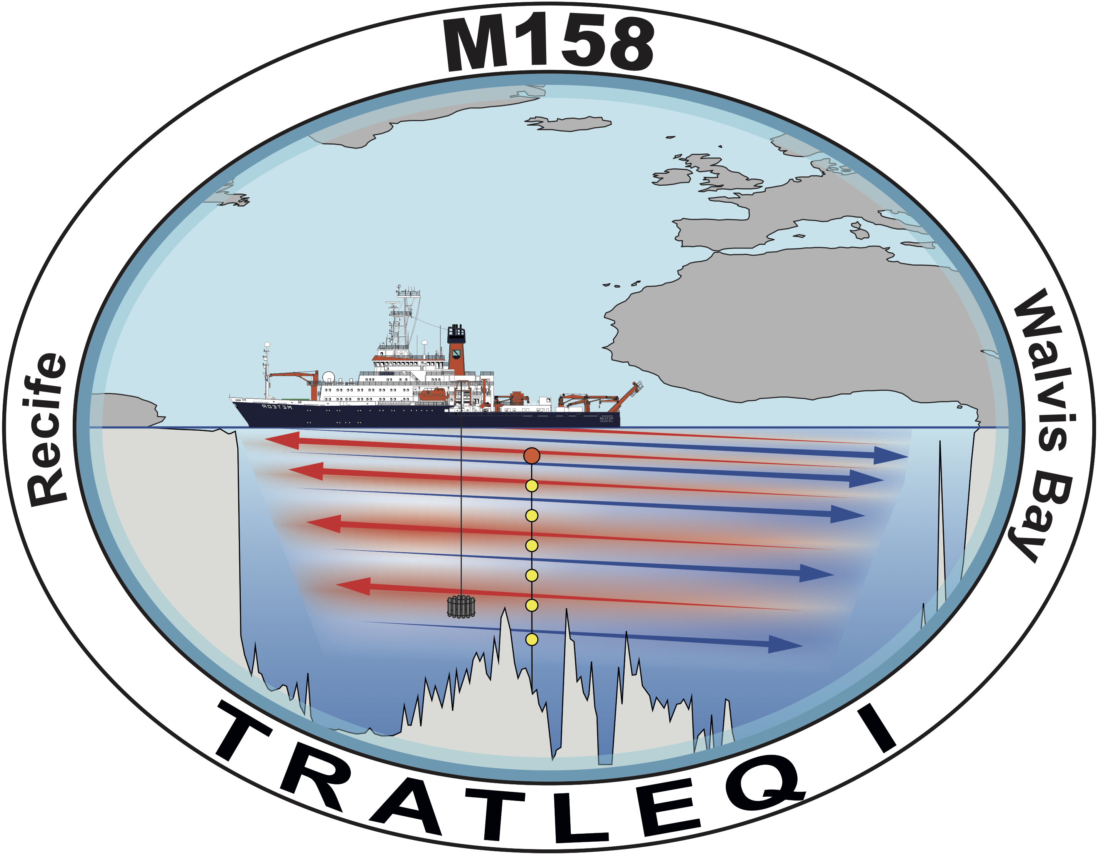
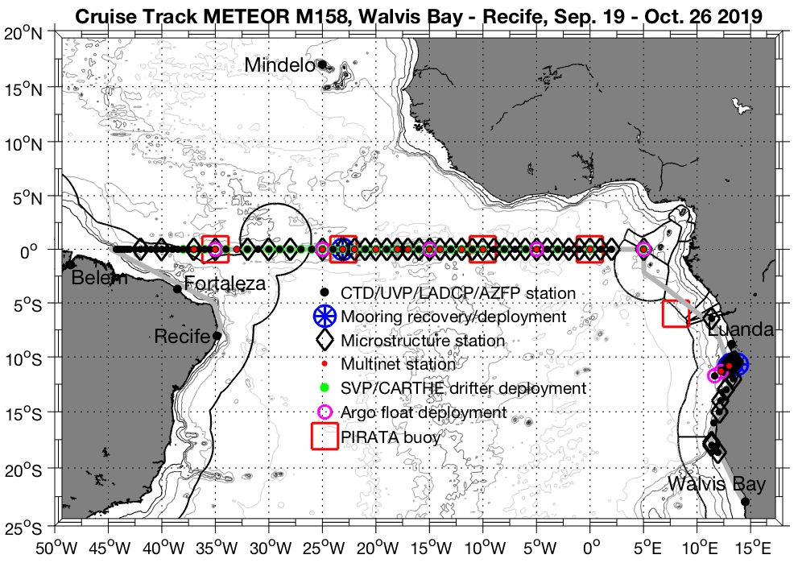

Meteor cruise TRATLEQ 1: physical, biogeochemical, biological program along the equator;
Hydrographic measurements, exchange of long-term equatorial mooring, 23$°$W
Oxygen distribution along the equator with OMZ in the East;
Deep deoxygenation, but strong oxygen increase in the upper 300m relative to climatology

Slide 4

Habitat of pelagic fish can be defined as surface oxygenated layer (SOL) here defined above 120 $μ$mol/kg;
Deep (500m) at the western boundary, shallow (50m) above OMZs in the East
In the equatorial region, there is a multi-decadal variability in the SOL thickness;
Since 2000, equatorial oxygen increase and SOL thickening

Slide 5
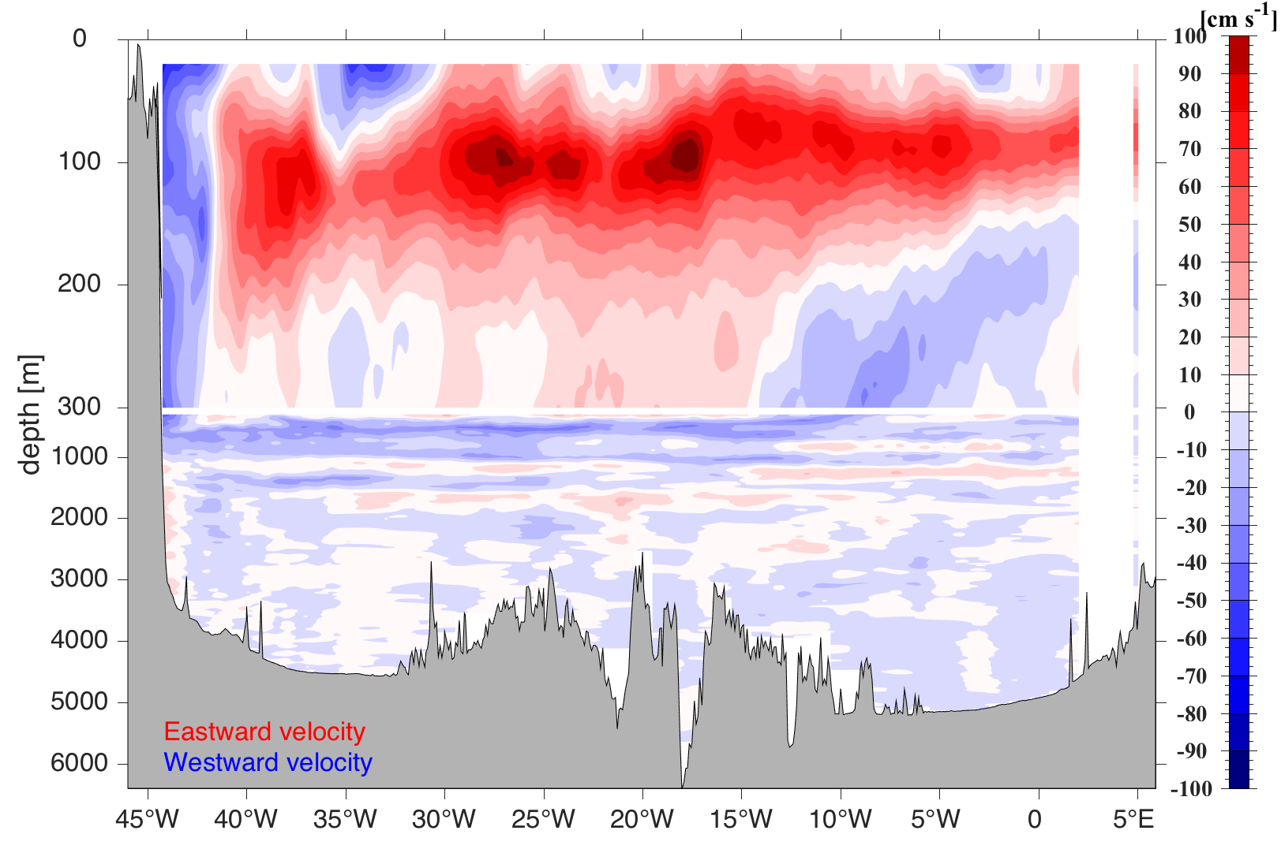

EUC transport anomaly from 23°W mooring
Zonal velocity along the equator measured during TRATLEQ 1;
Strong eastward flow of the Equatorial Undercurrent (EUC) in the upper 300m, below equatorial deep jets
Current meter mooring at 23$°$W allows calculating EUC transport: mean 14 Sv; Since 2008, about 20% increase in EUC transport and associated eastward oxygen transport

Slide 6
Decadal variability of circulation and oxygen in the upper equatorial Atlantic
Peter Brandt (GEOMAR, Kiel, Germany), Johannes Hahn, Sunke Schmidtko, Franz Philip
Tuchen, Robert Kopte, Rainer Kiko, Bernard Bourlès, Rena Czeschel, Marcus Dengler

