Slide 1
An example of spatial correlation between soil water content and irrigated alfalfa yield at sub-field scale
Anatoly Zeyliger, Olga Ermolaeva
Russian State Agrarian University – Moscow Timiryazev Agricultural Academy, Moscow, Russian Federation, E-mail: azeiliguer@mail.ru
EGU-2020 Online Session HS6.3 - "Remote sensing of soil moisture“ (EGU2020-16529)
The 8 May 2020

Slide 2
Research objective
To reveal the presence of spatial correlation between soil water content and biomass productivity of irrigated alfalfa sowing

Slide 3
Research objectives
To develop and test the method of field mapping of soil water content in the soil coverage;
Carry out field mapping of biomass for sowing irrigated alfalfa.

Slide 4
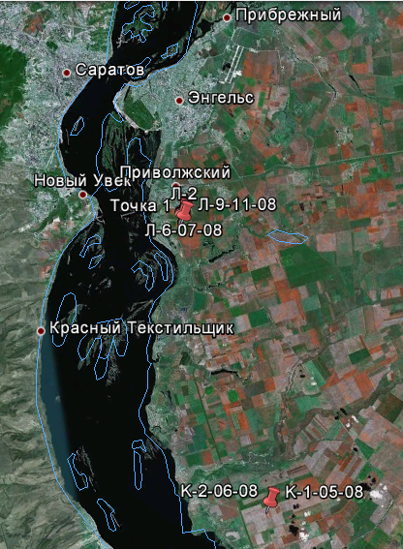
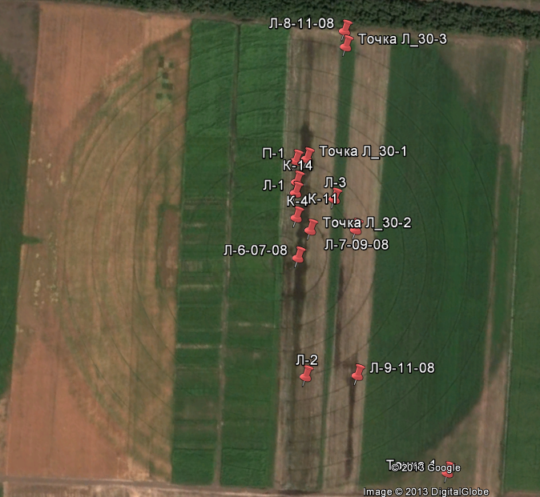
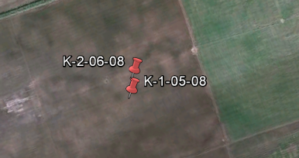
Objects of research (Left Bank of Middle part of River Volga)

Slide 5
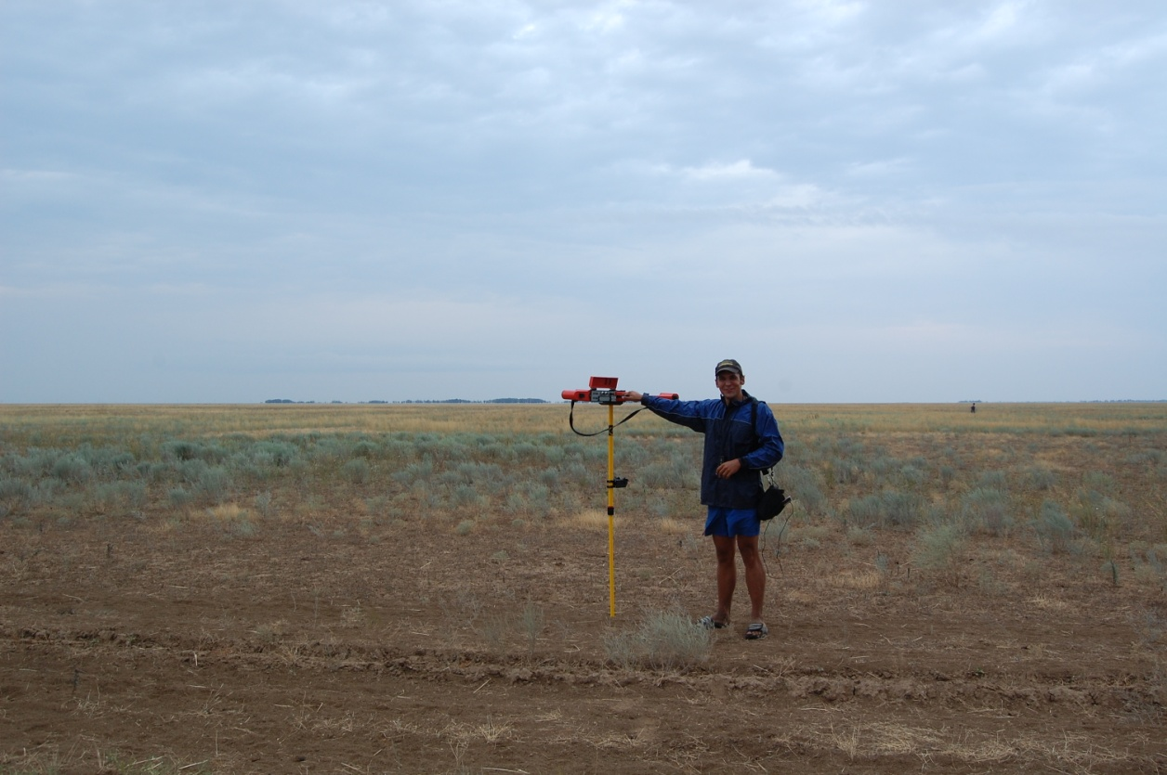
Used measuring device EM-38

Slide 6
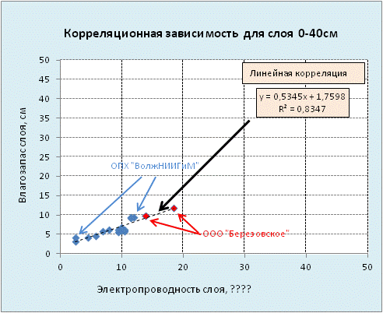
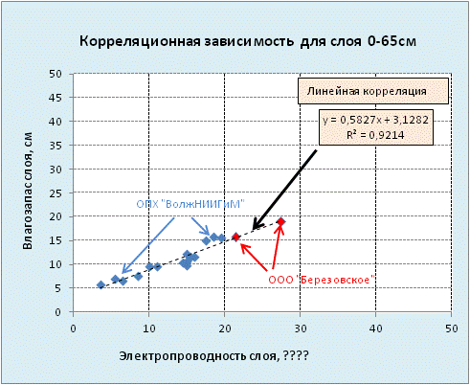
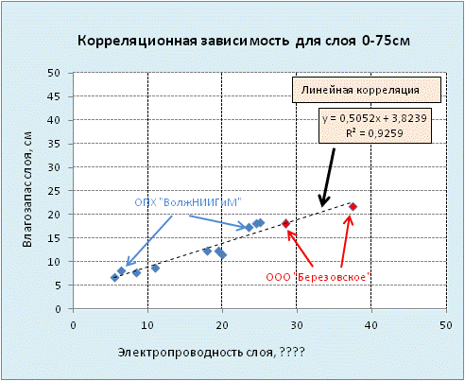
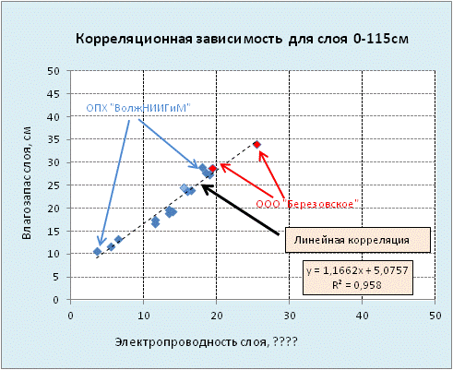
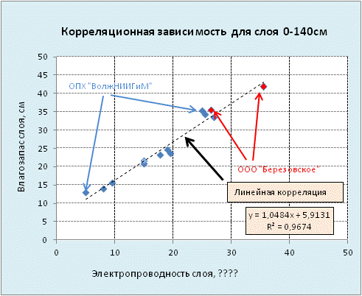
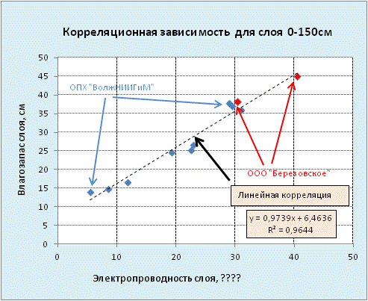
Methodology for mapping the soil water content at soil coverage

Slide 7
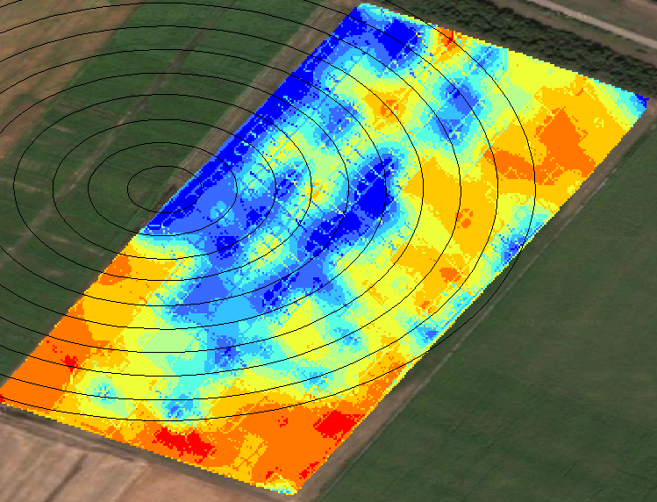
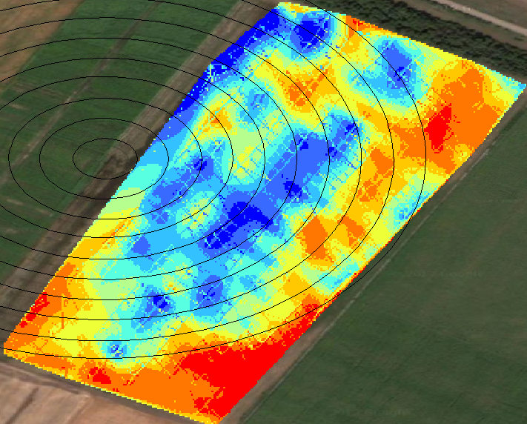
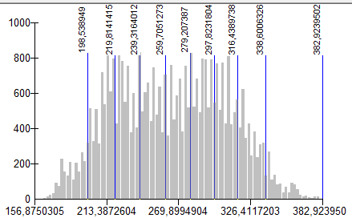
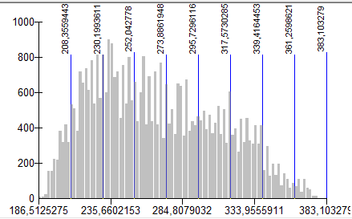
Cartograms of soil moisture storage at 0-150 cm of two adjacent events
09-08-2012 (soil depth 0-150см)
Before pain fall
11-08-2012 (soil depth 0-150см)
After rain fall

Slide 8
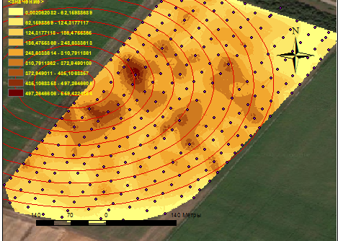
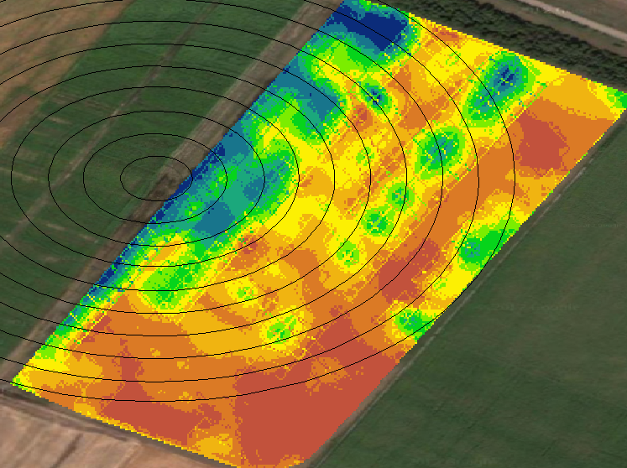
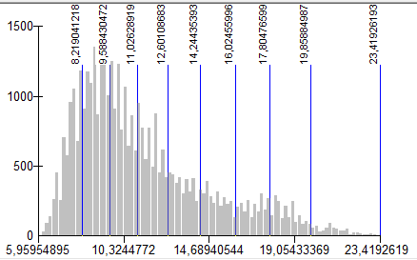
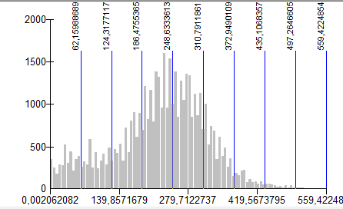
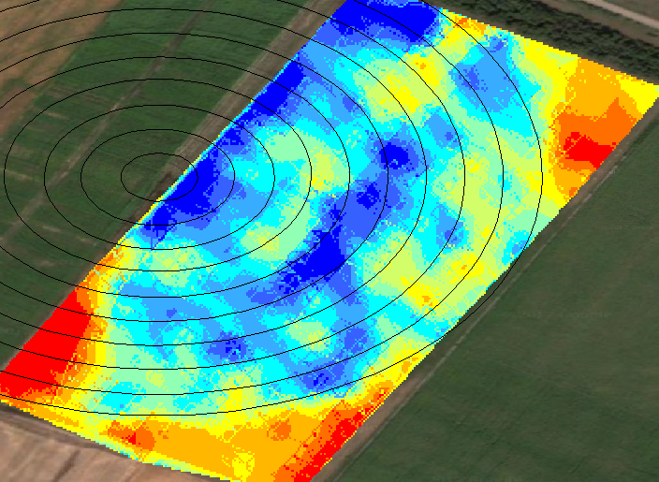
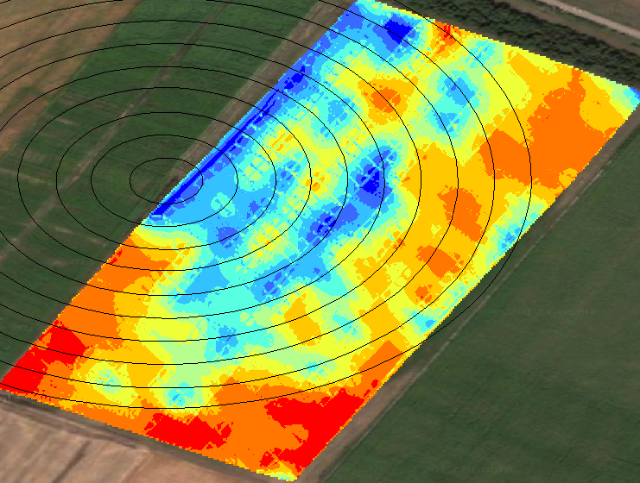
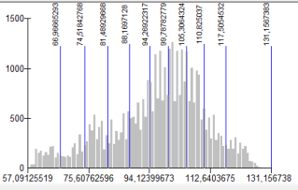
Results
Biomass productivity15-07-2012
19-07-2012 (soil water contentn 0-75см)
01-08-2012 (soil water contentn 0-75см)
09-08-2012 (soil water contentn 0-150см)

Slide 9
Conclusion
The results of field mapping of biomass and soil water content at soil coverage indicate the presence of spatial correlation between both of them

Slide 10
Thanks for your time and attention!

