Slide 1
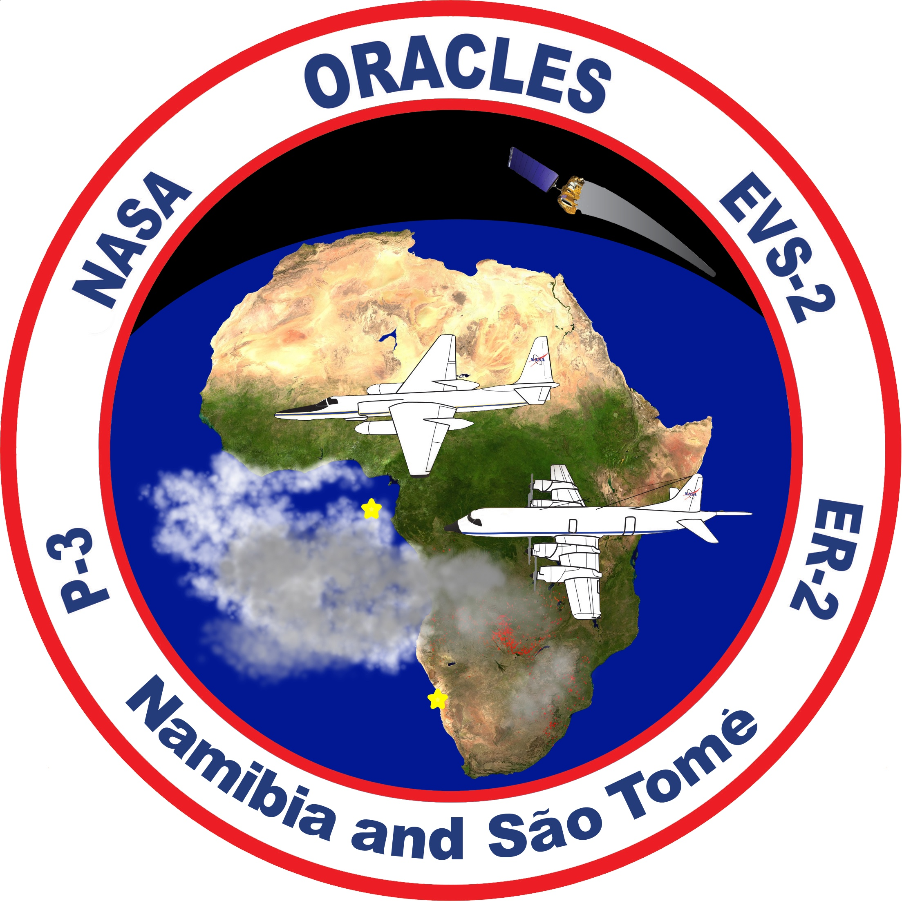
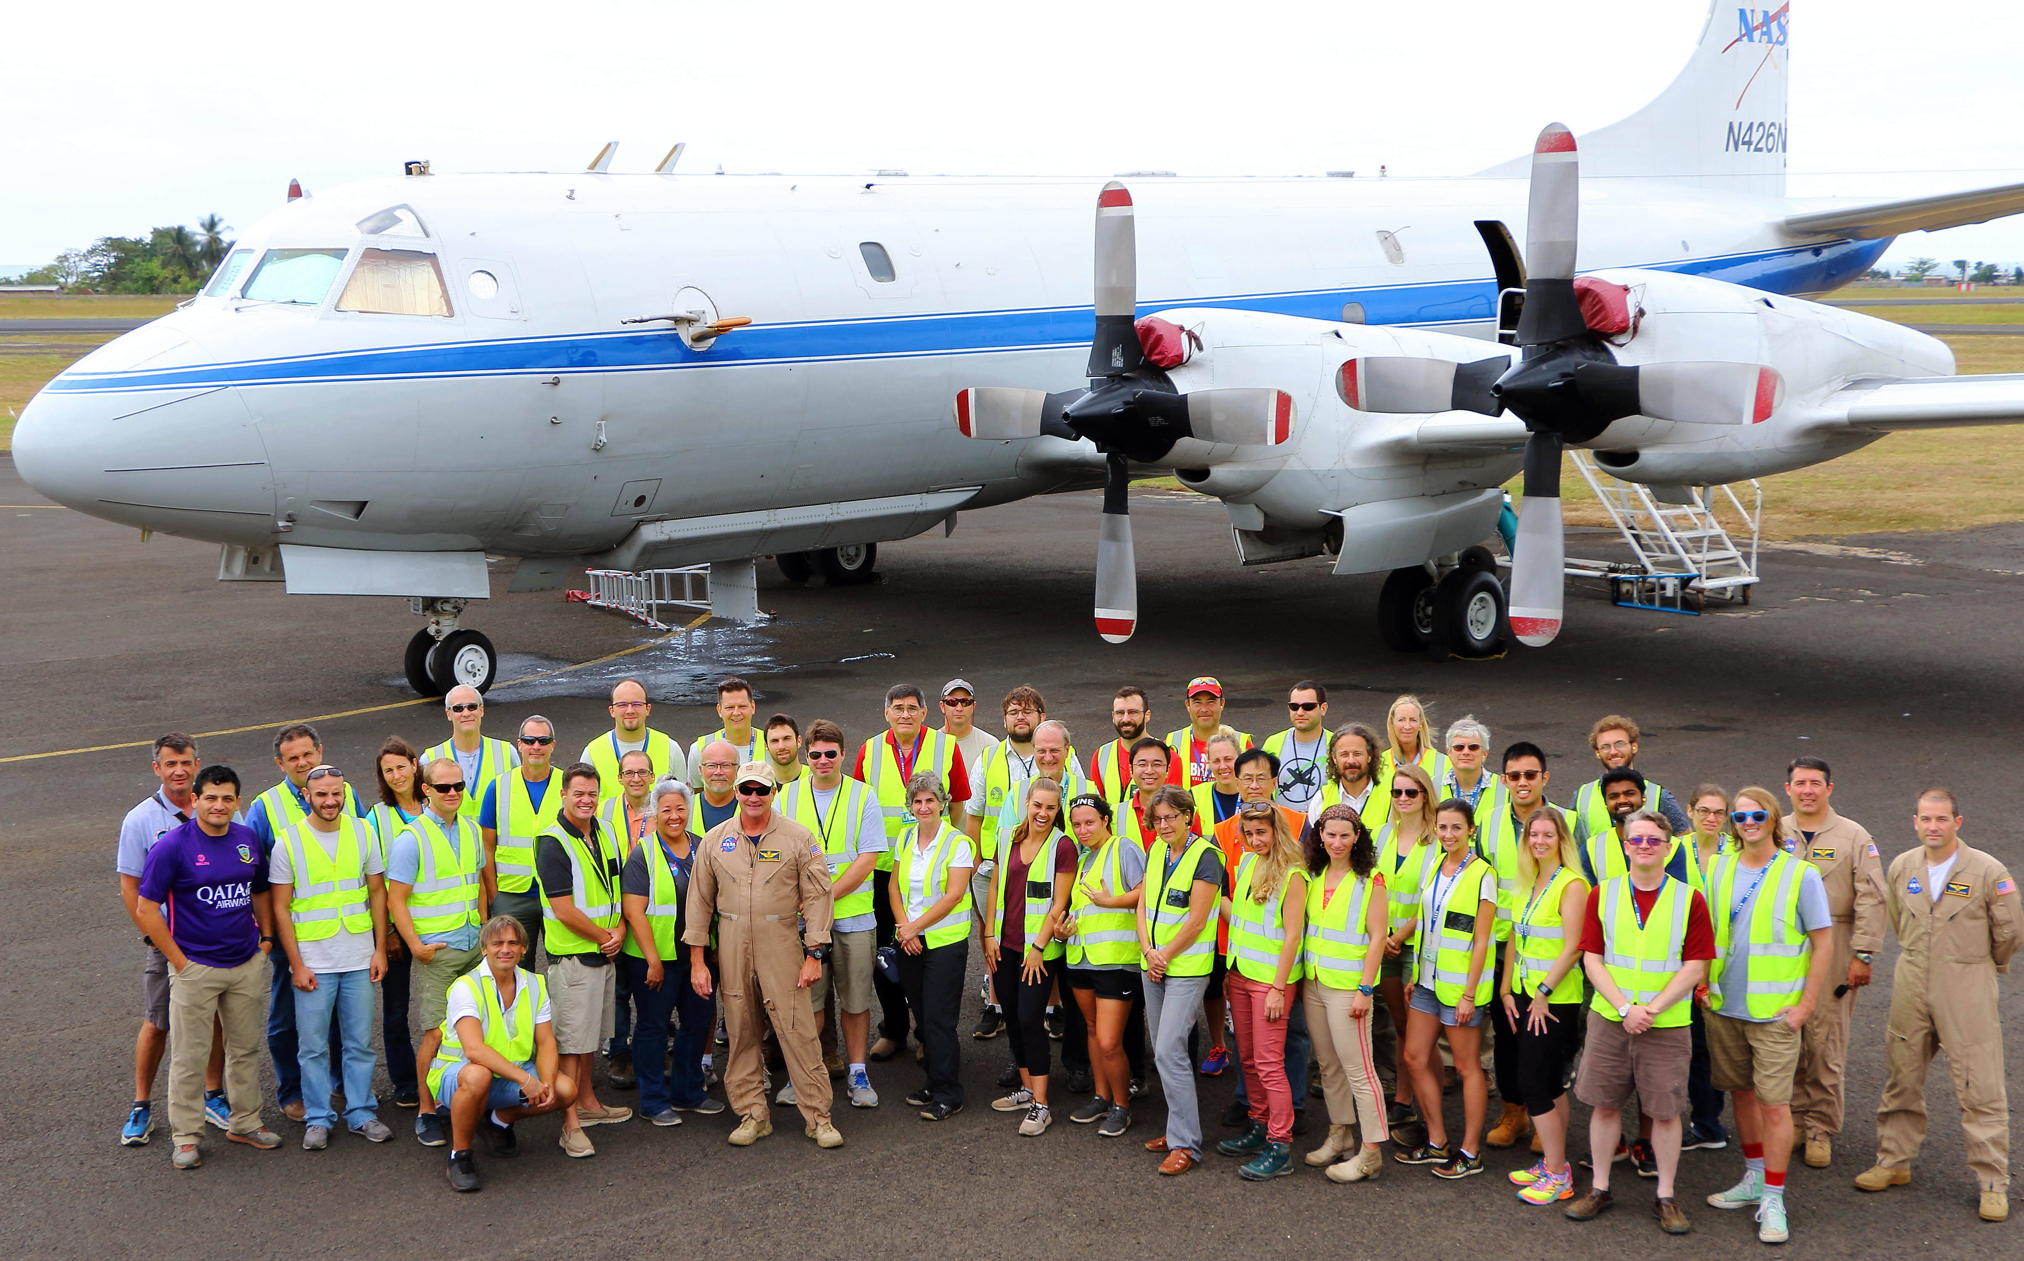
The NASA ORACLES* airborne flight projects – lessons learned for future multi-platform missions to study aerosol-cloud-climate interactions (*ObseRvations of Aerosols Above Clouds and Their IntEractionS)
Jens Redemann,
& the ORACLES Science Team
¹School of Meteorology - OU, OK 73019, USA
EGU 2020 – General Assembly 4–8 May 2020
Sharing Geoscience Online

Slide 2
The NASA ORACLES* airborne flight projects – lessons learned
Contents
ORACLES (NASA Earth Venture Suborbital) – Background
Implementation & Science Questions
2016 & 2017 & 2018 – Flight summaries
Preliminary Science
Lessons learned for multi-platform missions
Conclusions

Slide 3
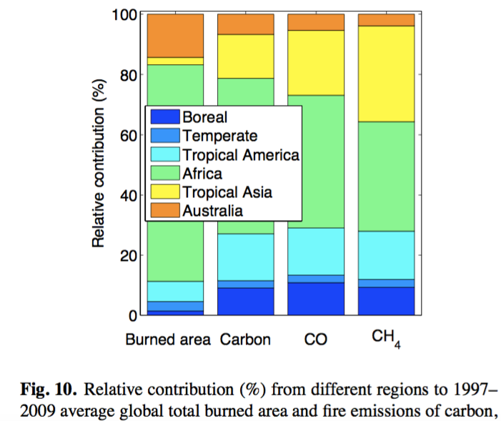
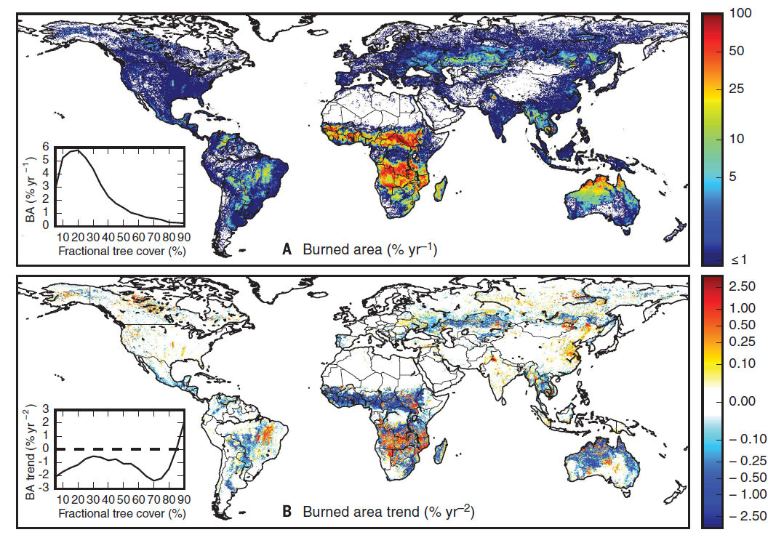
ORACLES (NASA Earth Venture Suborbital) – Background
World’s largest emissions of biomass-burning aerosols are in Africa: 50% of all carbon
Trends in burned area globally decreasing.
In Africa, trend is increasing.
Andela et al., 2017
v. d. Werf et al., 2010
Notes:
MOTIVATION

Slide 4
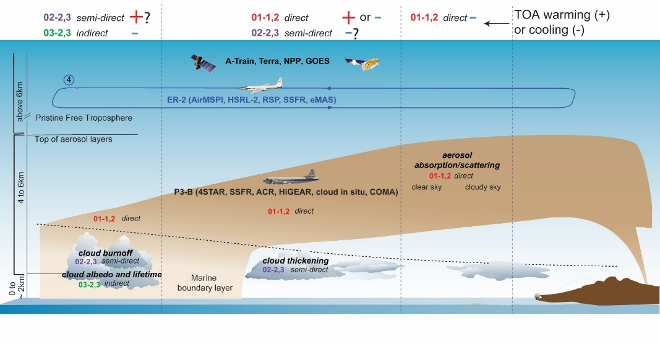
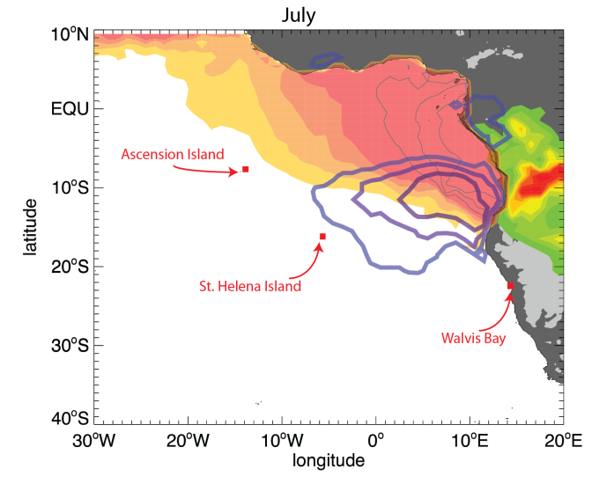
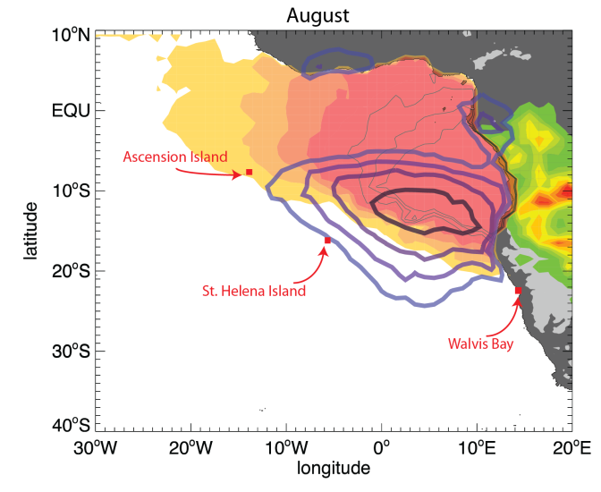
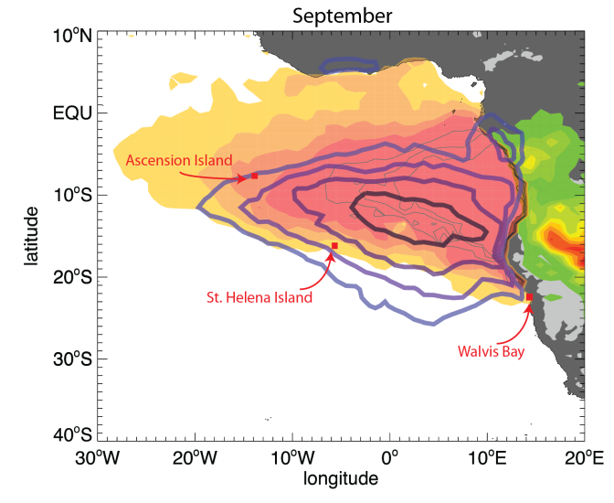
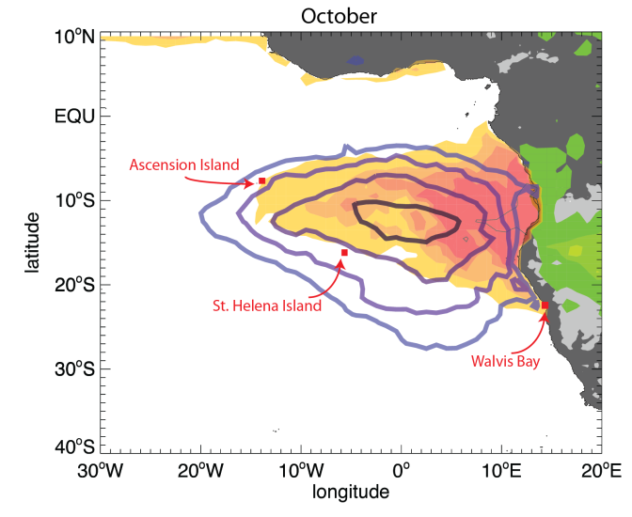
Aerosol-radiation-cloud interactions over the SE Atlantic:
What we know from satellite observations
AOD
July
August
Fire counts
fractional
cloud cover
(stratocumulus)
September
October
Centroid of Stratocumulus (Sc) cloud deck changes only slightly during season (Jul-Sep)
Location of peak biomass burning moves southward
Presence of clouds greatly limits passive aerosol remote sensing from satellites
Adebiyi et al., 2015
2002-2012 climatology
Notes:
MOTIVATION & why we’re measuring where / when we are.

Slide 5
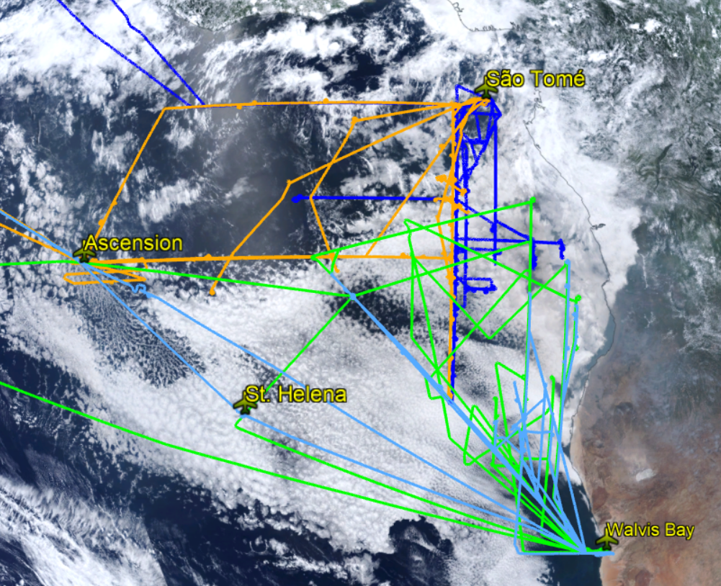
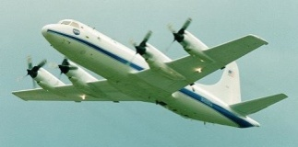
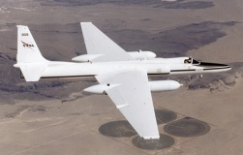
Aerosol-radiation-cloud interactions over the SE Atlantic
ORACLES Implementation
Three campaigns with NASA P-3 (2016-18), one with NASA ER-2 aircraft
Sep 2016: 15 P-3 and 12 ER-2 flights (Namibia)
Aug 2017: 13 P-3 flights (Sao Tome)
Oct 2018: 15 P-3 flights (Sao Tome)
Observations of radiation, aerosol & cloud microphysics with various remote sensing and in situ instruments:
ER-2: HSRL-2, SSFR, eMAS, RSP, AirMSPI
P-3: HSRL-2, SSFR, 4STAR, APR-3, RSP, AMPR, aerosol and cloud in situ, CO/CO₂, H₂O and isotopes
Coordinated with international airborne partner projects (CLARIFY, LASIC, AEROCLO-sA)
Involves 6 NASA centers, 10 universities
Establishes 2 new AERONET sites, many other central African sites re-established simultaneously
5 yr total duration, 2014 – 2020 (no-cost extension)
Includes LES, WRF-Chem, and GEOS-5 modeling
50% routine flights to facilitate model-obs comparisons (for regional & global models)
P-3: Profiling aircraft 2016, 2017 & 2018
ER-2: High-flying 2016 only
Science Questions
Q1: What is the direct radiative effect of the African biomass burning (BB) aerosol layer in clear and cloudy sky conditions over the SE Atlantic?
Q2: How does absorption of solar radiation by African biomass burning (BB) aerosol change atmospheric stability, circulation, and ultimately cloud properties?
Q3: How do BB aerosols affect cloud droplet size distributions, precipitation and the persistence of clouds over the SE Atlantic?

Slide 6
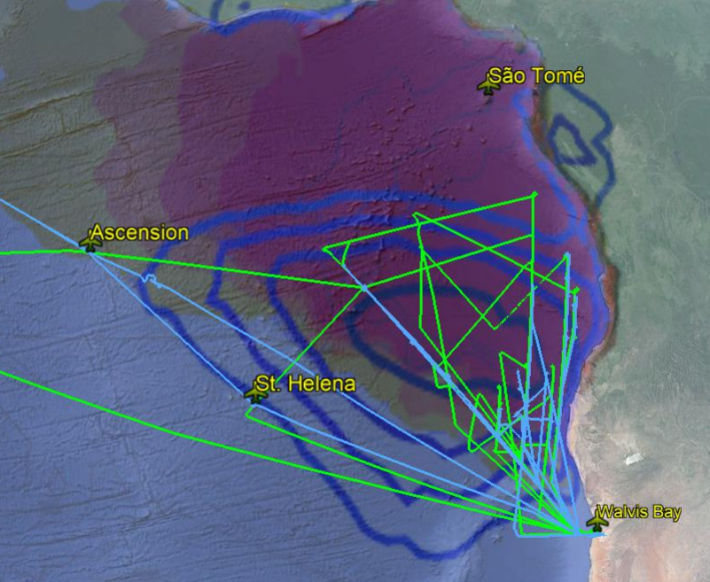
ORACLES 2016: NASA P-3 & ER-2 flights from Namibia
NASA ER-2
High-altitude (18km)
Remote sensing
Large spatial coverage
2016 only
NASA P-3
Profiles (0-8km)
In-situ + remote sensing
2016, 2017 & 2018
Image: August Climatology
MODIS low cloud fraction contours (open blue)
MODIS aerosol optical depth (filled orange)
Coordinated flight
segments
Notes:
Hit briefly on where exactly we measured, and with what

Slide 7
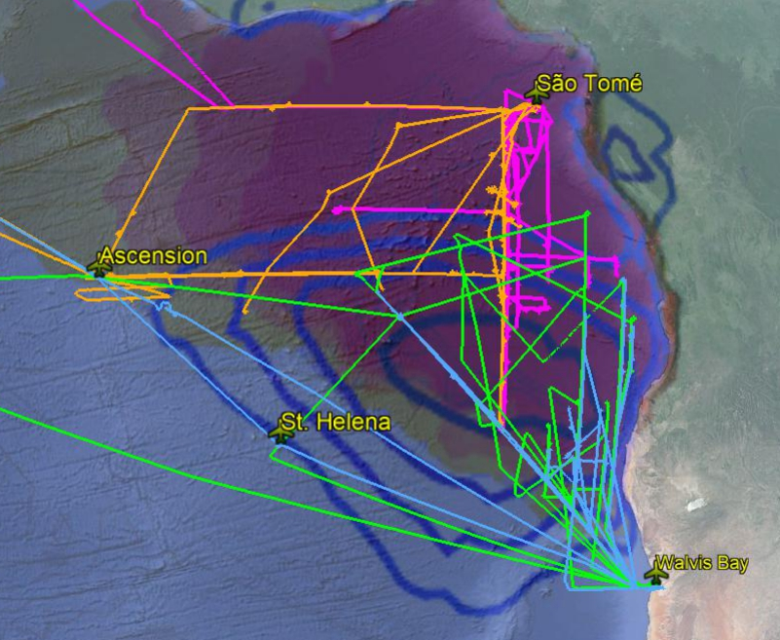
ORACLES 2016: NASA P-3 & ER-2 flights from Namibia
ORACLES 2017 & 2018: Flights out of São Tomé with NASA P-3
NASA ER-2
High-altitude (18km)
Remote sensing
Large spatial coverage
2016 only
NASA P-3
Profiles (0-8km)
In-situ + remote sensing
2016, 2017 & 2018
Image: August Climatology
MODIS low cloud fraction contours (open blue)
MODIS aerosol optical depth (filled orange)
Coordinated flight
segments
Notes:
Hit briefly on where exactly we measured, and with what

Slide 8
ORACLES 2016: NASA P-3 & ER-2 flights from Namibia
ORACLES 2017 & 2018: Flights out of São Tomé with NASA P-3
Flight hour summary
September 2016 – Walvis Bay
P-3: 15 flights (115.2 hrs)
ER-2: 12 flights (97.3 hrs)
8 flights coordinated
August 2017 - São Tomé
P-3: 13 flights (112.0 hrs)
October 2018 - São Tomé
P-3: 15 flights (121.4 hrs)
Totals:
P-3: 43 flights (348.6 hrs)
ER-2: 12 flights (97.3 hrs)
Image: August Climatology
MODIS low cloud fraction contours (open blue)
MODIS aerosol optical depth (filled orange)
Notes:
Hit briefly on where exactly we measured, and with what

Slide 9
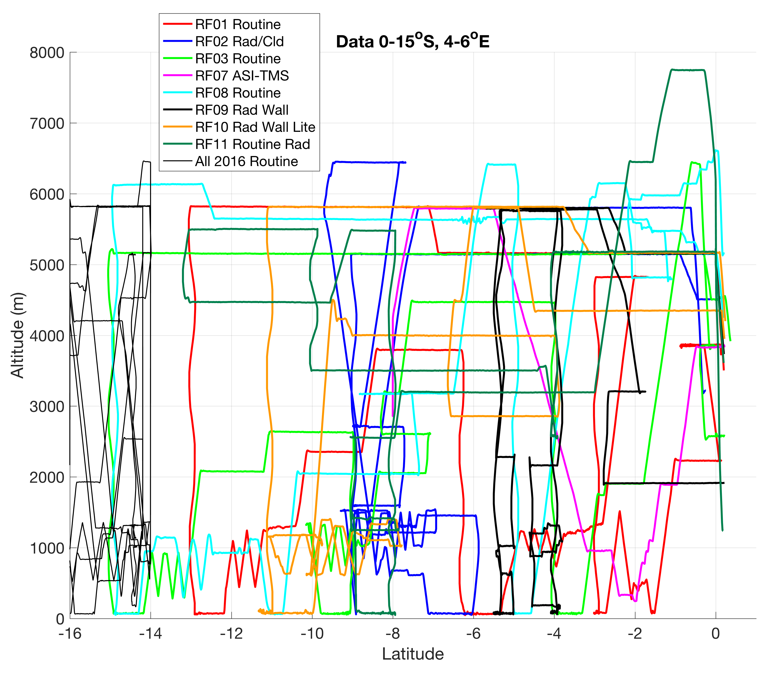
ORACLES 2016: NASA P-3 & ER-2 flights from Namibia
ORACLES 2017 & 2018: Flights out of São Tomé with NASA P-3
2017 & 2018 “Routine”
Flight Track
(5-6 flights + several w/ data on this track)
Latitude
2016 “Routine” Flight Track
(6 flights)
Image: August Climatology
MODIS low cloud fraction contours (open blue)
MODIS aerosol optical depth (filled orange)
Notes:
Hit briefly on where exactly we measured, and with what

Slide 10
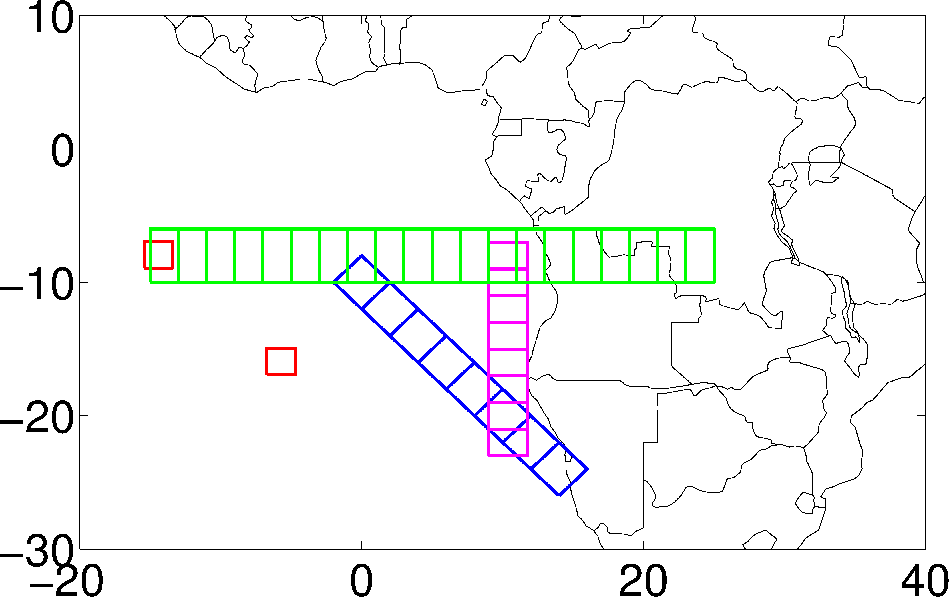
ORACLES: Framework for Model / observation comparisons
2017&2018 ROUTINE TRACK
{E-W transect for model gradient}
Ascension -- LASIC
2016: frequent flights N-S
St. Helena
2016 ROUTINE TRACK

Slide 11
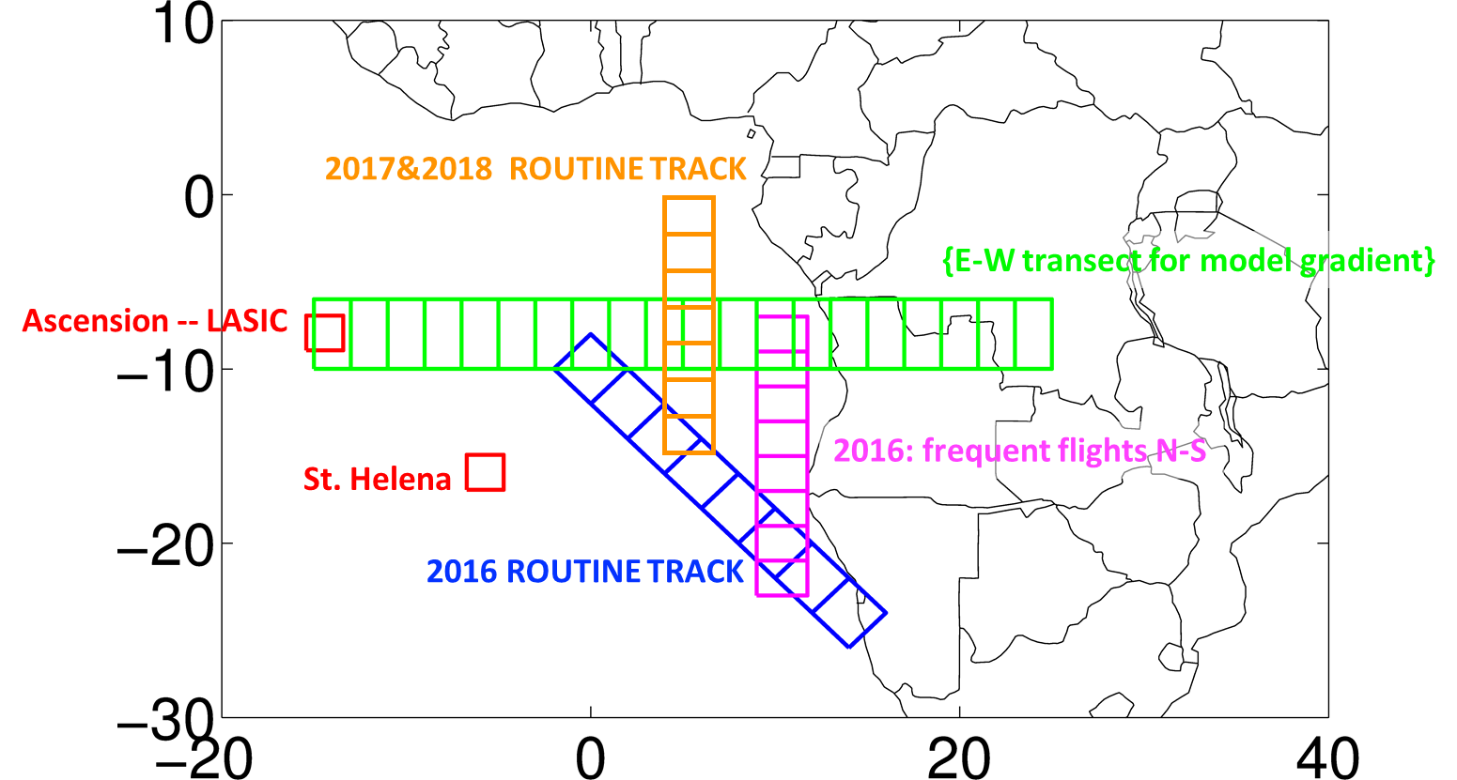
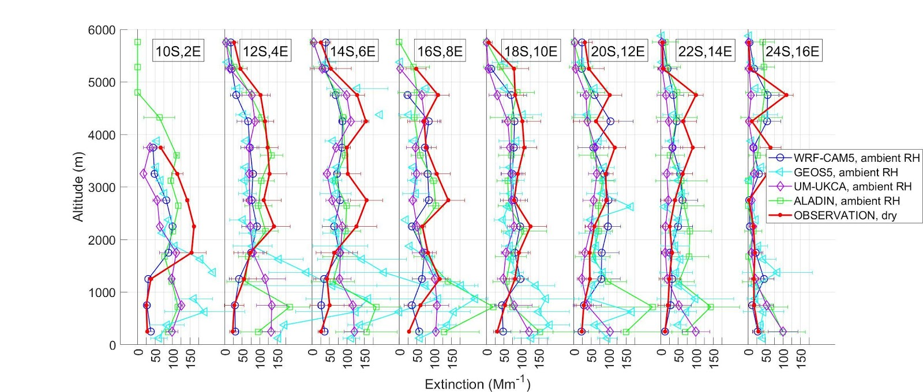
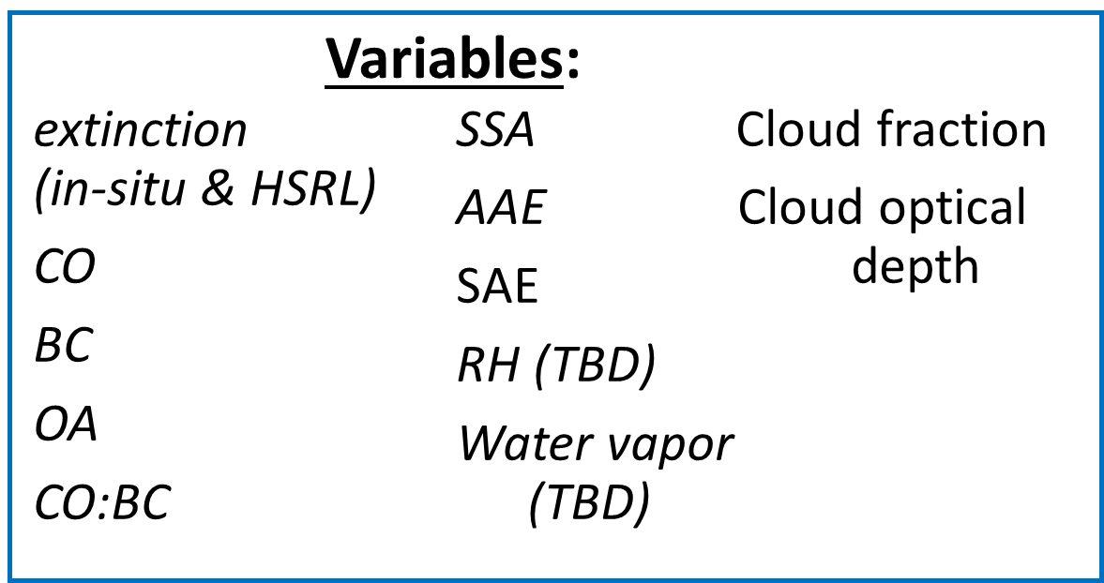
Model/obs comparisons: Aerosol Extinction
Gridbox-average comparisons (2016 only)
NW-SE transect gridboxes (shown left→right = NW→SE)
WRF-CAM5
GEOS-5
UM-UKCA
ALADIN
Airborne Obs.
Doherty, Saide, Shinozuka, Zuidema, et al.
Notes:
WOULD LOVE TO ADD ONE LIKE THIS FOR 2016 -- Paquita do you have?

Slide 12
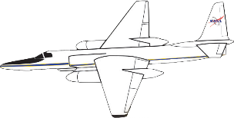
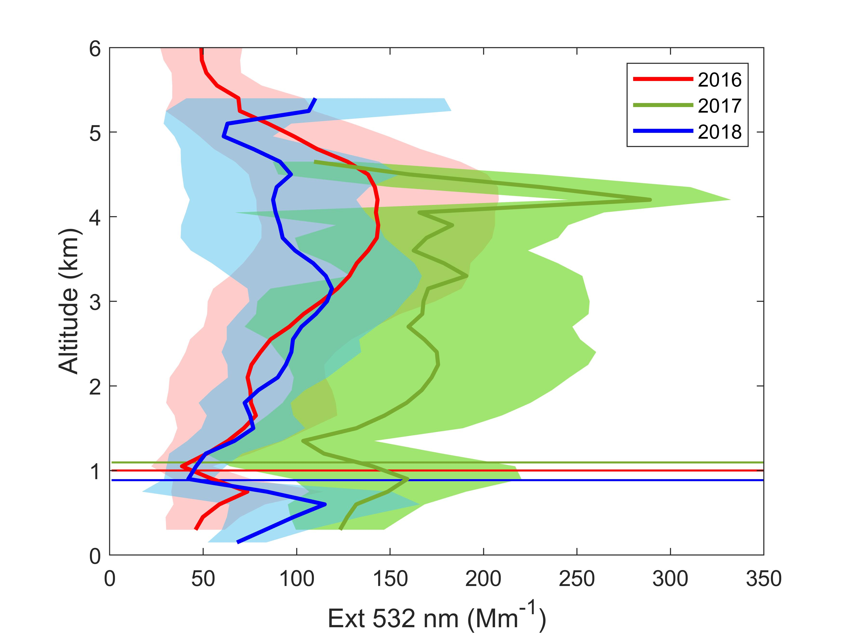
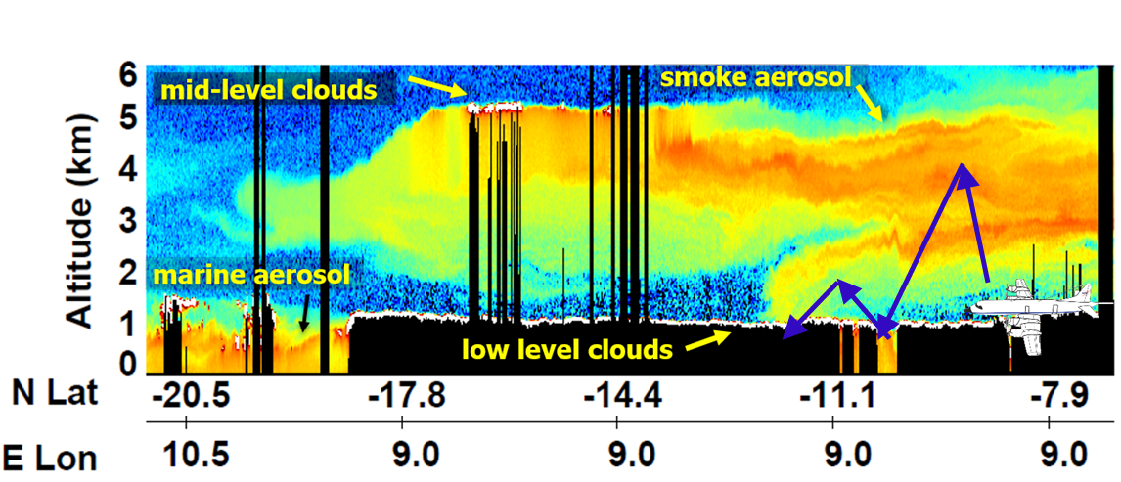
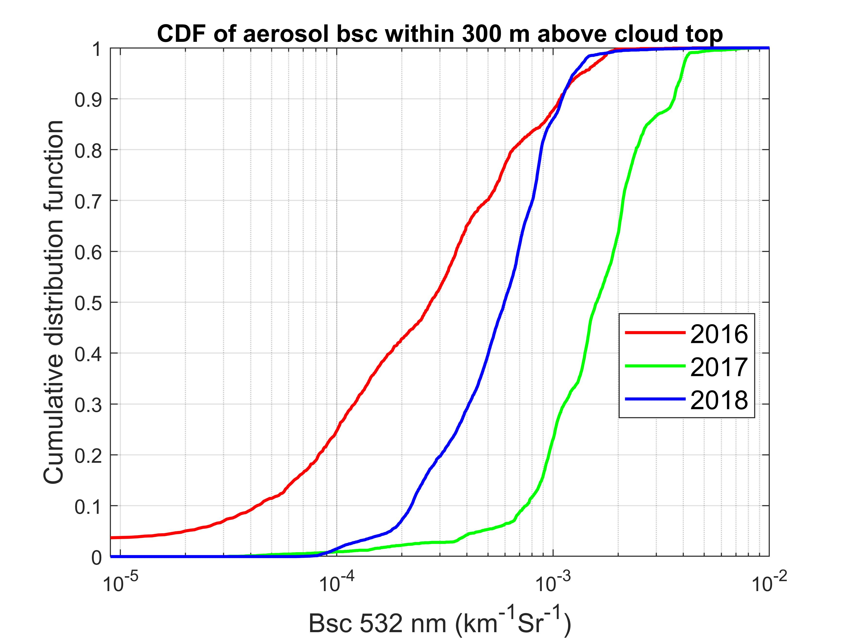
ORACLES: Process-level insight through a suite of coordinated in-situ & remote sensing measurements
HSRL-2 Aerosol Extinction Profiles
Bsc frequency (0-300m above cloud)
0.25 Mm⁻¹sr⁻¹
HSRL-2 captures detailed plume structure and mixing into Sc cloud deck!
In 2016, on average, the smoke layer was in contact with low level clouds over 40% of the time, more frequently than assumed.
Ferrare, Burton, Hostetler, HSRL-2 team (NASA LaRC)
Conclusion on gap frequency depends on threshold definition!
Yet, even for a given threshold, Sep 2016 shows more contact than Aug 2018, which shows more than Oct 2017.
Notes:
In tis and the two slides that follow I am trying to QUICKLY hit on the type of measurements we made so they know what kind of data are going to be available.

Slide 13
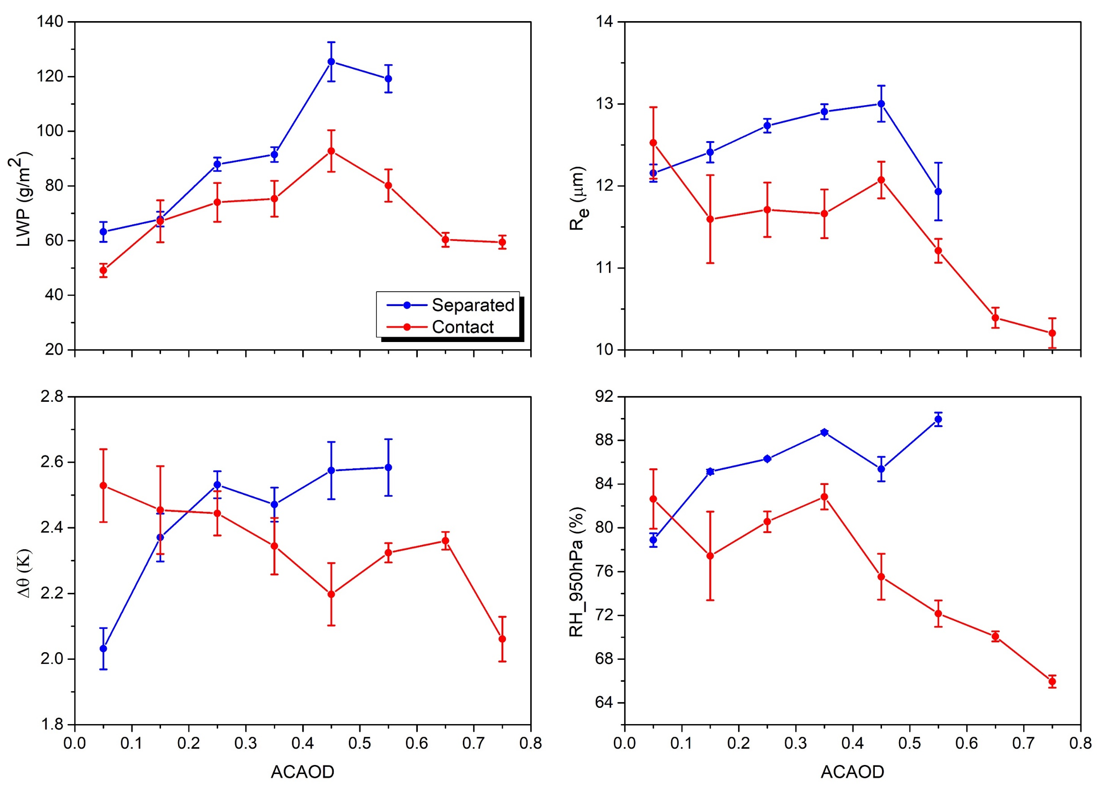
Cloud properties and environmental conditions as a function of Above-cloud AOD (SST 290-292 K)
LWP (from RSP) increases with ACAOD in separated case while it first increases then decreases in the contact case.
R_{e} does not change much in separated case (slightly increases due to thicker cloud) while it decreases in contact case.
Δθ (from Merra2) increases in the separated case and decreases in the contact case.
BL RH increases in separated case and decreases in the contact case.
Separated: aerosol bsc (532nm) < 0.25 Mm⁻¹Sr⁻¹ for 100 m vertical layer above cloud top.
Contact: aerosol bsc > 0.25 Mm⁻¹Sr⁻¹ for 100 m vertical layer above cloud top.
Δθ is defined as the difference in potential temperature within 100 m above cloud, serving as entrainment rate.
Gao et al. (in prep.)

Slide 14
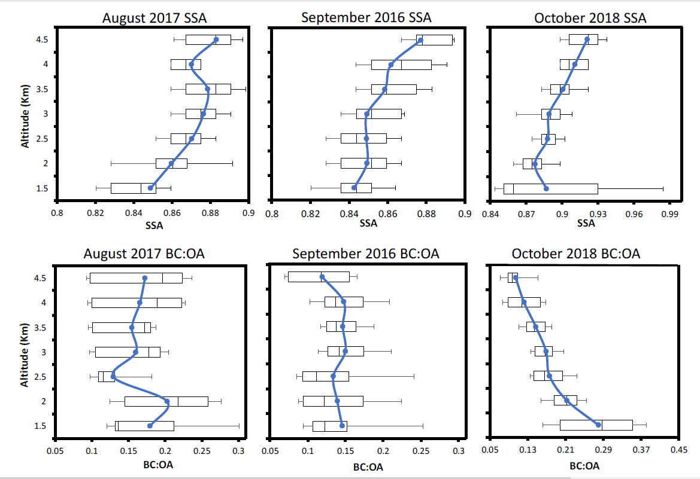
ORACLES: Process-level insight through a suite of coordinated in-situ & remote sensing measurements
Vertical distribution of aerosol single scattering albedo (SSA) is directly linked to vertical distribution of carbonaceous aerosol composition!
Dobracki, Zuidema, Howell, Shinozuka
2018 data: preliminary
Notes:
Multiple approaches to quantifying aerosol properties – particularly of interest to AeroCom community. Esp spectral absorption and ability to relate it to composition….

Slide 15
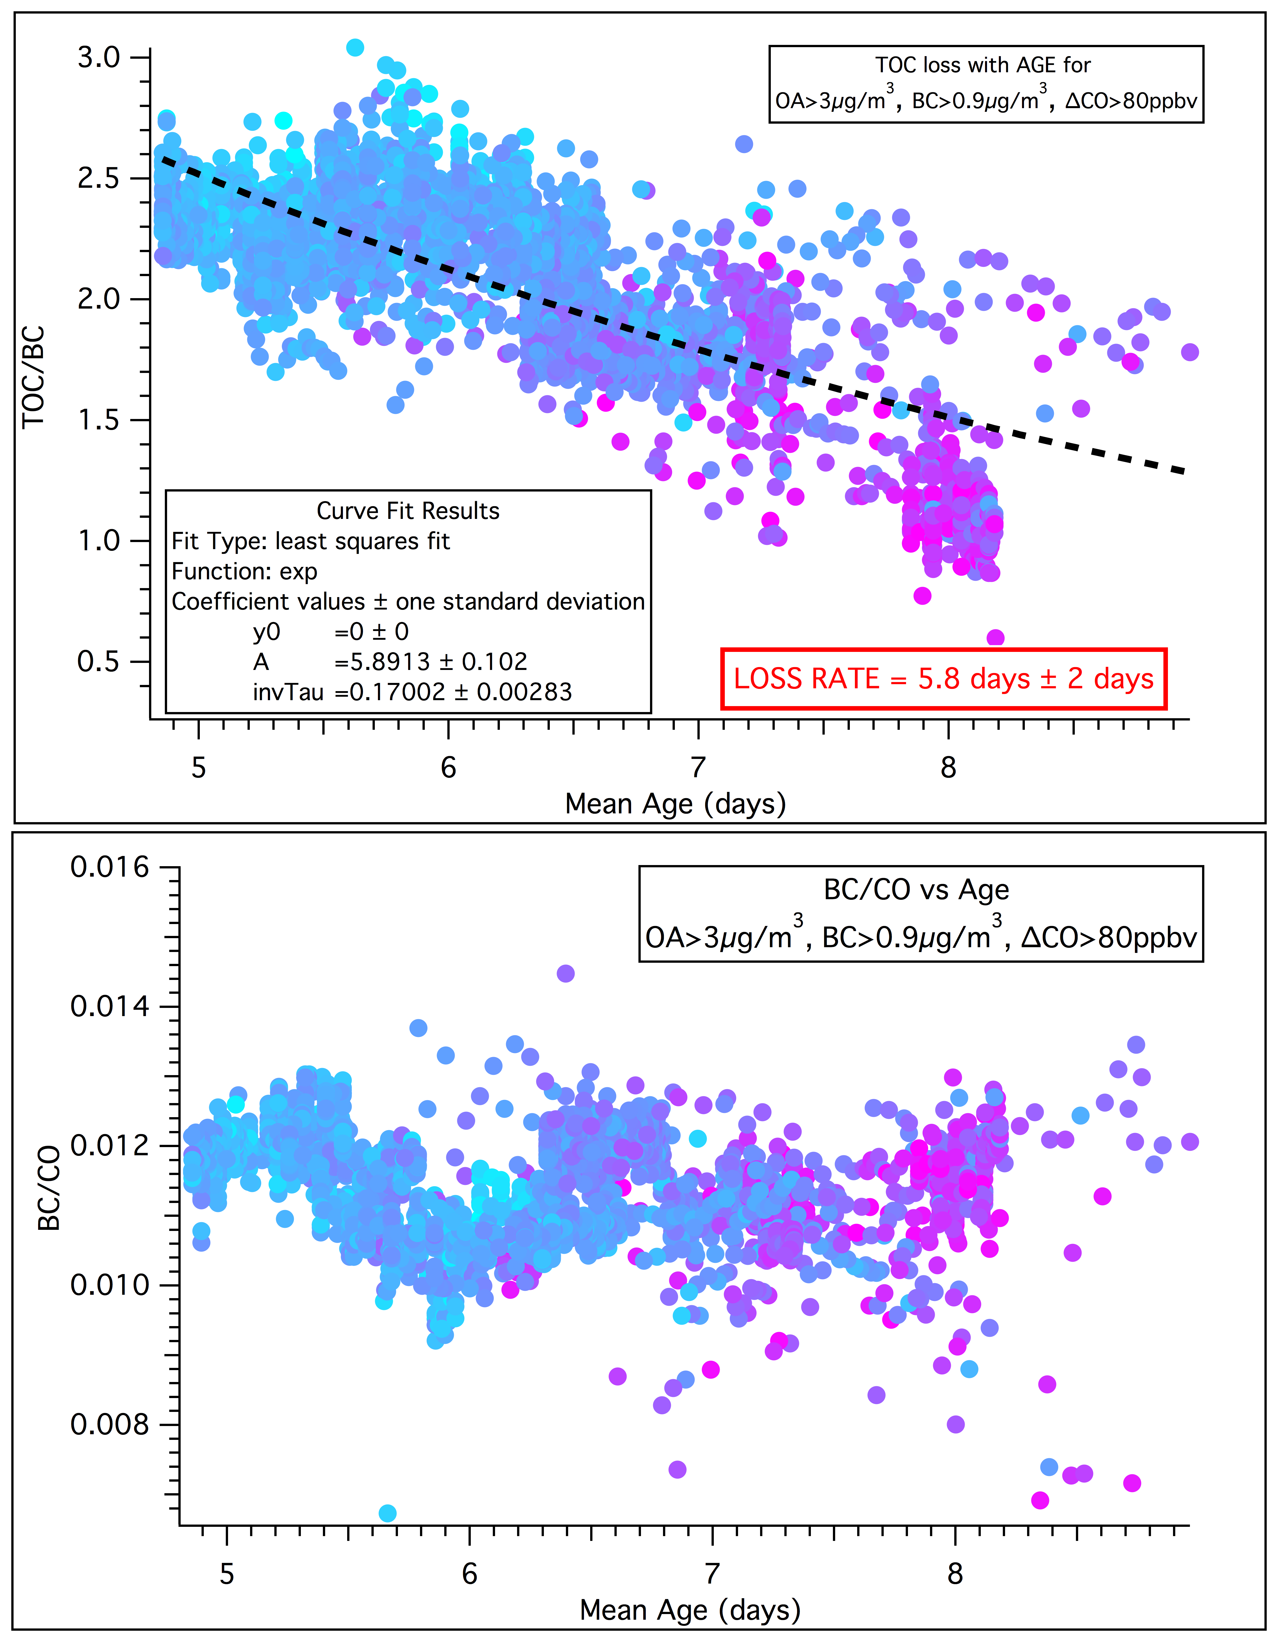
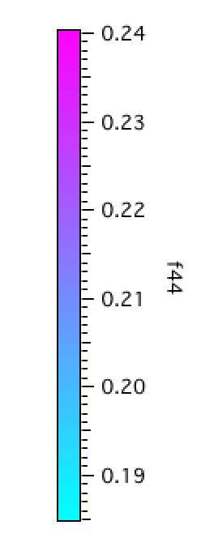
ORACLES-2016&2017: total organic carbon (TOC) loss/lifetime
TOC/BC
Plume age: WRF-Chem model, corroborated by AMS f44 – parameter = highly oxygenated OA
Can use f44 as a qualitative tracer for aerosol age (Cubison et al., 2010)
TOC from AMS, BC from SP2 instruments
Various Filters on OA, BC, and CO
Exponential decay to calculate TOC lifetime
f(x)= y0 + Ae^{(-t/𝝉)}
Preliminary campaign averages:
2016&2017: τ = 7.2 ± ~2 days
TOC Lifetime = 6±2 days
Mean plume age (days)
BC/CO
Dobracki, Zuidema (U of Miami), Howell, Freitag (U of HI/U of Miami),
Saide (UCLA), Carmichael (U of Iowa), Sedlacek (BNL), Podolske (ARC)
Mean plume age (days)

Slide 16
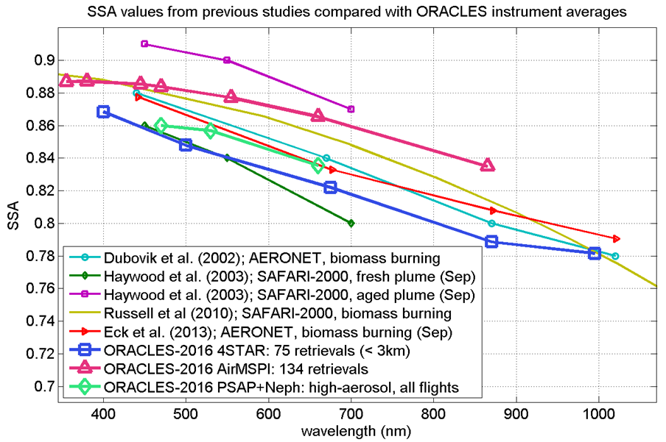
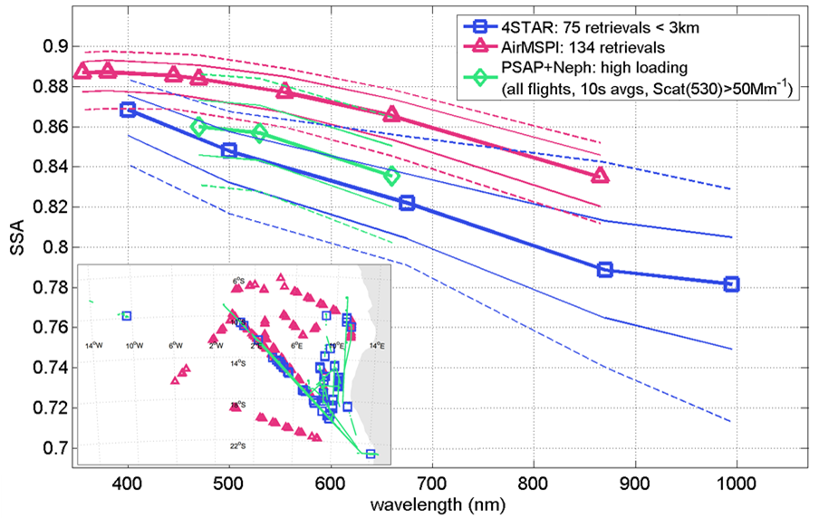
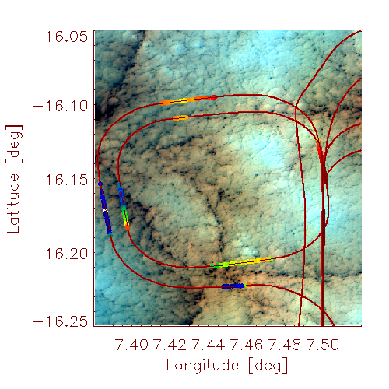
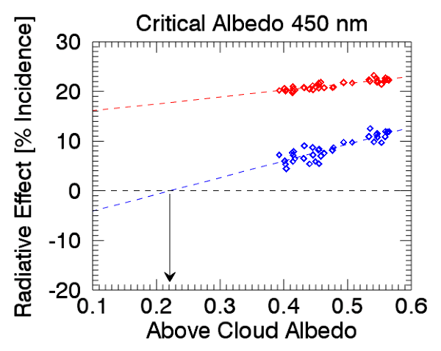
SSA comparison: 2016 average and previous literature values
eMAS imagery (ER-2)
Cochrane, et al., (2019)
See also Talk A14E-06
P-3 spiral
layer absorption
top-of-layer
radiative effect
Warming
Cooling
Critical Albedo = 0.22
Aerosol-induced radiative effects and heating rates depend critically on aerosol absorption/composition and scene albedo!
First-ever direct measurements of aerosol radiative effects in the presence of clouds support new satellite retrieval techniques.
Pistone, et al., ACP (2019)
Schmidt, Cochrane, Gore (U of Colorado, ARC)

Slide 17
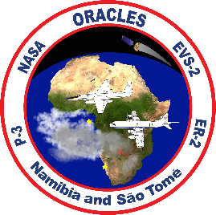
A summary of ORACLES-deployments in 2016-2018 to study aerosol-radiation-cloud interactions in the South-East Atlantic
Conclusions - 1 (general scientific)
Three ORACLES flight campaigns (2016-2018): 348+ P-3 and 97+ ER-2 flight hours - an unprecedented data set on aerosol, cloud and radiation (3 months & large part of the SE Atlantic).
A number of findings were uniquely enabled by the multi-platform, airborne approach:
a significantly different aerosol/cloud vertical distribution on the Northern edge of the plume (as observed in 2017, and 2018), with less frequent gaps above cloud,
significant mixing of BB aerosol into the BL via a multitude of pathways,
a reproducible vertical variation of aerosol chemical composition, consistent with plume age,
a reproducible vertical/spectral structure of aerosol radiative properties, consistent with chemical composition,
aerosol-induced modifications of Sc cloud properties, and some evidence for the suppression of drizzle,
systematic cloud property variations along routine flight track,
chemical transport models and climate models exhibiting a fairly systematic underestimation of aerosol loadings in the SE Atlantic.
ORACLES data is publicly available now: https://espoarchive.nasa.gov/archive/browse/oracles.

Slide 18
A summary of ORACLES-deployments in 2016-2018 to study aerosol-radiation-cloud interactions in the South-East Atlantic
Conclusions - 2 (lessons learned for logistics and flight planning)
ORACLES science objectives and questions provided crucial guidance for flight execution in each of the deployment years;
progress towards achieving science objectives was facilitated by the book-keeping of flight maneuvers that relate directly to the various detailed science objectives, although book-keeping proved challenging in the field;
a newly developed flight planning tool was efficiently used to incorporate correlative model output, satellite data overpasses and trajectory analyses; (see Samuel LeBlanc. (2018). samuelleblanc/fp: Moving Lines: NASA airborne research flight planning tool release (Version v1.21). Zenodo. http://doi.org/10.5281/zenodo.1478126)
joint efforts to develop flight plans by scientists with nominally different flight objectives (e.g., cloud microphysics and radiation) revealed that relatively minor adjustments to flights often resulted in data that can address a broad range of science questions;
scientific connection to international deployment efforts (CLARIFY, AEROCLO-sA) in the same region and timeframe as ORACLES-2017 proved a worthy investment of time; there are measurable outcomes from the international scientific collaborations in terms of the geographic extension of data sets (e.g., Mallet et al., 2019);
routine sampling strategies for about half of the ORACLES flights allowed for a statistical assessment of climate and chemical transport models, unprecedented for suborbital efforts in this field of study;
the involvement of the climate modeling community in the development of the ORACLES project in general, and its flight planning specifically, proved to be invaluable for collecting a data set that can be used for addressing model deficiencies that hamper our ability to accurately simulate aerosol-cloud-climate interactions.

