Slide 1
Bridging the gap from caldera unrest to resurgence
Valerio Acocella
PROBLEM
How does the short-term inflation relates to
long-term resurgence?
Are unrest and resurgence manifestations of the same process observed at different time frames, or not?

Slide 2
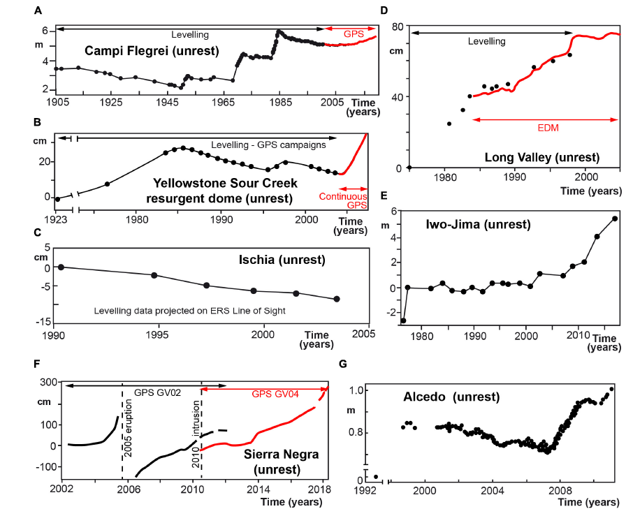
Unrest

Slide 3
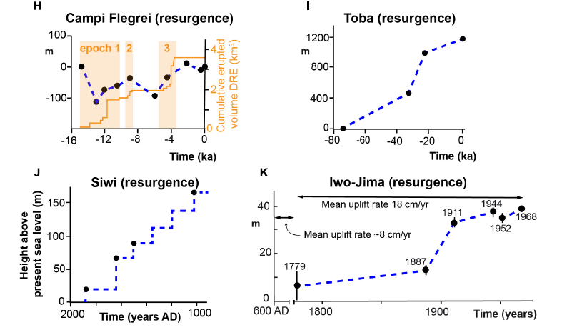
Resurgence

Slide 4
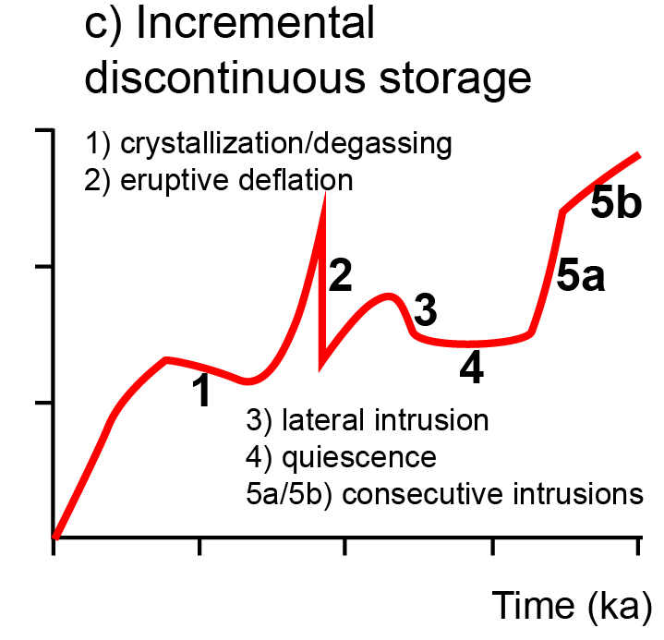
Resurgence appears as the
longer-term continuation of unrest
Proposed uplift model
for resurgence
Acocella V., (2019) Bridging the gap from caldera unrest to resurgence.
Frontiers Earth Science, 7:173. doi: 10.3389/feart.2019.00173.

