Slide 1
Uncertainties in breakup markers along the Iberian Newfoundland margins: The need for a new North Atlantic Plate Model
Annabel Causer ¹
Jürgen Adam¹, Lucía Pérez-Díaz^{1,2} and Graeme Eagles ^{1 ,3}
COMPASS Consortium, Royal Holloway University of London, Egham, UK
Oxford University, Oxford, UK
Alfred Wegener Institute, Bremerhaven, Germany

Slide 2
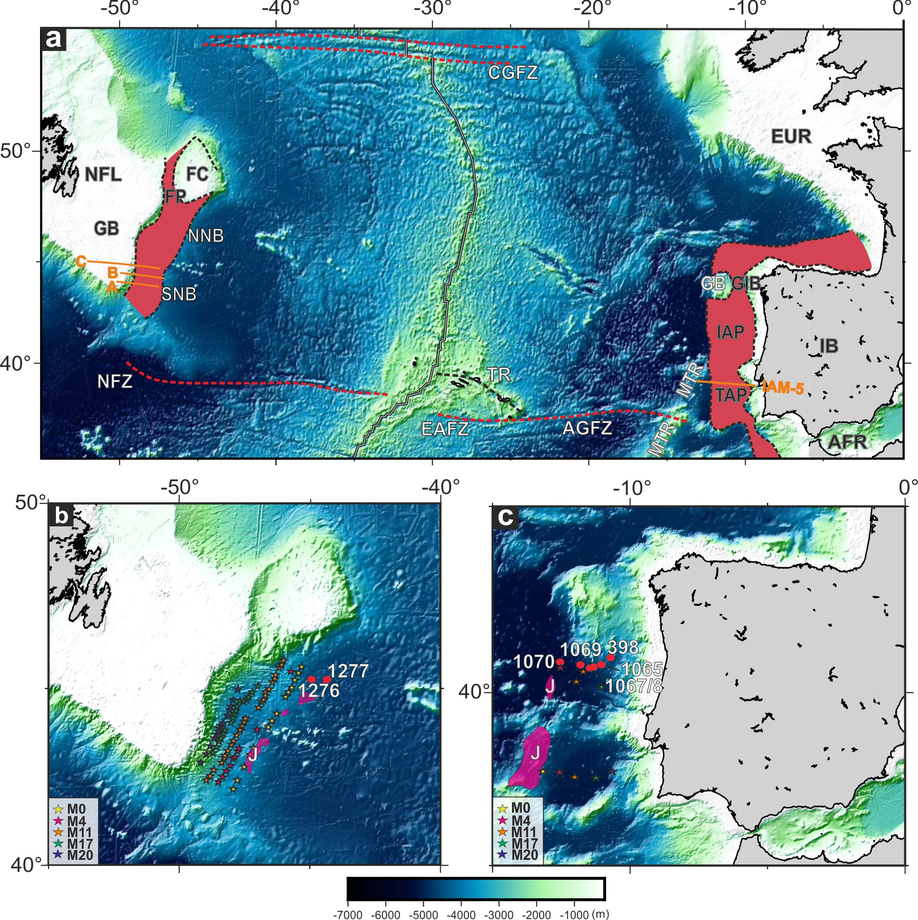
Iberian - Newfoundland Conjugate Margin
Ideally, to study early continental separation we use conjugate seismic profiles on either margin.
But the identification of conjugate profiles are heavily dependent on the plate model upon which they are picked, introducing a range of uncertainty.
Here we show and interpret three previously-unpublished 2D seismic profiles (A-C) imaging the regional tectonic structure and crustal architecture of the Southern Newfoundland margin from the shelf to the deepwater oceanic basin.
Study area showing the location of structural and tectonic features significant to our study. Red envelopes mark the extent of the COTZ as compiled by Eagles et al., (2015). Double black line: mid-ocean ridge; Red dashed lines: fracture zone traces. Orange lines: seismic profiles presented and discussed in this study. Background image is Sandwell and Smith (2014) gridded satellite altimetry. FC; Flemish Cap, FP; Flemish Pass, GB; Galicia Bank, GBA; Grand Banks, GIB; Galicia Interior Basin, IAP; Iberian Abyssal Plain, IB; Iberia, MTR; Madeira-Tore Rise, NFL; Newfoundland, NNB; North Newfoundland Basin, SNB; Southern Newfoundland Basin, TAP; Tagus Abyssal Plain.
Uncertainties in breakup markers along the Iberian Newfoundland margins: The need for a new North Atlantic Plate Model

Slide 3
Breakup Markers Iberian - Newfoundland Conjugate Margin
Earliest stages of continental rifting, often relying heavily on the identification of so-called break-up features imaged in seismic profiles or interpreted from potential field data.
Along the Iberian-Newfoundland margins, widely used break-up markers include interpretations of old magnetic anomalies from the M-Series, as well as the J-anomaly, believed to mark the occurrence and spatial extent of first oceanic lithosphere.
Location of magnetic profiles across the Southern Newfoundland Basin and conjugate Tagus Abyssal Plain shown in (b) and (c) respectively.
Uncertainties in breakup markers along the Iberian Newfoundland Conjugate Margin as illustrate by new seismic data
Notes:
Remove ODP Sites

Slide 4
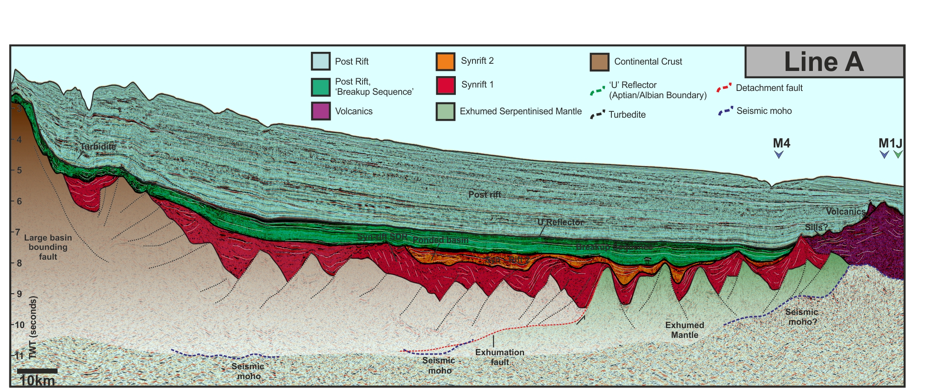
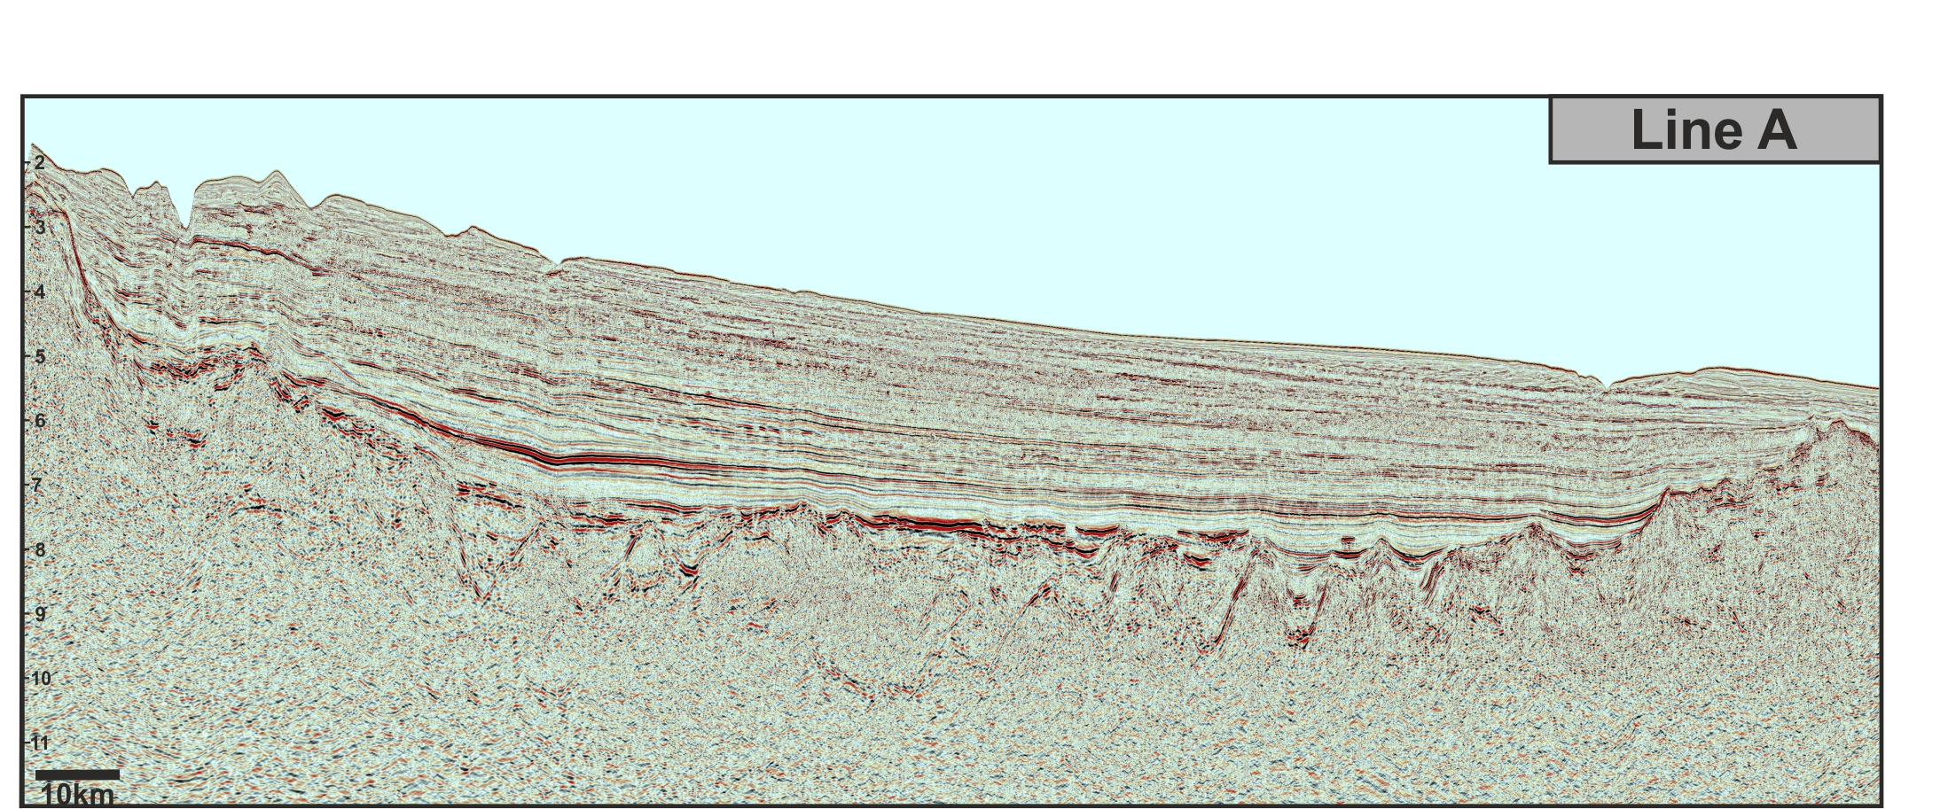
Southern Newfoundland Basin
M-Series (M1-M4) and J Anomaly are sourced within zones of exhumed mantle which, in places, may be intruded by magmatic additions of uncertain age.
The volcanic edifice, sills and feeder dykes may also be coeval with the final stages of plate rupture, or, a relic of post-rift magmatism.
Uncertainties in breakup markers along the Iberian Newfoundland margins: The need for a new North Atlantic Plate Model

Slide 5
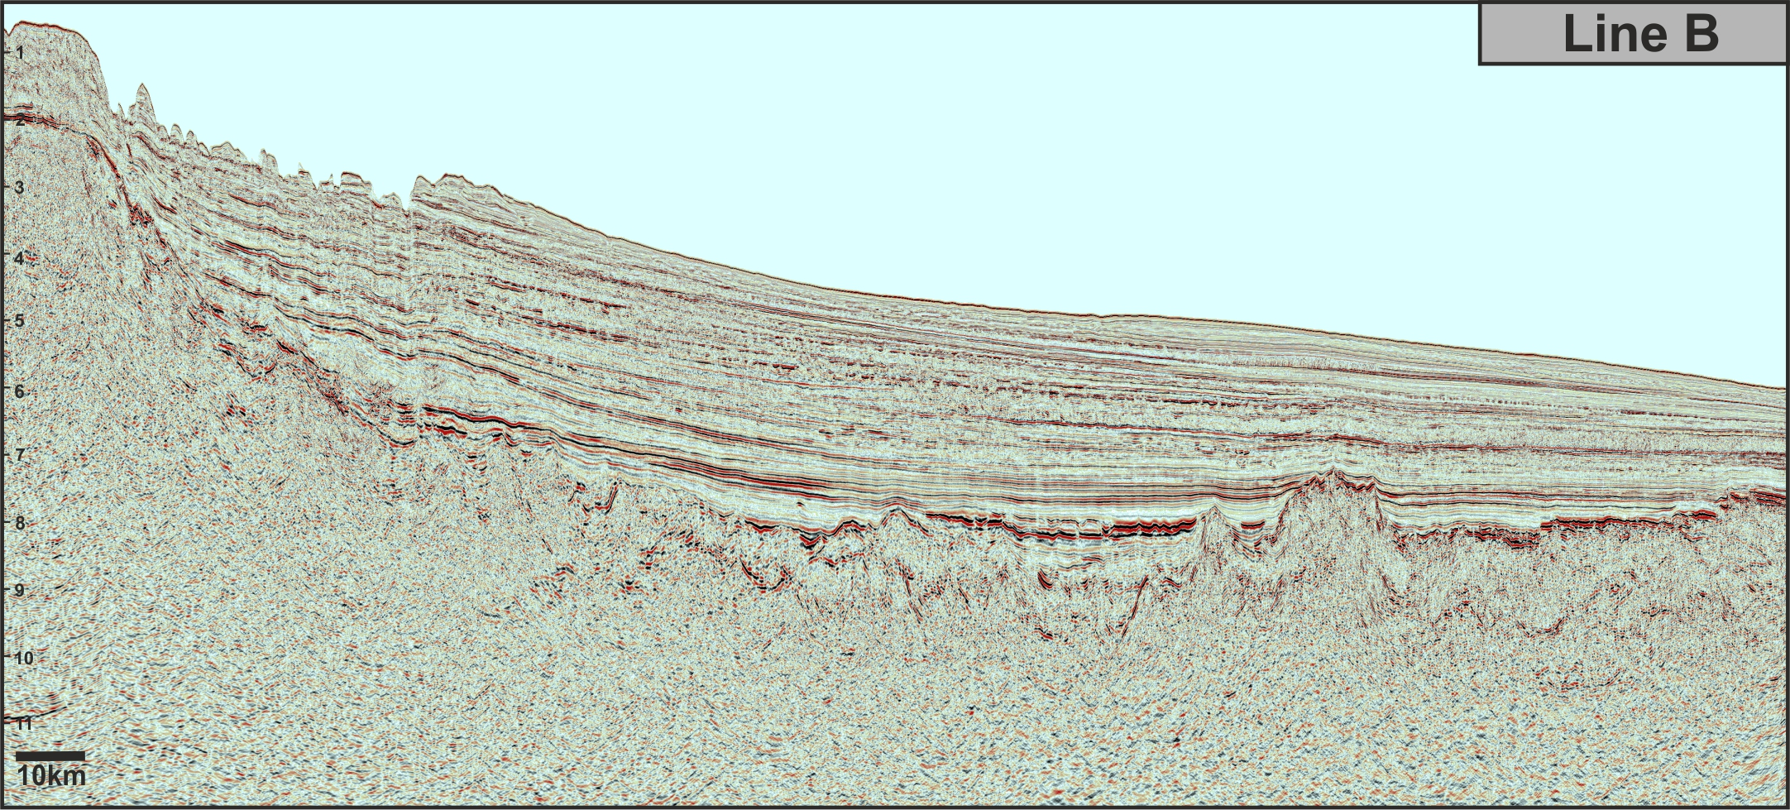
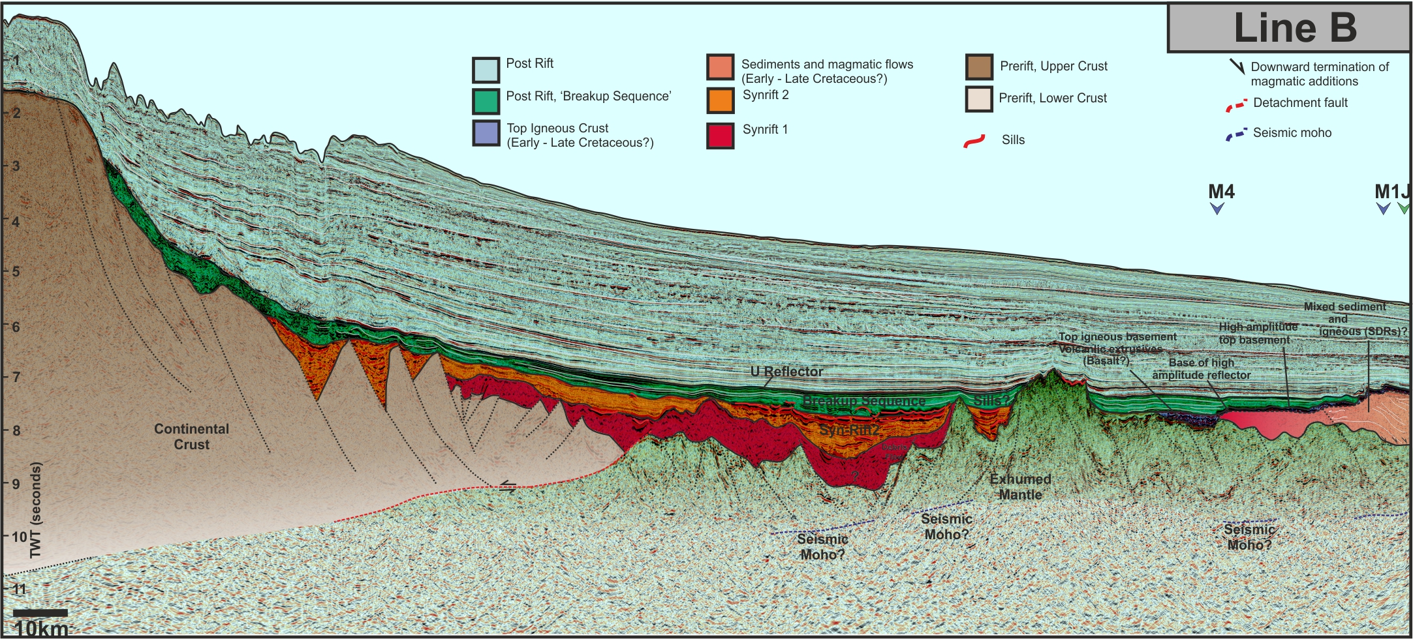
Southern Newfoundland Basin
Seaweard end, we interpret a package of seaward dipping reflectors the top of which is marked by a high amplitude reflector.
By analogy to drilled margins with similar characteristics (e.g. the south Australian margin, Ball et al., 2013), we suggest the acoustic basement to comprise a mixture of sediments and lava flows.
Laterally, SDRs are seen to on-lap onto a fault, perhaps indicating a degree of control by extension processes on magmatism.
Uncertainties in breakup markers along the Iberian Newfoundland margins: The need for a new North Atlantic Plate Model

Slide 6
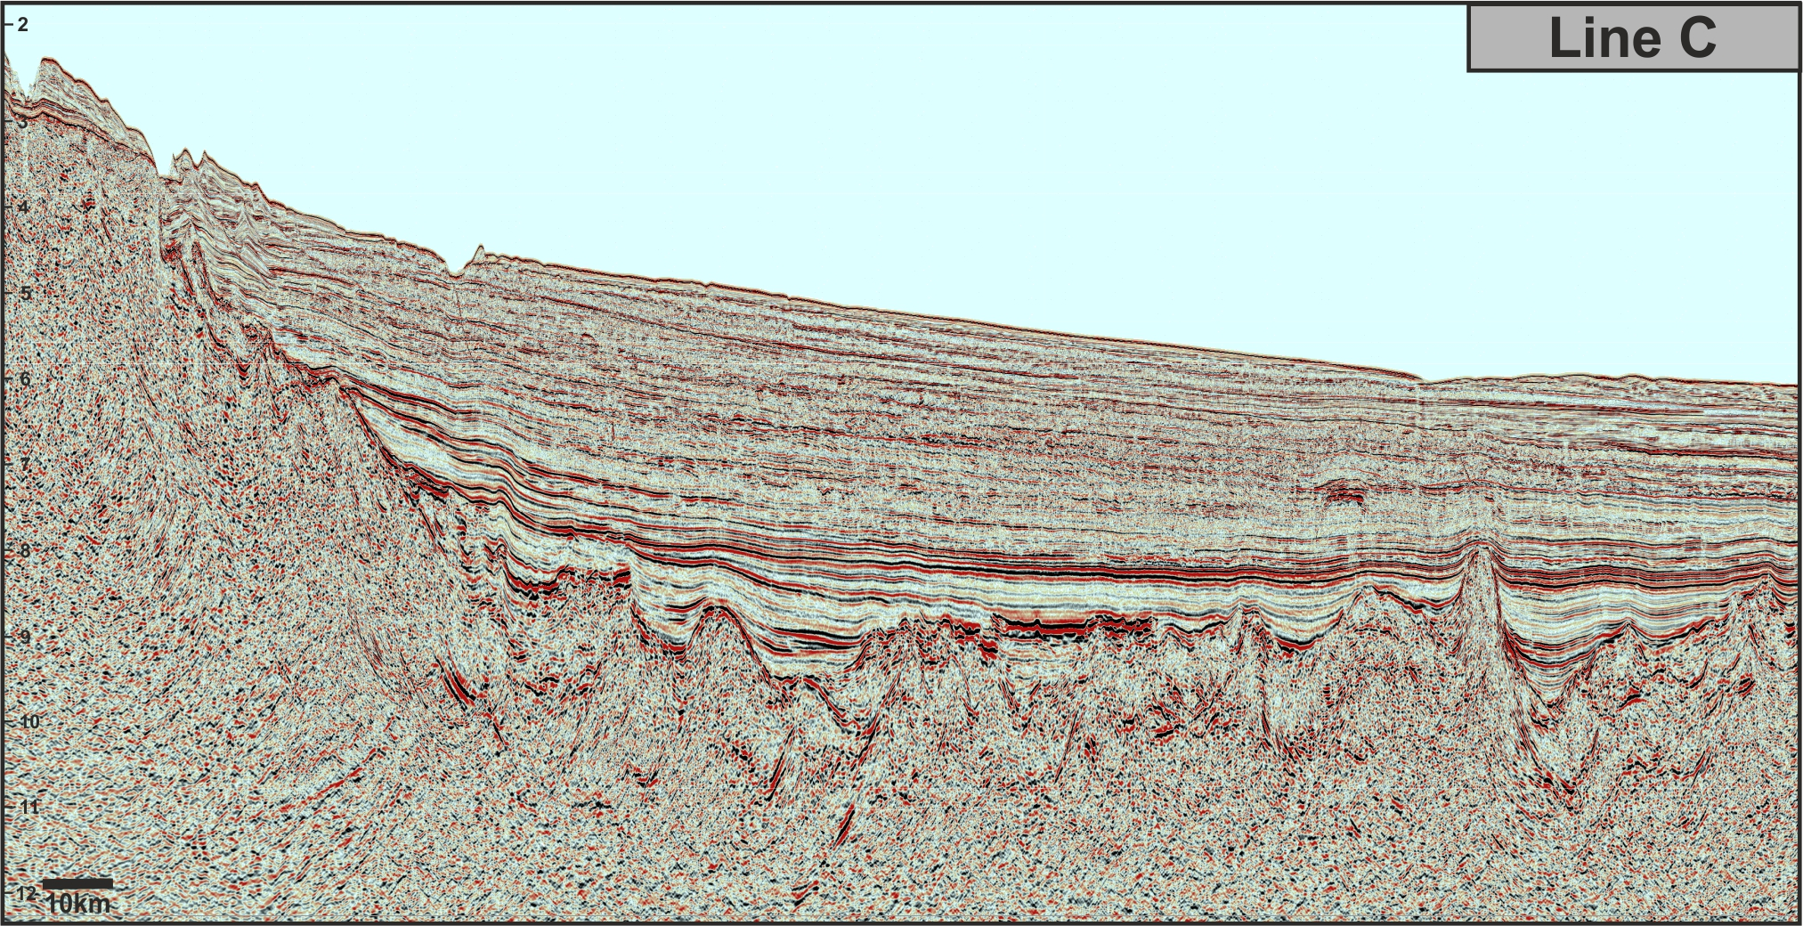
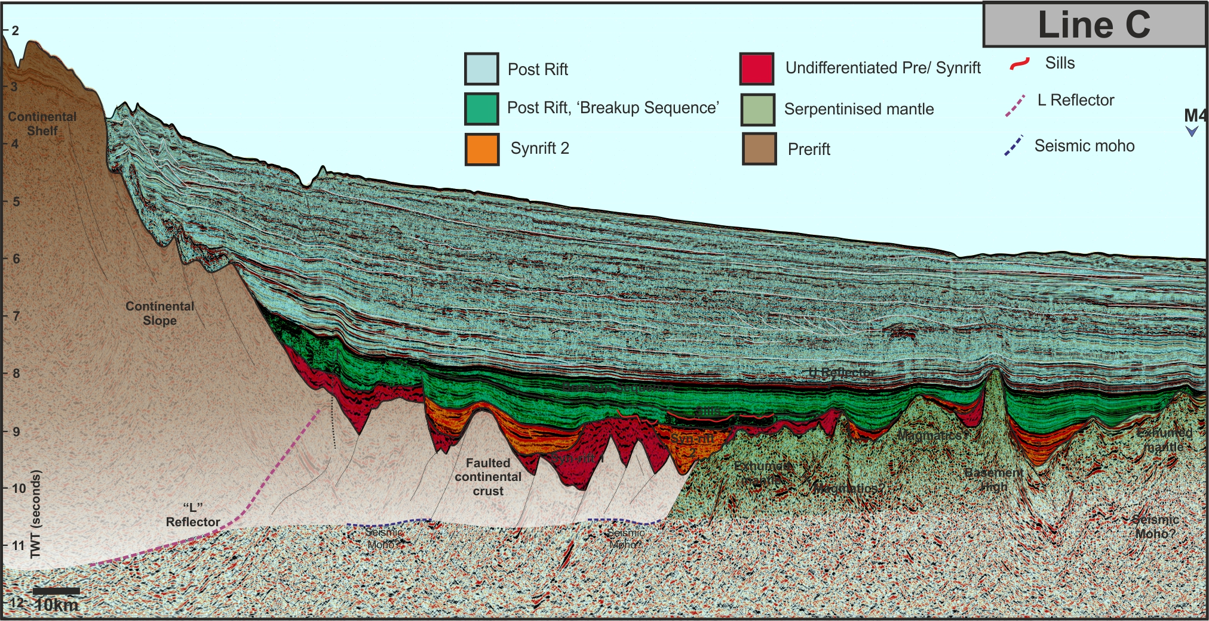
Southern Newfoundland Basin
Line C does not image much of the younger M-Series or the J Anomaly. However, it shows us the “L” reflector an alternative breakup marker used in reconstructions (e.g. Keen & Voogd, 1988) .
Uncertainties in breakup markers along the Iberian Newfoundland margins: The need for a new North Atlantic Plate Model

Slide 7
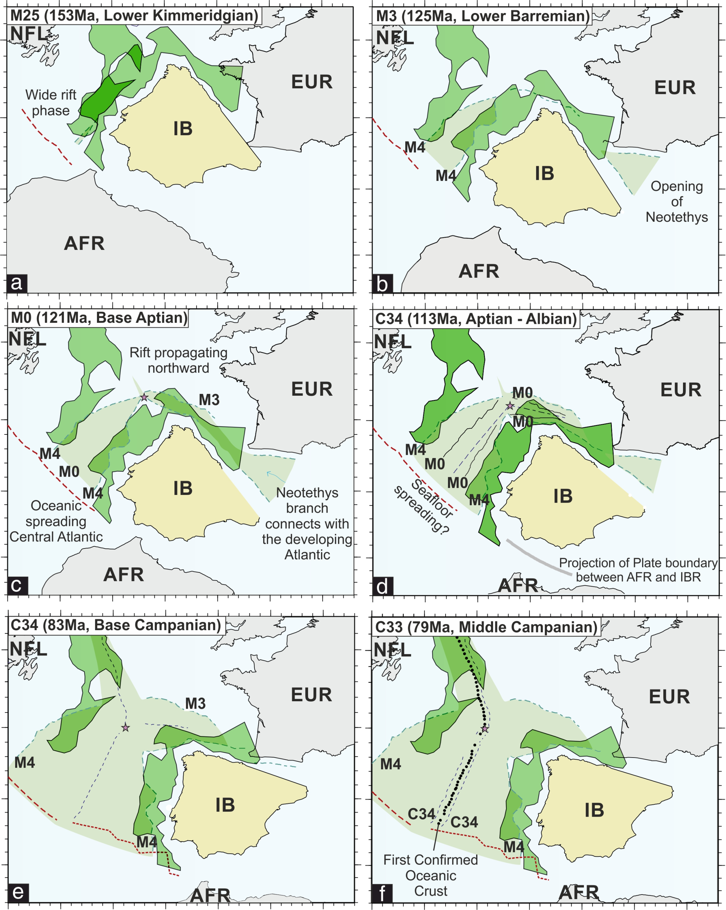
Breakup Markers Southern Newfoundland Basin
Magnetic Isochron Interpretation:
M-Series magnetic anomalies are not diagnostic of true oceanic crust instead attributed zones of exhumed mantle with magmatic additions.
In the SNB we suggest the J Anomaly source bodies to be a result of mantle dynamics during plate rupture.
Events associated with the J anomaly are not instantaneous, thus the J Anomaly is not a good kinematic marker.
Although the younger M-Series do not image oceanic crust, if we assume they mark the minimum possible age of the basement we show magmatism in the SNB occurred 6-8 Ma earlier than published alternatives.
An alternative approach could be to select conjugates by rotating margin-wide seismic lines into coincidence at pre-drift times. However, the results of doing this are strongly dependent on the choice of rotation scheme and their inherent uncertainties.
Six stages of development of the North Atlantic, from Late Jurassic to Late Cretaceous. Bright green envelopes show the maximum extent of the COTZ (Eagles et al., 2015). Light green shading shows oceanic lithosphere extent according to Sibuet et al., (2007) for the Atlantic and Sibuet, et al., (2004) for the Bay of Biscay. Pink star: location of the triple junction between EUR-IB-NA. Adapted from Vissers and Meijer, (2012).
Uncertainties in breakup markers along the Iberian Newfoundland margins: The need for a new North Atlantic Plate Model

Slide 8
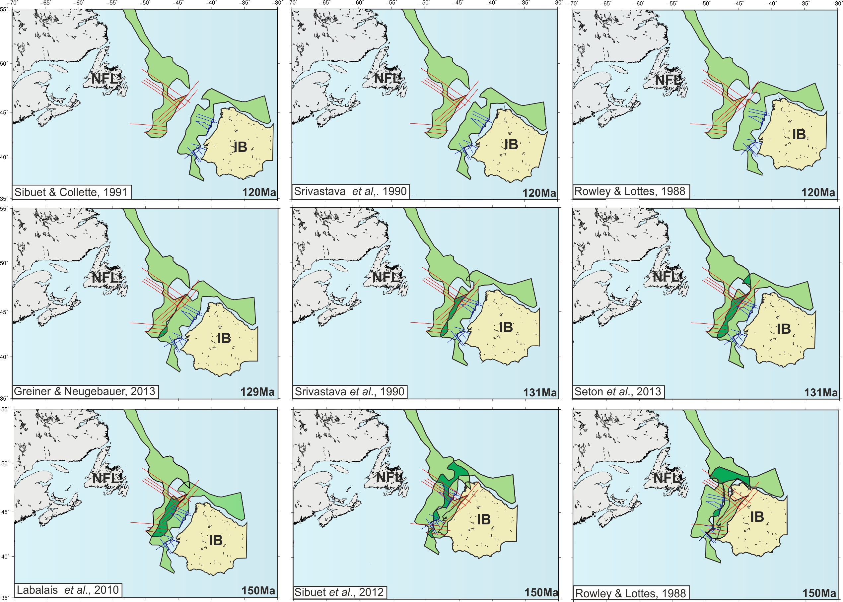
Kinematic Reconstructions Iberian Newfoundland Margin
Aptian/Albian Boundary
Barremian
Late Jurassic
Reconstructions of the COTZ envelope from Eagles et al. (2015) at (a) Aptian, (b) Barremian and (c) Tithonian (‘full fit) times, showing the range of virtual conjugates generated by alternative rotation schemes. Blue and red lines are the TGS Iberian and Newfoundland datasets, respectively. NFL: Newfoundland; IB: Iberia.
Uncertainties in breakup markers along the Iberian Newfoundland Conjugate Margin as illustrate by new seismic data

Slide 9
Barremian Conjugate Pairs
Uses magnetic M-Series
Uses structural markers
Conjugate Line B and IAM5
Conjugate Line C and IAM5
Reconstructions of the COTZ envelope from Eagles et al. (2015) at Barremian times, showing the range of virtual conjugates generated by alternative rotation schemes. Blue and red lines are a sub-set of the TGS Iberian and Newfoundland datasets, respectively. Black dashed line marks the IAM5 seismic profile. NFL: Newfoundland; IB: Iberia.
Uncertainties in breakup markers along the Iberian Newfoundland margins: The need for a new North Atlantic Plate Model

Slide 10
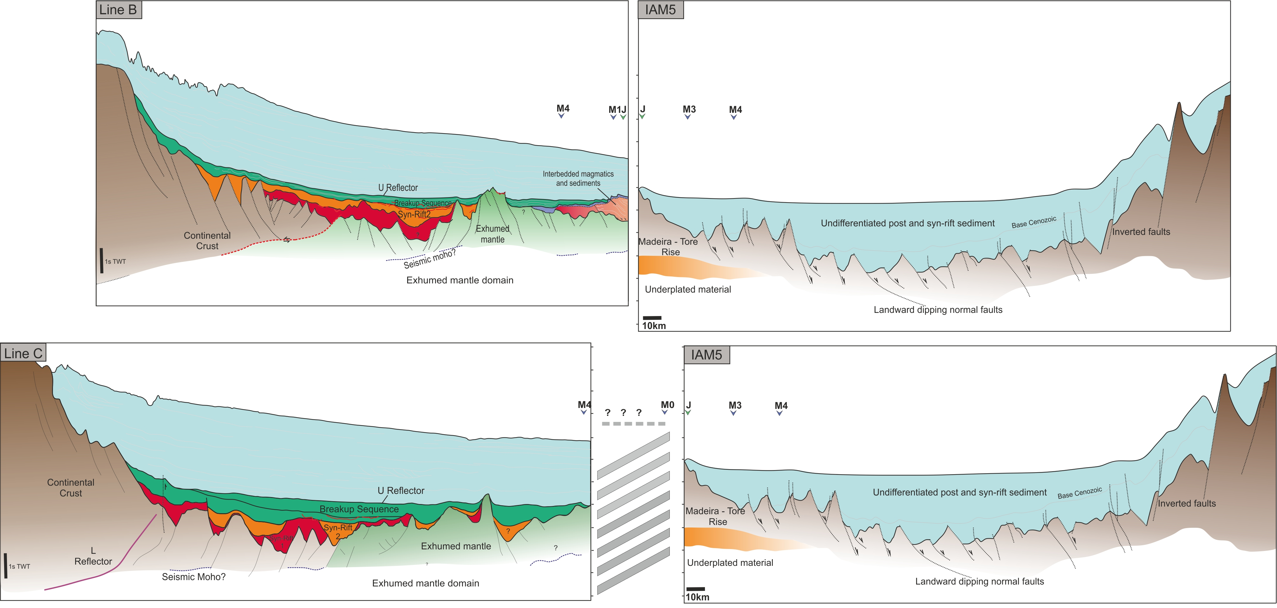
Conjugate Pairs
Discriminating between “good” and ‘bad” reconstructions on the basis of the transects they reunite is clearly challenging.
No strong arguments can be made regarding which of our new seismic lines (Line B or Line C) is the more likely conjugate to IAM5 based on their structural and stratigraphic characteristics.
Comparison of ‘conjugate’ seismic lines chosen on the basis of alternative rotation schemes for Barremian times. Conjugates according to (a) Greiner and Neugebauer, (2013) and Seton et al., (2013) and (b) Srivastava et al., (1990). Conjugate comparisons are hung on 10s TWT.
Uncertainties in breakup markers along the Iberian Newfoundland margins: The need for a new North Atlantic Plate Model

Slide 11
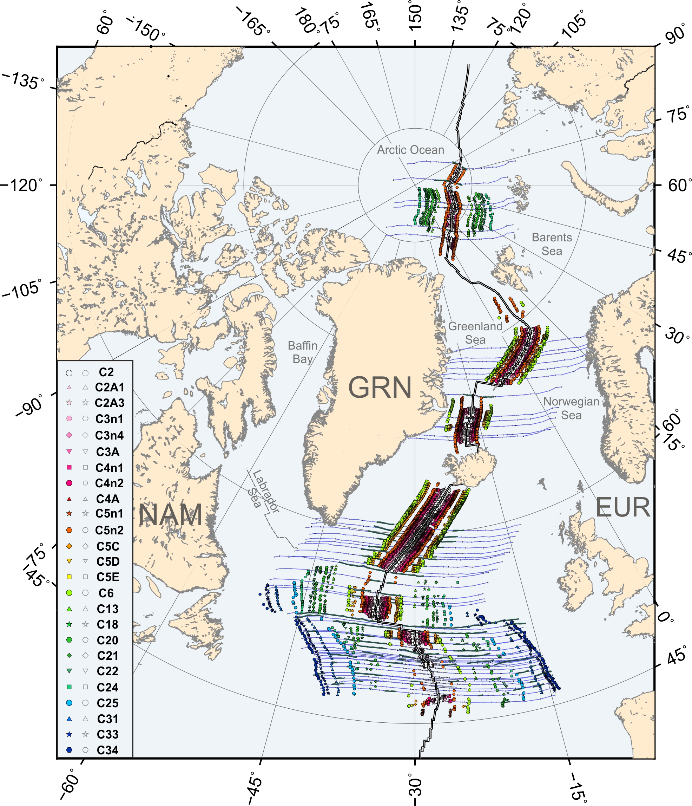
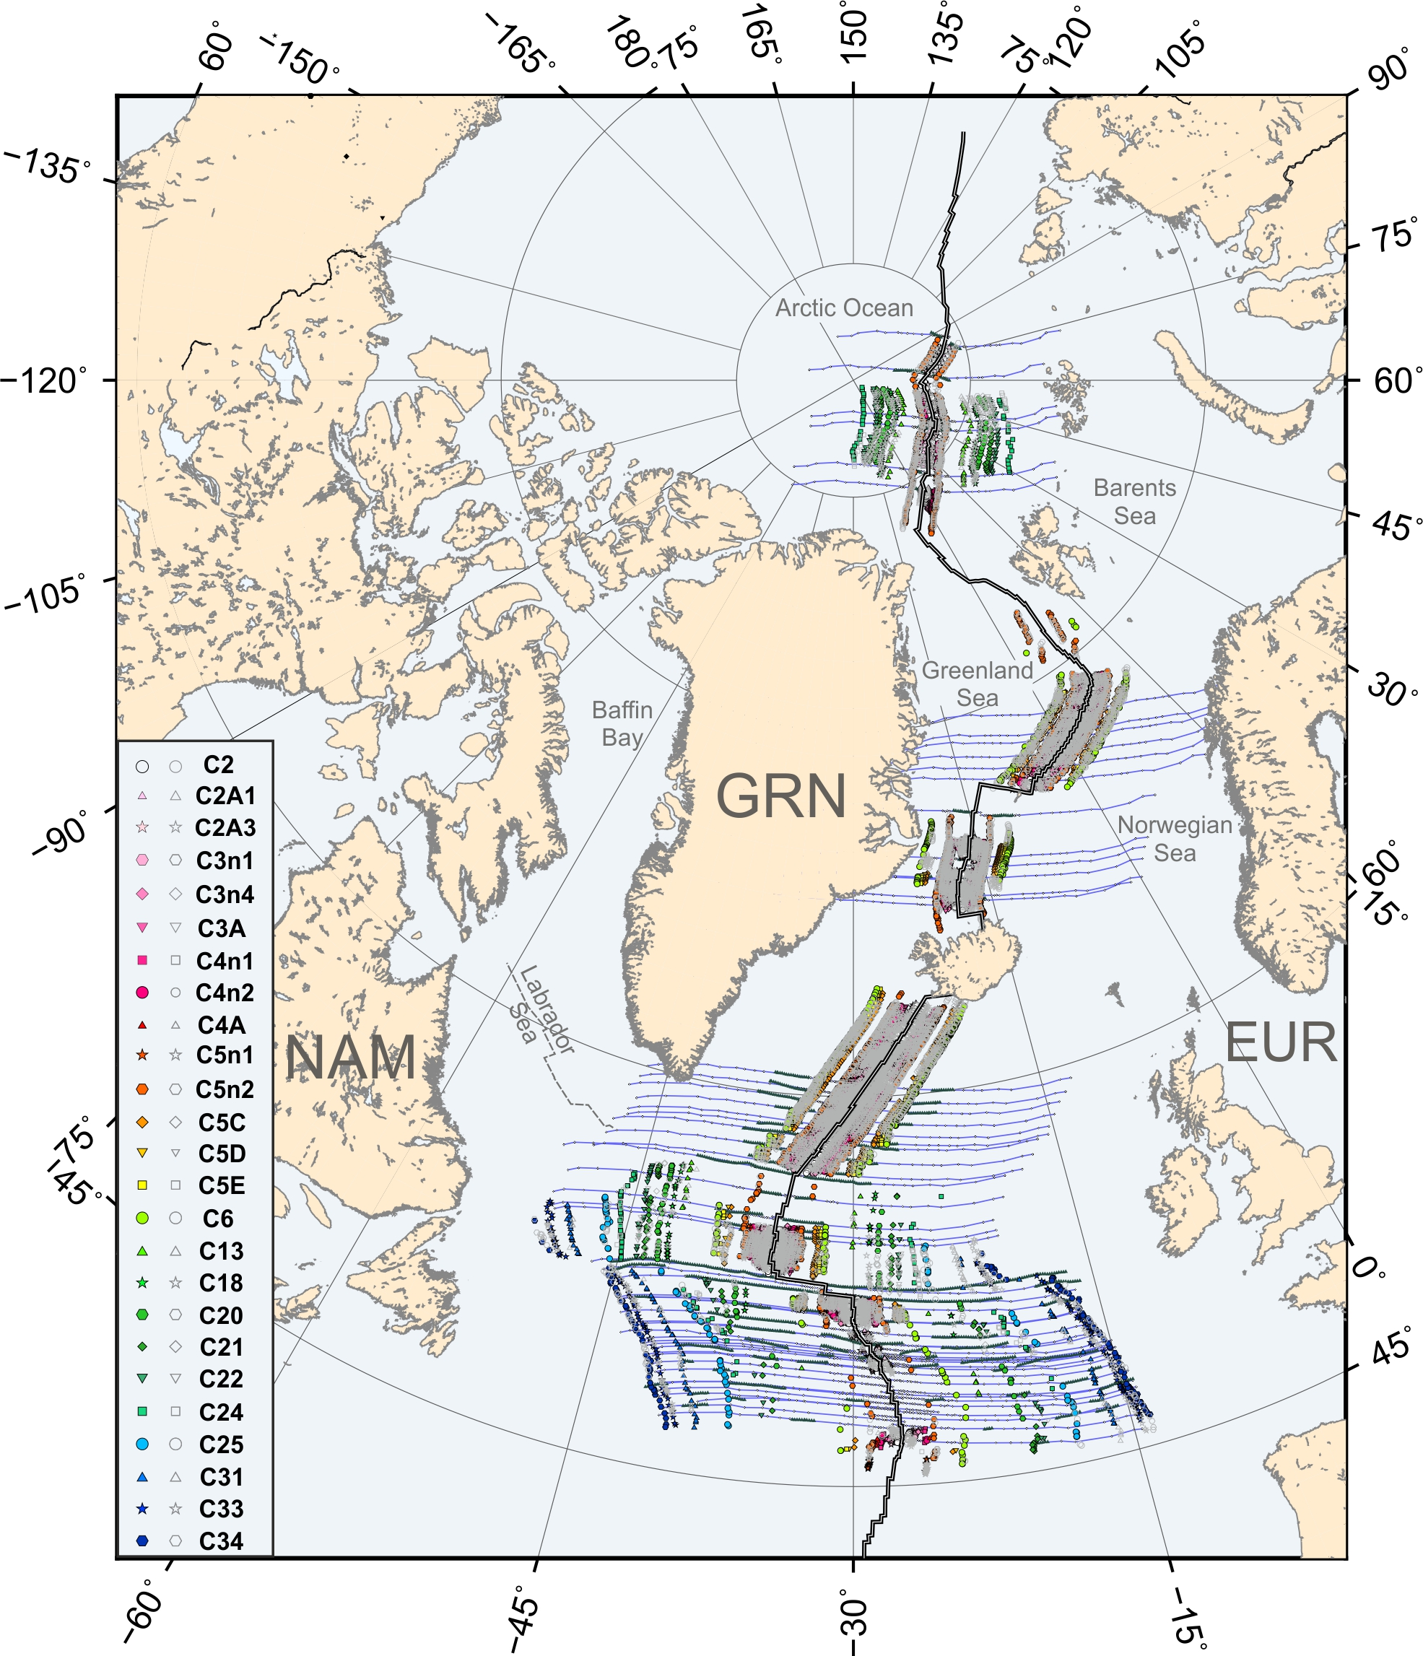
A New North Atlantic Plate Model
These observations illustrate the challenge of discriminating between “good” and “bad” rotation schemes on the basis of the conjugate transects they produce. This challenge could be greatly eased if informed by robust plate models built from high-confidence data with quantified uncertainties.
As a result we suggest a larger more comprehensive plate kinematic model, for constraining movement of the Iberian plate in the Early Cretaceous.
We do this by using seafloor spreading data and a statistically robust inversion method as the basis for a number of purpose built two-plate models for Africa, Morocco, Iberia, Eurasia, Greenland and North America, with quantified uncertainties.
Inversion model for the Northern North Atlantic Ocean for the North American and Eurasian plates. Blue lines: Synthetic flowlines, Green triangles: Fracture Zone picks; Coloured symbols: Magnetic Anomaly picks as in key, and Grey symbols: Rotated magnetic picks.
Uncertainties in breakup markers along the Iberian Newfoundland margins: The need for a new North Atlantic Plate Model

