Slide 1
The past and the future of the tropical forest carbon sink
insights from permanent forest inventory plots
Wannes Hubau, Simon L. Lewis, Oliver L. Phillips, H. Beeckman,
the AfriTRON Consortium & the RAINFOR consortium

Slide 2
Affiliations
1 University of Leeds, School of Geography, Leeds, UK (whubau@gmail.com; S.L.Lewis@leeds.ac.uk; o.phillips@leeds.ac.uk)
2 Royal Museum for Central Africa, Service of Wood Biology, Tervuren, Belgium (wannes.hubau@africamuseum.be; hans.beeckman@africamuseum.be)
3 Ghent University, Department of Environment, Laboratory of Wood Technology Ghent, Belgium (wannes.hubau@ugent.be)
4 University College London, Department of Geography, London, UK (s.l.lewis@ucl.ac.uk)

Slide 3
Co-authors
AfriTRON consortium:
W. Hubau, S.L. Lewis, O.L. Phillips, K. Affum-Baffoe, H. Beeckman, A. Cuní-Sanchez, A.K. Daniels, C.E.N. Ewango, S. Fauset, J.M. Mukinzi , D. Sheil, B. Sonké, M.J.P. Sullivan, T.C.H. Sunderland, H. Taedoumg, S.C. Thomas, L.J.T. White, K.A. Abernethy, S. Adu-Bredu, C.A. Amani, T.R. Baker, L.F. Banin, F. Baya, S.K. Begne, A.C. Bennett, F. Benedet, R. Bitariho, Y.E. Bocko, P. Boeckx, P. Boundja, R.J.W. Brienen, T. Brncic, E. Chezeaux, G.B. Chuyong, C.J. Clark, M. Collins, J.A. Comiskey, D.A. Coomes, G.C. Dargie, T. de Haulleville, M. Djuikouo Kamdem, J. Doucet, A. Esquivel-Muelbert, T.R. Feldpausch, A. Fofanah, E.G. Foli, M. Gilpin, E. Gloor, C. Gonmadje, S. Gourlet-Fleury, J.S. Hall , A.C. Hamilton, D.J. Harris, T.B. Hart, M.B.N. Hockemba, A. Hladik, S.A. Ifo, K.J. Jeffery, T. Jucker, E. Kasongo Yakusu, E. Kearsley, D. Kenfack, A. Koch, M.E. Leal, A. Levesley, J.A. Lindsell, J. Lisingo, G. Lopez-Gonzalez, J.C. Lovett, J. Makana, Y. Malhi, A.R. Marshall, J. Martin, E.H. Martin, F.M. Mbayu, V.P. Medjibe, V. Mihindou, E.T.A. Mitchard, S. Moore, P.K.T. Munishi, N. Nssi Bengone, L. Ojo, F. Evouna Ondo, K.S.-H. Peh, G.C. Pickavance, A.D. Poulsen, J.R. Poulsen, L. Qie, J. Reitsma, F. Rovero, M.D. Swaine, J. Talbot, J. Taplin, D.M. Taylor, D.W. Thomas, B. Toirambe, J. Tshibamba Mukendi, D. Tuagben, P.M. Umunay, G.M.F. Van Der Heijden, H. Verbeeck, J. Vleminckx, S. Willcock, H. Woell, J.T. Woods, L. Zemagho
RAINFOR consortium:
R.J.W. Brienen, O.L. Phillips, T.R. Feldpausch, E. Gloor, T.R. Baker, J. Lloyd, G. Lopez-Gonzalez, A. Monteagudo-Mendoza, Y. Malhi, S.L. Lewis, R. Vásquez Martinez, M. Alexiades, E. Álvarez Dávila, P. Alvarez-Loayza, A. Andrade, L.E.O.C. Aragão, A. Araujo-Murakami, E.J.M.M. Arets, L. Arroyo, G.A. Aymard C., C. Baraloto, J. Barroso, D. Bonal, R.G.A. Boot, J.L. Camargo, C.V. Castilho, V. Chama, K.J. Chao, J. Chave, J.A. Comiskey, F. Cornejo Valverde, L. da Costa, E.A. Oliveira, A. Di Fiore, T.L. Erwin, S. Fauset, M. Forsthofer, D.R.Galbraith, E.S. Grahame, N. Groot, B. Hérault, N. Higuchi, E.N. Honorio Coronado, H. Keeling, T.J. Killeen, W.F. Laurance, S. Laurance, J. Licona, W.E. Magnusson, B.S. Marimon, B.H. Marimon-Junior, C. Mendoza, D.A. Neill, E.M. Nogueira, P. Núñez, N.C. Pallaqui Camacho, A. Parada, G. Pardo, J. Peacock, M. Peña-Claros, G.C. Pickavance, N.C.A. Pitman, L. Poorter, A. Prieto, C.A. Quesada, F. Ramírez, H. Ramírez-Angulo, Z. Restrepo, A. Roopsind, A. Rudas, R.P. Salomão, M. Schwarz, N. Silva, J.E. Silva-Espejo, M. Silveira, J. Stropp, J Talbot, H. ter Steege, J. Teran-Aguilar, J. Terborgh, R. Thomas-Caesar, M. Toledo, M. Torello-Raventos, R.K. Umetsu, G.M.F. van der Heijden, P. van der Hout, I.C. Guimarães Vieira, S.A.Vieira, E. Vilanova, V. Vos, R.J. Zagt

Slide 4
Abstract
Structurally intact tropical forests sequestered ~1 Pg C yr-1 over the 1990s and early 2000s, equivalent to ~15% of fossil fuel emissions. Climate-driven vegetation models typically predict that this carbon sink will continue for the remainder of the 21st century. However, recent plot inventories from Amazonia show a declining rate of carbon sequestration, potentially signaling an imminent end to the sink. Here we assess whether the African tropical forest sink is also declining.
Records from 244 multi-census plots across 11 countries reveal that the African tropical forest sink in aboveground live biomass has been stable for three decades, at 0.66 Mg C ha-1 yr-1, from 1985-2015 (95% CI, 0.53-0.79). Thus, the carbon sink responses of Earth’s two largest expanses of tropical forest have diverged over recent decades. A statistical model including CO2, temperature, drought, and forest dynamics can account for the trends. Despite the past stability of the African carbon sink, our data and model show that very recently the sink has begun decreasing, and that it will continue to decline in the future. This implies that the intact tropical forest carbon sink on both continents is set to end decades sooner than even the most extreme vegetation model estimates.
Published independent observations of inter-hemispheric atmospheric CO2 concentration indicates increasing carbon uptake into the Northern hemisphere landmass, offsetting a weakening of the tropical forest sink, which reinforces our conclusion that the intact tropical forest carbon sink has already saturated. Nevertheless, continued on-the-ground monitoring of the world’s remaining intact tropical forests will be required to test our prediction that the intact tropical forest carbon sink will continue to decline. Our findings were recently published in Nature (March 2020) and have important policy implications: given tropical forests are likely to sequester less carbon in the future than Earth System Models predict, an earlier date to reach net zero anthropogenic greenhouse gas emissions will be required to meet any given commitment to limit the global heating of Earth.

Slide 5
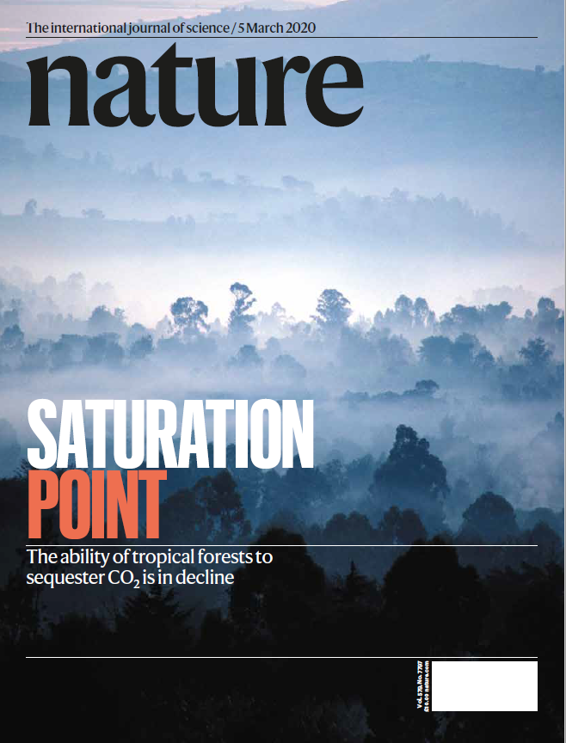
Original publication: Hubau et al. 2020 Nature

Slide 6
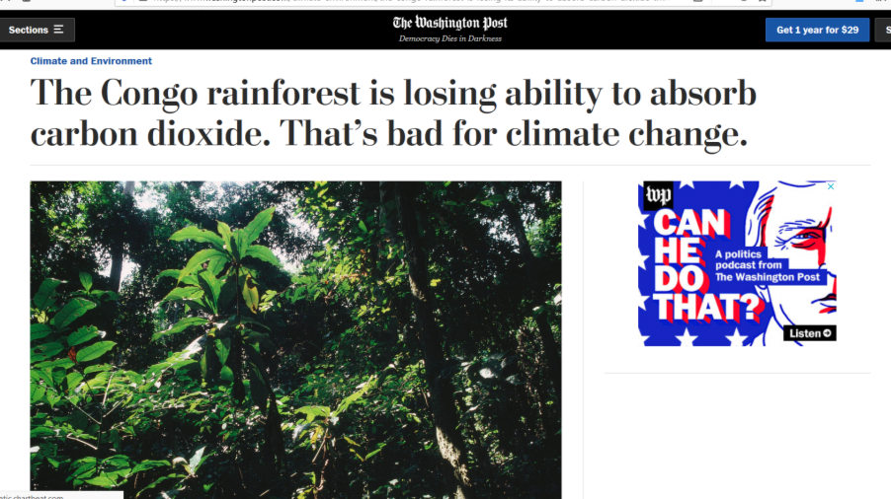
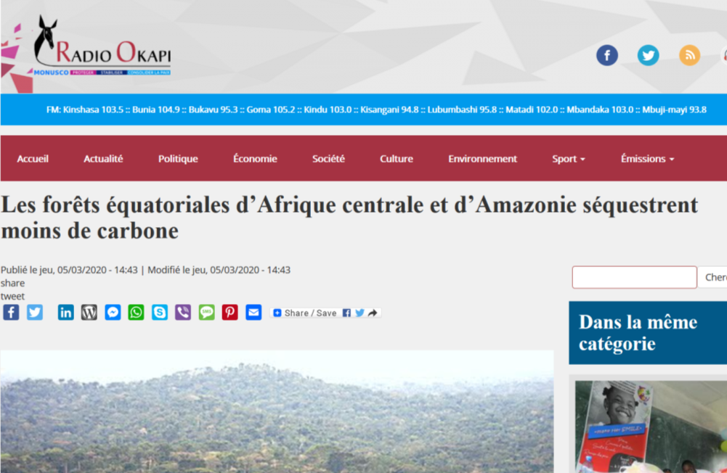
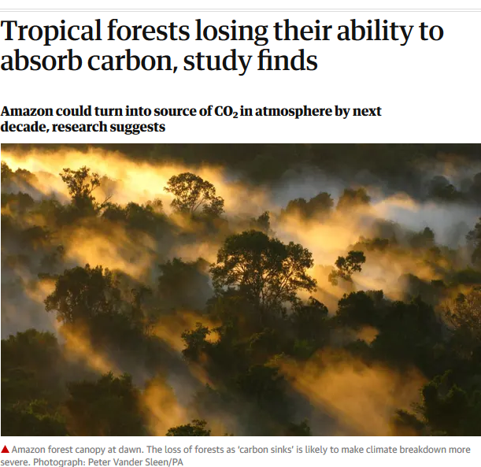
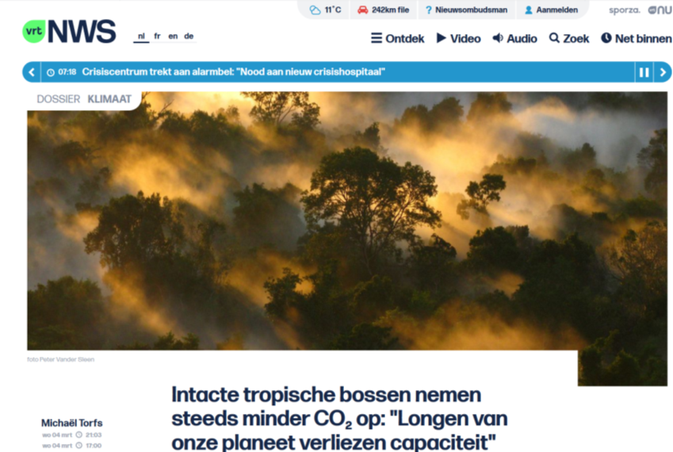
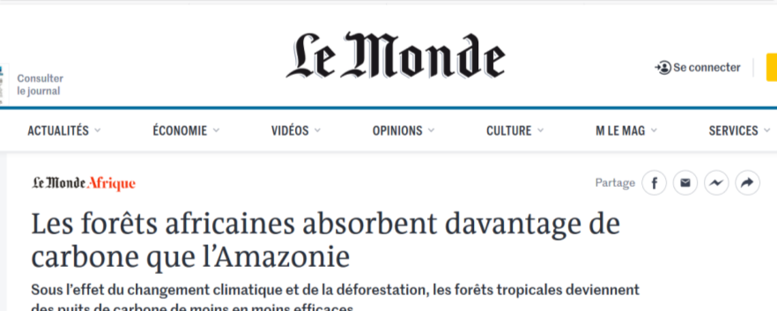
Press coverage
>150 news items
>25 countries

Slide 7
ELEVATOR
PITCH
Tropical forest carbon sink is rapidly weakening
Intact tropical forests are well-known as a crucial global carbon sink, slowing climate change by removing carbon from the atmosphere and storing it in trees, a process known as carbon sequestration.
Climate models typically predict that this tropical forest carbon sink will continue for decades.
However, our analysis of three decades of tree growth and death from 565 undisturbed tropical forests across Africa and the Amazon shows that this will not be the case.

Slide 8
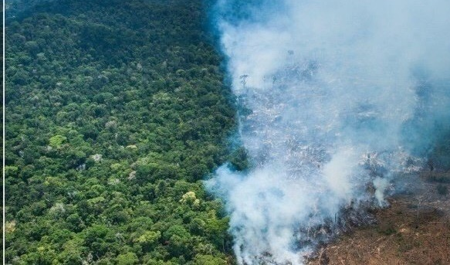
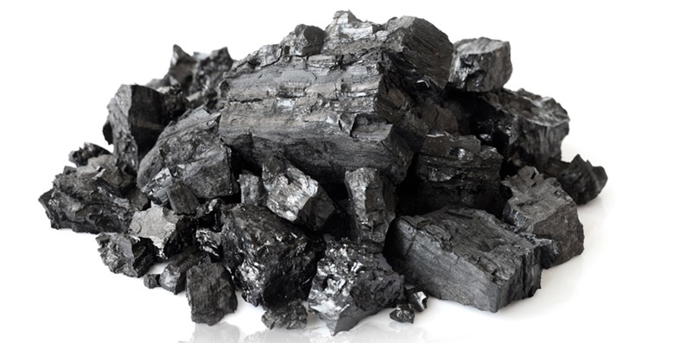
INTRO
The global carbon balance
4 major carbon reservoirs
760
atmosphere
oceans
land
38.000
2.300
Earth crust
100.000.000
Carbon in reservoirs
is expressed in Gigatonnes
Global Carbon Budget 2015
Le Queré et al Earth Syst. Sci. Data

Slide 9
INTRO
The global carbon balance
natural balance
of fluxes between reservoirs
760
atmosphere
respiration
gross primary productivity
oceans
land
weathering
38.000
2.300
sedimentation
Earth crust
100.000.000
Carbon in reservoirs
is expressed in Gigatonnes
Global Carbon Budget 2015
Le Queré et al Earth Syst. Sci. Data

Slide 10
INTRO
The global carbon balance
But this natural balance has been disturbed since The Industrial Revolution (~1800) when we started large-scale burning of fossil fuels …
Leeds 1880

Slide 11
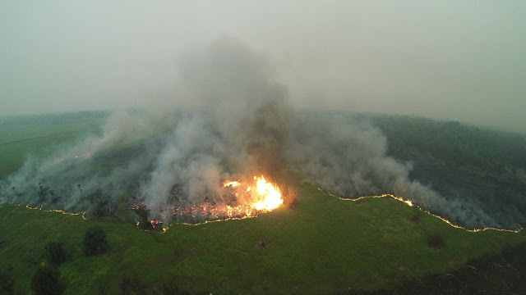
INTRO
The global carbon balance
…and we are changing our Planet like never before
Forest and peat fires in Indonesia 2015
© OuTrop

Slide 12
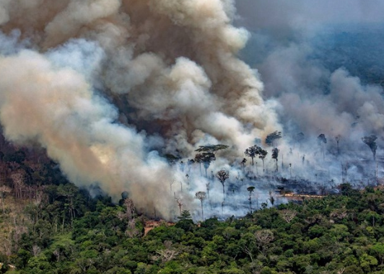
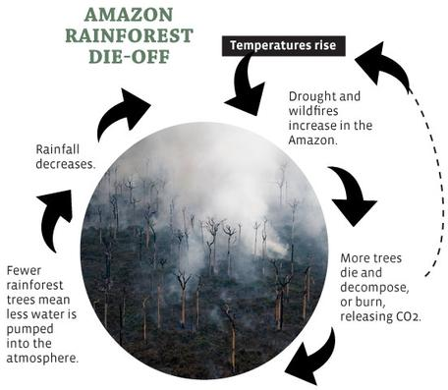
INTRO
The global carbon balance
…and we are changing our Planet like never before
© National Broadcasting Company (2019)
Amazon forest fires 2019
Australia bush fires 2020
© Science Education Resource Center (2017)

Slide 13
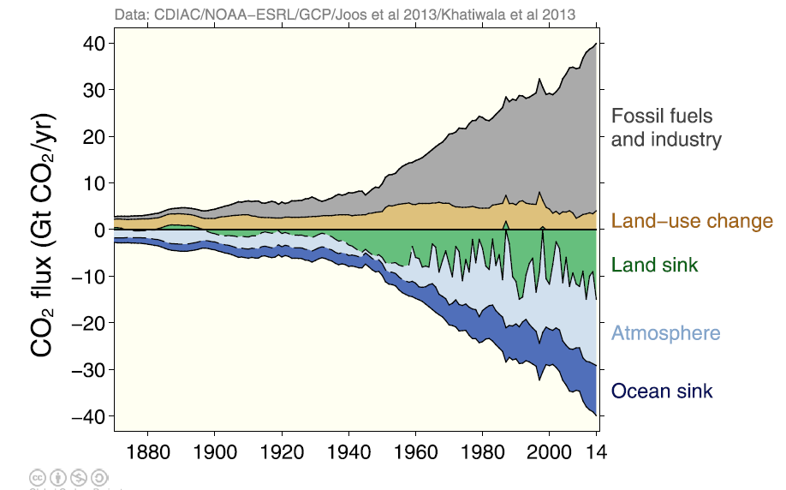
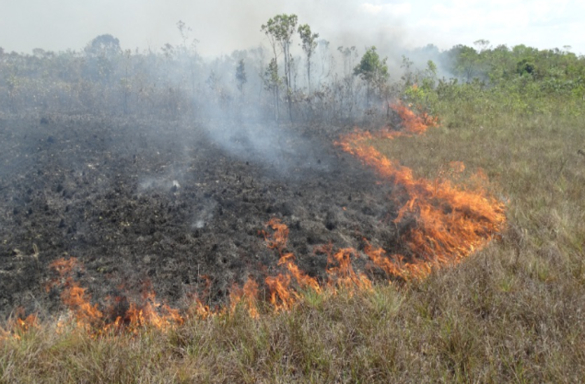
INTRO
The global carbon balance
New sources of carbon into the atmosphere
Fossil fuels
Carbon flux (Pg C yr-1)
-10 -5 0 5 10
In 2015: ~10 Gigatonnes C per year
Global Carbon Budget 2015 Le Queré et al Earth Syst. Sci. Data
Land-use change

Slide 14
INTRO
The global carbon balance
SOURCES OF CARBON
760
1
atmosphere
9
oceans
land
38.000
2.300
Earth crust
Carbon fluxes between reservoirs
are expressed in Gigatonnes C yr⁻¹
100.000.000
Carbon in reservoirs
is expressed in Gigatonnes
Global Carbon Budget 2015
Le Quéré et al Earth Syst. Sci. Data

Slide 15
INTRO
The global carbon balance
nature compensates for our excess by providing SINKS OF CARBON
Land sink + Ocean sink:
~5,6 Gigatonnes
C per year (in 2015)
Carbon flux (Pg C yr-1)
-10 -5 0 5 10
Global Carbon Budget 2015
Le Quéré et al Earth Syst. Sci. Data

Slide 16
INTRO
The global carbon balance
SINKS OF CARBON
760
1
atmosphere
4,4
2,6
3
9
oceans
land
38.000
2.300
Earth crust
Carbon fluxes between reservoirs
are expressed in Gigatonnes C yr⁻¹
100.000.000
Carbon in reservoirs
is expressed in Gigatonnes
Global Carbon Budget 2015
Le Quéré et al Earth Syst. Sci. Data

Slide 17
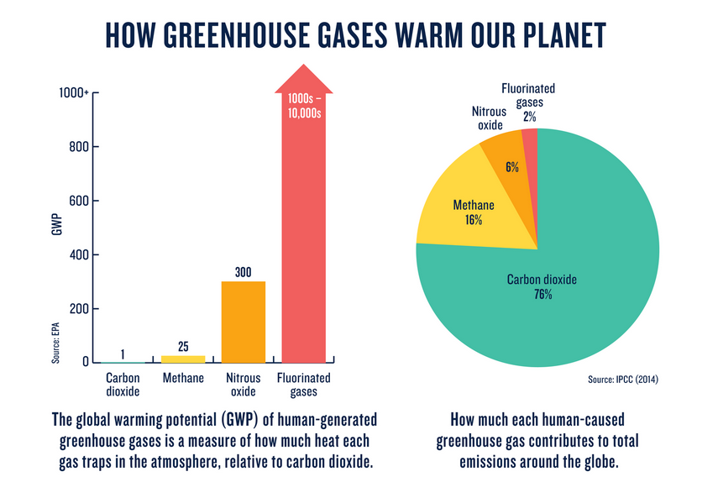
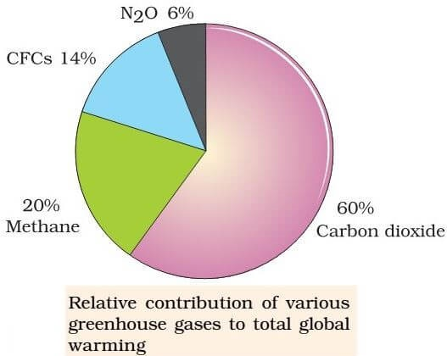
INTRO
The global carbon balance
© PMF IAS
© IPCC
4,4 Gigatonnes of carbon per year remains in the atmosphere as CO₂
=> ~60% of total global warming

Slide 18
INTRO
The global carbon balance
Although annually ~4.4 Gigatonnes of anthropogenic carbon remain in the atmosphere, the land and ocean carbon sinks absorb ~5.6 tonnes of anthropogenic carbon per year, providing an important ecosystem service
Yet will this always be the case?

Slide 19
INTRO
The global carbon balance
We focus on
the tropical component
of the land sink
760
atmosphere
1
2,6
3
9
oceans
land
38.000
2.300
Earth crust
Carbon fluxes between reservoirs
are expressed in Gigatonnes C yr⁻¹
100.000.000
Carbon in reservoirs
is expressed in Gigatonnes
Global Carbon Budget 2015
Le Quéré et al Earth Syst. Sci. Data

Slide 20
INTRO
The global carbon balance
tropical forests are important reservoirs and sinks!
In 2000-2010:
The Land Carbon Reservoir : ~2300 Pg C
tropical forests : ~460 Pg C (20%)
The Land Carbon Sink : ~3 Pg C yr-1
tropical forests : ~1 Pg C yr-1 (33%)

Slide 21
QUESTIONS
What was the evolution of the tropical carbon sink over the last decades?
2. What are the drivers of the sink?
3. How does the future of the sink look like?

Slide 22
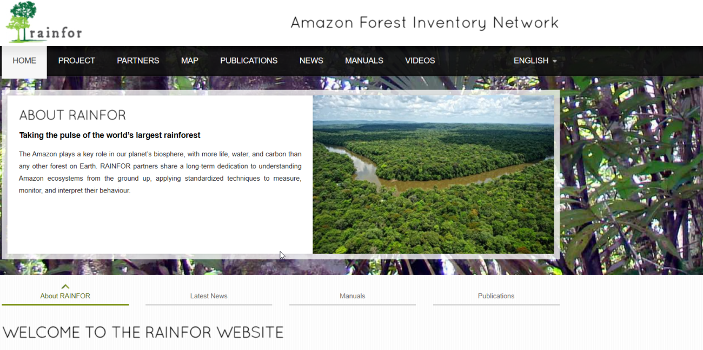
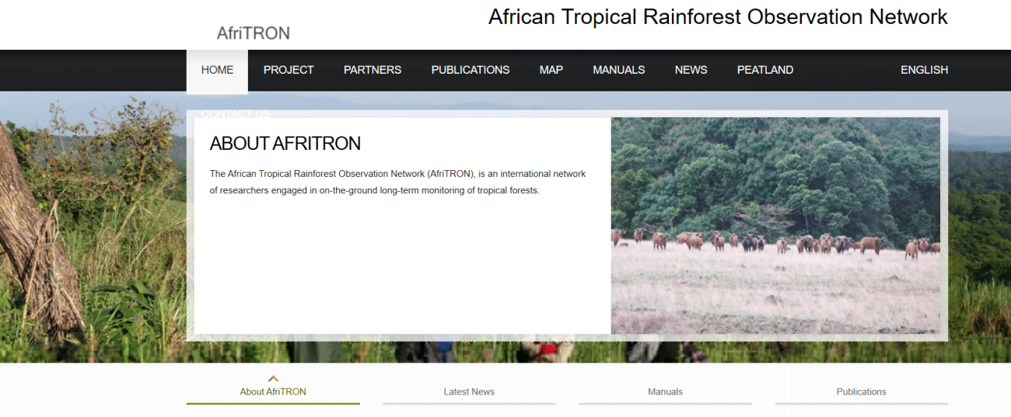
METHODS
repeated inventories of permanent forestplots
We work in PERMANENT FOREST INVENTORY PLOTS
We carefully select plots from large databases

Slide 23
METHODS
repeated inventories of permanent forestplots
We work in PERMANENT FOREST INVENTORY PLOTS
We carefully select plots from large databases
Intact forest (free of fire and industrial logging)
All trees with diameter at reference height ≥10 cm
All trees measured at least twice
Plot surface ≥0.2 ha area (median = 1 ha)
<1500 m.a.s.l. altitude
MAT ≥20.0°C⁵¹
annual precipitation ≥1000 mm⁵¹
located ≥50 m from anthropogenic forest edges

Slide 24
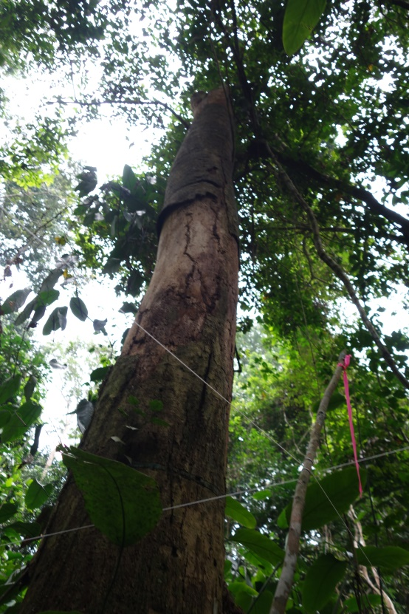
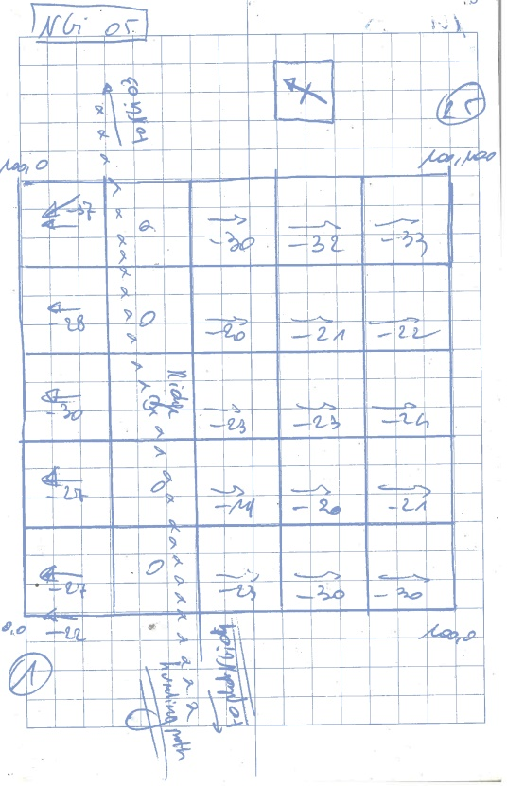
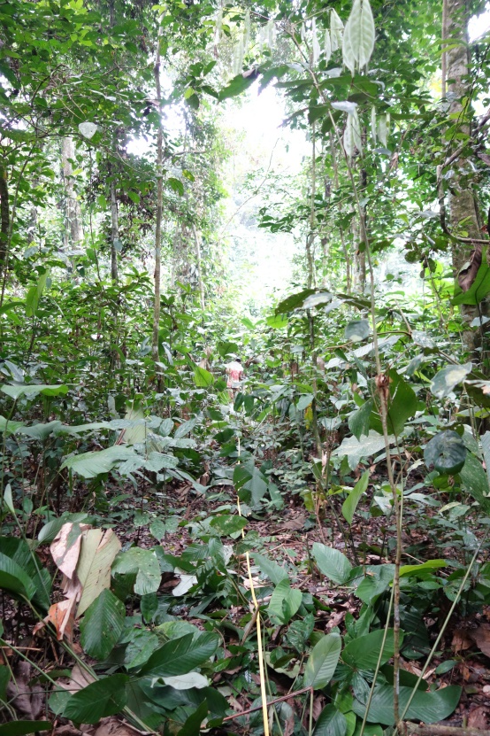
METHODS
repeated inventories of permanent forestplots
We work in PERMANENT FOREST INVENTORY PLOTS
We carefully demarcate each plot and divide it in subplots

Slide 25
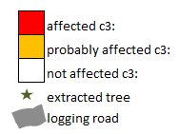
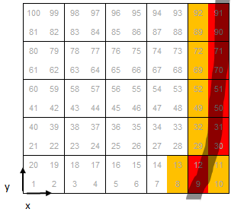
METHODS
repeated inventories of permanent forestplots
We work in PERMANENT FOREST INVENTORY PLOTS
We exclude damaged subplots from analysis

Slide 26
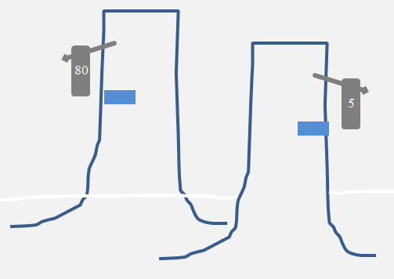
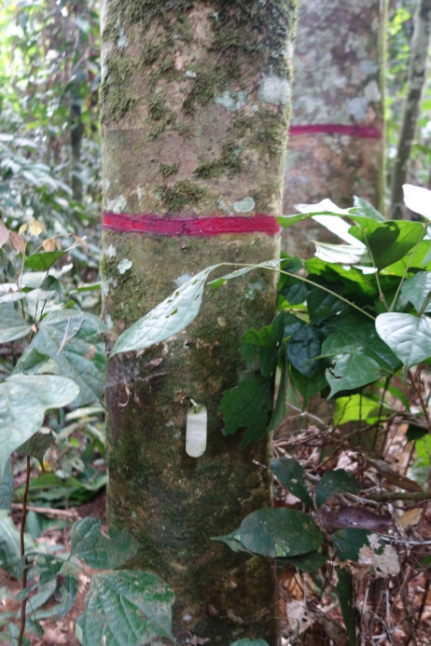
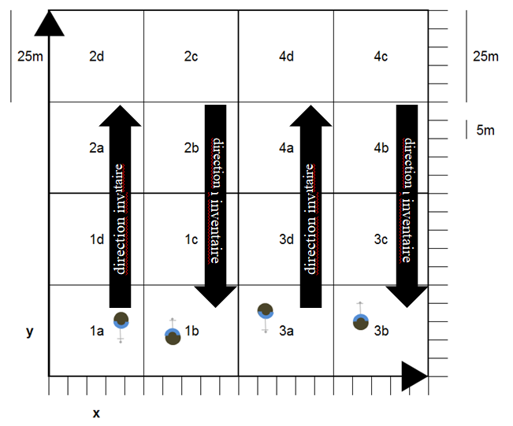
METHODS
repeated inventories of permanent forestplots
We work in PERMANENT FOREST INVENTORY PLOTS
We carefully tag and map the trees

Slide 27
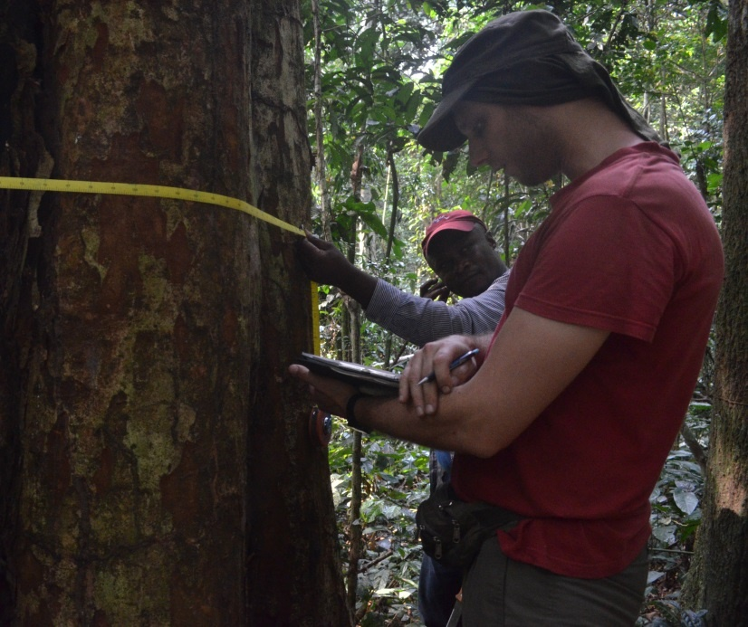
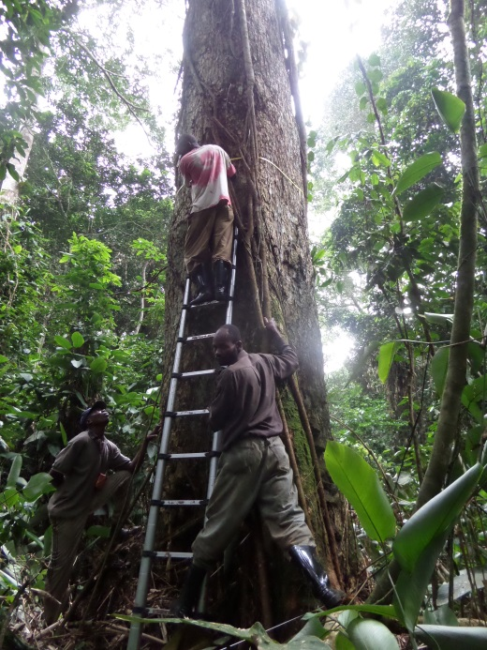
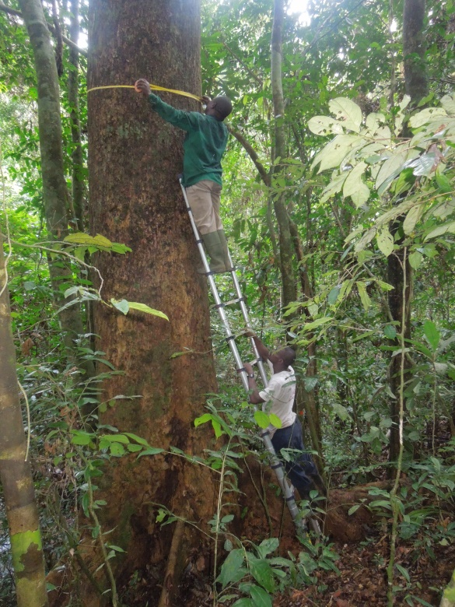
METHODS
repeated inventories of permanent forestplots
We measure trees in INTACT RAINFORESTS
We carefully measure diameter and height

Slide 28
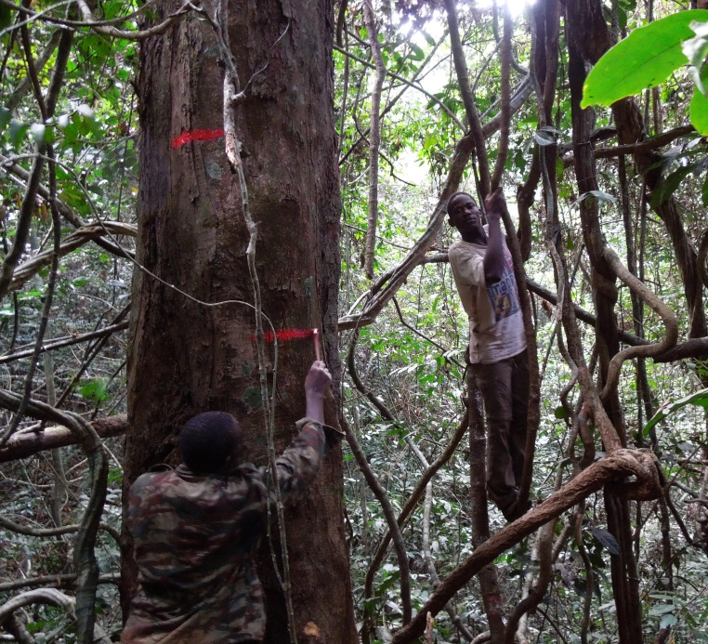
METHODS
repeated inventories of permanent forestplots
We repeat the measurements to create TIME SERIES
We carefully indicate the Point of Measurement (paint!)

Slide 29
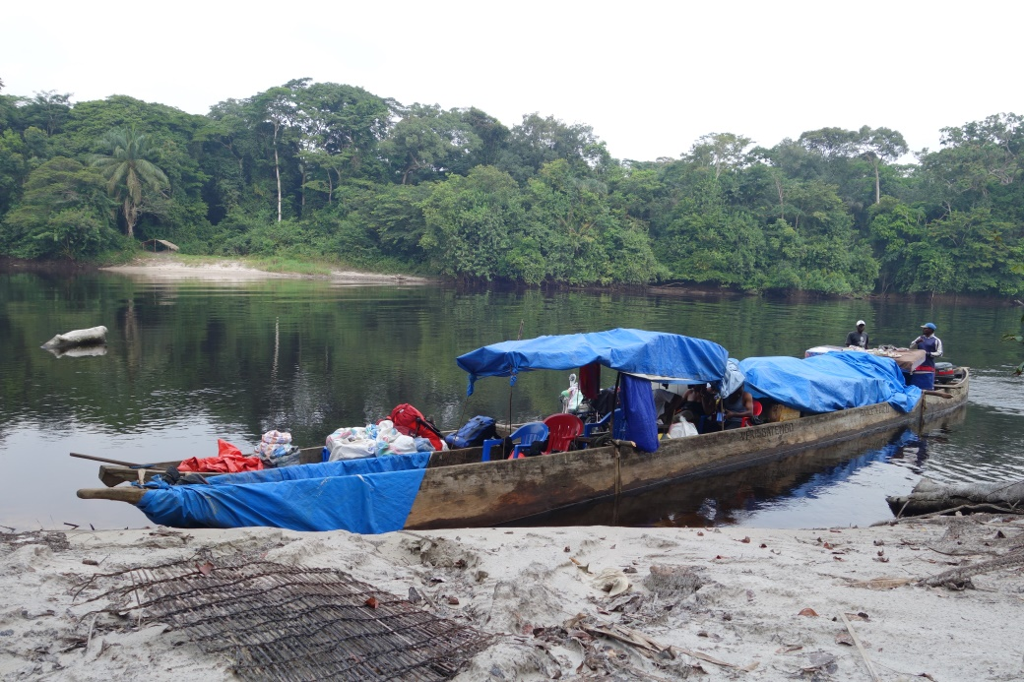
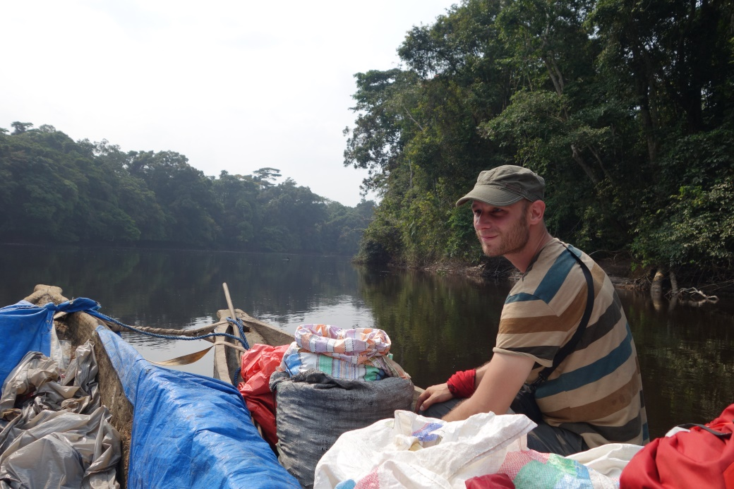
METHODS
repeated inventories of permanent forestplots
The plots are often located in remote areas…

Slide 30
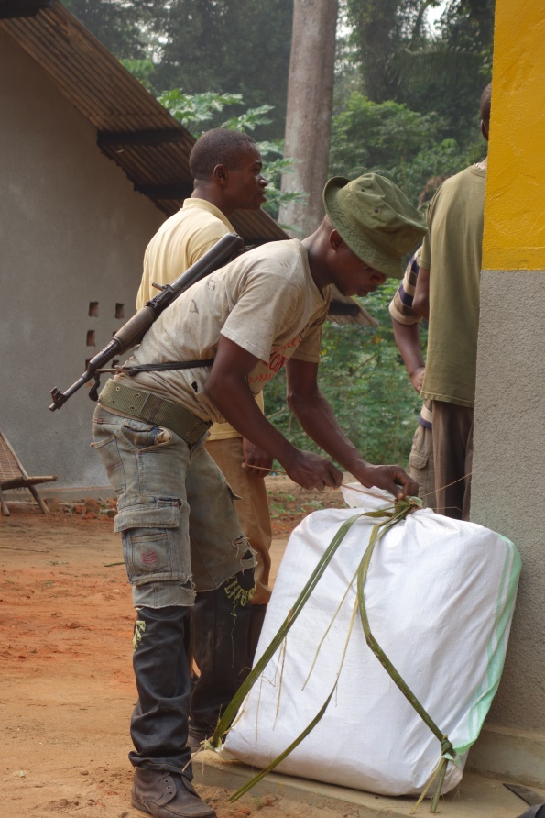
METHODS
repeated inventories of permanent forestplots
…the work is done in challenging conditions…

Slide 31
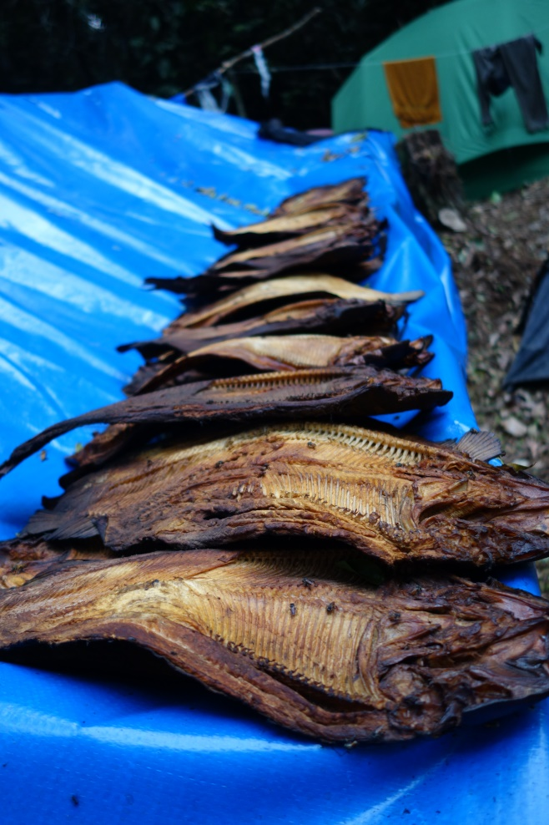
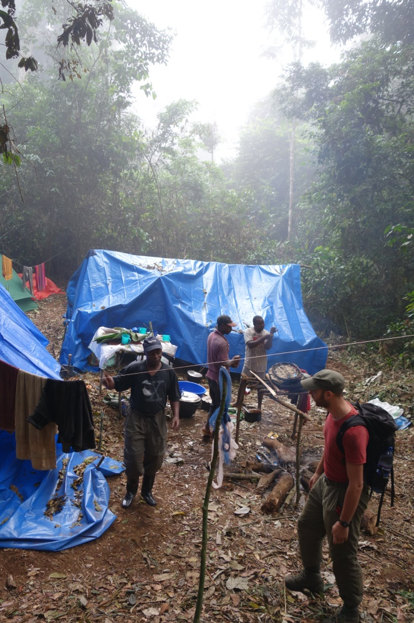
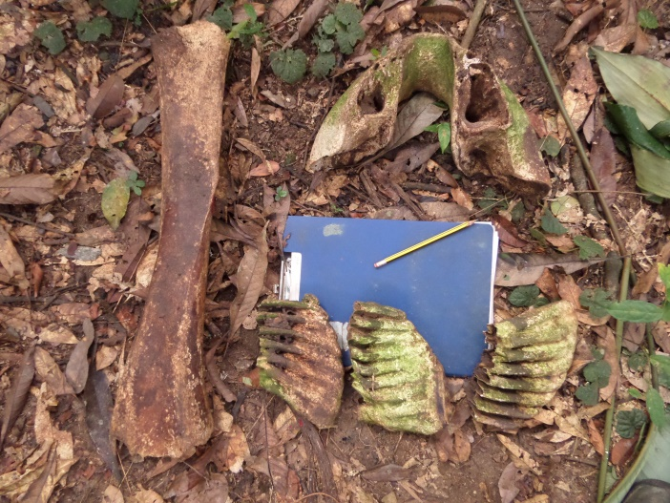
METHODS
repeated inventories of permanent forestplots
…the work is done in challenging conditions…

Slide 32
METHODS
repeated inventories of permanent forestplots
…the work is done in challenging conditions…

Slide 33
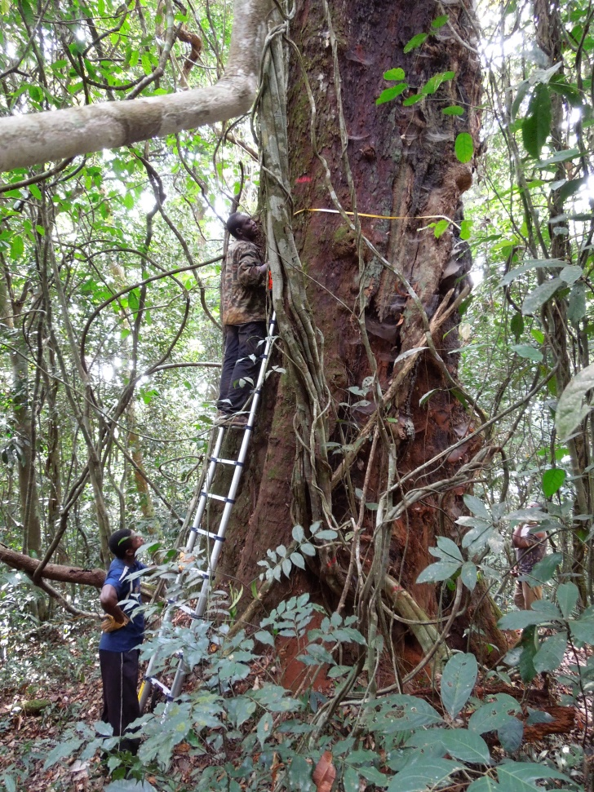
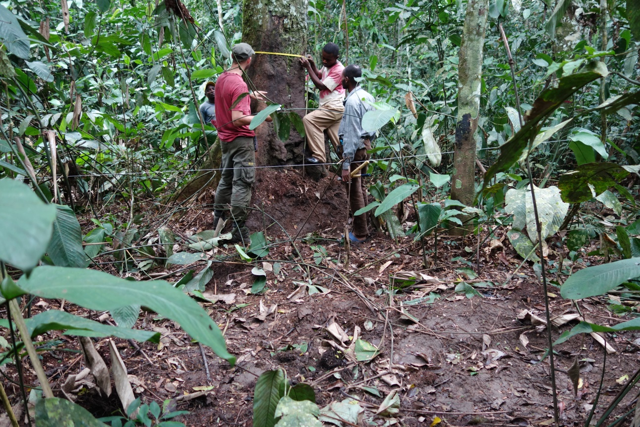
METHODS
repeated inventories of permanent forestplots
…and the trees are not always easy to measure…

Slide 34
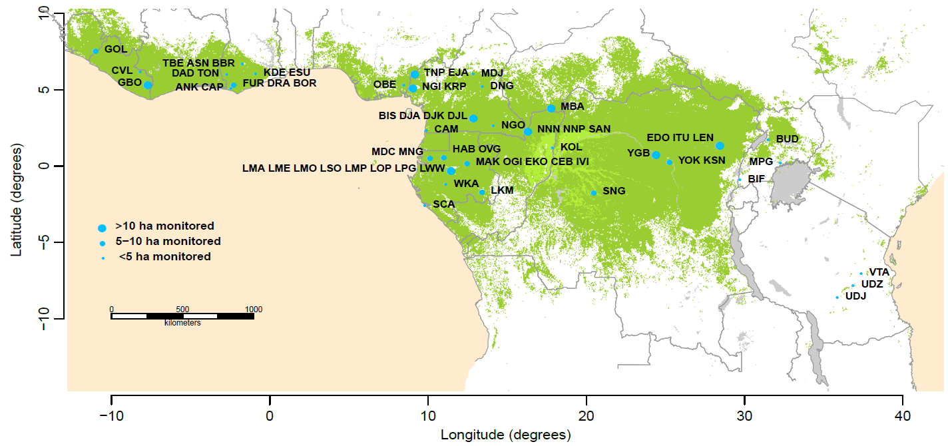
METHODS
repeated inventories of permanent forestplots
…but the results are impressive:
Largest network of repeatedly measured plots
IN INTACT RAINFOREST

Slide 35
METHODS
repeated inventories of permanent forestplots
Largest network of repeatedly measured plots
IN INTACT RAINFOREST
Africa
244 plots, 278 ha
11 countries
47 years of monitoring
>130.000 trees
>390.000 measurements
Hubau et al 2020 Nature
Amazonia
321 plots, 343 ha
7 countries
36 years of monitoring
>189.000 trees
>850.000 measurements
Brienen et al 2015 Nature

Slide 36
METHODS
repeated inventories of permanent forestplots
Most plot data curated on Forestplots.net
Managed by Leeds University
African Tropical Rainforest
Observation Network

Slide 37
METHODS
calculating carbon gains, loss, change of a plot
How do we calculate carbon content
in a tree? …in a plot?
How do we calculate the change
in carbon content over time?

Slide 38
METHODS
calculating carbon gains, loss, change of a plot
1.Estimate carbon content for each tree, each census
2.Estimate carbon gain from tree growth for each tree, for each interval between subsequent measurements, divide by the interval lenght (in Mg C yr-1)
3.Sum carbon gains of all trees in a plot, per interval, divided by plot area (in Mg C ha-1 yr-1)
Chave et al 2014 GCB

Slide 39
METHODS
calculating carbon gains, loss, change of a plot
4.Carbon losses are the sum of carbon from all stems that died during an interval, divided by the census length and plot area (in Mg C ha-1 yr-1)
5.Net carbon change of a plot is estimated as carbon gains minus carbon losses (in Mg C ha−1 yr−1)

Slide 40
METHODS
calculating carbon gains, loss, change of a plot
Gains, in Mg C ha⁻¹ yr⁻¹
Losses, in Mg C ha⁻¹ yr⁻¹
Net carbon change, in Mg C ha⁻¹ yr⁻¹
Net carbon change, in Mg C ha⁻¹ yr⁻¹

Slide 41
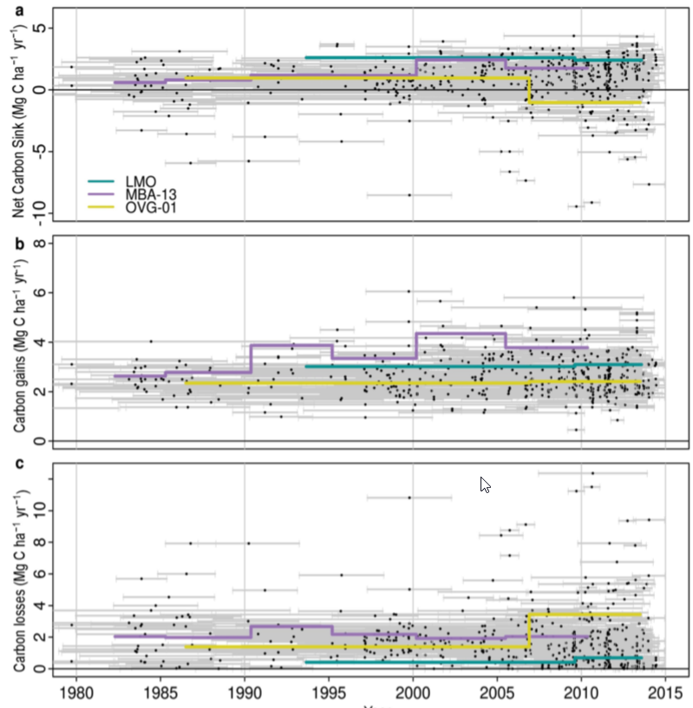
METHODS
calculating carbon change of 244 plots

Slide 42
ANSWERS
What was the evolution of the tropical carbon sink over the last decades?
2. What are the drivers of the sink?
3. How does the future of the sink look like?

Slide 43
ANSWERS
1. Decadal-scale evolution of the carbon sink?
Stable African forest carbon sink between 1983-2010,
at 0.66 Mg C ha-1 yr-1
=> Sinks of Earth’s two largest tropical forests have diverged

Slide 44
ANSWERS
1. Decadal-scale evolution of the carbon sink?
… but a marked decline in the African sink since the 2010s
(134 most intensively monitored plots)
=> Asynchronous carbon sink saturation on the two continents

Slide 45
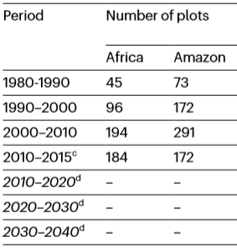
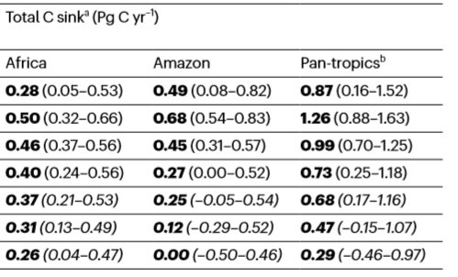
ANSWERS
1. Decadal-scale evolution of the carbon sink?
The pantropical sink has peaked/saturated in the 1990s and declined ever since

Slide 46
ANSWERS
What was the evolution of the tropical carbon sink over the last decades?
2. What are the drivers of the sink?
3. How does the future of the sink look like?

Slide 47
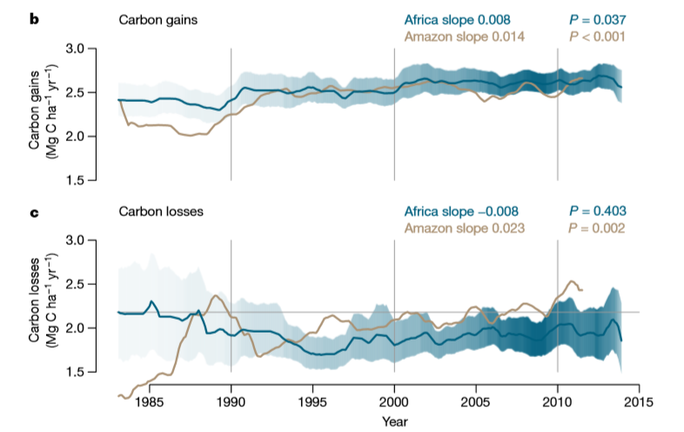
ANSWERS
2. Drivers of the sink?
The difference is largely driven by carbon loss from tree mortality

Slide 48
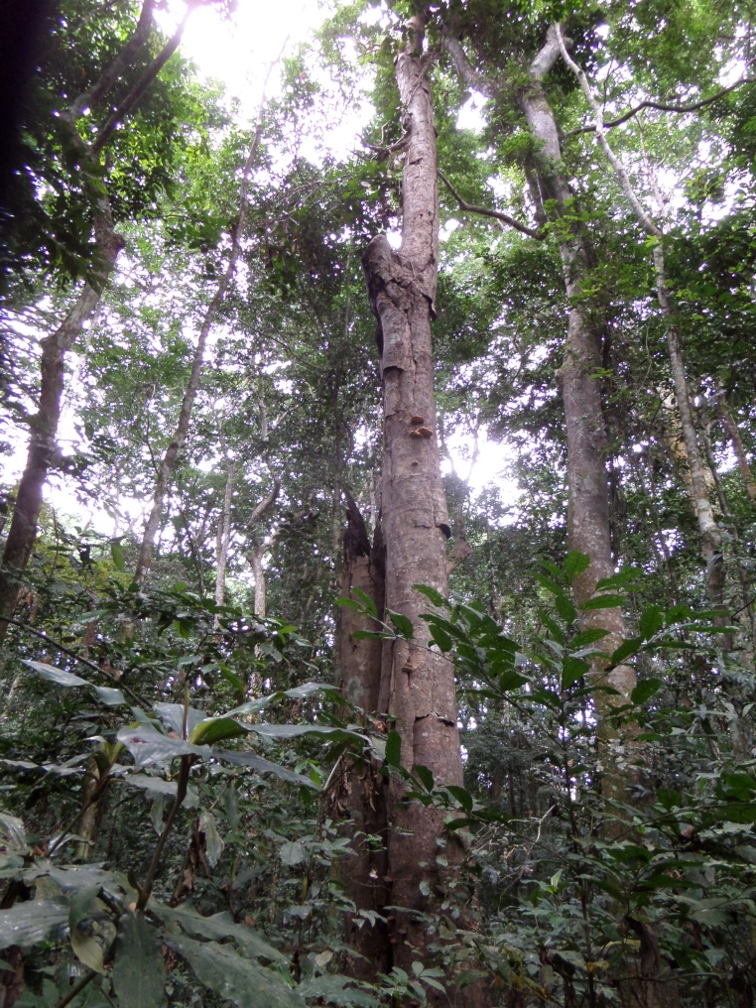
ANSWERS
2. Drivers of the sink?
The difference is largely driven by carbon loss from tree mortality

Slide 49
ANSWERS
2. Drivers of the sink?
Carbon gains:
Positive CO₂ fertilization effect
Negative effects of higher temperatures and drought, explaining ‘levelling off’ since 1990s

Slide 50
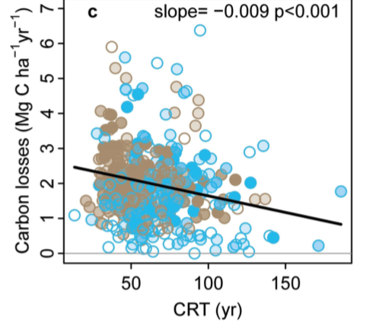
ANSWERS
2. Drivers of the sink?
Carbon losses:
No relation with CO₂, temperature or drought
Significant relation with Carbon Residence Time (CRT)
CRT = AGC / gains
CRT = a measure for how long carbon stays in the system
greater losses in forests with shorter CRT
=> ‘high-gain, high-loss’ forest dynamics pattern

Slide 51
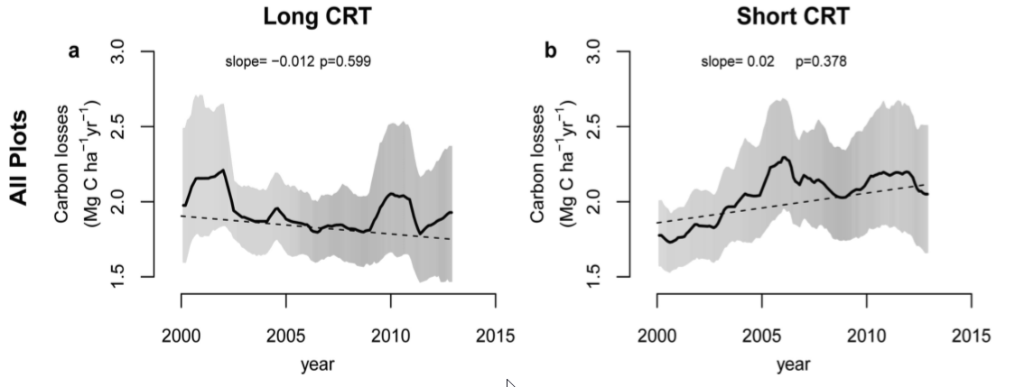
ANSWERS
2. Drivers of the sink?
Forests with higher productivity (~shorter CRT)
=> higher (increasing) losses
=> lower (decreasing) net sink
=> faster saturation

Slide 52
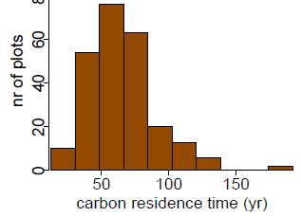
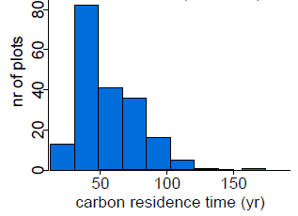
ANSWERS
2. Drivers of the sink?
CRT in Amazonia is 13 years shorter than in Africa
=> Amazonia saturating first (1995 versus 2010) !
Africa:
CRT= 69 (66-72) years
Amazonia:
CRT= 56 (54-59) years

Slide 53
ANSWERS
2. Drivers of the sink?
Conclusion
The CO₂ fertilization effect is increasingly counteracted by the impacts of higher temperatures and droughts on tree growth and mortality,
This process is modulated by internal forest dynamics, with the “fastest” forests (Amazonia) saturating first.

Slide 54
ANSWERS
What was the evolution of the tropical carbon sink over the last decades?
2. What are the drivers of the sink?
3. How does the future of the sink look like?

Slide 55
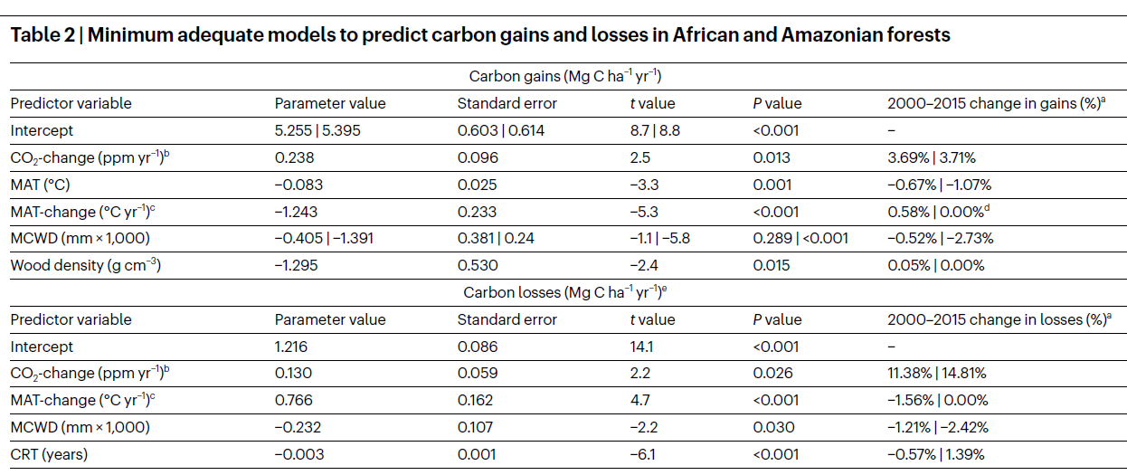
ANSWERS
3. Future evolution of the sink?

Slide 56
ANSWERS
3. Future evolution of the sink?
African sink will decline by 14% (vs 2010–15)
Amazon sink will reach zero in 2035
=> African tropical forests will play a more important role in the future global carbon balance!

Slide 57
CONCLUSION
Intact tropical forests remain major stores of carbon and are key centres of biodiversity
However, their ability to sequester carbon is waning
From 17% (1990s) to 6% (2010s) of anthropogenic CO2 emissions
33% decline in per unit area sink
19% decrease in intact forest area
46% increase in anthropogenic CO2 emissions
The intact tropical forest carbon sink is set to end sooner than even the most pessimistic climate-driven vegetation models predict

Slide 58
IMPLICATION
Scientific research:
Continue on-the-ground monitoring to reduce uncertainties
Regional scale trends?
Resilience due to species turnover?
Improve earth system models to capture gains-losses feedbacks
Policy :
Climate change impacts in the tropics may become more severe than predicted
An earlier date to reach net zero anthropogenic greenhouse gas emissions will be required to meet any given commitment to limit the global heating of Earth

Slide 59
IMPLICATION
Policy :
Apart from cutting emissions, we need :
To protect our existing rainforests, because they are still major reservoirs of carbon
Dedicated efforts to protect African forests (cf Theodore Trefon)
African forests will play an increasingly important role in the global carbon cycle!
Forest regeneration (reforestation)

Slide 60
IMPLICATION
Policy :
Urgent action!

Slide 61
FUTURE
RESEARCH
The Central Congo Basin
Scarcity of data in the Central Congo Basin !
1 plot cluster installed in 1990 (40 ha)
3 plot clusters installed in 2008-2011 (34 ha, e.g. Yangambi)

Slide 62
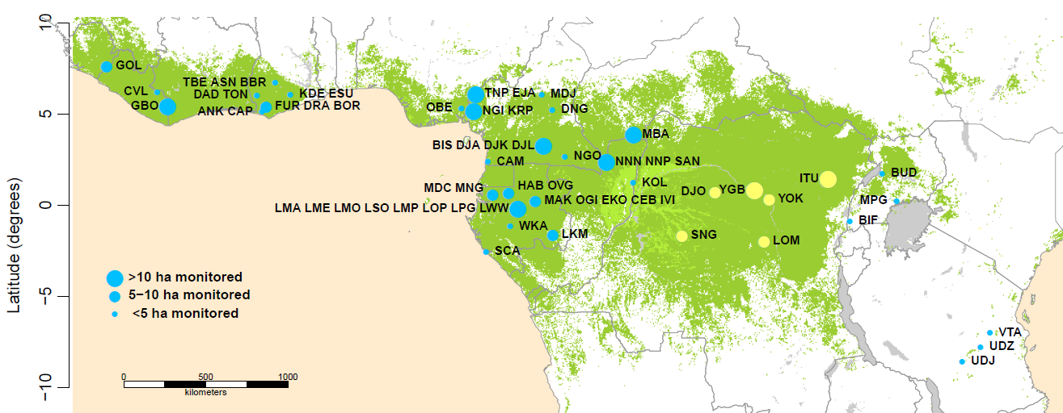
FUTURE
RESEARCH
The Central Congo Basin
By 2022, we will add 2 clusters and recensus the other 4 clusters
This will give us more than a decade of data (2008-2022)

Slide 63
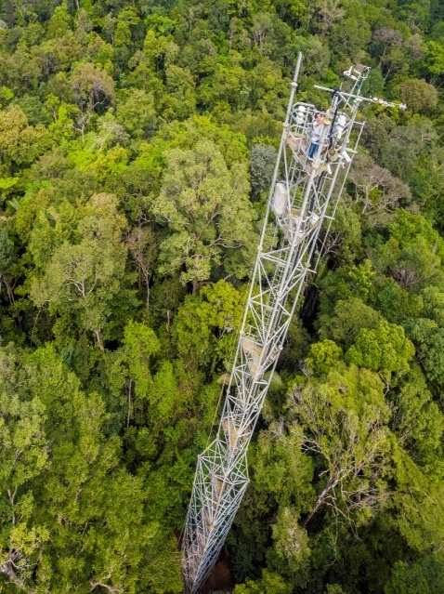
FUTURE
RESEARCH
The Yangambi Biosphere Reserve
Opportunities! forestplots within footprint of the CongoFlux tower
Daily net CO₂ flux
Daily net N₂O flux
Daily net CH₄ flux
Evapotranspiration
High-quality climate data
Construction of the tower is being finalized
A technician has been trained

Slide 64
FUTURE
RESEARCH
The Yangambi Biosphere Reserve
Opportunities: installation
of an in situ wood biology
laboratory
https://www.africamuseum.be/en/research/discover/news/yangambilab

Slide 65
Donors :

Slide 66
Thank you

