Slide 1
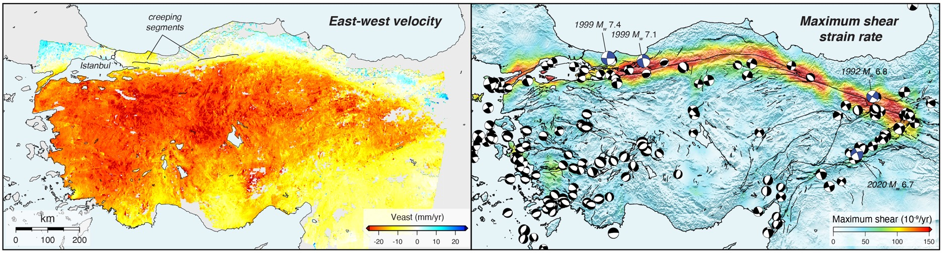

Measure Anatolian surface velocity and strain with InSAR and GNSS:
Implications for fault-locking, seismic hazard, and crustal dynamics
Jonathan R. Weiss^{1,2} Richard J. Walters³ Tim J. Wright² Yu Morishita^{2,4}
Hua Wang⁵ Milan Lazecky² Chris Rollins² and Andrew J. Hooper²
¹University of Potsdam ²COMET, University of Leeds ³COMET, University of Durham
⁴Geospatial Information Authority of Japan ⁵Guangdong University of Technology, China

Slide 2
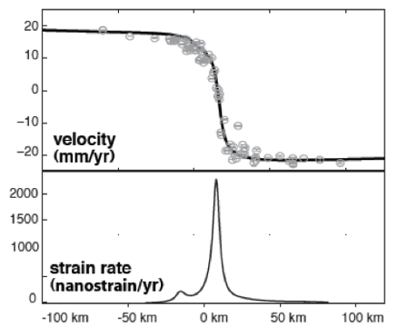
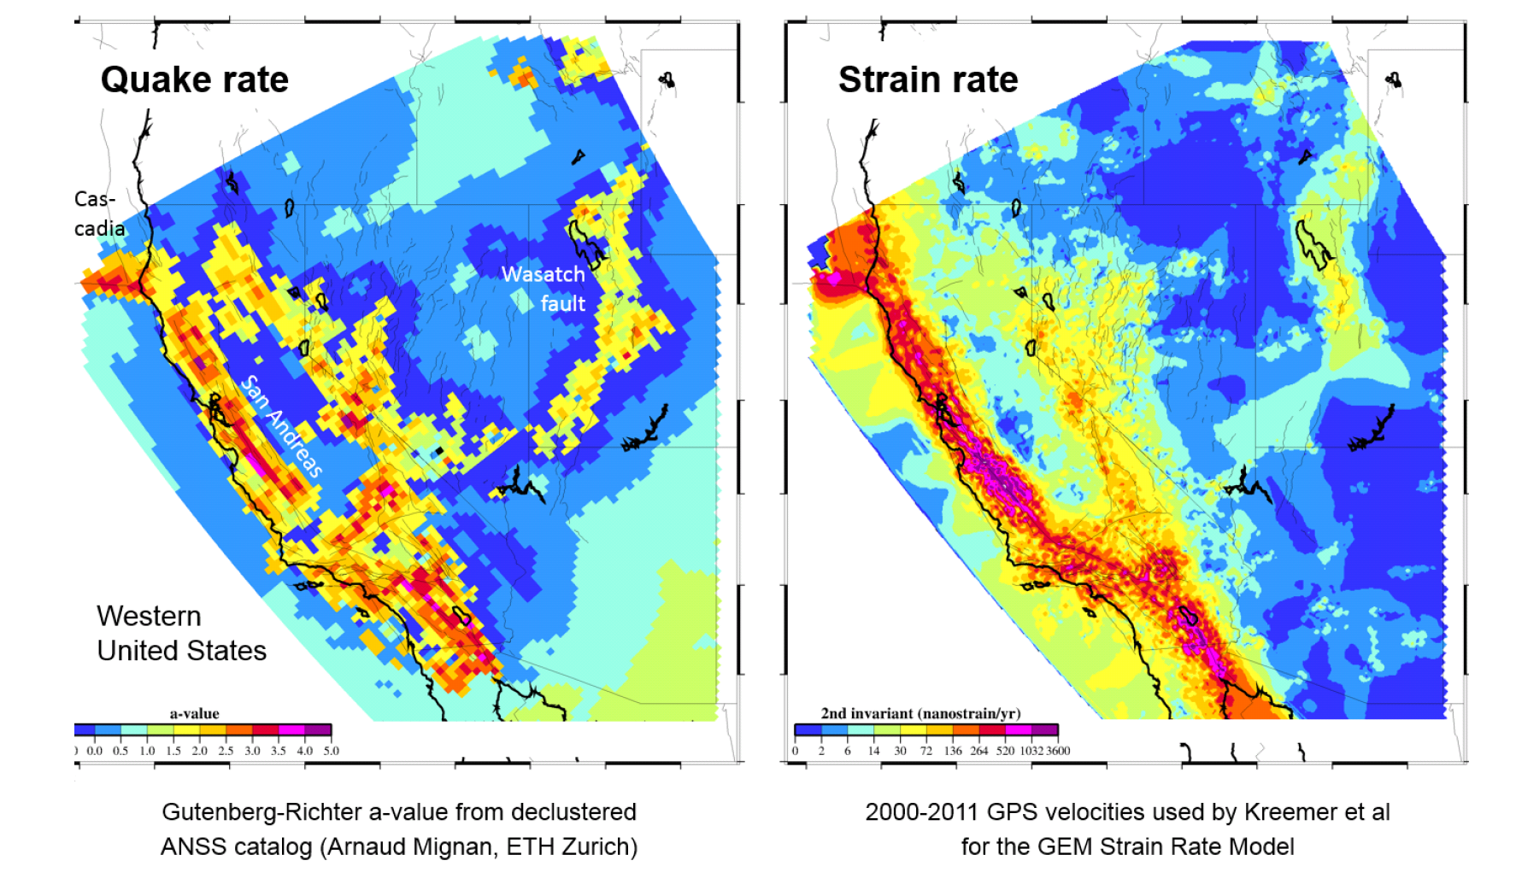
Strain Rates ⇔ Seismicity
Smith-Konter et al., 2010
If we can measure strain everywhere, we can improve estimates of seismic hazard.
(but we need accuracies of 10 ⁻⁸ yr ⁻¹, or 1 mm yr ⁻¹ over 100 km)
figure from Corné Kreemer, Univ. of Nevada, Reno and the Global Earthquake Model

Slide 3
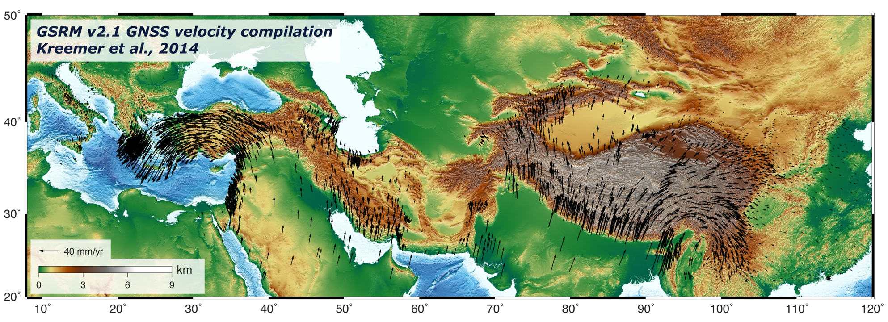

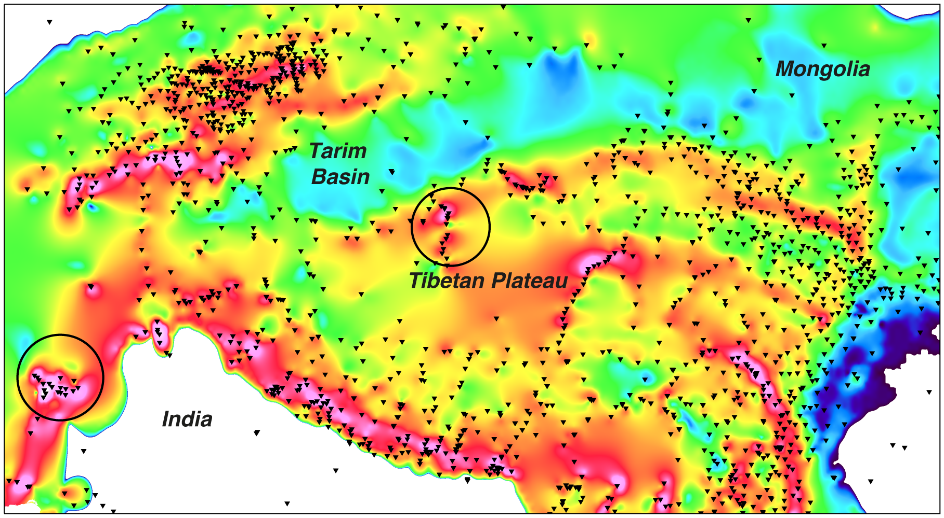
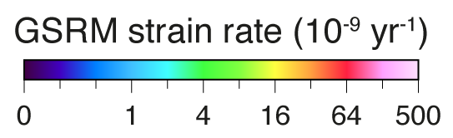
Why bother with InSAR? GNSS data density is insufficient

Slide 4
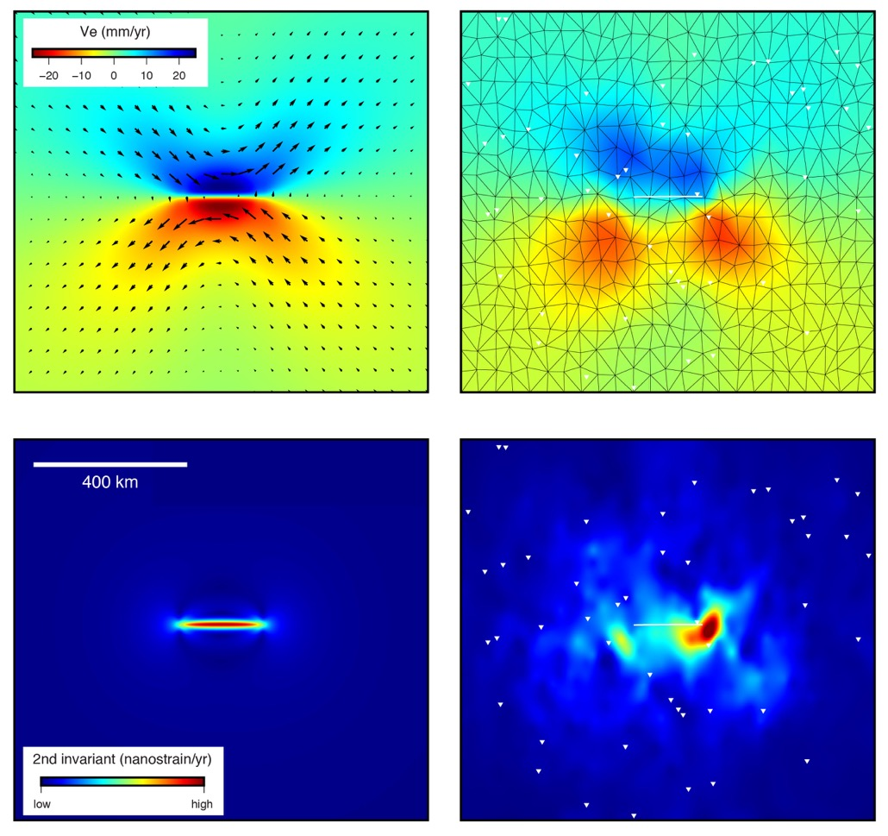
Why bother with InSAR? GNSS data density is insufficient
GNSS only
synthetic
velocity
recovered
velocity
synthetic
strain
rate
recovered
strain
rate

Slide 5
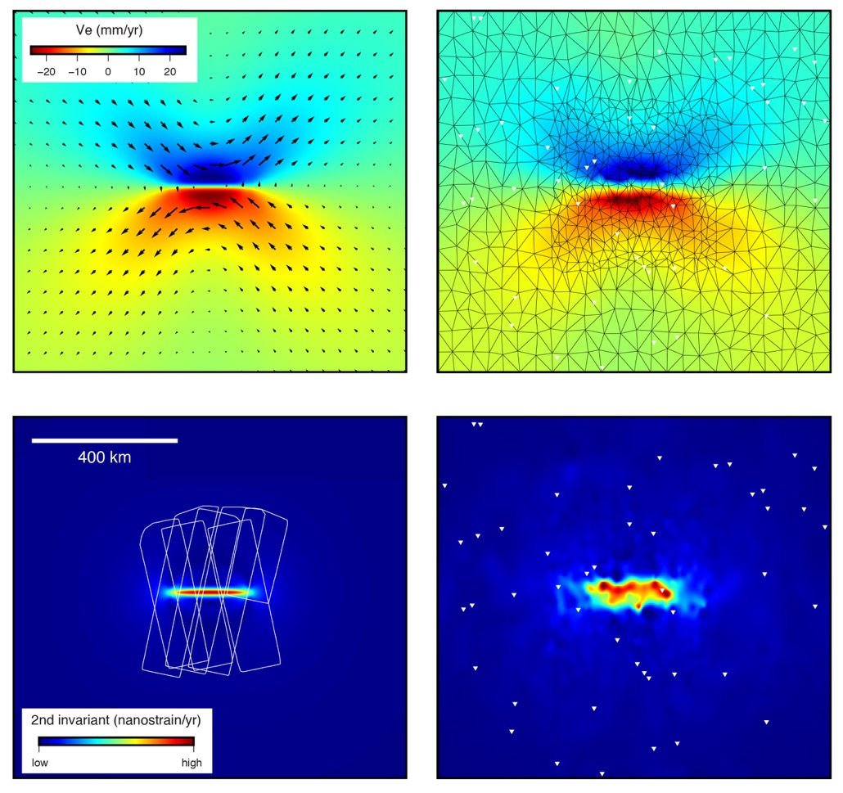
Why bother with InSAR? GNSS data density is insufficient
GNSS + InSAR
synthetic
velocity
recovered
velocity
synthetic
strain
rate
recovered
strain
rate

Slide 6
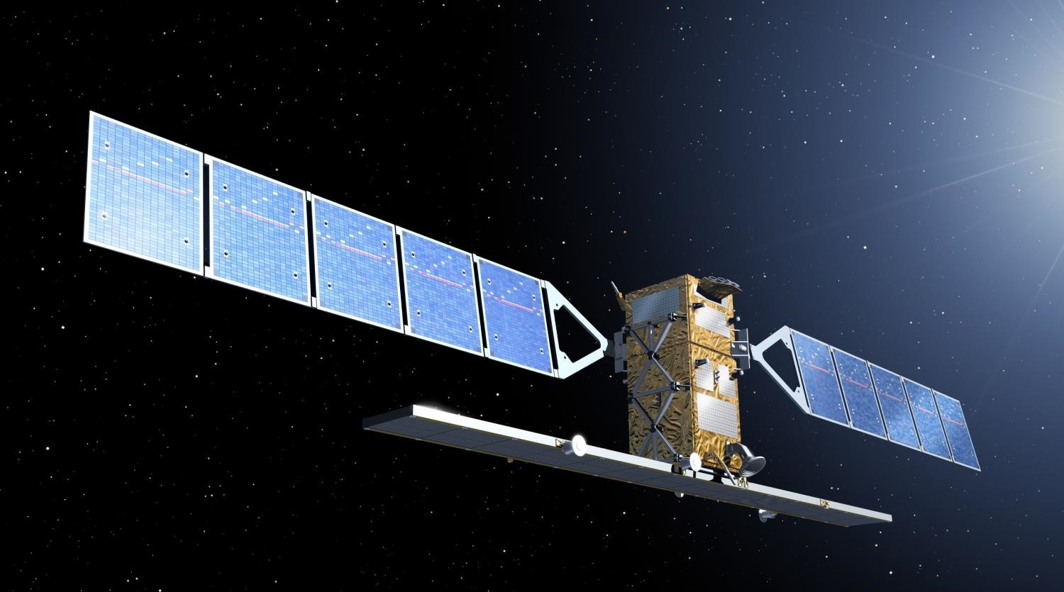
Sentinel-1 is a Game Changer for Tectonic InSAR
Acquiring at least 2 images
every 12 days for the global tectonic belts
Data are free and open
COMET is mass producing Sentinel-1 interferograms with the primary aim of measuring tectonic strain rates
Figure from ESA
Notes:
Also spare avaialble if launch fails. Second
6

Slide 7
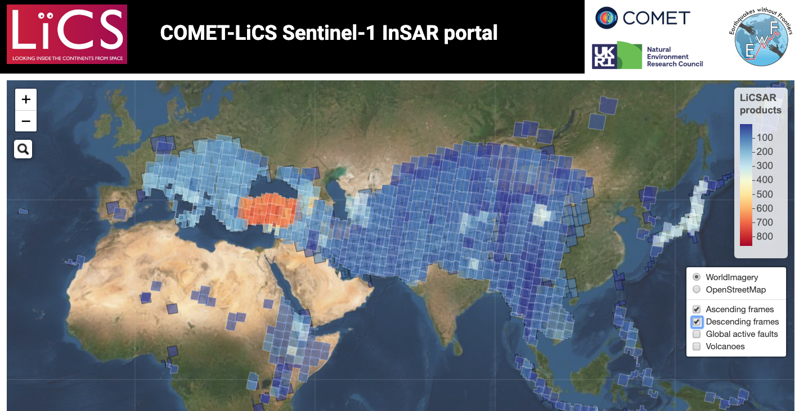
Coverage for the Alpine-Himalayan Belt
180,000+ifgs to date: http://comet.nerc.ac.uk/COMET-LiCS-portal

Slide 8
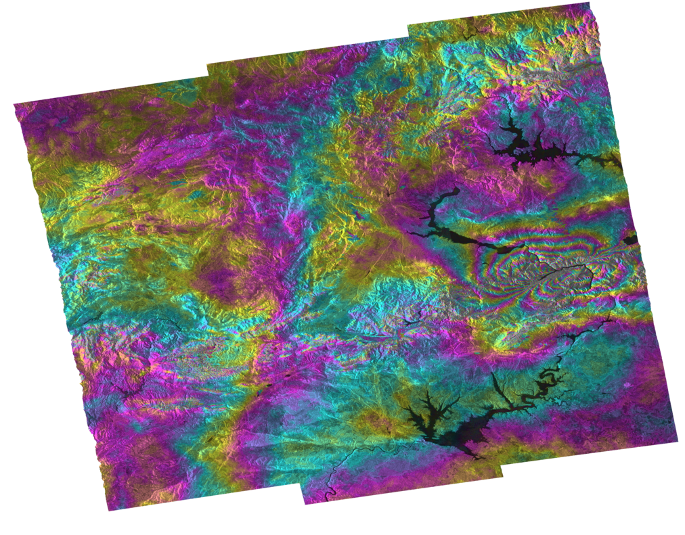
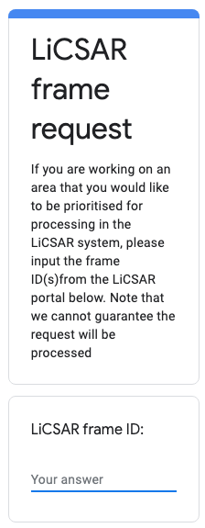
Coverage for the Alpine-Himalayan Belt
2020 M_{w} 6.7 Elaziğ earthquake
ifg: 20200115-20200127
180,000+ifgs to date: http://comet.nerc.ac.uk/COMET-LiCS-portal

Slide 9

COMET-LiCS Summary Work Flow
SAR images
InSAR processor
Precise orbits
Atmospheric correction
Phase unwrap
Interferograms
Interferogram (displacement)
Interferogram (displacement)
NERC Centre for Environmental Data Analysis (CEDA)

Slide 10
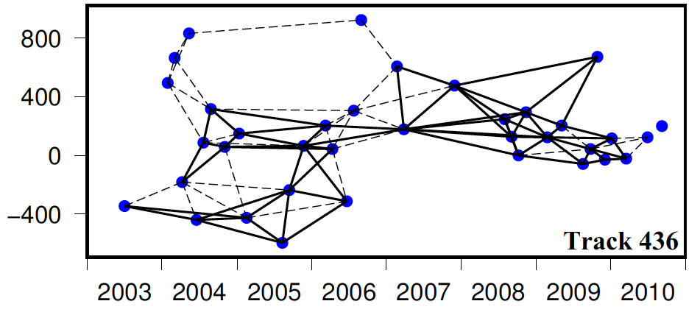
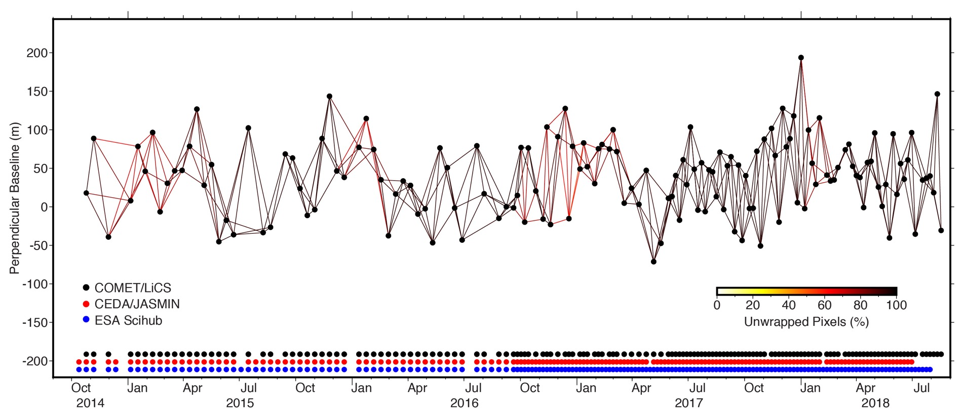
Baseline network: 116A_05168 (#_{ifg}=429)
Missing acquisitions; critical missing bursts; low-coherency timespans (i.e. winter), …
← Envisat network from Hussain et al., 2018
S1A
S1A + S1B

Slide 11
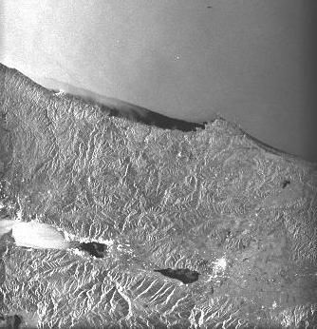
InSAR Time Series & Velocities
Interferograms
Interferogram (displacement)
Interferogram (displacement)
In Theory
Time-series processor
Average velocity map
Time-series for each pixel

Slide 12



LiCSBAS: LiCSAR Time Series & Velocities
Good data
*.unw
*.unw
Combine
cumulative
displacements
&
velocities
point-by-point
multi-
look
10x10 average
No
Full rank?
Yes
*.cum
$$Φ=Gm$$
*.unw
NSBAS
Simple inversion
$$\left[\begin{aligned}Φ \\ 0\end{aligned}\right]=\left[\begin{matrix}G & 0 \\ L & −∆T\end{matrix}\right]\left[\begin{aligned}m \\ V\end{aligned}\right]$$
$$Φ=Gm$$
vel
drmse
Identify bad data
(coverage, loop closure)
GACOS correction
discard
bad
data
*.inc
mask
n_rankdef
vel.mskd
Unwrap error correction
n_looperr
In Practice!
*.unw
residual
Bad data
inversion
github.com/yumorishita/LiCSBAS
Morishita et al., Remote Sensing, 2020

Slide 13
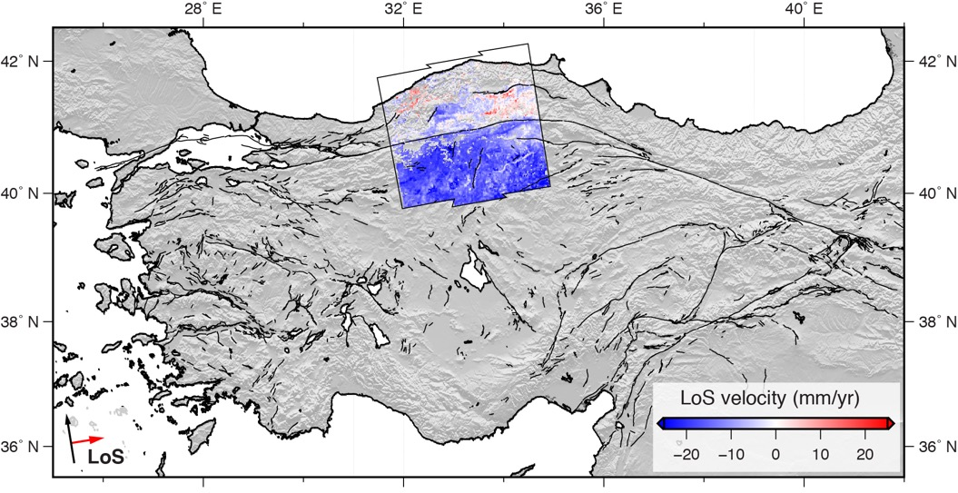
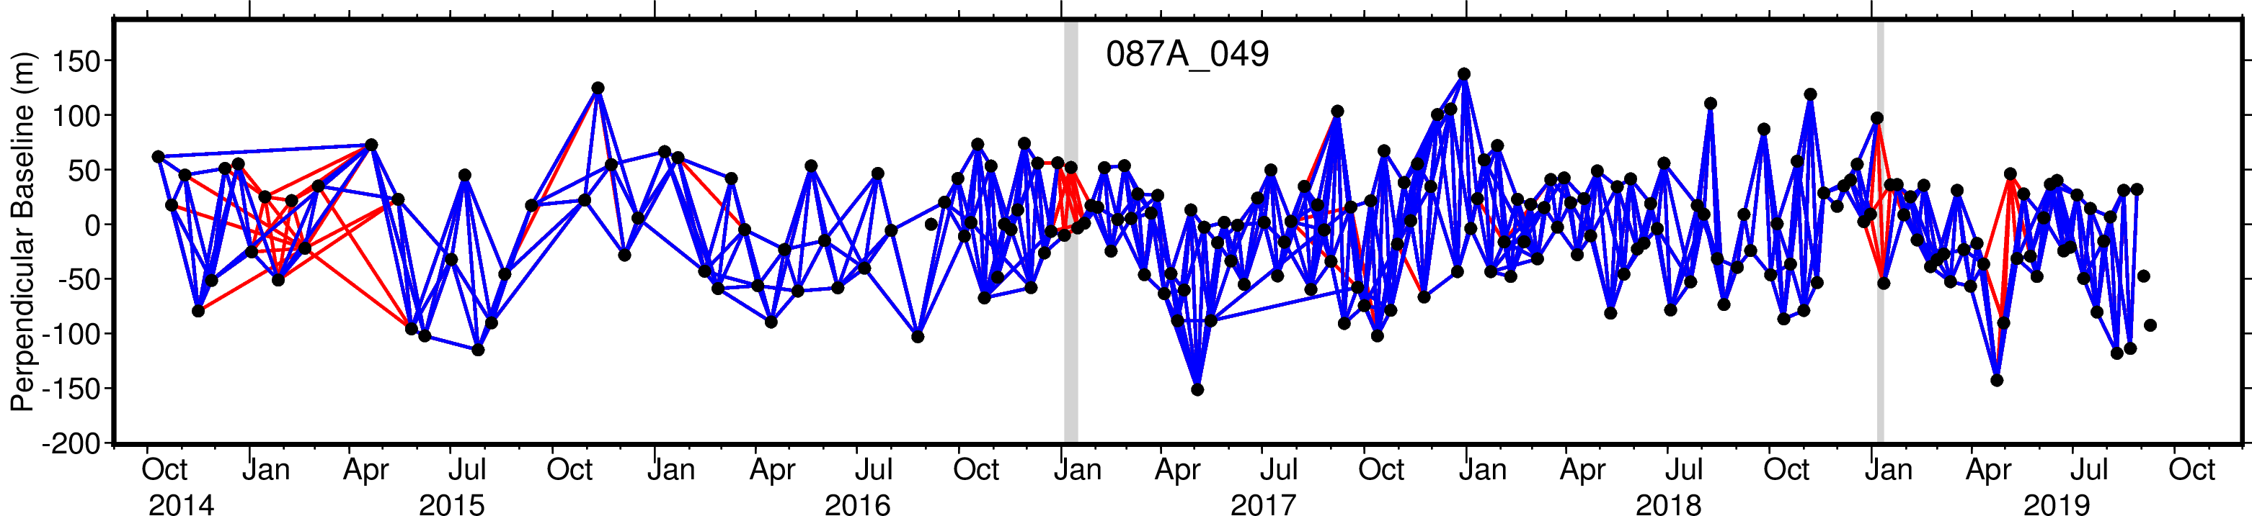
Black Sea
NAF
Eurasia
Anatolia
EAF
Arabia
Mediterranean Sea
Active faults from Emre et al., 2016
discarded ifg
used ifg n=622
gap
gap

Slide 14
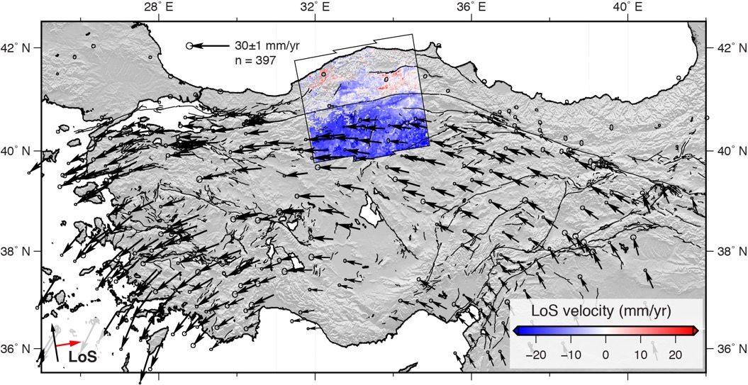
Transform the InSAR data to a Eurasia-fixed reference frame using culled GNSS data compilation from Nocquet 2012 & England et al., 2016

Slide 15
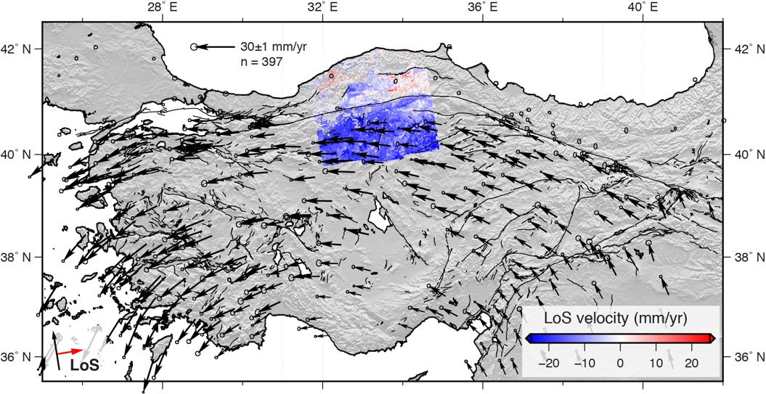
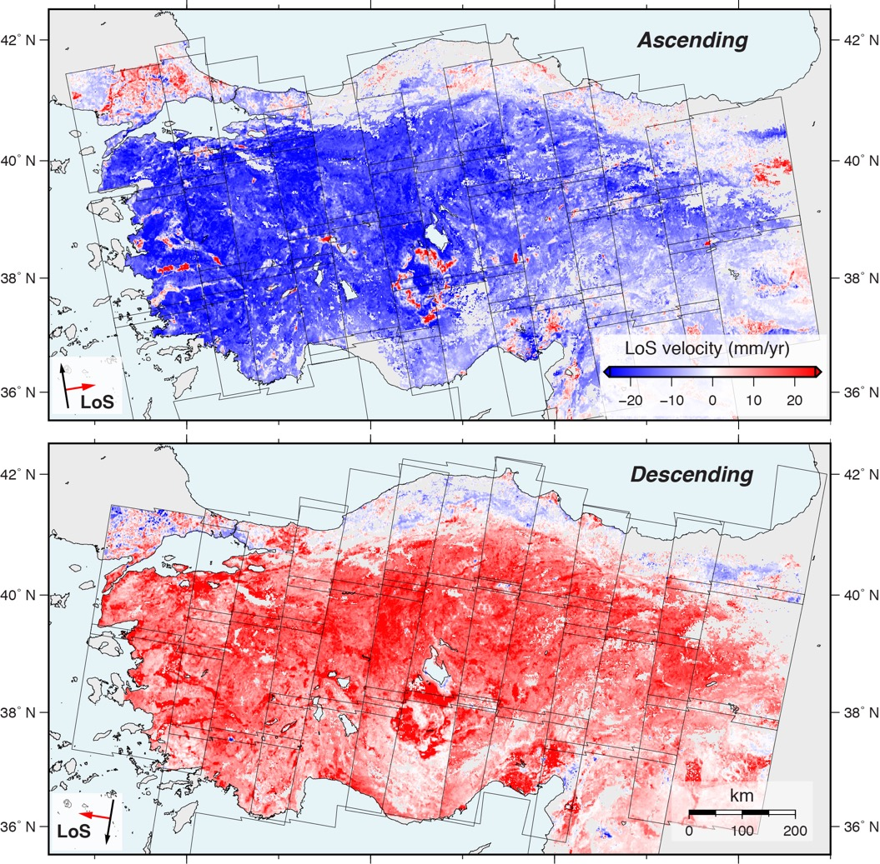
Transform the InSAR data to a Eurasia-fixed reference frame using culled GNSS data compilation from Nocquet 2012 & England et al., 2016

Slide 16
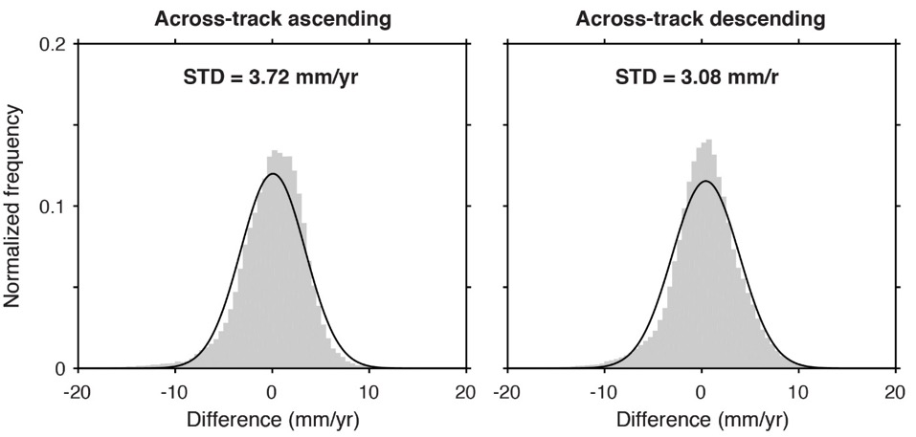
Sentinel-1 for Anatolia
2014 → 2019
∼200 images/frame
∼8,000 images
∼800 ifgs/frame
∼30,000 ifgs
∼ 800,000 km²
Line-of-sight accuracy ~2.4 mm/yr

Slide 17
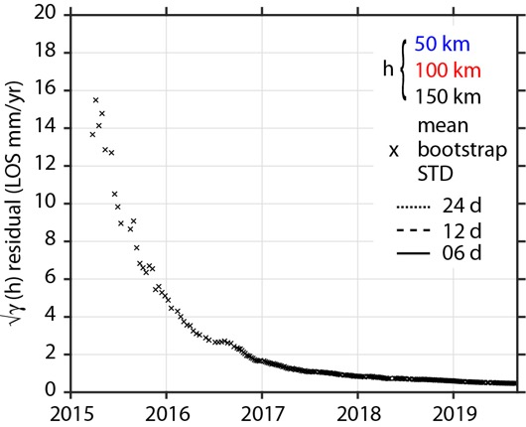
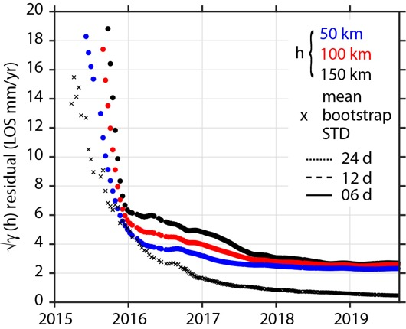
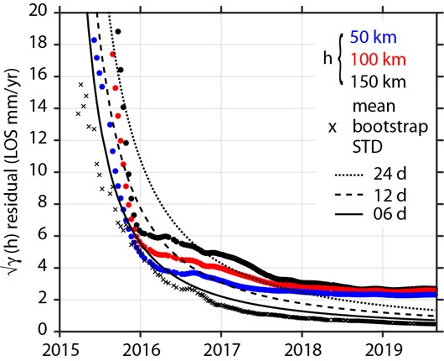
Sentinel-1 for Anatolia
2014 → 2019
∼200 images/frame
∼8,000 images
∼800 ifgs/frame
∼30,000 ifgs
∼ 800,000 km²
Zhang et al., JGR, 1997
Accuracy ~2.5 mm/yr@100 km

Slide 18
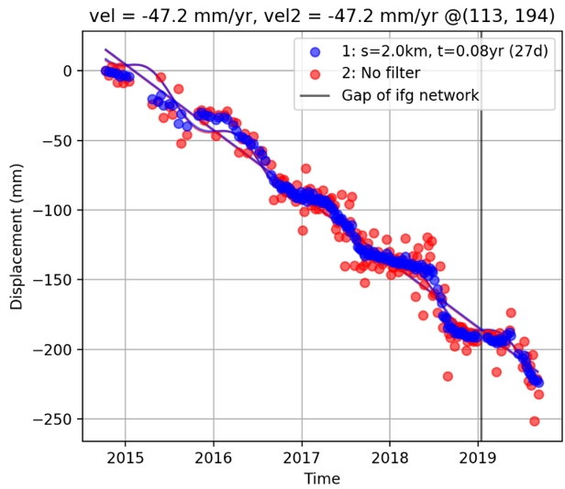
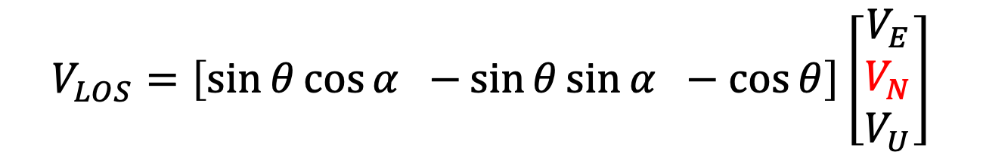
LiCSBAS time series for Konya Basin from subsiding region (red pixel) relative to adjacent “stable” region
3D velocity
Line-of-sight velocity
(i.e. ascending or descending)
$$V_{LOS}=\left[\sin{θ\cos{α −}}\sin{θ}\sin{α −\cos{θ}}\right]\left[\begin{matrix}V_{E} \\ V_{N} \\ V_{U}\end{matrix}\right]$$
from
GNSS
incidence angle
satellite heading
e.g. Wright et al., 2004
Ambiguity associated with interpreting LOS information

Slide 19
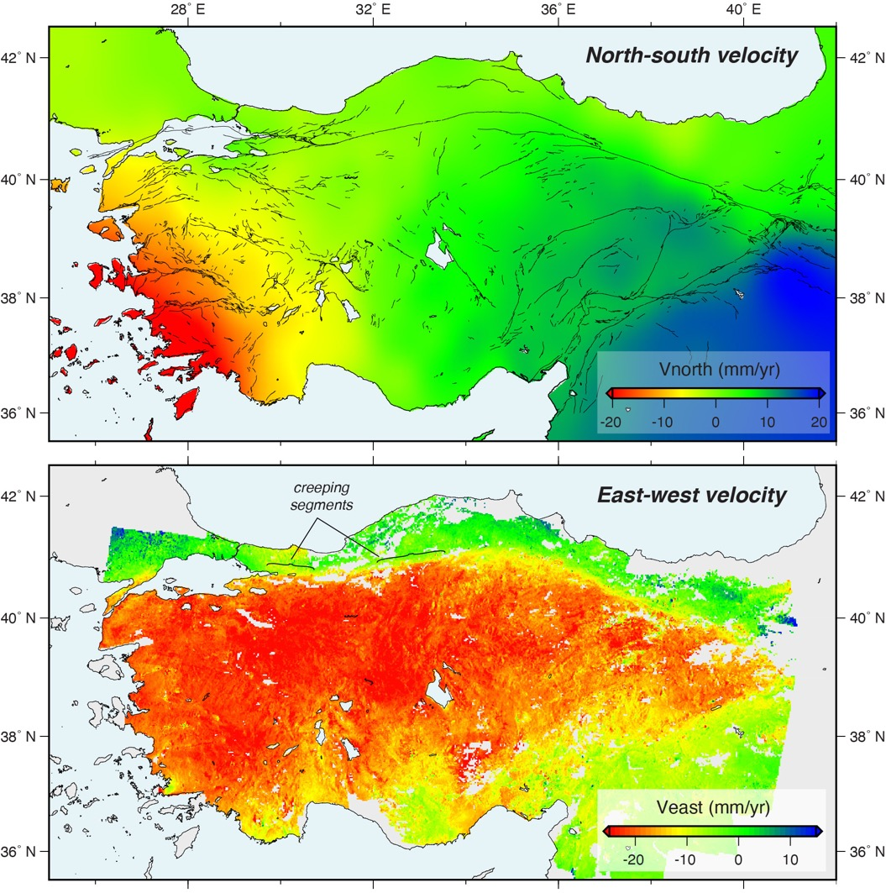
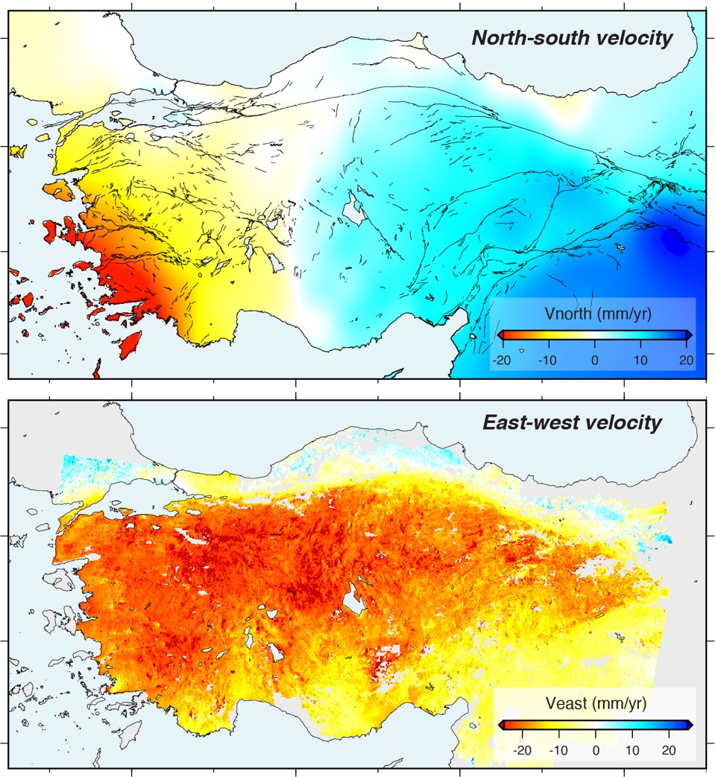
from
GNSS

Slide 20
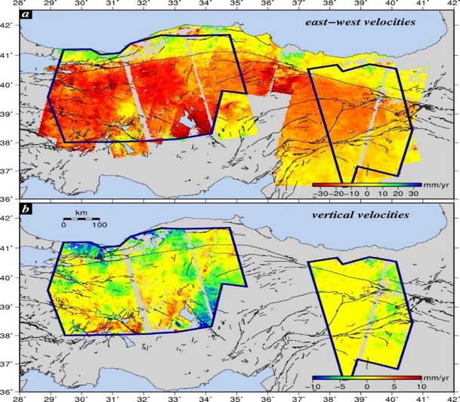
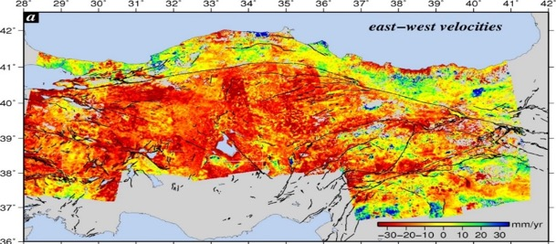
2002-2010 Envisat data
Hussain et al., 2018
1st 1.5 years of
Sentinel-1 data
1st ~ 5 years of
Sentinel-1 data
Wright et al., 2001

Slide 21
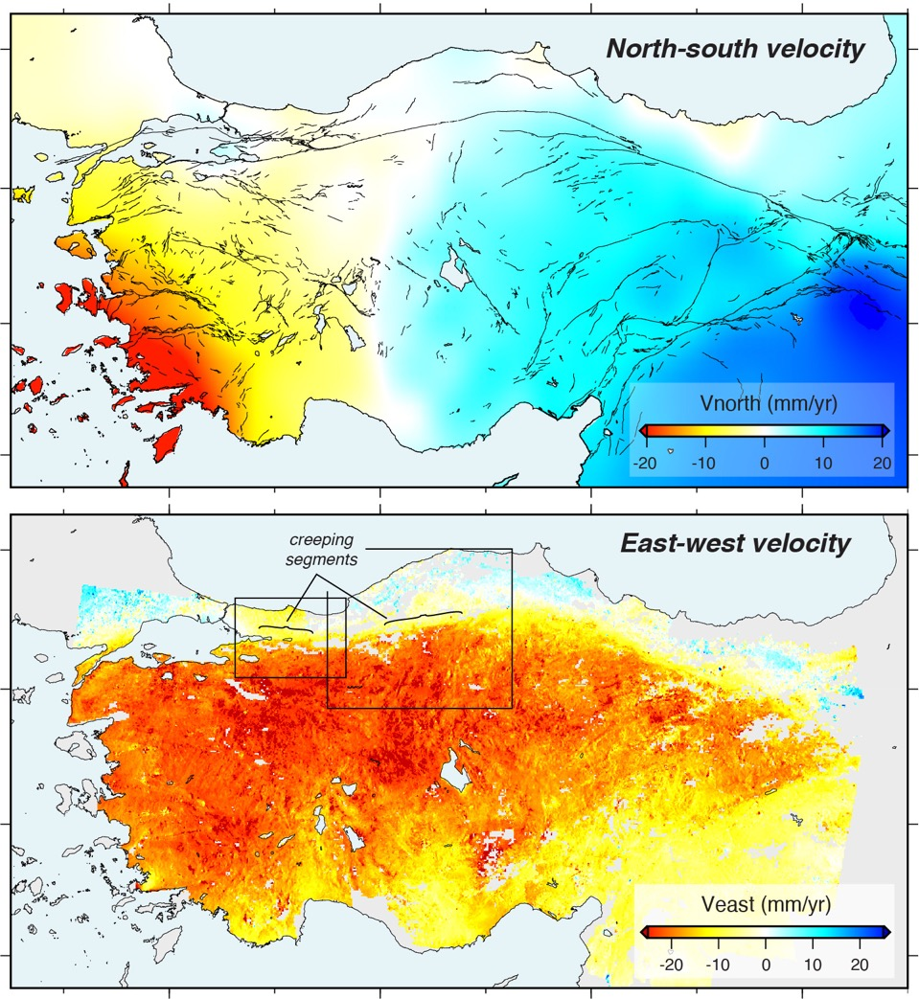
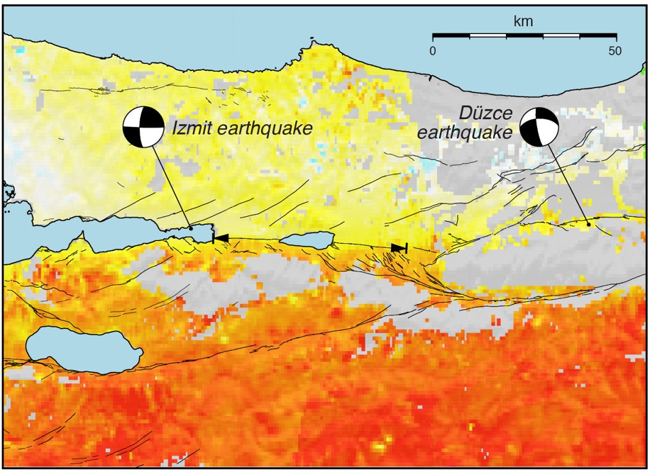
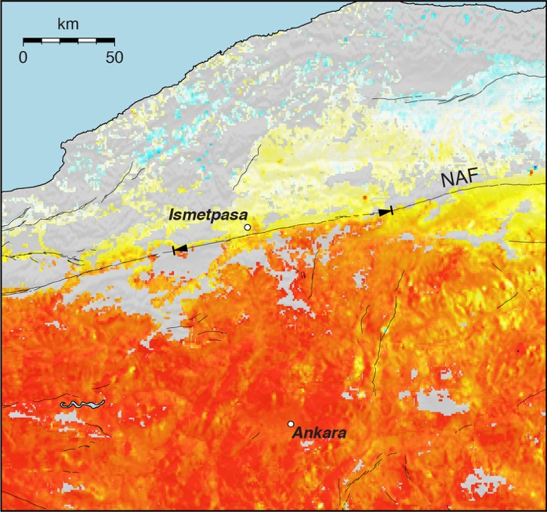
Creeping zone from Aslan et al., 2019
Creeping zone from Hussain et al., 2016

Slide 22
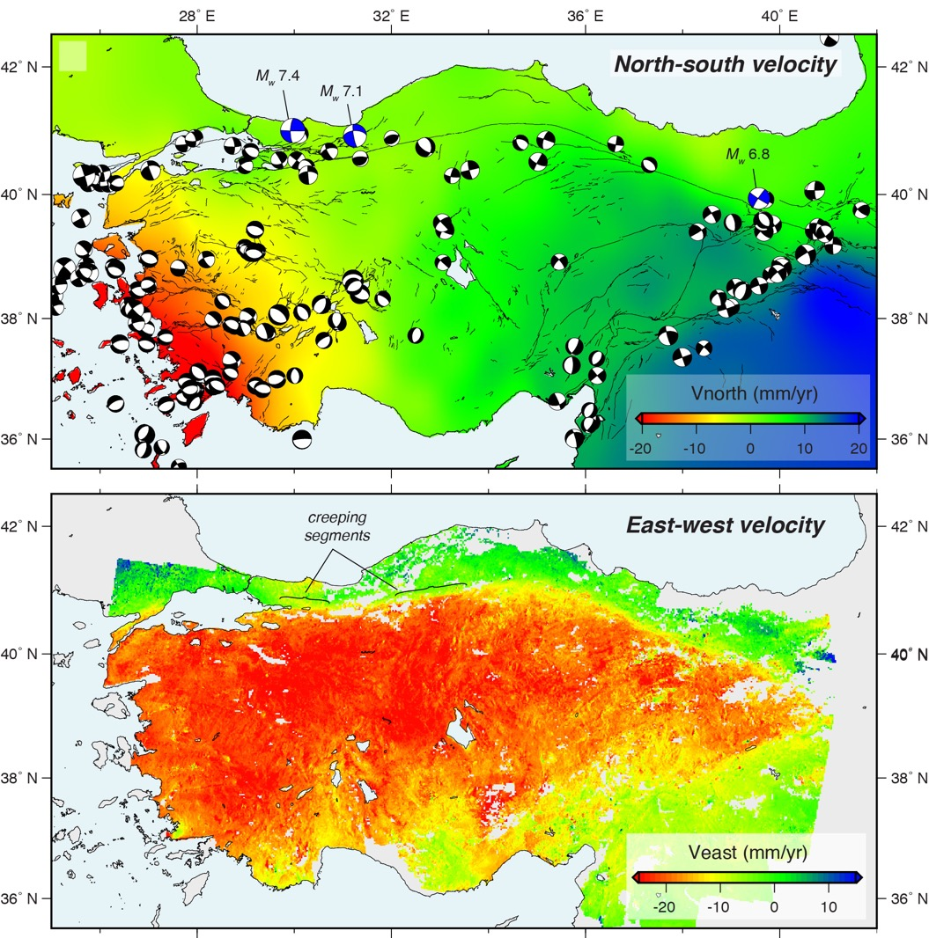
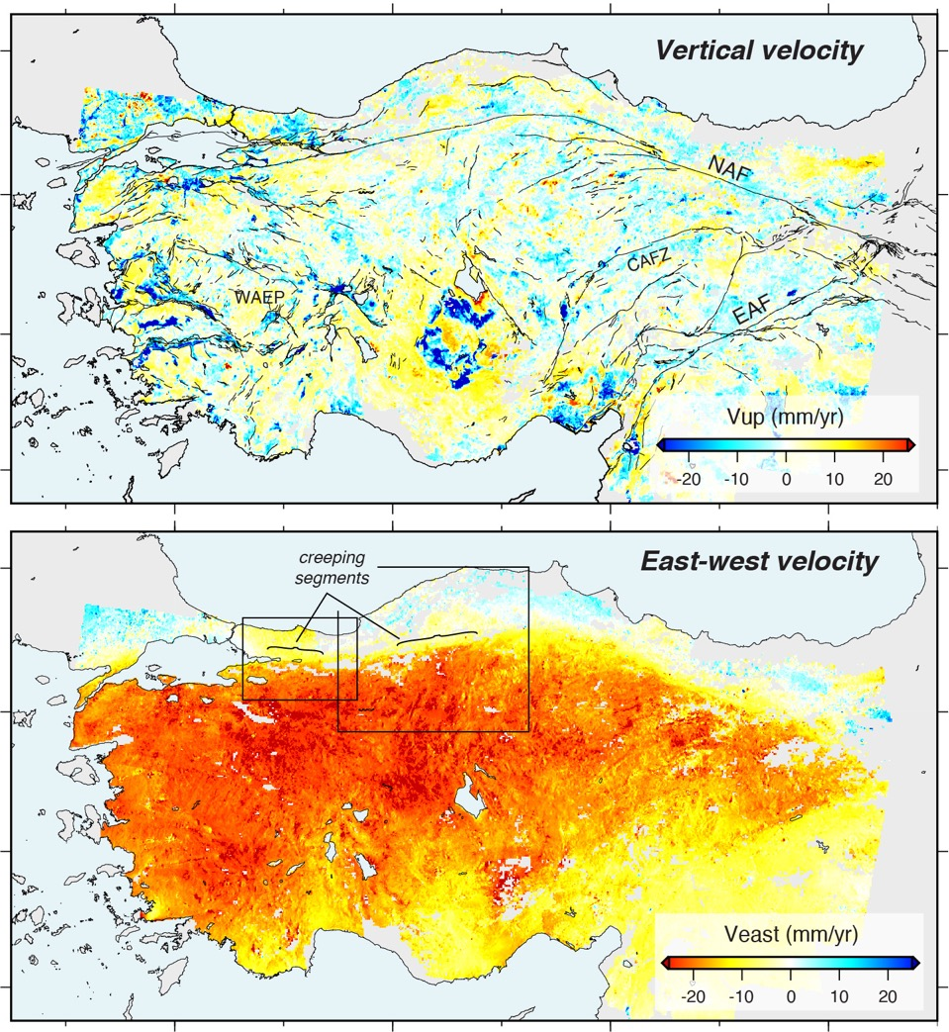

Slide 23

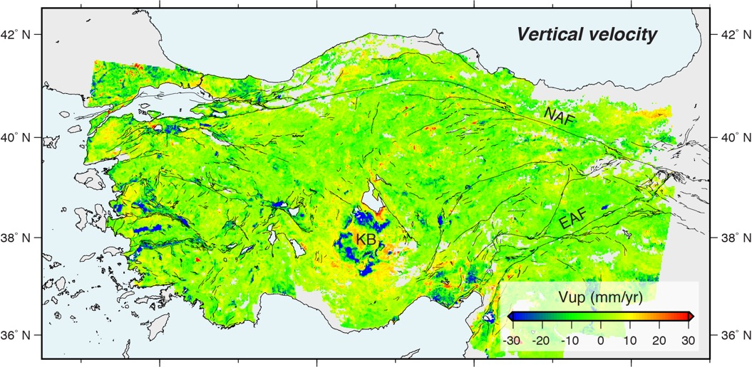
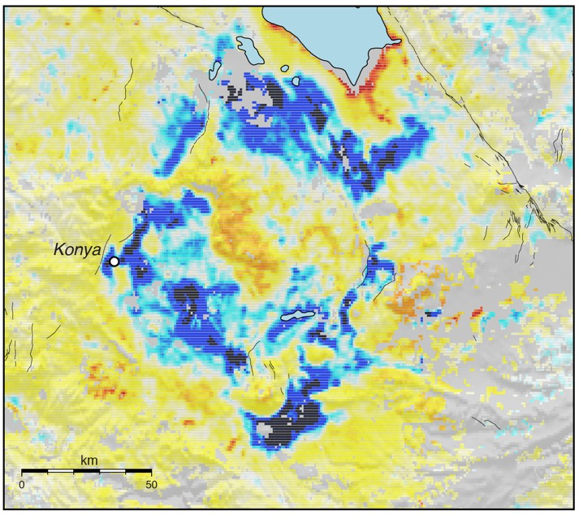
Black regions are subsiding at rates ≥50 mm/yr

Slide 24
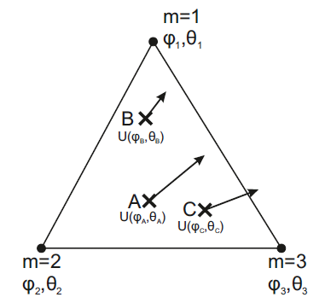
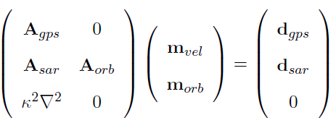
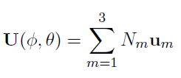
Velocity and Strain Rate Inversion with VELMAP
Wang & Wright, 2012, Wang et al., 2019; adapted from England & Molnar 1997, 2005; Savage et al., 2001
Avg. InSAR velocity map
Strain inversion
GNSS
velocities
Regularization
required
Strain-rate
map
Velocity at vertex
Velocity (obs)
Shape function

Slide 25
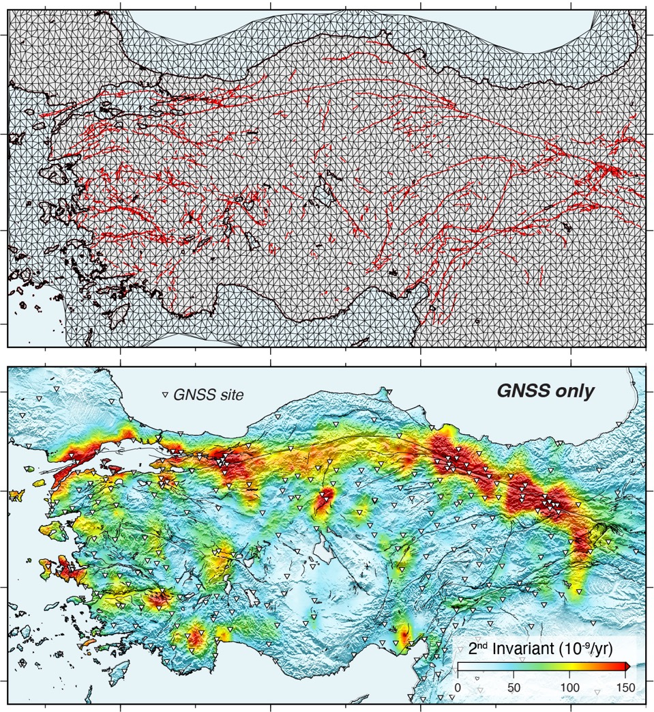
Triangular mesh - 15 km node spacing

Slide 26
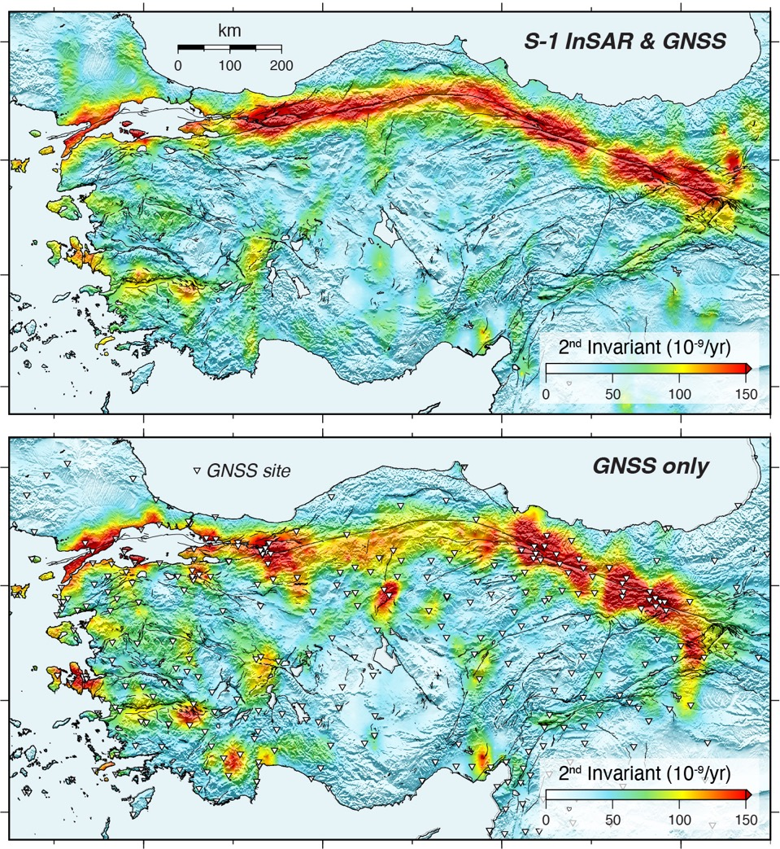

Slide 27
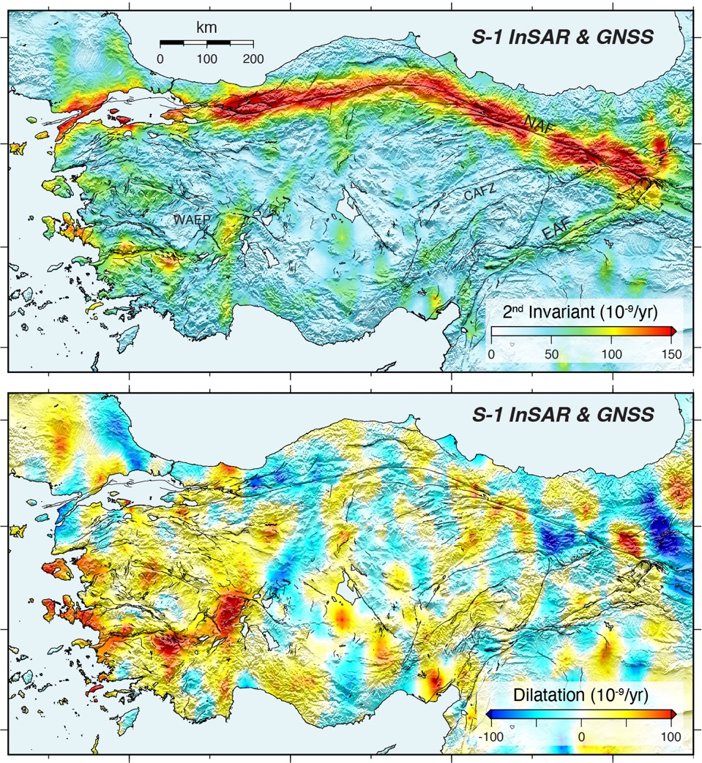

Slide 28
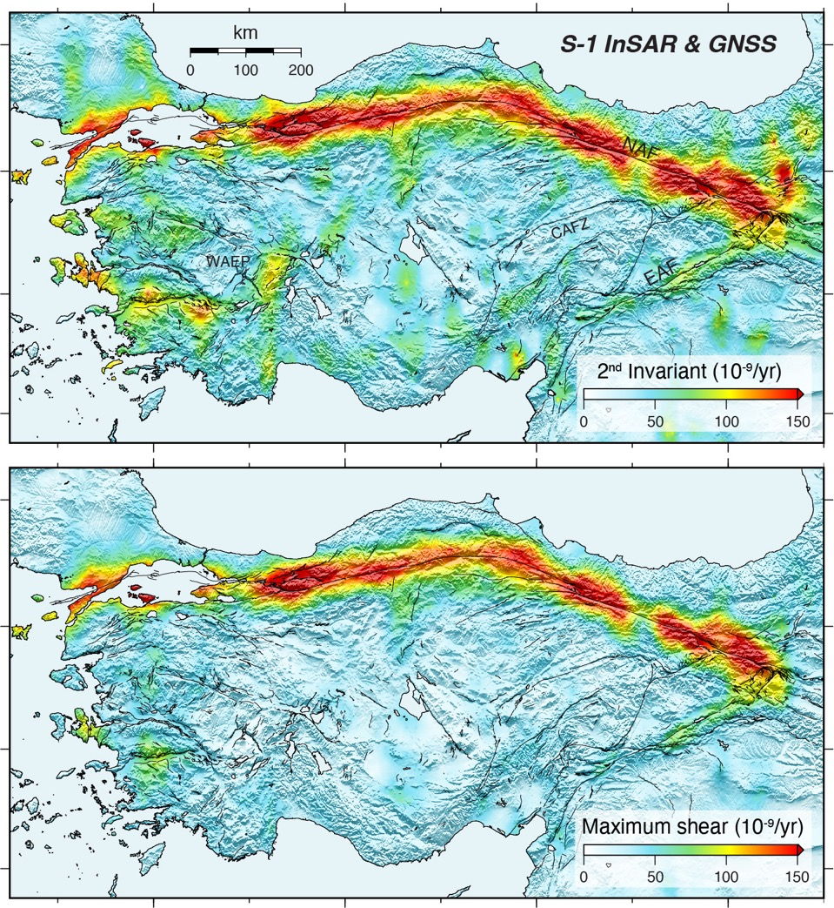

Slide 29
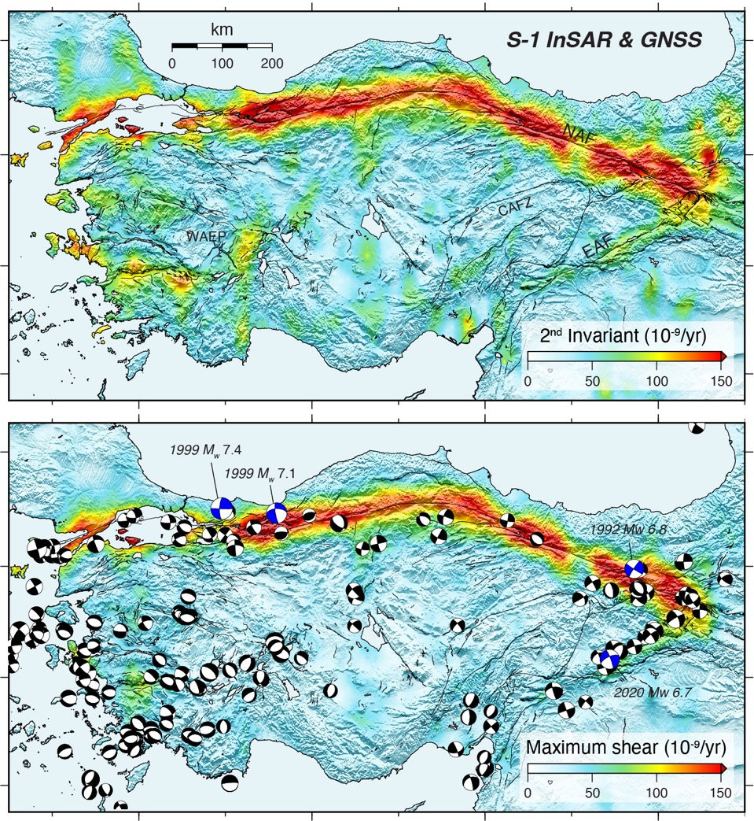

Slide 30
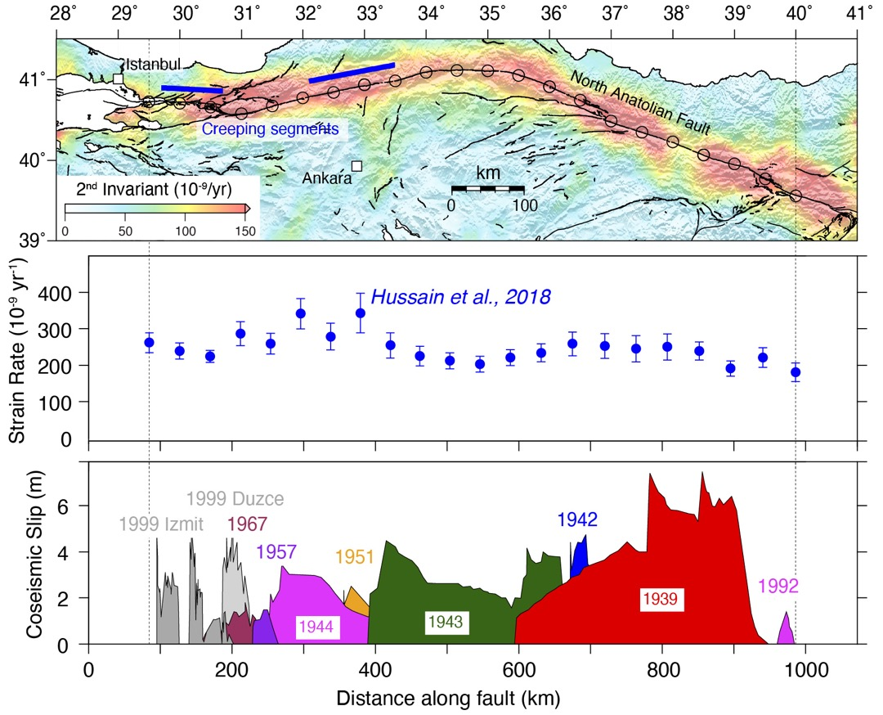
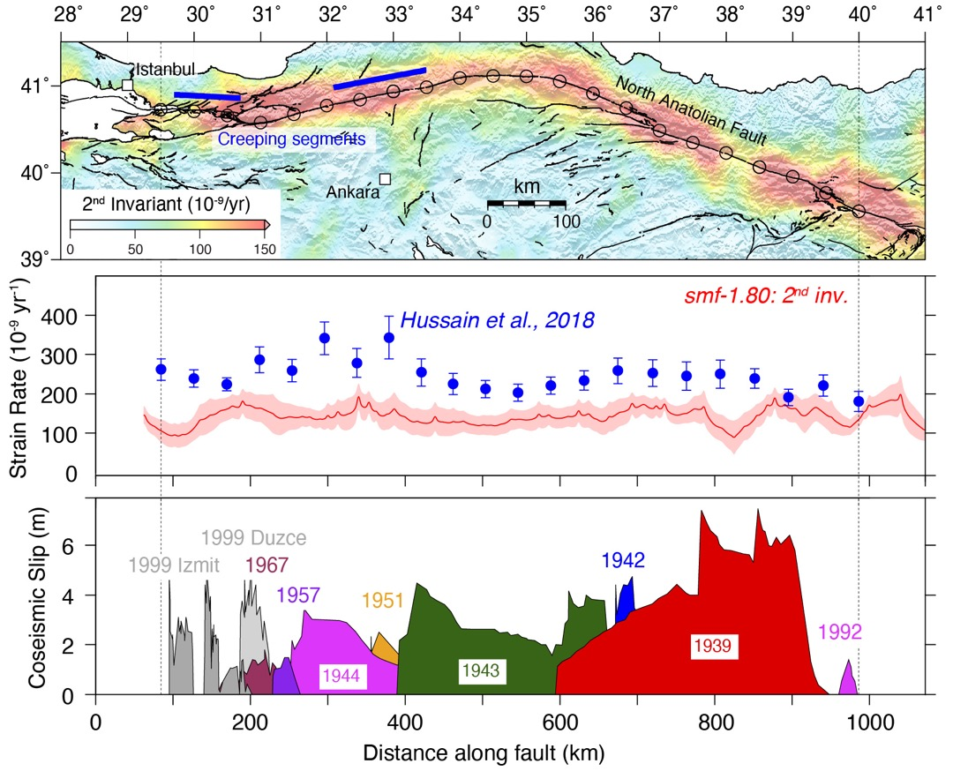
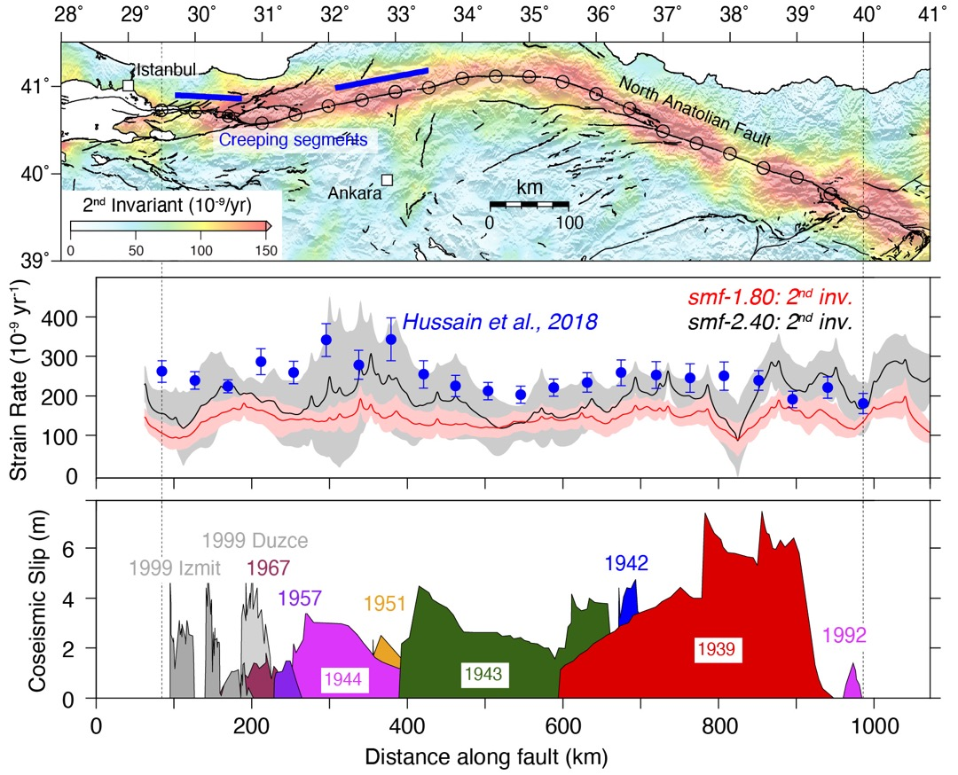
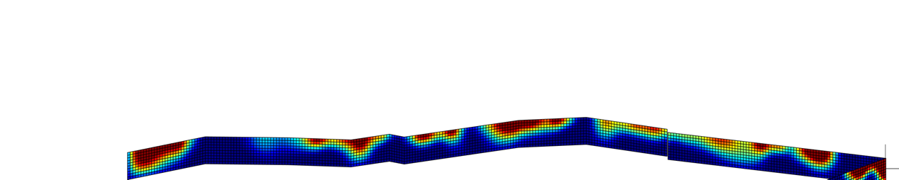
backslip/loading rate
creeping →
← locked
0
1
Work in progress led by R.J. Walters (Durham)

Slide 31
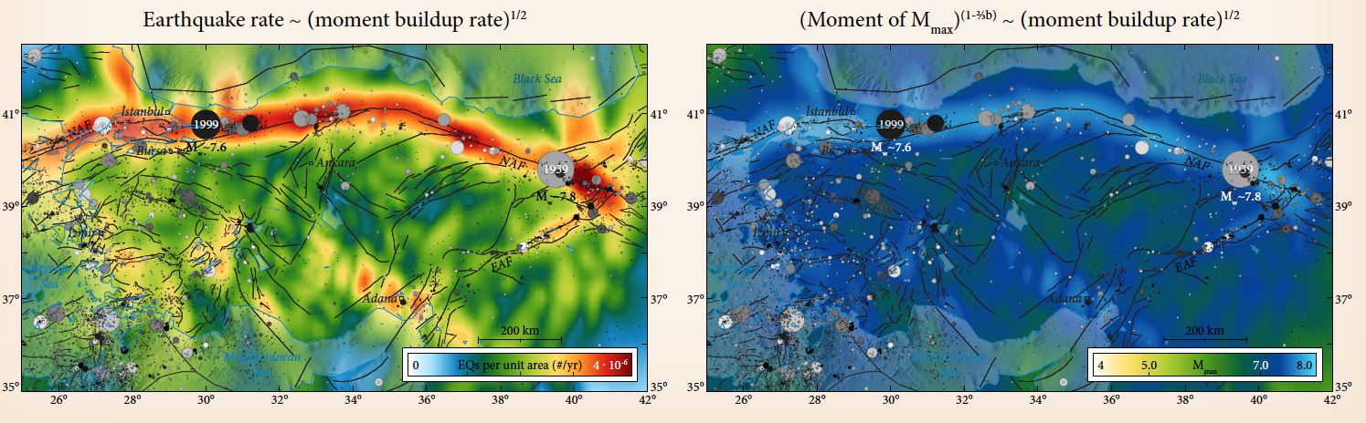
EGU2020-6144
Converting InSAR- and GNSS-derived strain rate maps into
earthquake hazard models for Anatolia
For more details see:
Weiss et al., in review, GRL
EarthArXiv preprint
COMET Webinar
https://comet.nerc.ac.uk/comet-webinar-series/
Work in progress led by Chris Rollins (Leeds)
https://meetingorganizer.copernicus.org/EGU2020/EGU2020-6144.html

